Slide 1
Kick-Off Meeting
Seminar Current Topics on Applied Computational Social Sciences
Instructor: Prof. Dr. Claudia Wagner
Date: 29.3.2023

Slide 2

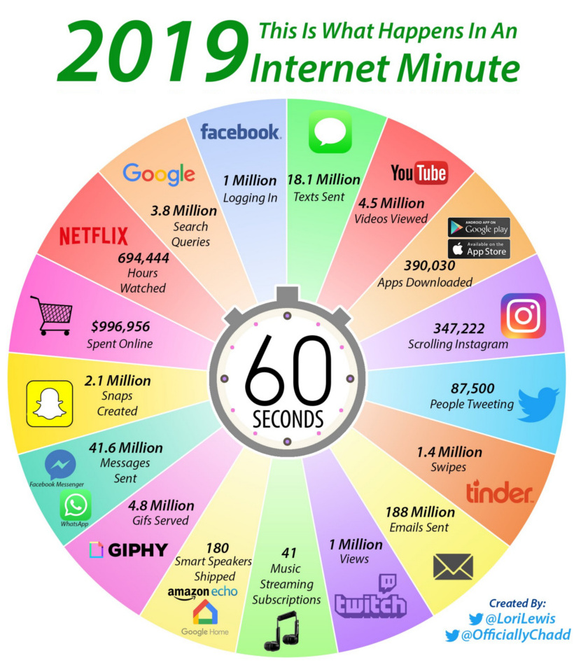

What is Applied CSS?
Apply computational methods to new types of data (digital behavioral data) to learn about social and socio-technical phenomena
Computer Science
Social Sciences
2009 Flu Epidemic [Ginsberg et al.]
2013 Personality [Kosinski et al.]
2010 Public sentiment [O'Connor et al.]
2014 Tie strength [Gilbert et al.]
2010 and 2016 Political attitude [Tumasjan et al. 2010, Barbera et al. 2016]
2017 Demographics of neighbourhoods [Timnit et al.]
2018 Sexual Orientation
[Wang et al.]
2014 and 2018 Mental Well-Being [De Choudhury et al 2014, Eichstaedt et al 2018]

Slide 3
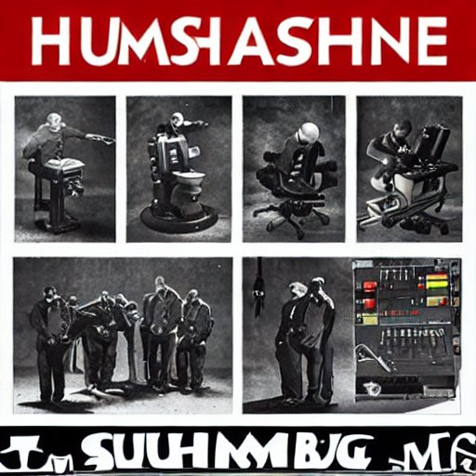
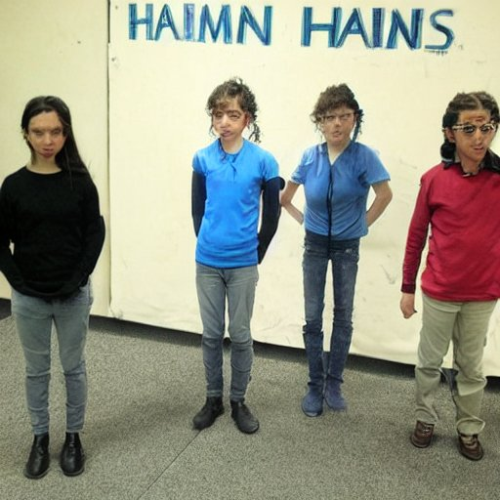

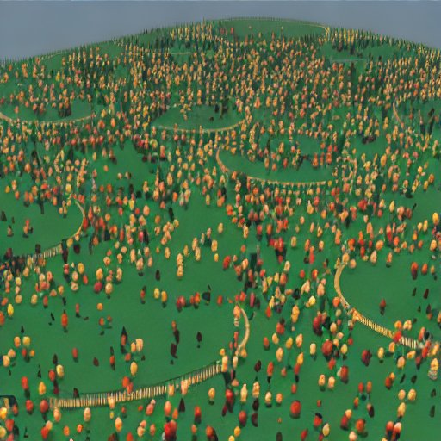
Two trending topics
Human-AI collaboration
Simulating human populations
(in silicio samples)
All images are created by DALL·E 2 (openai.com)

Slide 4
Logistics
Tasks and evaluation
Every participant will be assigned a research paper to work on over the course of this semester.
Each participant will present his/her paper
Goal of the presentation is to ensure that your colleagues understand the paper!
After each presentation, we will have a discussion
Participants submit a written summary of their paper at the end of the course.
The seminar report is about depth: presenting the paper in detail, read up on things you don’t understand
We grade presentations and reports

Slide 5
Seminar Applied CSS
Presentation
20-30 minutes presentation about the paper
It is required to strictly comply with the timing
English language required
Slides required
Presentation should be understandable by all students → be prepared to explain e.g. methods that are used in the paper
Presentation style and content are both graded
Consider and keep in mind Do‘s and Dont‘s of presentations
Presentation structure should be similar to report (see later slides), though it is not that strict

Slide 6
Seminar Applied CSS
Discussion
After every presentation, we will have a 20 minutes discussion about the paper
No feedback to the presentation itself, just to the paper
Other students are welcome to engage in the discussion and even more importantly, to ask questions

Slide 7
Seminar Applied CSS
Report about your paper
8-10 pages (including figures), plus unlimited references.
using templates for Springer LNCS style (Word accepted, LaTex preferred) http://www.springer.com/gp/computer-science/lncs/conference-proceedings-guidelines).
Should be structured as a scientific paper.
English language required.

Slide 8
Seminar Applied CSS
Report structure, focus on the paper
Introduction: this section should introduce the paper and ist goals.
Related work: it summarizes the state of the art. Puts the paper in context.
Methods: this section explains how the problem is approached, which techniques are used and why these ones and not others.
Results & Discussion: in this section, the results of the research are presented, and how they are related to the problem under study and to what it was known until date.
Conclusions and implications: this section summarizes the work and explain the main implications of the results (what have changed now that we know what we know? how could this influence future research?)
Reviewer Perspektive: What is the strength of the paper? What are its weaknesses?
Future Work (Limitations and Open Questions): this section discusses limitations of the state of the art and presents ideas for future work

Slide 9
Seminar Applied CSS
Seminar Logistics
Today: Assignment of topics
Every student presents once
Attendance at all presentation dates is mandatory for everybody
All presentations will be 28.6.2023 in Aachen
Report submissions are due to the 27.6.2023
You can consult during my office hours (Wednesdays) over the course of this semester, to get feedback on your current status of the report and your presentation. Please write an email before.

Slide 10
Seminar Applied CSS
Course ethics
Work on your own!
Cite your sources!
Plagiarism will result in failing the course without warning.

Slide 11
AI-based Simulation Human Populations
[2209.06899] Out of One, Many: Using Language Models to Simulate Human Samples (arxiv.org)
[2301.07543] Large Language Models as Simulated Economic Agents: What Can We Learn from Homo Silicus? (arxiv.org)
Using cognitive psychology to understand GPT-3 | PNAS
[2202.12299] Capturing Failures of Large Language Models via Human Cognitive Biases (arxiv.org)
[2209.14338] Who is GPT-3? An Exploration of Personality, Values and Demographics (arxiv.org)
[2302.02083] Theory of Mind May Have Spontaneously Emerged in Large Language Models (arxiv.org)

Slide 12
Hybrid Intelligence: Human-AI Collaboration
AI Chat Assistants can Improve Conversations about Divisive Topics 2302.07268.pdf (arxiv.org)
Can AI Enhance People’s Support for Online Moderation and Their Openness to Dissimilar Political Views? | Journal of Computer-Mediated Communication | Oxford Academic (oup.com)
Analyzing the Effectiveness of an Extensible Virtual Moderator | Proceedings of the ACM on Human-Computer Interaction
Human–AI collaboration enables more empathic conversations in text-based peer-to-peer mental health support | Nature Machine Intelligence
Frontiers | Human–Autonomy Teaming: Definitions, Debates, and Directions (frontiersin.org)
[2303.15056] ChatGPT Outperforms Crowd-Workers for Text-Annotation Tasks (arxiv.org)
Human heuristics for AI-generated language are flawed | PNAS

