Slide 1
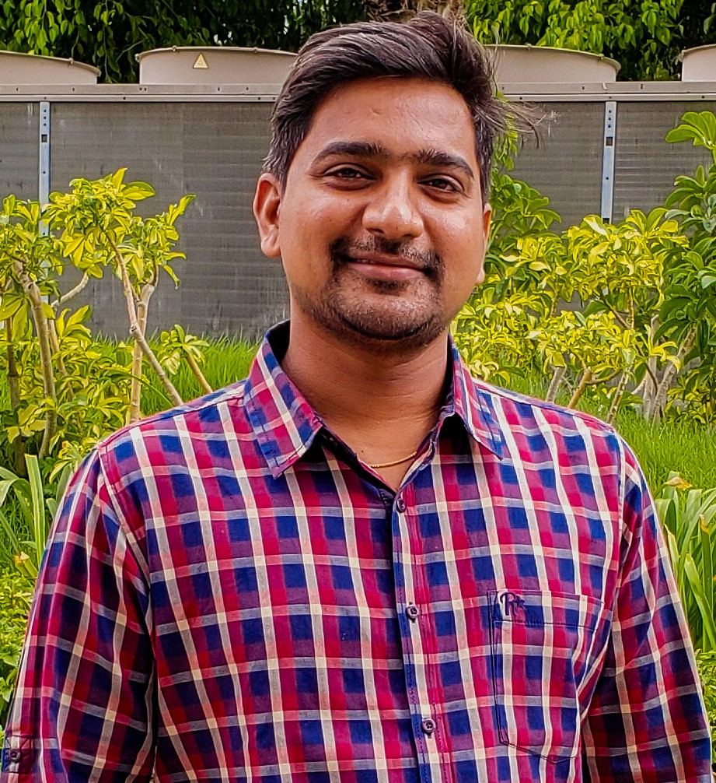
Technical Lead – Cloud & DevOps
Rama Krishna
Technical Lead – Cloud & DevOps
Hyderabad
Overall 10+ years of experience in developing and maintaining Enterprise applications.
Worked in various industry sectors like Telecom, Health Care, Banking, Finance.
Strong exposure on the DevOps tools like Jenkins, SCM, Artifactory.
End-to-End design and implementation of Canary deployments for the larger products in health care sector.
Designed End-to-End solution with Ansible for configuration management, and application-deployment tool enabling infrastructure as code.
Designed various scalable solutions with the help of Frameworks like Spring Boot, Netflix OSS, Angular.
Designed and implemented high available private cloud platform such as Open stack with the help of open source tools like Python, Ansible.
Large exposure on container orchestration platforms like Kubernetes, Openshift, Google Anthos.

