Slide 1
Our DevOps Goals
Speed
Security
Quality
Reliability
Monitoring
Scalability
Self-Healing
Redundancy (HA & DR)
Alerting
Zero Downtime deployments

Slide 2
Our DevOps Goals & Objectives
Goals
Objectives
Establish a consistent and automated way to build, package, and deploy applications.
Quicken release cycles
Increase quality & reliability
Security compliance
Standardize CICD
Automate software delivery pipeline
Notification & Authorization in pipeline
Blue-Green / Canary deployment support in pipeline
Alignment to future state technology and architecture standards and re-use
Promote ease of adoption through detailed documentation/playbook

Slide 3
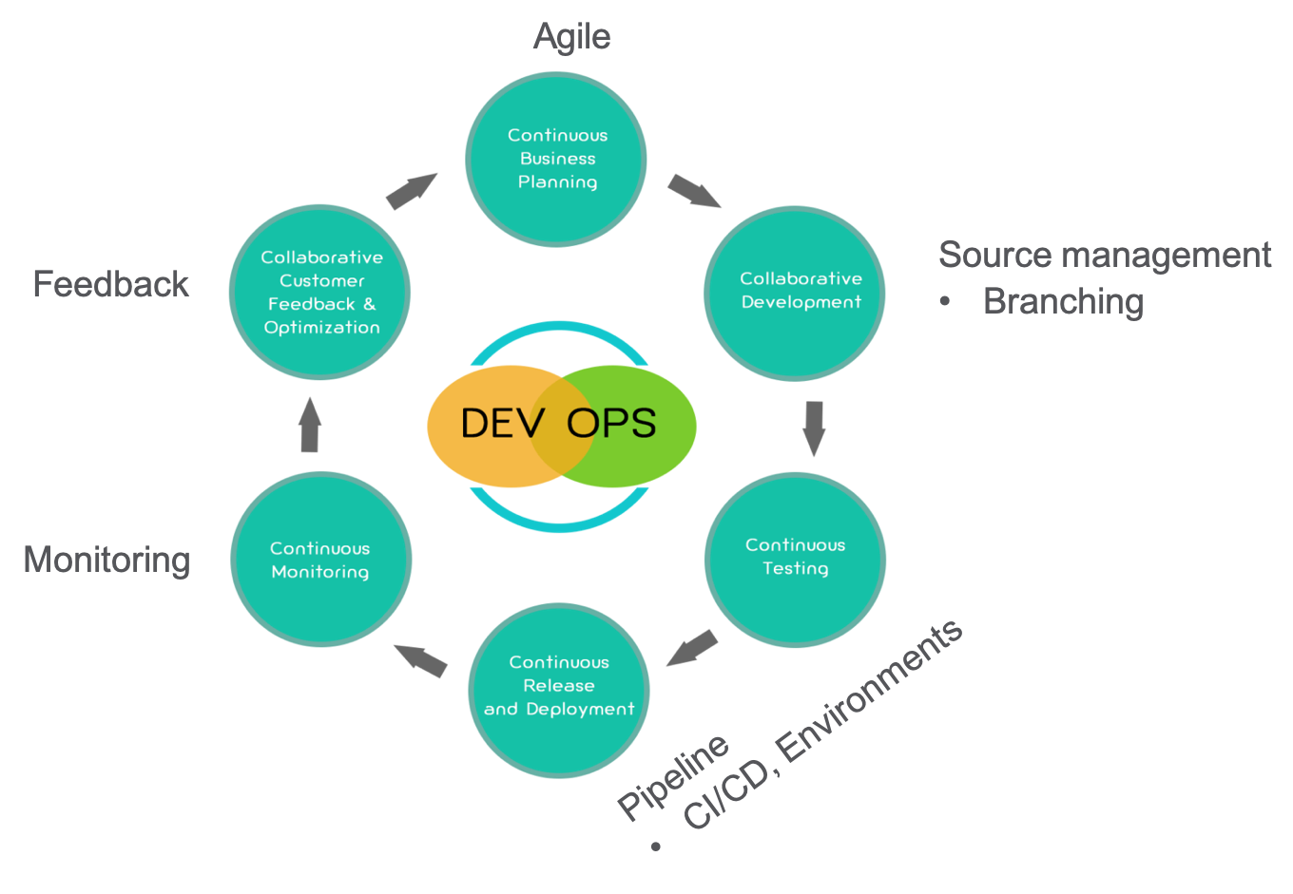
DevOps Strategy

Slide 4
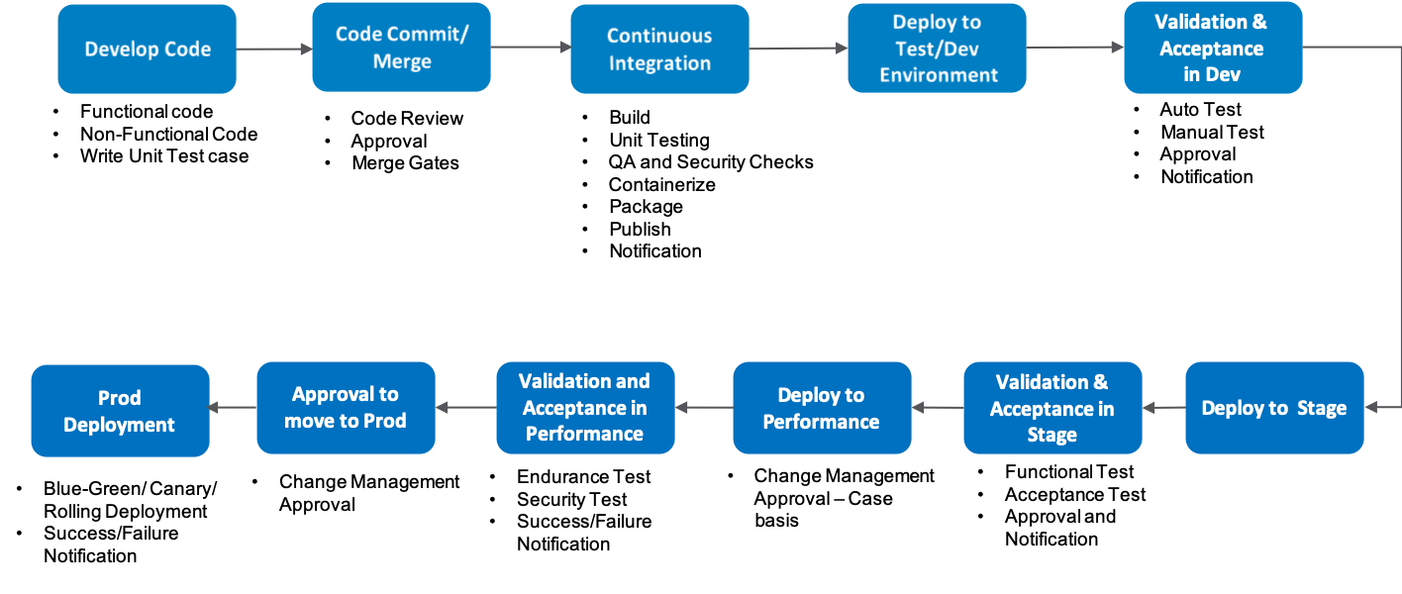
Deployment Flow

Slide 5
Deployment Environments
TEST/DEV
Environment available for Developers to deploy and Test the work in progress
Low configuration environment with policies to control cost
STAGE/QA/UAT
Environment for Functional, Regression, End-to-End test
Low Configuration and cost considerations
PERFORMANCE
Environment for Endurance/Performance/Stress test
Automatic Spin Up and tear down approach
PRODUCTION
Environment for production available to users
Support for Blue/Green/Canary Deployment
Secured and monitored

