Slide 1
Wind Turbine Failure Detection
Aeolus Renewables
Drivetrain condition assessment using 10-minute SCADA measurements
131,760
15
3.00%
sensor records
turbines
recorded faults
Predictive Modeling with Machine Learning and Neural Networks | Low-Code Path
MAIN PRESENTATION
Wind Turbine Failure Detection • 01
Submission date: October 11, 2026

Slide 2
Contents / Agenda
01
Executive summary and business problem
02
Exploratory analysis and preprocessing
03
Model comparison and final selection
04
Actionable recommendations
A
Appendix: data, baselines, tuning and evidence
MAIN PRESENTATION
Wind Turbine Failure Detection • 02

Slide 3
Executive Summary
VALIDATION RECALL
TEST RECALL
TEST PRECISION
TEST F1
92.49%
86.40%
49.48%
62.93%
Tuned ANN selected
1,245 / 1,441 faults
False-alert tradeoff
Balance of P and R
The operational decision
Use the ANN as analyst decision support, not an automatic turbine shutdown trigger.
1,271 false-positive records require remote triage; 196 fault records were missed.
MAIN PRESENTATION
Wind Turbine Failure Detection • 03

Slide 4
Business Problem Overview and Solution Approach
WHY IT MATTERS
Missed drivetrain faults can lead to extended downtime, emergency repairs and lost energy production.
CONDITION-BASED WORKFLOW
01
02
03
04
→
→
→
SCADA readings
Fault / normal model
Operations review
Maintenance action
Method: timestamp-grouped chronological split, training-only preprocessing, five baseline models, two tuned candidates, validation-driven selection.
MAIN PRESENTATION
Wind Turbine Failure Detection • 04

Slide 5
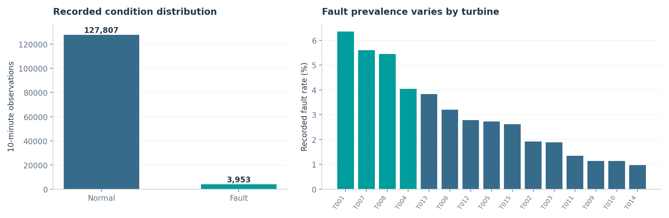
EDA Results — Class Balance and Asset Patterns
131,760 readings • 15 turbines • 3.00% recorded faults
The minority fault class makes accuracy alone misleading; turbine-level rates support prioritised investigation.
MAIN PRESENTATION
Wind Turbine Failure Detection • 05

Slide 6
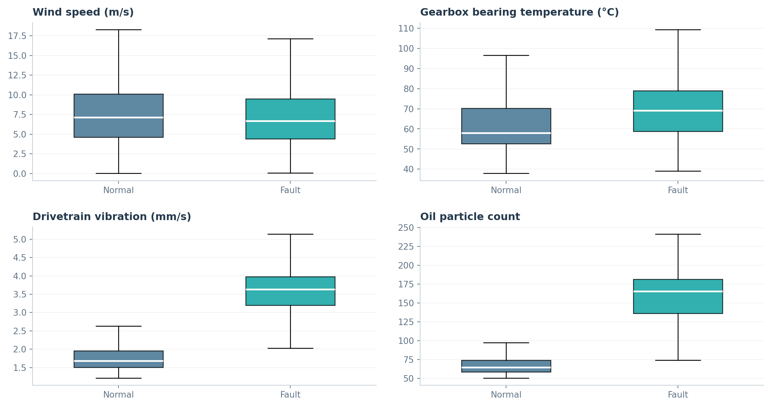
EDA Results — Sensor Evidence
KEY OBSERVATIONS
Vibration, gearbox temperature and oil particles are visibly elevated in fault-state records.
Wind speed alone provides weaker separation, supporting multi-signal evaluation.
MAIN PRESENTATION
Wind Turbine Failure Detection • 06

Slide 7
Data Preprocessing and Leakage Prevention
DATA QUALITY
TREATMENT
0 duplicate rows; missing gearbox-oil (645), generator-bearing (690), oil-pressure (636).
Training-median imputation; ANN StandardScaler fit using training rows only.
FEATURE ENGINEERING
EVALUATION DESIGN
Time cycles, power utilisation and temperature-rise variables.
Timestamp-grouped chronological 70% / 15% / 15%; test reserved until final evaluation.
MAIN PRESENTATION
Wind Turbine Failure Detection • 07

Slide 8
Model Performance Summary and Final Selection
Tuned model | Validation recall | F1 | Precision
ANN (selected) | 92.49% | 53.54% | 37.67%
XGBoost | 69.10% | 69.34% | 69.57%
Selection rule
Maximise validation recall; F1 and precision are secondary tie-breakers.
ANN catches more recorded fault states. XGBoost offers better precision and F1, so the false-alert tradeoff must be managed.
MAIN PRESENTATION
Wind Turbine Failure Detection • 08

Slide 9
Actionable Business Recommendations
01 Triage
02 Dispatch
Review persistent model alerts and corroborating sensor signals remotely.
Prioritise technician inspections when risk persists across successive intervals.
03 Learn
04 Validate
Link alerts to work orders; track false alarms, missed faults, and operational workload.
Run prospective field validation before promising lead time or cost savings.
MAIN PRESENTATION
Wind Turbine Failure Detection • 09
Evidence base: 196 missed SCADA fault observations support recall-first selection. The 1,271 false-positive SCADA observations are not 1,271 technician visits or incidents; remote triage and alert persistence should determine dispatch. Pilot KPIs: missed observations, alert workload, work-order confirmation, downtime and drift.

Slide 10
APPENDIX — Data Background and Contents
SCADA panel
8,784 timestamp groups, recorded at 10-minute intervals across 15 turbines.
Environment
Operation
Wind, ambient conditions
Power and rotational speeds
Condition
Asset history
Bearing heat, vibration, oil particles
Hours, load cycles and maintenance
Target: failure = 1 denotes a recorded fault condition, not a future failure horizon.
APPENDIX
Wind Turbine Failure Detection • 10

Slide 11
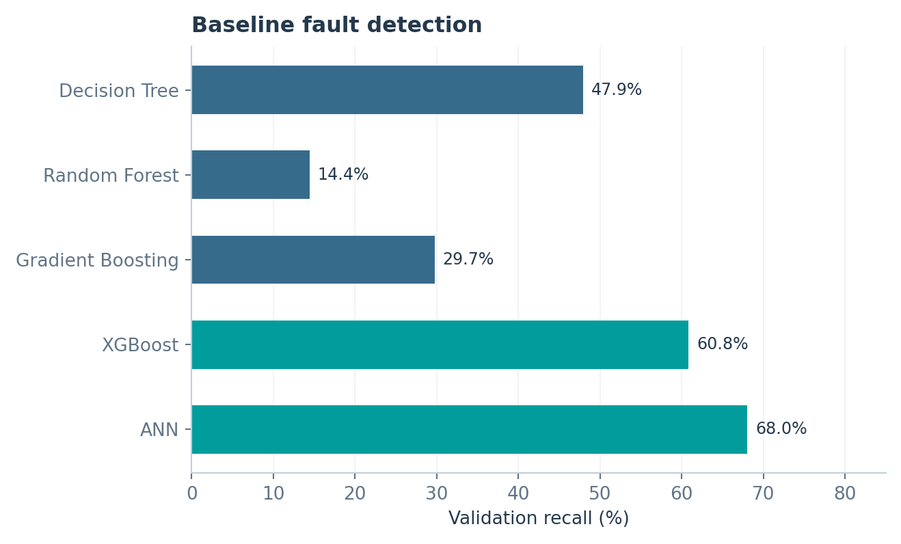
Model Building — Five Baseline Classifiers
Model | Accuracy | Precision | Recall | F1
Decision Tree | 90.70% | 27.74% | 47.93% | 35.14%
Random Forest | 95.35% | 82.87% | 14.44% | 24.59%
Gradient Boosting | 94.54% | 46.96% | 29.74% | 36.42%
XGBoost | 96.64% | 71.01% | 60.83% | 65.53%
ANN | 94.79% | 50.28% | 68.05% | 57.83%
ANN and XGBoost have the highest baseline recall and were selected for tuning.
APPENDIX
Wind Turbine Failure Detection • 11

Slide 12
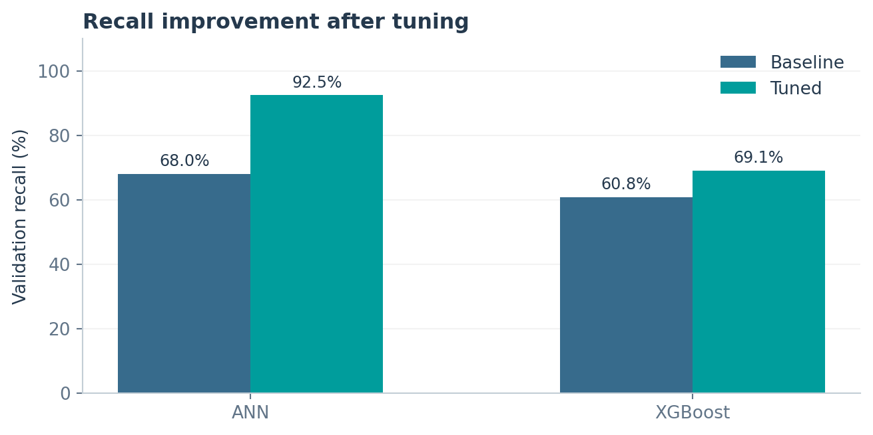
Model Improvement — Hyperparameter Tuning
XGBOOST
Six randomized XGBoost configurations; two timestamp-grouped expanding-window folds; recall objective.
Selected XGBoost: 160 trees, depth 3, learning rate 0.07, subsample 0.85, colsample 1.00, min-child weight 3. Best CV recall 48.45%; holdout validation recall 69.10%.
ANN
ANN configuration selection: the recorded run compared the baseline ANN with this regularised configuration; no multi-configuration ANN search was recorded. Final ANN: 64/24 units, BatchNorm, dropout 0.30/0.15, Adam, early stopping. Validation recall 92.49%.
APPENDIX
Wind Turbine Failure Detection • 12

Slide 13
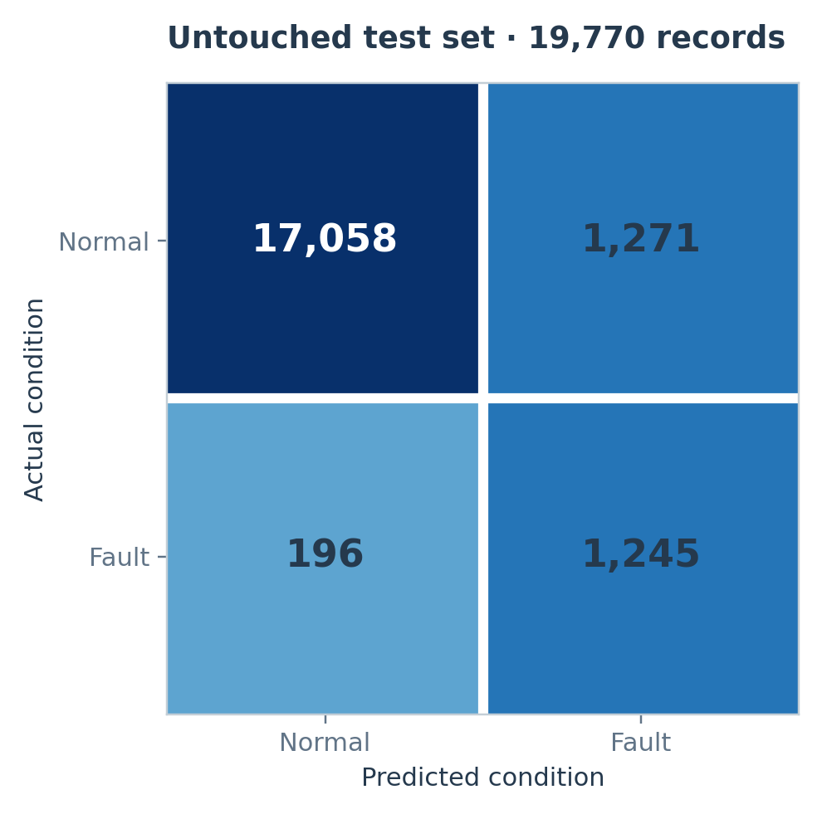
Final Model Performance — Untouched Test
TEST RECALL
TEST PRECISION
86.40%
49.48%
TEST ACCURACY
TEST F1
92.58%
62.93%
1,245 detected • 196 missed
1,271 false alerts • 17,058 true normals
APPENDIX
Wind Turbine Failure Detection • 13

Slide 14
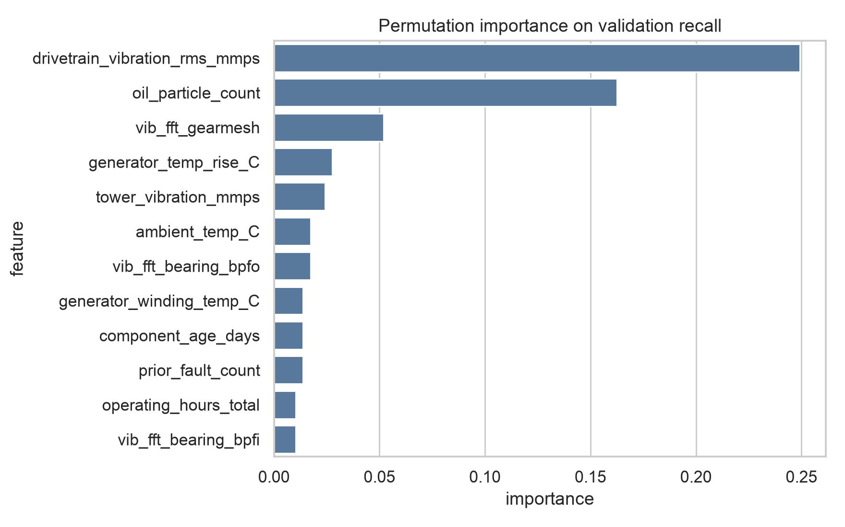
Feature Interpretation and Limitations
KEY DRIVERS
Drivetrain vibration and oil particle count show the largest validation-recall impacts.
Permutation importance measures association, not causation or a future-failure lead time.
APPENDIX
Wind Turbine Failure Detection • 14

Slide 15
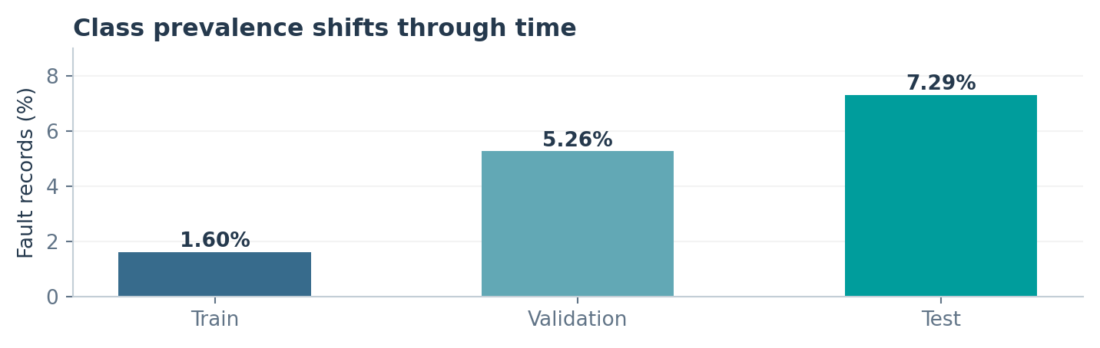
Timestamp-Grouped Split Verification
TRAIN
VALIDATION
TEST
92,220
19,770
19,770
6,148 timestamps
1,318 timestamps
1,318 timestamps
LEAKAGE CHECK
All 15 turbine records at a timestamp remain in the same partition. Failure prevalence changes over time.
APPENDIX
Wind Turbine Failure Detection • 15

Slide 16
Operational Use Case and Next Steps
STAGE 1
STAGE 2
STAGE 3
Model flags current abnormal condition.
Analyst checks persistence and supporting sensors.
Maintenance team prioritises planned inspection.
DEPLOYMENT GUARDRAILS
Retrospective proof of concept: prospectively validate alert value, technician workload, model drift and downtime outcomes before automated action or savings claims.
APPENDIX
Wind Turbine Failure Detection • 16

Slide 17
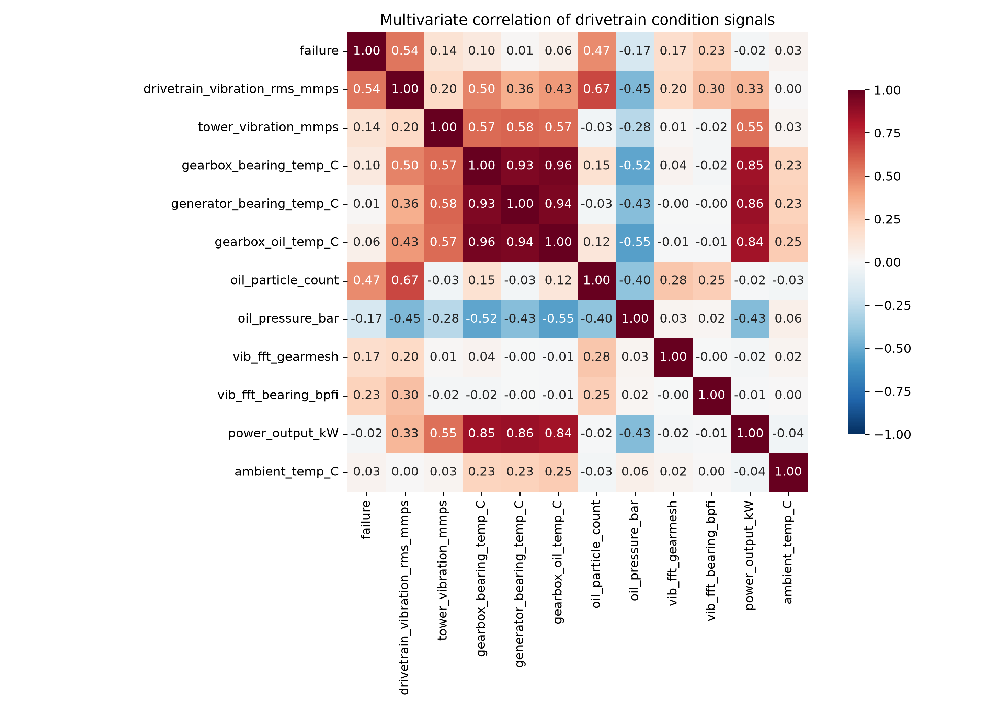
EDA Results — Multivariate Sensor Relationships
MAIN PRESENTATION • 17
What the heatmap adds
• Drivetrain vibration has the strongest correlation with recorded fault state (0.54).
• Oil-particle count is also material (0.47); bearing-frequency vibration is 0.23.
• Oil pressure is negative (−0.17); gearbox-bearing temperature is weaker (0.10).
Implication: Fault-state evidence is distributed across signals. A multi-feature model is more appropriate than a single sensor threshold.

Slide 18
Tuning Comparison — Recall First, Precision Trade-off
APPENDIX • 18
Candidates were selected from baseline validation recall. Test data did not influence tuning, selection or threshold choice.
Model | Baseline P / R / F1 | Tuned P / R / F1 | Configuration / method
ANN | 50.28 / 68.05 / 57.83 | 37.67 / 92.49 / 53.54 | 64/24 units; BatchNorm; dropout; Adam; early stopping
XGBoost | 71.01 / 60.83 / 65.53 | 69.57 / 69.10 / 69.34 | 6 randomized configurations; two expanding time folds
Selection rationale
Tuned ANN has the highest validation recall (92.49%) and therefore identifies more recorded fault observations under the declared recall-first criterion. XGBoost has higher precision and F1, making it a lower-alert-burden alternative, but its validation recall is 69.10%.

