Slide 1
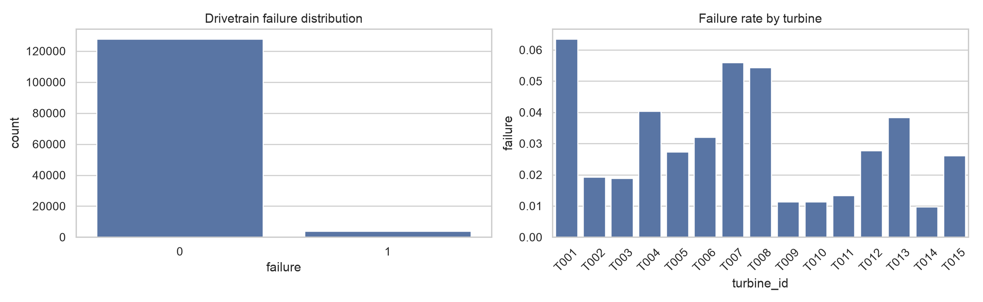
Wind Turbine Failure Detection
Aeolus Renewables
Drivetrain condition classification from 10-minute SCADA data
Validated timestamp-grouped chronological evaluation
Great Learning | Low-Code ML Assignment | Wind Turbine Failure Detection

Slide 2
Contents / Agenda
1 Executive summary and business problem
2 Exploratory analysis and preprocessing
3 Baseline models, tuning and final selection
4 Final performance, feature interpretation and recommendations
Appendix: data background, baseline table, tuning details and limitations
Main Presentation | Wind Turbine Failure Detection

Slide 3
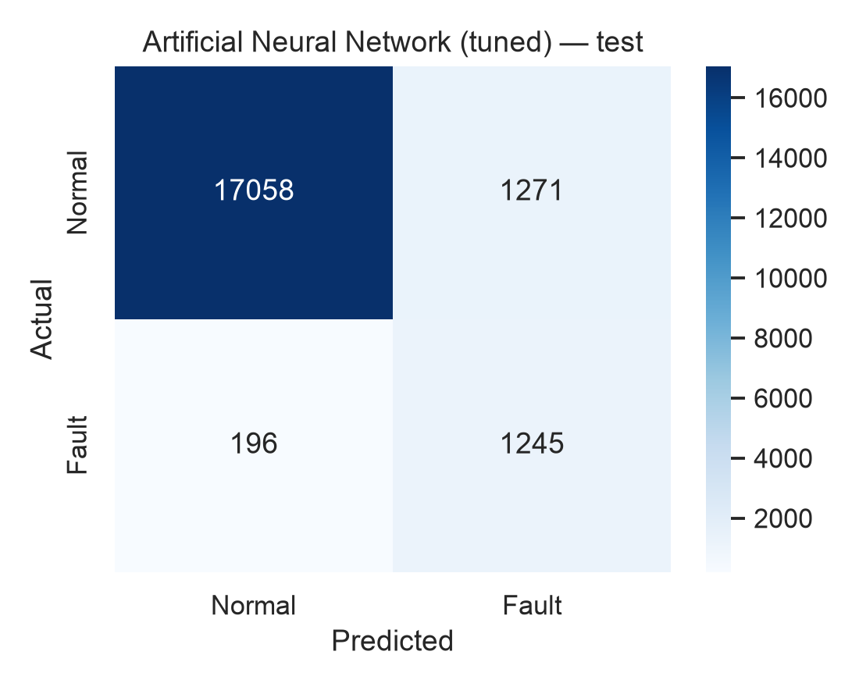
Executive Summary
Tuned ANN selected: 92.49% validation recall
Test recall: 86.40% — 1,245 of 1,441 recorded fault states identified
196 missed states remain the principal risk; 1,271 false positives require triage
Deploy as current-condition decision support, not as a proven future-failure predictor
Main Presentation | Wind Turbine Failure Detection

Slide 4
Business Problem Overview and Solution Approach
Business need
Reduce manual SCADA review by prioritising turbines with recorded drivetrain fault signatures.
Method
Timestamp-grouped 70/15/15 chronology; training-only imputation/scaling; five classifiers; tune ANN and XGBoost; select on validation recall; evaluate once on test.
Main Presentation | Wind Turbine Failure Detection

Slide 5
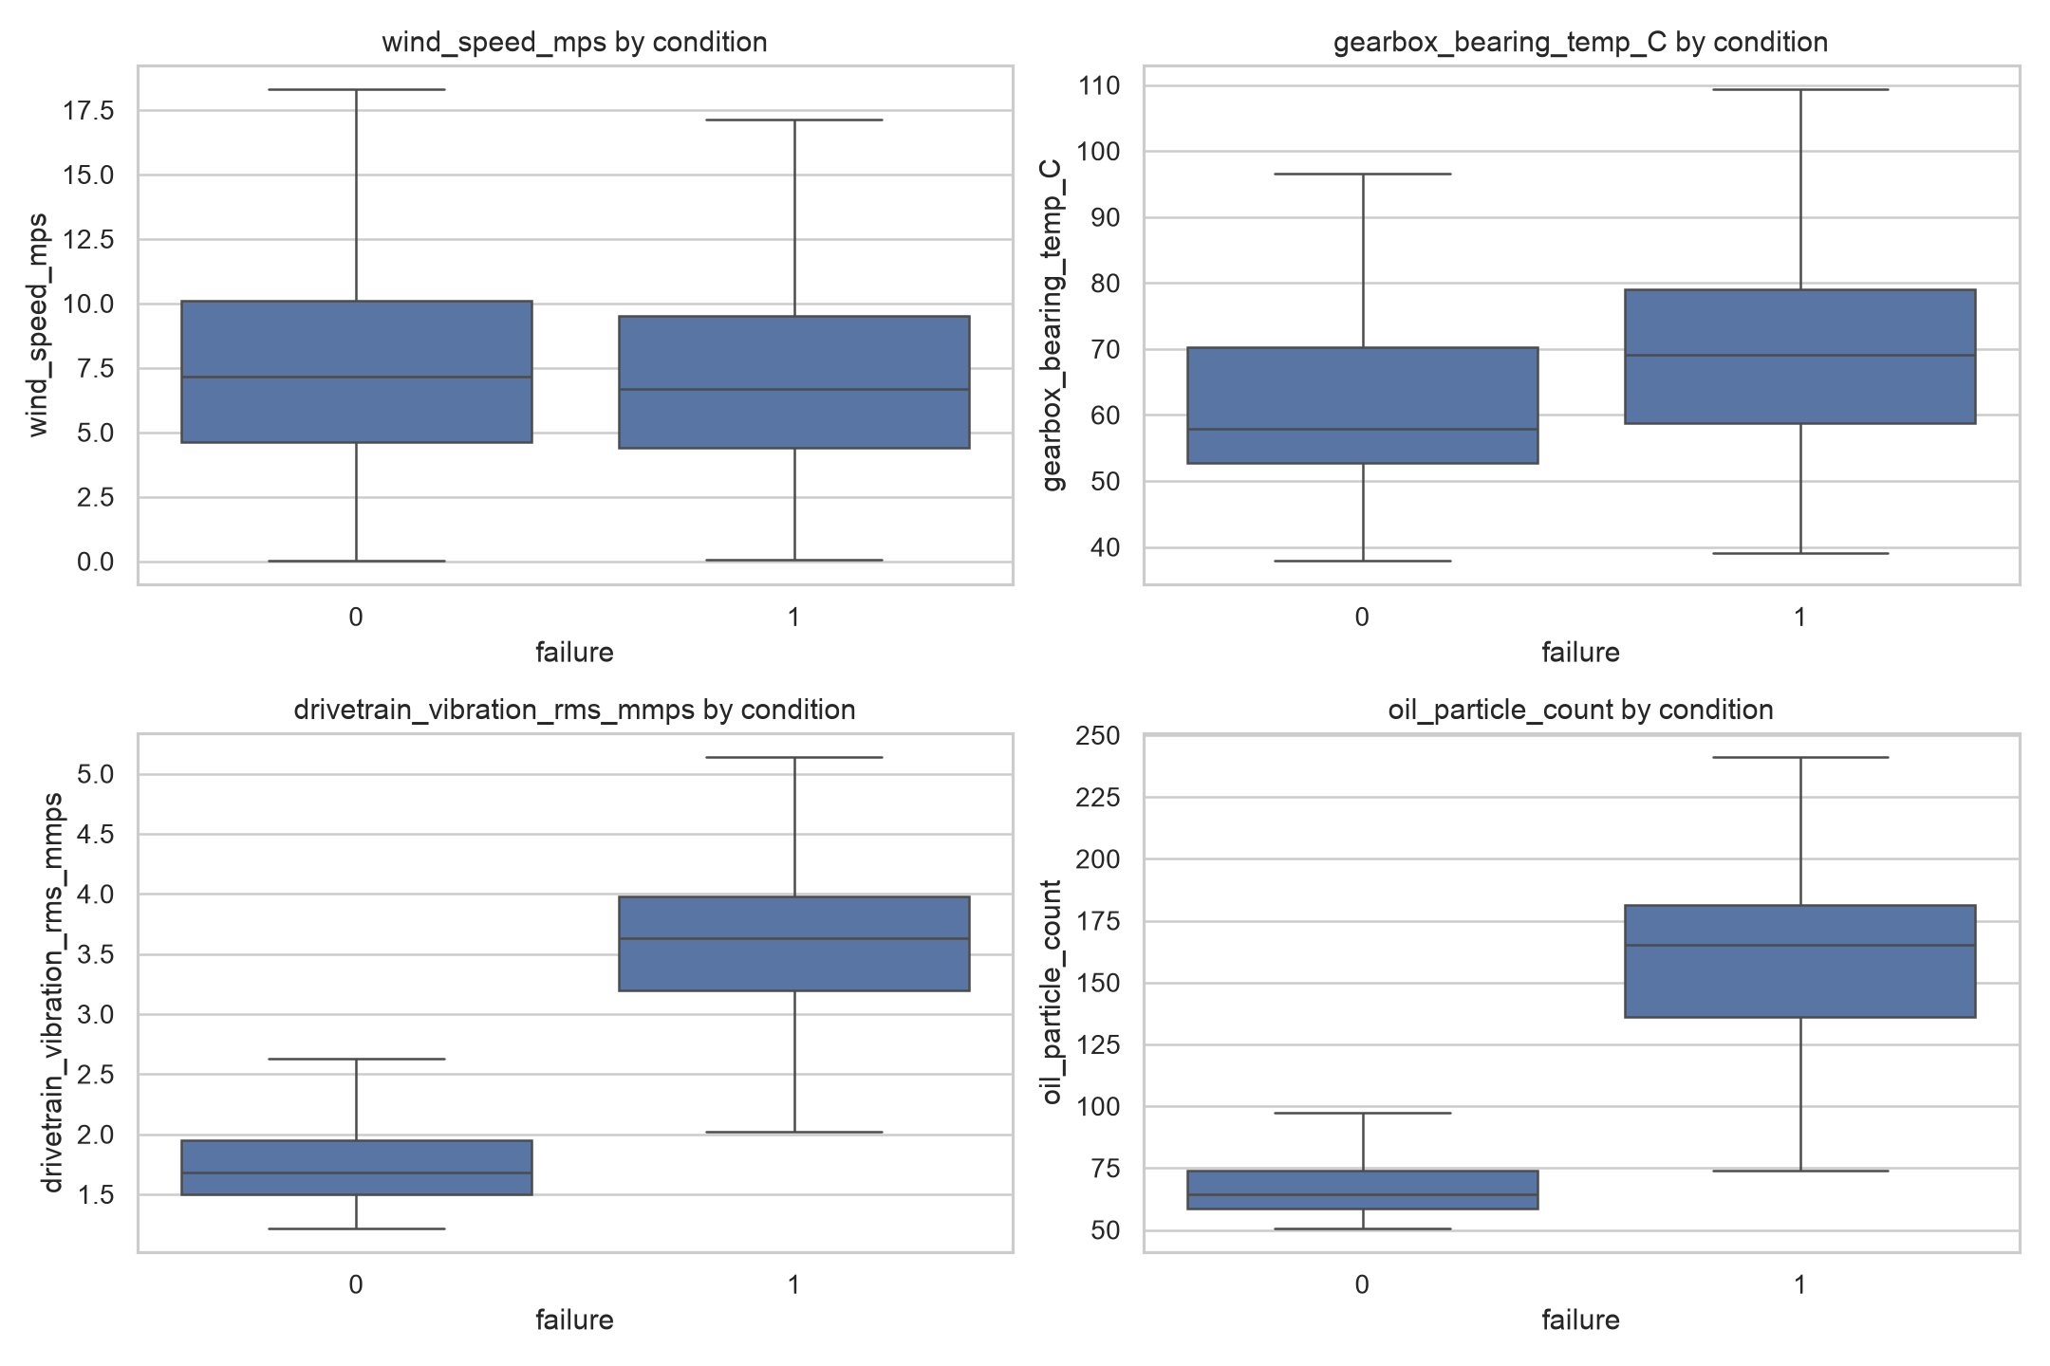
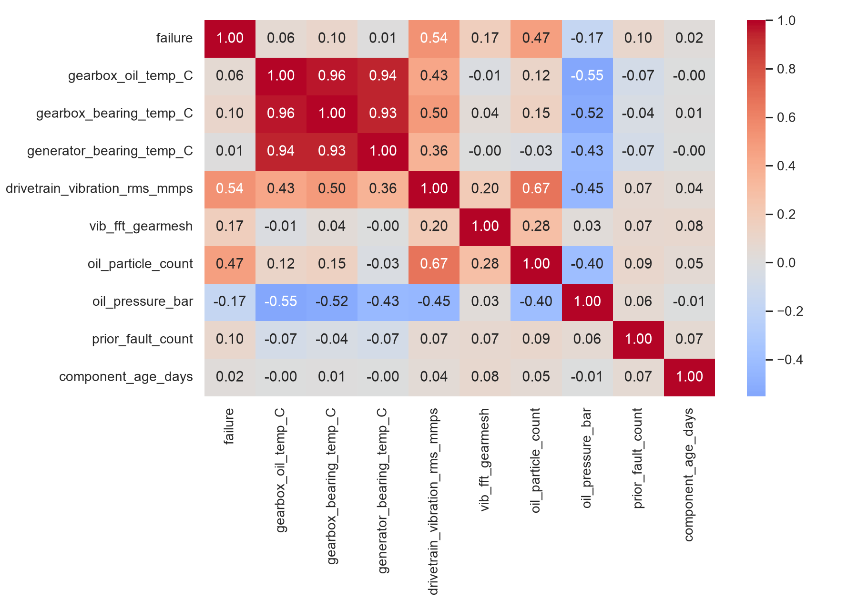
EDA Results — Fault Pattern and Sensor Evidence
131,760 records from 15 turbines; overall recorded-failure prevalence 3.00%.
Fault-state distributions shift in gearbox temperature, drivetrain vibration and oil-particle readings.
Use signal combinations rather than a single fixed threshold.
Main Presentation | Wind Turbine Failure Detection

Slide 6
Data Preprocessing and Leakage Prevention
Data quality
0 duplicates; 645 gearbox-oil, 690 generator-bearing and 636 oil-pressure missing readings.
Treatment
Median imputation fitted on training rows only; StandardScaler fitted on training rows only for ANN.
Features
Calendar cycles, power utilisation, gearbox and generator temperature rise.
Split
Timestamp-grouped chronological partitions prevent the same SCADA timestamp appearing in two splits.
Main Presentation | Wind Turbine Failure Detection

Slide 7
Model Performance Summary and Final Model Selection
Tuned model | Validation recall | F1 | Precision | Decision
ANN | 92.49% | 53.54% | 37.67% | Selected
XGBoost | 69.10% | 69.34% | 69.57% | Alternative
Selection rule: highest validation recall; F1 then precision only if recall ties.
ANN wins on recall; XGBoost is more precise and has better F1, but misses more recorded faults.
Test data did not influence tuning, selection or threshold choice.
Main Presentation | Wind Turbine Failure Detection

Slide 8
Actionable Business Recommendations
1. Rank persistent high-risk alerts for operations-centre review.
2. Check vibration, thermal, oil and maintenance context before dispatch.
3. Send recurring or multi-signal alerts to planned inspection queues.
4. Monitor missed states, false-alert workload, sensor drift and downtime outcomes.
5. Validate prospectively before claiming lead time or financial savings.
Main Presentation | Wind Turbine Failure Detection

Slide 9
APPENDIX — Data Background and Contents
SCADA panel data: 8,784 ten-minute timestamps across 15 turbines.
Input groups: weather, production, rotational speed, temperatures, vibration spectra, oil condition, operating history and maintenance context.
Target: failure indicates the condition recorded at the timestamp.
Appendix | Wind Turbine Failure Detection

Slide 10
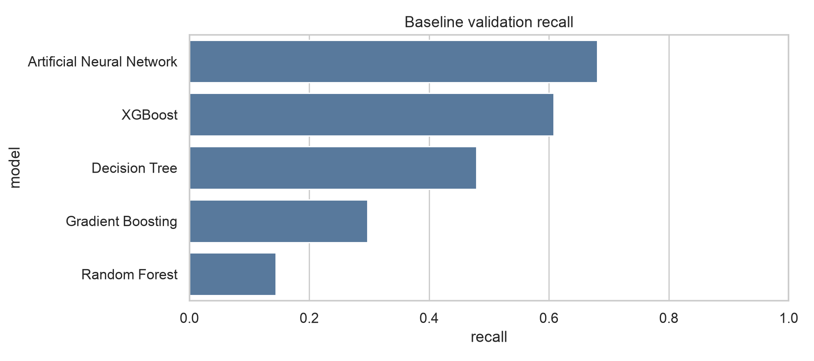
Model Building — Baseline Validation Comparison
Model | Accuracy | Precision | Recall | F1
Decision Tree | 90.7% | 27.7% | 47.9% | 35.1%
Random Forest | 95.3% | 82.9% | 14.4% | 24.6%
Gradient Boosting | 94.5% | 47.0% | 29.7% | 36.4%
XGBoost | 96.6% | 71.0% | 60.8% | 65.5%
Artificial Neural Network | 94.8% | 50.3% | 68.0% | 57.8%
Appendix | Wind Turbine Failure Detection

Slide 11
Model Improvement — Hyperparameter Tuning
XGBoost search: 6 randomized configurations; two timestamp-grouped expanding folds; recall optimization.
Ranges: 80–200 trees, depth 3–6, learning rate 0.02–0.10, row/column sampling 0.70–1.00, min-child weight 1–5.
Best XGBoost CV recall 48.45%; holdout validation recall 69.10%.
ANN: 64/24 layers, BatchNorm, dropout 0.30/0.15, Adam and early stopping.
Appendix | Wind Turbine Failure Detection

Slide 12
Final Model Performance — Untouched Test Set
Tuned ANN
Accuracy 92.58% | Precision 49.48% | Recall 86.40% | F1 62.93%
TN 17,058 | FP 1,271 | FN 196 | TP 1,245
Interpretation: false negatives require monitoring; false positives require remote review and alert-persistence rules.
Appendix | Wind Turbine Failure Detection

Slide 13
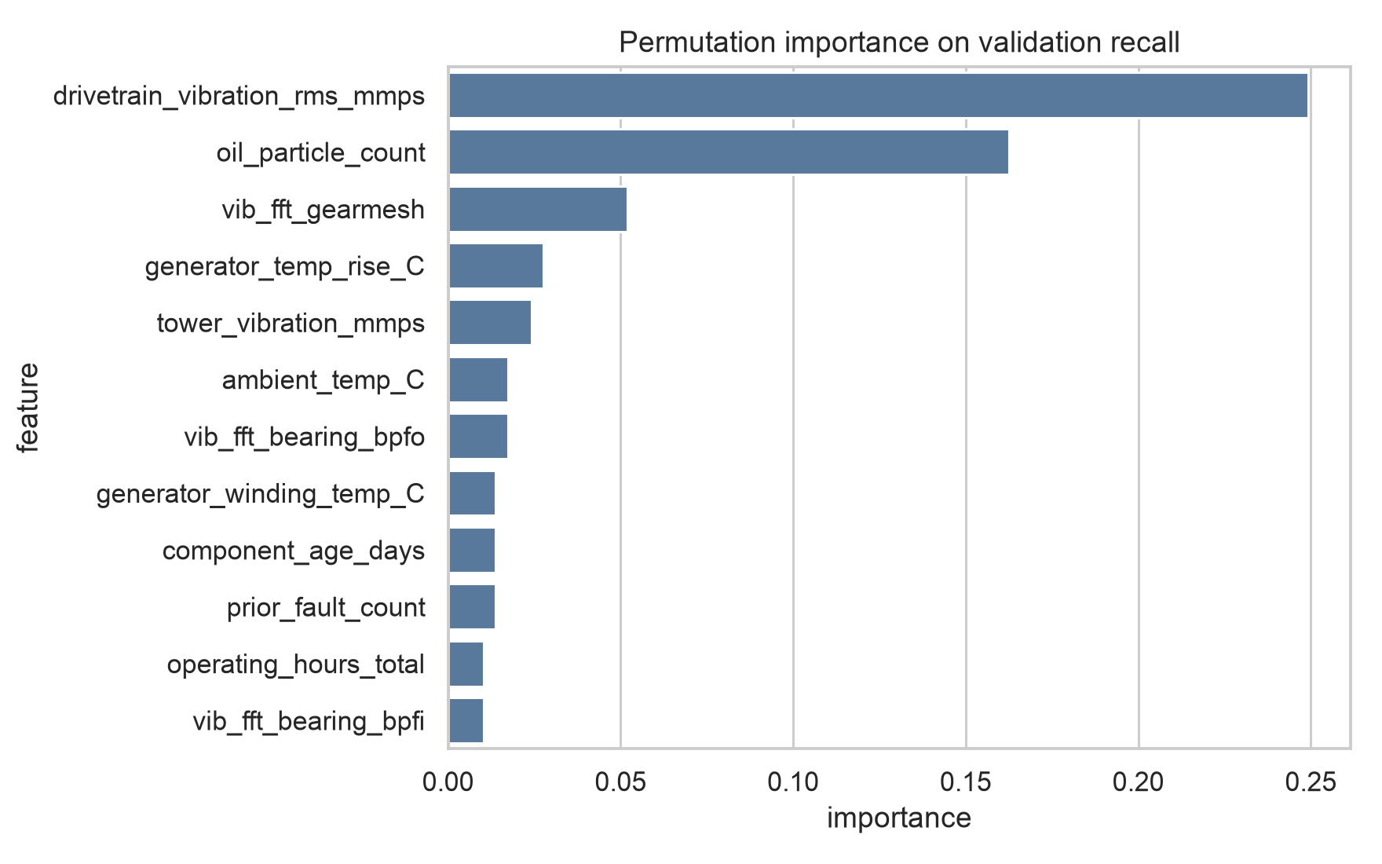
Feature Interpretation and Deployment Limitations
Permutation importance measures validation-recall reduction after shuffling an input.
It identifies associated condition signals, not causal mechanisms.
Use top signals to focus technician checks; retrain and monitor drift as operations change.
Appendix | Wind Turbine Failure Detection

Slide 14
Timestamp-Grouped Split Verification
Train: 92,220 rows | 6,148 timestamps | 1.60% faults
Validation: 19,770 rows | 1,318 timestamps | 5.26% faults
Test: 19,770 rows | 1,318 timestamps | 7.29% faults
No timestamp occurs in more than one partition.
Appendix | Wind Turbine Failure Detection

Slide 15
EDA Supporting View
Class distribution and turbine-level failure patterns frame the imbalanced classification task.
Failure prevalence differs over time; accuracy alone is insufficient.
Appendix | Wind Turbine Failure Detection

Slide 16
Operational Use Case
Operations centre reviews alert evidence remotely.
Technician dispatch follows persistence or corroborating signals.
Feedback from work orders supports recalibration and governance.
Appendix | Wind Turbine Failure Detection

