Slide 1
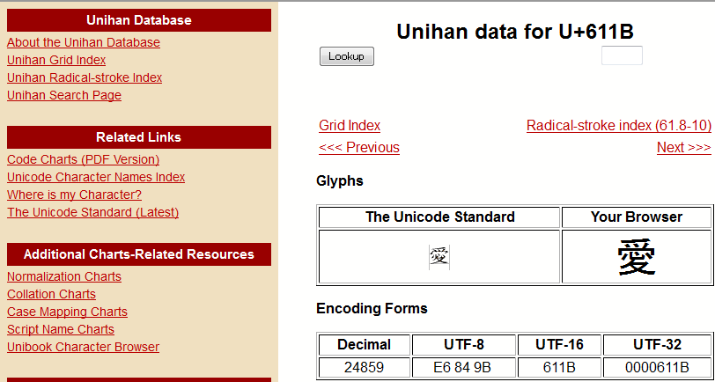
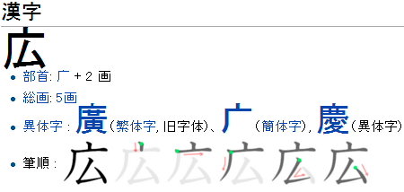
Chinese Characters Mapping Table of Japanese, Traditional Chinese and Simplified Chinese Chenhui Chu, Toshiaki Nakazawa, Sadao Kurohashi
(Graduate School of Informatics, Kyoto University)
Kanji & Hanzi
Freely Available Resources
A mapping table of Chinese characters in Japanese (Kanji) and Chinese (Hanzi) is useful for many Japanese-Chinese bilingual tasks
Unihan Database (http://unicode.org/charts/unihan.html)
Complicated relations between Kanji and Hanzi
 | C1 | C2 | C3 | C4 | C5 | C6 | C7
Kanji | 雪 | 愛 | 国 | 発 | 詑 | 鮃 | 込
Traditional Chinese | 雪 | 愛 | 國 | 發 | 詑 | N/A | N/A
Simplified Chinese | 雪 | 爱 | 国 | 发 | N/A | 鲆 | N/A
Character sets of Kanji and Hanzi
Kanji | JIS X 0208: Widely used (6,355 Kanji) JIS X 0213: Includes level 3 & 4 Kanji
Traditional Chinese | Big5: Widely used (13,060 TC) CNS 11643: Rarely used
Simplified Chinese | GB2312: Widely used (6,763 SC) GBK: Extension of GB2312
Hanzi Converter Standard Conversion Table (http://www.mandarintools.com/zhcode.html)
6,740 TC and SC pairs
Kanconvit Mapping Table (http://kanconvit.ta2o.net/)
3,506 one to one mappings of Kanji, TC and SC
1
2
Method & Resource
Completeness Evaluation
The method
p
Wiktionary (http://www.wiktionary.org/)
雪
愛
国
発
詑
鮃
込
・・・
雪
愛
國
發
詑
・・・
雪
爱
国
发
鲆
・・・
C1: 雪 雪 雪
C2: 愛 愛 爱
C3: 国 國 国
C4: 発 發 发
C5: 詑 詑 N/A
C6: 鮃 N/A 鲆
C7: 込 N/A N/A
・・・
Classification
Variants
JIS Kanji
BIG5
GB2312
Comparison results
Unihan
Hanzi Converter
Kanconvit
 | C1 | C2 | C3 | C4 | C5 | C6 | C7
Proposed | 3,141 | 1,847 | 177 | 550 | 342 | 16 | 282
Wiktionary | 3,141 | 1,781 | 172 | 503 | 412 | 30 | 316
Combination | 3,141 | 1,867 | 178 | 579 | 325 | 16 | 249
Resource statistics
Not found in Wiktionary
 | C1 | C2 | C3 | C4 | C5 | C6 | C7
Unihan | 3,141 | 1,815 | 177 | 533 | 384 | 16 | 289
+Hanzi Converter | 3,141 | 1,843 | 177 | 542 | 347 | 16 | 289
+Kanconvit | 3,141 | 1,847 | 177 | 550 | 342 | 16 | 282
Kanji | 尨 | 茘 | 値 | 幇 | 咲
Traditional Chinese | 尨,龍 | 荔 | 值 | 幫 | 笑
Simplified Chinese | 龙 | 荔 | 值 | 帮 | 笑
Multiple Hanzi forms
Not found in proposed method
Kanji | 弁 | 伝 | 鯰 | 働
Traditional Chinese | 弁,瓣,辦,辯,辮,辨 | 傳,伝 | 鯰 | 動,仂
Simplified Chinese | 弁,瓣,办,辩,辫,辨 | 传 | 鲶,鲇 | 动,仂
Kanji | 冴 | 扨 | 疂 | 滝 | 愼
Traditional Chinese | 冱,沍 | 扠,叉 | 疊 | 瀧 | 慎
Simplified Chinese | 冱 | 叉 | 叠 | 泷 | 慎
3
4

