Slide 1

Reiseplaner
Current status
Authors: Sven Osterwalder und Mira Günzburger
Professor: Dr. Jürgen Eckerle
Expert: Jean-Marie Leclerc
Date: 5th of December 2014
Notes:
Mira: Entwicklung Ontologie
Sven: GUI und Tutorial

Slide 2
Topic
Current situation
Development of ontology
GUI
Tutorial

Slide 3
Development of ontology
Starting at point zero
Stepwise development
by means of practical examples
From simple to complex

Slide 4
Ontology: First example
Family Muster plans a one day trip.
Their children are in an age where they need constant occupation.

Slide 5
Ontology: First example
Criteria
family-friendly
regional
action-packed

Slide 6
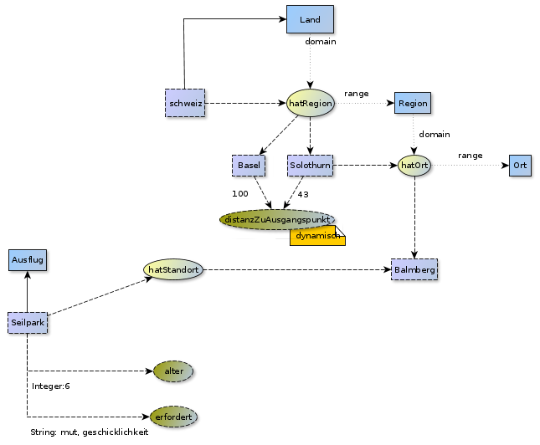
Ontology: First example: Overview

Slide 7
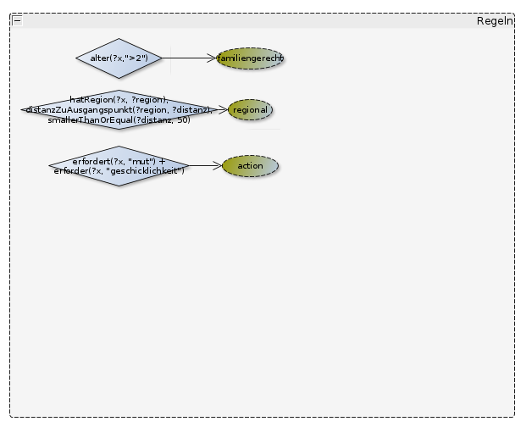
Ontology: First example: Rules

Slide 8
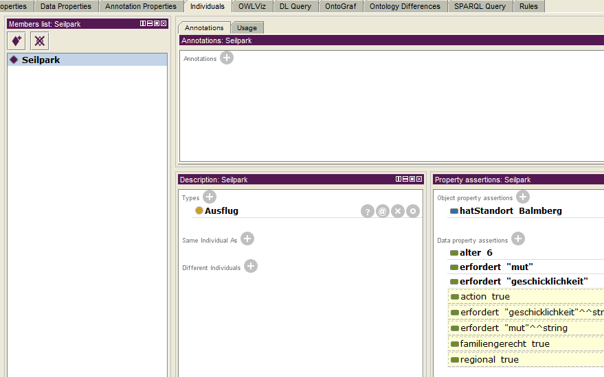
Ontology: First example: Reasoning

Slide 9
Ontology: First example: Query
SELECT
*
WHERE {
?object :familiengerecht true;
:regional true;
:action true.
}

Slide 10
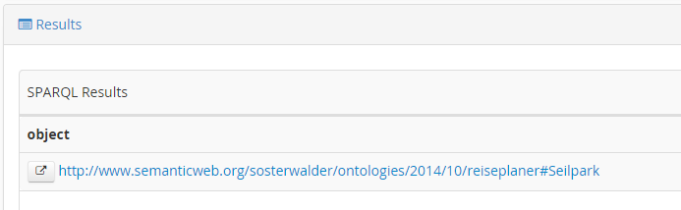
Ontology: First example: Result

Slide 11
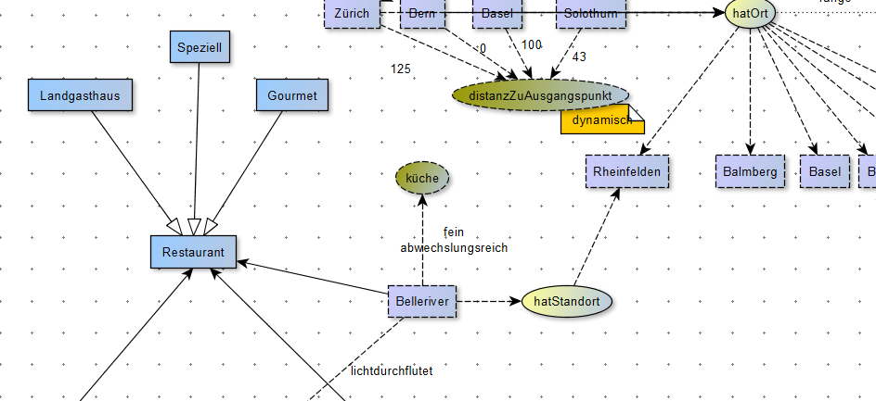
Ontology: Further development

Slide 12
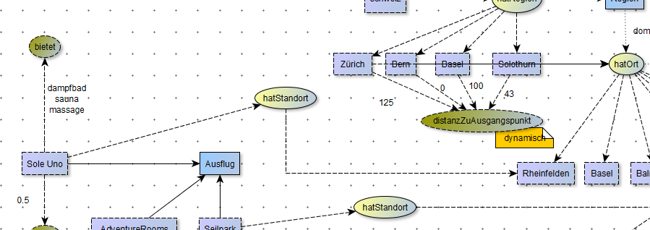
Ontology: Further development

Slide 13
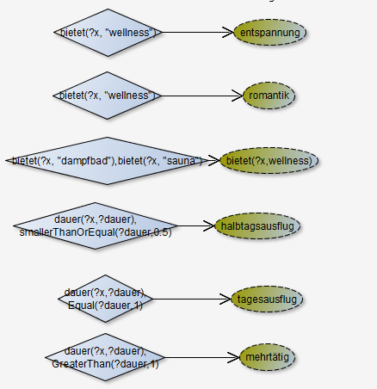
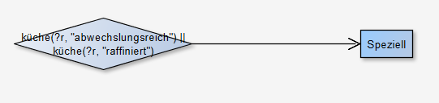
Ontology: Further development

Slide 14
Ontology: Further development
SELECT
?ausflug ?standort ?resti ?standort2
WHERE {
?ausflug :romantik true;
:entspannung true;
:halbtags true;
:hatStandort ?standort.
?region :hatOrt ?standort.
?resti a :Speziell;
:hatStandort ?standort;
FILTER(regex(str(?region),"Basel","i"))
}

Slide 15
Topic
Current situation
Development of ontology
GUI
Tutorial

Slide 16
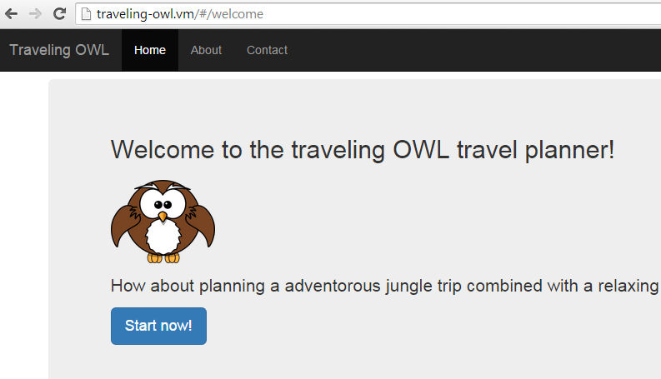
GUI
→ Demonstration
Notes:
action + regional oder wellness + halbtags + entspannig

Slide 17
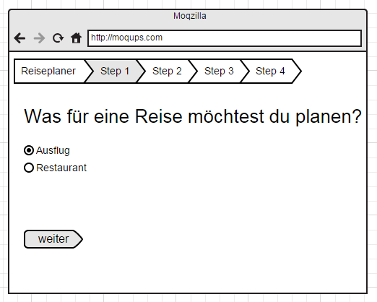
GUI Step 1
SELECT *
WHERE {
?a rdfs:domain :Ausflug
}

Slide 18
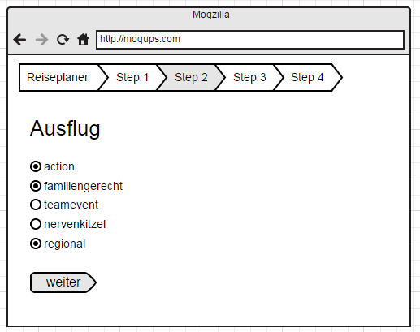
GUI Step 2
Select *
where {
?object :familiengerecht true;
:regional true.
:action true.
?object :url ?uri.
}

Slide 19
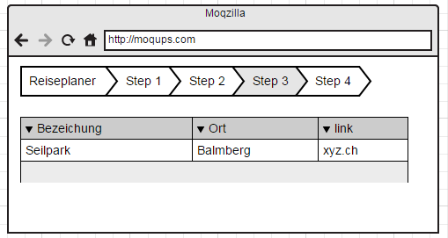
GUI Step 3

Slide 20
Topic
Current situation
Development of ontology
GUI
Tutorial

Slide 21
Tutorial
Part of the thesis documentation
Attachment
Proceedings of a knowledge engineer
Practical hints
Examplary procedure for building an ontology

Slide 22
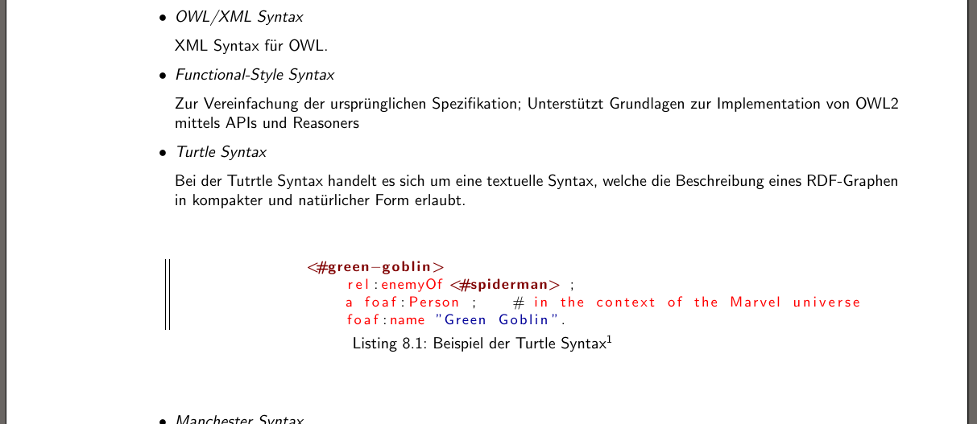
Tutorial

Slide 23
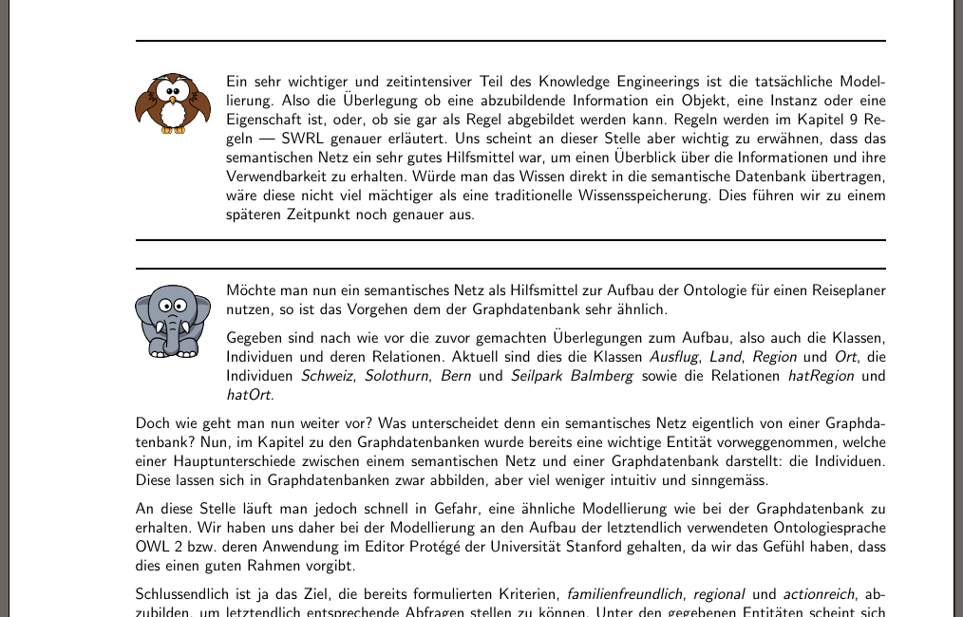
Tutorial

Slide 24
questions
?

