Slide 1
creational pattern factory
Program Studi Teknologi Informasi

Slide 2
Intro
There is more to making objects than just using the new operator. You’ll learn that instantiation is an activity that shouldn’t always be done in public and can often lead to coupling problems.
The Factory pattern provides a way to use an instance as a object factory. The factory can return an instance of one of several possible classes (in a subclass hierarchy), depending on the data provided to it.

Slide 3
Interface vs implementation
Interface : framework (berisikan fungsi2 tanpa body of method)
Implementation : concrete class, body of method

Slide 4
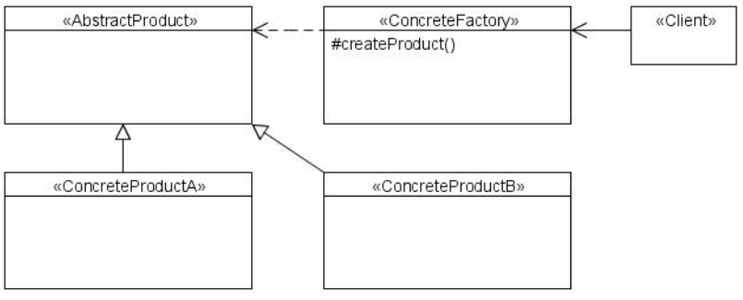
Structure

Slide 5
Benefits
The client does not need to know every subclass of objects it must create. It only need one reference to the abstract class/interface and the factory object.
The factory encapsulate the creation of objects. This can be useful if the creation process is very complex.

Slide 6
When to use
When a class can't anticipate which kind of class of object it must create.
You want to localize the knowledge of which class gets created.
When you have classes that is derived from the same subclasses, or they may in fact be unrelated classes that just share the same interface. Either way, the methods in these class instances are the same and can be used interchangeably.
When you want to insulate the client from the actual type that is being instantiated.

Slide 7
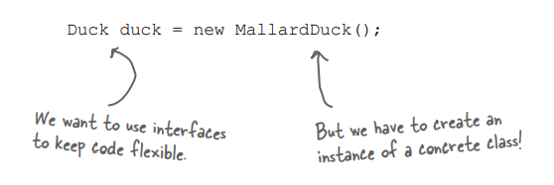
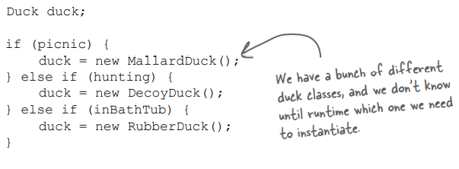
When to use

Slide 8
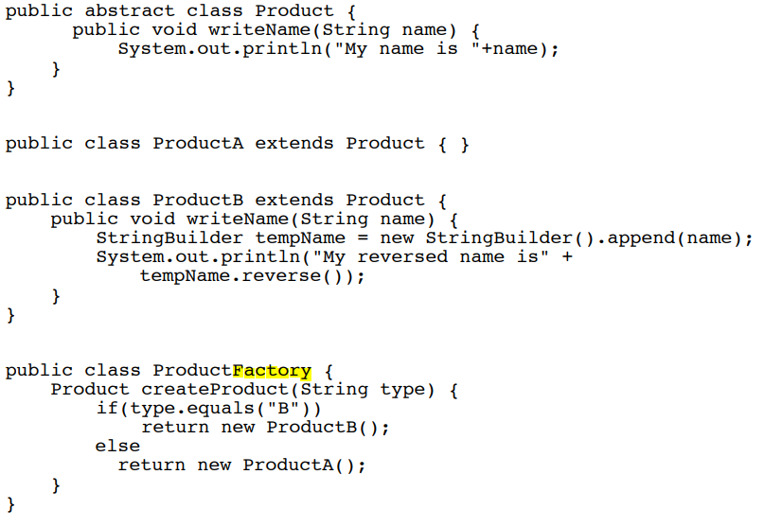
example

Slide 9
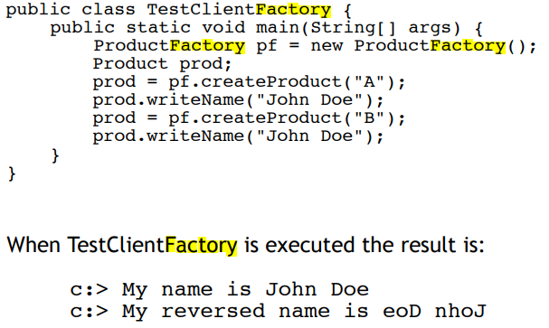
example

Slide 10
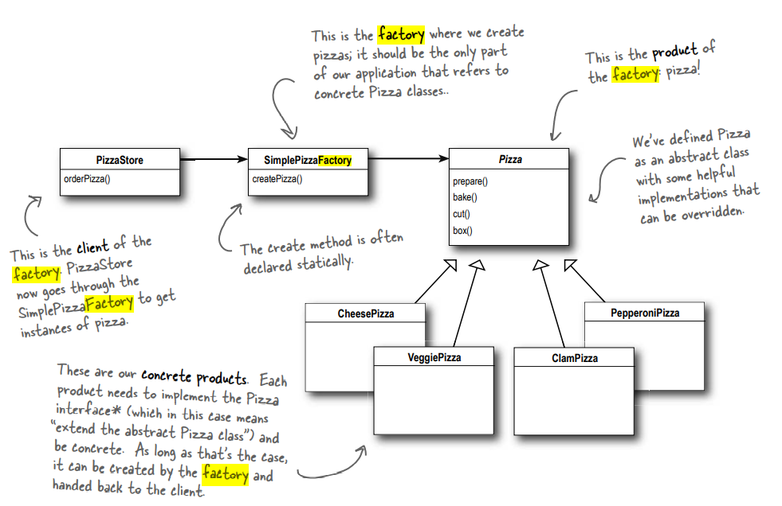

Slide 11


Example

Slide 12
Thank you….

