Slide 1
Direct Marketing Campaign Analysis
Our Clients and Campaign Operations
Pei Guo

Slide 2
The Campaign
Number of customers called: 3,999
Number of term deposit purchased: 458
Success rate: 8.73%
The Goal
Who are our clients?
What can we do to improve future campaigns?

Slide 3
The Data
Client Data | Campaign Related Data
Age | Contact type
Job | Last contact day of the month
Marital status | Last contact month of the year
Education | Contact duration
Default credit | No. of contacts per client
Average yearly balance | No. of pass days since last contact
Housing | No. of previous contacts per client
Personal loan | Outcome of previous campaign

Slide 4
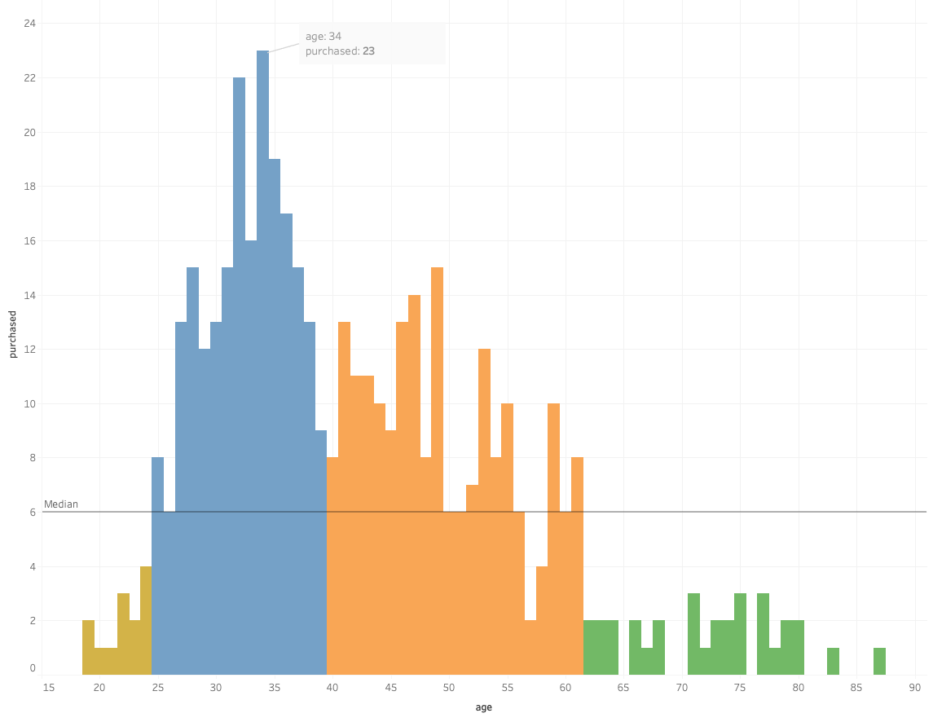
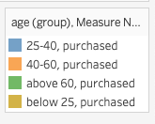
Clients: Age vs. Purchase

Slide 5
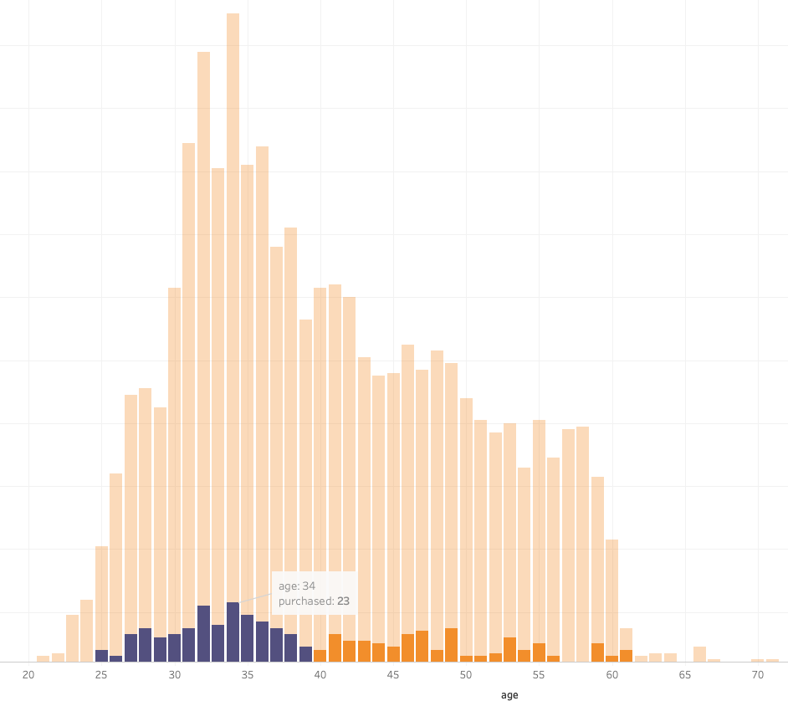
Clients: More Calls More Purchases

Slide 6
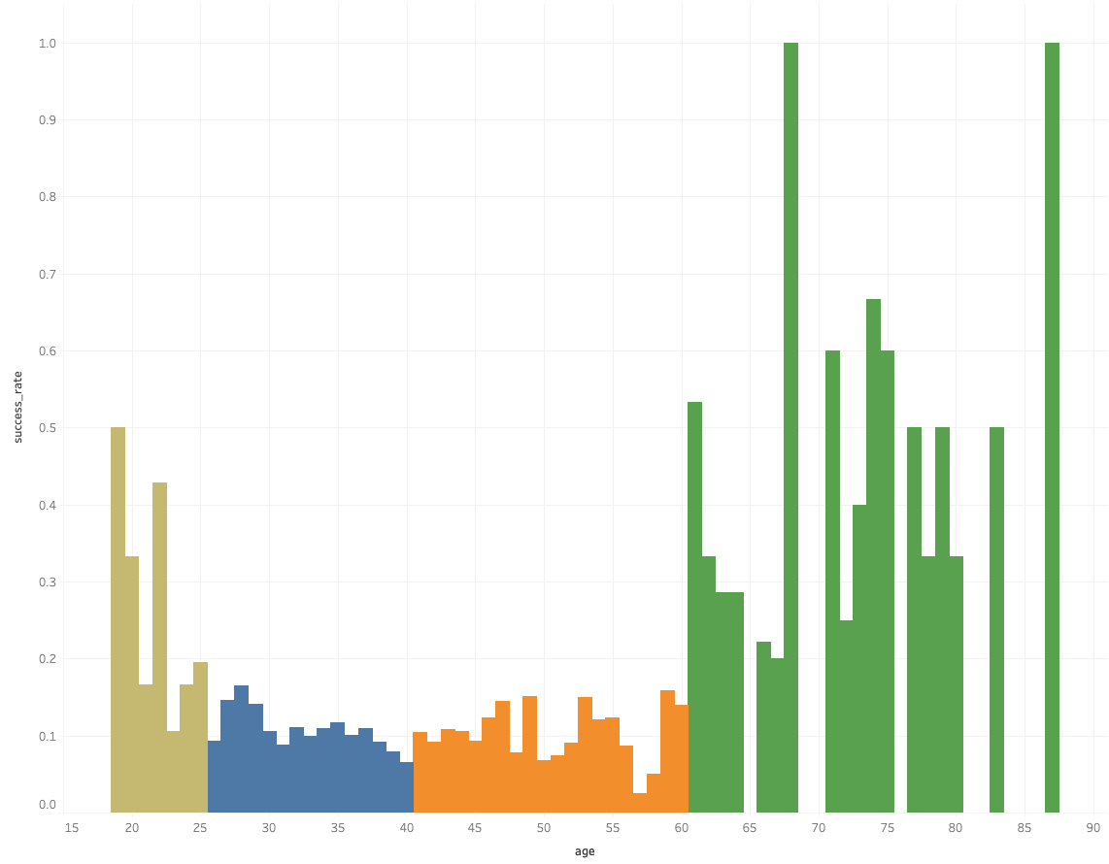
Clients: Call More Senior Clients!
purchase counts
purchase rates

Slide 7
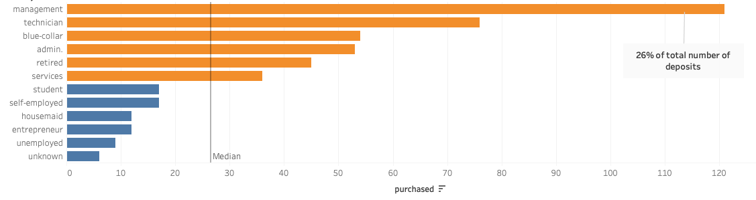
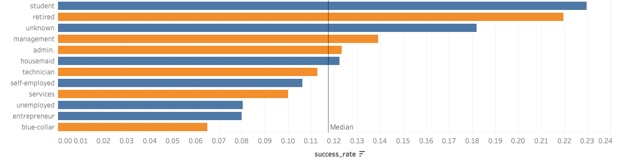
Clients: Job vs. Purchase
high purchase high rate | low purchase high rate | high purchase low rate | low purchase low rate
Management, admin, retired | Student, housemaid, unknown | Technician, blue-collar, services | Self-employed, entrepreneur, unemployed
High priority, Keep current | High priority, Call more | Mid priority Keep current | Low priority Call less

Slide 8
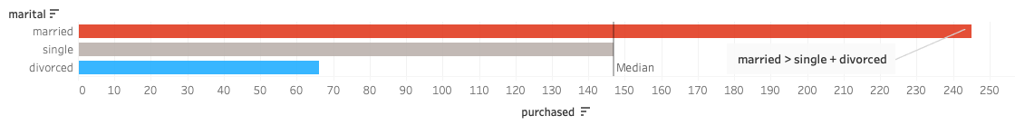
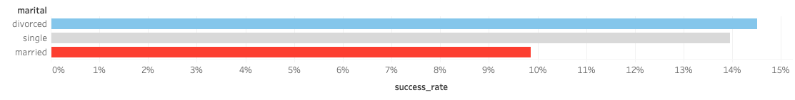
Clients: Marital vs. Purchase
high purchase high rate | low purchase high rate | high purchase low rate | low purchase low rate
 | Single , divorced | married
 | High priority, Call more | Low priority Call less

Slide 9
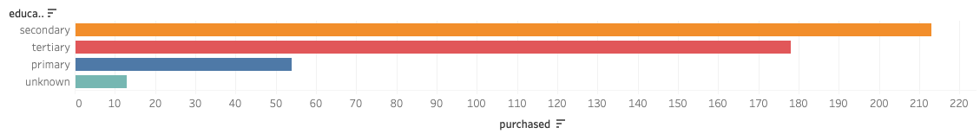
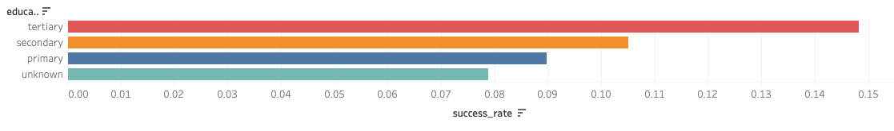
Clients: Education vs. Purchase
high purchase high rate | low purchase high rate | high purchase low rate | low purchase low rate
secondary | tertiary | primary | unknown
High priority, Keep current | High priority, Call more | Low priority Call less | Low priority Call less

Slide 10
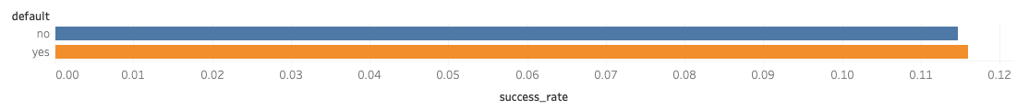
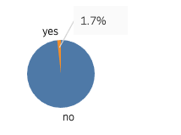
Clients: Default credit does not affect Purchase

Slide 11

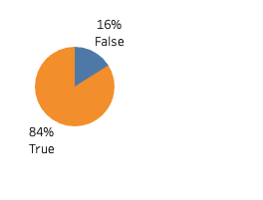
Clients: Positive average yearly balance is good!

Slide 12
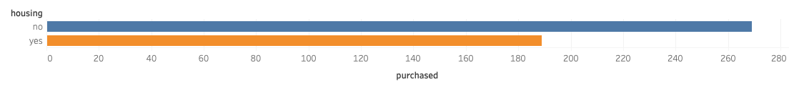
Clients: People without HOUSING have more money to save!

Slide 13
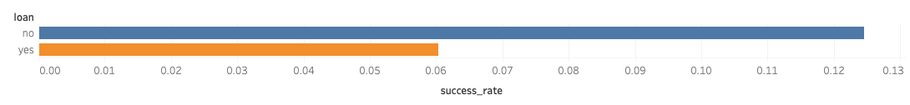
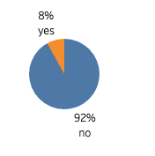
Clients: People without LOANS have more money to save!

Slide 14
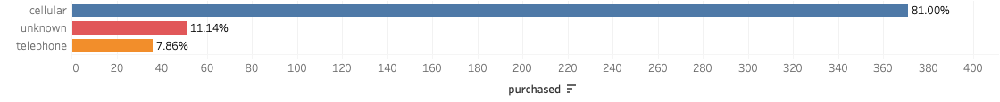
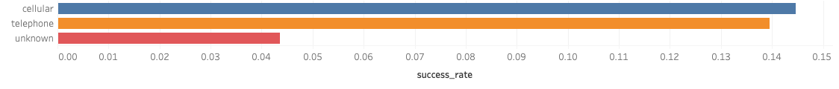
Campaign: Call more telephone clients

Slide 15
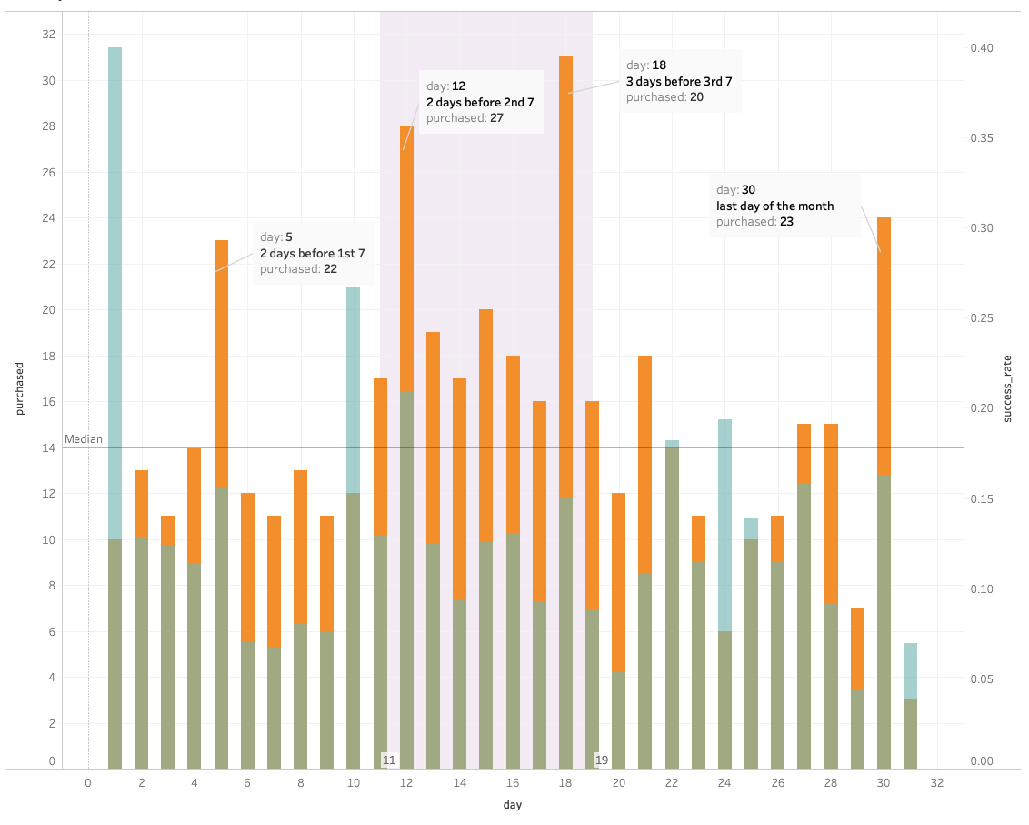

Campaign: Call 2-3 days before n*7th

Slide 16
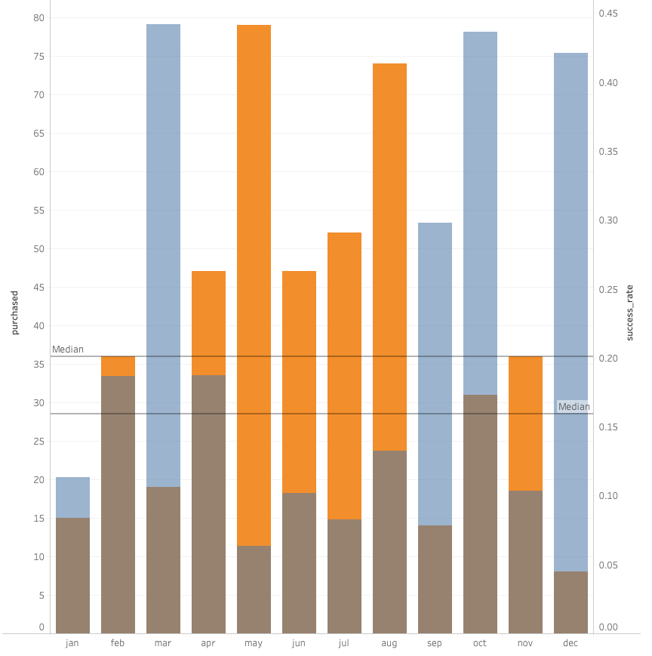

Campaign: Call more in month 3, 9, 10, 12 Summer needs more luck

Slide 17
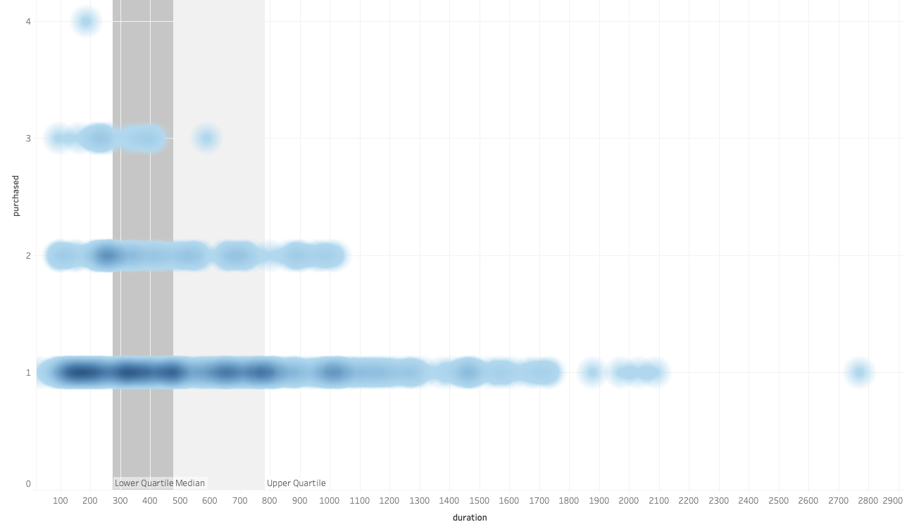
Campaign: Call duration 500 seconds (9 minutes)

Slide 18
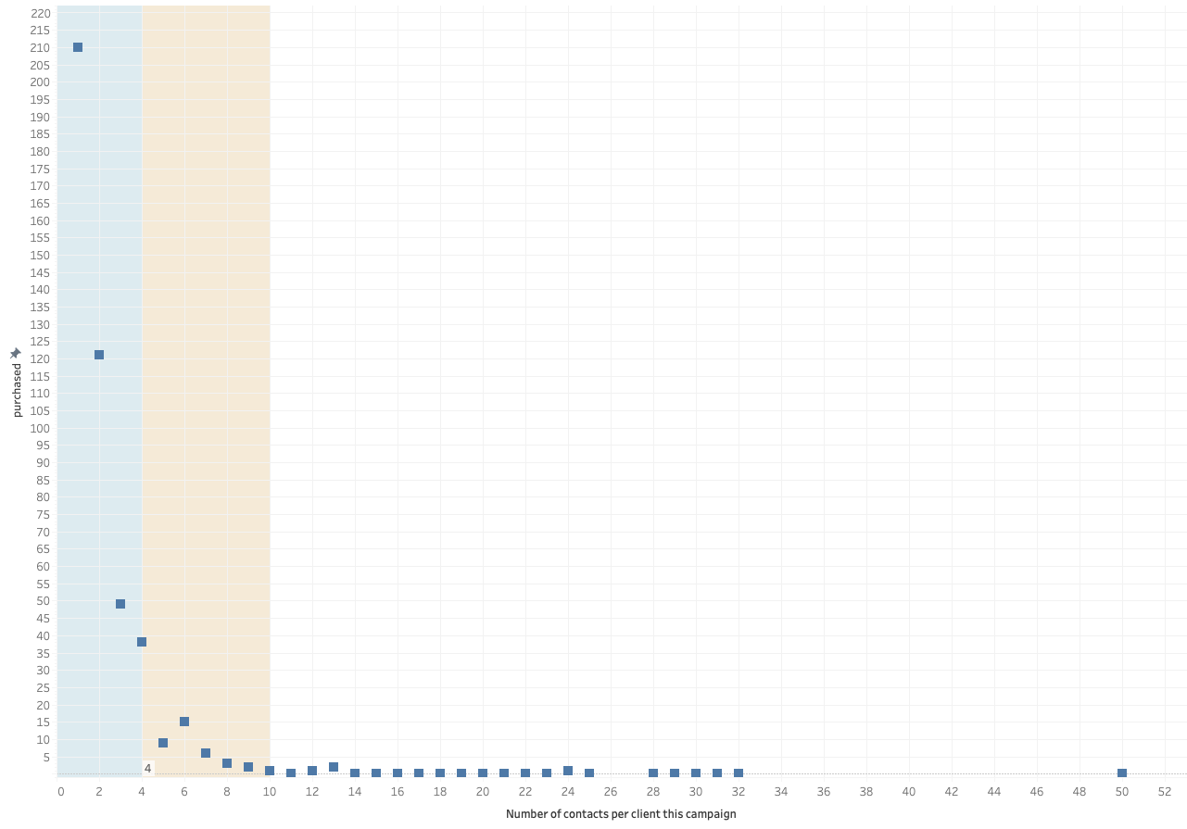
Campaign: Call 4 times, don’t call more than 10 times

Slide 19
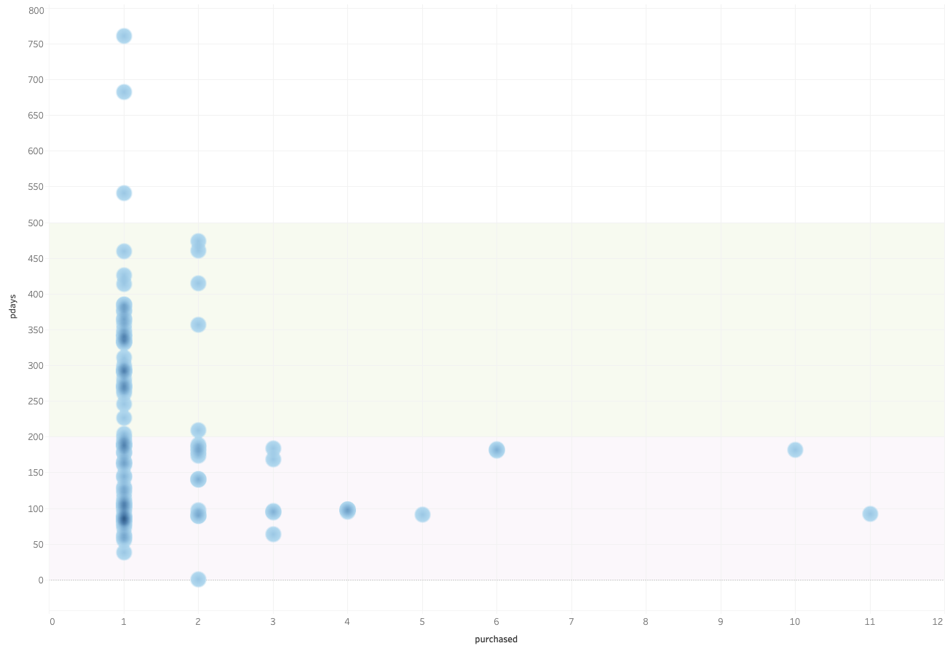
Campaign: Best contact again within 200 days

Slide 20
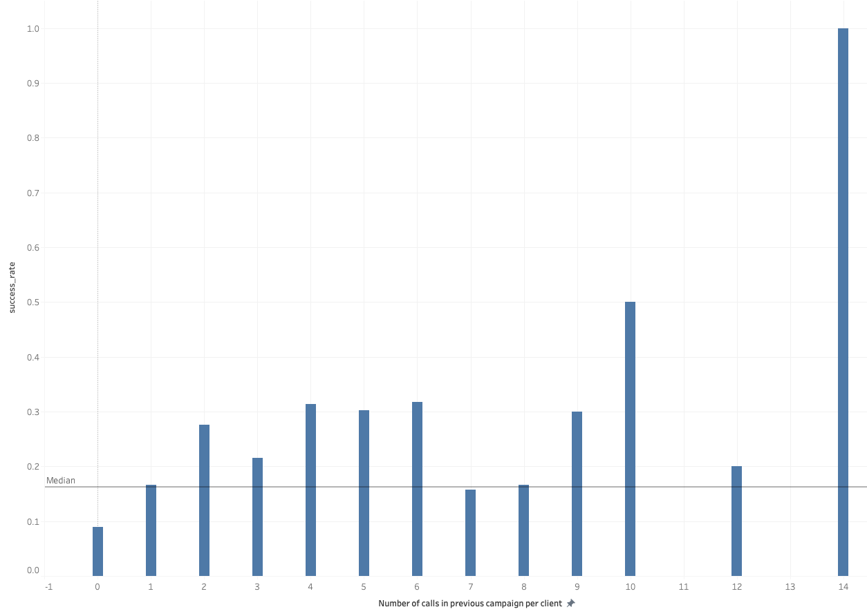
Campaign: Hard to win new customers Per customer, more calls more success

Slide 21
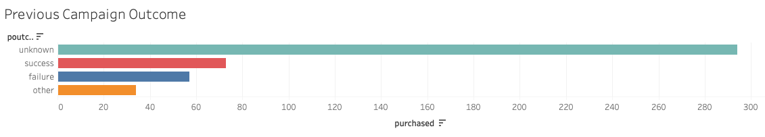
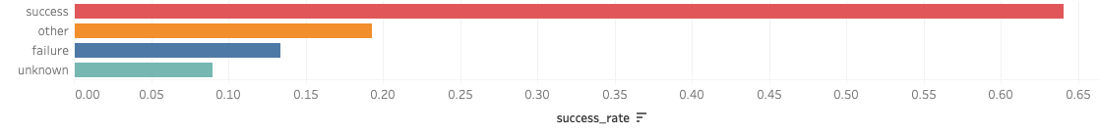
Campaign: Call less “unknown” Call more “success”

Slide 22
What to do differently next campaign?
Client Groups | Campaign Operations
focus on senior clients | call more telephone clients
focus high purchase rate job groups | Call 2-3 days before the n * 7th
call more single and divorced | More calls in month 3, 9, 10, 12
top priority tertiary | keep the call within 9 minutes
default credit does not matter | call 4 times is just right
positive average yearly balance | don’t wait over 200 days
no housing buy more | more previously contacted clients
no loan buy more | call less “unknown”, more “success”

Slide 23

Questions?

