Slide 1



WHAT DRIVES CAR PRICES?
Can we accurately predict a car’s price from its features, and which features most strongly determine the selling price?
ANDREW GUO

Slide 2

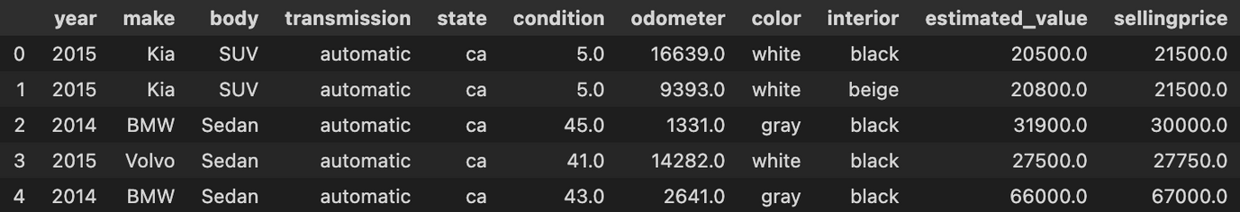
THE DATA
OVERVIEW
FEATURES
PREPROCESSING
Categories: 16 variables cut down to 9 key predictors
Numeric: Odometer, Year
Categorical: Body, Condition, Make, Color, State, Interior, Transmission
Body types simplified to 10 generic styles
Removed estimated_value category for more robust data
Test size of 25%
Source: Vehicle Sales Data (Kaggle)
Observations: 558836 rows
Condition: condition of the vehicle on scale of 1-100
https://www.kaggle.com/datasets/syedanwarafridi/vehicle-sales-data

Slide 3

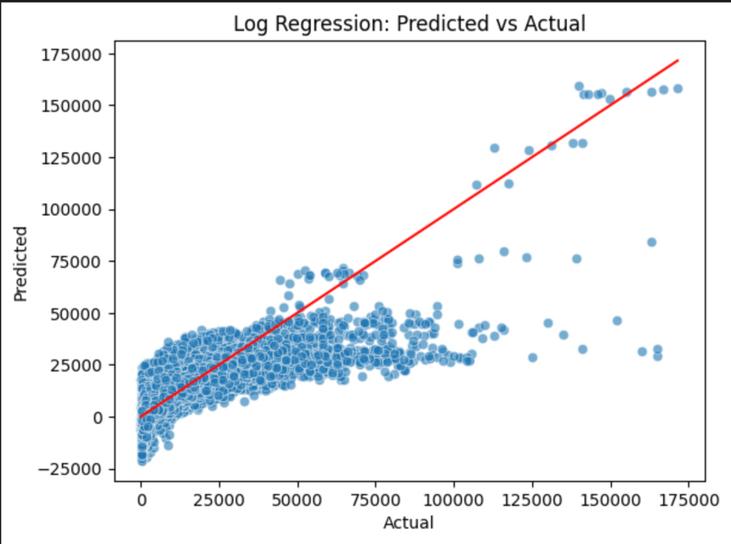
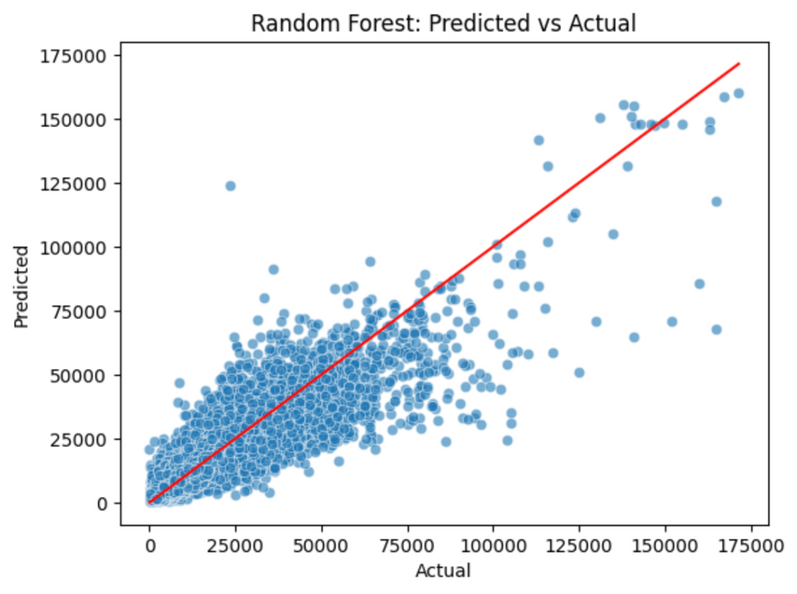
MODELS
LOG REGRESSION
RMSE: 5443.38
R2: 0.68
Some negative predictions,
accurately follows linear trends but struggles with non-linear relationships
RANDOM FOREST
RMSE: 3956.30
R2: 0.83
Mean residual: -21.18
Std of residuals: 3956.26
MAE: 2362.32

Slide 4
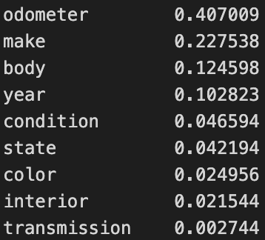
SUMMARY
Random Forest outperforms Linear Regression
  Lower RMSE and R2
  Both models have relatively high RMSE given that the vast majority of cars sell for under 50k
Influential Features
  Odometer, make, and body type were the most powerful predictors
  Transmission, interior material, and color were the least
Residuals (Random Forest Only)
  Mean: slightly underestimates price but is very close to 0
  Standard Deviation: very high, almost 10% error per prediction
  MAE: lower than STD, not as affected by outliers
Conclusion: Random Forest was very effective at predicting car selling prices but struggled with outliers at extremely high or low costs

