Slide 1

Intraspecific Competition
GUOCHUN SHEN
gcshen@des.ecnu.edu.cn
http:www.guochun.info

Slide 2
Outlines
Introduction
Density dependent mortality and fecundity
Regulation of population size
Density dependent growth & self-thinning
Asymmetric competition
Territoriality

Slide 3
Competition
Definition
  Competition is an interaction between individuals, brought about by a shared requirement for a resource, and leading to a reduction in the survivorship, growth and/or reproduction of at least some of the competing individuals concerned.
  Intraspecific competition
  Interspecific competition

Slide 4
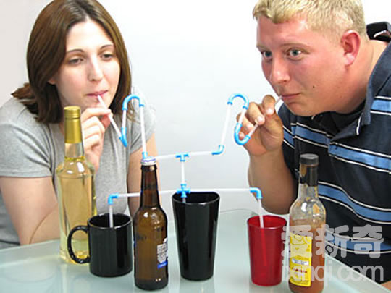
Competition
Exploitation: each individual is affected by the amount of resource that remains after that resource has been exploited by others. It only occur if the resource in question is in limited supply.

Slide 5
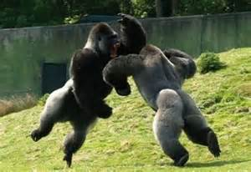
Competition
Interference: individuals interact directly with each other, and one individual will actually prevent another from exploiting the resources within a portion of the habitat.

Slide 6
Competition
In practice, many examples of competition probably include elements of both exploitation and interference.

Slide 7
Outlines
Introduction
Density dependent mortality and fecundity
Regulation of population size
Density dependent growth and self-thinning
Asymmetric competition
Territoriality

Slide 8
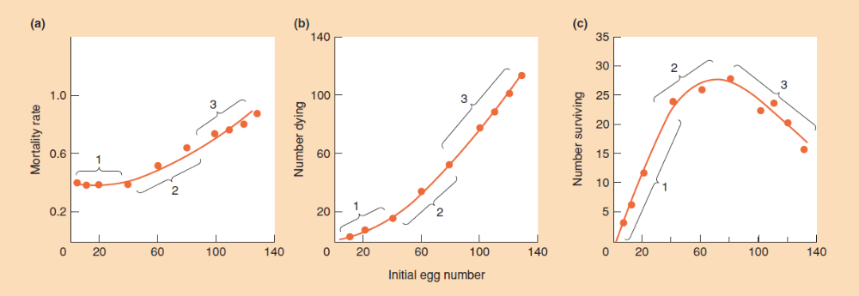
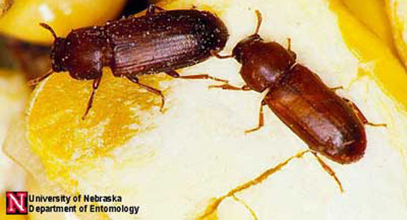
Density dependent mortality
Density-dependent mortality in the flour beetle Tribolium confusum

Slide 9
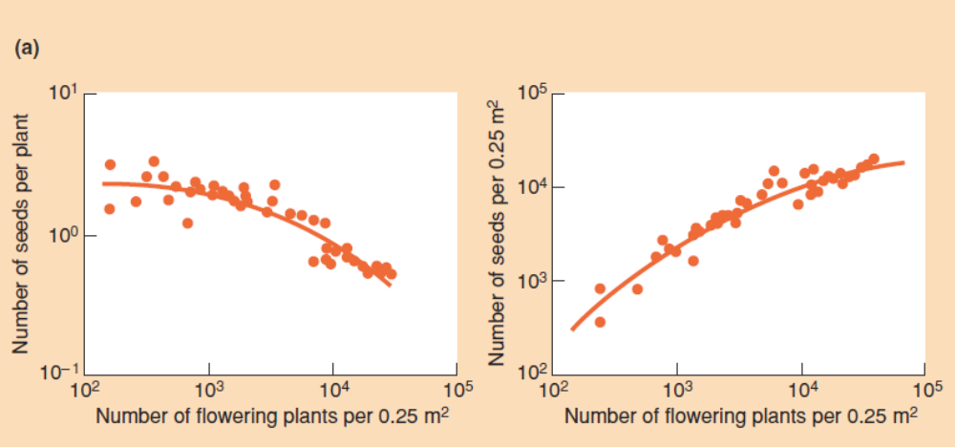
Density dependent fecundity
Density dependent fecundity of the annual dune plant Vulpia fasciculata

Slide 10
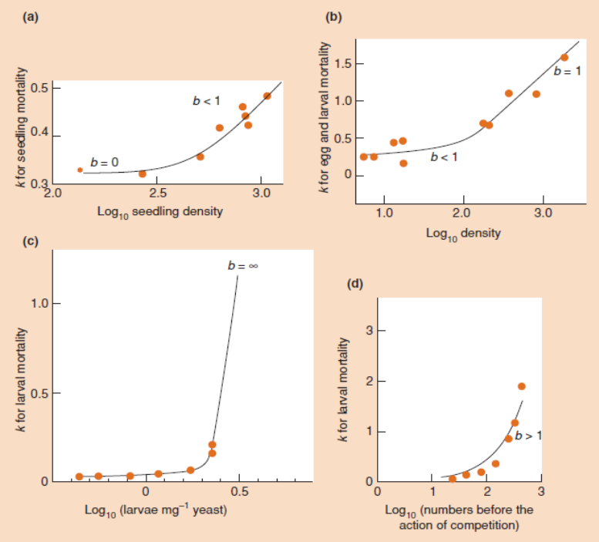
Quantify intensity of intraspecific competition
k=log( initial density) – log( final density )

Slide 11
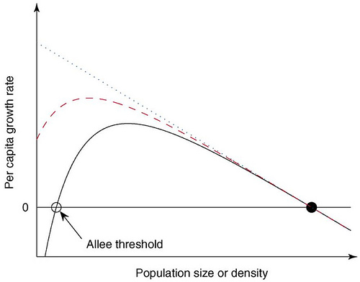
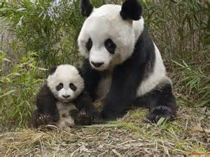
Density dependent effect
Positive density dependence (e.g. Allee effect)

Slide 12
Outlines
Introduction
Density dependent mortality and fecundity
Regulation of population size
Density dependent growth and self-thinning
Asymmetric competition
Territoriality

Slide 13
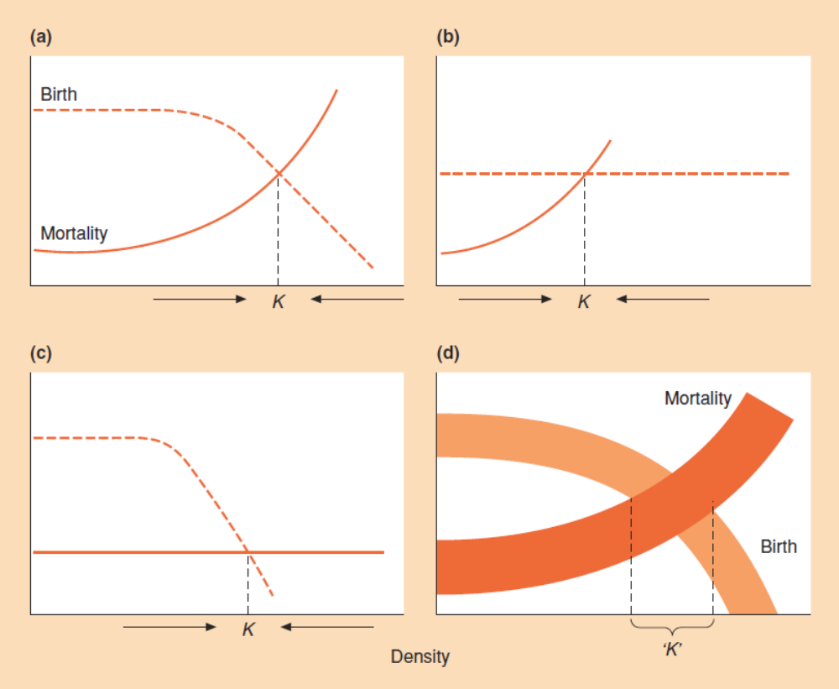
Carrying capacity

Slide 14
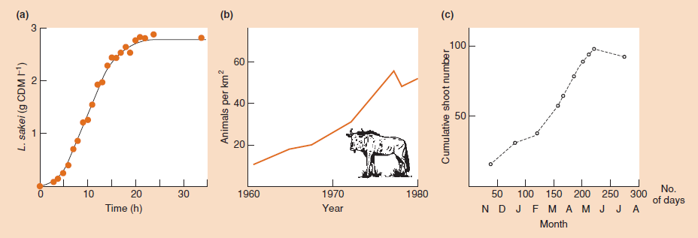
Carrying capacity

Slide 15
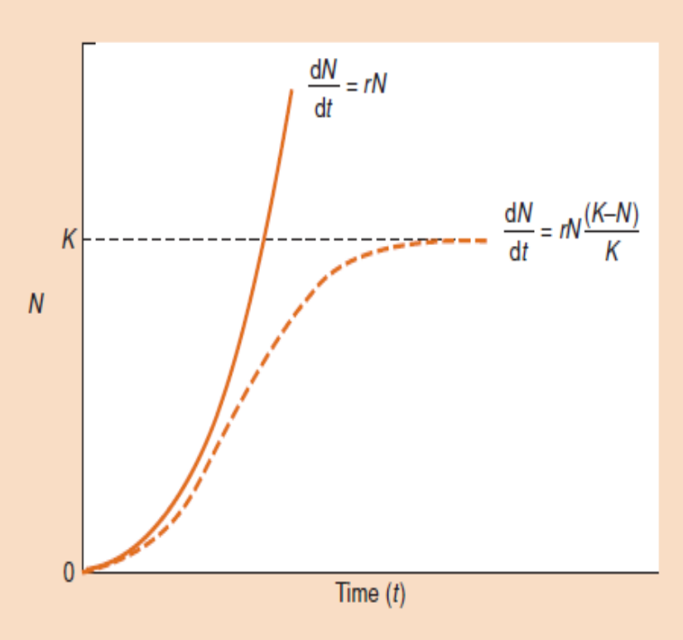
The logistic equation

Slide 16
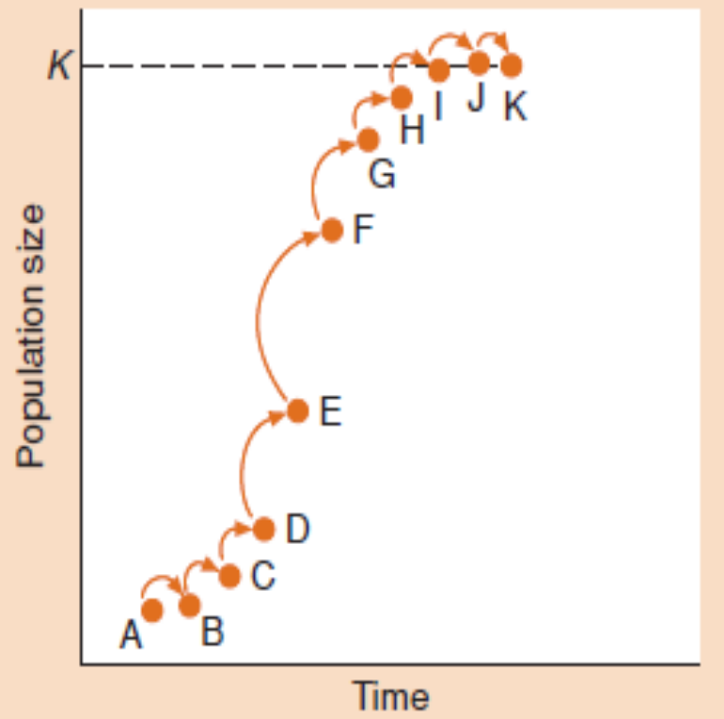
Carrying capacity

Slide 17
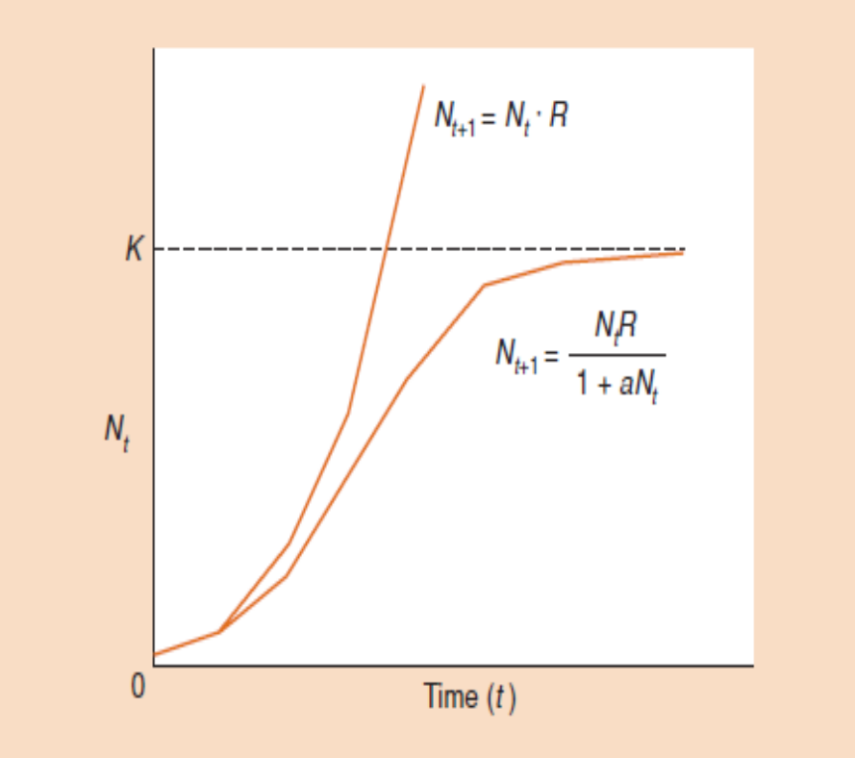
A model with discrete generation

Slide 18
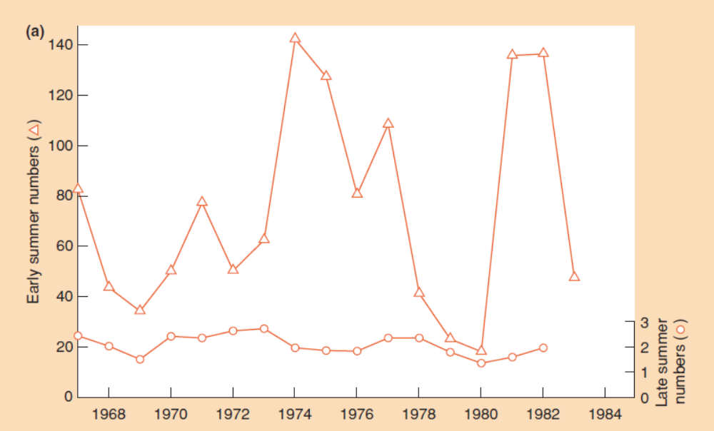
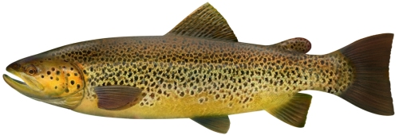
Real population size
Brown trout (Salmo trutta) in an English Lake District stream
Notes:
Real population dynamic seems quite irregular

Slide 19
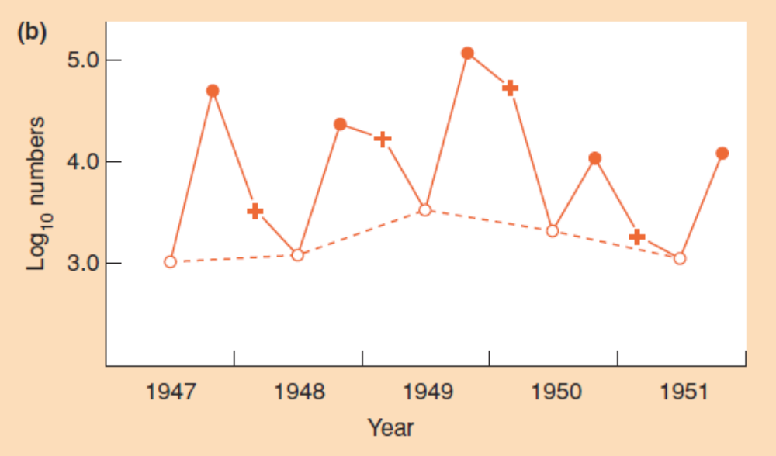
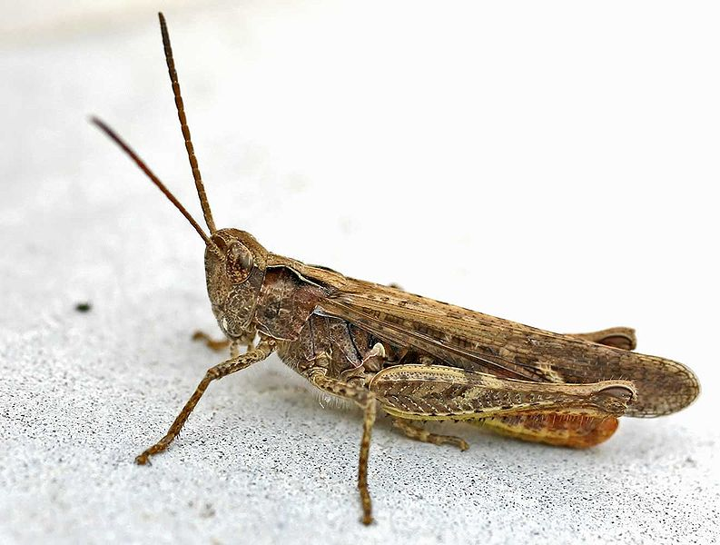
Real population size
eggs
nymphs
adults
Population dynamic of the grasshopper, Chorthippus brunneus in southern England.

Slide 20
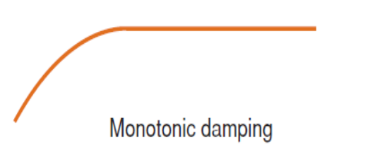
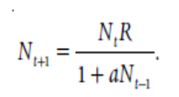
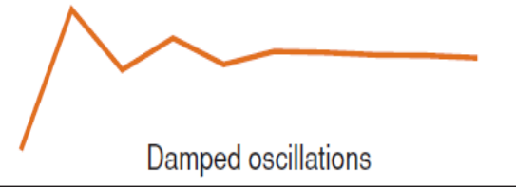
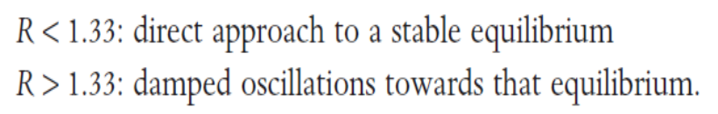
With time lag

Slide 21
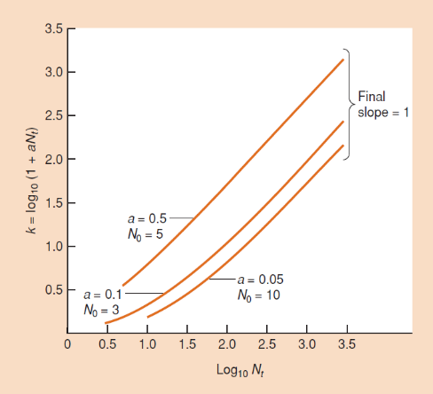
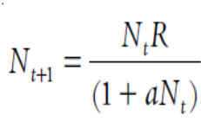
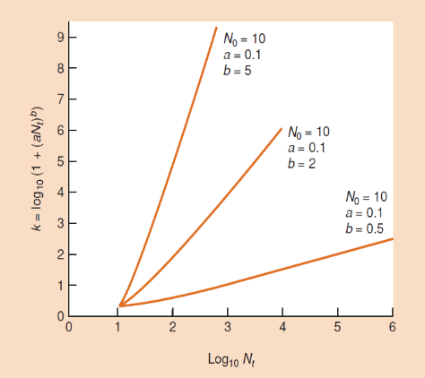
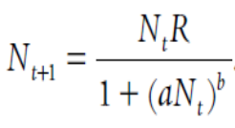
A range of competition

Slide 22
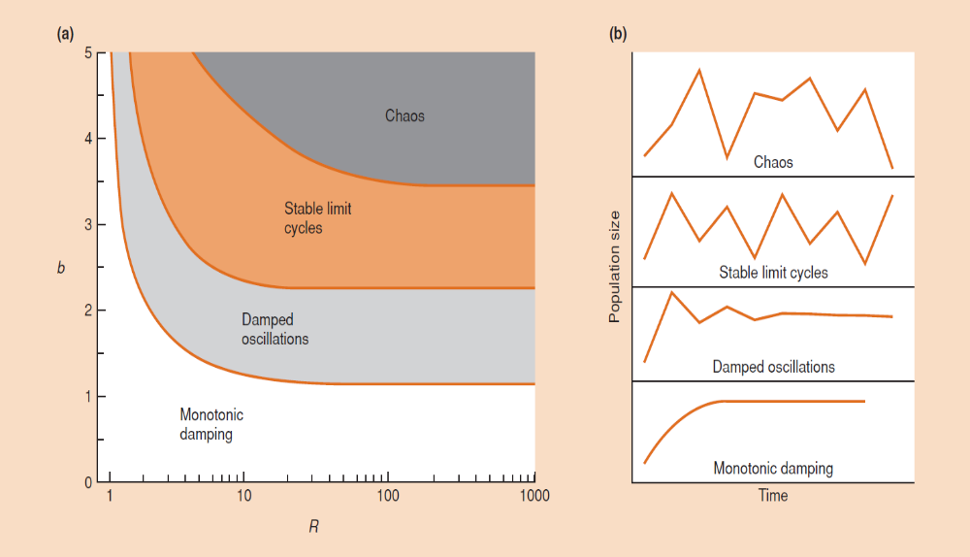
Population fluctuation

Slide 23
Outlines
Introduction
Density dependent mortality and fecundity
Regulation of population size
Density dependent growth and self-thinning
Asymmetric competition
Territoriality

Slide 24
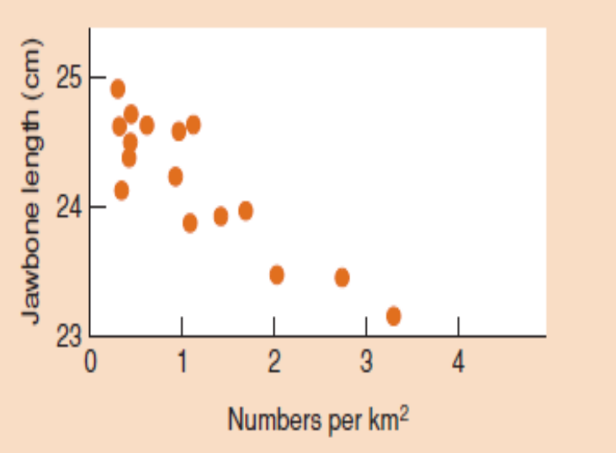
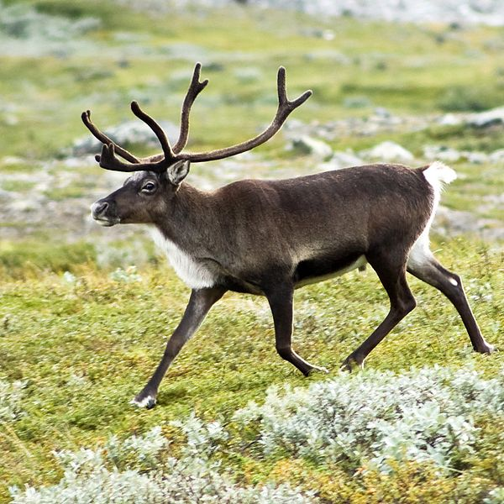
Density dependent growth
Jawbone length of reindeer

Slide 25
Self-thinning
A progressive decline in density in a population of growing individuals

Slide 26
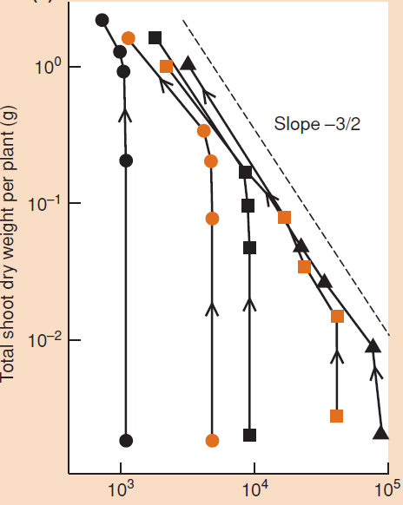
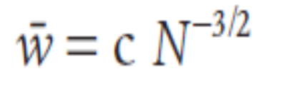
The -3/2 power law
Self-thinning in Lolium perenne sown at five densities

Slide 27
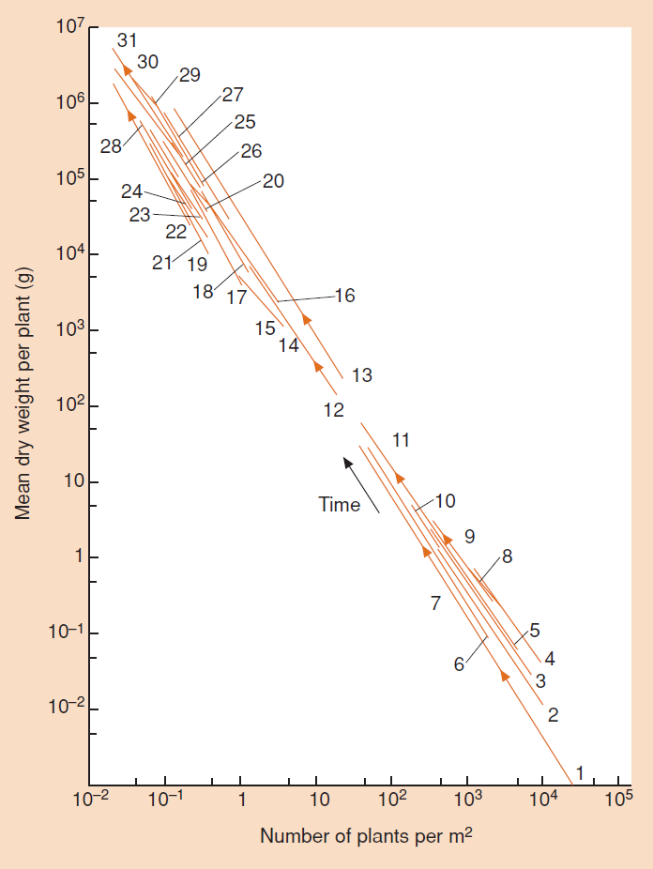
The -3/2 power law
Self-thinning in a wide variety of herbs and trees

Slide 28
The -3/2 power law
Theoretical explanation
  A geometric basic for self-thinning
  A resource-allocation basis for thinning boundaries
  -4/3

Slide 29
Outlines
Introduction
Density dependent mortality and fecundity
Regulation of population size
Density dependent growth and self-thinning
Asymmetric competition
Territoriality

Slide 30
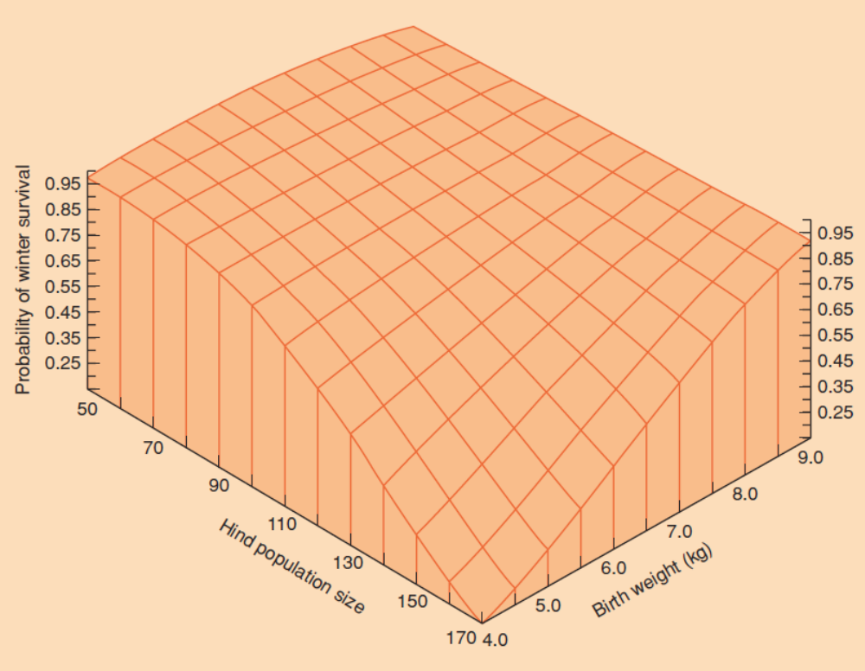
Asymmetric competition
Size inequalities
Those red deer that are smallest when born are the least likely to survive over winter when, at higher densities, survival declines.

Slide 31
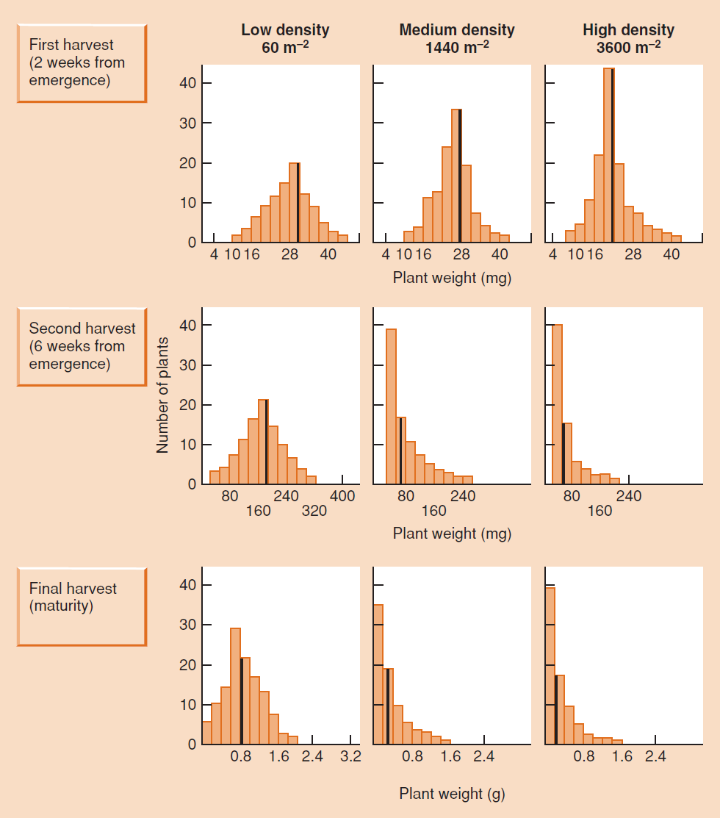
Asymmetric competition

Slide 32
Asymmetric competition
If competition is asymmetric because superior competitors preempt resources, then competition is most likely to be asymmetric when it occurs for resources that are most liable to be preempted.

Slide 33
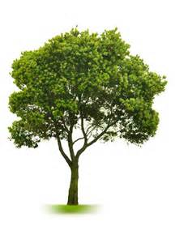
Asymmetric competition
Preempting resources

Slide 34
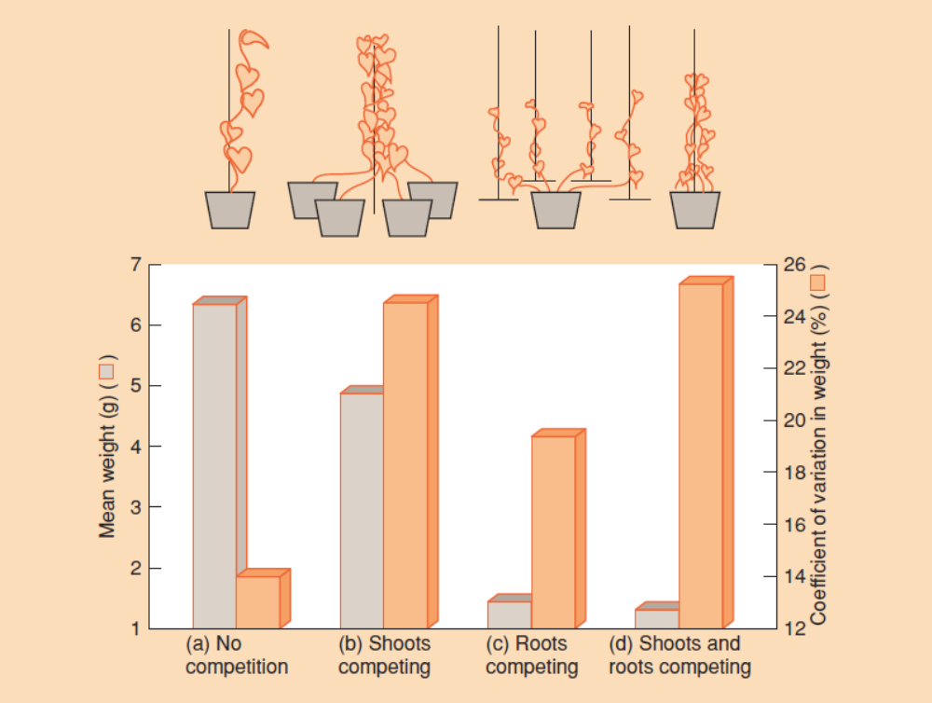
Asymmetric competition
Competition experiment of glory vine (Ipomoea tricolor).

Slide 35
Outlines
Introduction
Density dependent mortality and fecundity
Regulation of population size
Asymmetric competition
Territoriality

Slide 36
Territoriality
Territoriality is one particularly important and widespread phenomenon that results in asymmetric intraspecific competition.
It occurs when there is active interference between individuals, such that a more or less exclusive area, the territory, is defended against intruders by a recognizable pattern of behavior.

Slide 37
Territoriality
[video of territoriality]
BBC 01 27:40
BBC 10 8:00-16:00

Slide 38
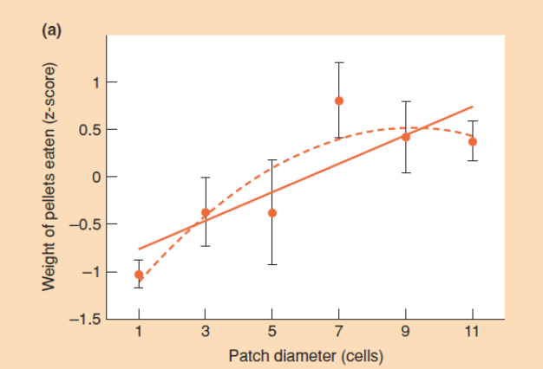
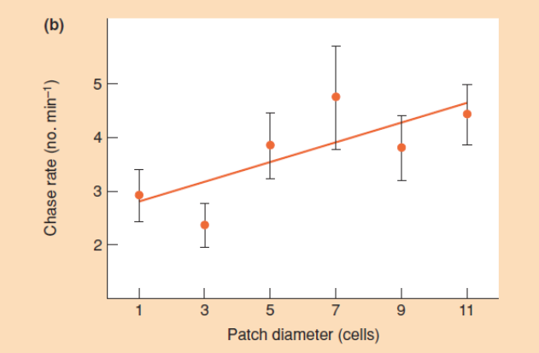
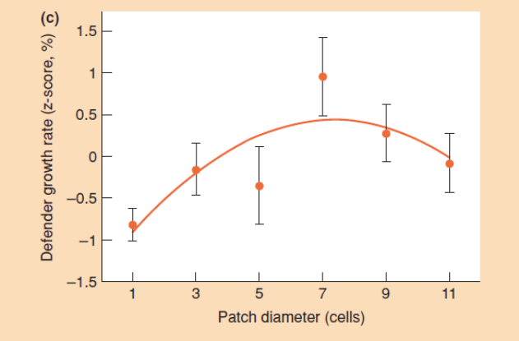
Benefit VS. Costs
Optimal territory size in the convict cichlid fish, Archocentrus nigrofasciatus

Slide 39
Recommended reading?
Density or crowding ?
  Lewontin, R.C. & Levins, R. (1989) On the characterization of density and resource availability. American Natruralist, 134, 523-524.

