Slide 1
Resources
Guochun Shen
gcshen@des.ecnu.edu.cn
http:www.guochun.info

Slide 2
Outlines
Introduction
Radiation
Carbon dioxide
Water, Mineral nutrients, Oxygen
Organisms as food resources

Slide 3
Resources
Definitions:
All things consumed by an organism
Consumed does not simply mean ‘eaten’. E.g. holes for some animals. An occupied territory is not available for other conspecific individuals.

Slide 4
Resources
Organisms will not compete for conditions (e.g. temperature),
but they may compete for resources (e.g. water).

Slide 5
Outlines
Introduction
Radiation
Carbon dioxide
Water, Mineral nutrients, Oxygen
Organisms as food resources

Slide 6
Radiation
Global map of the solar radiation absorbed annually in the earth-atmosphere system (J cm⁻² min⁻¹).

Slide 7
Radiation
Solar radiation is a resource continuum: a spectrum of different wavelengths.
The photosynthetic apparatus is only able to gain access to energy in only a restricted band (photosynthetically active radiation 400-700 nm) of this spectrum.

Slide 8
Radiation

Slide 9
Radiation

Slide 10
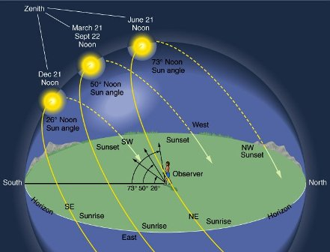
Radiation

Slide 11
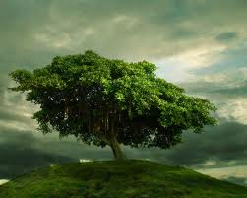
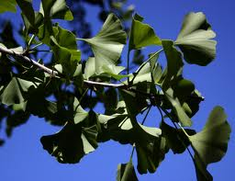
Radiation
Adaptation of tree to sun light
How do you do if you are trees?

Slide 12
Radiation
Changing spectral distribution of radiation with depth in Lake Burley Griffin, Australia

Slide 13
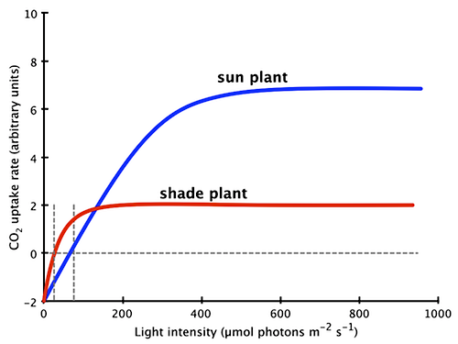
Sun & shade plant species
the compensation point

Slide 14
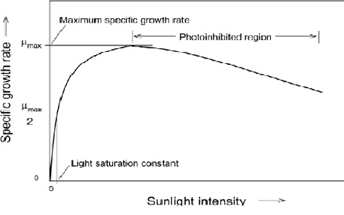
Sun & shade plant species
Photoinhibition

Slide 15
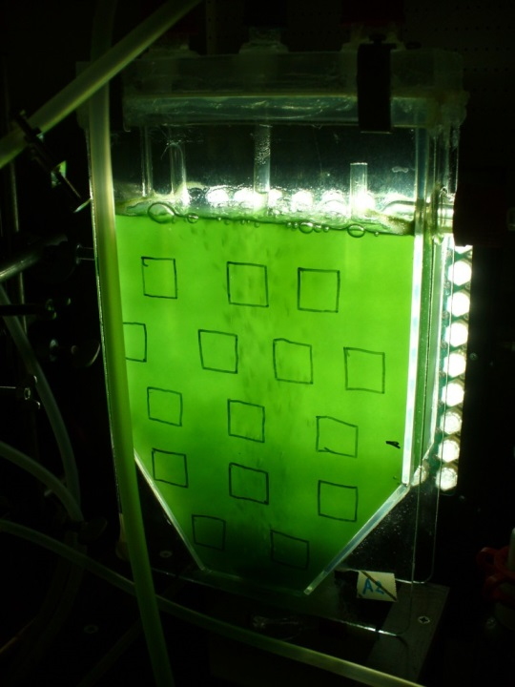
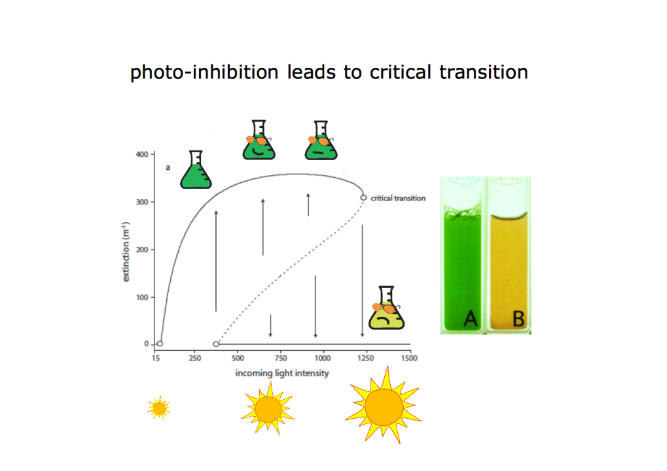
Sun & shade plant species

Slide 16
Sun & shade plant species
Sun plant canopy shape
Shade plant canopy shape

Slide 17
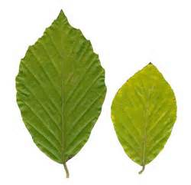
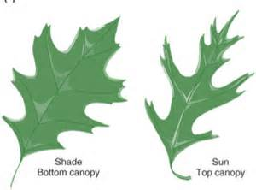
Sun & shade leaves
Notes:
Sun leaves are typically smaller and thicker than shade leaves. They sit at the top and outer edges of a plant, picking up the majority of the sunlight. Sun leaves are usually around two to three cells thick. This means the cells must move around to maximize absorption. Too much sunlight will damage the chloroplast, so cells take turns at the surface absorbing sunlight then move away to process it elsewhere in the cell. Shade leaves are larger and thinner than sun leaves. They are positioned closer to the middle and the bottom of the plant. They are thin, only one cell thick, which allows the cells to arrange themselves to maximize light absorption in minimal conditions. Even with fewer cells than sun leaves, shade leaves contain more chlorophyll, the photosynthetic chemical. Shade leaves are more efficient than sun leaves at photosynthesis and can be up to five times faster at producing energy.

Slide 18
Sun & shade
Computer reconstructions of stems of typical sun (a, c) and shade (b, d) plants of the evengreen shrub Heteromeles arbutifolia, viewed along the path of the sun’s rays in chaparral habitats in California.
Sun
Shade

Slide 19
Sun & shade
Shade plants successfully counterbalanced their reduced photosynthetic capacity at the leaf level with enhanced light-harvesting ability at the whole plant level.
Sun plants strikingly compromised between maximizing whole plant photosynthesis on the one hand while avoiding photoinhibition and overheating of individual leaves on the other.
Notes:
Despite receiving only one-seventh of the PFD of sun plants, shade plants reduced the differential in the amount absorbed to one-quarter.

Slide 20
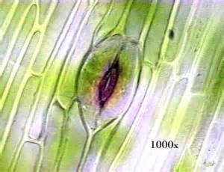
Photosynthesis or water conservation ?
Water
CO₂

Slide 21
Photosynthesis or water conservation ?
Solutions:
Short life in water abundant period (many annual weeds, most annual crop plants).
Produce leaves during periods of abundant water (most deciduous plants).
Transpire slowly and tolerate a water deficit, but unable to photosynthesize rapidly even when water is abundant (evergreen desert shrubs).
Use particular physiologies: C₄ and crassulacean acid metabolism.

Slide 22
Radiation
Liana
video: 09 4:10

Slide 23
Outlines
Introduction
Radiation
Carbon dioxide
Water, Mineral nutrients, Oxygen
Organisms as food resources

Slide 24
Carbon dioxide
Concentration of atmospheric carbon dioxide (CO₂) at the Mauna Loa Observatory, Hawaii.

Slide 25
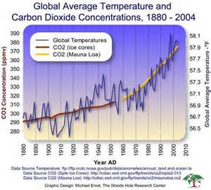
Global warming
?CO₂

Slide 26
Carbon dioxide
CO2 concentrations in the mixed deciduous Harvard forest, Massachusetts, USA.
Notes:
Seed, shrub and tree are experience different concentration of carbon dioxide.

Slide 27
Carbon dioxide
9.5m depth
0.7m depth
Left: Variation in CO₂ concentration with depth in Lake Grane Langso, Denmark in early July and again in later August
Right: photosynthetic rate of moss, Sphagnum subsecundum, taken from two depths.

Slide 28
Pathways of carbon fixation
The C₃ pathway
The C₄ pathway
The CAM pathway

Slide 29
Carbon dioxide
The relationship between percentage of C₄ species and mean summer (5-10) pan evaporation in 31 geographic regions of North American

Slide 30
CO₂ & Nutrients
There is a general tendency for CO₂ enrichment to change the composition of plants, and in particular to reduce nitrogen concentration in above-ground plant tissues – around 14% on average under CO₂ enhancement.

Slide 31
CO₂ & Nutrients
Changes in the concentrations of nutrients in plant material growth at twice-ambient atmospheric CO₂ concentrations.

Slide 32
CO₂ & Nutrients
Growth of larvae of the buckeye butterfly (Junonia coenia) feeding on Plantago lanceolata that had been grown at ambient and elevated CO₂ concentrations.

Slide 33
Outlines
Introduction
Radiation
Carbon dioxide
Water, Mineral nutrients, Oxygen
Organisms as food resources

Slide 34
Water
Video 09, 7:40; 33:18; 36:16

Slide 35
Mineral nutrients

Slide 36
Mineral nutrients
a) The relative concentration of various minerals in whole plants of four species in the Brookhaven Forest, New York. b) The relative concentration of various minerals in different tissues of the white oak (Quercus alba) in the Brookhaven Forest.

Slide 37
Mineral nutrients
The root systems of plants in a typical short-grass prairie after a run of years with average rainfall.

Slide 38
Mineral nutrients
Video, 09, 8:30

Slide 39
Oxygen
Animals
plants

Slide 40
Outlines
Introduction
Radiation
Carbon dioxide
Water, Mineral nutrients, Oxygen
Organisms as food resources

Slide 41
Autotrophs & heterotrophs
Autotrophic organisms (green plants and certain bacteria) assimilate inorganic resources into packages of organic molecules (proteins, carbohydrates, etc.).
There become the resources for heterotrophic organisms (decomposers, parasites, predators and grazers)

Slide 42
Specialists & generalists
Specialization is increasingly likely if a consumer has a short lifespan.
Individuals of long-lived species are likely to be generalists.

Slide 43
Specialists & generalists
The stylet of an aphid penetrating the host tissues and reaching the sugar-rich phloem cells in the leaf veins.

Slide 44
Resource composition

Slide 45
Defenses
Physical defenses
Chemical defenses
video: 09, 19:57

