Slide 1
A Primer of Ecology
Guochun Shen
gcshen@des.ecnu.edu.cn
http:www.guochun.info

Slide 2
Objectives
Love ecology
Follow the development of ecology
Thinking as an ecologist

Slide 3
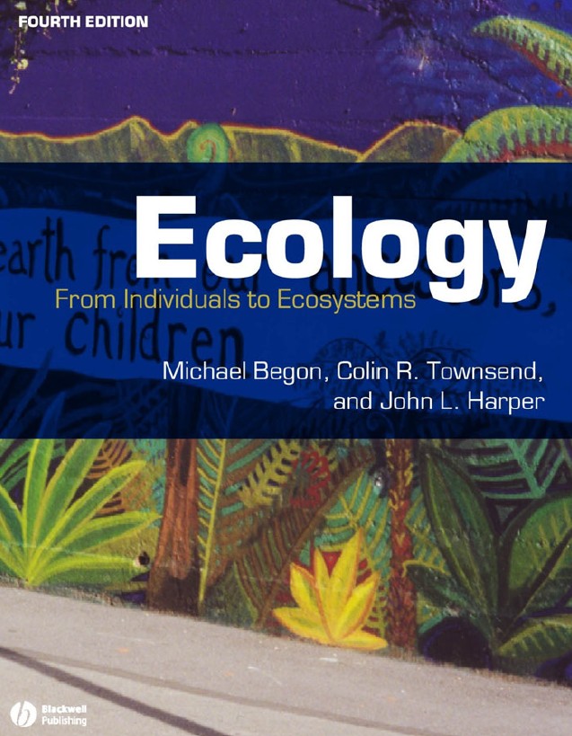
Text books
Ecology, From individuals to Ecosystems. 4th edition
Downloadable in the first two weeks at http://www.guochun.info

Slide 4
Reading & Discussion
Contemporary scientific papers.
Videos of life and evolution
Intergroup debates
Small theses

Slide 5
Scores
Daily performance: 40%
Attendance, classroom activity, …
Final examination: 60%
All of the stories I will talk in this class.

Slide 6
Questions & Suggestions
Sent mail to gcshen@des.ecnu.edu.cn

Slide 7
Schedule arrangement:
Course in the second week (10 Sep.) of this term will be rearranged.

