Slide 1
Structured Output
{"name": "
}}
Beijing
", "country": "
China
", "pop_m":
21.9
,"coordinates": {"latitude":
39.9042
, "longitude":
116.4074
{
"name": "Beijing",
"country": "China",
"pop_m": 21.9,
"coordinates": {
"latitude": 39.9042,
"longitude": 116.4074
}
}
这个颜色表示被限制的 token
这个颜色表示模型生成的 token

Slide 2
中文增强
通用 SFT
垂直领域 SFT
垂直领域
用大量中文语料，使其学会中文
用大量金融数据，使其懂金融
RLHF/DPO Alignment
训练领域大模型
Post-Pretrain
SFT
人类偏好对齐

Slide 3
ChatGPT的训练流程
预训练
row data
书籍、百科、网页
千亿级别
基础模型
有监督微调
标注用户指令+答案
万级
1-100GPU天
奖励建模
标注对比
百万级别
RM模型
二分类任务
1000+GPU月
SFT
1-100GPU天
强化学习
用户指令
十万级
RL强化学习
1-100GPU天
数据
算法
算力

Slide 4
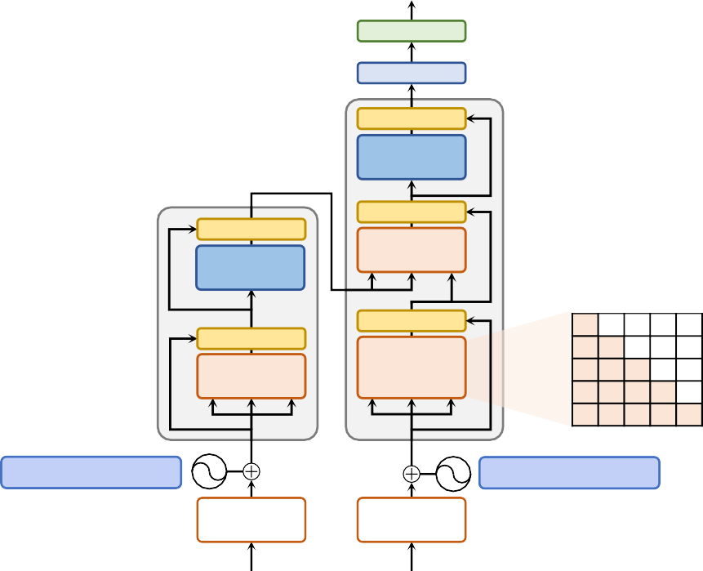
输出概率
Softmax
Linear
Add & Norm
位置感知前馈网络
Add & Norm
位置感知前馈网络
Add & Norm
多头 注意力
×N
N×
Add & Norm
多头 自注意力
Add & Norm
掩码多头自注意力
位置编码
位置编码
词元 嵌入表示
词元 嵌入表示
输入
输出
（迭代右移)

Slide 5
输入 Machine Learning嵌入表示 X1 X₂
查询
q1
q2
_{W}Q
键
k1
k2
_{W}K
值向量
v1
v2
_{W}V

Slide 6
k_{j}
k_{j}
k_{j}
k_{j}
k_{j}
q_{i}
q_{i}
q_{i}
q_{i}
q_{i}
(a) 全局注意力
(b) 带状注意力 (c) 膨胀注意力 (d) 随机注意力
五种基于位置的稀疏注意力基本类型
(e) 局部块注意力

Slide 7
Math Word Problems (free response)
Q: Roger has 5 tennis balls. He buys 2 more cans of tennis balls. Each can has 3 tennis balls. How many tennis balls does he have now?
Math Word Problems (multiple choice)
Q: How many keystrokes are needed to type the numbers from 1 to 500? Answer Choices: (a) 1156 (b) 1392 (c) 1480
(d) 1562 (e) 1788
CSQA (commonsense)
Q: Sammy wanted to go to where the people were. Where might he go?
Options: (a) race track (b) populated areas
(c) desert (d) apartment (e) roadblock
A:
Roger started with 5 balls. 2 cans
A:
There are 9 one-digit numbers
A:
The answer must be a place with a
of 3 tennis balls each is 6 tennis
from 1 to 9. There are 90 two-digit
lot of people. Race tracks, desert,
balls. 5 + 6 = 11.
The answer is 11.
numbers from 10 to 99. There are
apartments, and roadblocks don't
401 three-digit numbers from 100 to
have a lot of people, but populated
500. 9 + 90(2) + 401(3) = 1392.
The
areas do.
So the answer is (b).
answer is (b).
StrategyQA
Q: Yes or no: Would a pear sink in water?
Date Understanding
Q: The concert was scheduled to be on 06/01/1943, but was delayed by one day to today. What is the date 10 days ago in MM/DD/YYYY?
Sports Understanding
Q: Is the following sentence plausible? "Joao Moutinho caught the screen pass in the NFC championship."
A:
The density of a pear is about 0.6
g/cm^3, which is less than water.
A:
A:
Thus, a pear would float.
So the
One day after 06/01/1943 is
Joao Moutinho is a soccer player.
answer is no.
06/02/1943, so today is 06/02/1943.
The NFC championship is part of
10 days before today is 05/23/1943.
American football, not soccer.
So the
So the answer is 05/23/1943.
answer is no.
SayCan (Instructing a robot)
Human: How would you bring me something that isn’t a fruit?
Last Letter Concatenation
Q: Take the last letters of the words in “Lady Gaga” and concatenate them.
Coin Flip (state tracking)
Q: A coin is heads up. Maybelle flips the coin. Shalonda does not flip the coin. Is the coin still heads up?
Explanation: the user wants
A:
The last letter of “Lady” is “y”. The
A:
something to eat that isn’t a fruit. An
last letter of “Gaga” is “a”.
The coin was flipped by Maybelle.
energy bar is not a fruit, so I will bring
Concatenating them is “ya”.
So the
So the coin was flipped 1 time, which
the user an energy bar.
answer is ya.
is an odd number. The coin started
Plan: 1. find(energy bar) 2.
pick(energy bar) 3. find(user) 4. put(energy bar) 5. done().
heads up, so after an odd number of
flips, it will be tails up.
So the answer
is no.
COT

Slide 8
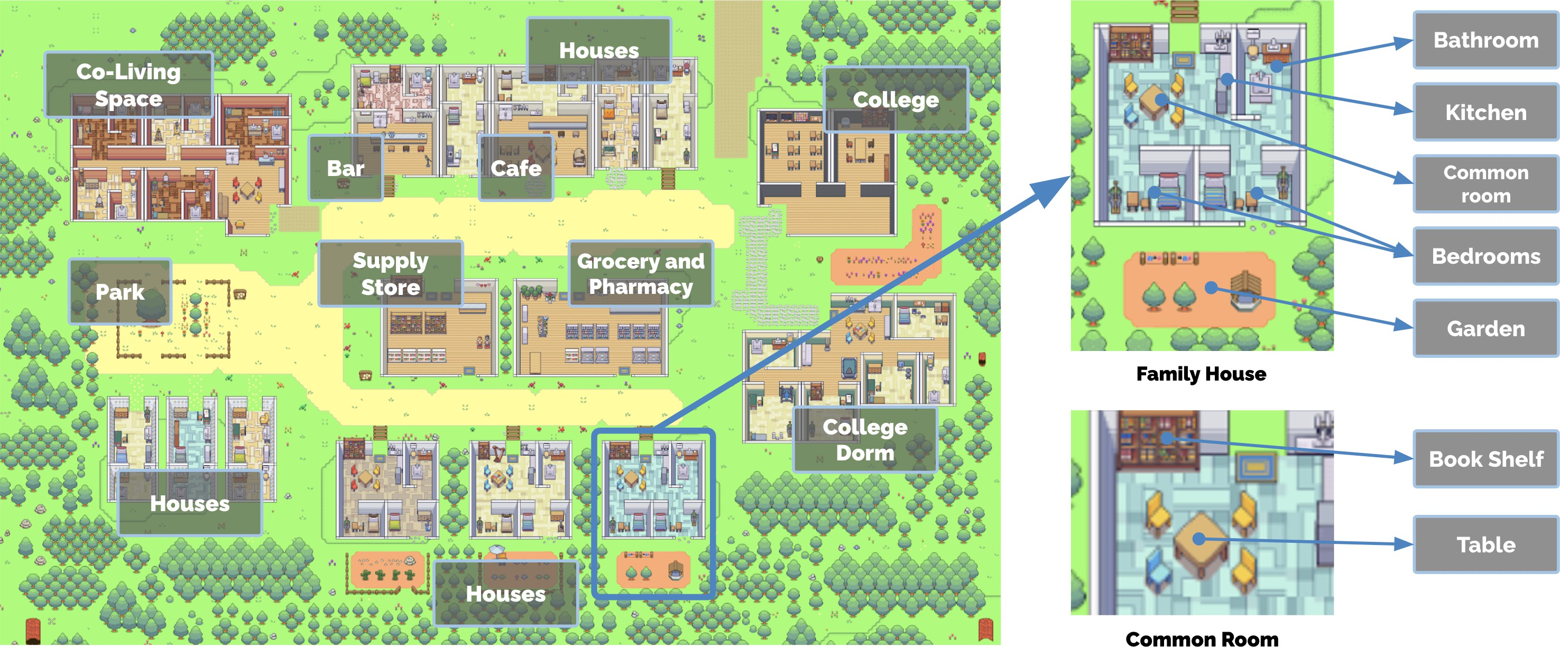

Slide 9
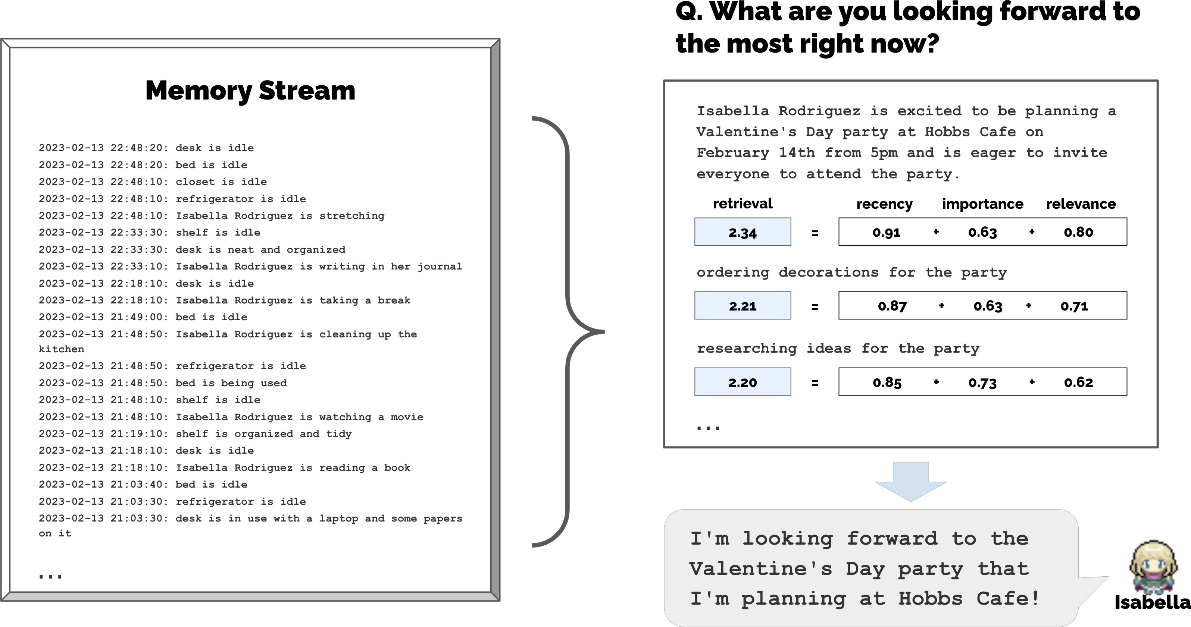

Slide 10
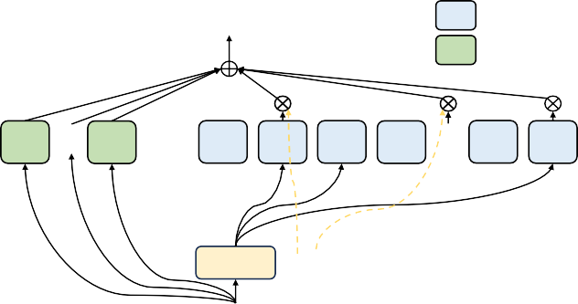
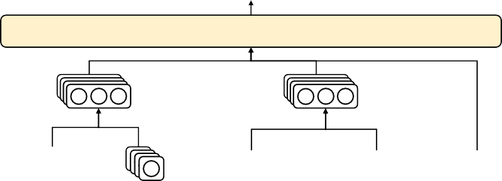
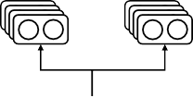
DeepSeekMoE
… …
Routed Expert Shared Expert
Output Hidden 𝐡𝐡′
Transformer Block ×𝐿𝐿
𝑡𝑡
Feed-Forward Network
1 … 𝑁𝑁_{𝑠𝑠}
1
2
3
4 … 𝑁𝑁_{𝑟𝑟}-1 𝑁𝑁_{𝑟𝑟}
RMSNorm
Router
Top-𝐾𝐾_{𝑟𝑟}
… …
Input Hidden 𝐮𝐮_{𝑡𝑡}
Multi-Head Latent Attention (MLA)
Attention
Cached During Inference
Output Hidden 𝐮𝐮_{𝑡𝑡} … …
Multi-Head Attention
RMSNorm
{[𝐪𝐪^{𝐶𝐶} ; 𝐪𝐪^{𝑅𝑅} ]}
{[𝐤𝐤^{𝐶𝐶} ; 𝐤𝐤^{𝑅𝑅}]}
𝑡𝑡,𝑖𝑖 𝑡𝑡
𝑡𝑡,𝑖𝑖 𝑡𝑡,𝑖𝑖
concatenate
concatenate
{𝐪𝐪^{𝐶𝐶} }
{𝐪𝐪^{𝑅𝑅} }
_{𝐤𝐤}𝑅𝑅
{𝐤𝐤^{𝐶𝐶} }
{𝐯𝐯^{𝐶𝐶} }
𝑡𝑡,𝑖𝑖
𝑡𝑡,𝑖𝑖
𝑡𝑡
apply RoPE
𝑡𝑡,𝑖𝑖
𝑡𝑡,𝑖𝑖
apply RoPE
…
Latent 𝐜𝐜^{𝑄𝑄}
𝑡𝑡
Latent 𝐜𝐜^{𝐾𝐾𝐾𝐾}
…
𝑡𝑡
Input Hidden 𝐡𝐡_{𝑡𝑡}
… …

Slide 12
一些主要的AI产品结构
用户请求
用户
后端系统
前端
用户端
Agent
Agent
后端
专家端
数据库
专家
数据库
转发回复架构
感知启动架构

Slide 14
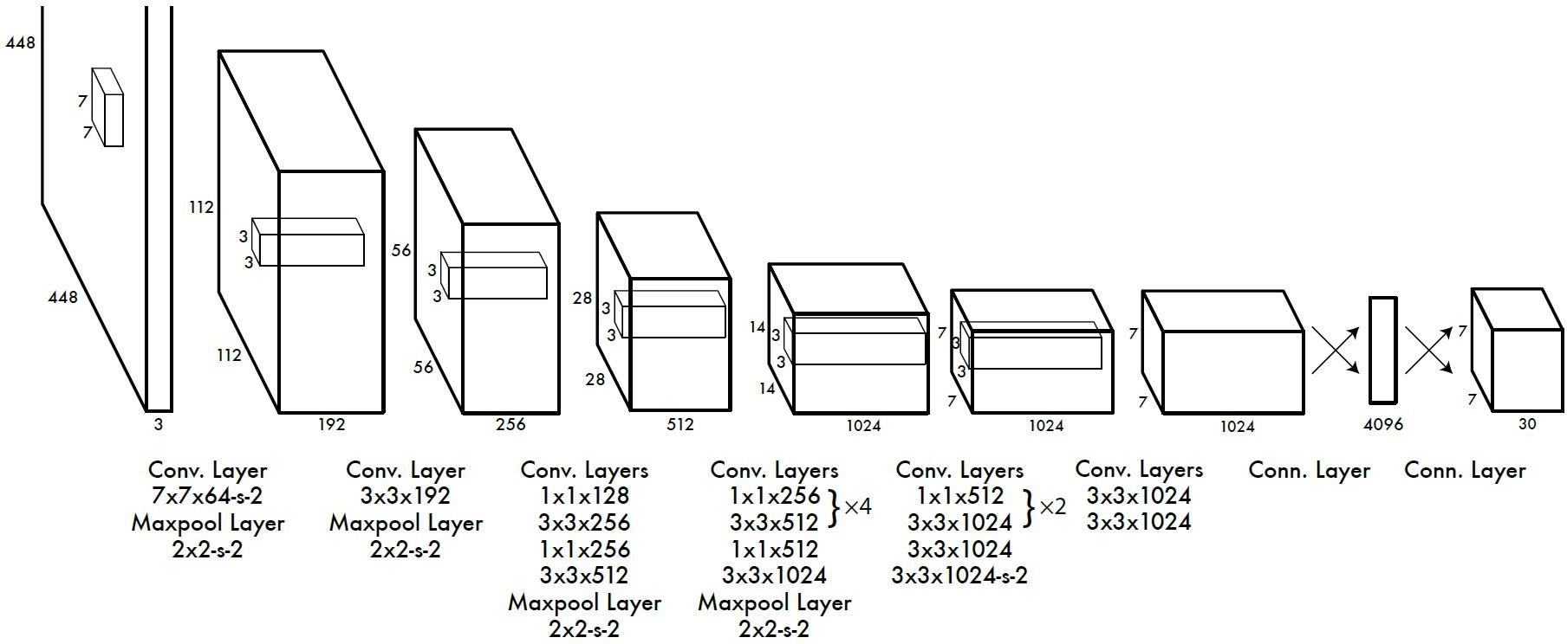
YOLO

Slide 15
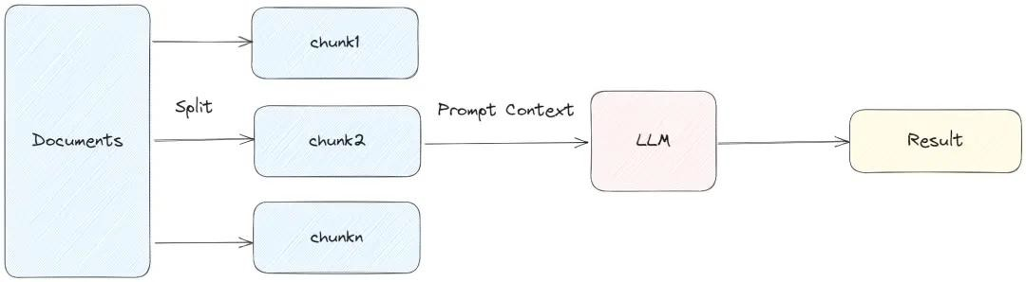
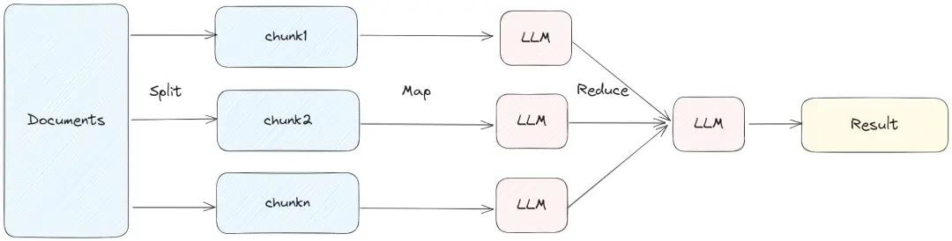
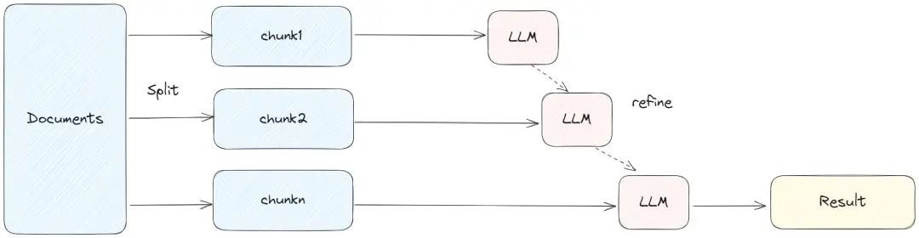
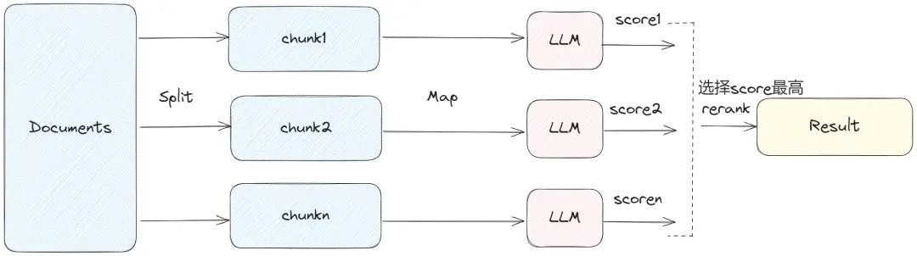
RAG 的不同架构

