Slide 1
M
O
N
G
K
A
R
C
H
Y
B
D
E
F
I
L
P
Q
S
T
U
V
W
X
Z
Playfair的key

Slide 2
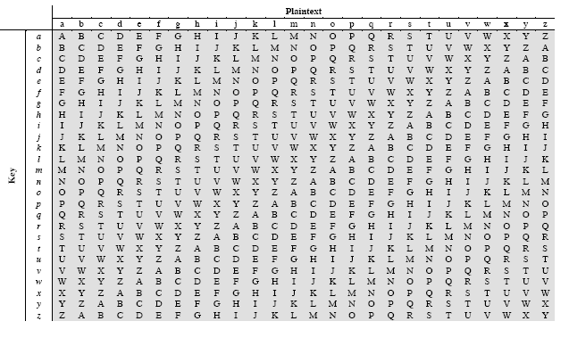
KEY:
PLAINTEXT:
CIPHERTEXT:
DECEPTIVEDECEPTIVEDECEPTIVE
WEAREDISCOVEREDSAVEYOURSELF
ZICVTWQNGRZGVTWAVZHCQYGLMGJ
维吉尼亚加密

Slide 3
维吉尼亚加密的周期分析
KEY:
PLAINTEXT:
CIPHERTEXT:
DECEPTIVEDECEPTIVEDECEPTIVE
WEAREDISCOVEREDSAVEYOURSELF
ZICVTWQNGRZGVTWAVZHCQYGLMGJ

Slide 4
Autokey Cipher
KEY:
PLAINTEXT:
CIPHERTEXT:
DECEPTIVEWEAREDISCOVEREDSAV
WEAREDISCOVEREDSAVEYOURSELF
ZICVTWQNGKZEIIGASXSTSLVVWLA

