Slide 1
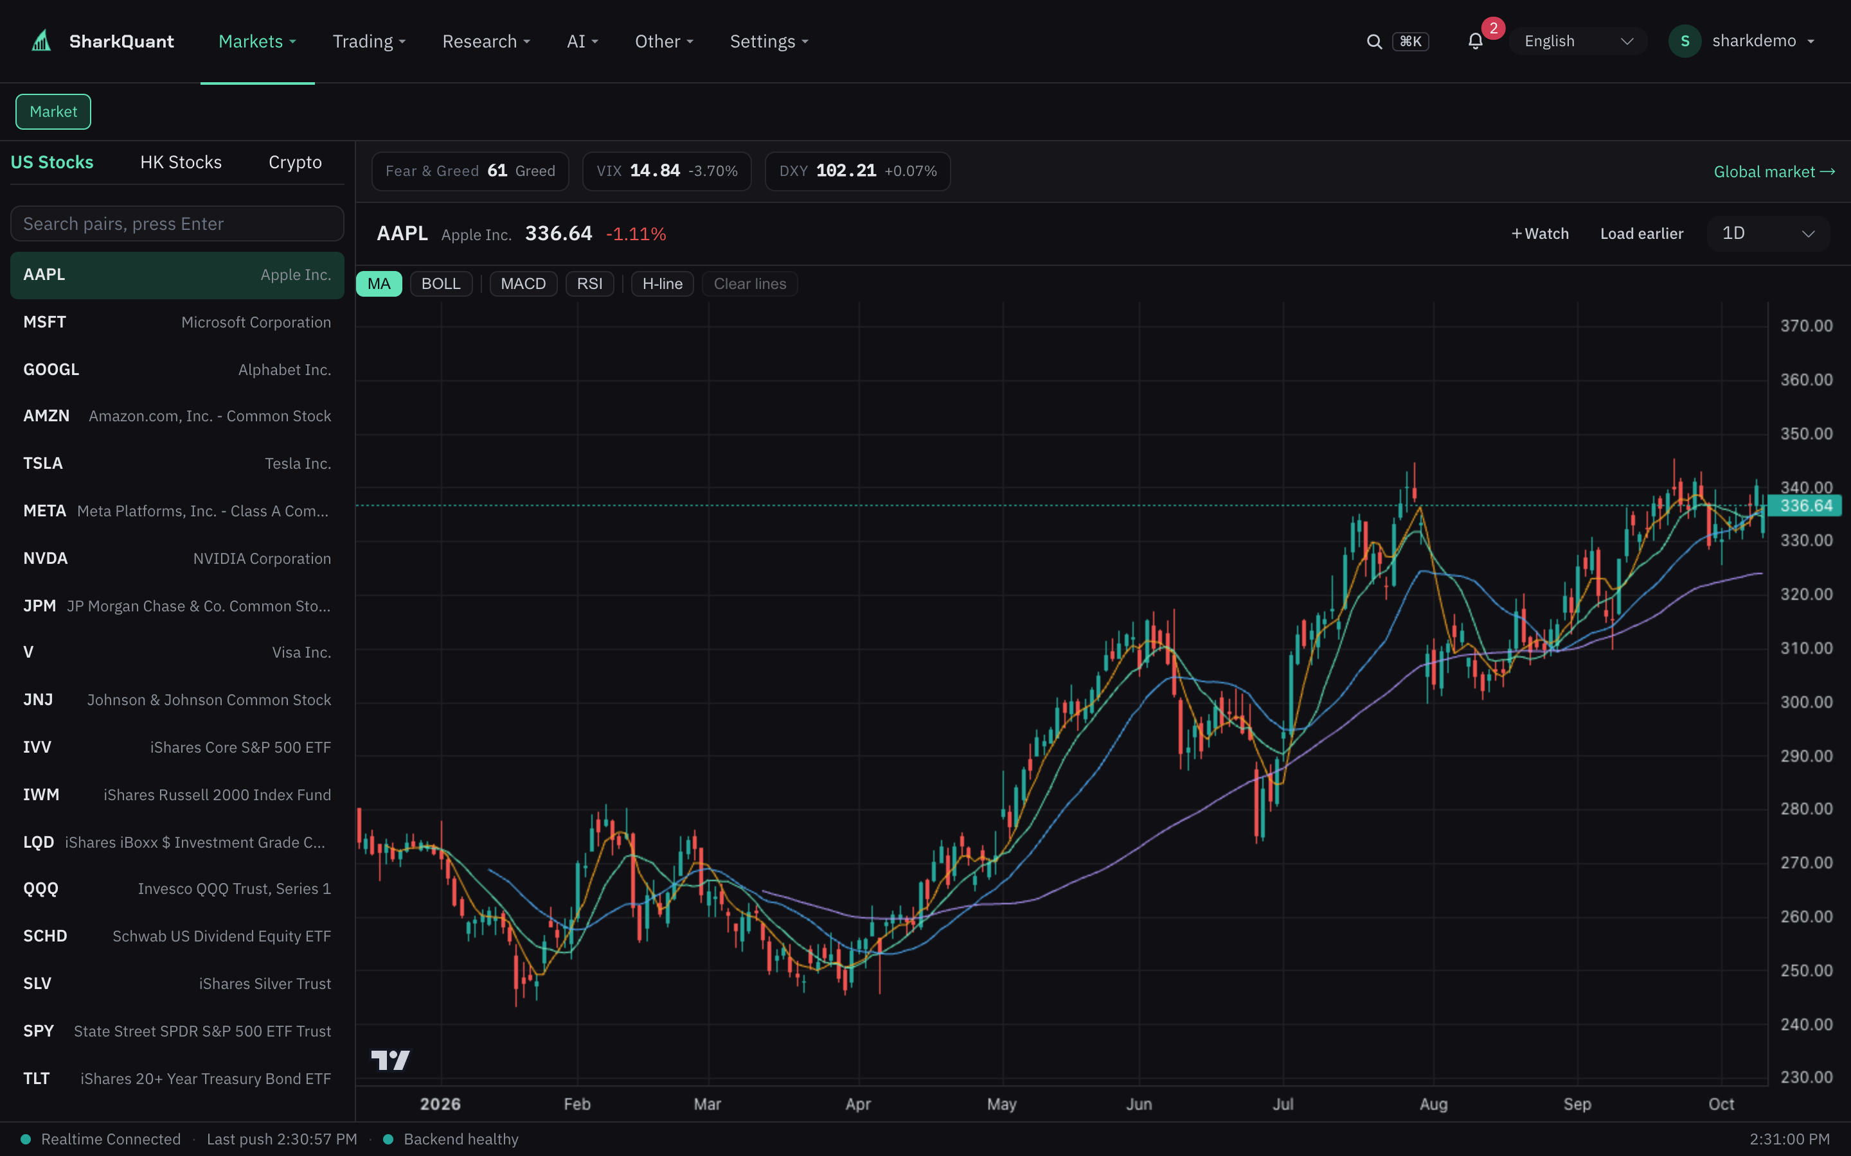
SharkQuant
AI-Native Quantitative Trading Platform
One person = a quant team
Markets · AI research · Strategy · Backtest · Automation
Investor Roadshow · October 2026 · Confidential

Slide 2
Three Walls Between Retail Traders and Quant Trading
Fragmented tools, broken chains — most traders can write a strategy but never run one
01
02
03
Data
Research
Execution
Charts, macro, news and sentiment live in 4+ different tools. Cross-market comparison is nearly impossible — you are always a step behind.
Writing a strategy = Python + a framework + your own data pipeline. Backtest and execution platforms are separate silos.
Manual orders while watching charts, emotional trading; automation tools cover one market only — crypto or US stocks.
Incumbents each own one slice — charts, engines, automation. Nobody built the retail full loop.

Slide 3
One Product, One Closed Loop
From "can write it" to "can run it" — without switching platforms
01 Markets
02 AI Research
03 Strategy
04 Backtest
05 Execution
06 Connectivity
Real-time quotes, sentiment & opportunity radar
Chat, fast analysis, event radar
AI generation + 264 factors & online IDE
Real data, full trade log & metrics
24×7 bots + manual trading terminal
8 venues + Agent Gateway
One account, one dataset, one risk engine — the whole flow never leaves the product.

Slide 4
Already Running in Production
39 pages · 7 asset classes · 8 trading venues · real-time WebSocket
shark.aiorz.cc · screenshots and data from the live system

Slide 5
Platform Capability Snapshot
Every number verifiable in production
39
7
8
264
58
18
Feature pages
Asset classes
Trading venues
Quant factors
MCP tools
Services
From charts to ops console
Crypto · US · HK · FX · futures…
6 exchanges + IBKR / Alpaca
Factor library + research
For Cursor / Claude / Codex
Trading-grade distributed stack
11 output languages · bilingual UI · 48-route bilingual QA · 0 known dependency vulnerabilities

Slide 6
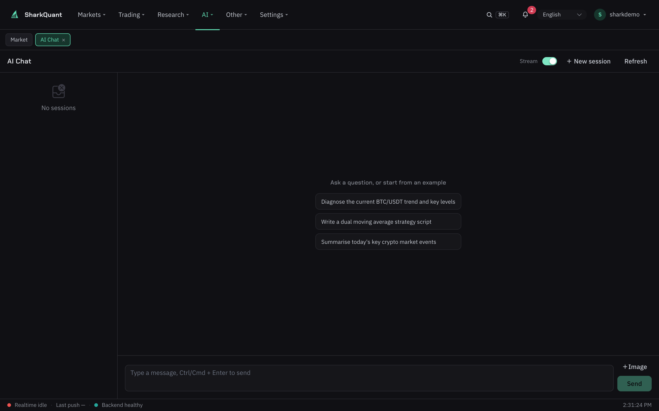
AI-Native: Not a Bolt-On Button
Conversational research — streaming answers with attachments, grounded in your positions and watchlist
Natural-language strategy generation — one sentence to backtestable code to a running bot
AI review reports — a pre-launch health check for every strategy (review 10 credits)
Event radar — AI assesses global news impact on your books
11 output languages — bilingual UI, built for global users
AI chat (live product screenshot)
From question to order, AI is present throughout

Slide 7
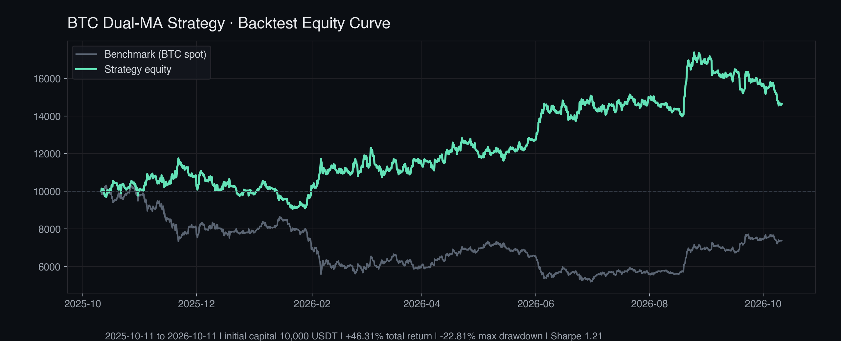
Real Backtest: BTC 4h Dual-MA
Total return
+46.31%
vs benchmark (BTC spot)
+72.54%
Max drawdown
-22.81%
Sharpe ratio
1.21
Initial capital 10,000 USDT · 2025-10-11 to 2026-10-11 · run on the built-in engine; historical results do not indicate future performance
Trades · win rate
42 · 45.2%

Slide 8
Safe AI-Agent Trading: The Industry Has No Answer Yet
MCP servers grew from ~50 to 8,000–12,000 in two years; agents entering finance is a matter of time
The status quo
SharkQuant Agent Gateway (live)
47–53%
58 MCP tools — quotes, backtests and paper trading for Cursor / Claude Code / Codex
Paper-only by default — live trading requires all four conditions to hold
Five scope classes — read/write/trade/notify/quota, rate-limited at 60 requests/min
Full audit trail — every agent action is traceable; safety comes before convenience
of organizations hit AI-agent permission incidents (DevSecOps 2026)
~23%
have a formal AI-agent identity system
0
production-ready trading-grade agent safety standards
Agent ecosystem = a new distribution channel: the first trade may start from a conversation.

Slide 9
Competitive Positioning: Integration × AI-Nativeness
X: full-loop integration (analysis → execution)｜Y: AI-nativeness
AI-nativeness ↑
Analysis tools × AI-enhanced
Full loop × AI-native
TradingView
3Commas / Composer
Chart leader · no execution · partial AI
Single-market automation · weak AI
Full-loop integration (analysis → execution) →
QuantConnect
SharkQuant
Institutional engine · engineer-grade · partial AI
Full loop · AI-native · agent open
Point tools × traditional
Automation × weak AI
Price check: TradingView $12.95–59.95/mo · 3Commas $15–60 · Composer $10–40 · SharkQuant from $19.9

Slide 10
Business Model: Four Built-In Revenue Streams
$19.9 / month
Subscriptions — $19.9/mo · $199/yr (hero tier) · $499 lifetime
Usage credits — AI and backtests metered (backtest 30, analysis 10, chat 5…)
Indicator marketplace — configurable take rate; creator ecosystem already live
Referrals — 100 signup credits, 3-tier 10/5/3% commissions (built in)
Subscriptions + credits + marketplace take rate + referrals
For global retail & semi-pro traders; 5 running strategies on the free tier, 10 on paid
Payments (Stripe + stablecoins) built in — switch on to monetize at scale

Slide 11
Engineering Moat: Trading-Grade Safety & Scale
The complexity of a full-loop product is the moat — every number is verifiable
Distributed runtime
Fund-safety by design
Scale & trust
18 container services: PostgreSQL as the single source of truth · Kafka versioned events · strategy runtimes physically isolated from the API tier.
Leases + heartbeats + fencing + idempotency keys prevent duplicate orders; a 4-condition gate for agent live trading; full audit trail.
0 known dependency vulnerabilities; 4-tier multi-tenancy; V6 target of 20k users / 100k concurrent strategies; private self-hosting supported.
Self-hosting: one-command install for data-sovereignty-sensitive studios and institutions

Slide 12
Three Months: From Architecture Upgrade to Production
Jul–Oct 2026; every step verifiable in production and in the repository
2026-07
2026-09-20
2026-10-08
2026-10-10
2026-10-11
v5.5 distributed upgrade
AI gate + billing
Self-built front end
Rebrand · go live
QA + security audit
Kafka pipeline · isolated strategy runtimes · native exchange clients
Strategy evolution (TPE / grid / walk-forward) + virtual accounts
P0–P2 shipped in one day, containerized for production
Full i18n · prediction markets · wallet · shark.aiorz.cc
48-route bilingual sweep · 0 known dependency vulnerabilities
Next: payment channels · marketplace settlement · V6 scale-out

Slide 13
Team & Raise
Team
The Raise
Founder / CEO: [TBD: name · one-line background]
CTO / Tech lead: [TBD]
Core members: [TBD: product / quant research / growth]
Advisors: [TBD, if any]
Round / amount / valuation: [TBD]
Use of funds (suggested):
R&D (AI + scale) 45%
Growth (content / community) 30%
Security & compliance 15%
Reserve 10%
Keywords: full-stack AI + financial engineering; three months from upgrade to production
12-month milestones: [TBD: paying users / MRR targets]
Unit economics (conversion / retention / ARPU / LTV / CAC) and the full financial model are in the DD pack

Slide 14
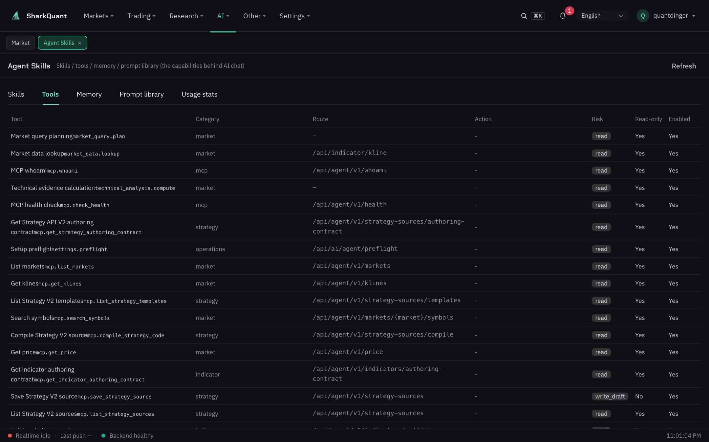
A Governed AI Control Plane
Admin view: visible, controllable, auditable AI capability (live product)
31 skills · 66 tools — all visible in-product; 58 exposed over MCP
Toggle each on/off — disabling removes it from the AI context instantly
Risk levels — read / write_draft / trading + read-only flags
Prompts renderable & auditable — install/remove skills, one-click prompt copy
One-click preflight — LLM · data sources · search · broker · credits
Admin view: full 66-tool table (risk level, read-only flag, enabled state)
For teams & institutions: AI capability is a controlled asset, not a black box

Slide 15
One person = a quant team
SharkQuant
Contact: [TBD: email / WeChat / phone] · shark.aiorz.cc
For investor evaluation only; not an offer or investment advice. Backtests are historical simulations and do not indicate future results. Crypto assets and leverage carry high risk. All product claims are verifiable in the live environment.

