Slide 1
IO
研发中心

Slide 2
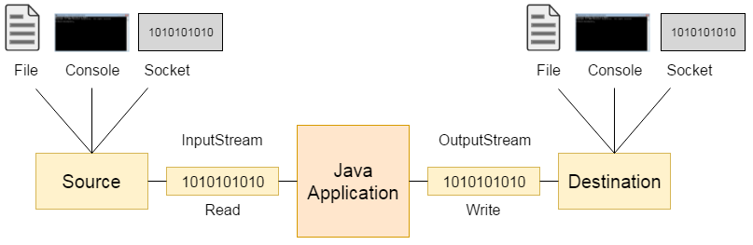
IO Streaming
Stream 连接一个数据源或数据目的地
我们从stream中读或向stream中写
Stream或是byte based (读写字节)或 character based (读写字符).

Slide 3
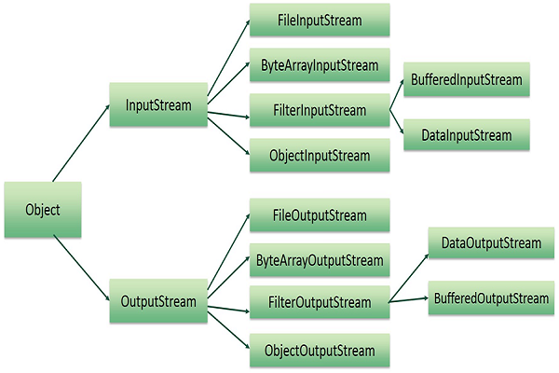
基本层次图

Slide 4
InputStream & OutputStream
InputStream
int read() // Reads the next byte
int read(byte[] b)
int read(byte[] b, int off, int len)
OutputStream
void write(byte[] b)
void write(byte[] b, int off, int len)
void write(int b) // Writes the specified byte

Slide 5
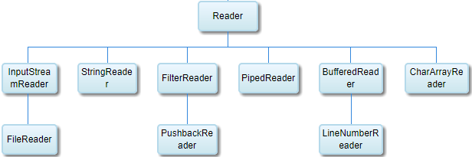
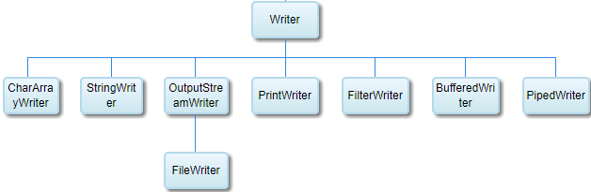
Reader & Writer

Slide 6
Reader
Reader
int read() // Reads a single character.
int read(char[] cbuf)
int read(char[] cbuf, int off, int len)
Writer
void write(char[] cbuf)
void write(char[] cbuf, int off, int len)
void write(int c)
void write(String str)
void write(String str, int off, int len)

