Slide 1
Servlet基础
研发中心

Slide 2
Servlet的作用
读来自客户机的请求数据
Form数据
Header中的数据
生成结果响应
各种类型的数据
设置响应状态码
设置响应Header数据

Slide 3
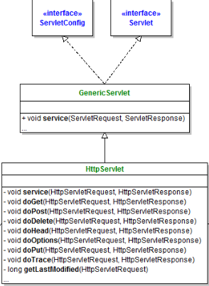
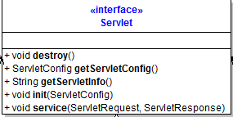
Servlet
生命期方法
init()
service()
destroy()

Slide 4
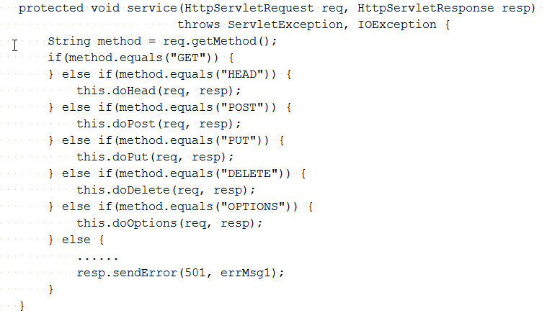
HttpServlet
doXXX()缺省时返回
405 Method Not Allowed

Slide 5
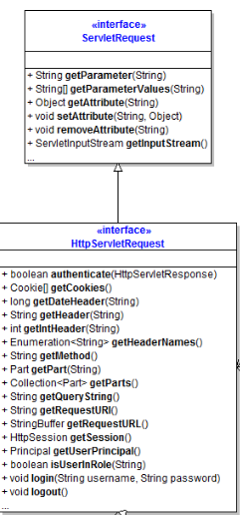
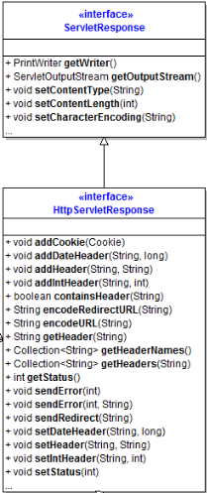
HttpServletRequest/Response
Request
getInputStream()
getQueryString()
getHeader()
getRequestURI()
Response
add/setHeader()
setStatue()
setCharacterEncoding()
setContentType()
setContentLength()

Slide 6
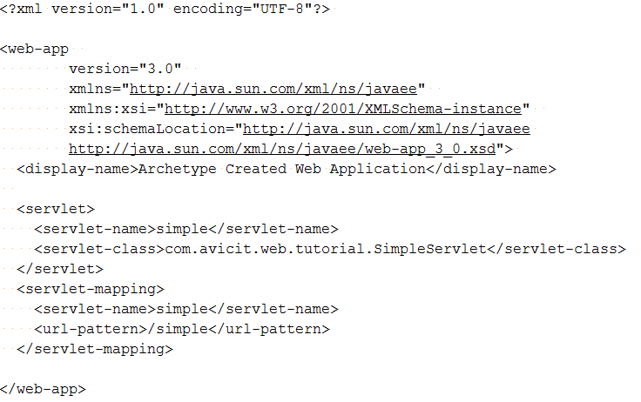
URI到Servlet的映射 – web.xml
@WebServlet("/simple")
web.xml

Slide 7
URI到Servlet的映射 – web.xml
myweb.war
http://localhost:8080/myweb/simple/a/b?q=hi&r=john
myweb - web context path
/simple – servlet context path
/a/b – path info
q=hi&r=john – query string

Slide 8
Form Data
HTML表单
<INPUT TYPE="TEXT" NAME="firstName">
GET请求
http://host/path?firstname=Marty+Hall&lastname=Lax
POST请求
enctype="application/x-www-form-urlencoded“
HttpServletRequest请求参数处理
String fn = request.getParameter("firstName")

Slide 9
请求Header
HttpServletRequest
getHeader
getHeaders
getHeaderNames
getContentLength
getContentType
getDateHeader
getIntHeader
getMethod,
getRequestURI
getQueryString

Slide 10
请求Body
获取InputStream
InputSream is = HttpServletRequest.getInputStream();
转换成Reader来读取字符
Reader reader = new BufferedReader(new InputStreamReader(is));

Slide 11
响应码
HttpServletResponse.setStatus(int)
HttpServletResponse.sendError(int code, String message)
HttpServletResponse.sendRedirect(String url)

Slide 12
响应Header
HttpServletResponse
setHeader(String headerName,String headerValue)
setDateHeader(String name, long millisecs)
setIntHeader(String name, int headerValue)
addHeader, addDateHeader, addIntHeader

Slide 13
设置常用的响应Header
HttpServletResponse
setContentType
setContentLength (可选)
addCookie
sendRedirect

Slide 14
Cookie和Sesssion
Cookie
在客户端（浏览器）上保存状态
Session
在服务器端保存状态

Slide 15
Listener - @WebListener
该注解用于将类声明为监听器，被 @WebListener 标注的类必须实现以下至少一个接口：
ServletContextListener
ServletContextAttributeListener
ServletRequestListener
ServletRequestAttributeListener
HttpSessionListener
HttpSessionAttributeListener

Slide 16
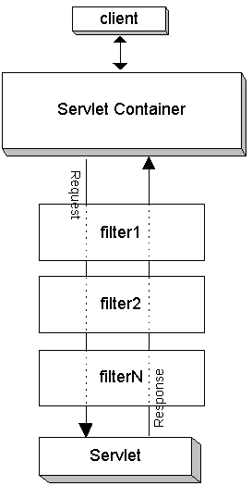
@WebFilter
@WebFilter 用于将一个类声明为过滤器
urlPatterns= {"/*"}

Slide 17
web.xml综述
<web-app>
<context-param/>
<listener/>
<filter/>
<filter-mapping/>
<servlet/>
<servlet-mapping/>
<jsp-config/>
<session-config/>
<welcome-file-list/>
</web-app>

Slide 18
示例
JSON响应
JSON请求
生成PDF

Slide 19
MVC
URI到Servlet的映射太繁琐
HttpServlet污染了代码
安全
事务

Slide 20
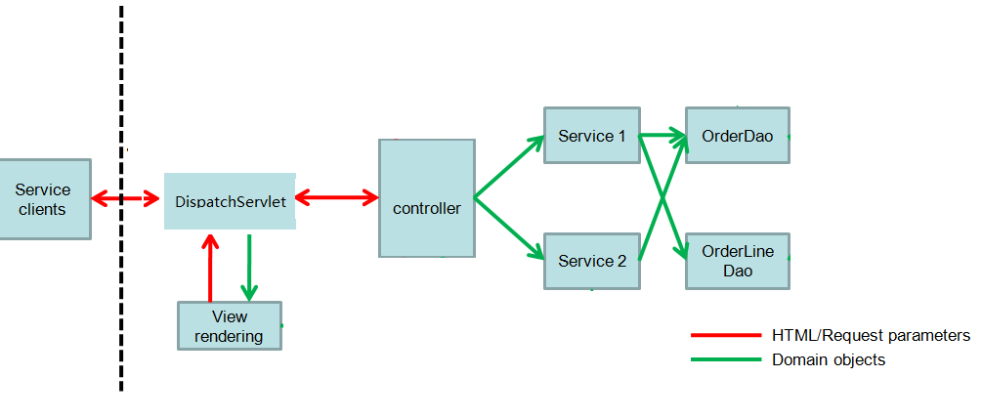
DispatchServlet & MVC

Slide 21
Model-View-Control
Model – 业务逻辑，相对稳定
View – 视图，UI，易变
Controller – 控制流程，易变

Slide 22
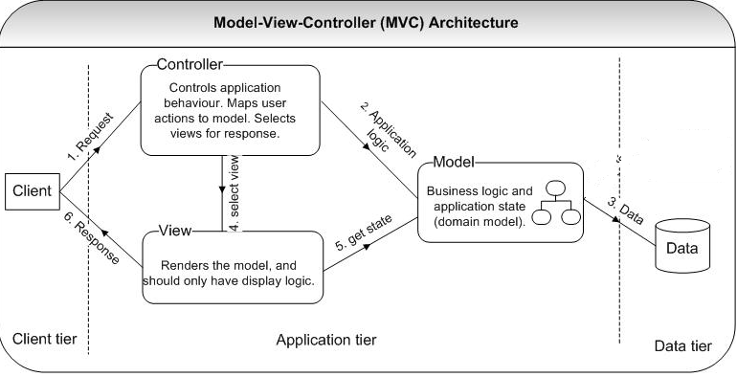
Model-View-Control(MVC)

