Slide 1
集合类
研发中心

Slide 2
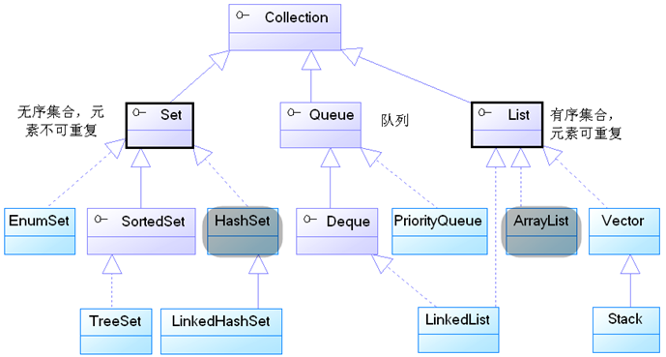
集合类

Slide 3
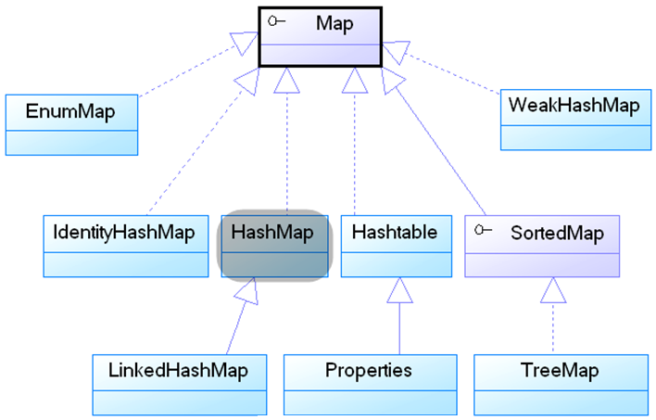
字典类

Slide 4
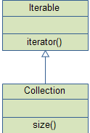
Iterable<T>
一个类，如果实现了Iterable<T>接口，就可以用于for循环中
List<Strirng> list = new ArrayList<String();
.....
for(String s : list){
//do something;
}
Iterable<T>只有一个方法
public interface Iterable<T> {
public Iterator<T> iterator();
}

Slide 5
Iterator<T>
Iterator<T>接口里定义了如下方法：
boolean hasNext()：如果被迭代的集合还元素没有被遍历，则返回true。
T next()：返回集合里下一个元素。
void remove()?：删除集合里上一次next方法返回的元素
Iterator<String> iterator = list.iterator();
while(iterator.hasNext()){
String s = iterator.next();
//do something to object;
}

Slide 6
Collection<E>
通用操作：添加，删除，包含
boolean add(E e)
boolean addAll(Collection<? extends E> c)
void clear()
boolean contains(Object o)
boolean containsAll(Collection<?> c)
boolean equals(Object o)
boolean isEmpty()
Iterator<E> iterator()
boolean remove(Object o)
boolean removeAll(Collection<?> c)
int size()
Object[] toArray()
<T> T[] toArray(T[] a)

Slide 7
List<E>
特定于有位置的通用操作：添加，删除，包含
void add(int index, E element)
boolean addAll(int index, Collection<? extends E> c)
E get(int index)
int indexOf(Object o)
int lastIndexOf(Object o)
E remove(int index)
E set(int index, E element)
List<E> subList(int fromIndex, int toIndex)

Slide 8
ArrayList<E>
ArrayList<String> obj = new ArrayList<String>();
/*This is how elements should be added to the array list*/
obj.add("Ajeet");
obj.add("Harry");
obj.add("Chaitanya");
/*Add element at the given index*/
obj.add(0, "Rahul");
obj.add(1, "Justin");
/*Remove elements from array list like this*/
obj.remove("Chaitanya");
obj.remove("Harry");
/*Remove element from the given index*/
obj.remove(1);

Slide 9
ArrayList<E>的初始化
List<String> t = Arrays.asList("Pratap", "Peter", "Harsh") ；
ArrayList<String> obj = new ArrayList<String>(t) ;

Slide 10
Set<E>
集合

Slide 11
HashSet<E>
HashSet<String> hset =
new HashSet<String>();
hset.add("Apple");
hset.add("Mango");
hset.add("Grapes");
hset.add("Orange");

Slide 12
TreeSet<E>
E first()
E last()
TreeSet<String> tset = new TreeSet<String>();
// Adding elements to TreeSet<String>
tset.add("ABC");
tset.add("String");
tset.add("Test");
String first = tset.first() ;

Slide 13
Map<K,V>
void clear()
boolean containsKey(Object key)
boolean containsValue(Object value)
Set<Map.Entry<K,V>> entrySet()
V get(Object key)
boolean isEmpty()
Set<K> keySet()
V put(K key, V value)
void putAll(Map<? extends K,? extends V> m)
V remove(Object key)
int size()
Collection<V> values()

Slide 14
HashMap
HashMap<Integer, String> hmap = new HashMap<Integer, String>();
/*Adding elements to HashMap*/
hmap.put(12, "Chaitanya");
hmap.put(2, "Rahul");
Set<Map.Entry<Integer, String>> set = hmap.entrySet();
Iterator<Map.Entry<Integer, String>> iterator = set.iterator();
while(iterator.hasNext()) {
Map.Entry<Integer, String> mentry = iterator.next();
System.out.print("key is: "+ mentry.getKey() + " & Value is: ");
System.out.println(mentry.getValue());
}

Slide 15
Collections.sort()
public class Student implements Comparable<Student> {
private String studentname;
private int rollno;
private int studentage;
...
@Override
public int compareTo(Student comparestu) {
int compareage=comparestu.getStudentage();
return this.studentage-compareage;
}
}

Slide 16
Collections.sort()
ArrayList<Student> arraylist = new ArrayList<Student>();
arraylist.add(new Student(223, "Chaitanya", 26));
arraylist.add(new Student(245, "Rahul", 24));
arraylist.add(new Student(209, "Ajeet", 32));
Collections.sort(arraylist);

