Slide 1
Spring MVC
研发中心

Slide 2
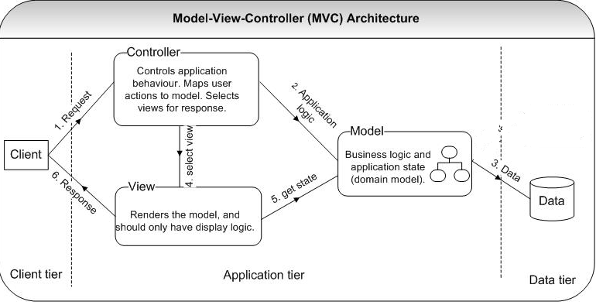
Model-View-Control(MVC)

Slide 3
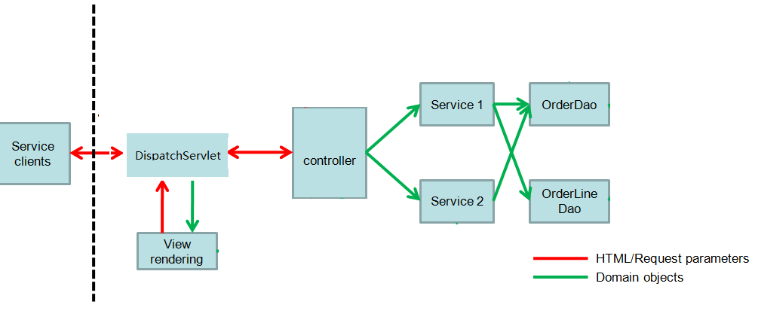
DispatchServlet & MVC

Slide 4
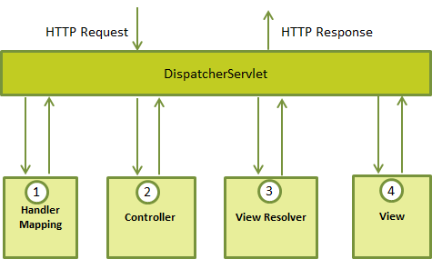
Spring DispatchServlet
Request到Controller的映射(RequestResolver)
处理结果到View的映射(ViewResolver)

Slide 5
Spring容器配置描述
/WEB-INF/config/springmvc-config.xml
Web.xml
JSP页面：WEB-INF/jsp

Slide 6
容器的启动
<servlet>
<servlet-name>springmvc</servlet-name>
<servlet-class>
org.springframework.web.servlet.DispatcherServlet
</servlet-class>
<init-param>
<param-name>contextConfigLocation</param-name>
<param-value>/WEB-INF/config/springmvc-config.xml</param-value>
</init-param>
<load-on-startup>1</load-on-startup>
</servlet>
<servlet-mapping>
<servlet-name>springmvc</servlet-name>
<url-pattern>/</url-pattern>
</servlet-mapping>

Slide 7
springmvc-config.xml
<context:component-scan base-package="controller"/>
<context:component-scan base-package="service"/>
<mvc:annotation-driven/>
<mvc:resources mapping="/css/**" location="/css/"/>
<mvc:resources mapping="/*.html" location="/"/>
<bean id="viewResolver" class="org.springframework.web.servlet.view.InternalResourceViewResolver">
<property name="prefix" value="/WEB-INF/jsp/"/>
<property name="suffix" value=".jsp"/>
</bean>

Slide 8
mvc:annotation-driven
所有被Spring IoC Container管理的对象被称为组件
@Component
@Controller
@Service
@Repository
依赖注入
@AutoWired

Slide 9
请求处理方法的参数
HttpServletRequest, HttpServletResponse
HttpSession
InputStream, Reader
OutputStream, Writer
Model(Spring)
@PathVariable,
@RequestParam, @RequestHeader
@RequestBody, @RequestPart

Slide 10
@RequestBody
@PostMapping("/saveProduct")
public String saveProduct(
@RequestBody ProductForm productForm) {....}
@PostMapping("/saveProduct")
public String saveProduct(
ProductForm productForm) {....}

Slide 11
Model参数
@RequestMapping(value="/product_save")
public String saveProduct(ProductForm productForm, Model model) {
Product product = new Product();
product.setName(productForm.getName());
product.setDescription(productForm.getDescription());
try {
product.setPrice(Float.parseFloat(
productForm.getPrice()));
} catch (NumberFormatException e) {
}
// add product
model.addAttribute("product", product);
return “ProductDetails”; ← 返回Ivew的id
}

Slide 12
Model参数
<p>
<h5>Details:</h5>
Product Name: ${product.name}<br/>
Description: ${product.description}<br/>
Price: $${product.price}
</p>
<

Slide 13
ModelAndView
@RequestMapping(value="/product_save")
public ModelAndView saveProduct(ProductForm productForm) {
Product product = new Product();
product.setName(productForm.getName());
product.setDescription(productForm.getDescription());
try {
product.setPrice(Float.parseFloat(
productForm.getPrice()));
} catch (NumberFormatException e) {
}
ModelAndView mv = new ModelAndView("ProductDetails",
"product", product);
return mv;
}

Slide 14
@ModelAttribute
@RequestMapping(value = "/product_save",
method = RequestMethod.POST)
public String submit(
@ModelAttribute("product") ProductForm product,
BindingResult result, ModelMap model) {
if (result.hasErrors()) {
return "error";
}
return "ProductDetails";
}

Slide 15
示例

