Slide 1

San Francisco Housing Choice
Kiki Guo
04/11/2020

Slide 2

Scenario:
Kiki got a new job in San Francisco City, so she will move to SF City. The public transportation in SF is great and Kiki has enough time on the commute. Thus, she does not need to stay near the company. However, Kiki needs to take her dogs for a walk in the parks and she also likes to do jogging in the park. Therefore, she prefers a place with most parks nearby.
Goal:
Help Kiki find the place with most parks or gardens.

Slide 3
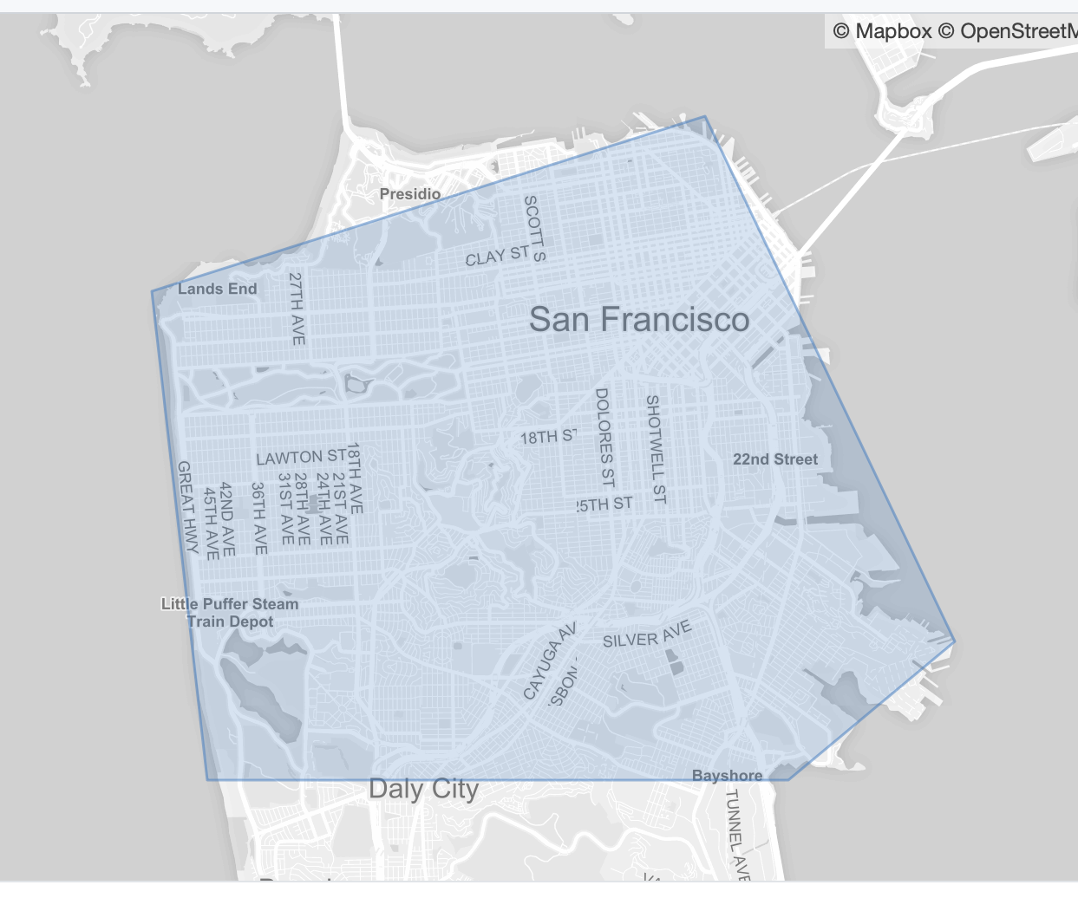
Dataset:
Source of the dataset: Json file of the San Francisco City from GitHub.
https://github.com/johan/world.geo.json/blob/master/countries/USA/CA/San%20Francisco.geo.json

Slide 4
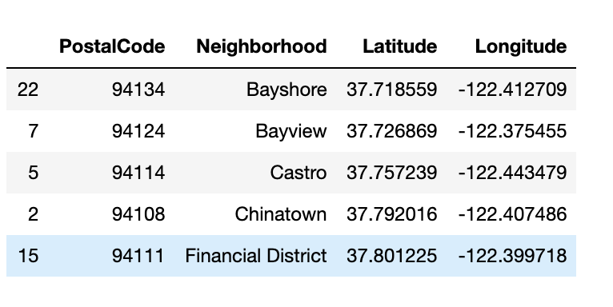
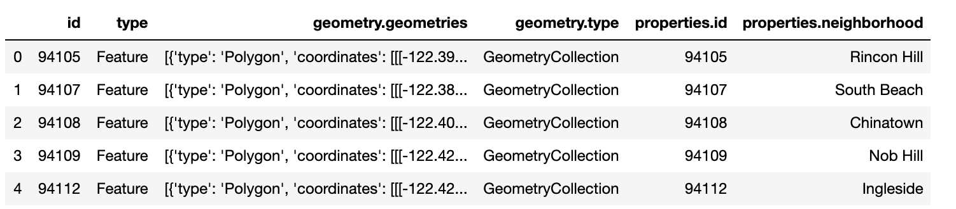
Cleaning of the Dataset:
The dataframe after transformation from the json file:
The dataframe after cleaning:

Slide 5
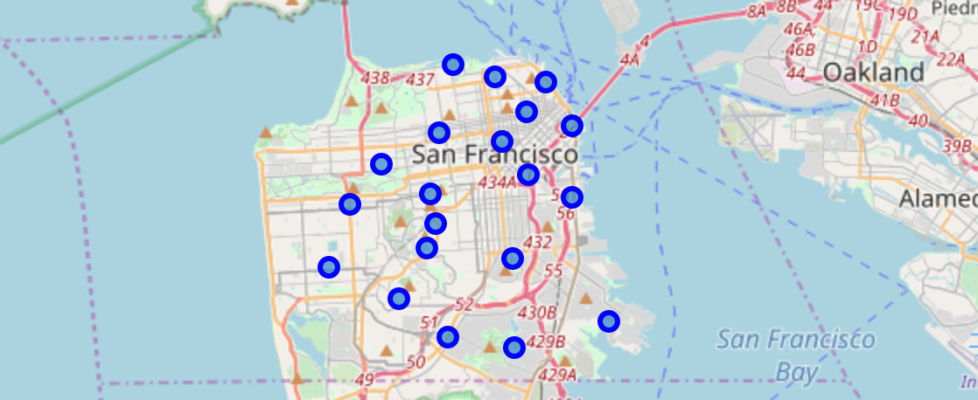
Geographical coordinates of SF

Slide 6
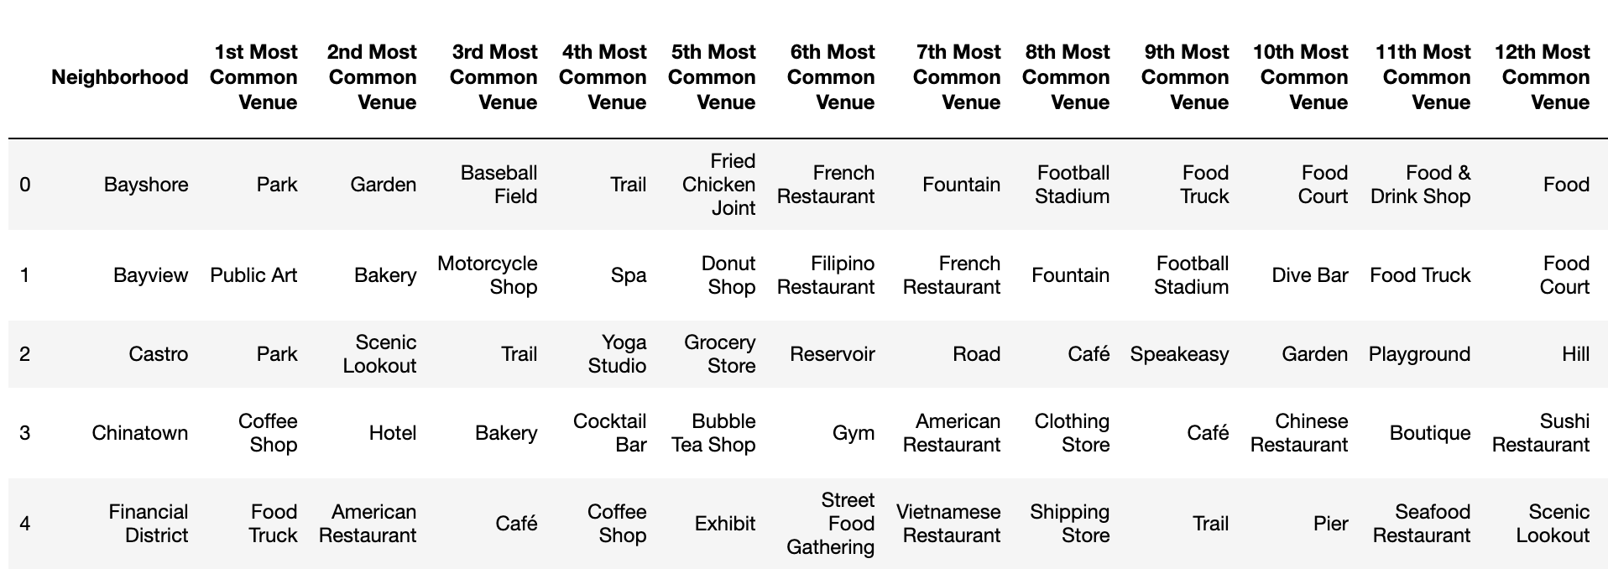
Analyze Each Neighborhood (Through API and Foursquare)

Slide 7
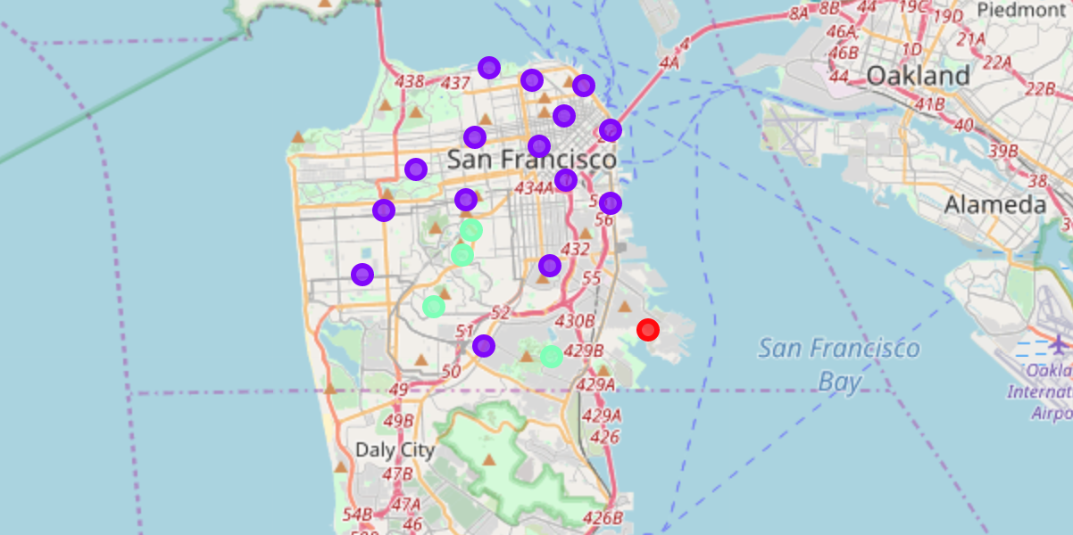
Cluster Neighborhoods

Slide 8
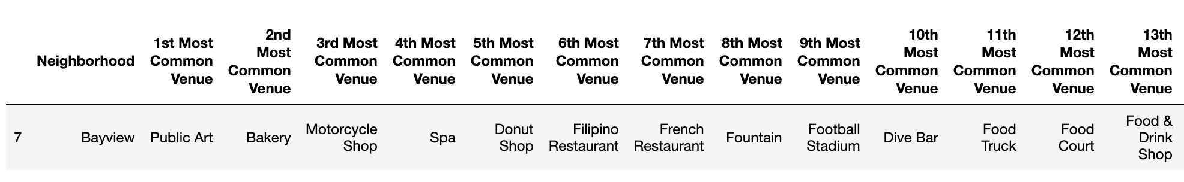
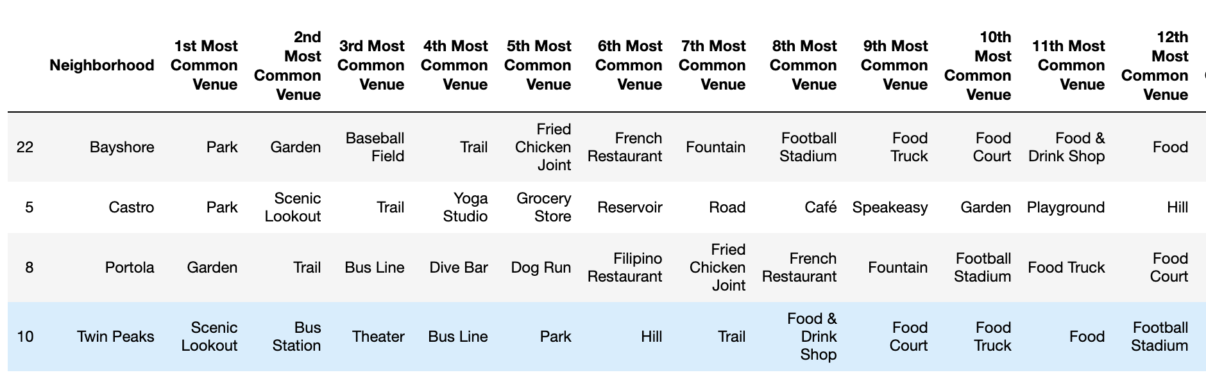
Examine Clusters:
Cluster 0:
Cluster 2:

Slide 9
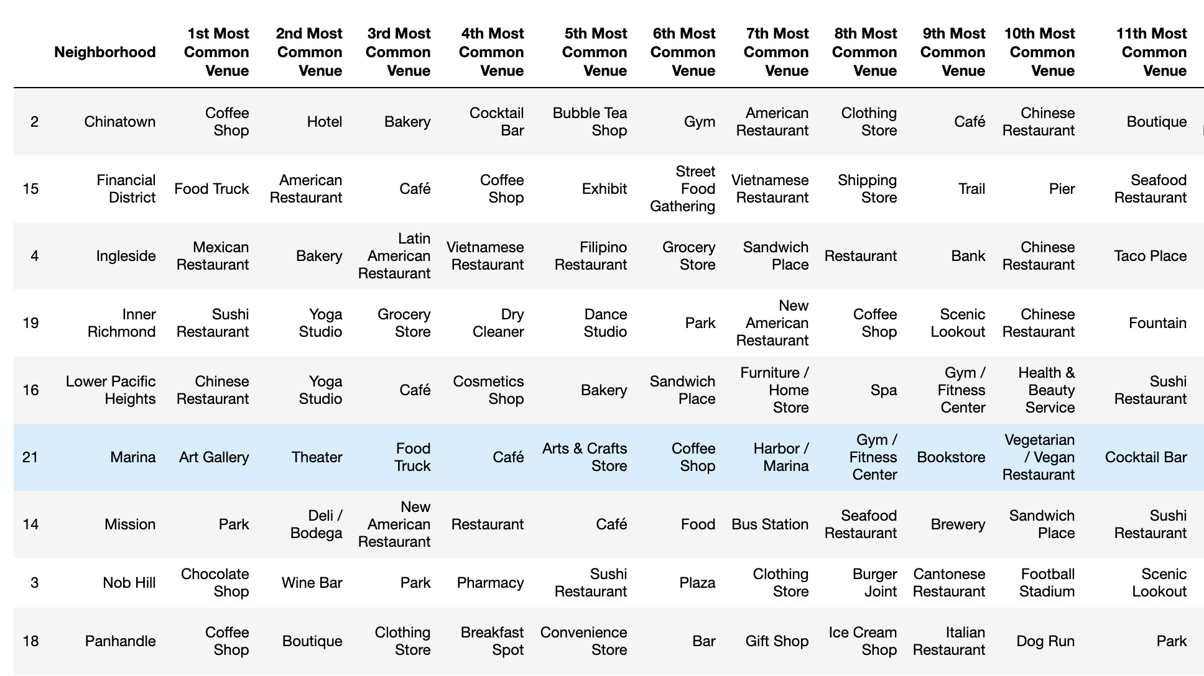
Cluster 1:

Slide 10


Results:
After trying 3,4 and 5 clusters, I found that three segments are the idealist. Then I examined the clusters. I found that Cluster 0 is surrounded with art, shops and then restaurants. Cluster 1 is surrounded with lots of restaurants and entertainment places. Cluster 2 is surrounded with gardens, lookouts and parks.
However, Cluster 0 and 2 are relatively far away from the downtown. The Cluster 1 are near the center of the downtown and has most neighborhoods.

Slide 11
Conclusion:
Based on the result, we can see that the neighborhoods in Cluster 2 are the most ideal one for Kiki. Although it is far from the downtown of the San Francisco City, it is not a matter for Kiki. Kiki does not care about the length of the commute. The neighborhoods included in Cluster 2: Bayshore, Castro, Portola, Twin Peaks.
Although there are four neighborhoods altogether in this cluster, they have similar characteristics. However, these four neighborhoods still have some little difference. For example, if Kiki would like a place near the bus station, the Twin Peaks in the Cluster 2 is the best choice.

