Slide 1
嵌入式OS与通信软件 uC/OS-II（补）
刘 健 培
嵌入式系统与网络通信研究中心
北京邮电大学 计算机学院

Slide 2
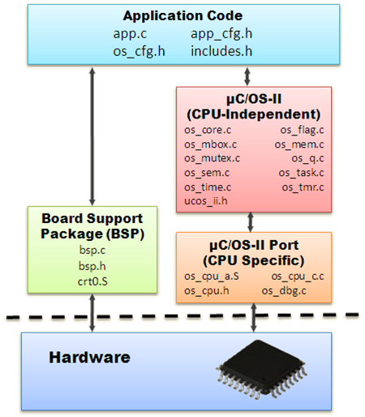
µC/OS-II结构

Slide 3
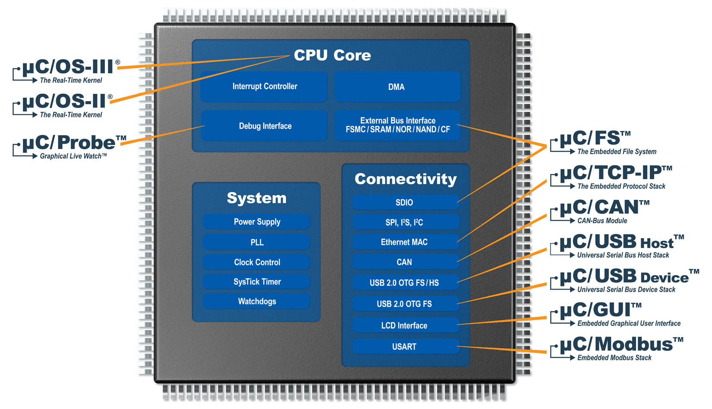
µC/OS-III

Slide 4
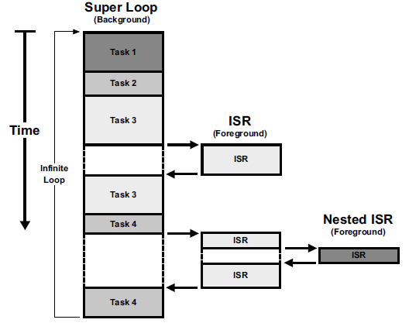
系统执行过程

Slide 5
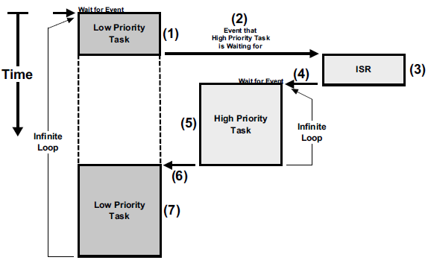
系统执行过程

Slide 6
分层看待完整的uC/OS-II
OS
任务切换、临界区开关中断、定时器
CPU
开关中断、堆栈方向、字长
Board BSP
初始化、中断与异常向量、时钟、串口、Led…
应用
配置接口

Slide 7
配置uC/OS-II

Slide 8
uC/OS-II对底层的要求
体系结构ISA
编译器
CPU
中断、堆栈方向
内存
外设
定时器

Slide 9
uC/OS-II多任务机制
从代码执行角度看任务的实质
任务=任务代码+堆栈+TCB
从代码执行角度看任务调度的实质
虚拟CPU—运行环境切换—PC切换—SP切换
uC/OS-II任务调度算法分析
任务链表-》二维数组-》二维位图
如何根据优先级快速找到位图点
如何位图点快速定位最高优先级

Slide 10
List of free OS_TCBs

Slide 11
µC/OS-II’s Ready List

Slide 12
Ready List
Making a task ready-to-run
OSRdyGrp |= OSMapTbl[prio >> 3];
OSRdyTbl[prio >> 3] |= OSMapTbl[prio & 0x07];
Removing a task from the ready list.
if ((OSRdyTbl[prio >> 3] &= ~OSMapTbl[prio & 0x07]) == 0)
OSRdyGrp &= ~OSMapTbl[prio >> 3];
Finding the highest priority task ready-to-run
y = OSUnMapTbl[OSRdyGrp];
x = OSUnMapTbl[OSRdyTbl[y]];
prio = (y << 3) + x;

Slide 13
Making a task ready-to-run
Removing a task from the ready list.
Finding the highest priority task ready-to-run
OSRdyGrp |= OSMapTbl[prio >> 3];
OSRdyTbl[prio >> 3] |= OSMapTbl[prio & 0x07];
if ((OSRdyTbl[prio >> 3] &= ~OSMapTbl[prio & 0x07]) == 0)
OSRdyGrp &= ~OSMapTbl[prio >> 3];
y = OSUnMapTbl[OSRdyGrp];
x = OSUnMapTbl[OSRdyTbl[y]];
prio = (y << 3) + x;

Slide 14
Task Scheduler
void OSSched (void)
{
INT8U y;
OS_ENTER_CRITICAL();
if ((OSLockNesting | OSIntNesting) == 0) { (1)
y = OSUnMapTbl[OSRdyGrp]; (2)
OSPrioHighRdy = (INT8U)((y << 3) + OSUnMapTbl[OSRdyTbl[y]]); (2)
if (OSPrioHighRdy != OSPrioCur) { (3)
OSTCBHighRdy = OSTCBPrioTbl[OSPrioHighRdy]; (4)
OSCtxSwCtr++; (5)
OS_TASK_SW(); (6)
}
}
OS_EXIT_CRITICAL();
}

Slide 15
µC/OS-II Initialization

Slide 16
Data structures after calling OSInit()

Slide 17
Free Pools

Slide 18
Variables and Data Structures after calling OSStart()

Slide 19
Servicing an interrupt

Slide 20
Cleanup by OSIntCtxSw()

Slide 21
Thank you!

