Slide 1
嵌入式系统
实时嵌入式系统基础
邝 坚
嵌入式系统与网络通信研究中心
北京邮电大学 计算机学院/软件学院

Slide 2
实时嵌入式系统基础
Embedded System
Real Time
HW Core
SW Core

Slide 3
A General Definition
Embedded systems are computing systems with tightly coupled HW and SW integration, that are designed to perform a DEDICATED function.
The word embedded reflects the fact that these systems are usually an internal part of a larger system, known as the embedding system.
Multiple embedded systems can coexist in an embedding system.
- Real-Time Concepts for Embedded Systems

Slide 4

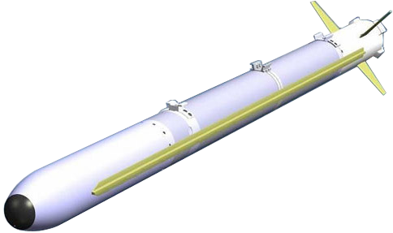
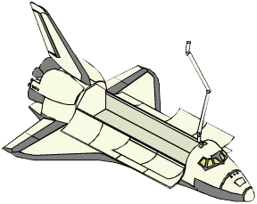
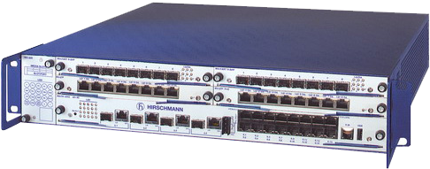

嵌入式系统无所不在

Slide 5

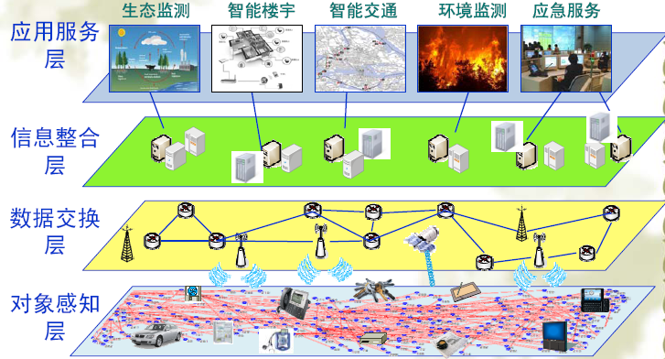
从热点看嵌入式系统
移动互联网
服务对象
安
全
服务
可
信
计
算
云计算、服务计算
大数据
理解
交换
嵌入式计算
感知

Slide 6

嵌入式系统应用的主要领域
Aerospace, Defense
Industrial Measurement & Control, Robotics
Telecom System
Personal & Consumer Device
Automobile
Medical Computer System
…
Internet – The Largest Embedded System in the world.

Slide 7
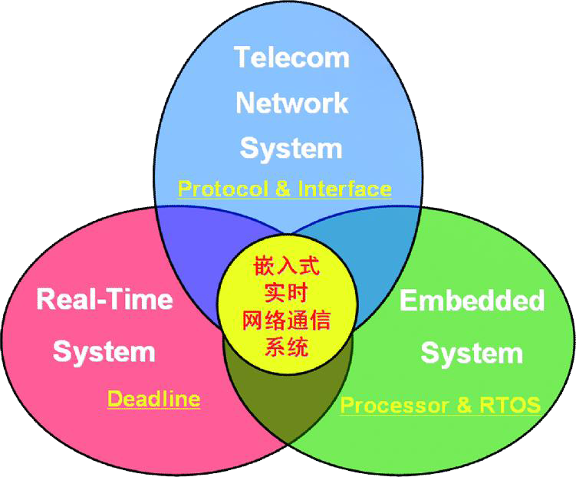
What-Why-How
HW core - Embedded Microprocessor
SW core - Embedded OS (RTOS)
RT TeleCom SYS - RT Framework + SDL

Slide 8
实时嵌入式系统基础
Embedded System
Real Time
HW Core
SW Core

Slide 9
What is a real-time system?
Real-time computing is computing where the system correctness depends not only on the correctness of the logical result of the computation but also on the result delivery time.
Pertaining a system or mode of operation in which computation is performed during the actual time that an external process occurs, in order that the computation results may be used to control, monitor, or respond in a timely manner to the external process. (IEEE 610.12 - 1990)
KEY – Use determinate time to process every asynchronous event.

Slide 10
Essential Characteristics
Logical or Functional Correctness –
system must produce correct computational result.
Timing Correctness –
The computations must conclude within a predefined period - DEADLINE

Slide 11

RT categories (Deadline)
Hard real-time: missing a deadline has catastrophic results for the system;
Firm real-time: missing a deadline has a non acceptable quality reduction as a consequence;
Soft real-time: deadlines may be missed and can be recovered from. The reduction of system quality is acceptable;
Non real-time: no deadlines have to be met.
Value
Deadline
Value
Deadline

Slide 12
Structure of Embedded real-time system
Dedicate
Job List
Management
Sensors
Trigger
Generator
Actuators
Execution
Tick(Clock)
Environment
Display

Slide 13
Keep in mind
即使在同一个实时系统内，对不同事件处理的实时性要求也是不同的
事件的分类：
Synchronous Events – 周期性的，系统可预见下一次同类事件发生的时刻
Asynchronous Events – 非周期性的，事件发生的时间不可预测
如何处理？

Slide 14
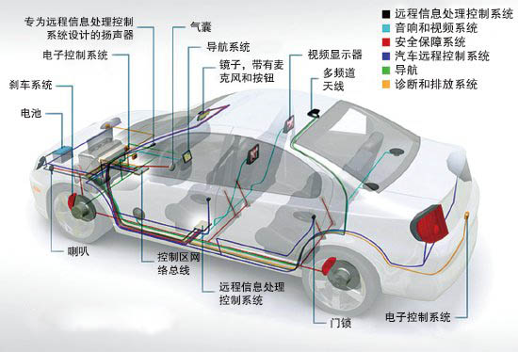

RT mission in a car
Steering
brakes
Radio
lights
Doors
Windows
…
这些功能的实时性如何？

Slide 15
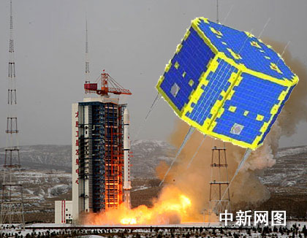

典型的实时嵌入式系统（1）
XW-1卫星无线电存储转发系统软件
资源紧凑型(128K Flash + 64K RAM)高可靠、高稳定性通信协议星载软件(2009年12月发射)
支持AX.25及PACSAT两个通信协议的多实例运行，C代码约12000行

Slide 16
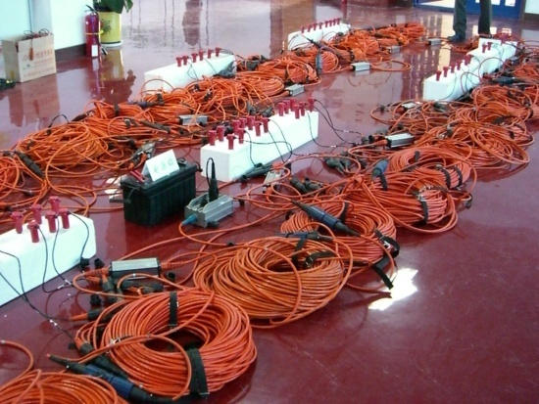
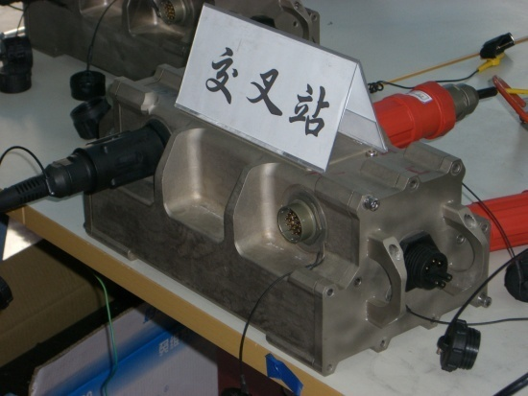

典型的实时嵌入式系统（2）
大型地震数据采集记录系统（2007-2008）
数据密集型高可靠多协议强实时嵌入式系统
MPC82XX+ VxWorks + GBit Switch
H
H
H
H
H
H
H
H
PMU
DAU
LMU
H
H
H
H
H
H
H
H
测线
仿真器
数据协议
控制协议
H
H
H
H
H
H
H
TU
(TMS)
LMU/FCU
交叉线仿真
FCU
主机系统
主机接口

Slide 17
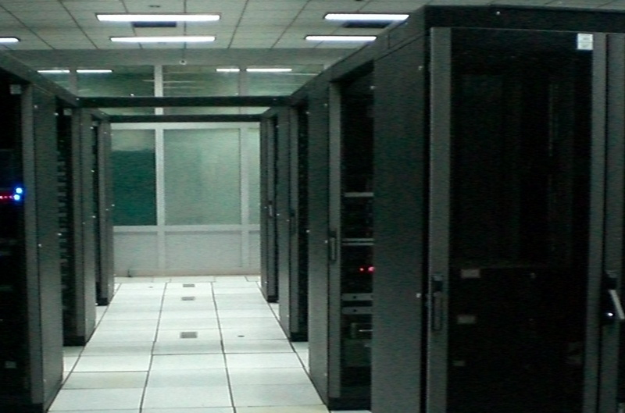
典型的实时嵌入式系统（3）
40万门ATM宽带话音交换系统
多处理机、多通信协议、大量协议实例的大型实时嵌入式系统
采用SDL形式化语言自动代码生成工具
X86 + M68K
pSOS+
C + SDL

Slide 18
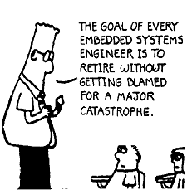
实时嵌入式系统特征
给定功能的专用计算机系统，不同系统的差异性大，软硬件协同设计要求强烈。对用户，相对封闭性强；
不同功能的实时性要求各异，难点一：强实时处理；
“嵌入”并不意味着一定是小(微)型系统；
“弱交互”、“固化代码”普遍存在；
“低功耗 + 资源紧凑”条件下的系统实现，要求OS及应用软件具有：精简、高效、深度优化特征（难点二）；
无人值守、长时间无间断工作、(极)低故障率需求，使系统研制具有“抗恶劣环境 + 高稳定性 + 高可靠性”的超强挑战性（难点三）；
开发环境相对桌面平台的弱，但在逐渐完备。
商业因素：成本，芯片、工具选型，时效 …

Slide 19
实时嵌入式系统基础
Embedded System
Real Time
HW Core - Architectures
SW Core

Slide 20
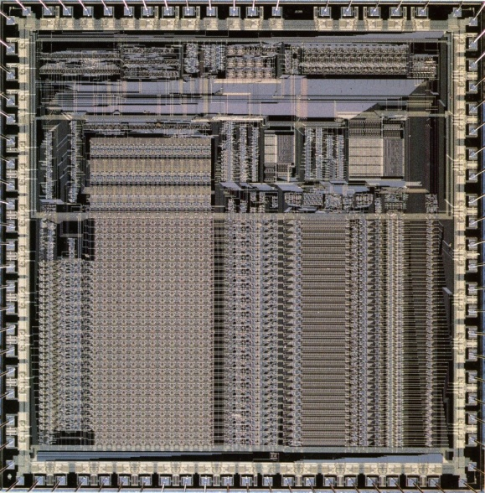
Embedded Microprocessor
What is Embedded Microprocessor?
A programmable processor whose programming interface is not accessible to end-user of the product.
The only user-interaction is through the actual application.

Slide 21
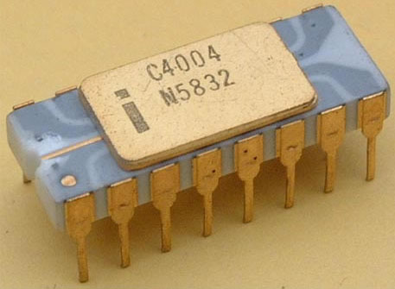


Something interesting
Intel 4004 – 计算器(1970, 4-bit CPU, 46 instructions)
当今的处理器中有90%以上是用于嵌入式设备(以百亿计/年)
不应该只知道或只了解X86！

Slide 22
From GP-Processor to Embedded Processor
Embedded Processor focuses on:
Performance that not achievable with GP-processor – Network & Telecom equipment.
Size, Power and Price – PAD – interactive and display intensive, rather then computation intensive.
Special – DSPs, Graphics Processors, Media Processors …

Slide 23
Categories
MPU – Microprocessor Unit
MCU – Microcontroller Unit
DSP – Digital Signal Processor
SoC – System On Chip
Muiti-Core
RISC+DSP
CSIC+RISC+DSP
DSC (DSP+MCU, Digital Signal Controller)
RISC*n

Slide 24
BIG Family - Embedded Processors (wikipedia)
Embedded processors can be broken into two(*) broad categories: ordinary microprocessors (μP) and microcontrollers (μC), which have many more peripherals on chip, reducing cost and size.
A long but still not exhaustive list of common architectures are: 65816, 65C02, 68HC08, 68HC11, 68k, 78K0R/78K0, 8051, ARM, AVR, AVR32, Blackfin, C167, Coldfire, COP8, Cortus APS3, eZ8, eZ80, FR-V, H8, HT48, M16C, M32C, MIPS, MSP430, PIC, PowerPC, R8C, RL78, SHARC, SPARC, ST6, SuperH, TLCS-47, TLCS-870, TLCS-900, TriCore, V850, x86, XE8000, Z80, AsAP etc.
作为嵌入式系统从业者，不应该只知道或只了解ARM！

Slide 25
Freescale MPC8260
SYSTEM INTERFACE UNIT
EC603e
PowerPC
Core
16 KB I-Cache
60x Bus Interface Unit
IMMU
1
PowerPC-to-Local Bridge
16 KB D-Cache
2
DMMU
Local Bus Interface Unit
Memory Controller
3
COMM. PROCESSOR MODULE
Time Counter/PIT
Four
Timers
Interrupt
Controller
Internal
Memory
Space
Serial
DMAs
Virtual
IDMAs
Bus Arbiter
Parallel I/O
L2 Cache Controller
Baud Rate
Generators
32-bit RISC and
Program ROM
System Functions
Timers
MCC1
MCC2
FCC1
FCC2
FCC3
SCC1
SCC2
SCC3
SCC4
SMC1
SMC2
SPI
I²C
Time Slot Assigner
Serial Interface
8 TDMs
3 MII
2 UTOPIA

Slide 26
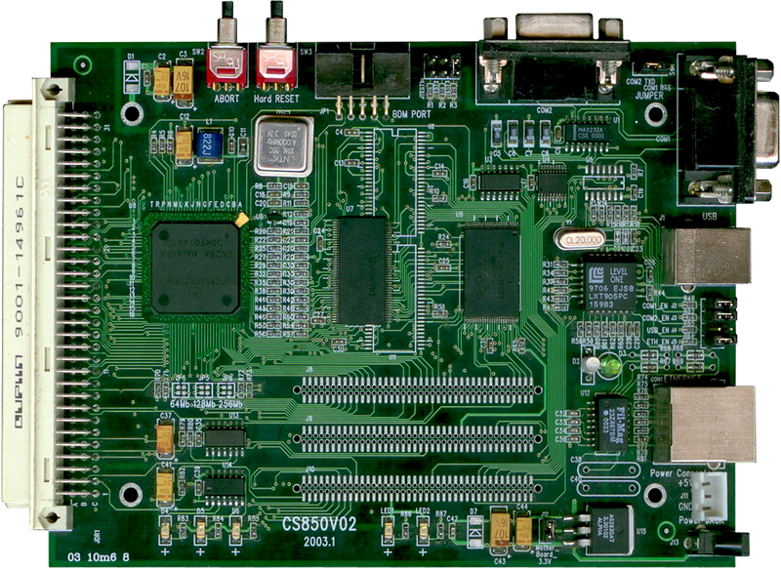
CS8xx Evaluation Board BUPT

Slide 27
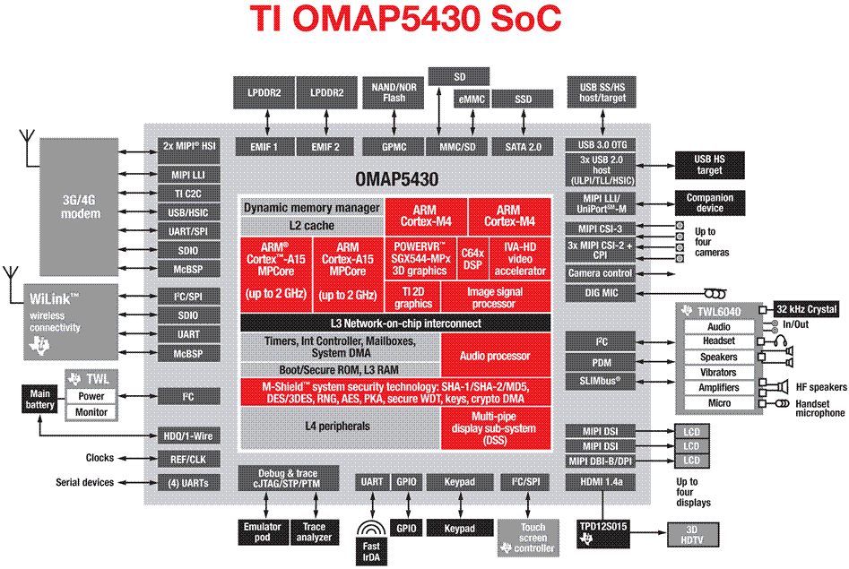
TI OMAP3530

Slide 28
国产CPU状况
全新自主指令系统
Unicore - 北大众志；
C*Core - 浙江大学、苏州国芯、杭州中天，M*CORE + PowerPC；
申威 -上海高性能集成电路设计中心；
兼容国际主流、自主指令系统
龙芯2/3(MIPS32/MIPS64) - 中国科学院计算所；
FT(SPARC) - 国防科技大学；
Xburst(MIPS32) - 北京君正。

Slide 29
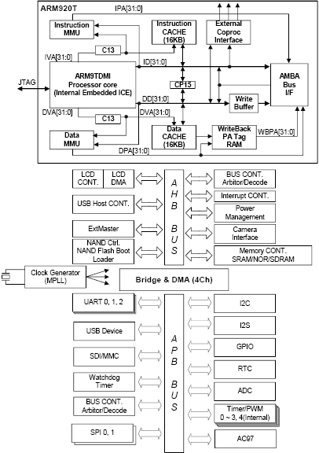
Our HW Target
S3C2440
体系结构具有代表性
RISC
MMU/Cache
Harvard architecture
片上I/O经典
教学资源丰富
应用广泛

Slide 30
实时嵌入式系统基础
Embedded System
Real Time
HW Core
SW Core - RTOS

Slide 31
RTOS
An OS that schedule execution in a strong timely manner, manage system resources, and provide a consistent foundation for developing application code.
An RTOS that can usually or generally meet a deadline is a soft real-time OS, but if it can meet a deadline deterministically it is a hard real-time OS.
KEY – Real time (less jitter, definitely determined), Highly modularized, MultiTasking, High performance, compact and scalable.
Notes:
讲OS时，以手机OS为例，提问学生

Slide 32
RTOS vs GPOS
专业化强 - 每一种实时嵌入式操作系统通常面向特定类型或几种相近类型应用。某些操作系统会根据不同的应用对象采用不同的模块搭配。有些操作系统甚至是自行研制的内部产品。
实时性 - 大多数嵌入式系统工作在实时性要求很高的环境中，对外部事件的响应，包括数据的获取、处理和数据的输出都必须在deadline规定的时间内完成。这就要求实时嵌入式操作系统必须将实时性作为一个重要指标。
强稳定性 - 与桌面系统不同，大多数嵌入式系统一旦开始运行就不需要人过多的干预。在这种条件下，要求作为系统资源总管的操作系统具有较高的稳定性。

Slide 33
RTOS vs GPOS
固化代码 - 在嵌入式系统中，操作系统与应用软件代码通常被固化在嵌入式系统的ROM中。目前辅助存储器（如磁盘）在嵌入式系统中很少使用，因此，实时嵌入式操作系统的文件管理功能应该能够很容易裁减，取而代之的是各种内存文件系统。
弱交互性 - 除消费类电子设备以外，大多数嵌入式系统的工作过程不需要人的干预。因此多数实时嵌入式操作系统所提供用户操作接口相对简单，主要通过系统调用命令向用户程序提供服务。

Slide 34
评价指标
任务切换时间（Task switch time）。系统中两个具有相同优先级任务之间切换所需要的平均时间。
抢占时间（Preemption time）时间。系统中某个高优先级任务抢占低优先级的任务花费的平均时间。
中断等待时间（Interrupt latency time）。从CPU收到中断请求到执行中断服务程序的第一条指令所用的时间。
信号量延迟时间（Semaphore-shuffle time）。从一个任务释放信号量到另一个等待信号量的任务被激活的时间延迟。
死锁解脱时间（Deadlock break time）。指系统解开死锁所需的平均时间，造成死锁的原因是高优先级任务抢占某一低优先级任务后，进而需要刚刚被抢占任务所拥有的资源。
任务间消息传递延迟（Intertask message latency）。非零长度消息在任务间传递的操作系统内部延迟时间。
数据报吞吐量（Datagram throughput time）。任务间利用操作系统通信原语传递数据，每秒所传送的字节数。
…

Slide 35












Some RTOS maybe you know
哪个你知道？

Slide 36
Huge Family - RTOS List
Abassi, AMX RTOS, ARTOS, Atomthreads, AVIX, BeRTOS, BRTOS, CapROS, ChibiOS/RT, ChorusOS, CMX RTOS, cocoOS,Concurrent CP/M, Concurrent DOS, Contiki, COS, Deos, DioneOS, DNIX, GEC DOS, DrRtos, DSPnano RTOS, DSOS, eCos, eCosPro, embOS, Embox, ERIKA, Enterprise, EROS, Femto OS, FlexOS, FreeOSEK, FreeRTOS, FunkOS, Fusion RTOS, HeartOS, Helium, HP-1000/RTE, Hybridthreads, IBM 4680 OS, IBM 4690 OS, INTEGRITY, IntervalZero RTX, ITRON, uITRON, microITRON, ioRTOS, iRTOS, LynxOS, MaRTE OS, MAX II,IV, MenuetOS, Milos, MP/M, MQX, MERT, Multiuser DOS, Nano-RK, Neutrino, Nokia OS, Nucleus OS, NuttX RTOS, On Time RTOS-32, OS20, OS21, OS4000, OPENRTOS, OSA, OSE, OS-9, OSEK, Phar Lap ETS, PaulOS, PICOS18, picoOS, Phoenix-RTOS, PikeOS, Portos, POK, PowerTV, Prex, Protothreads, pSOS, QNX, Q-Kernel, QP, RDOS, ReaGOS, REAL/32, Real-time Linux, REX OS, RMX, RSX-11, RT-11, RTAI, RTEMS, rt-kernel, RTLinux, RT-Thread, RTXC Quadros, SAFERTOS, Salvo, SCIOPTA, scmRTOS, SDPOS, SHaRK, SimpleAVROS, SINTRAN III, Sirius RTOS, SMX RTOS, SOOS Project, Symbian, Talon DSP RTOS, TargetOS, T-Kernel, THEOS, ThreadX, Trampoline Operating System, TNKernel, Transaction Processing Facility, TRON ProjectTUD:OS, Unison RTOS, μC/OS-II, μC/OS-III, UNIX-RTR, uSmartx, μTasker, u-velOSity, velOSity, VRTX, VxWorks, Windows CE, Xenomai, xPC Target, Y@SOS, MontaVista Linux, μnOS, uOS
哪些个你知道？
List of real-time operating systems - wikipedia

Slide 37
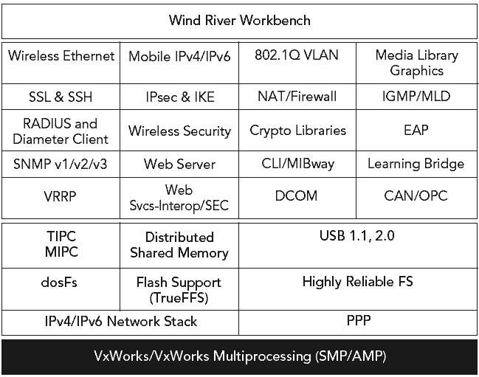
VxWorks 6.9

Slide 38
Android Architecture
Applications
Home
Contacts
Phone
Browser
……
Application Framework
Activity Mgr
Windows Mgr
Content Provider
View System
Package Mgr
Telephony Mgr
Resource Mgr
Location Mgr
Notification Mgr
Native Libraries
runtime
Surface Mgr
libc
SQLite
Core Libraries
Media
FreeType
Webkit
Dalvik VM
Open GL|ES
SGL
SSL
Linux Kernel
Display Driver
Flash Driver
USB Driver
BT Driver
Binder Driver
Wifi Driver
Audio Driver
Power Driver
Camera Driver
Keypad Driver

Slide 39
Our OS Target
uC/OS-II (uC/OS-III)
Hard Real-Time RTOS内核
源码公开
结构小巧 (5-24KB)
资源丰富
稳定性强，可靠性高 – FAA (Federal Aviation Administration，联邦航空局)DO-178B认证，
应用广泛
Avionics
Medical equipment/devices
Data communications equipment
White goods (appliances)
Mobile Phones, PDAs
Industrial controls
Consumer electronics
Automotive
实时嵌入式系统
入门者的最佳选择之一

Slide 40

下面该干什么？

