Slide 1
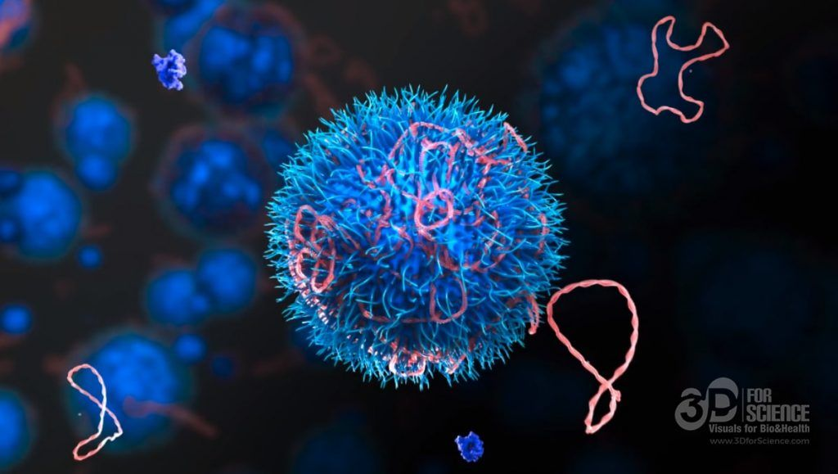

Mechanisms of Action(MoA) Prediction
Xinbo Xia
Haoyu Guo
Rocha Zhou
https://github.com/guohaoyu110/EE542_final
Notes:
Slides can vary as per your presentation, but header and footer should be consistent

Slide 2
A Real World Problem
Problem: More and more new diseases that human never saw before are threatening human’s health. For example, people have suffered and died on COVID-19 and still can not find a cure.
Our solution: Using machine learning and deep learning, we create a prediction model that can classify MoA of a drug based on biological activity. Knowing MoA of a drug is very crucial to develop new effective drug for new disease.
Market: Drug market is tremendous, especially when a new effective drug comes out because it is needed by all humans. 1.25 trillion dollars are spent in medicines in 2019. I believe this number will be further increased if vaccines to COVID-19 are invented.

Slide 3
Why Would An Investor Want This?
Because our model is accurate and easy to use. Investors only need to input biological activity of a certain drug and our model can classify the MoA of it.
citations:
“Mechanism matters” by Nature Medicine 16 347, 2010
Url: https://www.nature.com/articles/nm0410-347
Corsello et al. “Discovering the anticancer potential of non-oncology drugs by systematic viability
profiling,” Nature Cancer, 2020, https://doi.org/10.1038/s43018-019-0018-6
Subramanian et al. “A Next Generation Connectivity Map: L1000 Platform and the First 1,000,000
Profiles,” Cell, 2017, https://doi.org/10.1016/j.cell.2017.10.049

Slide 4
Our Approach
Traditional approach to know about MoA of a medicine is doing actual experient onto the drug.
The novelty of our approach is that we will try different machine learning and deep learning algorithms.
With huge amounts of data that is collected by advanced technologies, provided by MIT and Harvard, we can use most data to train our machine learning model and the rest of the data to do the test. We believe we can get a satisfying model at last.
Before training the data, we will clean the data first. Then, with multilayered neural network and some other potential algorithms, we can train the model in a good shape. To speed up the training process, we will deploy technologies such as cloud computing(AWS), to increase our product’s competities.

Slide 5
Cost and preference
Cost:
The dataset used in this competition is not a large one. We need to train algorithms on AWS platform for about 10 days, cost around $200. Material cost and labor cost doesn’t count in this task.
Preference:
Users will prefer our approach for two reasons. First, our solution can give vivid demos and clear predictions; second, our model provides integration of different models, shows better predictions than normal methods

Slide 6
Team Assignments
Rocha Zhao: Data analysis and visualization
skills: Python, C++, data visualization
Haoyu Guo: Propose deep learning training algorithms and model assembling
skills: Python, C++, PyTorch, Caffe, Docker
Xinbo Xia: Propose machine learning training algorithms and model assembling
Skills: Python, C++, Machine Learning

Slide 7
Project Schedule
By Nov 14 : Finish data processing (prepare data for training)
Nov 14 - Nov 21 : Deploy machine learning algorithm
Nov 21 - Nov 29: Try more deep learning algorithms and do transfer learning
Nov 29 - Dec 9: Model assembling and integration, submit the task and write report

Slide 8
Contents of The Final Presentation
Describe How You Are Going to Capture Attention (Analogy)
Use vivid demos and real world use case
Describe 1 or 2 Detailed Trace of Your System Operation
In data analysis, we need to see the train and test data size and some of their examples. Deal with two different target dataframes, non-scored and scored. The non-scored ones are not used for scoring, but we can make use of them to pretrain our network.
When dealing with control group which does not have the desired effect or MoAs here, meaning the target labels are zero for them. I will drop the data for this group, and we will later set all predictions of this group to zero. We will keep track of the control group indexes. I dropped cp_type column and mapped the values of time and dose features.

Slide 9
Contents of The Final Presentation
Describe the Experiments You Plan to Run to Demo Your System
Run the training process on AWS and test the accuracy on Kaggle Competition platform
Describe the Summary Diagrams You Will Create
Different charts of our integrated models. (For example: Histogram, Scatter plot, Regression plot)

Slide 10
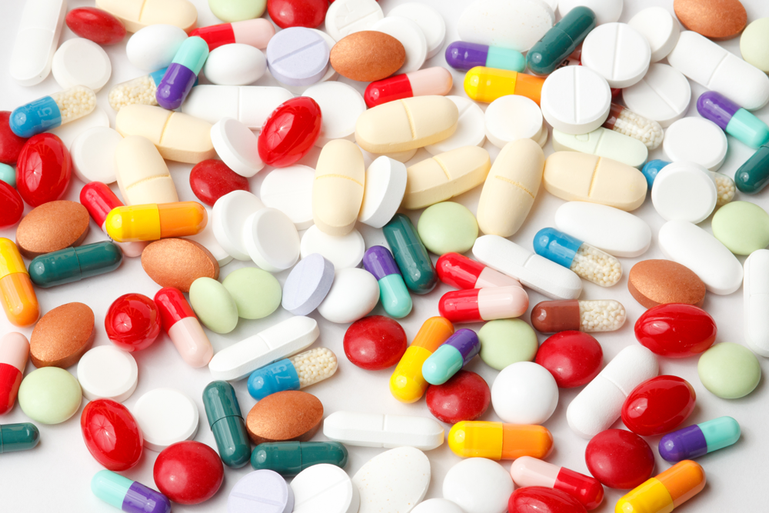
Thank you!

