Slide 1
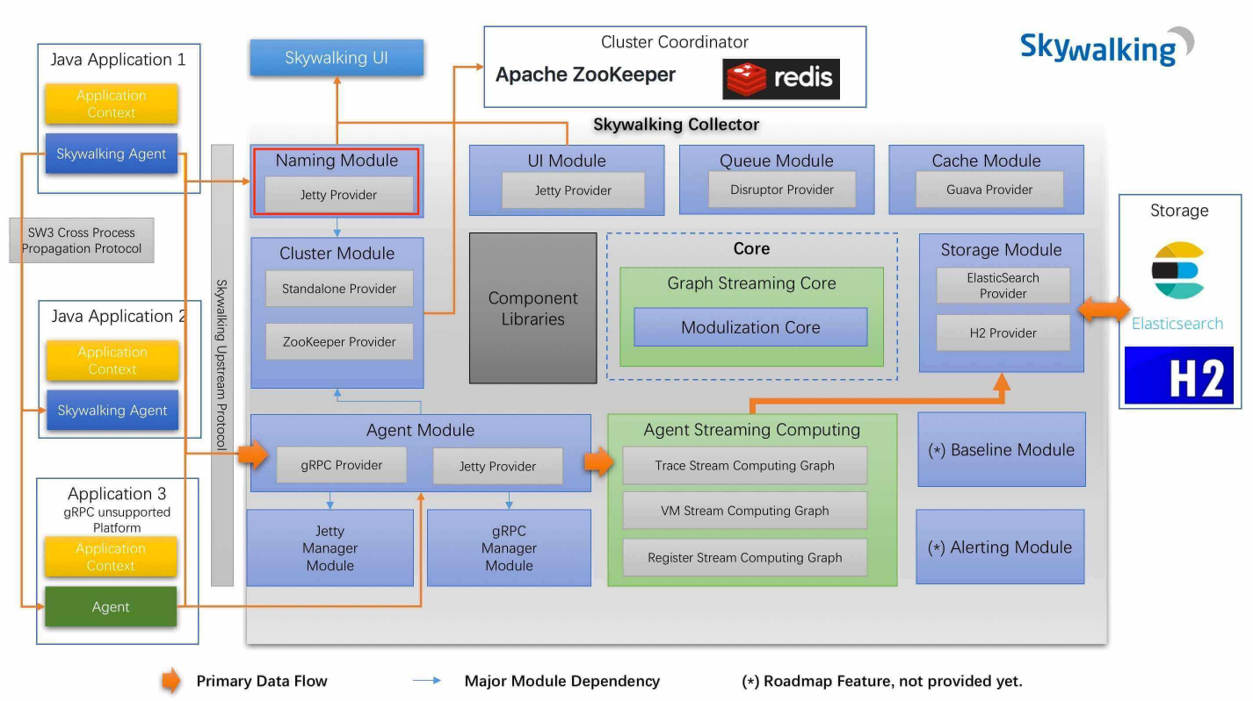
1、opentrace 官方标
2、数据采集——> 数据分析---> 数据存储 ---> 数据渲染
Notes:
环境：https://cloud.tencent.com/developer/article/1587102

Slide 2
Naming Module
集群
collector
Agent Server
collector Naming Server
集群
collector
gRPC Server

Slide 3
trace数据流转
Agent
Collector
Stroage
TraceSegment
一条 TraceSegment ，用于记录所在线程( Thread )的链路。
一次分布式链路追踪，可以包含多条 TraceSegment ，因为存在跨进程( 例如，RPC 、MQ 等等)，或者垮线程( 例如，并发执行、异步回调等等 )。
链路
TraceSegment | TraceSegment | TraceSegment | TraceSegment | TraceSegment
span | span | span | span | span

Slide 4
TraceSegment结构
编号（全局唯一） | traceSegmentId
父类引用 | TraceSegmentRef [] refs
线程内数据块 | spans
是否忽略链路 | ignore
是否超过span上限 | isSizeLimited
分布式链路ID | DistributedTraceId
1、为什么会有多个父类？
一般MQ批量消费时，存在多个父类上游traceSegment
2、ID组成
应用实例编号.线程编号.时间戳串
3、ENTRY_SPAN-->LOCAL_SPAN--> EXIT_SPAN
Notes:
环境调试：https://www.iocoder.cn/SkyWalking/build-debugging-environment/

Slide 5
web ui
3.2.6-6.0： https://github.com/apache/skywalking-ui
http://localhost:12800/traceStack/globalTraceId
Notes:
自定义插件开发： https://github.com/HuiWang1995/skywalking-plugin-example
@Trace: https://blog.csdn.net/a17816876003/article/details/113702511
https://www.cnblogs.com/swave/p/11347711.html
https://blog.csdn.net/wanxiaoderen/article/details/106536562
源码分析
https://blog.csdn.net/u010928589/article/details/105343949/
https://www.iocoder.cn/SkyWalking/build-debugging-environment/

Slide 6
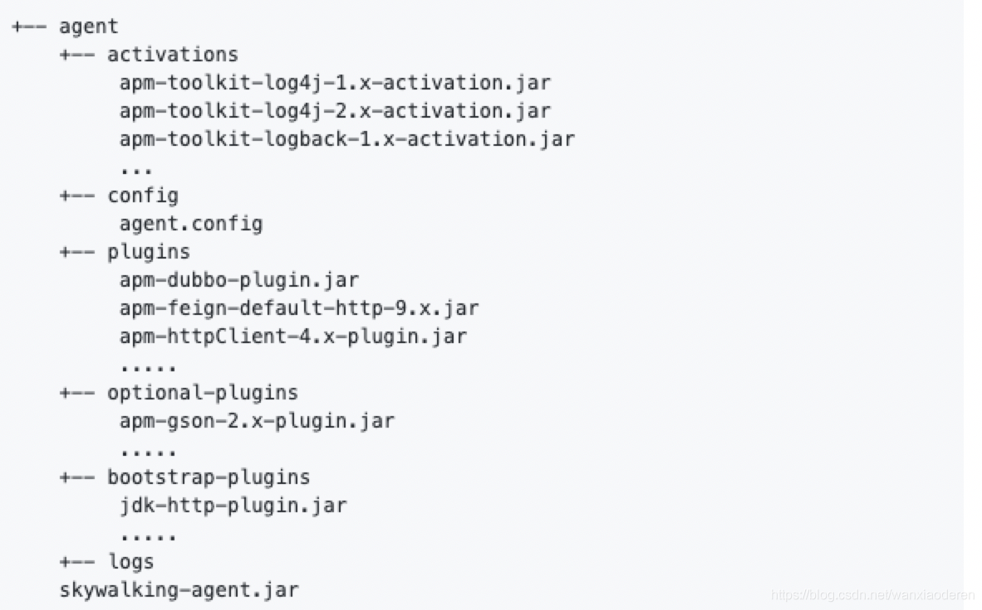
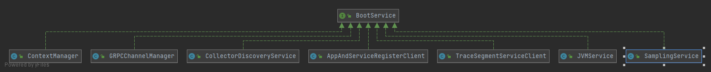
GRPCChannelManager--->List<GRPCChannelListener> listeners
beforeBoot
1、JvmService
2、AppAndServiceRegisterClient
3、TraceSegmentServiceClient
4、....
boot
afterBoot
SnifferConfigInitializer.initialize() 配置发现
1、ClollectorDiscoverService# findServerList
GET http://127.0.0.1:10800/agent/gRPC HTTP/1.1 ---》 grpc-serviers: localhost:11800

Slide 7
插件增强
PluginBootstrap
PluginFinder
loadPlugins
origin class-> proxy filter list
save enhance mapping

Slide 8
tomcat-embed-core
spring-web
logback:PatternLayout
核心流程讲解
StanardWrapperValue
InvocableHandlerMethod
LogbackPatternConverter
1、global traceId的生成
TomcatInvokeInterceptor
InvokeForRequestInterceptor
invoke
FormattingConvert#write
invokeForrequest
RequestMappingMethodInterceptor
PrintTraceIdInterceptor
业务入口请求
convert

Slide 9
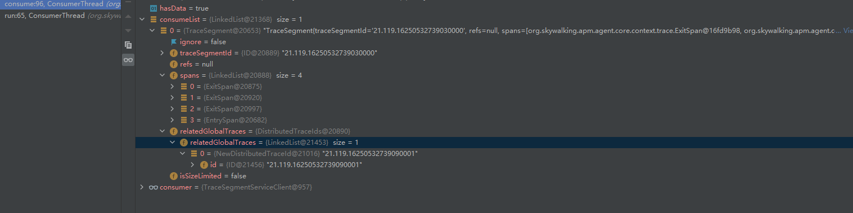
activeSpanStack搬迁
before method
span存在多次触发, 只有最后一次退出才搬迁
EntrySpan:0 tomcat
EntrySpan:0 tomcat | ExistSpan:1 jedis
NULL
NULL
stackDepth=1
EntrySpan:0 tomcat | jedis get
after method
EntrySpan:0 tomcat | dubbo
TracingContext
TraceSegment
head
finished span
1
segment: TraceSegment
traceSegmentId:ID
 | ExistSpan:1 dubbo | ExistSpan:1 jedis:get | ExistSpan:1 jedis:set
activeSpanStack: List<AbstractSpan>
spans:List<AbstractTracingSpan>
refs:List<TradeSegmentRef>
activeSpanStack Empty 触发上报
spanIdGeneratort:int
channels
relatedGlobalTraces:DistributedTraceIds
samplingService:<S>
ignore:false
isSizeLimited:false
代理类内部可能存在多种调用的情况，复用存在多次触发method 增强，故span定义了stackDeth去控制退出， 比如 JedisCluster和Jedis的操作是复用的，多次操作增强，只有最后一次才能作为释放的结束
图中1为上报点
Notes:
# 切面方式
-javaagent:D:\Users\Desktop\java\opensource\skywalking\apm-sniffer\apm-agent\target\skywalking-agent.jar -Dskywalking.agent.service_name=apm-demo -Dskywalking.collector.backend_service=10.2.7.70:11800
#AbstractSpan
AbstractSpan span = ContextManager.createEntrySpan(request.getRequestURI(), contextCarrier);
Tags.URL.set(span, request.getRequestURL().toString());
Tags.HTTP.METHOD.set(span, request.getMethod());
span.setComponent(ComponentsDefine.TOMCAT);
SpanLayer.asHttp(span);
-- SamplingService（采样服务）
ContextManager（上下文管理器）
-- ThreadLocal: AbstractTracerContext
1、创建上下文
--采样: TracingContext
-- segment: TraceSegment
-- traceSegmentId
-- spans: LinkedList<AbstractTracingSpan> (已完成的span)
-- relatedGlobalTraces: DistributedTraceIds
-- relateGlobalTraces: LinkedList<DistributeTraceId> (第一个ID即traceId)
-- spanIdGenerator:[0,300)
-- samplingService
-- activeSpanStack: LinkedList<AbstractSpan> (如何断定什么时候开始，什么时候结束) 转移到已完成span
第二个加入判断最后一个十分为EntrySpan
--不采样： IgnoredTracerContext
2、 创建入口span(createEntrySpan)
-- AbstractTracingSpan
| -- spanId
| -- parentSpanId
| -- List<KeyValuePair> tags （只有stackDepth == currentMaxDepth才可设置）
| -- operationName
| -- operationId （OperationNameDictionary本地存操作，后一个span创建发现存在，则++）
| -- layer:SpanLayer
| -- startTime
| -- endTime
| -- errorOccurred
| -- componetId:0
| -- componentName
|
--- StrackBasedTracingSpan
| --- stackDepth
|
---- EntrySpan
---- currentMaxDepth
操作
1、构造函数-- EntrySpan(spanIdGenerator++, parentSpanceId, operationId)
2、启动start()
a: 深度为1时， 设置startTime
3、加入activeSpanStack
4、通知已完成 TracingContext#notifyFinish
a: 移除 ContextManager中的Context
b: AppAndServiceRegisterClient 更新最后一个segment的时间
c: TraceSegmentServiceClient( 进行上报) ----》DataCarrier.producer
// 跟踪链路
AppAndServiceRegisterClient#run --> OperationNameDictionary#syncRemoteDictionary
第二步： 上报后的数据合并及查询
增强核心
AbstractClassEnhancePluginDefine#define ---> ClassEnhancePluginDefine#enhance -->#enhanceInstance--->
String interceptor = instanceMethodsInterceptPoint.getMethodsInterceptor(); 获取拦截的方法和interceptor
LogbackPatternConverterActivation#getInstanceMethodsInterceptPoints
StackBasedTracingSpan#finish

Slide 10
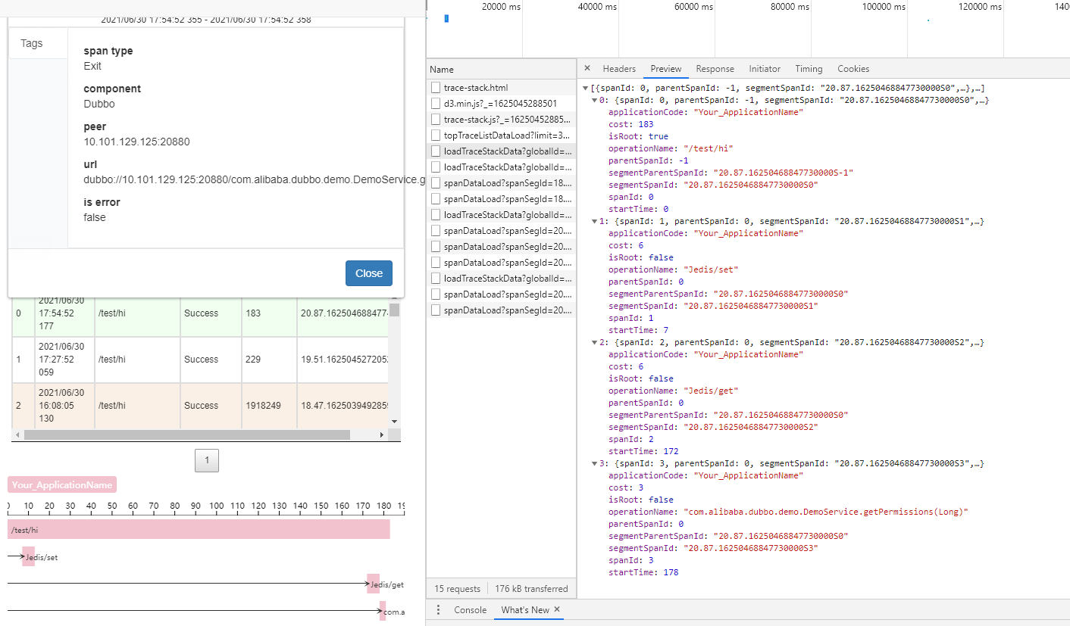

Slide 11
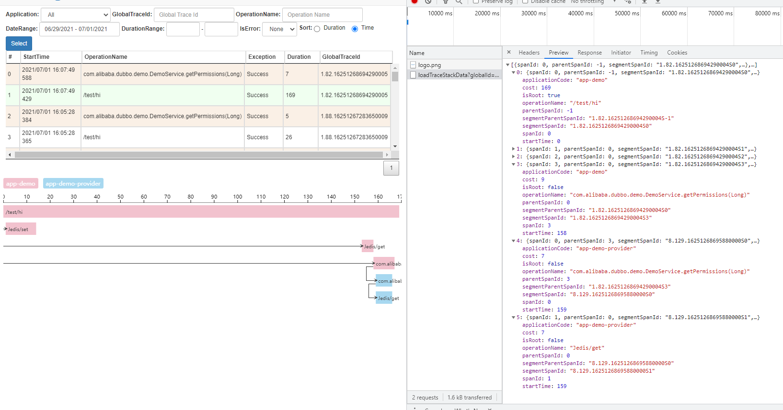
CarrierItem 承载上游数据携带
@Override
public void extract(ContextCarrier carrier) {
this.segment.ref(new TraceSegmentRef(carrier)); this.segment.relatedGlobalTraces(carrier.getDistributedTraceId());
}
跨进程传递
Notes:
[{spanId: 0, parentSpanId: -1, segmentSpanId: "1.82.16251268694290004S0",…},…]
0: {spanId: 0, parentSpanId: -1, segmentSpanId: "1.82.16251268694290004S0",…}
applicationCode: "app-demo"
cost: 169
isRoot: true
operationName: "/test/hi"
parentSpanId: -1
segmentParentSpanId: "1.82.16251268694290004S-1"
segmentSpanId: "1.82.16251268694290004S0"
spanId: 0
startTime: 0
1: {spanId: 1, parentSpanId: 0, segmentSpanId: "1.82.16251268694290004S1",…}
applicationCode: "app-demo"
cost: 13
isRoot: false
operationName: "Jedis/set"
parentSpanId: 0
segmentParentSpanId: "1.82.16251268694290004S0"
segmentSpanId: "1.82.16251268694290004S1"
spanId: 1
startTime: 1
2: {spanId: 2, parentSpanId: 0, segmentSpanId: "1.82.16251268694290004S2",…}
applicationCode: "app-demo"
cost: 5
isRoot: false
operationName: "Jedis/get"
parentSpanId: 0
segmentParentSpanId: "1.82.16251268694290004S0"
segmentSpanId: "1.82.16251268694290004S2"
spanId: 2
startTime: 153
3: {spanId: 3, parentSpanId: 0, segmentSpanId: "1.82.16251268694290004S3",…}
applicationCode: "app-demo"
cost: 9
isRoot: false
operationName: "com.alibaba.dubbo.demo.DemoService.getPermissions(Long)"
parentSpanId: 0
segmentParentSpanId: "1.82.16251268694290004S0"
segmentSpanId: "1.82.16251268694290004S3"
spanId: 3
startTime: 158
4: {spanId: 0, parentSpanId: 3, segmentSpanId: "8.129.16251268695880000S0",…}
applicationCode: "app-demo-provider"
cost: 7
isRoot: false
operationName: "com.alibaba.dubbo.demo.DemoService.getPermissions(Long)"
parentSpanId: 3
segmentParentSpanId: "1.82.16251268694290004S3"
segmentSpanId: "8.129.16251268695880000S0"
spanId: 0
startTime: 159
5: {spanId: 1, parentSpanId: 0, segmentSpanId: "8.129.16251268695880000S1",…}
applicationCode: "app-demo-provider"
cost: 7
isRoot: false
operationName: "Jedis/get"
parentSpanId: 0
segmentParentSpanId: "8.129.16251268695880000S0"
segmentSpanId: "8.129.16251268695880000S1"
spanId: 1
startTime: 159

Slide 12
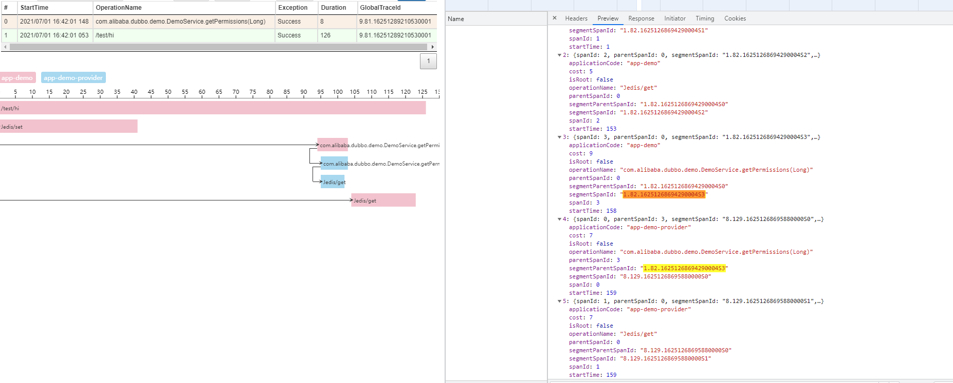
String segmentSpanId = segmentId + Const.SEGMENT_SPAN_SPLIT + String.valueOf(spanId);
String segmentParentSpanId = segmentId + Const.SEGMENT_SPAN_SPLIT + String.valueOf(parentSpanId);

Slide 13
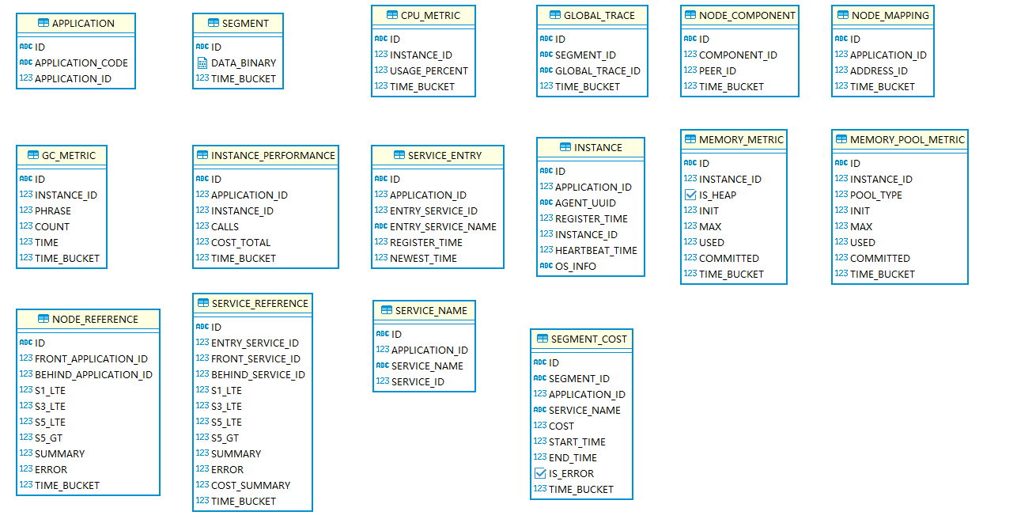
数据存储
tracesegment 二进制存储
traceId查詢

