Slide 1
Hunan Face Recognition Using Sparse Coding
Peng Li, Hong Guo
Columbia University

Slide 2
Motivation
Sparse coding has emerged as a much better performance comparing to traditional vector quantization.
Previous research results showed that the power of sparse coding is at encoding phase.
Sparse coding has achieved state-of-the-art performance in object image recognition. In our experiment, we are trying to apply sparse coding technique to different and extensive human face databases.

Slide 3
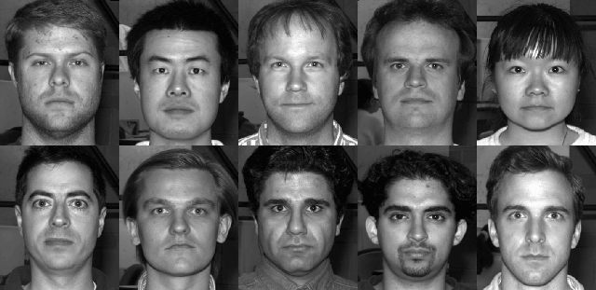
Resources of Datasets
The Yale Face Database B: 16128 images of 28 human subjects.

Slide 4


Resources of Datasets
Labeled Face in the Wild: more than 13000 images of faces. The images are also aligned in different ways: funneled images and deep funneled images.

Slide 5
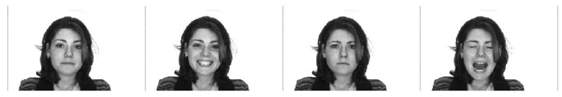
Resources of Datasets
The Facial Recognition Technology (FERET) :
14051 human heads from different angle of views
AR database: 4000 color images of 126 people’s faces with different facial expression

Slide 6
Workflow for Our Experiment
Various
Learning
Models
Raw Image Representation
Image Patches
Dictionary
Sparse
Coding
Ridge
Regression
Pooling
Classification Results
Image Representation
Encoded Image Patches

Slide 7
Results

Slide 8
Discussion and Future Direction
Our results have state-of-the-art performance on those four databases.
May incorporate second-order pooling or

