Slide 1
Design Patterns
Guohua Liu

Slide 2
Builder
Factory
Abstract Factory
Prototype
Singleton
Adapter
Bridge
Composite
Decorator
Facade
Flyweight
Proxy
Chain of Responsibility
Command
Interpreter
Iterator
Mediator
Observer
Memento
State
Strategy
Template Method
Visitor
Model-View-Controller (MVC)
Object Pool
Curiously Recurring Template

Slide 3
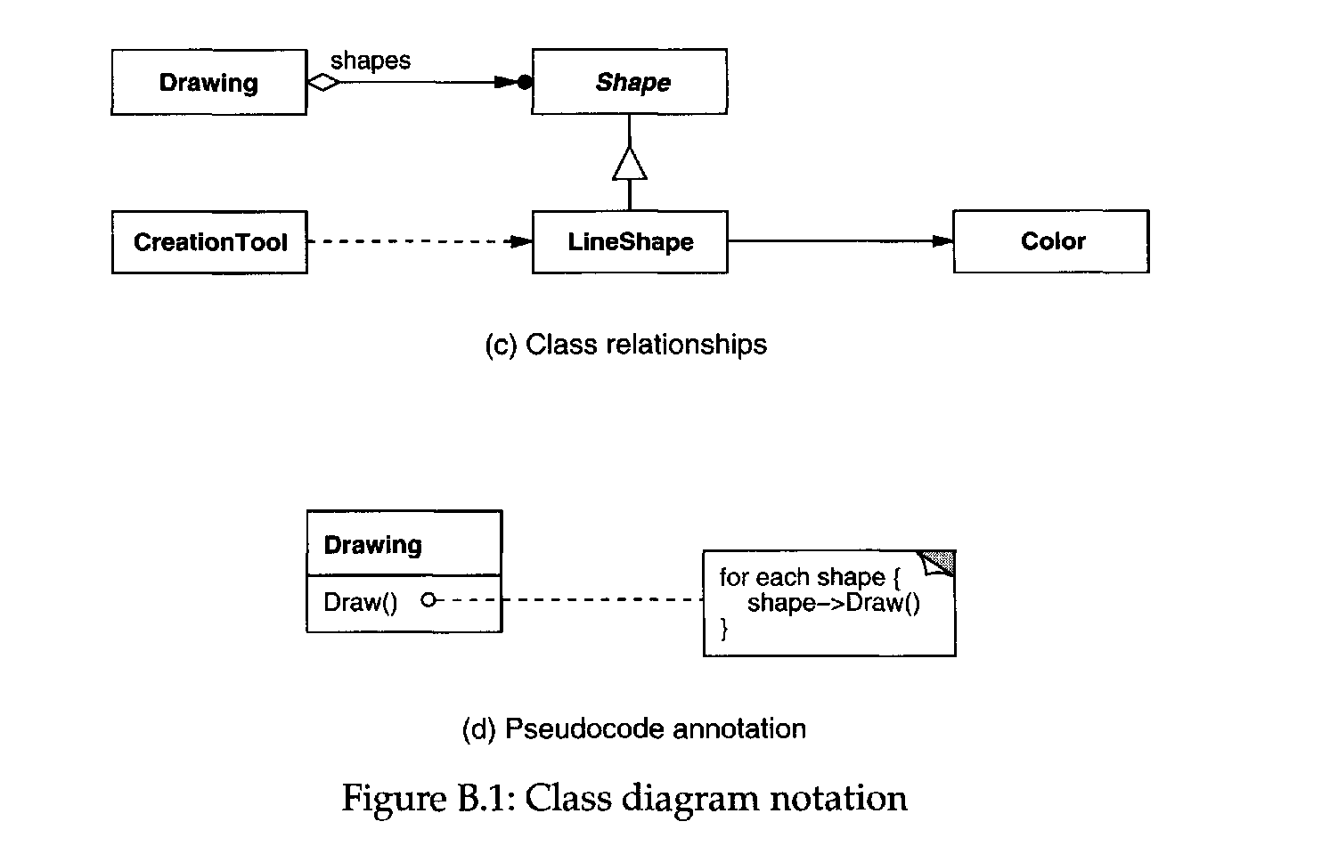
many
Aggregates
acquaitance (object reference)
Creates
one

Slide 4
Diagram Notations: Class and Object
All notations are From [1].
Class Name

Slide 5
Builder
The Builder Creational Pattern is used to separate the construction of a complex object from its representation so that the same construction process can create different objects representations.
Problem: We want to construct a complex object, however we do not want to have a complex constructor member or one that would need many arguments.
Solution: Define an intermediate object whose member functions define the desired object part by part before the object is available to the client. Builder Pattern lets us defer the construction of the object until all the options for creation have been specified.
PizzaBuilder
unique_ptr<Pizza> m_pizza;
virtual void buildDough() = 0;
virtual void buildTopping() = 0;
void createNewPizza();
Pizza* getPizza();
Pizza
string m_dough
string m_topping
void setDough(const string& dough);
void setTopping(const string& topping);
void open() const;
m_pizza = make_unique<Pizza>();
return m_pizza.release();
m_dough = dough;
m_topping = topping;
HawaiianPizzaBuilder
virtual void buildDough();
virtual void buildTopping();
cout << “Pizza with:”
<< m_dough << “and” <<
m_topping << endl;
m_pizza.setDough(“cross”);
m_pizza.setTopping(“ham+pinApple”);
SpicyPizzaBuilder
virtual void buildDough();
virtual void buildTopping();
m_pizza.setDough(“pan baked”);
m_pizza.setTopping(“pepperoni+salami”);

Slide 6
Builder
My understanding:
Pizza is the complex object, the constructor of which need parameters of pizza
type (or dough and topping types).
The build of Pizza is deferred to the Client who specify all the options, i.e,
PizzaBuilder types, for creation.
Function openPizza() makes Pizza available to Client.
“Cook” is the “Director” in the UML next page. But I think a method “cook” can be
created in Builder parent class, which call “buildDough” and “buildTopping”.
TBD: the pattern is not like this?
Cook
PizzaBuilder* m_pizzaBuilder
void openPizza()
void makePizza(PizzaBuilder* pb)
m_pizzaBuilder->getPizza()->open();
m_pizzaBuilder = pb;
m_pizzaBuilder->createNewPizza();
m_pizzaBuilder->buildDough();
m_pizzaBuilder->buildTopping();
Client
int main()
Cook cook;
HawaiianPizzaBuilder hawaiianPizzaBuilder;
SpicyPizzaBuilder spicyPizzaBuilder;
cook.makePizza(&HawaiinPizzaBuilder);
cook.openPizza();
cook.makePizza(&spicyPizzaBuilder);
cook.openPizza();

Slide 7

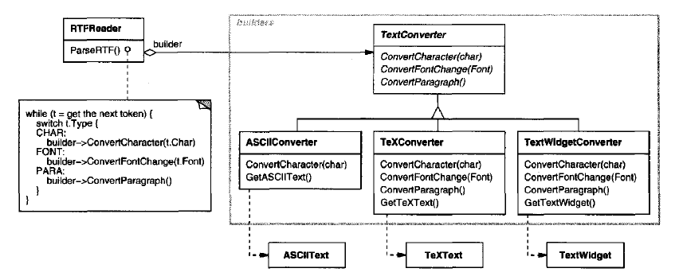
Builder

Slide 8
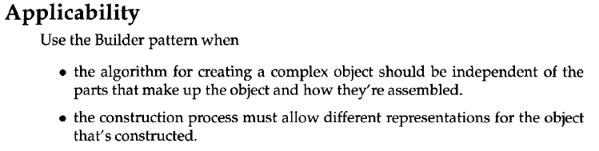
Builder

Slide 9
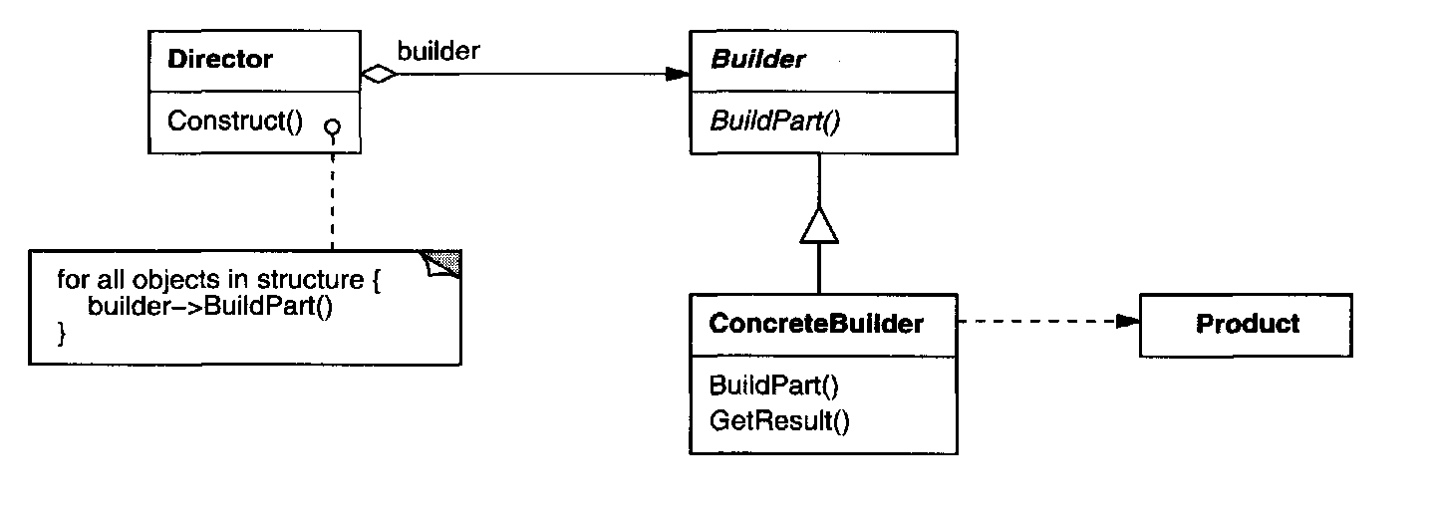
Builder
Structure

Slide 10
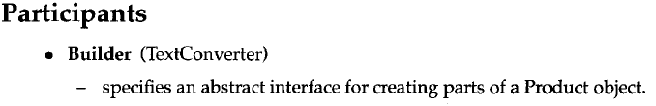
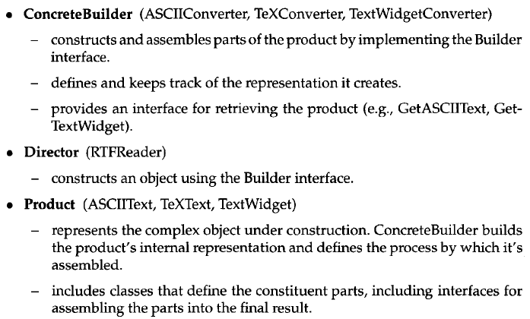
Builder

Slide 11
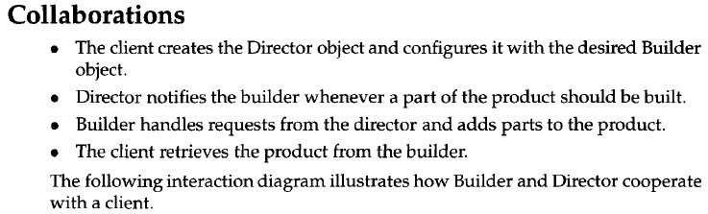
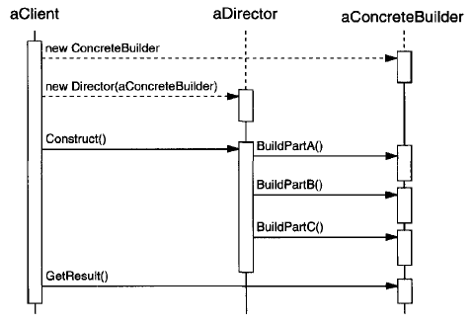
Builder

Slide 12
Builder
Keys:
- Builder has methods to build parts of Product (usually no or less parameters needed);
- Builders are derived from a common class;
- Director has a method calling all methods in Builder;
- Structure diagram key point: Director and Produce are separated by Builder;

Slide 13
Factory
Definition: A utility class that creates an instance of several families of classes. It can also return a factory for a certain group.
Problem: We want to decide at run time what object is to be created based on some configuration or application parameter. When we write the code, we do not know what class should be instantiated.
Solution: Define an interface for creating an object, but let subclasses decide which class to instantiate. Factory Method lets a class defer instantiation to subclasses.
Computer
virtual void Run() = 0;
ComputerFactory
static Computer* newComputer(const string& description)
if(description == “laptop”{
return new Laptop;
}
if(description == “desktop”{
return new Desktop;
}
Laptop
bool m_Hibernating;
void Run() override;
Laptop
bool mHibernating;
void Run() override;
m_Hibernating = false;
Desktop
bool m_On;
void Run() override;
Laptop
bool mHibernating;
void Run() override;
m_on = true;

Slide 14
Factory
Client
int main();
ComputerFactory computerFactory;
string description = “laptop”;
computerFactory.newComputer(description);
description = “desktop”;
computerFactory.newComputer(description);
My understanding:
Factory pattern focuses on that a factory can build different products;
Builder pattern focuses on that builder avoid the use of the parameters for
product construction;

Slide 15
Factory
Second Example
Keys:
- Factory has Factory Method which may take a parameter to determine what Product to produce;
- Products are derived from a common class which is the return type of the Factory Method;
- Subclasses override Factory Method, which really create objects;
Computer
virtual void Run() = 0;
ComputerFactory
static Computer* newComputer() = 0;
Laptop
same as before;
Laptop
same as before
LaptopFactory
static Computer* newComputer()
return new Laptop;
Desktop
same as before;
Laptop
same as before
LaptopFactory
static Computer* newComputer()
return new Laptop;
Client
int main();
ComputerFactory computerFactory;
…
// at this point computerFactory should be instantiated to a
// derived class;
// How to get instantiated is out of consideration of the
// design pattern;
computerFactory.newComputer();

Slide 16
Factory
Keys:
- Above are examples are from Wiki page which are not what the book have;
- See the book Examples and Structure in subsequent slides;
- Factory has Factory Method which may take a parameter to determine what Product to produce;
- Products are derived from a common class which is the return type of the Factory Method;

Slide 17

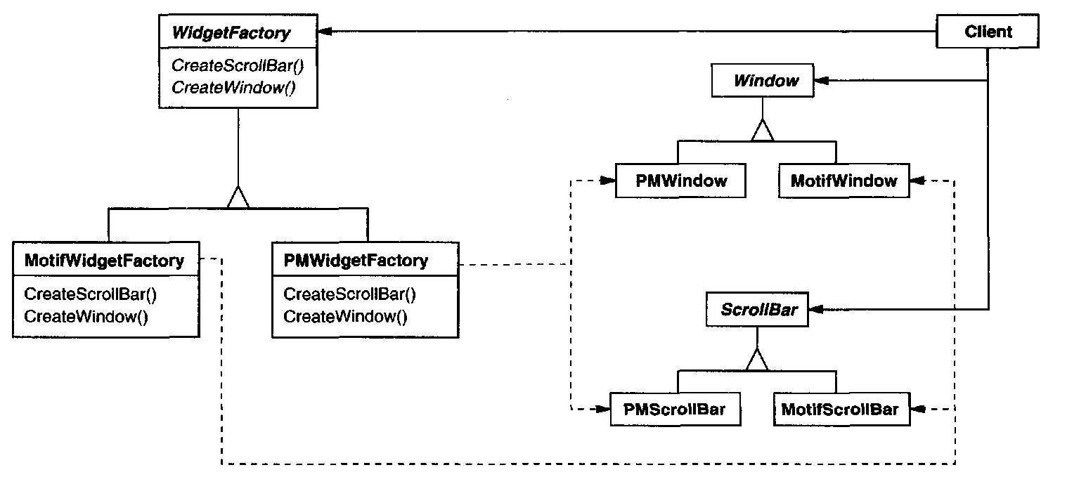
Abstract Factory

Slide 18
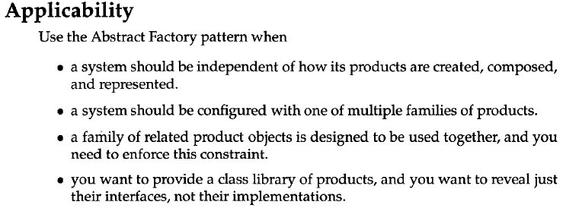
Abstract Factory

Slide 19
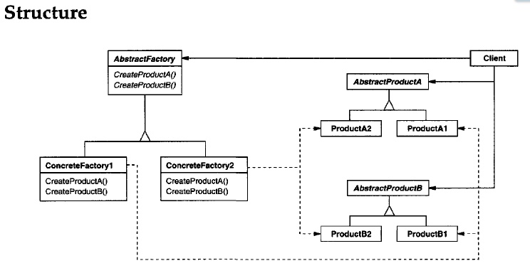
Abstract Factory

Slide 20
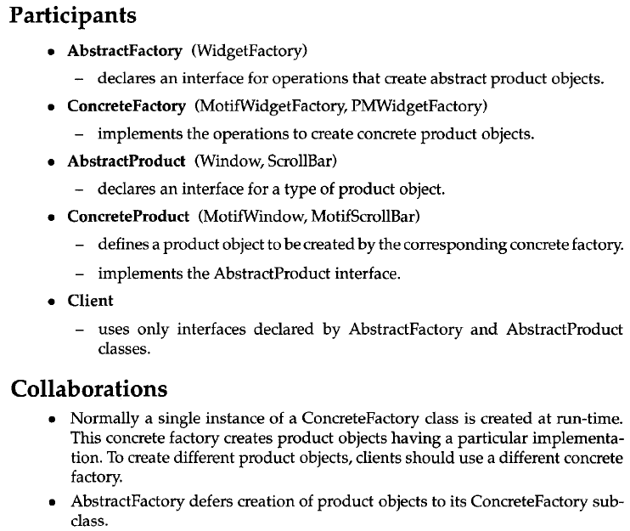
Abstract Factory

Slide 21

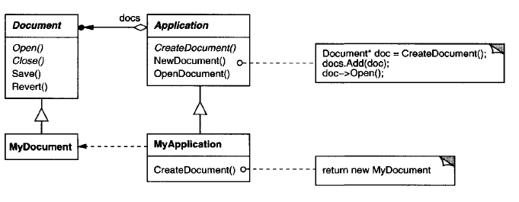
Factory Method

Slide 22
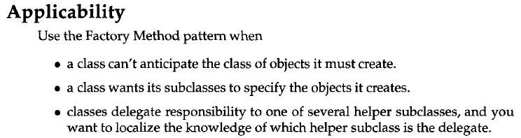
Factory Method
Abstract Factory:
- facilitate create a family of sub-products;
- creatation procedure of the product is shared by differenct concreate Factory;
- Abstract Factory is used as parameter to configure the creator;
Factory Method:
- delay instantiation to sub-classes;
- creatation procedure of the product is shared by different concrete product;
Builder:
- creaation procedure of the product may be different for concrete products;
- Bilder is use as parameter to configure the creator;

Slide 23
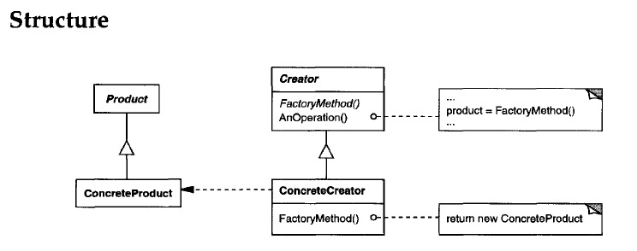
Factory Method `

Slide 24
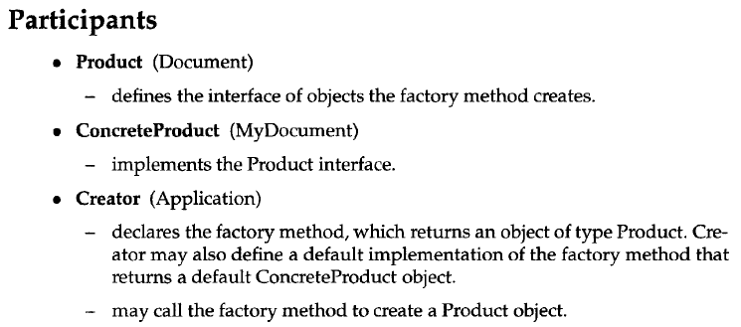
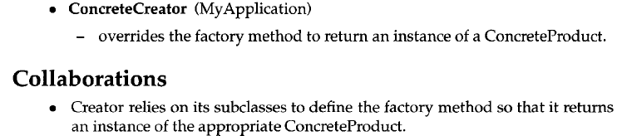
Factory Method

Slide 25
Factory Method
Keys:
- Factory has Factory Method which may take a parameter to determine what Product to produce;
- Products are derived from a common class which is the return type of the Factory Method;
- Subclasses override Factory Method, which really create objects;
- Structure diagram key: (1) Creator has FactoryMethod and AnOperation where “product” is referenced; (2) ConcreteCreater inherits Creater's AnOperation while has its own FactoryMethod, so that the Product referenced in its AnOpertaion is created using the ConcreteCreater's FactoryMethod

Slide 26
Prototype
A prototype pattern is used in software development when the type of objects to create is determined by a prototypical instance, which is cloned to produce new objects. This pattern is used, for example, when the inherent cost of creating a new object in the standard way (e.g., using the new keyword) is prohibitively expensive for a given application.
Implementation: Declare an abstract base class that specifies a pure virtual clone() method. Any class that needs a "polymorphic constructor" capability derives itself from the abstract base class, and implements the clone() operation. The client, instead of writing code that invokes the new operator on a hard-wired class name, calls the clone() member function on the prototype, calls a factory member function with a parameter designating the particular concrete derived class desired, or invokes the clone() member function through some mechanism provided by another design pattern.
Record
virtual unique_ptr<Record> clone() = 0;
RecordFactory (Client)
map<RecordType, Record*> mp;
RecordFactory();
Record* createRecord(RecordType recordType);
mp[CAR] = new CarRecord(“Ferrari”, 05);
mp[PERSON] = new PersonRecrd(“Tom”, 25);
CarRecord
string m_name;
int m_id;
CarRecord(string name, int id);
Record* clone() override;
mp[recordType]->clone();
m_name = name;
m_id = id;
return this;
enum RecordType{
CAR;
PERSON;
};
PersonRecord
string m_name;
int m_age;
PersonRecord(string name, int age);
Record* clone() override;
m_name = name;
m_age = age;
return this;

Slide 27
Prototype
My understanding:
RecordFactory does not call constructor (“new” operator) of any
concrete Record; All constructions are done by “clone”; Using
RecordType as an argument to determine which clone to use;
In Factory Pattern, the operator “new” is used;
The “expensive” mentioned in the Introduction of last page is inappropriate.
To be more appropriate: the arguments needed to create an object might not
be available to a client. Here, “arguments” are “name”, “id”, “age”;
“client” is RecordFactory.
Refer the example of Prototype pattern in the book for a better introduction.
FinalClient
int main();
RecordFactory recordFactory;
auto record = recordFactory.createRecord(CAR);
record = recordFactory.createRecord(PERSON);

Slide 28

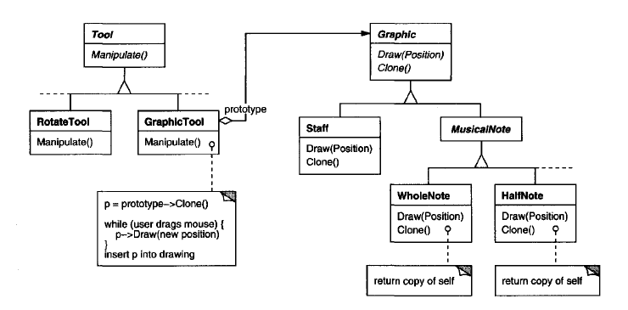
Prototype

Slide 29
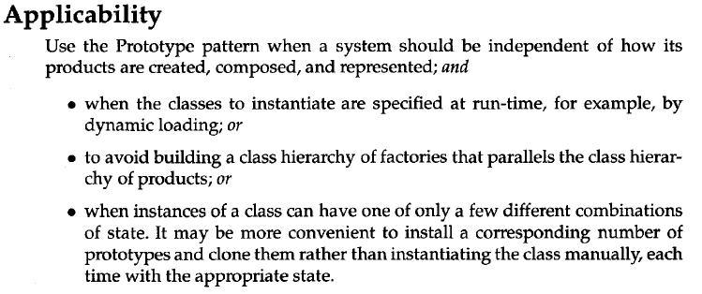
Prototype

Slide 30
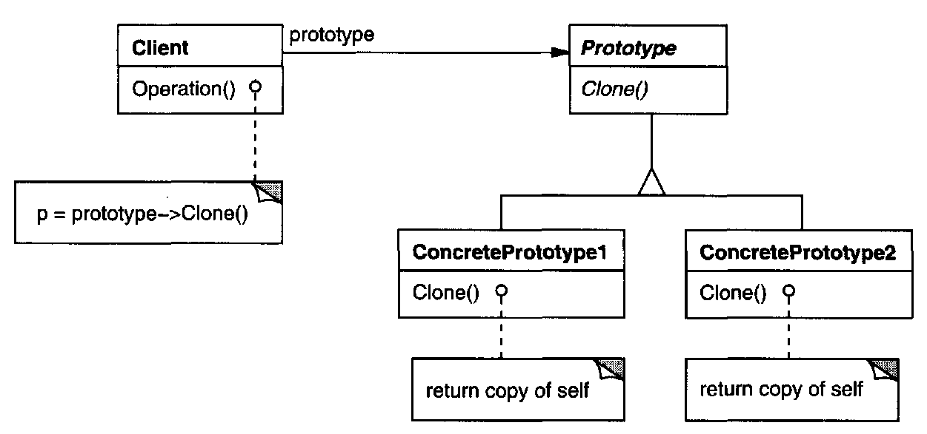
Prototype
Structure

Slide 31
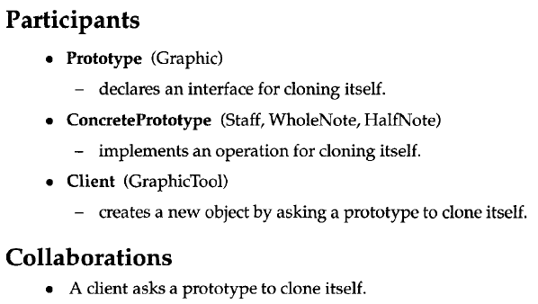
Prototype

Slide 32
Prototype
Keys:
- Prototype class has a clone() method;
- Client use Prototype object;
- Client calls its Protoype::clone() to create Prototype objects;
- concrete clone() method returns “copy of self”;

Slide 33
Singleton
The Singleton pattern ensures that a class has only one instance and provides a global point of access to that instance. This is useful when exactly one object is needed to coordinate actions across the system.
Check list:
- Define a private static attribute;
- Define a public static accessor function;
- Do “lazy initialization” (creation on first use) in the accessor function;
- Define all constructors to be protected or private;
- Clients may only use the accessor function to manipulate the Singleton;
StringSingleton
private: string mString;
public: string getString();
public: static StringSingleton& Instance();
private: StringSingleton(){};
private: StringSingleton(const StringSingleton &old);
const StringSingleton &operator=(const const StringSingleton &old);
~StriingSingleton(){};
//private data for an instance of this class, itself;
// The magic function, which allows access to the class from anywhere
// To get the value of the instance of the class, call:
// StringSingleton::Instance().GetString();
//accessor functions for the class
return mString;
// This line only runs once, thus creating the only instance in existence
static std::auto_ptr<StringSingleton> instance( new StringSingleton );
// dereferencing the variable here, saves the caller from having to use
// the arrow operator, and removes temptation to try and delete the
// returned instance.
return *instance; // always returns the same instance
// see next page;
Did not understand:
- why is GetString is “for the class, itself”; it is “public”??
- why is “instance” “This line only runs once”; it can be called 2 times as:
string s1 = StringSingleton::instance();
string s2 = StringSingleton::instance();?? (I have tried this in VS!)
- answer: there should be a “private: static StringSingleton m_stringSingleton where the keyword “static”
guarantee only 1 “mstring” is generated.
refer: https://stackoverflow.com/questions/28927030/how-to-guarantee-only-one-instance-of-a-class-through-singletons
- answer: the static local variable “instance” in the function guarantees that only 1 SringSingleton instance exists during the
the lifetime of the program.

Slide 34
Singleton
// default constructor available only to members or friends of this class;
StringSingleton
private: string mString;
public: string getString();
public: static StringSingleton& Instance();
private: StringSingleton(){};
private: StringSingleton(const StringSingleton &old);
const StringSingleton &operator=(const const StringSingleton &old);
~StriingSingleton(){};
// Note thest two functions are not given bodies, thus any attempt
// to call them implicitly will return as compiler errors. This prevents
// accidental copying of the only instance of the class.
// Note that although this should be allowed,
// some compilers may not implement private destructors
// This prevents others from deleting our one single instance,
// which was otherwise created on the heap;

Slide 35
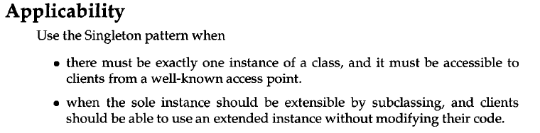
Singleton

Slide 36
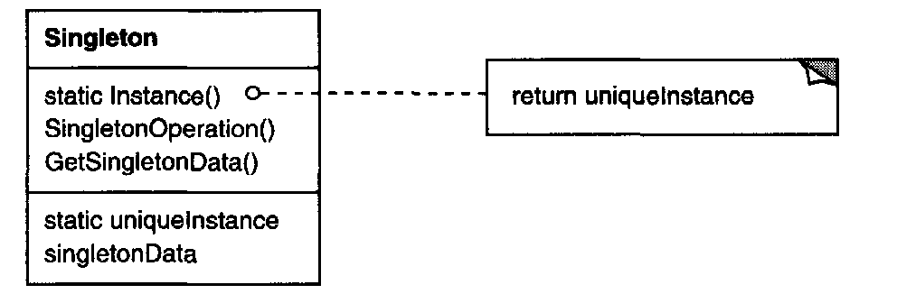
Singleton
Structure

Slide 37
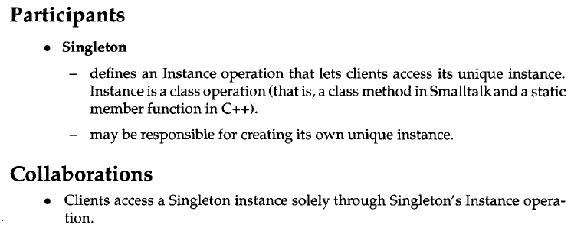
Singleton

Slide 38
Singleton
Keys:
- Singleton class has a static member variable;
- Singleton class has a static instantiation function to create a static object – this function must be “static”, otherwise there is no way to create a singleton instance, since no default constructor or constructor is available;
- Singleton class has public accessor function to access the member variable in singleton object;
- Define all Constructors (default, copy, assign) to be Protected or Private;

Slide 39
Adpater
Convert the interface of a class into another interface that clients expect. Adapter lets classes work together that couldn't otherwise because of incompatible interfaces.
This inheritance enables MuslimAdpater
perform Muslim Ritual, which further enables
HinduFemale perfrom Muslim Ritual;
MuslimRitual
void carryOutRitual(Muslim* muslim);
Muslim
virtual void performMuslimRitual() const = 0;
Muslim
virtual void performMuslimRitual() const = 0;
cout << “On with the Muslim rituals!” << endl;
muslim->performMuslimRitual();
MuslimFemale
virtual void performMuslimRitual();
MuslimFemale
virtual void performMuslimRitual();
MuslimAdapter
Hindu* hindu;
void performMuslimRitual();
cout << “Muslim girl performs Muslim ritual” << endl;
cout << “Muslim girl performs Muslim ritual” << endl;
Muslim
virtual void performMuslimRitual() const = 0;
Hindu
virtual void performHinduRitual() const = 0;
hindu->performHinduRitual();
MuslimFemale
virtual void performMuslimRitual();
HinduFemale
virtual void performHinduRitual();
cout << “Hindu girl performs Hindu ritual” << endl;

Slide 40
Adpater
Client
int main()
HinduFemale* hinduGirl =new HinduFemale;
MuslimRitual muslimRitual;
// this will not compile;
// muslimRitual.carryOutRitual(hindu);
// hinduGirl is adapted to a Muslim!
MuslimAdapter* adaptedHindu = new MuslimAdapter(hinduGirl);
// hinduGirl can do Muslim ritual now!
muslimRitual.carrayOutRitual( adaptedHindu );

Slide 41

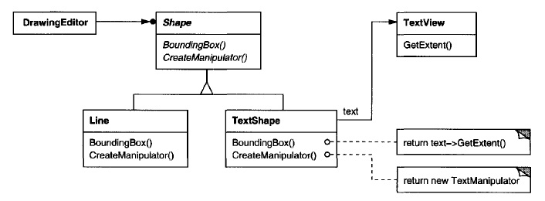
Adpater

Slide 42
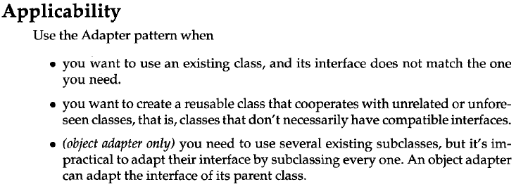
Adpater

Slide 43
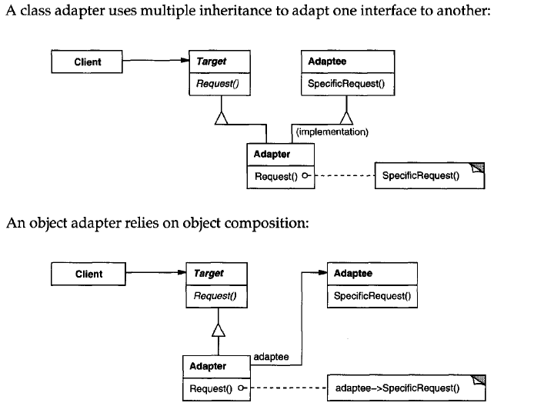
Adpater
Structure

Slide 44
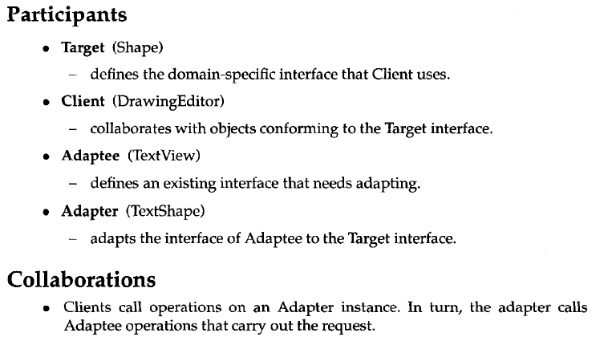
Adpater

Slide 45
Adpater
Key points:
- Adapter is derived from Target class;
- Adpatee is a member variable of Adapter;
- targetFunction is overrided in Adpater as Adaptee->targetFunction();
- Adapter enables Adaptee to do targetFunction;

Slide 46
Bridge
The Bridge Pattern is used to separate out the interface (abstraction) from its implementation. Doing this gives the flexibility so that both can vary independently. Refer the Book for a better Motivation
Circle
double m_x;
double m_y;
double m_r
DrawingAPI* m_drawingAPI;
Circleshape(double x, double y, double r, DrawingAPI* drawingAPI);
void draw();
DrawingAPI
virtual void drawCircle(double x, double y, double r) = 0;
DrawingAPII
void drawCircle(double x, double y, double r) ;
cout << “API1.circle at” << x << “:” << y << ' ' << r << endl;
drawingAPI->drawCircle(m_x, m_y, m_r);
My understanding:
Circle is the “interface” (more properly, “abstraction”) and DrawingAPI is the
“implementation” mentioned in the introduction. Circle does not care how
DrawingAPI draw a Circle;
This example shows that the “implementation” can vary independent of “abstraction”;
it is not show how the “abstraction” can vary independent of “implementation”. Refer
the book's “Window” example for the latter.
The key in this Pattern is:
- Separate how to Draw a circle (DrawingAPI) from Circle;
- “Bridge” them together by makding DrawingAPI a member variable of Circle;
DrawingAPI2
void drawCircle(double x, double y, double r) ;
cout << “API2.circle at” << x << “:” << y << ' ' << r << endl;

Slide 47
Bridge
Client
main()
Circle circle1(1, 2, 3, new DrawingAPI1());
Circle circle2(5, 7, 11, new DrawingAPI2());
circle1.draw();
circle2.draw();

Slide 48

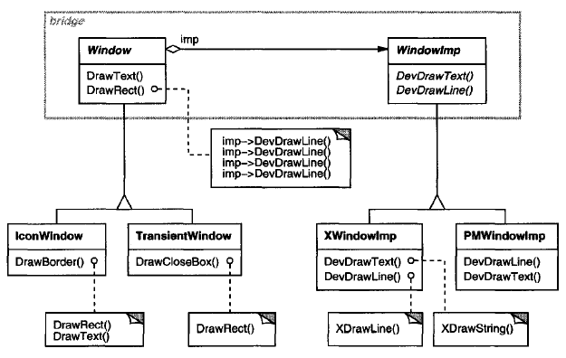
Bridge

Slide 49
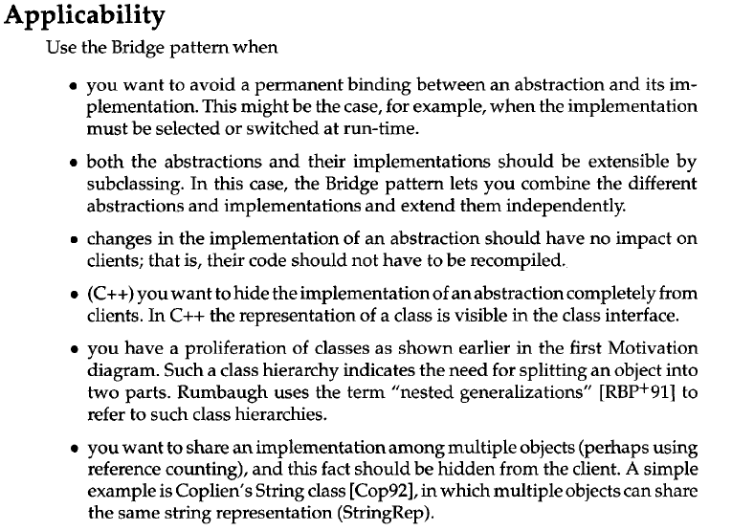
Bridge

Slide 50
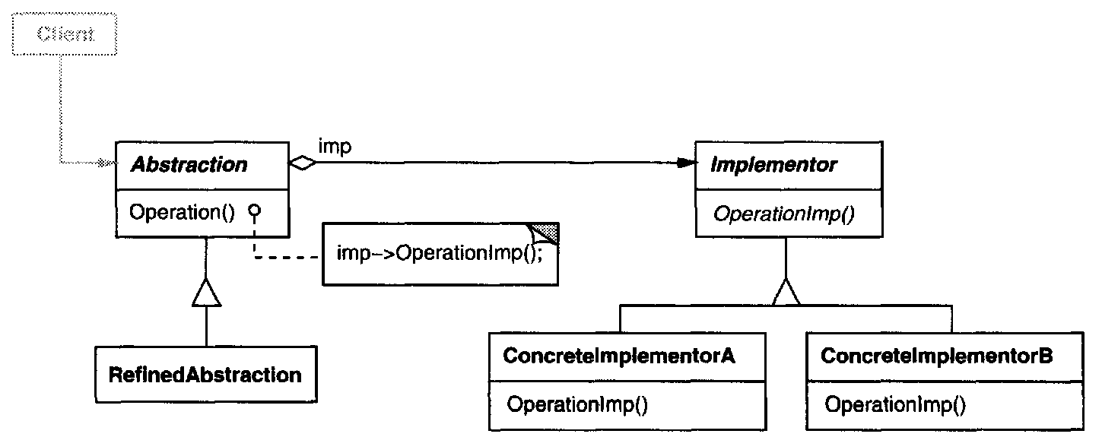
Bridge
Structure

Slide 51
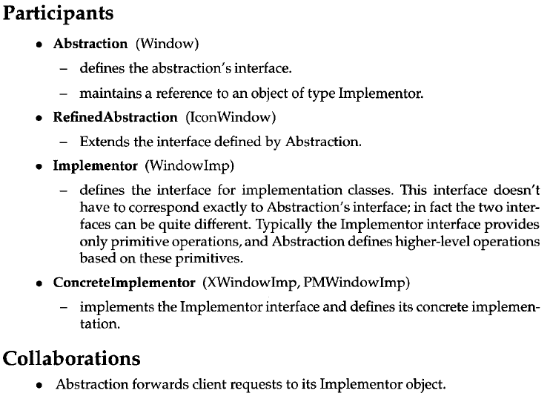
Bridge

Slide 52
Bridge
Key Points:
- make Implementor class;
- Implementor has a method which is the implementation;
- add an Implementor member variable to Interface class;
- Implemtation member variable is the bridge between Interface and Implementation

Slide 53
Composite
Composite lets clients treat individual objects and compositions of objects uniformly. The Composite pattern can represent both the conditions. In this pattern, one can develop tree structures for representing part-whole hierarchies.
According to the book, Composite patter is used when
- you want to represent part-whole hierarchies of objects;
- you want clients to be able to ingore the difference between
compositions of objects and individual objects;
Graphic
virtual void print() = 0;
Ellipse
void print()
cout << “Ellipse \n” << endl;
CompositeGraphic
vector<Graphic*> graphicList_;
void print();
void add(Graphic* aGraphic);
for(Graphic* g : graphicList_){
g->print();
}
graphicList_.push_back(aGraphic);

Slide 54
Composite
Note in the Client conde:
- client ignore print() details of CompositeGraph and Ellipse;
- get() will return *this (it is omitted from respective classes since
it is not the key idea of the Composite pattern);
const Ellipse* ellipse1 = new Ellipse();
const Ellipse* ellipse2 = new Ellipse();
const Ellipse* ellipse3 = new Ellipse();
CompositeGraphic* graphic = new CompsiteGraphic();
CompositeGraphic* graphic1 = new CompositeGraphic();
CompositeGraphic* graphic2 = new CompositeGraphic();
graphic1->add(ellipse1.get());
graphic2->add(ellipse2.get());
graphic->add(graphic1.get());
graphic->add(graphic2.get());
graphic->print();
Client
main()

Slide 55

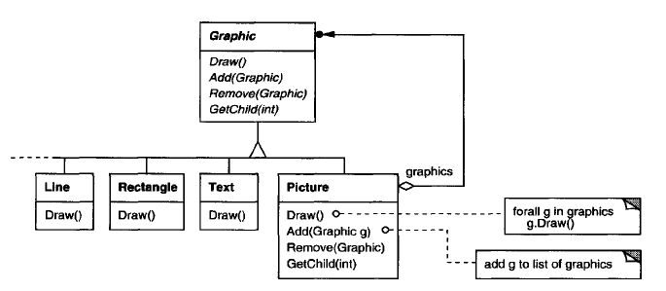
Composite

Slide 56
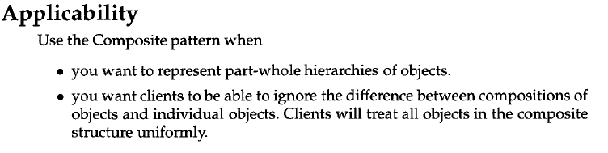
Composite

Slide 57
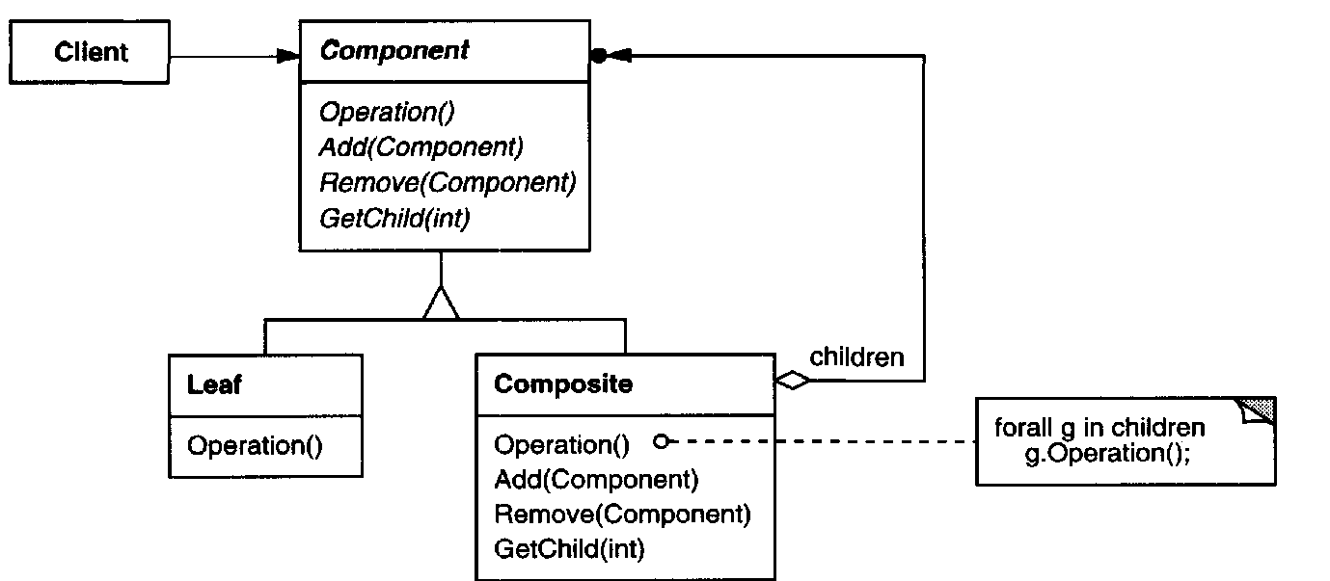
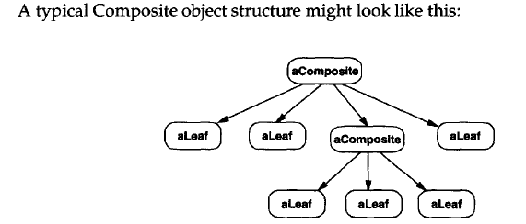
Composite
Structure
Component is the Graphic;
Leaf is the Ellipse;

Slide 58
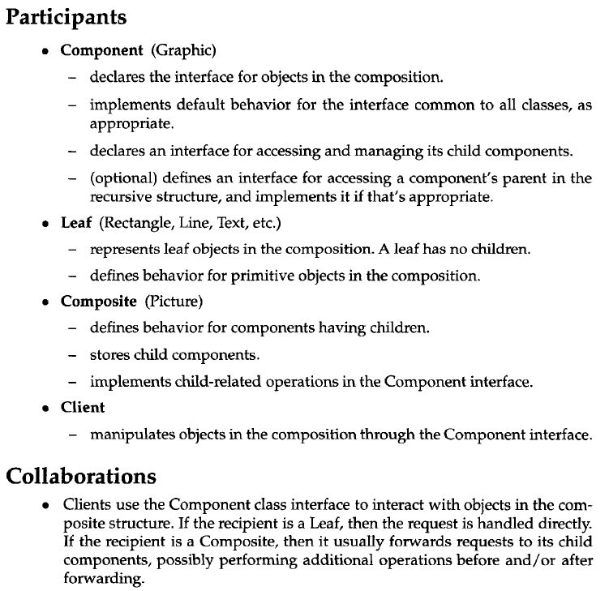
Composite

Slide 59
Composite
Key:
- Composite class is dervied from the Base Class of Individual Class;
- Composite class has a list of Individuals;
- Composite's targetFunction calls Individual's targetFunction;

Slide 60
Decorator
The decorator pattern helps to attach additional behavior or responsibilities to an object dynamically and transparently. Decorators provide a flexible alternative to subclassing for extending functionality. This is also called “Wrapper”. If your application does some kind of filtering, then Decorator might be good pattern to consider for the job.
Car
virtual double getCost() = 0;
OptionsDecorator
// no member variable or functions // specific to this abstract class
Navigation
car* m_b;
double getCost();
CarModel1
double getCost();
return 372 + m_b->getCost();
return 31000;
ManualTransmission
car* m_b;
double getCost();
return 25 + m_b->getCost();
Note:
OptionsDecorator and CarModel has same base class, this provides
transparency to client. Transparency lets you nest decoration recursively, there by allowing an unlimited number of added options. It allows OptionsDecorator appears anywhere CarModel1 can. refer [1] for this.
Note:
OptionsDecorator does not implement the pure virtual function getCost(), therefore it is an Abstract Class;

Slide 61
Decorator
// basic car;
Car *b = new CarModel1();
b->getCost();
// better car;
b = new Navigation(b);
b->getCost();
// even better car;
b = new ManualTransmission(b);
b->getCost();
Client
main()

Slide 62

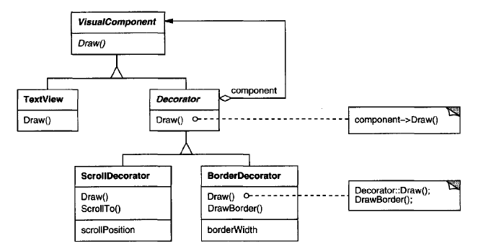
Decorator

Slide 63
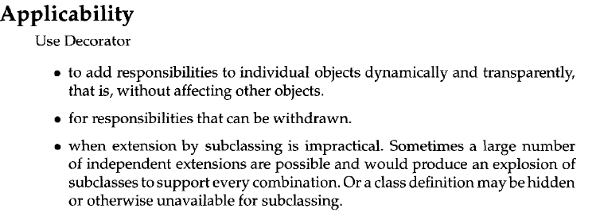
Decorator

Slide 64
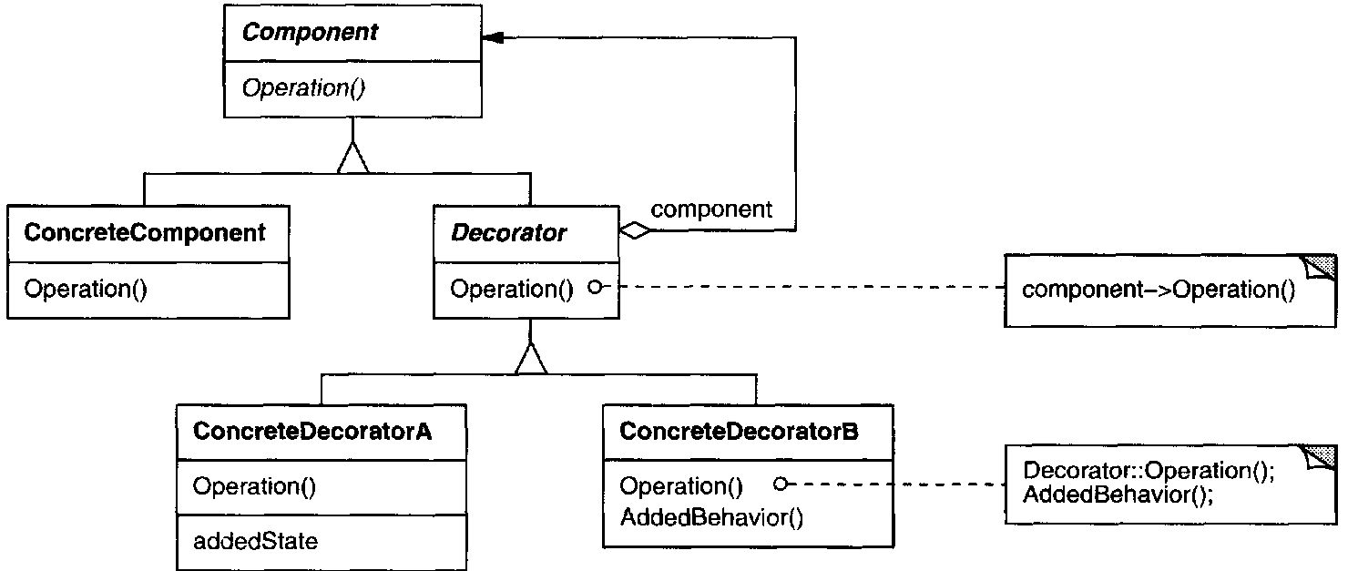
Decorator
Note:
Decorator::Operation() is optional;
It is not in my example;
Structure

Slide 65
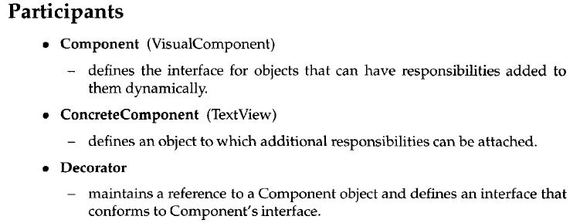
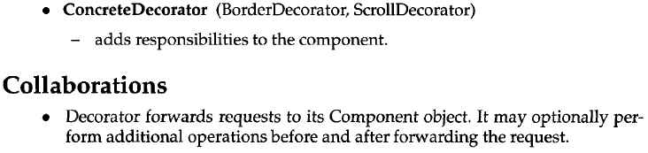
Decorator

Slide 66
Decorator
Key:
- Decorator and Decoratee share the same Base Class;
- Decorator class has additional functions;
- Decorator class has a Decoratee member variable;
- Decorator class has the function that is Decoratee's function + additional functions;

Slide 67
Facade
The Facade Pattern hides the complexities of the system by providing an interface to the client from where the client can access the system on a unified interface.
Alarm
void alarmOn();
void alarmOff();
cout << “Alarm is on” << endl;
cout << “Alarm is off” << endl;
HouseFacade
Alarm m_alarm;
AC m_ac;
void goToWork();
void comeHome();
m_alarm.alarmOn();
m_ac.acOff();
Ac
void acOn();
void acOff();
m_alarm.alarmOff();
m_ac.acOn();
cout << “Ac is on” << endl;
cout << “Ac is off” << endl;

Slide 68
Facade
Client
main()
HouseFacade hf;
hf.goToWork();
hf.comeHome();

Slide 69

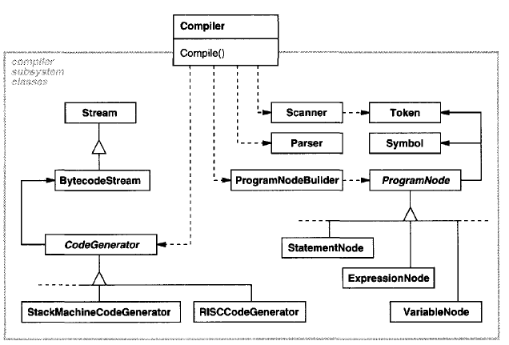
Facade

Slide 70
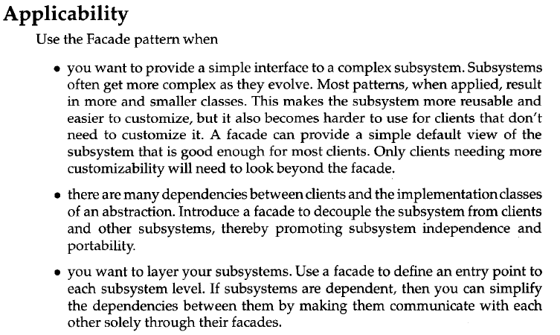
Facade

Slide 71
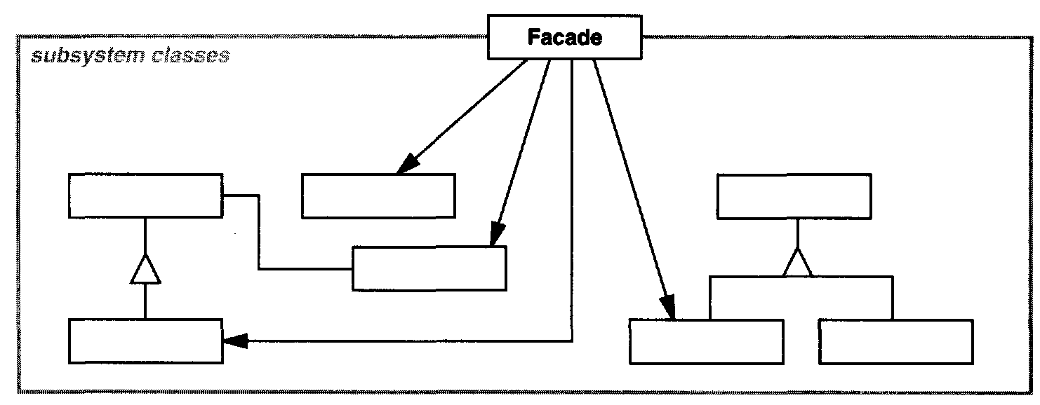
Facade
Structure
TODO: check [1] to see why the boxes are blank;

Slide 72
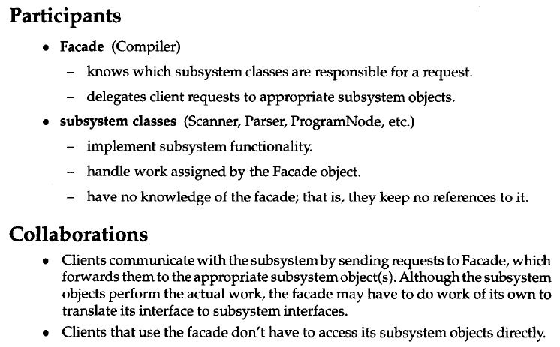
Facade

Slide 73
Facade
Key:
- Facade function call Subsystem's functions;
- Clients send requrests to to Facade;

Slide 74
Flyweight
The pattern for saving memory (basically) by sharing properties of objects. Imagine a huge number of similar objects which all have most of their properties the same. It is natural to move these properties out of these objects to some external data structure and provide each object with the link to that data structure.
FlyweightCharBuilder
public: static vector<float> m_fontSizes;
public: static vector<string> m_fontNames;
static void setFontsAndNames();
static FlyweightChar createFlyweightChar( unsigned short fontSizeIndex, unsighed short fontNameIndex);
vector<float> FlyweightCharBuilder::m_fontSizes(2);
vector<string> FlyweightCharBuilder::m_fontNames(2);
m_fontSizes[0] = 1.0;
m_fontSizes[1] = 1.5;
m_fontNames[0] = font1;
m_fontNames[1] = font2;
FlyweightChar fc(fontSizeIndex, fontNameIndex);
return fc;
FlyweightChar
unsigned short fontSizeIndex;
unsigned short fontNameIndex;
FlyweightChar( unsigned short fontSizeIndex, unsigned short fontNameIndex);

Slide 75
Flyweight
vector<FlyweightChar> chars;
FlyweightCharBuilder::setFontsAndNames();
for (unsigned short i = 0; i < 1000; i++) {
chars.push_back(FlyweightCharBuilder::createFlyweightChar(0, 0, i));
chars.push_back(FlyweightCharBuilder::createFlyweightChar(1, 1, i + 1 * limit));
chars.push_back(FlyweightCharBuilder::createFlyweightChar(2, 2, i + 2 * limit));
}
/*
Each char stores links to its fontName and fontSize so what we get is:
each object instead of allocating 6 bytes (convention above) for string
and 4 bytes for float allocates 2 bytes for fontNameIndex and fontSizeIndex.
That means for each char we save 6 + 4 - 2 - 2 = 6 bytes.
we will have 2 groups of chars with 1000 chars in each group which will save
2 * 1000 * 6 - (2 * 6 + 2 * 4) = 11980 saved bytes.
2 * 6 + 2 * 4 is a number of bytes allocated by FlyweightCharBuilder.
*/
Client
main()

Slide 76
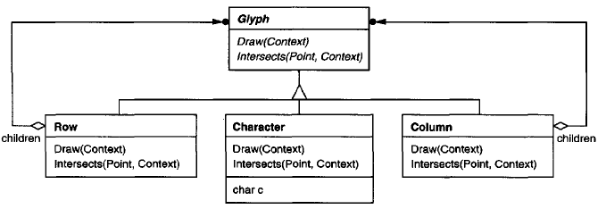

Flyweight
From the book: “The key concept here is the distinction between intrinsic and extrinsic state. Intrinsic state is stored in the flyweight, it consists of information that's independent of the flyweight's context, thereby making it sharable. Extrinsic depends on and varies with the flyweight's context and therefore can't be shared. Client object is responsible for passing extrinsic state to the fly weigh when it needs it.
Pevious page presents an example from Wikipage which is not as good as the example in this page which is from the book, since the FontSizes and FontNames are better to be considered as extrinsic state.
Considering the example in next page demonstrate the sharing of FontSizes and FontNames that saves memory, keep the example.

Slide 77
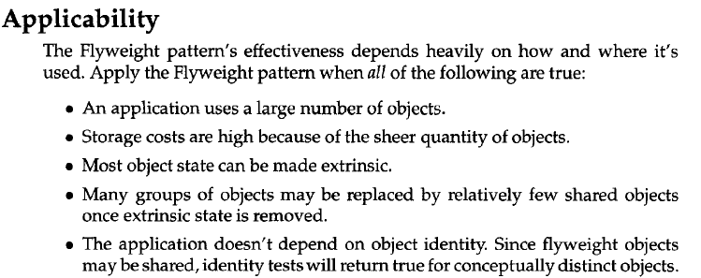
Flyweight

Slide 78
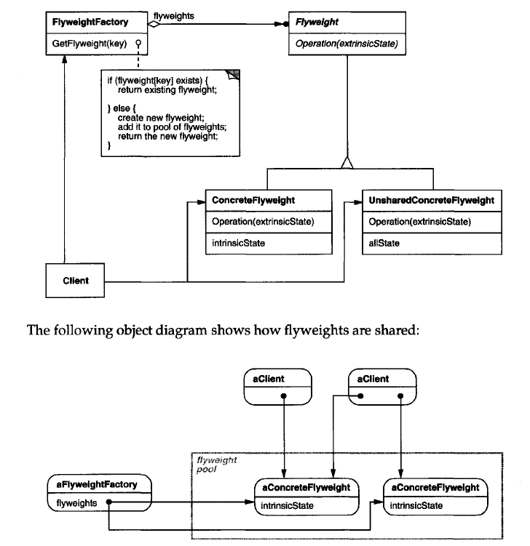
Flyweight
Structure
My understanding:
FontName and FontSize are instrinsicState;
createFlyWeightChar is the counter part of GetFlyweight;

Slide 79
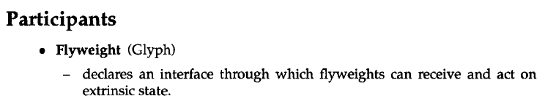

Flyweight

Slide 80

Flyweight

Slide 81
Flyweight
Key:
- FlyweightBuilder class contains common properties;
- FlyweightBuilder commont properties are (better to be) static;
- Flyweight class contains light-weight properties;
- Flyweight Builder build Flyweight objects;

Slide 82

Proxy
The Proxy Pattern will provide an object a surrogate or placeholder for another object to control access to it. It is used when you need to represent a complex object with a simpler one. If creation of an object is expensive, it can be postponed until the very need arises and meanwhile a simpler object can serve as a placeholder. This placeholder object is called the “Proxy” for the complex object.
- Draw() is expensive;
- GetExtent() is cheap;
- DocumentEditor may need the extent of an image but not necessarily the image, e.g., when open the document and format it;
- ImageProxy provide the extent without having to draw the image;

Slide 83
Proxy
Client
int main()
string imageFileName = “anImageFile.jpg”;
// cheap;
ImageProxy imageProxy(imageFileName);
// Document has a place-holder for Image;
Document document(imageProxy);
// Cheap:
int extent = document.getExtend();
// expensive; This may only be called at a few pages of a long document;
document.draw();

Slide 84


Proxy

Slide 85


Proxy

Slide 86

Proxy
Structure

Slide 87


Proxy

Slide 88

Proxy

Slide 89
Proxy
Key:
- Proxy constructor is cheaper than Subject constructor;
- Proxy has a function which, in turn, call the Subject's corresponding function;
- Client has a Proxy member variable;

Slide 90
Chain of Responsibility
Chain of Responsibility pattern has the intent to avoid coupling the sender of a request to its receiver by giving more than one object a chance to handle the request;
Handler
Handler* next;
virtual void request(int value) = 0;
SpecialHandler
int myLimit;
int myId;
void request(int value);
If(value < myLimit){
cout << “myId handle” << endl;
}
else{
next->request(value);
}

Slide 91
Chain of Responsibility
Client
int main()
Handler* h1 = new SpecialHandler(10, 1);
Handler* h2 = new SpecialHandler(20, 2);
h1->next = h2;
h1->request(18);

Slide 92




Chain of Responsibility

Slide 93

Chain of Responsibility

Slide 94

Chain of Responsibility
Structure

Slide 95


Chain of Responsibility

Slide 96
Chain of Responsibility
Key:
- HandlerBase class has a next Handler member variable;
- Handlers are derived from HandlerBase;
- Handler has a RequestHandling function (could be only defined in HandlerBase);
- RequestHandling function call next Handler's RequestHandling function;

Slide 97
Command
Decouples sender and receiver by encapsulating a request as an object, there by letting you parameterize clients with different requests, queue of log requests, and support undoable operations. It can also thought as an object oriented equivalent of call back method.
Call back: it is a function that is registered to be called at later point of time based on user actions.
Command
virtual void execute() = 0;
Light
void turnOn();
void turnOff();
FlipUpCommand
Light theLight;
execute();
theLight.turnOn();
FlipDownCommand
Light theLight;
execute();
theLight.turnOff();

Slide 98
Command
My understanding: “Requests” are flipUpCommand and flipDownCommand; Client (and Sender) is “Switch” and it does not know the details of Receiver which is “Light”.
Switch
Command& flipUpCommand;
Command& flipDownCommand;
void flipUp();
void flipDown();
flipUpCommand.execute();
flipDownCommand.execute();
Client
int main()
Light lamp;
FlipUpCommand switchUp(lamp);
FlipDownCommand switchDown(lamp);
Switch s(switchUp, switchDown);
s.flipUp();
s.flipDown();

Slide 99



Command

Slide 100


Command

Slide 101

Command
Structure

Slide 102



Command

Slide 103
Command
Key:
- Command has a Receiver member variable;
- Receiver has an Action function;
- Command has a execute function that calls Receiver's Action function;
- Invoker has a number of Commands member variable;
- Client calls Invoker to invoke commands;

Slide 104
Interpreter
Given a language, define a representation for its grammar along with an interpreter that uses the representation to represent sentences in the language
Expression
virtue int interpret(Map variables) = 0;
map<string, Expression> Map;
Number
int number;
virtue int interpret(Map variables);
return number;
Plus
Expression* leftOperand;
Expression* rightOperand;
virtue int interpret(Map variables);
return leftOperant->interpret(variables) + rightOperand->interpret(variables);
Minus
Expression* leftOperand;
Expression* rightOperand;
virtue int interpret(Map variables);
return leftOperant->interpret(variables) - rightOperand->interpret(variables);
Variable
string name;
virtue int interpret(Map variables);
return variables[name]->interpret(variables);
Evaluator
see next page

Slide 105
Interpreter
a parser which parse a string to an Expression is in Evaluator contructor. The parser is not part of the Interpreter pattern. It is here to provide Expressions to use Interpreter.
Evaluator : public Expression
Expression* syntaxTree;
Evaluator(string expression);
int interpret(Map context);
// parse “w x z - +” to Expression w + (x – z);
stack<Expression*> st;
find a token from left to right;
if (token == “+”){
pop stack to find the left and right operands to create Plus Expression;
push stack;
}
else if (token == “-”){
pop stack to find the left and right operands to create Minus Expression
push stack;
}
else{
create Variable Expresion;
push stack;
}
// set the member variable which will call the member function;
syntaxTree = stack.top();
After parsing, *syntaxTree is a
Plus Expression:
leftOperand is a
  Variable
      name = “w”;
rightOperand is a
  Minus Expression:
      leftOperand is a
          Varible
- name = “x”
- rightOperand is a
          Varible
- name = “z”
// this is the key part;
return syntaxTree->interpret(context);
Client
void main()
Evaluator sentence(“w x z - +”);
Map variables;
variables[“w”] = new Number(5);
variables[“x”] = new Number(10);
variables[“z”] = new Number(42);
// res = -27;
int res = sentence.interpret(variables);

Slide 106



Interpreter

Slide 107

Interpreter

Slide 108

Interpreter
Structure
Variable and Number are TerminalExpression;
Plus and Minus are NonterminalExpression;

Slide 109


Interpreter

Slide 110

Interpreter

Slide 111
Interpreter
Key:
- An AbstractExpression class is the base class of TerminalExpression and NonTerminalExpression classes;
- AbstractExpression class has an interpret(.) which is overrided by TerminalExpression and NonTerminalExpression classes;
- interpret() is usually a recursive function;
- An Evaluator class can be build to build Expressions and invoke interpret(); (not the key of the pattern)

Slide 112
Iterator
The basic idea of the iterator is that it permits the traversal of a container (like a pointer moving across an array). However, to get to the next element of a container, you need not know anything about how the container is constructed. This is the iterators job. By simply using the member functions provided by the iterator, you can move, in the intended order of the container, from the first element to the last element.
template <Class Item> Abstract List
Iterator<Item>* createIterator();
template <Class Item> List
vector<Item> data;
ListIterator<Item>* createIterator();
return new ListIterator<Item>(data);
template <Class Item> SkipList
vector<Item> data;
SkipListIterator<Item>* createIterator();
return new SkipListIterator<Item>(data);

Slide 113
Iterator
template <Class Item> Iterator
protected: int idx;
protected: int total;
Iterator() {}
int current (int idx);
int next();
int isEnd();
return idx == total;
template <Class Item> ListIterator
vector<Item> data;
ListIterator(List* l);
int current (int idx);
int next();
data = l->data;
idx = 0;
total = data.size();
return data[idx];
idx++;
template <Class Item> SkipListIterator
vector<Item> data;
SkipListIterator(SkipList* s);
int current();
int next();
data = s->data;
idx = 0;
total = data.size();
return data[idx];
idx += 2;

Slide 114
Iterator
Employee
Client
main()
Employee e1;
Employee e2;
vector<Employee> v({e1, e2});
List<Empolyee> l(v);
SkipList<Employee> s(v);
ListIterator<Employee>* lit = l.createIterator();
SkipListIterator<Employee>* sit = s.createIterator();
while(!lit.isEnd()){
Employee e = lit.current();
e.print();
}
while(!sit.isEnd()){
Employee e = sit.current();
e.print();
}

Slide 115


Iterator

Slide 116

Iterator

Slide 117

Iterator
Structure
Aggregate in the example is the ConcreteAggregate;
Iterator in the example is the ConcreteIterator

Slide 118


Iterator

Slide 119
Iterator
Key:
- Iterator class contains Aggregate class object;
- Iterator has methods to iterate Aggregate object's data, e.g., methods first(), next(), isDone();
- Aggregate class has a method to create Iterator object;
- The key idea in this pattern is to take the responsibility of access and traversal out of the list object
and put it into an iterator object. (From the book).

Slide 120
Mediator
Define an object that encapsulates how a set of objects interact. Mediator promotes loose coupling by keeping objects from referring to each other explicitly, and it lets you vary their interaction independently
ColleagueInterface
virtual void sendMessage(const MediatorInterface&, const string&) = 0;
vitrual void receiveMessage(const ColleagueInterface*, const string&) = 0;
Colleague
vitrual void sendMessage(const MediatorInterface& mediator, const string& message);
vitrual void receiveMessage(const ColleagueInterface* sender, const string& message);
mediator.distributeMessage(this, message);
cout << “from” << sender->getName() << “:” << message;
MediatorInterface
list<ColleagueInterface> colleagueList;
list<ColleagueInterface> getColleagueList();
virtual void distributeMessage(const colleagueInterface* sender, const string message) = 0;
virtual void registerColleague(ColleagueInterface* colleague);
colleagueList.emplace_back(colleague);
Mediator
virtual void distributeMessage(const ColleagueInterface* sender, const string message);
for(collleagueInterface* x : getColleagueList()){
x->receiveMessage(sender, message);
}

Slide 121
Mediator
- In the example, Sam does not refer his buddies and Bob explicitly;
The interactions are varied indepently;
-
Colleague* bob;
Colleague* sam;
Colleague* frank;
Colleague* tom;
Colleague* staff[] = {bob, sam, frank, tom};
Mediator mediatorStaff;
Mediator mediatorSamsBuddies;
for( Colleague* x : staff ){
mediatorStaff.register(x);
}
mediatorSamsBuddies.registerColleague(frank);
mediatorSamsBuddies.registerColleague(tom);
bob->sendMessage( mediatorStaff, “I am quiting”);
sam->sendMessage( mediatorSamsBuddies, “Hooray!, let us go for a drink!”);
Client
int main()

Slide 122


Mediator

Slide 123

Mediator

Slide 124

Structure
Mediator
In the example, there Colleague->Mediator reference is in sendMessage.

Slide 125

Mediator

Slide 126
Mediator
Key:
- Colleagues do not communicate to each other;
- Colleague sends message to Mediator;
- Mediator has list of Colleagues;
- Mediator distribute message to the list of Colleagues;
- Suppose that Colleague maintains a list of his Buddies (Colleagues), then he must has methods to manage the list, e.g., add, remove; Using Mediator, the management is moved to Mediator. I think this is the essential of Mediator pattern;

Slide 127
Observer
The Observer Pattern defines a one-to-many dependency between objects so that when one object changes state, all its dependents are notified and updated automatically.
ObserverBoardInterface
virtual void update(float a) = 0;
DisplayBoardInterface
virtual void show() = 0;
CurrentConditionBoard
float m_a;
CurrentConditionBoard();
void update(float a);
void show();
m_a = a;
cout << m_a << endl;
StatisticBoard
float m_minA;
StaticBoard();
void update(float a);
void show();
m_minA = min(a, m_minA);
cout << m_minA << endl;

Slide 128
Observer
ParaWeatherData* wData = new ParaWeatherData;
CurrentConditionBoard* currentB = new CurrentConditionBoard();
StatisticBoard* statisticB = new StatisticBoard();
wData.register(currentB);
wData.register(statisticB);
wData->sensorDataChange(8.5);
wData.removeOb( currentB);
wData->sensorDataChange(9.2);
WeatherDataInterface
virtual void registerOb(ObserveBoardInterface* ob) = 0;
virtual void removeOb(ObserverBoardInterface* ob) = 0;
virtual void notifyOb() = 0;
Client
main();
ParaWeatherData
float m_a;
list<OberverBoardInterface*> m_obs;
void sensorDataChange(float a);
void registerOb(ObserverBoardInterface* ob);
void unregister(ObserverBoardInterface* ob);
notifyOb();
m_a = a;
notifyOb();
m_obs.push_back(ob);
m_obs.remove(ob);
auto it = m_obs.begin();
while( it != m_obs.end()){
(ObserverBoardInterface*)(*it)->update(m_a);
(dynamic_cast<DisplayBoardInterface*>(*it))->show();
it++
}

Slide 129


Observer

Slide 130

Observer

Slide 131

Observer
Structure

Slide 132

Observer

Slide 133


Observer

Slide 134
Observer
Key:
- Observer has Subject;
- Subject has a list of Observers;
- Subject register/unregister Observers;
- Subject notify its Observers by call their own Update methods;
- Observers may have different Update methods;
Observer vs Mediator:
- Size: Supose X, Y, Z need to communitcate to each other;
- Observer: xObserverList has: Y, Z; yObserverList has: X, Z, zObserverList has: X, Y;
- Mediator: has a list X, Y, Z which is smaller in size than Observer;
- Participants:
- Observer never update (send message to) Subject;
- Colleagues update each other;

Slide 135
Memento
Memento Pattern will capture and externalize an object’s internal state so that the object can be restored to this state later. The Originator (the object to be saved) creates a snap-shot of itself as a Memento object, and passes that reference to the Caretaker object. The Caretaker object keeps the Memento until such a time as the Originator may want to revert to a previous state as recorded in the Memento object.
Best use case is “Undo-Redo” in an editor.
Object
int value;
Memto* createMemento();
void reinstateMemento(Memnto* mem);
Memento* mem = new Memento (*this);
return mem;
*this = mem->getObject();
Memento
Object object;
Object getObject();
return object;

Slide 136
Memento
typedef void (Object::*Action)();
Command
Object* receiver;
Action action;
static vector<Command*> commandList;
static vector<Mmento*> mementoList;
int numCommands;
void execute();
static void undo();
static void redo();
memntoList[ numCommands ] = receiver->createMemento();
commandList[ numCommands] = this;
numCommands++;
(receiver)->*action();
commandList[numCommands]->receiver->reinstateMemento(mementoList[ numCommands ]);
numCommands--;
Command* commandRedo = commandList[ numCommands ];
commandRedo->receiver->*(commandRedo->action());
numCommands++;
Object* object = new Object(1);
vector<Commands*> Command::commandList;
vector<Memento*> Command::mementoList;
Command* commands[2];
commands[0] = new Command(object, &Object::doubleValue);
comamnds[1] = new Command(object, &Object::increaseByOne);
int i;
cin >> i;
while(i != 0){
if( i==3){
Command::undo();
}
else if( i == 4){
Command::redo();
}
else{
commands[i - 1]->execute();
}
}
Better use stack to track undo (push last command to stack) and redo (pop command from stack) commands
this way multiple undo and redo are implemented;
Client
int main()

Slide 137



Memento

Slide 138

Memento

Slide 139

Memento
Structure
- Object is Originator;
- Command is Caretaker;
- Originator setMemento can be used for “undo”;
- Originator.state is Object (*this), thus it is not in Object;

Slide 140

Memento

Slide 141

Memento

Slide 142
Memento
Key:
- Memento contains State;
- Originator contains State (which can be itself as in the example);
- Caretaker maintains Mementos;
- Originator use Memento to reset its State (or itself as in the example);

Slide 143
State
The State Pattern allows an object to alter its behavior when its internal state changes. The object will appear as having changed its class.
enum Input {DUCK_DOWN, STAND_UP};
FighterState
virtual void handleInput(Fighter& , Input) = 0;
switch(input){
case DUCK_DOWN:
cout << “remains in ducking state” << endl;
case STAND_UP;
shared_ptr<StandingState> standingState = new StandState;
fighter.changeState(standingState);
fighter.standUp();
DuckingState
virtual void handleInput(Fighter&, Input);
switch(input){
case DUCK_DOWN:
shared_ptr<DuckingState> duckingState = new DuckingState;
fighter.changeState(duckingState);
fighter.ducksDown();
case STAND_UP;
cout << “remains standing” << endl;
StandingState
virtual void handleInput(Fighter&, Input);

Slide 144
State
Fighter
shared_ptr<FighterState> m_state;
virtual void handleInput(Input input)
void changeState(shared_ptr<FighterState newState>);
void updateWithNewState();
m_state->handleInput(*this, input);
state = newState;
updateWithNewState();
// update every related member variable
// according to the new state;
StandingState standing;
Fighter fighter(standing);
Input input = Duck_DOWN;
figther.handleInput(input);
input = STAND_UP;
fighter.handleInput(input);
Client
main()

Slide 145

State
Intent
Allow an object to alter its behavior when its internal state changes. The object
will appear to change its class.

Slide 146

State

Slide 147

State
Structure
Fighter is Context;

Slide 148


State

Slide 149
State
Key:
- State handle request;
- Context has State;
- Context or State has changeState() (to keep context's tate updated to ensure appropriate Handle function called).
- Context::Request() looks like a delegation of State::Handle();

Slide 150
Strategy
Defines a family of algorithms, encapsulates each one, and make them interchangeable. Strategy lets the algorithm vary independently from clients who use it.
StrategyInterface
virtual void execute() const = 0;
Context
private: StrategyInterface* strategy_;
explicit Context(StrategyInterface* strategy);
void set_strategy(StrategyInterface* strategy);
void execute() const;
strategy_ = strategy;
StrategyA
virtual void execute();
strategy_ = strategy;
strategy_->execute();
cout << “called concrete strategy A” << endl;
StrategyB
virtual void execute();
cout << “called concrete strategy B” << endl;

Slide 151
Strategy
Client
main()
StrategyA strategyA;
StrategyB strategyB;
Context contextA(strategyA);
Context contextB(strategyB);
contextA.execute();
contextB.execute();
contextA.set_Strategy(&strategyB);
contextA.execute();

Slide 152


Strategy

Slide 153

Strategy

Slide 154

Strategy
Structure

Slide 155

Strategy

Slide 156
Key:
- Strategy has a family of derived classes;
- Strategy has a method execute();
- Context has m_Strategy;
- Context::execute() call m_Strategy.execute();

Slide 157
Template Method
By defining a skeleton of an algorithm in an operation, deferring some steps to subclasses, the Template Method lets subclasses redefine certain steps of that algorithm without changing the algorithm's structure.
Game
int playerCount;
int movesCount;
int playerWon;
public: void playOneGame(int playersCount);
protected: virtual void initializeGame() = 0;
protected: virtual void makePlay(int Player) = 0;
protected: virtual endOfGame() = 0;
protected: void printWinner() = 0;
My understanding:
playOneGame is the “skeleton of an algorithm”;
initilizeGame, makePlay, and printWinner are steps deferred to subclasses; details of them can be removed.
InitilizeGame();
if (playersCount){
this->playersCount = playersCount;
}
int j = 0;
while(!endOfGame()){
makePlay(j);
j = (j+1)% this->playersCount;
if(!j){
++movesCount;
}
}
printWinner();
Monopoly
int playerCount;
int movesCount;
int playerWon;
virtual void initializeGame();
virtual void makePlay(int Player);
virtual endOfGame();
void printWinner();
playersCount = rand() * 7 / RAND_MAX + 2;
int chances = (movesCount > 199) ? 199 : movesCount;
int random = rand();
if(random < chances){
playerWon = player;
}
return (-1 != playersCount);
cout << “Monopoly winer!” << endl;

Slide 158
Template Method
Game
see last page;
Game* game = NULL;
Chess chess;
game = &chess;
game->playOneGame();
Monopoly monopoly;
game = &monopoly
game->playOnegame();
Client
main();
Chess
int playerCount;
int movesCount;
int playerWon;
virtual void initializeGame();
virtual void makePlay(int Player);
virtual endOfGame();
void printWinner();
playersCount = 2;
int chances = (movesCount > 99) ? 99 : movesCount;
int random = rand();
if(random < chances){
playerWon = player;
}
return (-1 != playersCount);
cout << “Chess winer!” << endl;

Slide 159


Template Method

Slide 160

Template Method

Slide 161

Template Method
Structure

Slide 162

Template Method

Slide 163
Template Method
Key:
- AbstractClass has the template/skeleton of an algorithm;
- template algorithm consists of a set of methods;
- ConcreteClass defint the methods in the template algorithm;

Slide 164
Visitor
The Visitor Pattern will represent an operation to be performed on the elements of an object structure by letting you define a new operation without changing the classes of the elements on which it operates.
My understanding:
Not need to:
define CarElementPrintVisitor as an method of CarElement, and
later add a new method CarElementDoVisitor to the class;
Instead, accept method do all the work.
struct CarElementVisitor
virtual void visit(Wheel& wheel) const = 0;
virtual void visit(Engine& engine) const = 0;
struct CarElement
virtual void accept(const CarElementVisitor& visitor) const = 0;
CarElementPrintVisitor
void visit(Wheel& wheel) const;
void visit(Engine& engine) const;
void visit(Car& car);
Wheel
virtual void accept(const CarElementVisitor& visitor) const
cout << “visit wheel << endl;
cout << “visit engine << endl;
vector<CarElements>* elements =
car.getElements;
for(CarElement* e : elements){
e->accept(*this);
}
visitor.visit(*this);
Engine
virtual void accept(const CarElementVisitor& visitor) const
CarElementDoVisitor
void visit(Wheel& wheel) const;
void visit(Engine& engine) const;
void visit(Car& car);
cout << “kick wheel << endl;
visitor.visit(*this);
cout << “start engine << endl;
vector<CarElements>* elements =
car.getElement;
for(CarElement* e : elements){
e->accept(*this);
}

Slide 165
Visitor
Car
vector<CarElements*> elements_;
Car()
vector<CarElements*> getElements()
elements_.push_back(new Wheel(“1”);
elements_.push_back(new Wheel(“2”);
elements_.push_back(new Wheel(“3”);
elements_.push_back(new Wheel(“4”);
elements_.push_back(new Engine);
return elements_;
My understanding:
the following revision shows the essential of the pattern with less code:
remove Engine class;
remove visit(Car&) from both CarElementPrintVisitor and CarElementDoVisitor;
change Client::main() to
Client
int main();
Car car;
CarElementPrintVisitor printVisitor;
CarElementDoVisitor doVisitor;
printVisitor.visit(car);
doVisitor.visit(car);
CarElement wheel;
CarElementPrintVisitor printVisitor;
CarElementDoVisitor doVisitor;
wheel.accept(printVisitor);
wheel.accept(doVisitor);

Slide 166




Visitor

Slide 167

Visitor

Slide 168

Visitor
Structure

Slide 169


Visitor

Slide 170

Visitor

Slide 171
Visitor
Key:
- Visitor has concrete VisitOperationMethod;
- Element has Accept(Visitor) method;
- Element::Accept(Visitor) calls Visitor's VisitOperationMethod;

Slide 172
MVC
The Model is the actual data representation (for example, Array vs Linked List) or other objects representing a database. The View is an interface to reading the model or a fat client GUI. The Controller provides the interface of changing or modifying the data, and then selecting the "Next Best View" (NBV).
Calculator.rc (Resource.h)
IDC_BUTTON_1
IDC_BUTTON_PLUS
Calculator
LeftExpression m_leftExpression;
LeftTerm m_leftTerm;
addInput(const Action& input)
getCurrentResult()
#define IDC_BUTTON_1 1005
// Computation Logic
#define IDC_BUTTON_PLUS 1011
return m_leftExpression.hasValue() ?
m_leftExpression.getValue() :
m_leftTerm.getValue();
CCalculatorDlg
Calculator m_calculator
CString m_output
ON_BN_CLICKED(IDC_BUTTON_1, &CCalculatorDlg::OnBnClickedButton1)
ON_BN_CLICKED(IDC_BUTTON_PLUS, &CcalculatorDlg::OnBnClickedButtonPlus)
OnBnClickedButton1
OnBnClickedButtonPlus
addDigit(char digit)
doOperation(CCalculator::ActionType operation, bool handleNumber=true);
addDigit('1');
doOperation(Calculator::ActionType::Plus);
m_output += digit;
Ccalculator::Action input;
input.value = _wtof(m_output);
m_calculator.addInput(input);
curResult = m_calculator.getCurrentResult();
m_output = curResult.c_str();
UpdateData(); //<---MFC built in function

Slide 173
MVC
The example is the Calculator Example in Pekka's MFC tutorial on Youtube;
https://www.youtube.com/watch?v=U9a1rQmehsg&list=PLbbMKXzfxUBQLuH54g_z6WHl1Cq5mRMh7;
V
M
CalculatorApp (Client)
InitInstance()
CCalculatorDlg dlg;
m_pMainWnd = &dlg;
INT_PTR nResponse = dlg.DoModal();
Calculator.rc
Calculator
4
2
1
3
1. ON_BN_CLICKED
2. m_calculator.addInput
3. m_calculator.getCurrentResult
4. UpdateData
CCalculatorDlg
data flow direction
C

Slide 174
MVC
Key:
- Model has the logic of computation of data;
- Viewer has the logic of display data;
- Controller has logic of: Button-Method assoociation, e.g., on_Bn_Clicked(), call model to compute, and update View, e.g., UpdateData();
- Model and Viewer do not exchange data;

Slide 175
Object Pool
a software creational design pattern that uses a set of initialized objects kept ready to use – a "pool" – rather than allocating and destroying them on demand. When working with a large number of objects that are particularly expensive to instantiate and each object is only needed for a short period of time, the performance of an entire application may be adversely affected. An object pool design pattern may be considered to use;
// a global mutex
std::mutex = mtx;
mtx.lock();
for(Object& o : m_objects){
if(! o.isInUse()){
o.setIsInUse(true);
mtx.unlock();
return o;
}
}
Object newO();
newO.setIsInUse(true);
m_objects.push_back(newO);
mtx.unlock();
return newO;
Object
bool m_isInUse;
void setIsInUse(bool isInUse)
Object Pool
vector<Object> m_objects;
Object acqureObject();
void releaseObject(Object o);
m_isInUse = isInUse;
mtx.lock()
for(Object& ob : m_objects){
if(o == ob){
o.setIsInUse(false);
mtx.unlcok();
return;
}
}
// does not exist in pool;
mtx.unlock();
return;

Slide 176
Object Pool
Client
int main()
ObjectPool op;
Object o = op.acquireObject();
op.release(o);

Slide 177
Client
Object Pool
vector<Object> m_objects
Object
Object acquireObject()
m_isInUse;
releaseObject(Object o)
setIsInUse(bool isInUse)
for(obj: m_objects){
if(obj == o){
obj.setInUse(false);
return;
}
}
o.setInUse(false);
m_objects.push_bakc(o);
for(o : m_objects){
if(!o.m_isInUse){
o.setInUse(true);
return o;
}
}
Object o = new Object();
m_objects.push_back(o);
return *o;

Slide 178
Object Pool
Key:
- ObjectPool has a pool of Objects;
- Client acquire and release Objects through ObjectPool;

Slide 179
Curiously Recurring Template
a class X derives from a class template instantiation using X itself as template argument;
https://en.wikipedia.org/wiki/Curiously_recurring_template_pattern
General Form
template<class T>
class Base
{
// methods within Base uses template argument T to access members of Derived
};
class Derived : public Base<Derived>
{
// ...
};

Slide 180
Usage 1: Static Polymorphism (can be used to implement that any derived class of a class is a singleton)
template <class T>
struct Base
{
void interface()
{
// ...
static_cast<T*>(this)->implementation();
// ...
}
static void static_func()
{
// ...
T::static_sub_func();
// ...
}
};
struct Derived : Base<Derived>
{
void implementation();
static void static_sub_func();
};

Slide 181
Usage 2: object counter
Usage 2: object counter
Usage 2: object counter
Counter of objects of different classes
template<typename T>
struct counter {
static int m_cnt;
counter() {
m_cnt++;
}
~counter() {
m_cnt--;
}
};
template<typename T> int counter<T>::m_cnt(0);
class A : counter<A> {
};
class B : counter<B> {
};
int main() {
A a1;
A a2;
cout << counter<A>::m_cnt << endl;
B b1;
cout << counter<B>::m_cnt << endl;
}

Slide 182
Usage 3: Polymorphic chaining
// Base class
template <typename ConcretePrinter>
class Printer
{
public:
Printer(ostream& pstream) : m_stream(pstream) {}
template <typename T>
ConcretePrinter& print(T&& t)
{
m_stream << t;
return static_cast<ConcretePrinter&>(*this);
}
private:
ostream& m_stream;
};
// Derived class
class CoutPrinter : public Printer<CoutPrinter>
{
public:
CoutPrinter() : Printer(cout) {}
CoutPrinter& SetConsoleColor(Color c)
{
// ...
return *this;
}
};
// usage
CoutPrinter().print("Hello ").SetConsoleColor(Color.red).print("Printer!");

Slide 183
Usage 4: Polymorphic copy construction: When using polymorphism, one sometimes needs to create copies of objects by the base class pointer. A commonly used idiom for this is adding a virtual clone function that is defined in every derived class. The CRTP can be used to avoid having to duplicate that function or other similar functions in every derived class.
// Base class has a pure virtual function for cloning
class Shape {
public:
virtual ~Shape() {};
virtual Shape *clone() const = 0;
virtual string getName() { return "Shape"; };
};
// This CRTP class implements clone() for Derived
template <typename Derived>
class Shape_CRTP : public Shape {
public:
virtual Shape *clone() const {
Shape* res = new Derived(static_cast<Derived const&>(*this));
cout << res->getName() << endl;
return res;
}
};
// Nice macro which ensures correct CRTP usage
#define Derive_Shape_CRTP(Type) class Type: public Shape_CRTP<Type>
// Every derived class inherits from Shape_CRTP instead of Shape
Derive_Shape_CRTP(Square) {
public:
string getName() { return "Square";}
};
Derive_Shape_CRTP(Circle) {
public:
string getName() {return "Cirle";}
};
int main() {
Square sq;
Circle cir;
Shape* psq = sq.clone();
Shape* pcir = cir.clone();
}
// Base class has a pure virtual function for cloning
class Shape {
public:
virtual ~Shape() {};
virtual Shape *clone() const = 0;
};
// This CRTP class implements clone() for Derived
template <typename Derived>
class Shape_CRTP : public Shape {
public:
virtual Shape *clone() const {
return new Derived(static_cast<Derived const&>(*this));
}
};
// Nice macro which ensures correct CRTP usage
#define Derive_Shape_CRTP(Type) class Type: public Shape_CRTP<Type>
// Every derived class inherits from Shape_CRTP instead of Shape
Derive_Shape_CRTP(Square) {};
Derive_Shape_CRTP(Circle) {};
Runable example

Slide 184
This structure only depicts Usage 1:
template<class T> BaseClass
void f()
T::f();
DerivedClass : public BaseClass<DerivedClass>
void f()

Slide 185
Reference:
[1] Design Patterns Elements of Reusable Object-Oriented Software E. Gamma, R. Helm, R. Johnson, J. Vlisside

