Slide 1
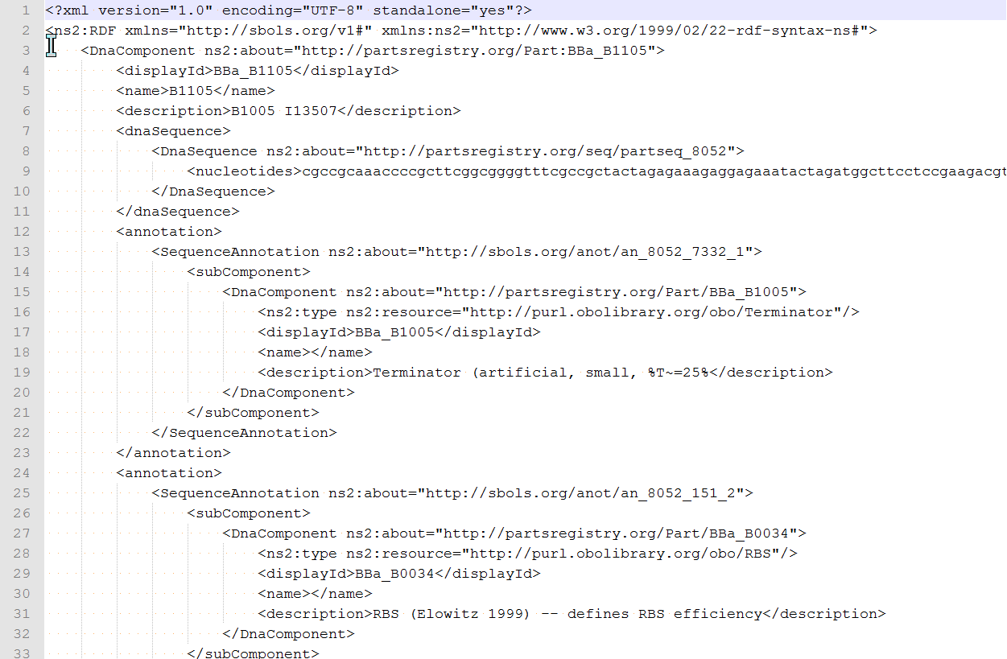
DnaComponent
DnaSequence
Subpart

