Slide 1
Actor-Critic
Hung-yi Lee
Notes:
SVG
DPG
DDPG
Similar to GAN
DQN
4.5 Double DQN (Tensorflow)
4.6 Prioritized Experience Replay (DQN) (Tensorflow) say this?
4.7 Dueling DQN (Tensorflow)

Slide 2
Asynchronous Advantage Actor-Critic (A3C)
Volodymyr Mnih, Adrià Puigdomènech Badia, Mehdi Mirza, Alex Graves, Timothy P. Lillicrap, Tim Harley, David Silver, Koray Kavukcuoglu, “Asynchronous Methods for Deep Reinforcement Learning”, ICML, 2016

Slide 3

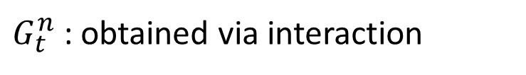

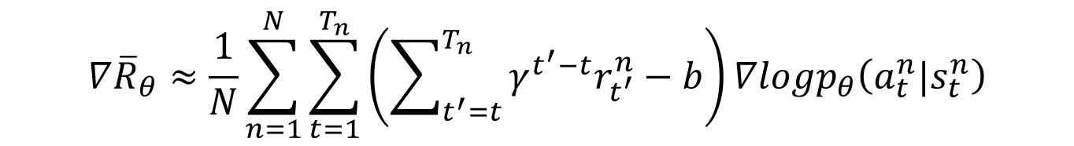





Review – Policy Gradient
baseline
$$∇{\overline{R}}_{θ}≈\frac{1}{N}\sum_{n=1}^{N}{\sum_{t=1}^{T_{n}}{\left(\sum_{t^{′}=t}^{T_{n}}{γ^{t^{′}−t}r_{t^{′}}^{n}}−b\right)∇logp_{θ}\left(a_{t}^{n}|s_{t}^{n}\right)}}$$
$G_{t}^{n}$: obtained via interaction
Very unstable
With sufficient samples, approximate the expectation of G.
$$G=100$$
$$G=3$$
$$a$$
$$G=1$$
$$s$$
$$G=2$$
Can we estimate the expected value of G?
$$G=−10$$

Slide 4



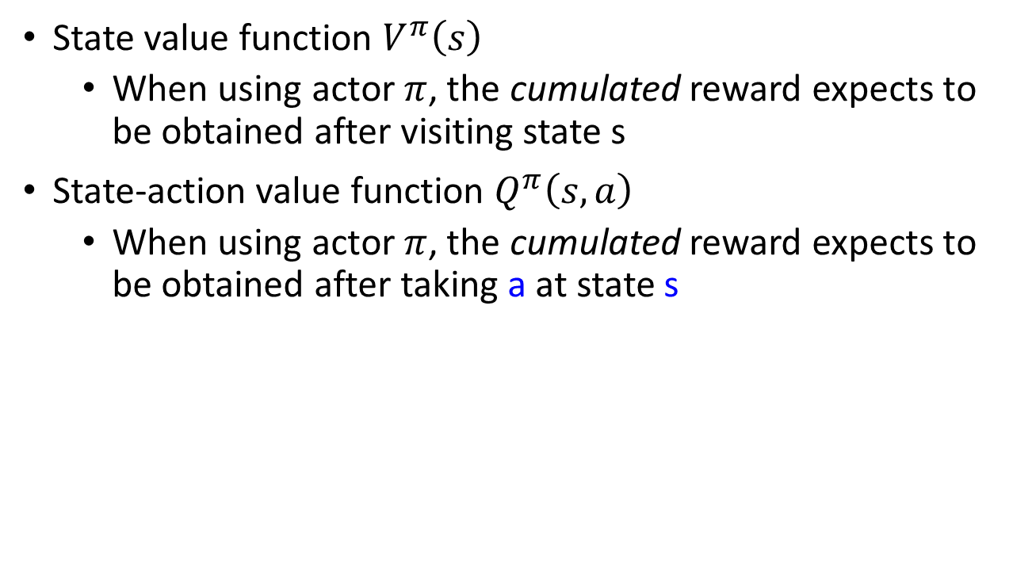



Review – Q-Learning
State value function $V^{π}\left(s\right)$
When using actor $π$, the cumulated reward expects to be obtained after visiting state s
State-action value function $Q^{π}\left(s,a\right)$
When using actor $π$, the cumulated reward expects to be obtained after taking a at state s
for discrete action only
$$V^{π}$$
$$Q^{π}$$
$$Q^{π}\left(s,a=left\right)$$
$$V^{π}\left(s\right)$$
s
s
$$Q^{π}\left(s,a=right\right)$$
scalar
$$Q^{π}\left(s,a=fire\right)$$
Estimated by TD or MC

Slide 5
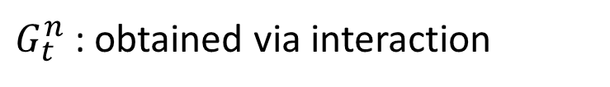

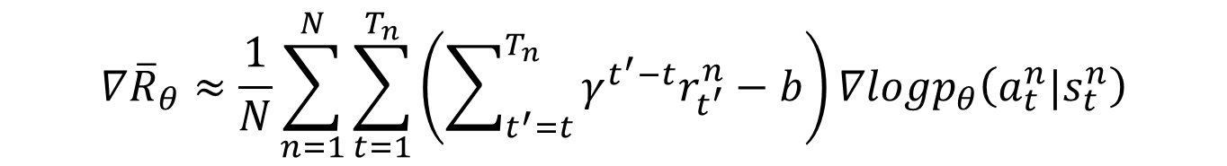



Actor-Critic
$$Q^{π_{θ}}\left(s_{t}^{n},a_{t}^{n}\right)−V^{π_{θ}}\left(s_{t}^{n}\right)$$
$$V^{π_{θ}}\left(s_{t}^{n}\right)$$
baseline
$$∇{\overline{R}}_{θ}≈\frac{1}{N}\sum_{n=1}^{N}{\sum_{t=1}^{T_{n}}{\left(\sum_{t^{′}=t}^{T_{n}}{γ^{t^{′}−t}r_{t^{′}}^{n}}−b\right)∇logp_{θ}\left(a_{t}^{n}|s_{t}^{n}\right)}}$$
$G_{t}^{n}$: obtained via interaction
$$E\left[G_{t}^{n}\right]=$$
$$Q^{π_{θ}}\left(s_{t}^{n},a_{t}^{n}\right)$$

Slide 6




Advantage Actor-Critic
Estimate two networks? We can only estimate one.
$$Q^{π}\left(s_{t}^{n},a_{t}^{n}\right)−V^{π}\left(s_{t}^{n}\right)$$
Only estimate state value
$$r_{t}^{n}+V^{π}\left(s_{t+1}^{n}\right)−V^{π}\left(s_{t}^{n}\right)$$
A little bit variance
$$Q^{π}\left(s_{t}^{n},a_{t}^{n}\right)=E\left[r_{t}^{n}+V^{π}\left(s_{t+1}^{n}\right)\right]$$
$$Q^{π}\left(s_{t}^{n},a_{t}^{n}\right)=r_{t}^{n}+V^{π}\left(s_{t+1}^{n}\right)$$

Slide 7
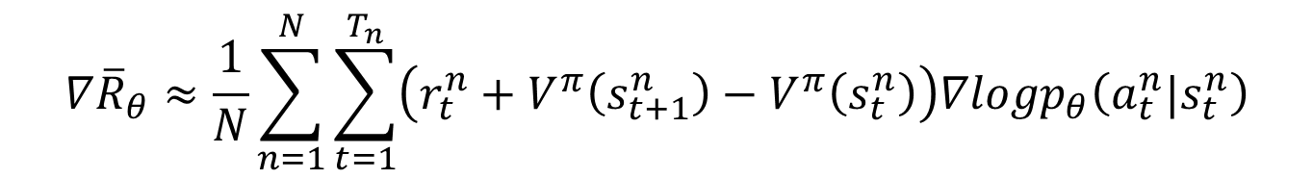

Advantage Actor-Critic
$π$ interacts with the environment
𝜋 interacts with the environment
Learning $V^{π}\left(s\right)$
Learning 𝑉^𝜋 (𝑠)
Update actor from $π→π’$ based on $V^{π}\left(s\right)$
Update actor from 𝜋→𝜋’ based on 𝑉^𝜋 (𝑠)
$$π=π^{′}$$
TD or MC
$$∇{\overline{R}}_{θ}≈\frac{1}{N}\sum_{n=1}^{N}{\sum_{t=1}^{T_{n}}{\left(r_{t}^{n}+V^{π}\left(s_{t+1}^{n}\right)−V^{π}\left(s_{t}^{n}\right)\right)∇logp_{θ}\left(a_{t}^{n}|s_{t}^{n}\right)}}$$

Slide 8

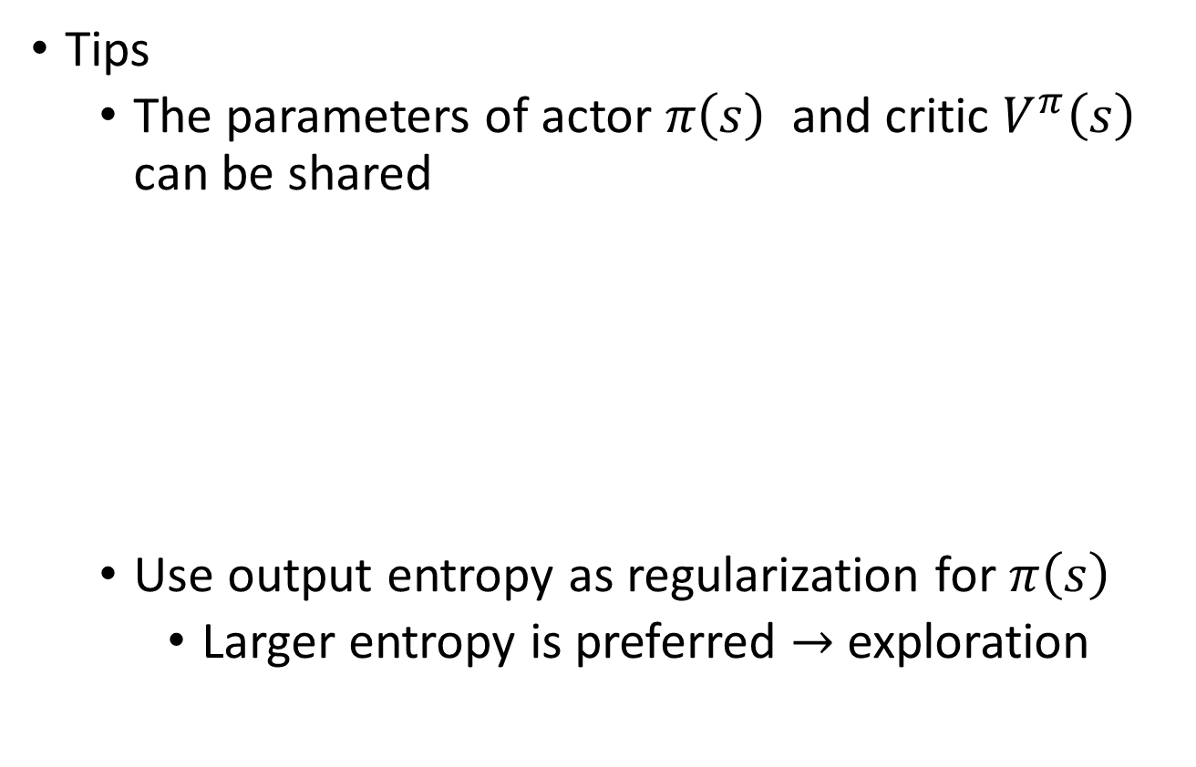

Advantage Actor-Critic
Tips
The parameters of actor $π\left(s\right)$ and critic $V^{π}\left(s\right)$ can be shared
Use output entropy as regularization for $π\left(s\right)$
Larger entropy is preferred $→$ exploration
Network
left
Network
right
$$s$$
fire
Network
$$V^{π}\left(s\right)$$

Slide 9
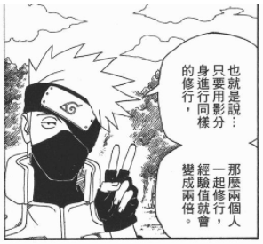
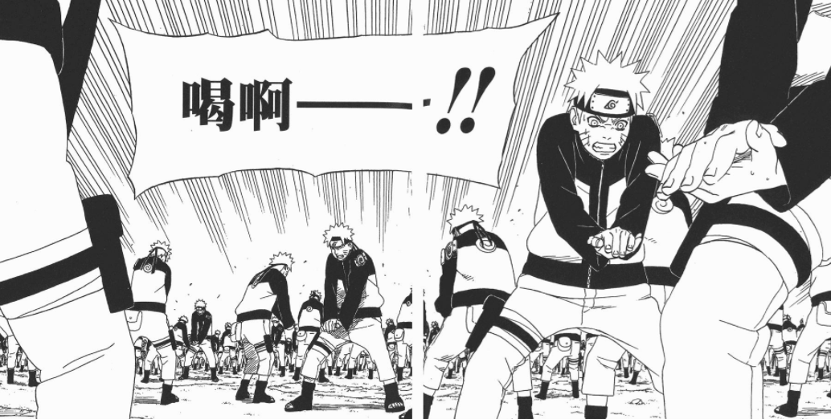
Asynchronous Advantage Actor-Critic (A3C)
The idea is from 李思叡

Slide 10
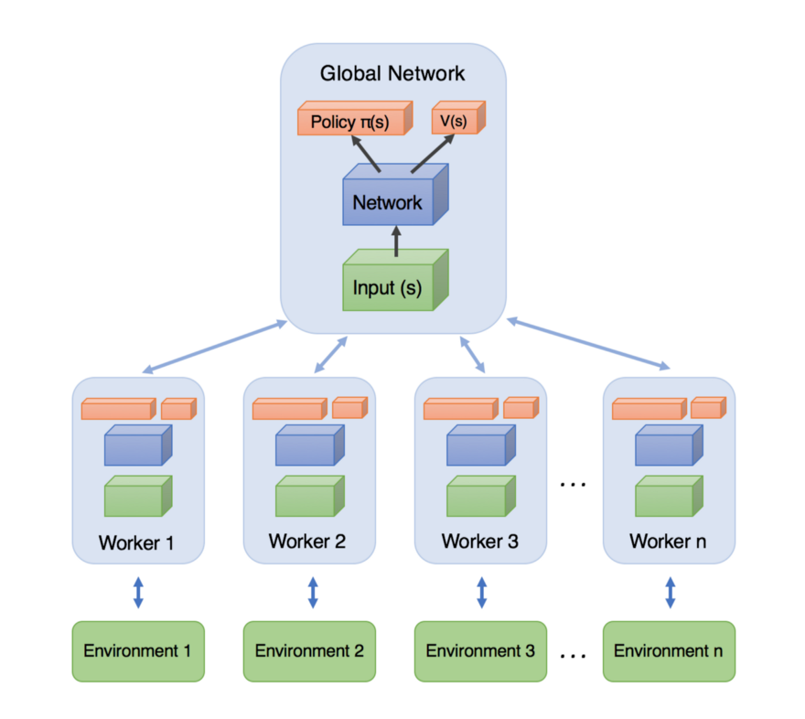







Asynchronous
Source of image: https://medium.com/emergent-future/simple-reinforcement-learning-with-tensorflow-part-8-asynchronous-actor-critic-agents-a3c-c88f72a5e9f2#.68x6na7o9
$$θ^{1}$$
$$+η∆θ$$
$$θ^{2}$$
1. Copy global parameters
(other workers also update models)
2. Sampling some data
$$∆θ$$
3. Compute gradients
$$θ^{1}$$
4. Update global models
$$θ^{1}$$
$$∆θ$$

Slide 11
Pathwise Derivative Policy Gradient
David Silver, Guy Lever, Nicolas Heess, Thomas Degris, Daan Wierstra, Martin Riedmiller, “Deterministic Policy Gradient Algorithms”, ICML, 2014
Timothy P. Lillicrap, Jonathan J. Hunt, Alexander Pritzel, Nicolas Heess,
Tom Erez, Yuval Tassa, David Silver, Daan Wierstra, “CONTINUOUS CONTROL WITH DEEP REINFORCEMENT LEARNING”, ICLR, 2016

Slide 12






Another Way to use Critic
$$Q^{π}\left(s,a\right)$$
Original Actor-critic
$$a_{1}$$
$$a_{2}$$
decrease
increase
Pathwise derivative policy gradient
We know the parameters of Q function
$$Q^{π}\left(s,a\right)$$
From Q function we know that taking a’ at state s is better than a
$$a′$$
$$a$$

Slide 13
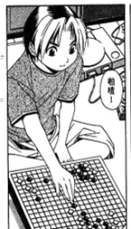
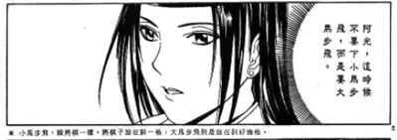

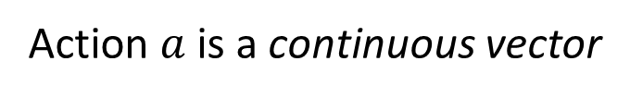



Actor
Critic
Pathwise derivative policy gradient
Original Actor-critic
http://www.cartomad.com/comic/109000081104011.html
Action $a$ is a continuous vector
$$s$$
Actor
$$a$$
$$π$$
$$a=arg\max_{a}{Q\left(s,a\right)}$$
Actor as the solver of this optimization problem

Slide 14


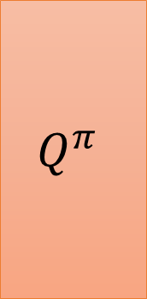
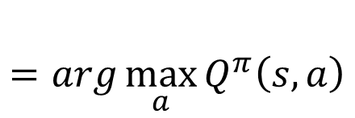
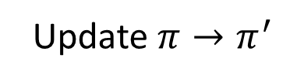




Pathwise Derivative Policy Gradient
$$=arg\max_{a}{Q^{π}\left(s,a\right)}$$
$$π^{′}\left(s\right)$$
a is the output of an actor
Gradient ascent:
Fixed
$$θ^{π^{′}}←θ^{π}+η∇_{θ^{π}}Q^{π}\left(s,a\right)$$
$$Q^{π}$$
$$s$$
Update $π→π^{′}$
$$Q^{π}\left(s,a\right)$$
$$s$$
Actor
$$a$$
=
$$a$$
$$π$$
This is a large network

Slide 15






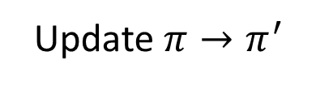



$π$ interacts with the environment
𝜋 interacts with the environment
Learning $Q^{π}\left(s,a\right)$
Learning 𝑄^𝜋 (𝑠,𝑎)
Find a new actor $π^{′}$ “better” than $π$
Find a new actor 𝜋^′ “better” than 𝜋
Replay
Buffer
Exploration
$$π=π^{′}$$
TD or MC
$$θ^{π^{′}}←θ^{π}+η∇_{θ^{π}}Q^{π}\left(s,a\right)$$
$$Q^{π}$$
$$s$$
Update $π→π^{′}$
$$Q^{π}\left(s,a\right)$$
$$s$$
Actor
$$a$$
$$π$$
=
$$a$$
Notes:
Add some noise

Slide 16
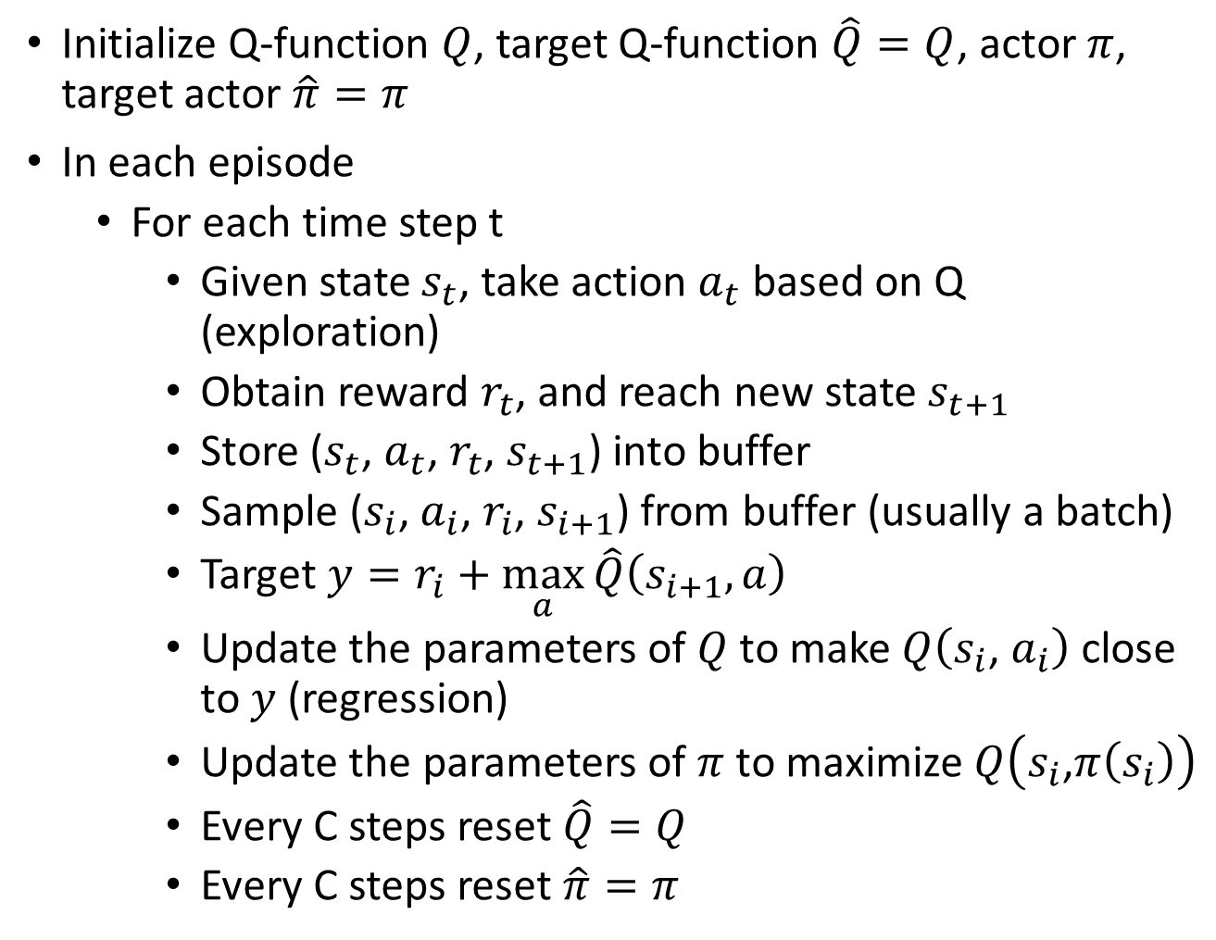
Q-Learning Algorithm
Initialize Q-function $Q$, target Q-function $\hat{Q}=Q$, actor $π$, target actor $\hat{π}=π$
In each episode
For each time step t
Given state $s_{t}$, take action $a_{t}$ based on Q (exploration)
Obtain reward $r_{t}$, and reach new state $s_{t+1}$
Store ($s_{t}$, $a_{t}$, $r_{t}$, $s_{t+1}$) into buffer
Sample ($s_{i}$, $a_{i}$, $r_{i}$, $s_{i+1}$) from buffer (usually a batch)
Target $y=r_{i}+\max_{a}{\hat{Q}\left(s_{i+1},a\right)}$
Update the parameters of $Q$ to make $Q\left(s_{i}\text{, }a_{i}\right)$ close to $y$ (regression)
Update the parameters of $π$ to maximize $Q\left(s_{i}\text{,}π\left(s_{i}\right)\right)$
Every C steps reset $\hat{Q}=Q$
Every C steps reset $\hat{π}=π$

Slide 17


Q-Learning Algorithm
Pathwise Derivative Policy Gradient
Initialize Q-function $Q$, target Q-function $\hat{Q}=Q$, actor $π$, target actor $\hat{π}=π$
In each episode
For each time step t
Given state $s_{t}$, take action $a_{t}$ based on Q (exploration)
Obtain reward $r_{t}$, and reach new state $s_{t+1}$
Store ($s_{t}$, $a_{t}$, $r_{t}$, $s_{t+1}$) into buffer
Sample ($s_{i}$, $a_{i}$, $r_{i}$, $s_{i+1}$) from buffer (usually a batch)
Target $y=r_{i}+\max_{a}{\hat{Q}\left(s_{i+1},a\right)}$
Update the parameters of $Q$ to make $Q\left(s_{i}\text{, }a_{i}\right)$ close to $y$ (regression)
Update the parameters of $π$ to maximize $Q\left(s_{i}\text{,}π\left(s_{i}\right)\right)$
Every C steps reset $\hat{Q}=Q$
Every C steps reset $\hat{π}=π$
1
$$π$$
2
$$\hat{Q}\left(s_{i+1}\text{,}\hat{π}\left(s_{i+1}\right)\right)$$
3
4

Slide 18
Connection with GAN
David Pfau, Oriol Vinyals, “Connecting Generative Adversarial Networks and Actor-Critic Methods”, arXiv preprint, 2016

