Slide 1
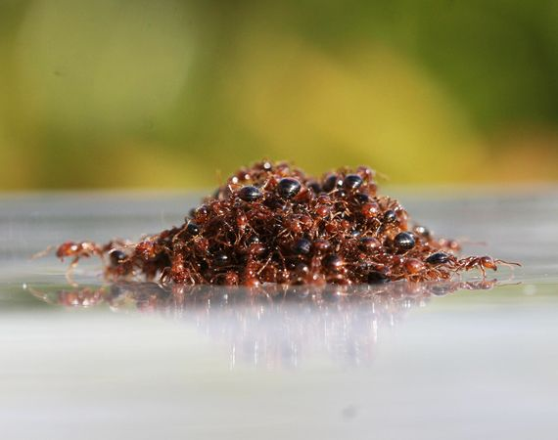
Character Lessons We Can Learn From Ants…
Adapted from a power point:
12 Life Lessons From Tiny Ants
by Sompong Yusoontorn

Slide 2
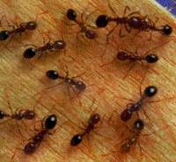
Lesson 1: Ants are organized!!!
There are three types of ants in a colony:
Queen
Workers
Male
Everyone has their own specific job.
Everyone does their job so that a task gets done more quickly (gathering food)

Slide 3
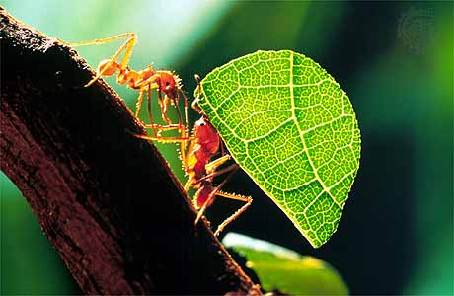
Lesson 2: Ants share!!
When one ant finds food, they let the rest of the colony know so that everyone can share it! Ants are never selfish.

Slide 4
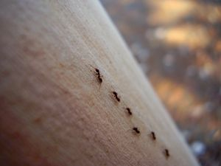
Lesson 3: Ants are disciplined…
They march in line one after another. They move about in order and they never cut the line!
Aren’t ants amazing??

Slide 5
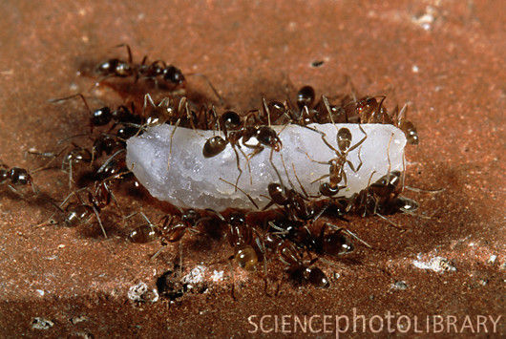
Lesson 4: Ants stay busy…
Ants always have work to do for the colony. They work all day long!
Ants are never lazy or refuse to do work.

Slide 6
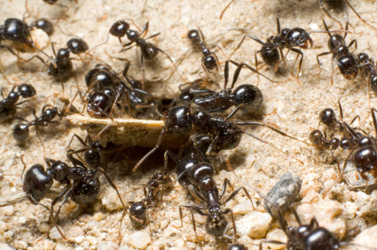
Lesson 5: Ants never give up!!
Even when something is hard or gets in the way of them doing their best work, they keep trying until they overcome the obstacle!!

Slide 7
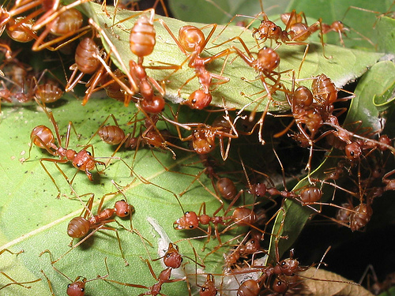
Lesson 6: Ants are FAST!
Ants might be small, but they sure are fast!
They always do their best work, but they try to get things done as quickly as they can.
Often they work together so that they can get more done in a day.

Slide 8
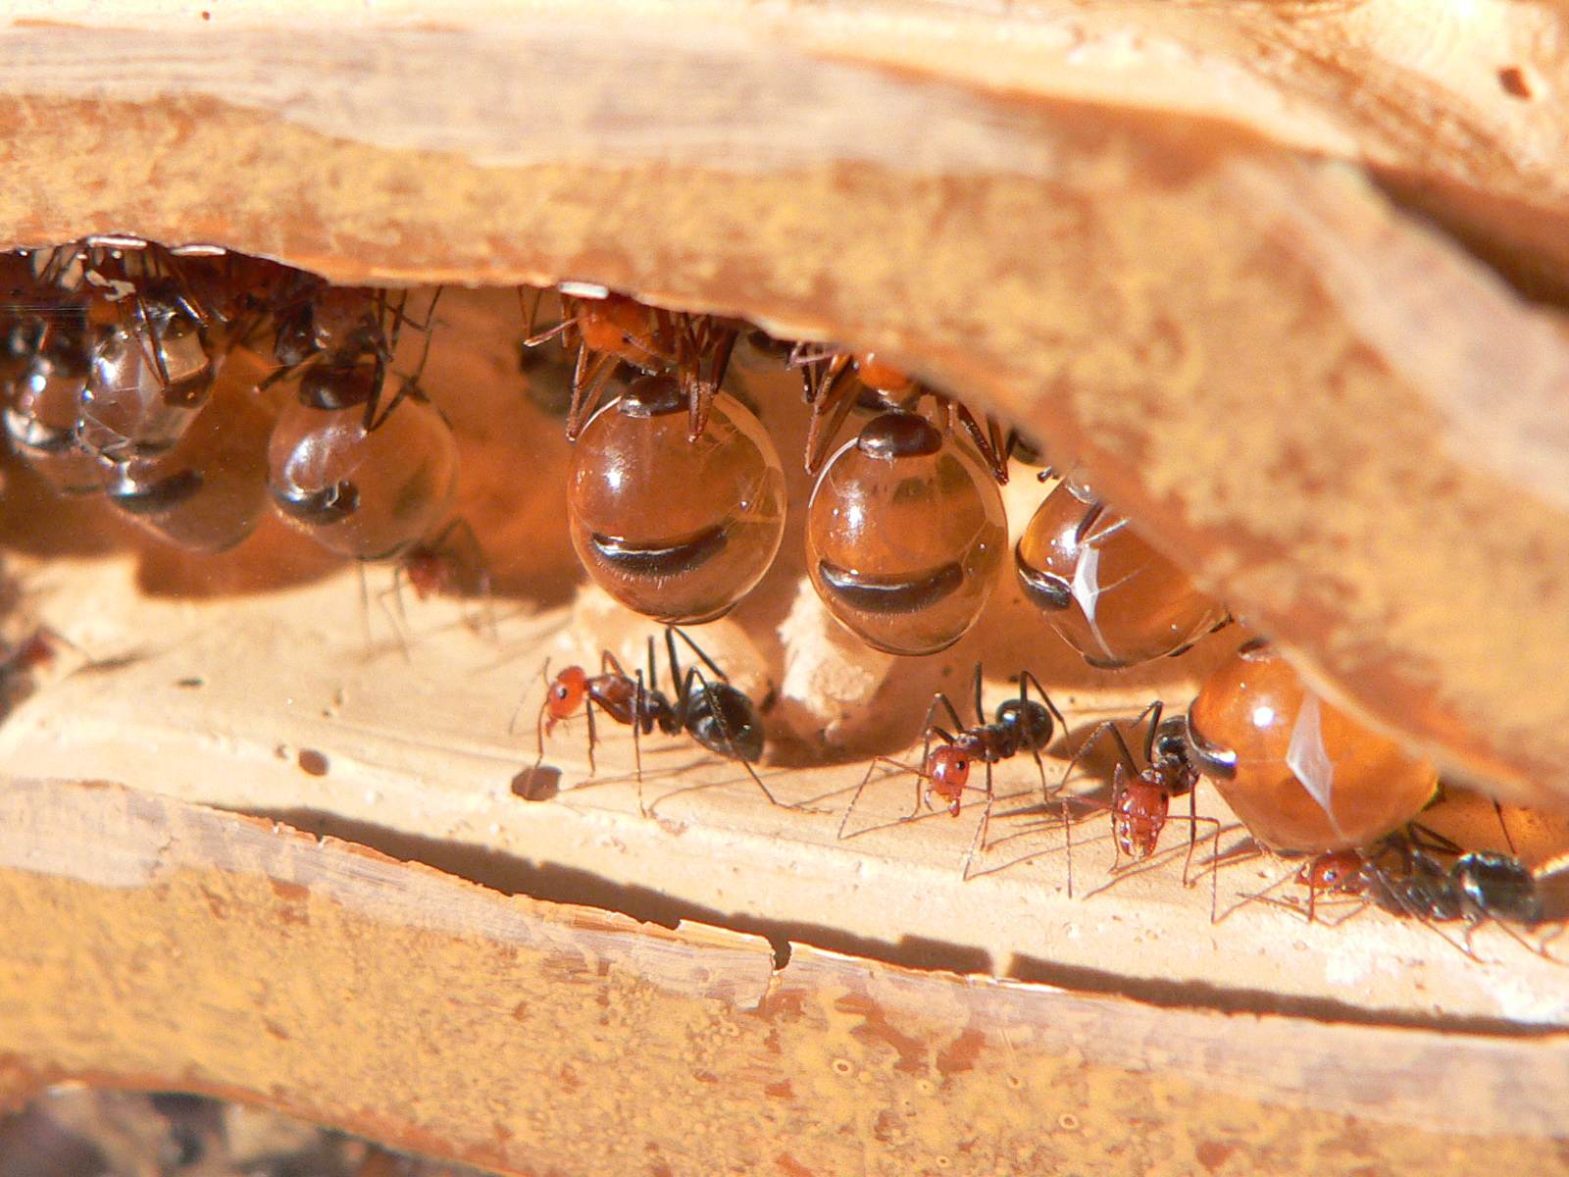
Lesson 7: Ants plan ahead…
Honey ants work all summer to store enough food for the colony to survive on during the winter. Good planning!

Slide 9
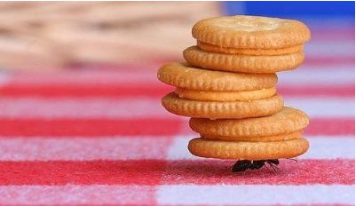
Lesson 8: Ants are hard workers!
Did you know ants can carry 10 times their body weight!?!?
Just because something is hard, doesn’t mean an ant will give up… and neither should you!!

Slide 10
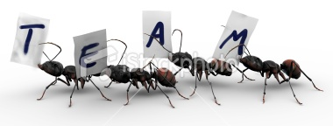
Lesson 9: Ants use TEAMWORK!!
Everything an ant does, is to benefit the colony. Everyone works together!
They know their job and they get it done!
One might be digging tunnels, another might be gathering food.. But every job is important and everyone will notice if one ant is not doing their job.

Slide 11
Lesson 10: Ants stick together…
They take care of each other…
They help each other…
They look out for one another…
Are ants bucket fillers??

