Slide 1
Godiva CRM 2025 Annual Review & 2026 Strategy Plan
Feb 2026

Slide 2
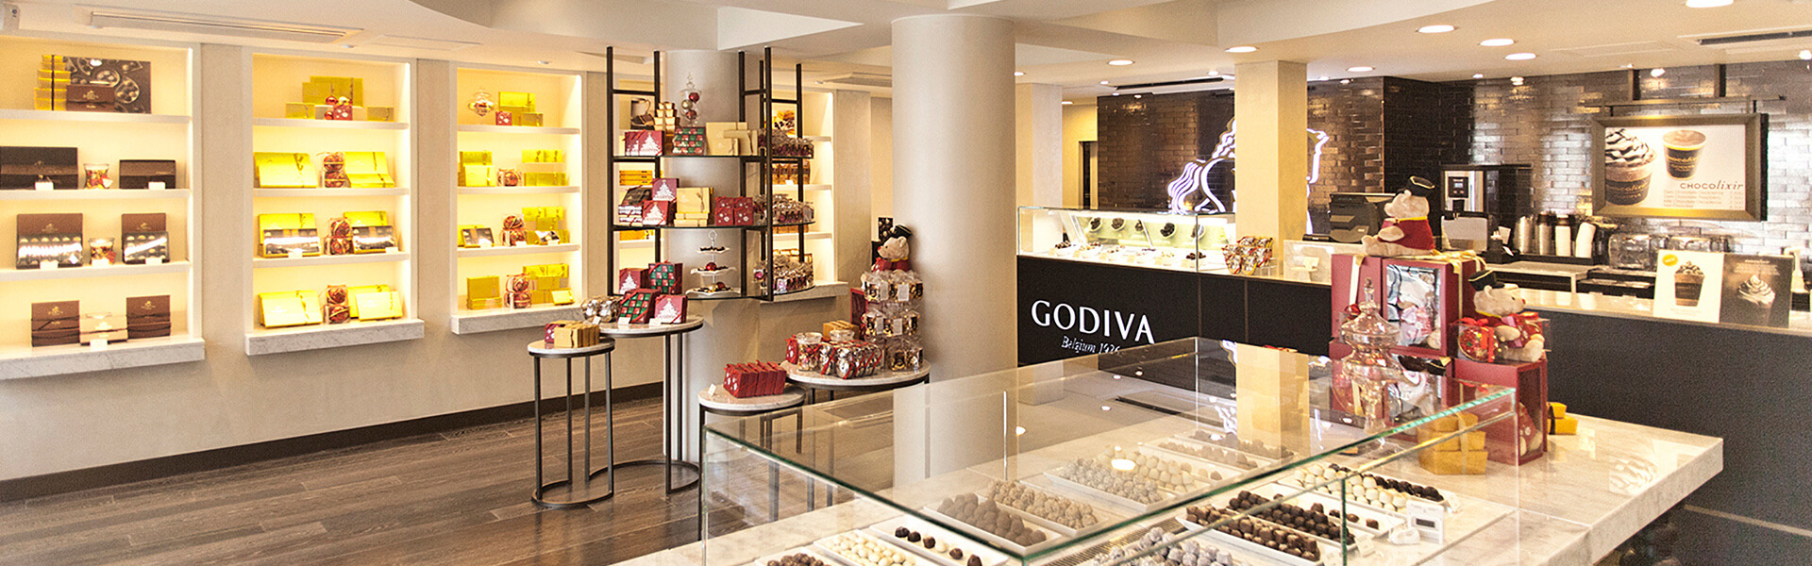
Contents
01
02
03
04
Market Trend 2026
CRM data insight deep dive
2026 CRM strategy
CRM Action Plan in 2026

Slide 3
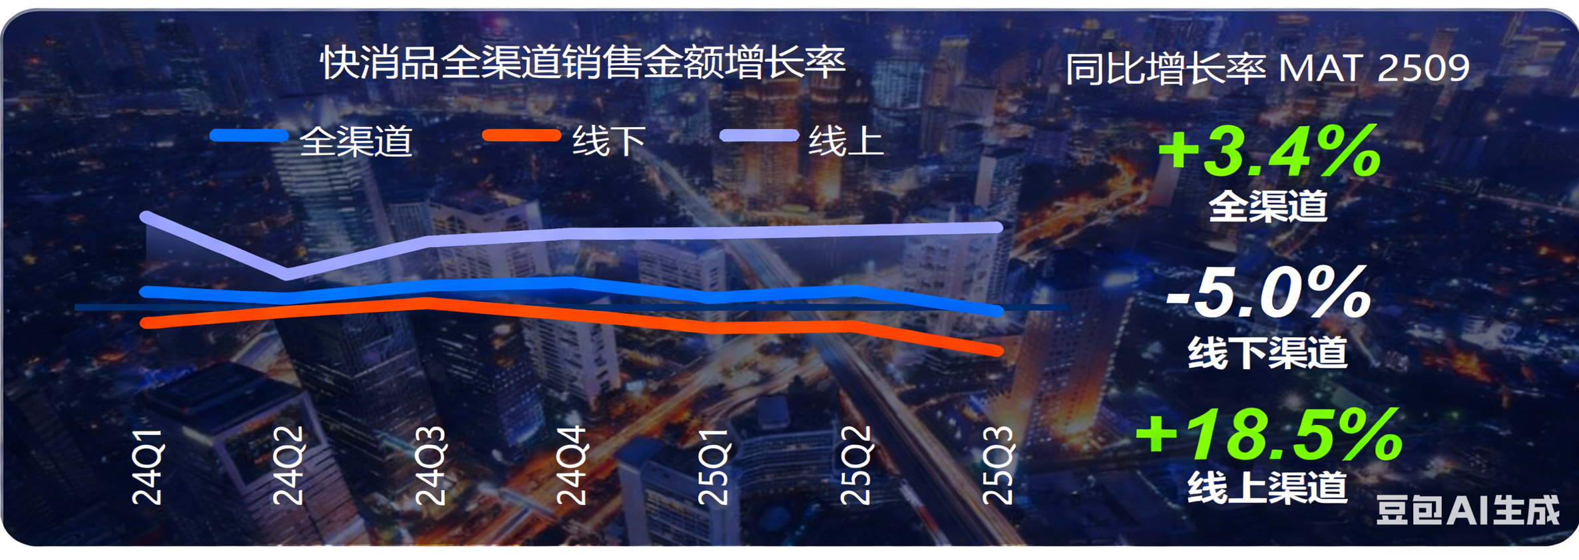
FMCG Omnichannel Growth Fluctuates, Online Stabilizes While Offline Faces Pressure
Core Strategic Trends
Industry Growth Rates & Insights
Online Channels: Traffic Capture
Leverage omnichannel strategies to effectively capture and retain digital traffic.
Beverage
Diversification of consumption scenarios
Sugar-free tea and functional beverage categories are driving growth
+2.7% Growth
Offline Channels: Essence & Transformation
Snack
Increased health consciousness leads to narrowed demand
Niche concept products like black truffle crackers and probiotic candy show counter-trend growth
-7.6% Decline
Align with consumption essence and continue transformation to enhance in-store experience.
-8.5% Decline
Product Innovation: Health & Self-indulgence
Dairy
Insufficient market demand across the overall category
Products with high-calcium, no-additive concepts gain market share
Collaborate with scenario expansion; health and self-indulgence sub-categories maintain steady growth.
Alcohol
High-end and personalized product innovation stimulates premiumization
Beer and red wine show relatively fast growth
+4.5% Growth
Personal Care
Increased self-care and health care awareness
Personalized/functional cosmetics categories drive growth
+12.9% Growth
Maternal & Infant
Rebound in birth rate drives category recovery
Market demand becomes more diversified
+0.3% Growth

Slide 4
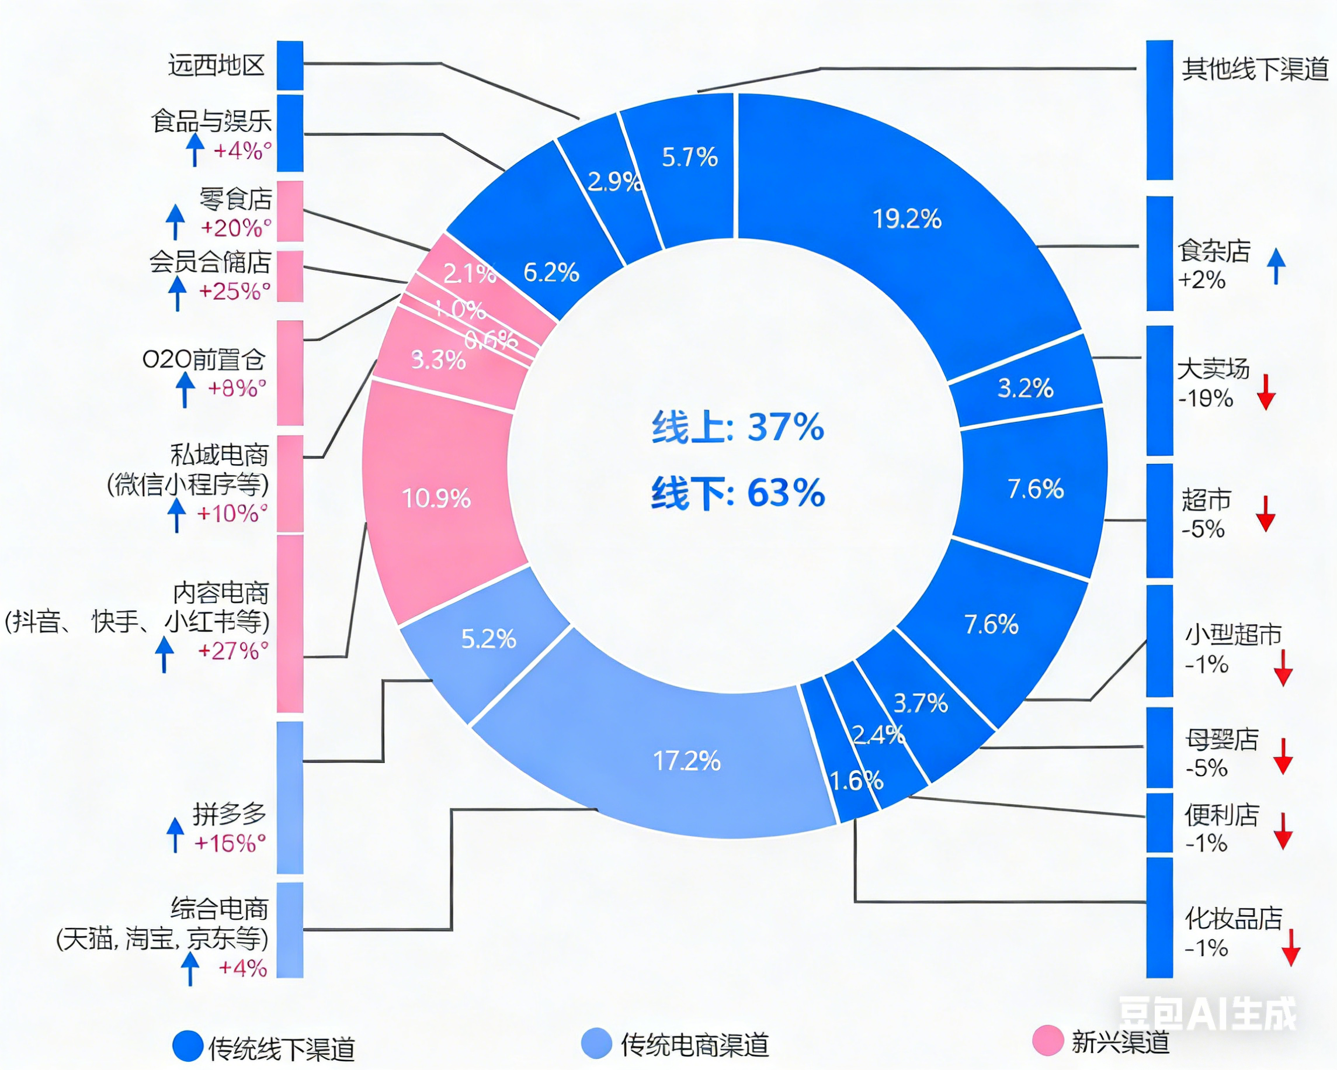
Channel Differentiation Deepens, with Offline Store Resurgence and High Growth in Snacks & Membership Stores
The Importance and Growth Rate of Omnichannel Sales in Fast-Moving Consumer Goods
Online Channels: Dual-line Synergy Drives Growth
Content E-commerce: New Growth Engine
High-speed growth becomes a new online driver, tapping into new consumer segments.
Comprehensive E-commerce: The Solid Base
Remains the online basic, ensuring stable core revenue flow.
Manufacturer Strategy: Dual-line Synergy
Implement "defend the base, seize new growth": Stabilize core revenue via comprehensive platforms while exploring content e-commerce for sustainable expansion.
Offline Channels: Optimizing Advantageous Layout
Channel Differentiation & Trends
Emerging channels (membership, snacks, O2O) show high growth; traditional hypermarkets explore transformation.
Focus on High-Growth Segments
Capitalize on the resurgence of small stores and specialty channels to capture market share.
Manufacturer Strategy: Adaptive Optimization
Adjust layout according to channel trends, optimize supply chain, and adapt to changing consumer behavior to consolidate offline presence.

Slide 5
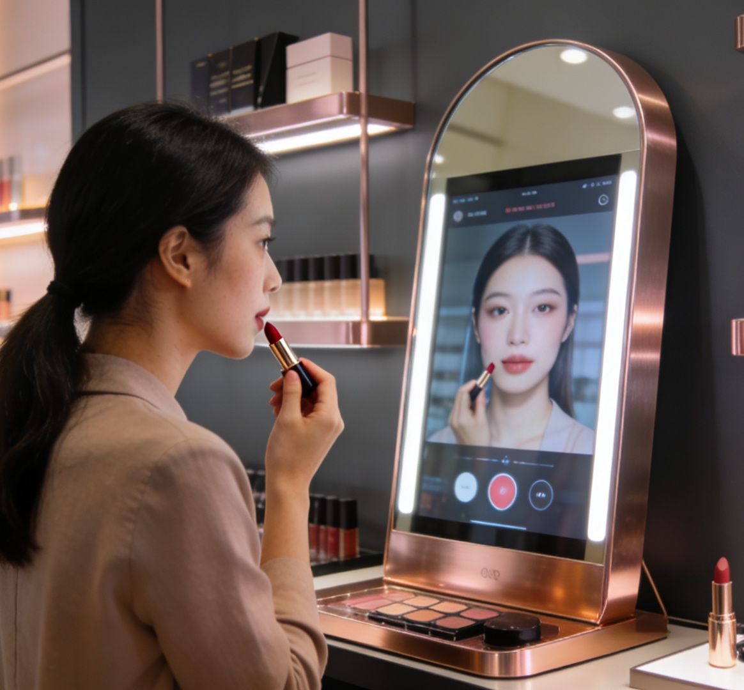
Sephora's Omni-channel Strategy: The Foundation of Success
Unified Customer Profile
Consolidates online, in-store, and app data to create a 360-degree view, forming the cornerstone of personalized service.
Personalized Beauty Experience
Leverages AI/AR tools like 'Virtual Artist' and 'Color IQ' for virtual try-ons and precise shade matching.
Seamless Fulfillment
Offers flexible options like BOPIS (Buy Online, Pick Up In-Store) and same-day delivery for frictionless convenience.
Engaging Loyalty Program
The 'Beauty Insider' program fosters exclusivity and repeat purchases through tiered benefits and early access.

Slide 6
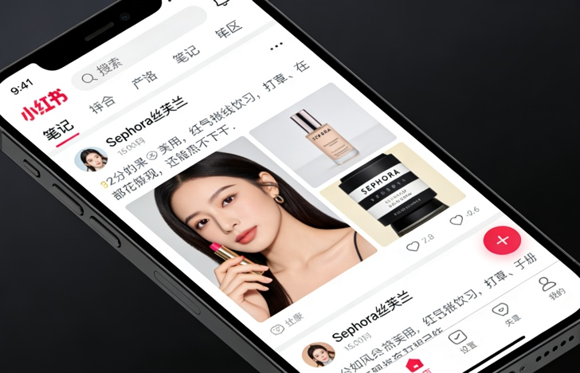
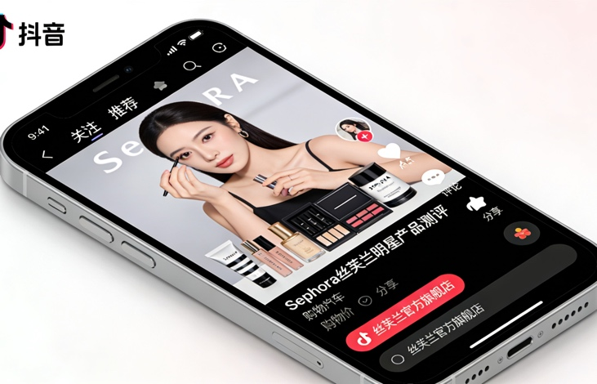
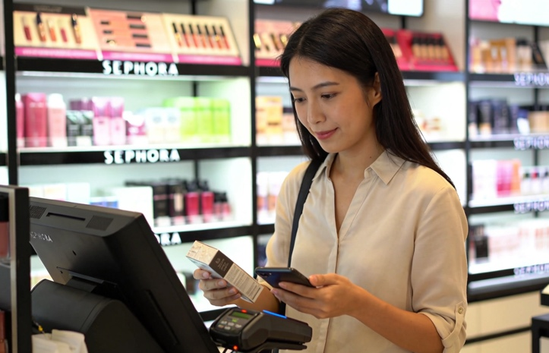
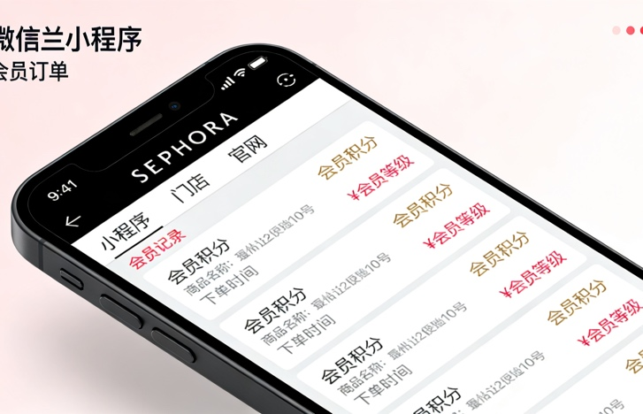
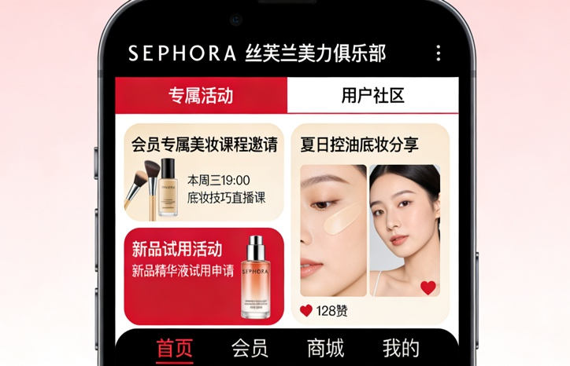
The Seamless Consumer Journey
01 Discovery
02 Research
03 Purchase
04 Post-Purchase
05 Advocacy
Begins with social media, influencer partnerships, and targeted ads to create initial brand awareness.
Extensive product research via app/website, using reviews, tutorials, and AR tools for virtual try-ons.
Flexible channels: in-store for experience, online for convenience, or BOPIS/same-day delivery.
The membership app unifies purchase records across all channels, consolidating spending to calculate tier, points, and benefits for true omni-channel integration.
Building community through Beauty Insider events to turn customers into brand advocates.

Slide 7
Key Takeaways & Best Practices
Customer-Centricity is Paramount
All strategies and technologies should revolve around enhancing the customer experience and making their journey seamless.
01
02
Consistency Across Channels
Ensure a cohesive brand voice, look, and feel across all touchpoints to build trust and recognition.
Data-Driven Personalization
Leverage customer data to understand preferences, anticipate needs, and deliver highly relevant and personalized interactions.
04
05
Community Building
Foster a sense of community and belonging to drive long-term loyalty and advocacy beyond transactions.
03
Technology as an Enabler
Embrace AI, AR, and unified commerce platforms to break down silos and create a truly integrated experience.

Slide 8
Contents
01
02
03
04
Market Trend 2026
CRM data insight deep dive
2026 CRM strategy
CRM Action Plan in 2026

Slide 9
In 2025, store traffic faced significant challenges, and the new recruitments fell short of the target. With the strong cooperation of the stores, member orders accounted for 83% of total sales. CRM launched two member festivals, achieving target values in Repeat, Retention, and campaign sales.
1
2
3
4
5
# of members recruited
PRR
Repeat
Retention
Campaign
Target in Retail | 398K | -% | 17% | 16% | 33M
Y24 Actual | 388K | 70% | 16% | 15% | 31M
YTD Achievement | 363K | 83% | 21% | 18% | 39M
YTD Achievement% | 91% | - | - | - | 119%
* YTD 2025.01.01-2025.12.31(Boutique only).

Slide 10

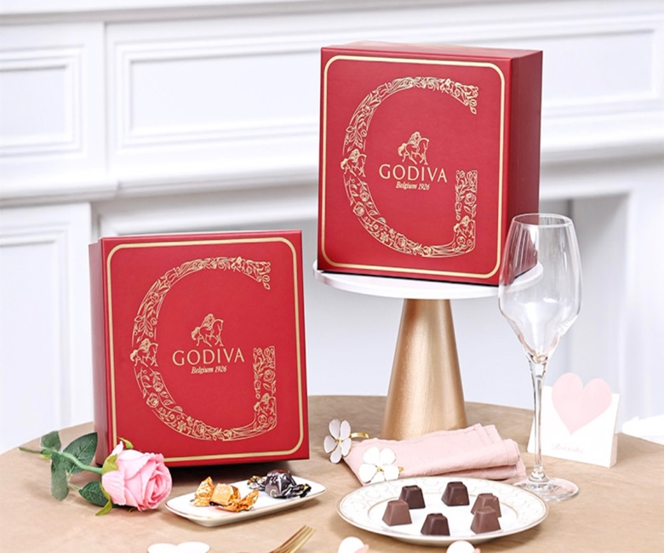
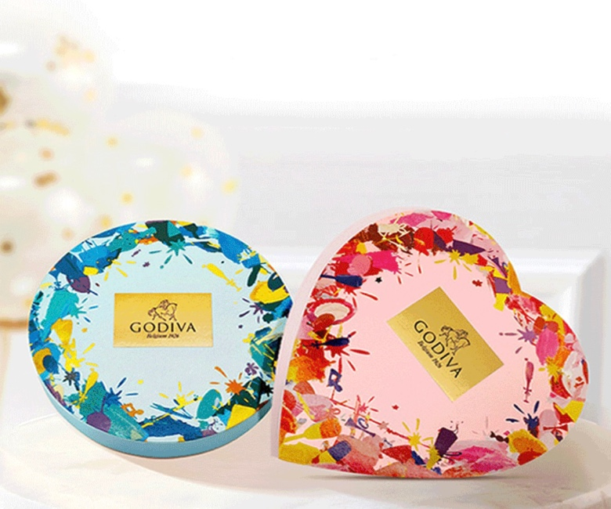
CRM data insight deep dive
01
02
03
Campaign
Recruit & PRR
Repeat & Retention

Slide 11
CRM campaigns have two main categories: Lifecycle campaigns and MKT campaigns. Lifecycle-related activities include Member Festival, VIP gifting initiatives, and regularly scheduled Member Weeks, etc. MKT campaigns include seasonal communications, new product recommendations, and support for store openings and closings.
Platinum Hamper
CNY
Convert Rate:
89.7%
Contributed sales:
¥ 3,791,468
Convert Rate:
6.9%
Contributed sales:
¥ 2,878,624
Top1
Top1
MAF
D11 Member Festival
Top2
Top2
Convert Rate:
7.9%
Contributed sales:
2,192,758
Contributed sales:
¥ 3,483,999
618 Member Festival
V day
Top3
Top3
Contributed sales:
¥ 2,647,805
Convert Rate:
3.9%
Contributed sales:
¥ 945,285

Slide 12
CRM conducted 33 campaigns in 2025, and sales contribution reached 39M, major contributed by Platinum Hamper, Member Festival and CNY.
LABUBU Autumn
Convert Rate:
5.6%
Contributed sales:
¥ 2,614,723
Top2 Sales
LABUBU Summer
Convert Rate:
5.6%
Contributed sales:
¥ 987,353
LABUBU Chocolate
Convert Rate:
5.8%
Contributed sales:
¥ 1,508,514
Member Festival
Convert Rate:
-%
Contributed sales:
¥ 3,483,999
Top1 Sales
New
Top4 Sales
New
New
Platinum Hamper
Convert Rate:
89.7%
Contributed sales:
¥ 3,791,468
Bear For VIPs Convert Rate:
11.13%
Contributed sales:
¥ 1,355,193
Member Festival
Convert Rate:
-%
Contributed sales:
¥ 2,647,805
MAF Redeem
Convert Rate:
54.4%
Contributed sales:
¥ 1,506,126
MAF Sleeping Gold
Convert Rate:
-
Contributed sales:
¥ 138,868
Xmas Gift
Convert Rate:
51.3%
Contributed sales:
¥ 1,341,309
New
Birthday, Member Week, Points Mall......
Store Open & Closing
Jan
Feb
Mar
May
Jun
Jul
Aug
Sep
Oct
Nov
Dec
Top3 Sales
CNY
Convert Rate:
6.9%
Contributed sales:
¥ 2,878,624
Women's day
Convert Rate:
2.6%
Contributed sales:
¥ 352,354
Mother’s Day
Convert Rate:
4.0%
Contributed sales:
¥ 678,455
Children'd Day
Convert Rate:
5.4%
Contributed sales:
¥ 483,938
Father's Day
Convert Rate:
4.6%
Contributed sales:
¥ 324,170
MAF
Convert Rate:
7.9%
Contributed sales:
2,192,758
Halloween
Convert Rate:
4.3%
Contributed sales:
¥ 700,331
V day
Convert Rate:
3.9%
Contributed sales:
¥ 945,285
Labour Day
Convert Rate:
1。0%
Contributed sales:
¥ 80,608
520
Convert Rate:
8.00%
Contributed sales:
¥ 937,090
DBF
Convert Rate:
1.7%
Contributed sales:
¥ 287,085
CVD
Convert Rate:
3.0%
Contributed sales:
¥ 700,171
National Day
Convert Rate:
4.3%
Contributed sales:
¥ 399,684
Xmas
Convert Rate:
2.9%
Contributed sales:
¥933,361
Member lifecycle Campaign
New Product
Seasonal
Notes:
MKT Campaign / Member lifecycle Campaign
标题：total贡献了多少，其中campaign贡献了多少；
增加生日/会员周

Slide 13

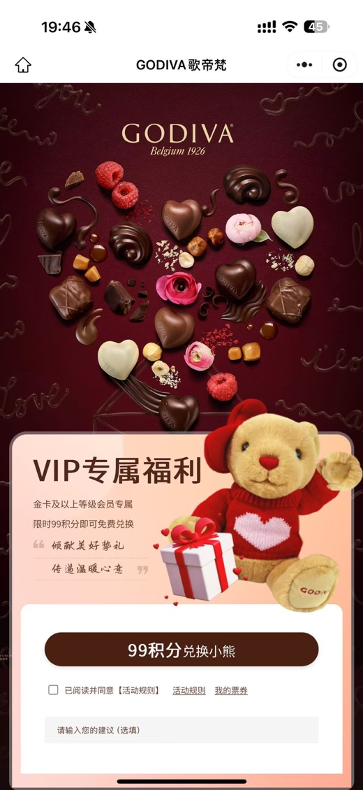
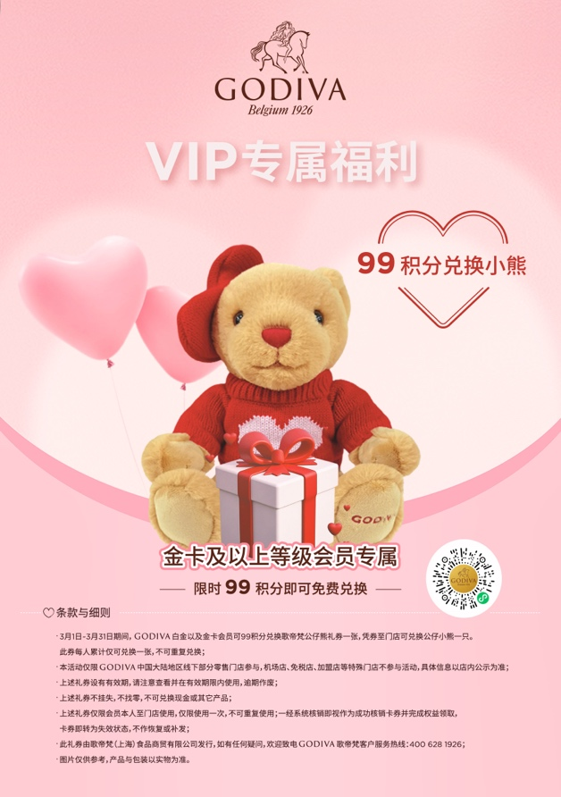
In Bear for VIPs campaign, 2,291 members picked up the bear, of them 201 members participated by upgrading to Gold membership, the # of active Gold members increased by +15% MoM.
LABUBU Summer
Convert Rate:
5.6%
Contributed sales:
987,353
LABUBU Autumn
Convert Rate:
5.6%
Contributed sales:
2,614,723
LABUBU Chocolate
Convert Rate:
5.8%
Contributed sales:
1,508,514
Member Festival
Convert Rate:
-%
Contributed sales:
3,483,999
Top2 Sales
New
In addition to the bear coupons, the CRM also distributed RMB20 cash coupon and RMB280-50 coupons to boost sales.
The redeem rate of RMB 20 cash coupon was up to 47%, the cumulative contribution sales of 789,632 yuan.
Top1 Sales
New
Top4 Sales
New
Platinum Hamper
Convert Rate:
89.7%
Contributed sales:
3,791,468
Bear For VIPs Convert Rate:
11.13%
Contributed sales:
1,355,193
Member Festival
Convert Rate:
-%
Contributed sales:
2,647,805
MAF Redeem
Convert Rate:
54.4%
Contributed sales:
1,506,126
MAF Sleeping Gold
Convert Rate:
-
Contributed sales:
138,868
Xmas Gift
Convert Rate:
51.3%
Contributed sales:
1,341,309
New
TA | # of participators | # of bears redeemed | # of RMB 20 coupon redeemed | # of RMB 280-50 coupon redeemed | Contributed Sales | Avg. spending
17,153 | 2,291 | 1,899 | 1,087 | 499 | 760,448 | 388
Birthday, Member Week, Points Mall......
Jan
Feb
Mar
May
Jun
Jul
Aug
Sep
Oct
Nov
Dec
Top3 Sales
CNY
Convert Rate:
6.9%
Contributed sales:
¥ 2,878,624
Women's day
Convert Rate:
2.6%
Contributed sales:
¥ 352,354
Mother’s Day
Convert Rate:
4.0%
Contributed sales:
¥ 678,455
Children'd Day
Convert Rate:
5.4%
Contributed sales:
¥ 483,938
Father's Day
Convert Rate:
4.6%
Contributed sales:
¥ 324,170
MAF
Convert Rate:
7.9%
Contributed sales:
2,192,758
Halloween
Convert Rate:
4.3%
Contributed sales:
¥ 700,331
V day
Convert Rate:
3.9%
Contributed sales:
¥ 945,285
Labour Day
Convert Rate:
1。0%
Contributed sales:
¥ 80,608
520
Convert Rate:
8.00%
Contributed sales:
¥ 937,090
93%
47%
22%
DBF
Convert Rate:
1.7%
Contributed sales:
¥ 287,085
CVD
Convert Rate:
3.0%
Contributed sales:
¥ 700,171
National Day
Convert Rate:
4.3%
Contributed sales:
¥ 399,684
Xmas
Convert Rate:
2.9%
Contributed sales:
¥933,361
Member lifecycle Campaign
New Product
Seasonal
Notes:
MKT Campaign / Member lifecycle Campaign
标题：total贡献了多少，其中campaign贡献了多少；
增加生日/会员周

Slide 14
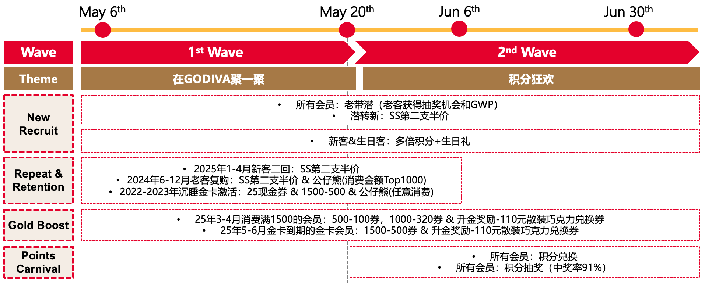
The D11 Membership Festival in 2024 achieved high sales contributions, leading to the addition of the 618 Membership Festival in 2025. By designing different mechanisms for different audience groups, the cumulative sales contribution reached 2.6M.
LABUBU Summer
Convert Rate:
5.6%
Contributed sales:
987,353
LABUBU Autumn
Convert Rate:
5.6%
Contributed sales:
2,614,723
LABUBU Chocolate
Convert Rate:
5.8%
Contributed sales:
1,508,514
Member Festival
Convert Rate:
-%
Contributed sales:
3,483,999
Top2 Sales
Gold Boost
Top1 Sales
New
Top4 Sales
New
New
Platinum Hamper
Convert Rate:
89.7%
Contributed sales:
3,791,468
Bear For VIPs Convert Rate:
11.13%
Contributed sales:
1,355,193
Member Festival
Convert Rate:
-%
Contributed sales:
2,647,805
MAF Redeem
Convert Rate:
54.4%
Contributed sales:
1,506,126
MAF Sleeping Gold
Convert Rate:
-
Contributed sales:
138,868
Xmas Gift
Convert Rate:
51.3%
Contributed sales:
1,341,309
New
4,329 Active Gold Members
+ 40% Increase vs. LY
Birthday, Member Week, Points Mall......
Jan
Feb
Mar
May
Jun
Jul
Aug
Sep
Oct
Nov
Dec
Top3 Sales
CNY
Convert Rate:
6.9%
Contributed sales:
¥ 2,878,624
Women's day
Convert Rate:
2.6%
Contributed sales:
¥ 352,354
Mother’s Day
Convert Rate:
4.0%
Contributed sales:
¥ 678,455
Children'd Day
Convert Rate:
5.4%
Contributed sales:
¥ 483,938
Father's Day
Convert Rate:
4.6%
Contributed sales:
¥ 324,170
MAF
Convert Rate:
7.9%
Contributed sales:
2,192,758
Halloween
Convert Rate:
4.3%
Contributed sales:
¥ 700,331
New Recruitment
Repeat & Retention
Points Carnival
+ 1,388 Invited New Potential
5% Convert Rate
2,328 Lucky Draw Participators
V day
Convert Rate:
3.9%
Contributed sales:
¥ 945,285
Labour Day
Convert Rate:
1。0%
Contributed sales:
¥ 80,608
520
Convert Rate:
8.00%
Contributed sales:
¥ 937,090
DBF
Convert Rate:
1.7%
Contributed sales:
¥ 287,085
CVD
Convert Rate:
3.0%
Contributed sales:
¥ 700,171
National Day
Convert Rate:
4.3%
Contributed sales:
¥ 399,684
Xmas
Convert Rate:
2.9%
Contributed sales:
¥933,361
+ 728 Converted to New Member
+ 9K Returning Members vs LY
3,499 Points Burn Participators
¥ 141K+ Sales Contribution
¥ 700K+ Sales from Coupon Redeem
¥ 1.7M+ Sales Contribution
Member lifecycle Campaign
New Product
Seasonal
Notes:
MKT Campaign / Member lifecycle Campaign
标题：total贡献了多少，其中campaign贡献了多少；
增加生日/会员周

Slide 15
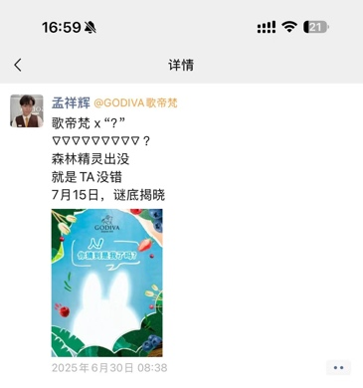
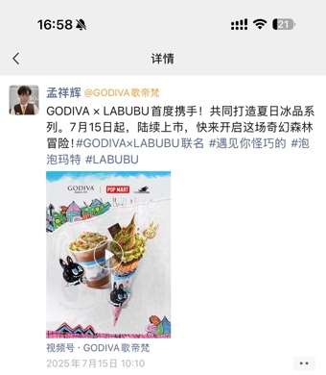
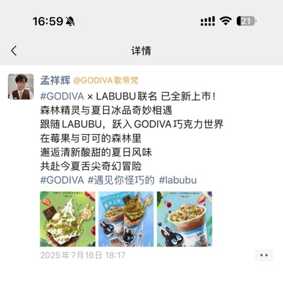
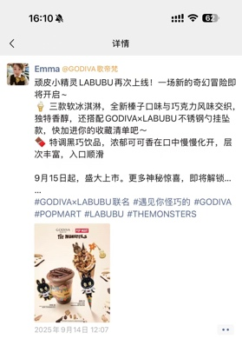
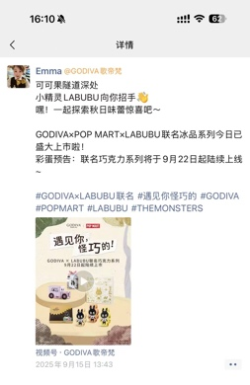
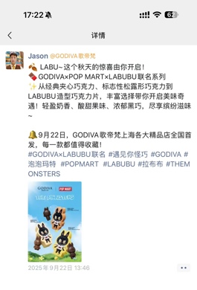
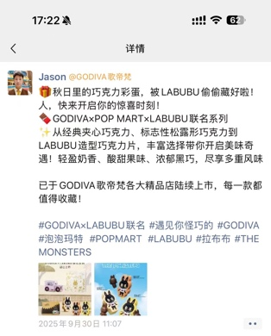
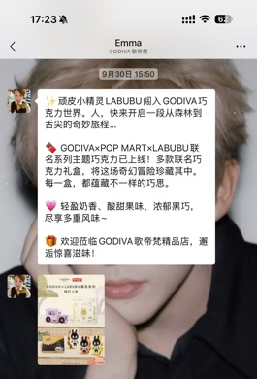

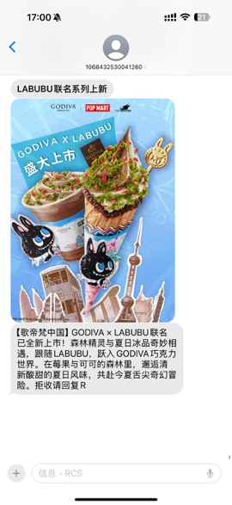
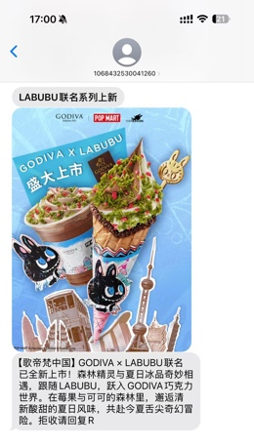
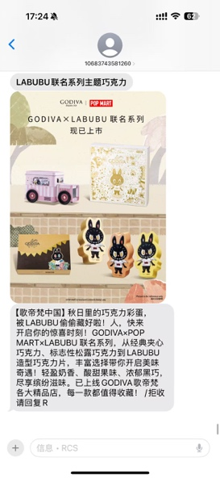
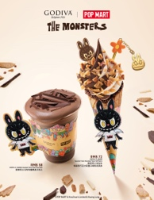
For LABUBU 3 round communications for product recommendation, CRM leveraged a combined WeCom and MMS approach to achieve broader reach and more precise targeting.
Jun 30th
Jul 15th ~ Jul 18th
Sep 14th ~ Sep 15th
Sep 22nd ~ Sep 30th
Pre-heat
Summer F&B
Autumn F&B
Chocolate
WeChat Moments impressions:
460,157
WeChat Moments impressions:
472,004
WeChat Moments impressions:
461,268
WeChat Moments impressions:
527,367
WeChat Moments impressions:
528,848
WeChat Moments impressions:
175,226
WeChat Moments impressions:
538,891
WeChat Mass Message:
489,812
Period: 7/18 ~ 7/31
Period: 9/15 ~ 9/29
Period: 9/30 ~ 10/14
TA: 50,465
TA: 75,451
TA: 58,237
MMS
Platinum members
Gold members who have purchased soft serve since May 2024
Classic members who have purchased two soft serves in a single order since May 2024
LABUBU联名秋日上新
Members who purchased the pistachio series twice or more last year
Members who have purchased F&B twice or more this year
Members who have purchased the first batch of Labubu F&B products
Members who have purchased the Labubu collaboration F&B
# of reached TA : 45,629
# of purchasers : 2,577 (6%)
Contributed sales : ¥ 982,029
Average spending : ¥ 381
GODIVA×POP MART×LABUBU联名冰品系列带来秋季新惊喜。三款软冰淇淋，全新榛子口味与巧克力风味交织，独特香醇，还搭配GODIVA×LABUBU不锈钢勺挂坠款；特调黑巧饮品，浓郁可可瞬间点燃味蕾，层次丰富，入口顺滑。9月15日起，中国大陆地区歌帝梵精品店盛大上市。一场新的奇幻冒险，等你来探索～拒收请回复R
# of reached TA : 68,156
# of purchasers : 3,835 (5.6%)
Contributed sales : ¥ 2,614,723
Average spending : ¥ 682
# of reached TA : 52,525
# of purchasers : 3,286 (6.3%)
Contributed sales : ¥ 1,757,914
Average spending : ¥ 535

Slide 16
The optimized registration process encouraged more members to complete their personal information. In 2025, the # of birthday coupons distributed, the redemption rate, and the sales contribution all exceeded the levels of 2024. In 2026, attempts will be made to leverage WeCom upgrades to implement automatic redeem reminders, increasing the redemption rate.
Birthday gift redemption drove a total sales contribution of 2.5 million on the same day, with an ROI of 3.
Membership tier | Birthday Offer | # of TA | YoY | # of Redemption | YoY | Redeem Rate | YoY | Total Sales | YoY
Platinum | RMB 200 for bulk chocolate | 866 | 37% | 580 | 59% | 67% | 9 PTS | 177,980 | 140%
 | 35% off coupon | 866 | 37% | 354 | 49% | 41% | 3 PTS | 1,392,468 | 91%
Gold | RMB 100 for bulk chocolate | 8,636 | 52% | 1,396 | 71% | 16% | 2 PTS | 192,910 | 108%
 | 20% off coupon | 8,636 | 52% | 520 | 60% | 6% | 0 PTS | 242,399 | 83%
Classic members w/ R12 speeding >200 | Free SS | 97,890 | 71% | 6,624 | 31% | 7% | -2 PTS | 172,839 | 0%
 | 10% off coupon | 97,890 | 71% | 1,475 | 69% | 2% | 0 PTS | 254,375 | 114%
Classic members w/ R12 speeding <200 | 10% off coupon | 117,194 | - | 672 | - | 1% | - | 83,088 | -

Slide 17
CRM data insight deep dive
01
02
03
Campaign
Recruit & PRR
Repeat & Retention

Slide 18
YTD # of new recruitments in 2025 was 363K, decreased by -7% YoY, achieving 91% of the KPI target.
# of
Member
Member Trans W%
2022 | 2023 | 2024 | 2025
2.4M | 2.8M | 3.2M | 3.5M
50% | 58% | 70% | 83%
New Member Recruited by Month
CNY & V-Day
MAF & National Day
HOL
Seasonal softness during key periods
The new member recruitments during CNY & V-Day (Jan & Feb), MAF & National Day (Sep & Oct), Holiday all declined.
Monthly data shows significant volatility
In Nov, new members increased by +13% YoY, primarily driven by the O2O redemption.
In Apr and Jun, the # of new members dropped sharply YoY.
*Boutique only.
*New member w/ purchase: members registered and made their first purchase within the same month.
Notes:
2025年新会员总量和增长势头不及2024年，且季节性高点表现疲软。
2025年月度数据波动性更大，招募活动的可持续性和可预测性降低。尤其四月和六月，同比下降严重
2025 年新客招募同比下滑 7%，季节性节点疲软；尤其CNY/V-Day、MAF / 国庆及假期招新均下滑，源于礼赠品类下滑超 14%
拆分位2页，一页season，一页平时；要包含好的和不好的

Slide 19
The F&B category still had the strongest recruitment performance, but the number of new recruits decreased by -6% YoY. Although Gifting accounted for only 12% of new recruits, its number of new recruits increased by 7% YoY.
Category | Member |  |  |  |  |  | New Member |  |  |  |  |  | Existing Member
 | # of Member (’K) | W% | vs. 2024 | Rev (’K) | W% | vs. 2024 | # of Member (’K) | W% | vs. 2024 | Rev (’K) | W% | vs. 2024 | # of Member (’K) | W% | vs. 2024 | Rev (’K) | W% | vs. 2024
Total | 572 | 100% | 3% | ¥177,436 | 100% | 6% | 363 | 100% | -5% | ¥79,817 | 100% | -2% | 209 | 100% | 21% | ¥97,619 | 100% | 14%
F&B | 459 | 80% | 3% | ¥68,456 | 39% | 10% | 287 | 79% | -6% | ¥37,389 | 47% | -1% | 173 | 83% | 21% | ¥31,067 | 32% | 26%
Gifting | 77 | 13% | 16% | ¥58,779 | 33% | 6% | 44 | 12% | 7% | ¥20,937 | 26% | -1% | 33 | 16% | 30% | ¥37,842 | 39% | 10%
Self Treat & Chocolate Case | 259 | 45% | 2% | ¥46,606 | 26% | 5% | 161 | 44% | -3% | ¥20,468 | 26% | -2% | 98 | 47% | 14% | ¥26,137 | 27% | 12%
Emerging | 8 | 1% | -58% | ¥3,134 | 2% | -29% | 3 | 1% | -65% | ¥901 | 1% | -42% | 4 | 2% | -49% | ¥2,232 | 2% | -23%
PKG | 21 | 4% | 52% | ¥462 | 0% | 148% | 12 | 3% | 65% | ¥121 | 0% | 274% | 9 | 4% | 37% | ¥341 | 0% | 121%

Slide 20
The decline in new member acquisition for the Classic Soft Serve the main reason for the decrease in new recruitments in 2025.
Top 15 Soft Serve by number of new recruits in 2025
Top 15 Soft Serve by number of new recruits in 2024
SKU Name | New Recruits | Recruits W% | YoY
醇黑巧巧 | 70,065 | 26% | 10%
双味巧巧 | 69,354 | 26% | 20%
浓醇黑巧克力味软冰淇淋 | 34,494 | 13% | -50%
浓醇双重巧克力味软冰淇淋 | 33,797 | 13% | -47%
歌帝梵 X 拉布布双重巧克力味软冰淇淋 | 21,869 | 8% | -
浓醇白巧克力味软冰淇淋 | 18,698 | 7% | -20%
歌帝梵X 拉布布榛果黑巧克力双重口味软冰淇淋 | 14,483 | 5% | -
浓醇抹茶巧克力味软冰淇淋 | 13,495 | 5% | 10%
浓醇榛果黑巧克力双重口味软冰淇淋 | 11,627 | 4% | -
日式柚子味软冰淇淋 | 10,655 | 4% | 26%
歌帝梵 X 拉布布黑巧克力味软冰淇淋 | 10,192 | 4% | -
浓醇柚子抹茶双重口味软冰淇淋 | 10,071 | 4% | -
浓醇柚子白巧克力味软冰淇淋 | 9,436 | 4% | -
双重巧克力味软冰淇淋配黑巧克力蝴蝶酥 | 9,089 | 3% | -
榛果黑巧双重口味软冰淇淋 | 8,218 | 3% | -
SKU Name | New Recruits | Recruits W% | VS. 2025
浓醇黑巧克力味软冰淇淋 | 69,451 | 24% | 101%
醇黑巧巧 | 63,808 | 22% | -9%
浓醇双重巧克力味软冰淇淋 | 63,479 | 22% | 88%
双味巧巧 | 57,902 | 20% | -17%
浓醇白巧克力味软冰淇淋 | 23,417 | 8% | 25%
日式柚子黑巧克力双重口味软冰淇淋 | 18,476 | 6% | -
浓郁开心果黑巧克力双重口味软冰淇淋 | 17,801 | 6% | -
浓醇草莓巧克力味软冰淇淋 | 14,490 | 5% | 1113%
浓醇抹茶巧克力味软冰淇淋 | 12,237 | 4% | -9%
草莓抹茶 | 10,289 | 4% | 945%
草莓抹茶双重巧克力味软冰淇淋 | 9,648 | 3% | 1940%
日式柚子味软冰淇淋 | 8,428 | 3% | -21%
浓郁开心果白巧克力味软冰淇淋 | 6,460 | 2% | -
如意金运双重巧克力味软冰淇淋 | 3,421 | 1% | -
如意金运黑巧克力味软冰淇淋 | 1,358 | 0% | -

Slide 21
From boutique point of view, excluded the impact of store openings and closures, the Southwest region experienced the most decline in new member acquisition.
 |  | 2025 New Recruits | 2024 New Recruits | YoY | 2025 Comp New Recruits | 2024 Comp New Recruits | YoY
Ceci Chen | 上海 | 35,330 | 38,226 | -8% | 34,813 | 38,014 | -8%
 | 杭州 | 22,452 | 24,016 | -7% | 13,742 | 15,742 | -13%
 | 宁波 | 3,615 | 4,949 | -27% | 3,615 | 4,668 | -23%
Rissa Sun | 苏州 | 35,837 | 29,585 | 21% | 17,140 | 13,497 | 27%
 | 南京 | 26,487 | 18,326 | 45% | 18,261 | 18,181 | 0%
 | 无锡 | 5,842 | 4,958 | 18% | 5,842 | 4,958 | 18%
 | 合肥 | 3,644 | 4,303 | -15% | - | - | -
Shinny Zhang | 上海 | 35,330 | 38,226 | -8% | 34,813 | 38,014 | -8%
Prince Liu | 北京 | 27,087 | 26,014 | 4% | 19,661 | 17,006 | 16%
Sunny Zhang | 天津 | 31,708 | 30,528 | 4% | 31,708 | 30,528 | 4%
 | 青岛 | 15,543 | 19,513 | -20% | 14,255 | 19,479 | -27%
 | 济南 | 13,225 | 14,606 | -9% | 13,225 | 14,606 | -9%
Chris Liu | 武汉 | 10,605 | 16,285 | -35% | 10,605 | 16,285 | -35%
 | 成都 | 10,708 | 17,588 | -39% | 7,456 | 11,111 | -33%
 | 西安 | 9,541 | 11,359 | -16% | 9,541 | 11,359 | -16%
 | 昆明 | 2,761 | 2,905 | -5% | - | - | -
 | 南昌 | 2,698 | 4,170 | -35% | - | - | -
Jenny Li | 广州 | 22,696 | 29,061 | -22% | 15,420 | 17,643 | -13%
 | 深圳 | 14,490 | 12,699 | 14% | 4,844 | 4,362 | 11%
 | 厦门 | 7,917 | 10,565 | -25% | 6,534 | 8,279 | -21%
 | 佛山 | 9,478 | 9,331 | 2% | 9,478 | 9,331 | 2%
 | 珠海 | 4,891 | 4,726 | 3% | 4,891 | 4,726 | 3%
Good execution helps increase the # of new recruited.
For example, in Beijing, with the improvement of PRR, the number of new customers increased by 4% year-on-year, and the number of new customers in comparable stores increased by 16%.
Regional performance shows significant divergence
The recruitment situation in cities in the southwest region has shown a negative growth trend overall, especially in the western regions such as Wuhan and Chengdu.
East Region
North Region
Southwest Region
Notes:
可比店

Slide 22


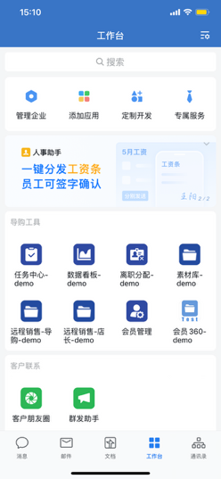
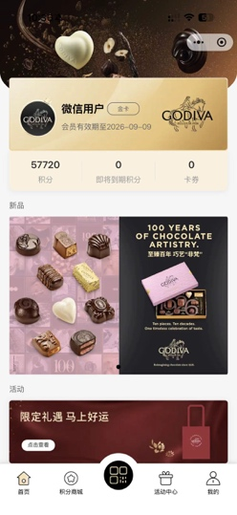
Centering on "core touchpoints (stores + member mini program + WeCom)", convert traffic from media, offline channels, and third-party platforms into new brand customers. However, at this stage, new customers cannot complete purchases without visiting the stores.
Third party Platform
Core Touchpoints
Ideal Operation
ele.me, Meituan, etc
Media Accounts
Expand remote sales scenarios to offer better door to door delivery service as added benefit, improve customer experience.
Official account
1
Social Media Acct
(eg. Red & Douyin, etc)
Channels (视频号)
Offline Scenarios
Boutique Store
WeCom
Member Mini Program
In-store QR code
2
Pop-Up promotion
3
Notes:
流量的来源之外
流量的转化路径，哪些是可以转为门店新客
分多条journey

Slide 23
Amid limited organic traffic, the stores' strong execution successfully converted visitors into brand members, with annual member orders accounting for as high as 83% and PRR also reaching 75%.
Member Trans W%
Membership orders accounted for 83%, representing a year-on-year increase of 13 pts.
WeCom
PRR
The YTD WeCom PRR was 75, representing a year-on-year increase of 14 pts..
*Boutique only.
*New member w/ purchase: members registered and made their first purchase within the same month.
Notes:
在自然流量有限的情况下，门店的强力执行将游客引导转化为品牌会员，年度会员订单占比高达83，PRR也达到75%

Slide 24
CRM data insight deep dive and Q3 performance review
01
02
03
Campaign
Recruit & PRR
Repeat & Retention

Slide 25
YTD 2025 total revenue decreased by -4% but members revenue increased by +7% vs. 2024, coming from more retention & higher frequency from existing members and higher spending from new member. Despite the increase in sales from existing members, their AUS decreased by -12% YoY.
¥ Total Rev.
216,501,838
YOY: -4%
¥ Member Rev.
185,837,813
w%: 86%
YOY: 8%
¥ Non-member Rev.
30,664,025
w%: 14%
YOY: -42%
# Member
571,809
YOY: 3%
¥ Avg. Spending
325
YOY: 4%
# Non-member
199,627
YOY: -48%
¥ Avg. Spending
154
YOY: 11%
¥New Member Rev.
86,590,942
W%: 47%
YOY: 1%
¥Existing Member Rev.
99,246,871
W%: 53%
YOY: 15%
# New Member
363,138
W%: 63.5%
YOY: -5%
¥ Avg. Spending
238
YOY: 5.8%
# Existing Member
208,671
W%: 36.5%
YOY: 22%
¥ Avg. Spending
476
YOY: -5.2%
# Frequency
1.42
YOY: 4.8%
¥ AUS
168
YOY: 1%
# IPT
4.7
YOY: 5%
# Frequency
2.11
YOY: 6.7%
¥ AUS
226
YOY: -11.1%
# IPT
6.0
YOY: -11%
*YTD 2025.01.01-2025.12.31(Boutique only).

Slide 26
YTD new member repeat purchase rate hit 21% (up +5 pts YOY); existing member’s retention rate was 18% (up +3 pts YOY).
By Month Repeat Rate (YTD)
By Month Retention Rate (YTD)
2025 FY Targeted
Rate: 16%
2025 FY Targeted
Rate: 17%
# of repeat members increased by 17,010, generating an additional RMB 2,864,649 in sales.
# of repeat members increased by 16,766, generating an additional RMB 7,328,451 in sales.
*YTD 2025.01.01-2025.12.31(Boutique only).
* Repeat rate =# of New members who purchased at least twice in the period / # of New members who purchased in the same period
* Retention rate = # of Members who purchased in the period of this year and last year / # of Members who purchased in last year
Notes:
门店通过企微对新客的运营
CRM会员节对于老客的维护

Slide 27
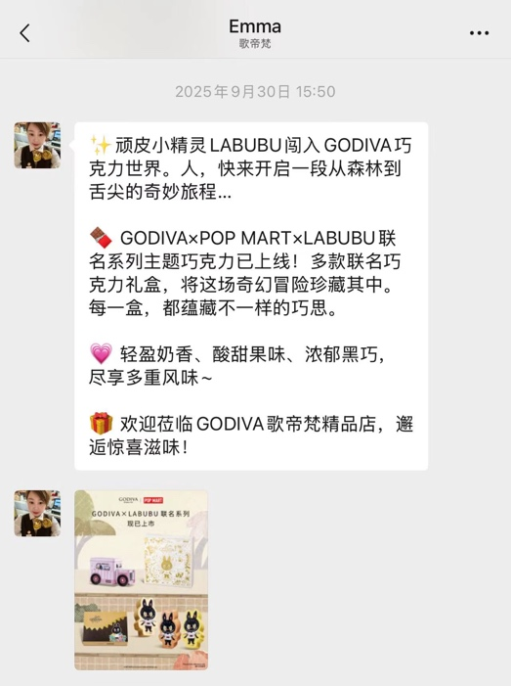
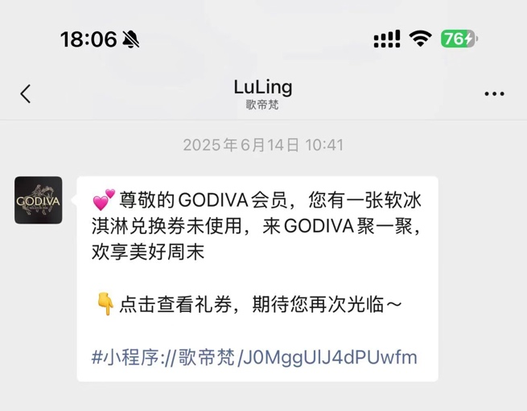
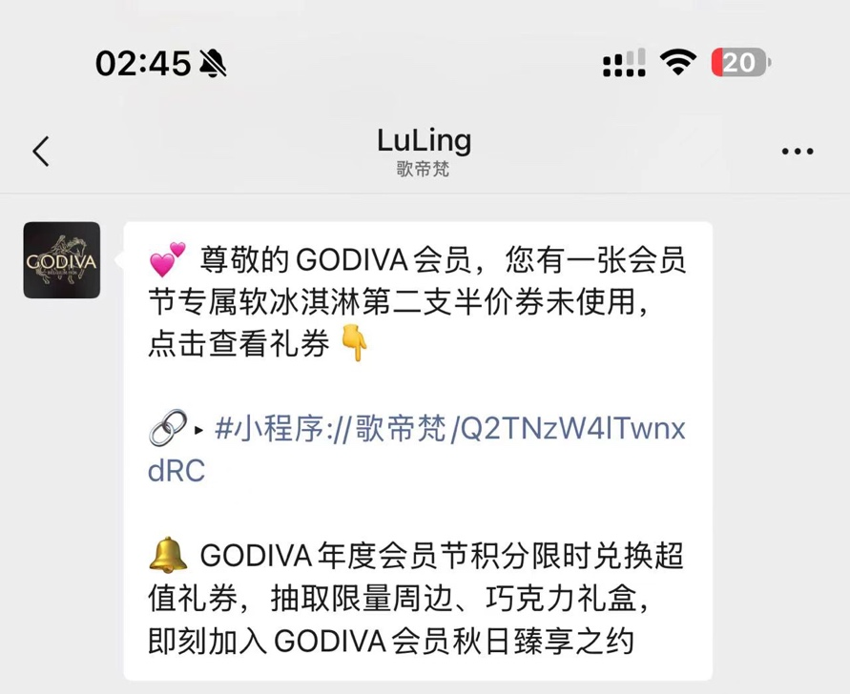
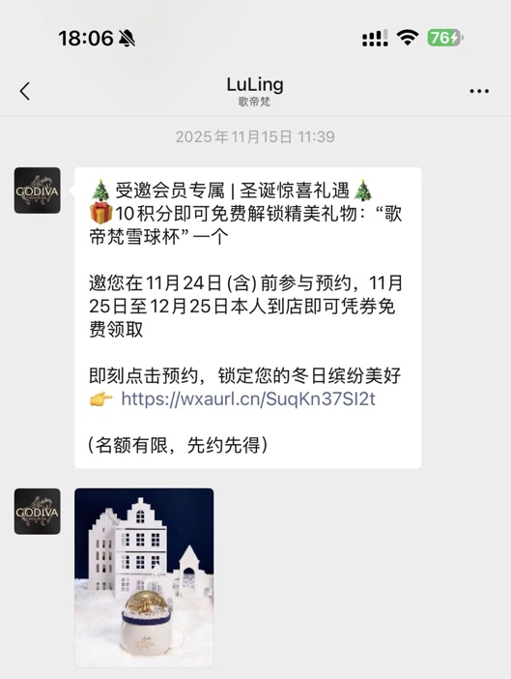
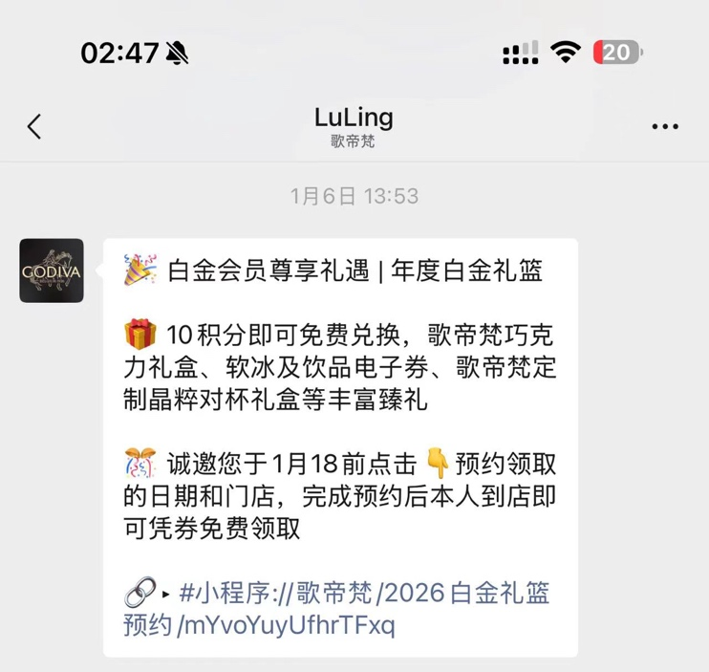
The role of WeCom in improving repeat rate and retention rate
Coupon Redeem Reminder
For Repeat Purchase
WeCom Moment
# of Tasks: 56
# of Reaches: 24,405,196
Mass message
# of Tasks: 84
# of Reaches: 2,750,189
Exclusive Gift for VIP
Retention Purchase
Exclusive Gift for VIP
Retention Purchase
Member Festival
For Active Members

Slide 28
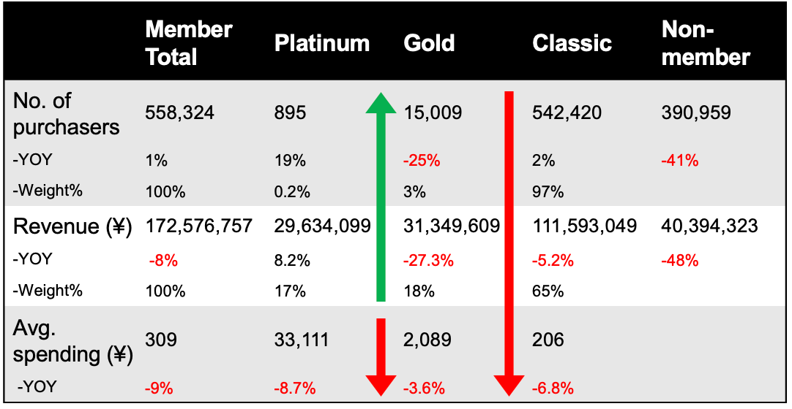
The proportion of spending by Platinum members increased by 1 pts vs. 2024, driven by higher transaction frequency. The # of Gold members continued to decline, W% of active members dropping by 0.5 pts and sales contribution decreasing by 1 pts. The sales contribution of Classic members remained flat vs. 2024.
 | Platinum | Gold | Classic | Non-member
No. of purchasers | 1,070 | 14,425 | 556,314 | 199,627
-YOY | 20% | -4% | 3% | -48%
Revenue (¥) | 34,180,549 | 31,155,340 | 120,501,923 | 30,664,025
-YOY | 15% | -1% | 8% | -42%
Avg. spending (¥) | 31,944 | 2,160 | 217 | 154
-YOY | -4% | 3% | 5% | 11%
Frequency | 56.32 | 5.64 | 1.46 | -
-YoY | 30% | 2% | 8%
AUS | 567 | 383 | 148 | -
-YoY | -26% | 2% | -2%
Platinum
# member purchasers: 1,070 (w%: 0.2%)
Revenue: 34M (w%: 18%)
Gold
# member purchasers : 14,425(w%: 2.5%)
Revenue: 31.2M (w%: 16.9%)
Classic
# member purchasers : 556,314 (w%: 97%)
Revenue: 120.5M (w%: 65%)
*YTD 2025.01.01-2025.12.31(Boutique only).
Notes:
金卡的人数占比少了，总的revenue占比基本不变
白金的生意占比提高

Slide 29
Compared to the past two years, the proportion of members contributing to the top 30% of sales has decreased, indicating greater concentration of sales among top-tier VIP members.
The average spending in the middle 50% of sales has declined, while the proportion of members in this segment has increased, forming the foundational member base for the brand. The average spending among bottom-tier members has increased, though their share of the total member base has decreased.
Spending range(RMB) | Sales w% | No. of Consumer | No. of Consumer w% | Average spending | Average frequency | AUS
>=42035 | 10% | 216 | 0.04% | 86,531 | 115.37 | 1,511
7861 - 41912 | 10% | 1,070 | 0.2% | 17,518 | 40.75 | 1,075
1999 - 7849 | 10% | 5,623 | 1.0% | 3,330 | 9.42 | 803
986 - 1999 | 10% | 14,091 | 2% | 1,328 | 4.62 | 533
610 - 986 | 10% | 24,739 | 4% | 757 | 3.20 | 370
406 - 610 | 10% | 38,317 | 7% | 489 | 2.45 | 277
275 - 406 | 10% | 56,111 | 10% | 334 | 1.94 | 220
187 - 275 | 10% | 83,933 | 15% | 223 | 1.50 | 173
128 - 187 | 10% | 129,149 | 22% | 145 | 1.15 | 134
<= 128 | 10% | 222,818 | 39% | 84 | 1.03 | 83
Original Loyalty
Optimized Loyalty
VENCHI
Laderach
Hagen-Dazs
Starbucks
omni-channel
omni-channel
Platinum
Platinum
Black
Diamond
Black Gold
Diamond
Platinum
Gold
Gold
Platinum
Platinum
Gold
Gold
VS.
Competitor
Gold
Gold
Silver
Silver
Silver
Jade
Classic
Silver
Classic
Explorer
Ordinary
Explorer
Explorer
Silver
Notes:
标注一下白金/金卡/经典卡

Slide 30
Membership benefits matrix
Type | Potential | Classic | Silver | Gold | Platinum
Est. No. | - | - | 110K | +5000 | 持平
Discount | - | - | - | 10% off | 20% off
Accelerated Points | - | 1x points | 1.2x points | 1.5x points | 2x points
Points Redemption | - | - | Exclusive redemption | Exclusive redemption | Exclusive redemption
Birthday Gift | - | 10% off coupon | 10% off coupon Free SS | 20% off coupon RMB 100 bulk chocolate | 35% off coupon RMB 200 bulk chocolate
Birthday Month Benefit | - | 1.5x points | 1.5x points | 2x points | 2.5x points
Exclusive Gift | - | - | - | - | Platinum Hamper
Brand Events | - | Event invitations | Event invitations | Event invitations | Event invitations

Slide 31
Contents
01
02
03
04
Market Trend 2026
CRM data insight deep dive
2026 CRM strategy
CRM Action Plan in 2026

Slide 32
Optimizing Member Engagement: A Precision Lifecycle Approach for 2026
Precise Member Engagement Driven by Lifecycle
New Initiative in 2026
GODIVA CRM 2026 Mission
Precise Member Engagement Driven by Lifecycle
What to offer:
Seamless consumer experience through omni channel in retail
Member Growth
Active Member Growth
Targeted Consumer Driven Growth
Drive new member registrations through increased store traffic；Focus on acquiring new members from store traffic.
Existing members' scenario-based lifecycle engagement
Focus on the engagement of mid-to-high-end customer segments.
Where to engage:
Differentiated member experience by moment
CRM Operation
Differentiate Content Communication via
WeChat Acct., WeCom through MA
Product Insights to
Boutique & Product Team
Customized Experience via WeCom by scenario in Boutique
Upgrade of the in-store experience in CRM Campaign Operation.
Loyalty Program Upgrade
How to configuer:
“Intelligentize” CRM operations
IT Platform and Application
New Loyalty Program
Data Analysis Platform
Dashboard
MA Upgrade
WeCom Upgrade
Notes:
基于member lifecycle 做更精细化的会员运营

Slide 33
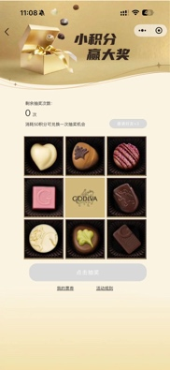
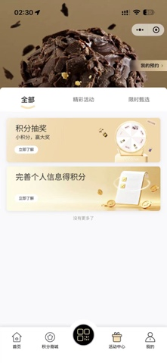
“As-is” Lifecycle Operation
Growth & Activation Phase
Decline & Early Warning Phase
Birthday Greeting
Member Week
Member Festival
Seasonal greeting for specific group
1
3
5
2
4
Acquisition & Onboarding Phase
Maturity & Loyalty Phase
Churn & Reactivation Phase
VIP membership benefits
HOL Gift for VIPs
Platinum Hamper
Member Festival
Follow Store WeCom & Register
Points rewards to encourage to complete personal info

Slide 34
Full Lifecycle Member Management
Lifecycle Model Design
Growth & Activation Phase
Decline & Early Warning Phase
Auto NPS filling invitation via WeCom
Auto repurchase coupon reminder via WeCom
Push scenario-based content such as "Afternoon Tea Inspiration" and "Office Snack Supply”.
Flag members who have not made a purchase in 30–90 consecutive days, and offer "Exclusive for Old Friends" high-value coupons or limited-edition product trial opportunities.
1
3
5
2
4
Acquisition & Onboarding Phase
Maturity & Loyalty Phase
Churn & Reactivation Phase
Drive traffic through chief table or other media channels.
Simplify the registration process and use points rewards to encourage users to complete preference information, accumulating key initial data for subsequent personalized operations.
More reward point activities lay the foundation for the point program.
Link upgrade tasks to spending and engagement behaviors and motivate tier growth through upgrade rewards.
Exclusive invited event for VIP, like Master Class.
During major brand events (e.g., annual promotions), re-engage low-value users as new potential customers.
For churned members with historically high spending, conduct one-on-one phone follow-ups via dedicated customer service.
Notes:
Highlight这一页跟下面use case相关的部分

Slide 35
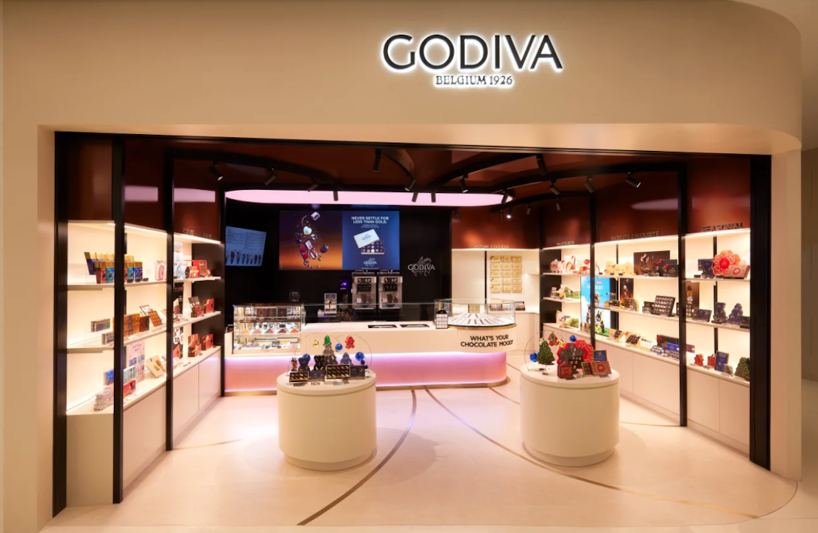
User Case 1: Attracting more in-store traffic and driving conversions through the Chief Table.
1
Store Experience & Traffic Acquisition
Attract and engage visitors by featuring the Chief Table in offline stores.
2
First-Purchase Conversion
Scan QR code to register, receive a complimentary tasting coupon, and get an exclusive registration gift after adding the Enterprise WeChat account.
3
Repurchase & Reminders
Use Enterprise WeChat and MA (Marketing Automation) tools to send coupon reminders within repurchase cycles.
4
Long-Term Engagement
Reach customers multiple times through birthday rewards, points malls, and other scenarios to foster loyalty and conversion.

Slide 36
User Case 2: CRM conducted a pilot of repeat coupon reminders via WeCom, which increased the redemption rate. The next step is to upgrade the WeCom to automate these reminders.
Standardize repeat coupon reminders via MA and WeCom
WeCom Reminder of Redeem
WeCom Reminder of Redeem
SAs receive and excite WeCom mass massage task
Members receive massage in WeChat
The CRM tracks task execution status via the SA dashboard.

Slide 37
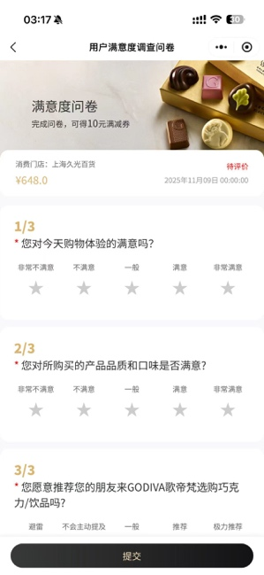
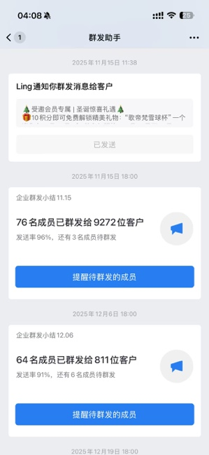
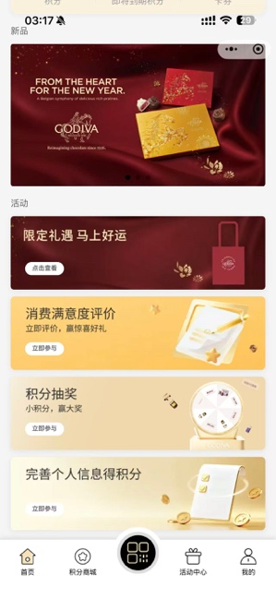
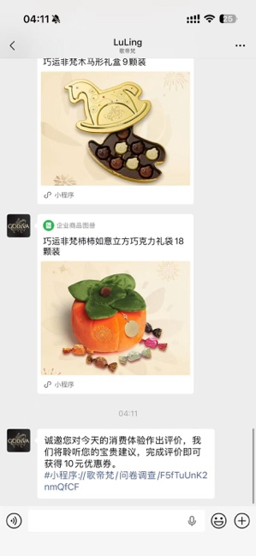
User Case 3: After purchase, member receive a customer satisfaction survey WeChat from SA.
The questionnaire content has been upgraded.
SA receive WeCom mass message tasks daily
Now
Future
Members receive message via WeChat
MP added questionnaire entry
Achieve Higher Collection Rate
The # of collected surveys increased MoM
+ 400%

Slide 38
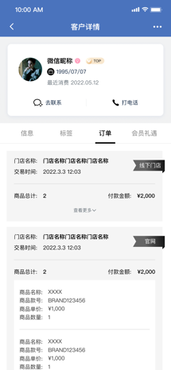
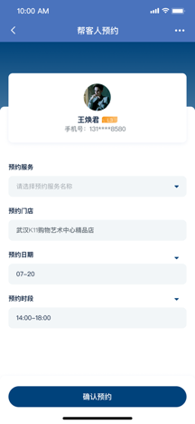
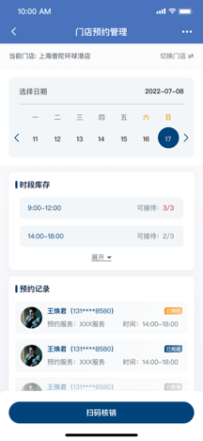
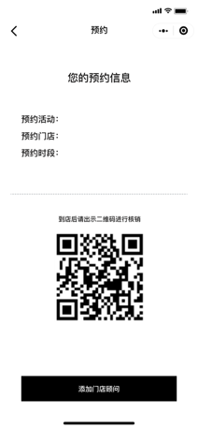
User Case 4: Optimize the Master Class process, involve stores in VIPs invitation efforts via WeCom, and deliver precise services
SA
Consumer
Member 360 Targeting Module
Filter Platinum/Premium members via tags
Cross-reference: Purchase history + Tier expiration dates
Send chocolate workshop invites via WeChat
WeChat Invitation Process
Receive SA's event invitation
Select date & submit registration
Mobile Preparation
View reservations in real-time
In-Store Experience
Bring guests + Present participation QR code
WeCom Check-in
Scan QR code for attendance verification

Slide 39
“As-is” Points mall gain high engagement within limited group. However, many members with low points are unable to participate in point redemption activities
Points Group | # Member | W% | # of Participators | Participate Rate | # of Redemption | Convert Sales | Avg. spending
1-200 | 320,631 | 63% | 1,606 | 0.5% | 2,124 | 49,372 | 77
200-500 | 131,107 | 26% | 1,156 | 0.9% | 1,669 | 62,000 | 108
500-1000 | 39,628 | 8% | 673 | 1.7% | 1,033 | 47,315 | 128
1,000-2,000 | 13,354 | 3% | 496 | 3.7% | 926 | 54,616 | 175
2,000-5,000 | 4,817 | 1% | 416 | 8.6% | 1,173 | 57,844 | 161
5,000-10,000 | 1,078 | 0.21% | 199 | 18.5% | 489 | 37,369 | 186
10,000-50,000 | 932 | 0.18% | 398 | 42.7% | 1,894 | 605,864 | 1,061
50,000-100,000 | 163 | 0.03% | 118 | 72.4% | 674 | 474,400 | 2,372
>100,000 | 77 | 0.02% | 60 | 77.9% | 542 | 752,991 | 4,858
Membership points distribution
Notes:
Highlight一些数据

Slide 40
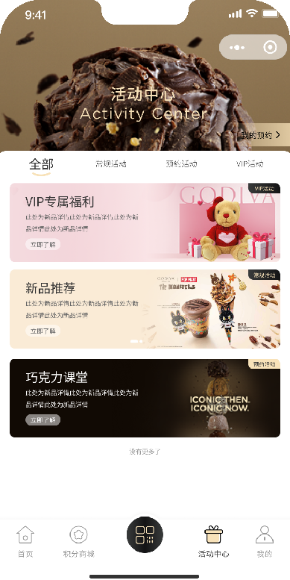
Upgrade the points mall with devise campaign to optimize member experience.
Points Rewards
Customers can earn points by checking in, or sharing their experiences with chocolate products.Enhance interaction between customers and brand, boost community activity, and improve customer retention.
Points Burn
Design limited-edition chocolate gift boxes or customized products that customers can redeem with points.
Launch activities such as redeeming points for event participation slots and chocolate tasting opportunities. Enhance brand recognition and improve customer loyalty through offline experiences.
Launch more point-based incentive activities in the activity center to boost member participation and redemption capabilities.

Slide 41
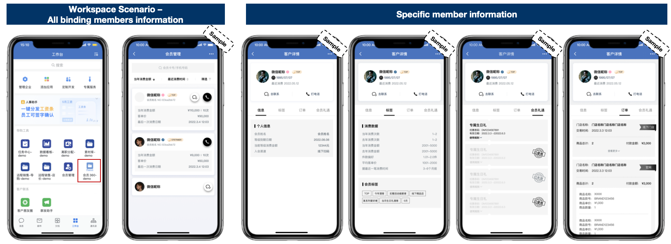
How to Engage: Integrate with D365 & SCRM to improve member profile
SAs retrieve member profiles by customer ID in the WeCom Workstation mobile app.
Provide product recommendations based on purchase history
Check the member‘s tier status and renewal date and remind guests to renew in time to maintain their level.
Including the following relationships:
- Binding Members
- WeCom Friends
- Binding Members & WeCom Friends
Binding members information of:
- Basic Information (like membershiptier, membershiptier renew date...)
- Tags
- Orders
- Coupon
Check if the guest has any unused coupons and remind them to use them before expiration.
Notes:
User Journey

Slide 42
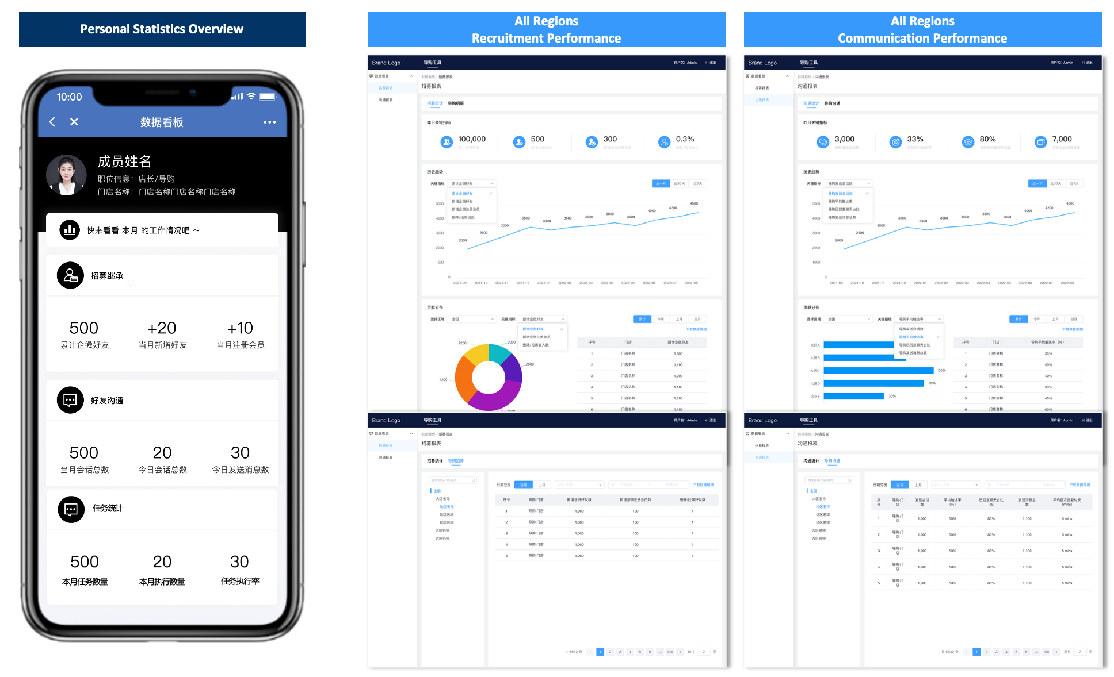
How to Engage: Monitor the recruitment of members in real time and the execution of WeCom tasks through the SA dashboard

Slide 43
Contents
01
02
03
04
Market Trend 2026
CRM data insight deep dive
2026 CRM strategy
CRM Action Plan in 2026

Slide 44
KPI Targets
# of members recruited
PRR
Repeat Rate
Retention Rate
Campaign Contributions
2026 Target
363K
80%
18%
18%
39M
2025 Actual
363K
75%
17%
18%
39M
Notes:
放2025年的数据
增长率

Slide 45
CRM Planning & Calendar in 2026
Jan | Feb | Mar | Apr | May | Jun | Jul | Aug | Sep | Oct | Nov | Dec
Seasonal Members Communication
CRM Campaign
Lifecycle Campaign
1. New member engagement; 2. Repeat & Retention; 3. Win-back & Awaken; 4. Birthday; 5. Anniversary Greeting; 6. NPS Revamp
Burn Points: Points Mall + Member Day
Regular Store Support
Store Open & Close Support + 400 Hotline
V-Day 2/14
*Women’s Day 3/8
* Spring
* Labor Day 5/1
* Children’s Day 6/1
* Father’s Day 6/21
* CVD 8/19
* FMC Autumn LTO
* National day 10/1
* Halloween 11/1
CNY 2/17
* New Pastry
* Centennial Praline
* Mother’s Day 5/10
* 520 5/17
* DBF 6/19
* MAF Aug- Sep
* Centennial Truffle
* X’mas 12/25
* Centennial Wave 1 LTO
* Core SS & Beverage
*Chilled Bliss
*Summer LTO
* Centennial Wave 2 LTO
* Platinum Hamper
*Member Festival
*Member Festival
* Platinum Booster
* Gold membership limited
* Points Clean up
* Platinum membership limited
* X'mas Gift

Slide 46
CRM Project Timeline 2026
Q1 2026
Q2 2026
Q3 2026
Q4 2026
WeCom 2nd Phase
Launch new features
Develop dashboards to view WeCom data
MA Upgrade
Create scenarios in CEA
Integrate with WeCom
Loyalty Program
Update Loyalty Program
Mini-program Upgrade (2nd Phase)
Upgrade the Points Mall

