Slide 1
L17: Introduction to “Irregular” Algorithms and MPI, cont.
November 8, 2011

Slide 2
Administrative
Class cancelled, Tuesday, November 15
Guest Lecture, Thursday, November 17, Ganesh Gopalakrishnan
CUDA Project 4, due November 21
  Available on CADE Linux machines (lab1 and lab3) and Windows machines (lab5 and lab6)
  You can also use your own Nvidia GPUs

Slide 3
Outline
Introduction to irregular parallel computation
  Sparse matrix operations and graph algorithms
Finish MPI discussion
  Review blocking and non-blocking communication
  One-sided communication
Sources for this lecture:
  http://mpi.deino.net/mpi_functions/
  Kathy Yelick/Jim Demmel (UC Berkeley): CS 267, Spr 07 • http://www.eecs.berkeley.edu/~yelick/cs267_sp07/lectures
  “Implementing Sparse Matrix-Vector Multiplication on Throughput Oriented Processors,” Bell and Garland (Nvidia), SC09, Nov. 2009.

Slide 4
Motivation: Dense Array-Based Computation
Dense arrays and loop-based data-parallel computation has been the focus of this class so far
Review: what have you learned about parallelizing such computations?
  Good source of data parallelism and balanced load
  Top500 measured with dense linear algebra
    How fast is your computer?” = “How fast can you solve dense Ax=b?”
  Many domains of applicability, not just scientific computing
    Graphics and games, knowledge discovery, social networks, biomedical imaging, signal processing
What about “irregular” computations?
  On sparse matrices? (i.e., many elements are zero)
  On graphs?
  Start with representations and some key concepts

Slide 5
Sparse Matrix or Graph Applications
Telephone network design
  Original application, algorithm due to Kernighan
Load Balancing while Minimizing Communication
Sparse Matrix times Vector Multiplication
  Solving PDEs • N = {1,…,n}, (j,k) in E if A(j,k) nonzero, •
  WN(j) = #nonzeros in row j, WE(j,k) = 1
VLSI Layout
  N = {units on chip}, E = {wires}, WE(j,k) = wire length
Data mining and clustering
Analysis of social networks
Physical Mapping of DNA

Slide 6
Dense Linear Algebra vs. Sparse Linear Algebra
Matrix vector multiply:
for (i=0; i<n; i++)
for (j=0; j<n; j++)
a[i] += c[j][i]*b[j];
What if n is very large, and some large percentage (say 90%) of c is zeros?
Should you represent all those zeros? If not, how to represent “c”?

Slide 7
Sparse Linear Algebra
Suppose you are applying matrix-vector multiply and the matrix has lots of zero elements
  Computation cost? Space requirements?
General sparse matrix representation concepts
  Primarily only represent the nonzero data values
  Auxiliary data structures describe placement of nonzeros in “dense matrix”

Slide 8
Some common representations
[
]
1 7 0 0
0 2 8 0
5 0 3 9
0 6 0 4
A =
[
]
ptr = [0 2 4 7 9]
indices = [0 1 1 2 0 2 3 1 3]
data = [1 7 2 8 5 3 9 6 4]
* 1 7
* 2 8
5 3 9
6 4 *
data =
offsets = [-2 0 1]
Compressed Sparse Row (CSR): Store only nonzero elements, with “ptr” to beginning of each row and “indices” representing column.
DIA: Store elements along a set of diagonals.
[
]
[
]
1 7 *
2 8 *
5 3 9
6 4 *
0 1 *
1 2 *
0 2 3
1 3 *
data =
indices =
row = [0 0 1 1 2 2 2 3 3]
indices = [0 1 1 2 0 2 3 1 3]
data = [1 7 2 8 5 3 9 6 4]
ELL: Store a set of K elements per row and pad as needed. Best suited when number non-zeros roughly consistent across rows.
COO: Store nonzero elements and their corresponding “coordinates”.

Slide 9
Connect to dense linear algebra
Dense matvec from L15:
for (i=0; i<n; i++) {
for (j=0; j<n; j++) {
a[i] += c[j][i] * b[j];
}
}
Equivalent CSR matvec:
for (i=0; i<nr; i++) {
for (j = ptr[i]; j<ptr[i+1]-1; j++)
t[i] += data[j] * b[indices[j]];

Slide 10
Other Representation Examples
Blocked CSR
  Represent non-zeros as a set of blocks, usually of fixed size
  Within each block, treat as dense and pad block with zeros
  Block looks like standard matvec
  So performs well for blocks of decent size
Hybrid ELL and COO
  Find a “K” value that works for most of matrix
  Use COO for rows with more nonzeros (or even significantly fewer)

Slide 11
Today’s MPI Focus – Communication Primitives
Collective communication
  Reductions, Broadcast, Scatter, Gather
Blocking communication
  Overhead
  Deadlock?
Non-blocking
One-sided communication

Slide 12
Quick MPI Review
Six most common MPI Commands (aka, Six Command MPI)
  MPI_Init
  MPI_Finalize
  MPI_Comm_size
  MPI_Comm_rank
  MPI_Send
  MPI_Recv
Send and Receive refer to “point-to-point” communication
Last time we also showed Broadcast communication
  Reduce

Slide 13
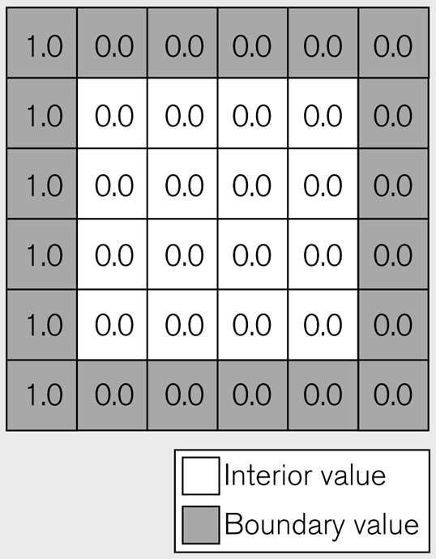
More difficult p2p example: 2D relaxation
Replaces each interior value by the average of its four nearest neighbors.
Sequential code:
for (i=1; i<n-1; i++)
for (j=1; j<n-1; j++)
b[i,j] = (a[i-1][j]+a[i][j-1]+
a[i+1][j]+a[i][j+1])/4.0;
Copyright © 2009 Pearson Education, Inc. Publishing as Pearson Addison-Wesley

Slide 14
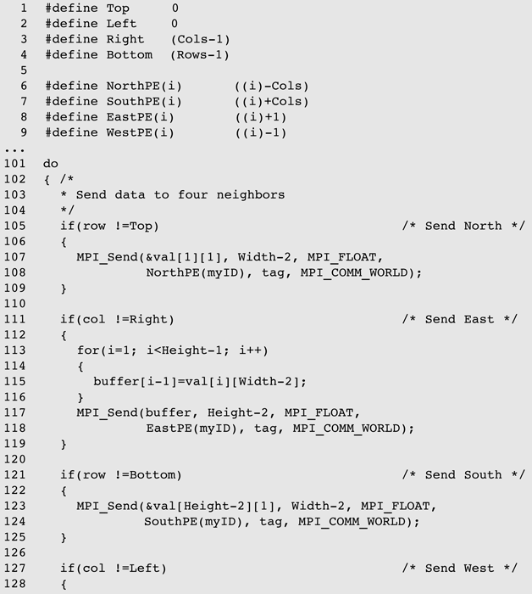
MPI code, main loop of 2D SOR computation
Copyright © 2009 Pearson Education, Inc. Publishing as Pearson Addison-Wesley

Slide 15
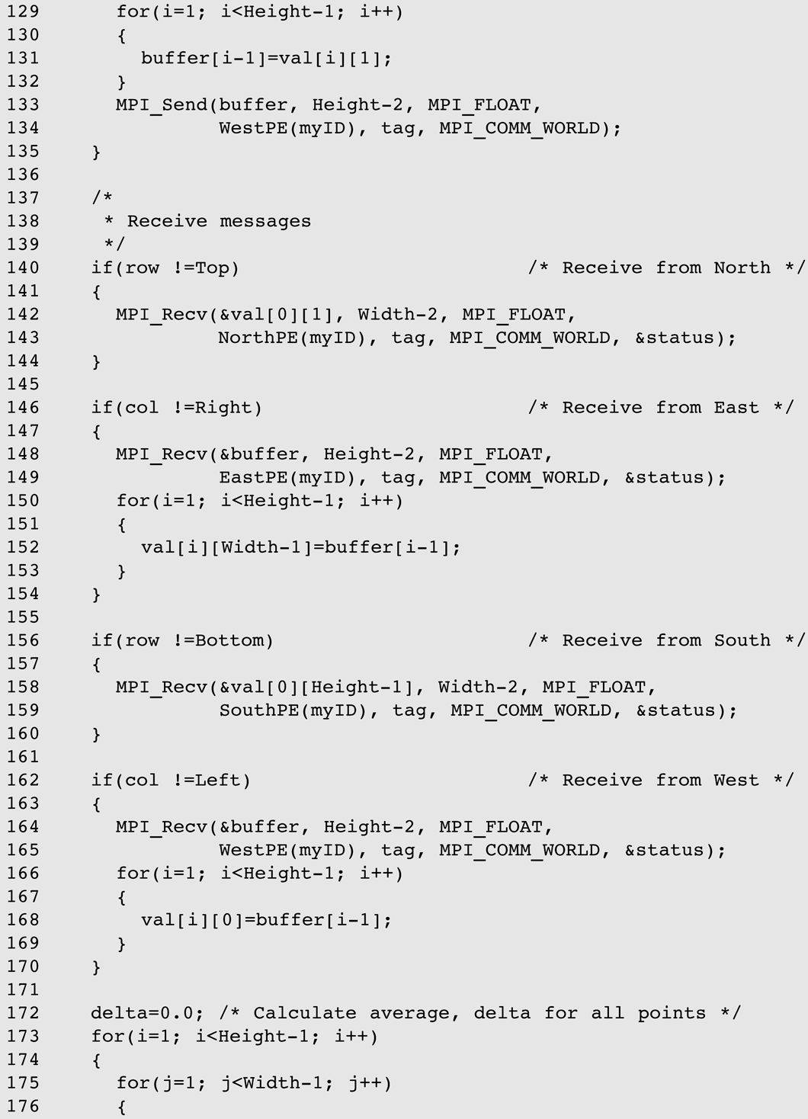
MPI code, main loop of 2D SOR computation, cont.
Copyright © 2009 Pearson Education, Inc. Publishing as Pearson Addison-Wesley

Slide 16
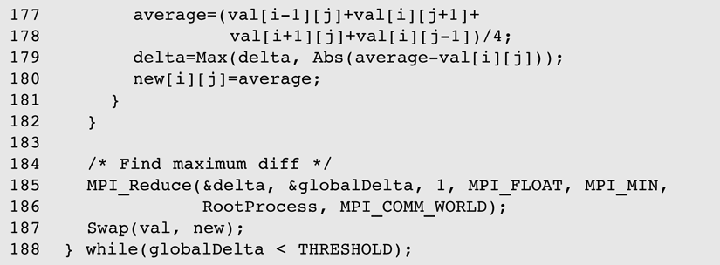
MPI code, main loop of 2D SOR computation, cont.
Copyright © 2009 Pearson Education, Inc. Publishing as Pearson Addison-Wesley

Slide 17
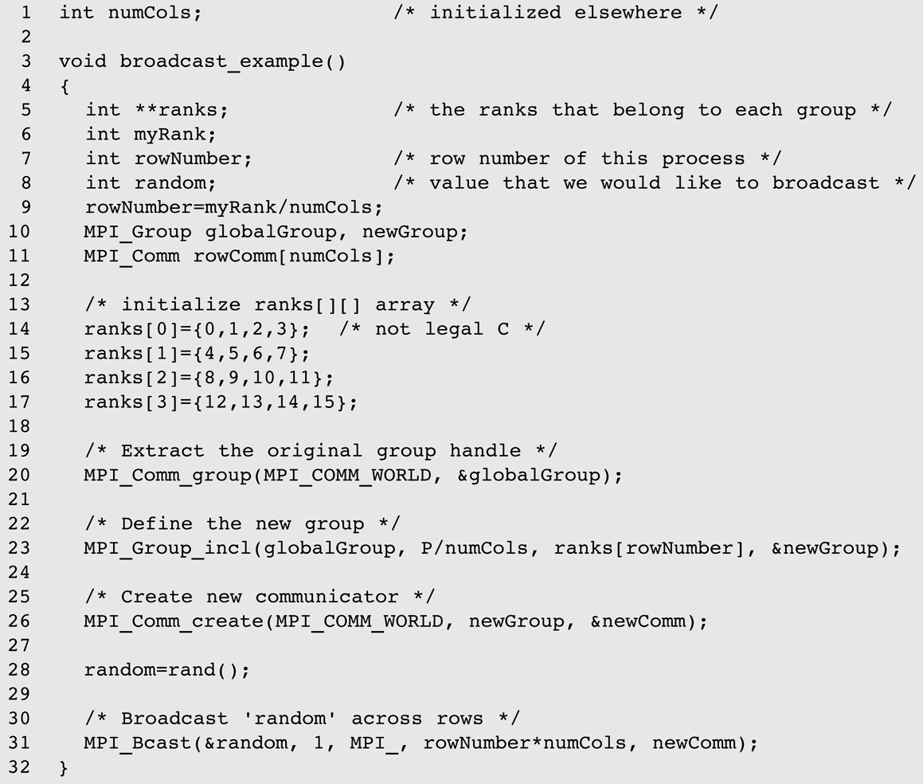
Broadcast: Collective communication within a group
Copyright © 2009 Pearson Education, Inc. Publishing as Pearson Addison-Wesley

Slide 18
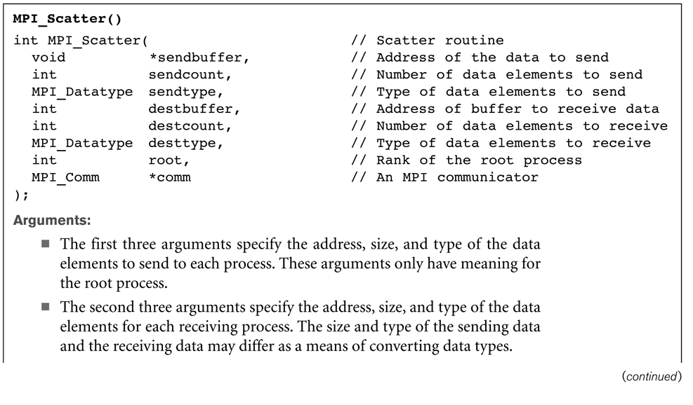
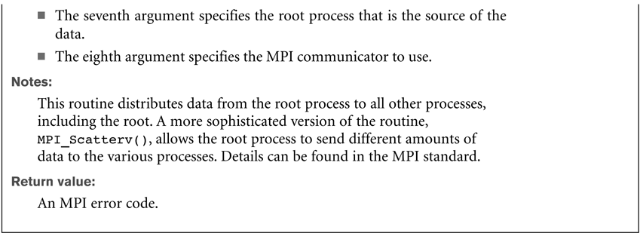
MPI_Scatter()
Copyright © 2009 Pearson Education, Inc. Publishing as Pearson Addison-Wesley

Slide 19
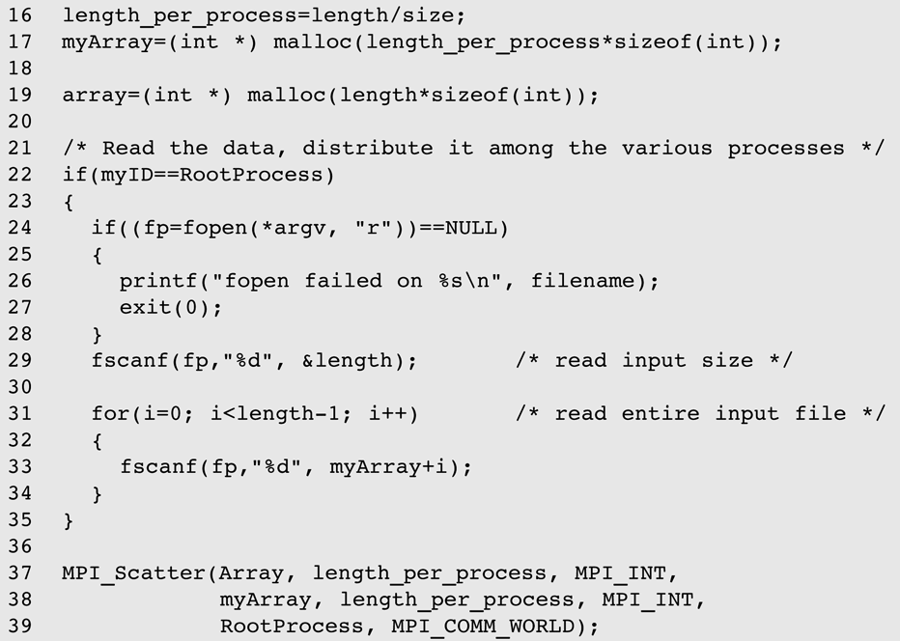
Distribute Data from input using a scatter operation
Copyright © 2009 Pearson Education, Inc. Publishing as Pearson Addison-Wesley

Slide 20
Other Basic Features of MPI
MPI_Gather
    Analogous to MPI_Scatter
Scans and reductions (reduction last time)
Groups, communicators, tags
  Mechanisms for identifying which processes participate in a communication
MPI_Bcast
  Broadcast to all other processes in a “group”

Slide 21

The Path of a Message
A blocking send visits 4 address spaces
Besides being time-consuming, it locks processors together quite tightly
Copyright © 2009 Pearson Education, Inc. Publishing as Pearson Addison-Wesley

