Slide 1
Advanced Servlet技术

Slide 2

内容
Servlet 4.0
文件上传
文件下载
生成图像
Session
Filter
Listener

Slide 3
1.Servlet 3.0和4.0
Servlet 3.0 Introduction
Create Servlet 3.0 Project
Servlet 3.0 Example

Slide 4
Servlet 3.0
Java EE 6规范的核心内容
新增功能包括：
  标注（annotation）代替web.xml配置
  文件上传支持
  异步的Servlet

Slide 5
Servlet4.0
Servlet 4.0 是 Servlet的最新版本，也是 Java EE 8 规范的核心更新。
Servlet 4.0 支持 HTTP/2
新增功能主要是服务器推送

Slide 6
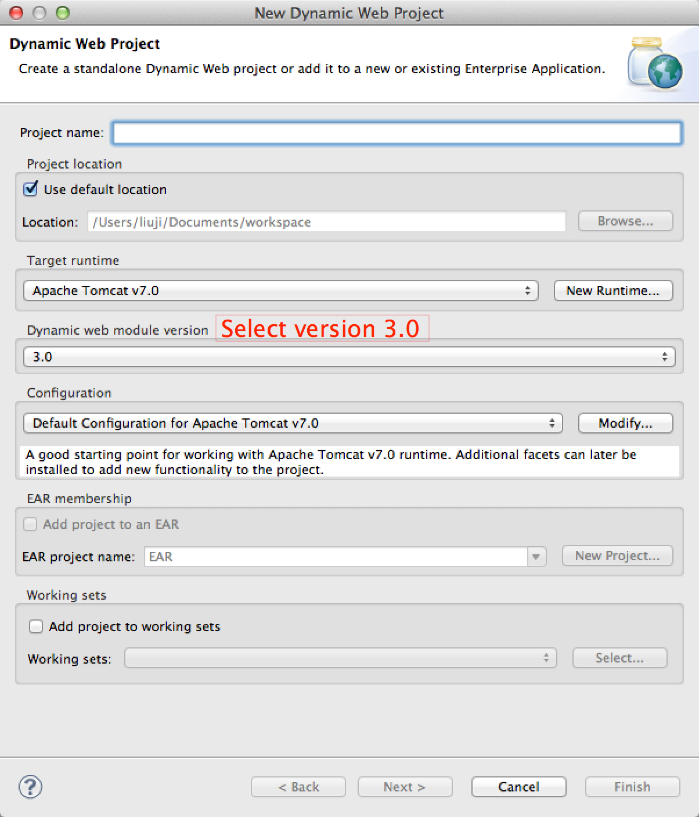
Create Servlet 3.0 Project

Slide 7
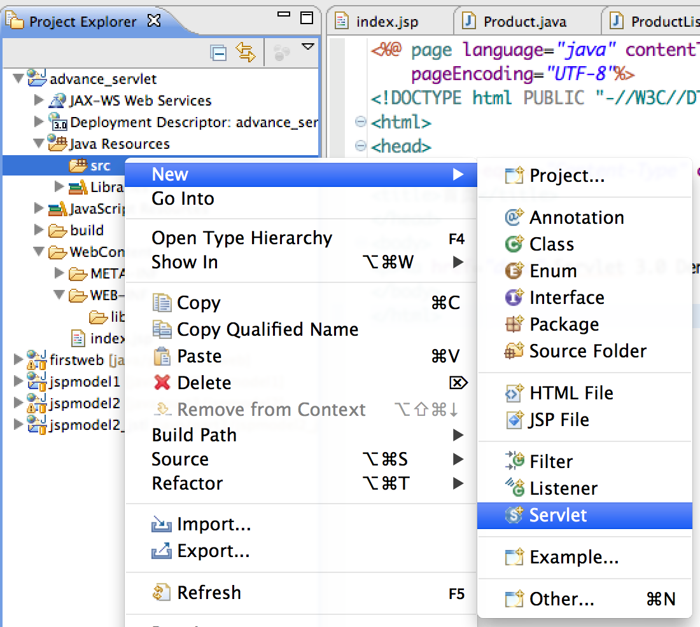
Create a Servlet

Slide 8
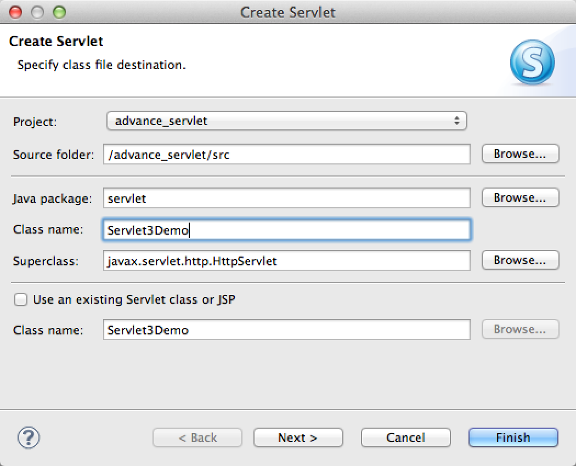
Create a Servlet

Slide 9
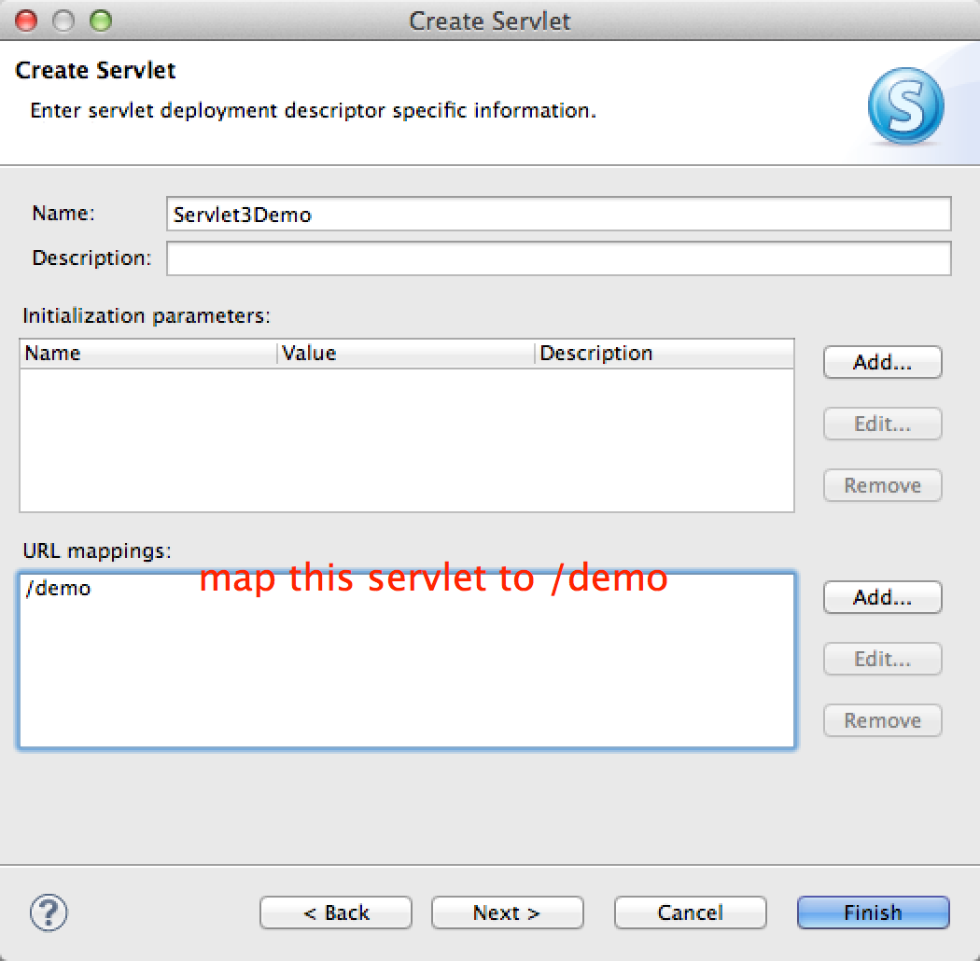
Create a Servlet

Slide 10
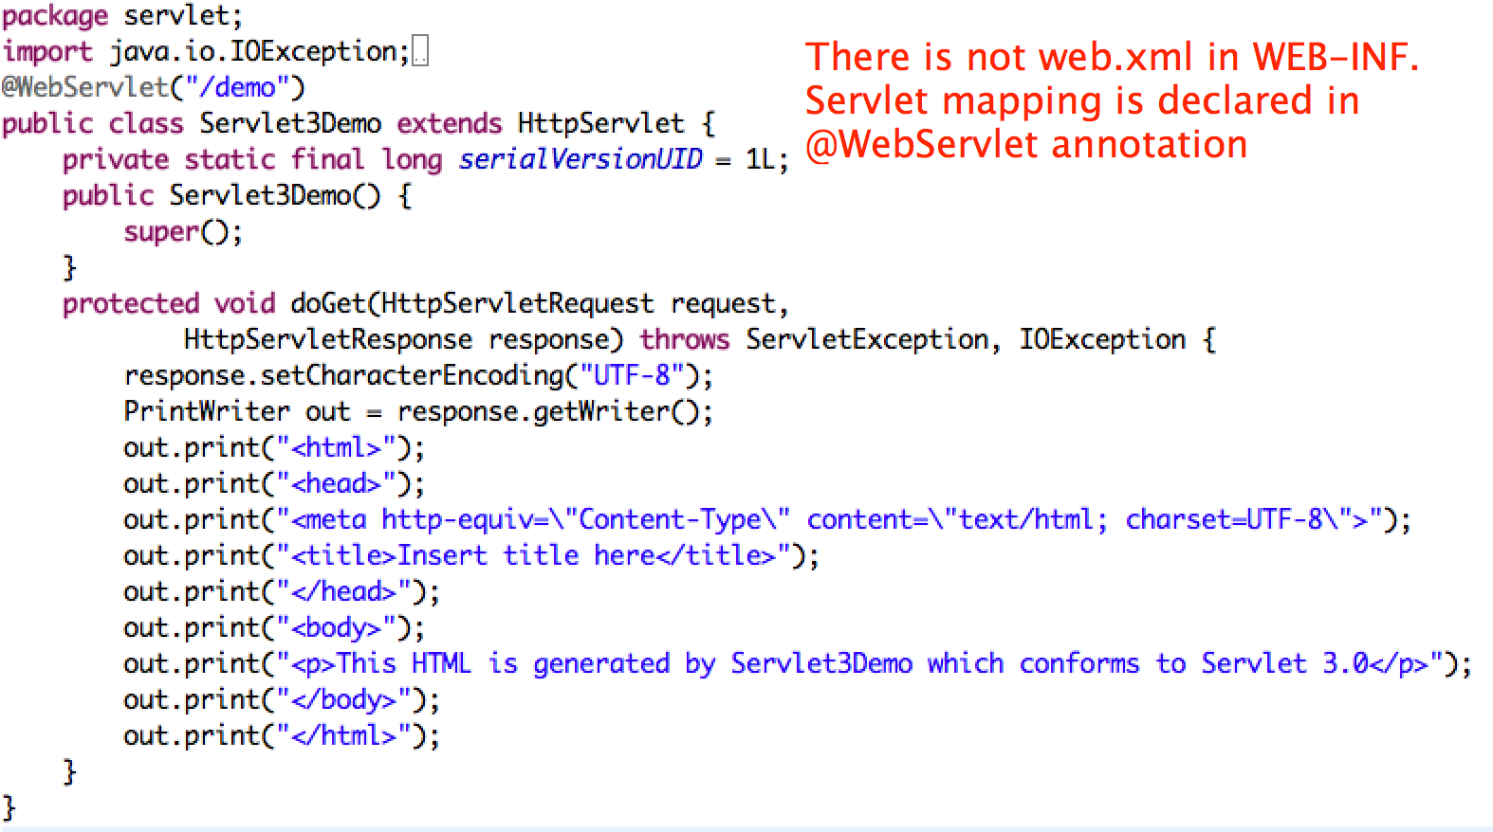
Servlet 3.0 Example

Slide 11
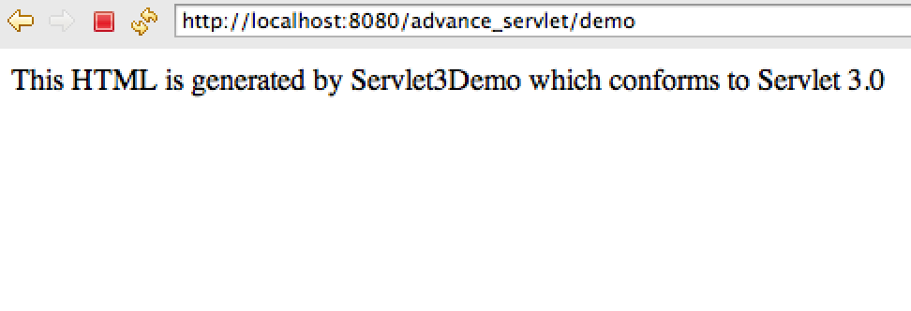
Test Result

Slide 12
2.File Upload
Write a file upload form
Write a file upload servlet

Slide 13
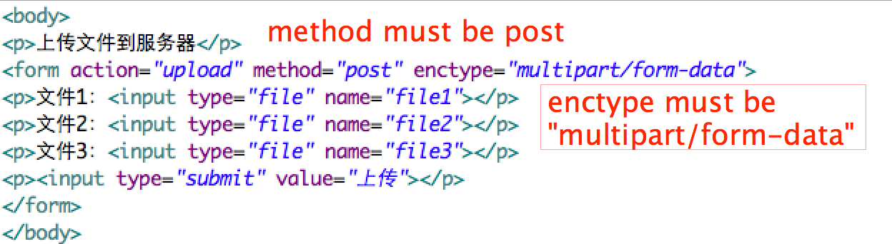
Write a Upload Form

Slide 14
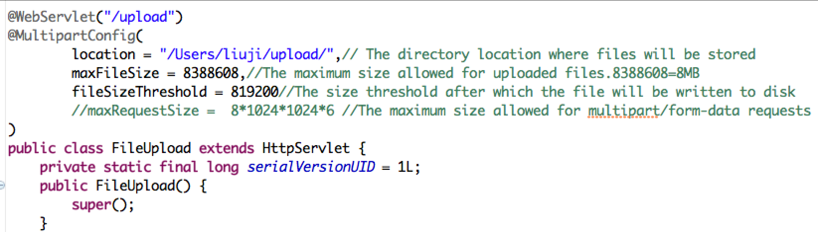
Write a Upload Servlet(1)

Slide 15
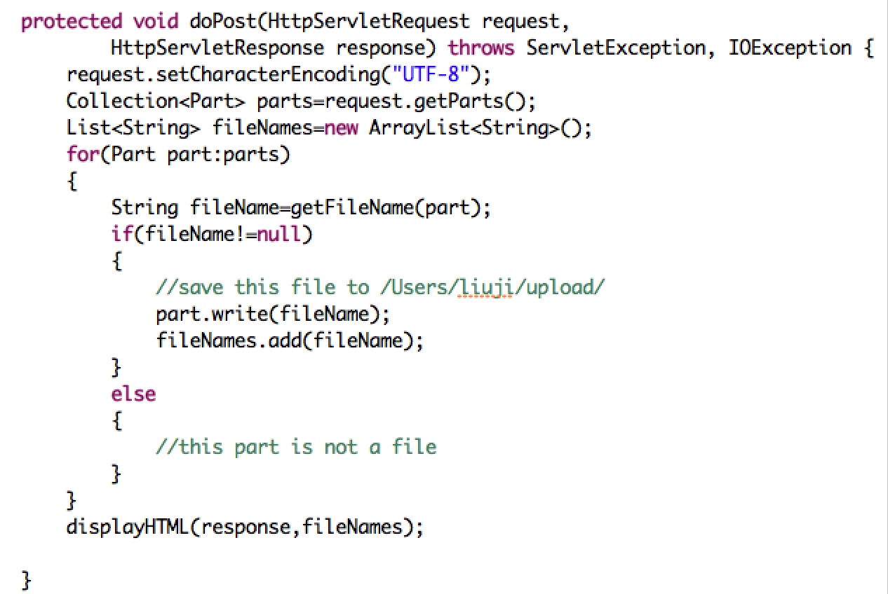
Write a Upload Servlet(2)

Slide 16
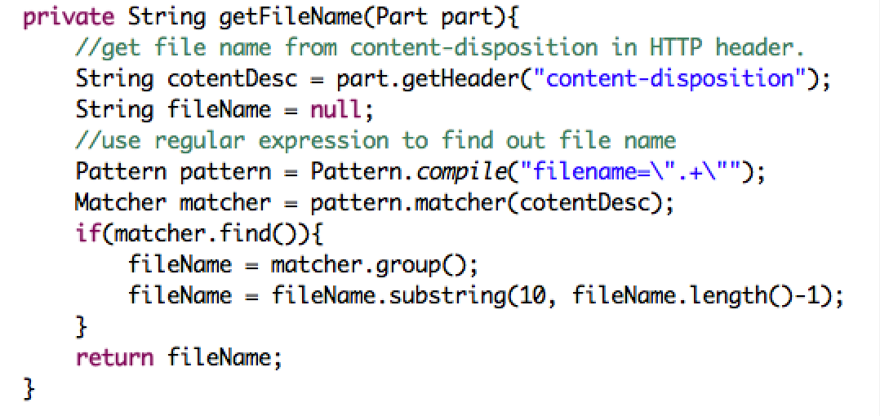
Write a Upload Servlet(3)

Slide 17
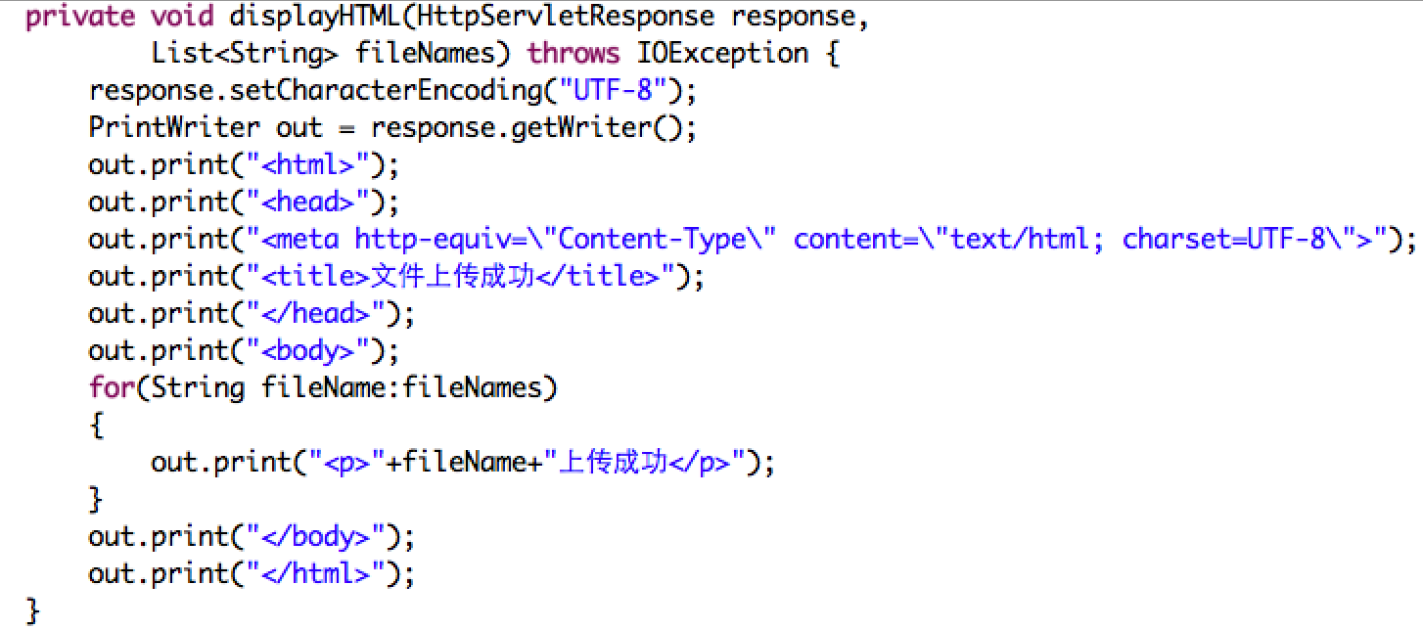
Write a Upload Servlet(4)

Slide 18
3.File Download
List files on Server
File Download Servlet
Encoding issue

Slide 19
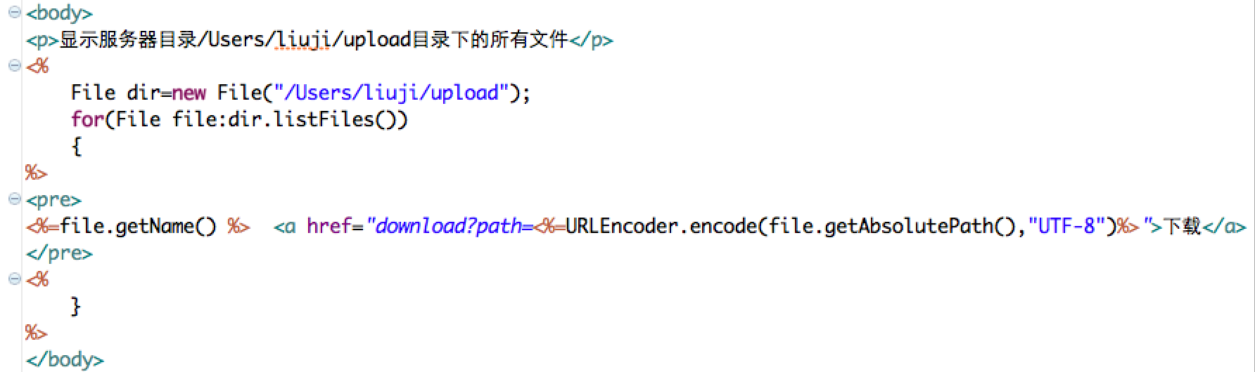
List files on Server

Slide 20
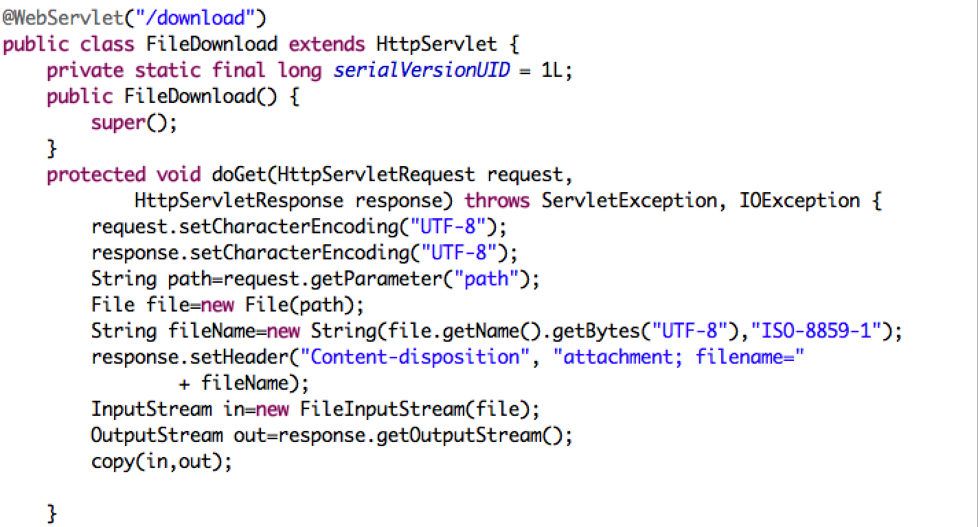
File Download Servlet(1)

Slide 21
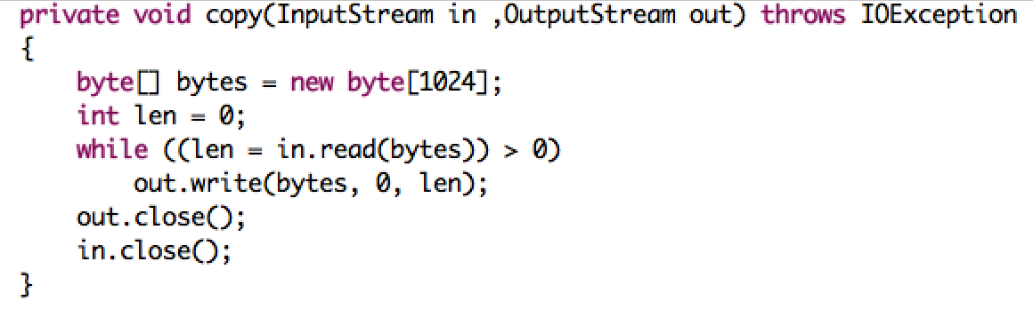
File Download Servlet(2)

Slide 22
Encoding issue
This program uses URL to send file name to the server.
If file name contains non-ASCII characters, it will encounter encoding issue. The following settings must be done:
  “URIEncoding=UTF-8” should be added to connector setting of server.xml
  Query string of links in listFile.jsp should be encoded to UTF-8
  Encoding of Request and response should be set to UTF-8 in File download servlet
  The encoding of filename in the response of http header is ISO-8859-1

Slide 23
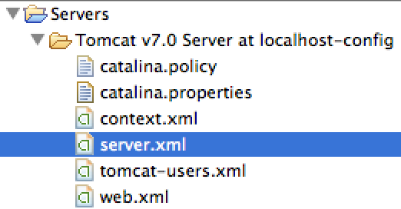
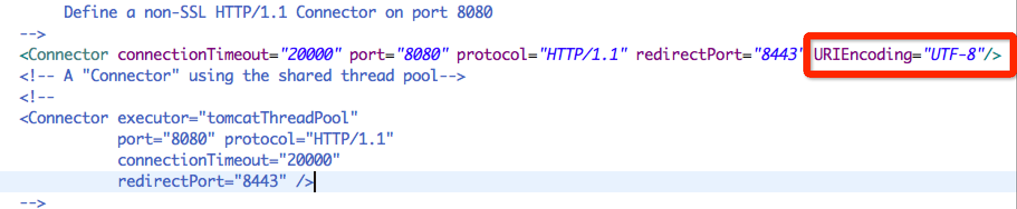
Add URIEncoding=UTF-8

Slide 24
Encode Query String

Slide 25
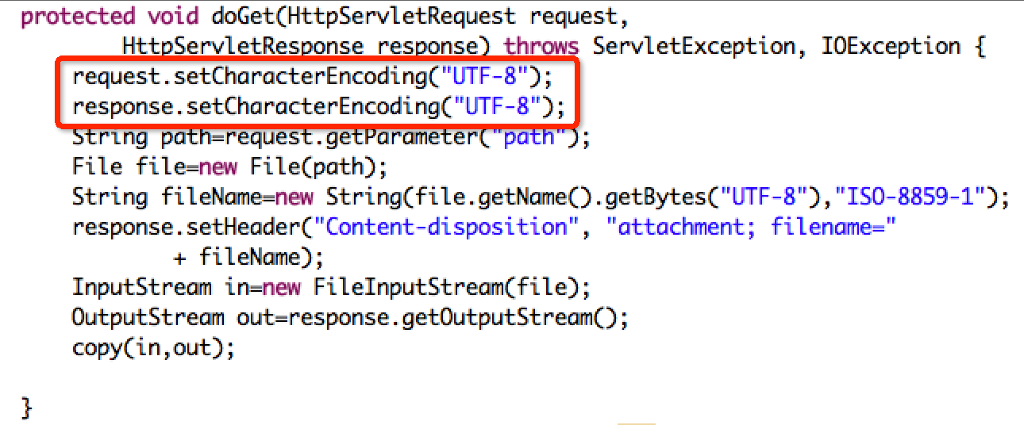
Set Encoding of Request and Response

Slide 26
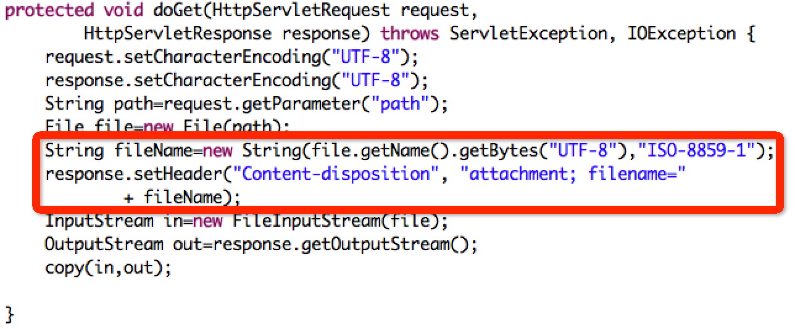
Set file name encoding

Slide 27
4.Generate image
Write a image servlet
Write a html to test image servlet

Slide 28
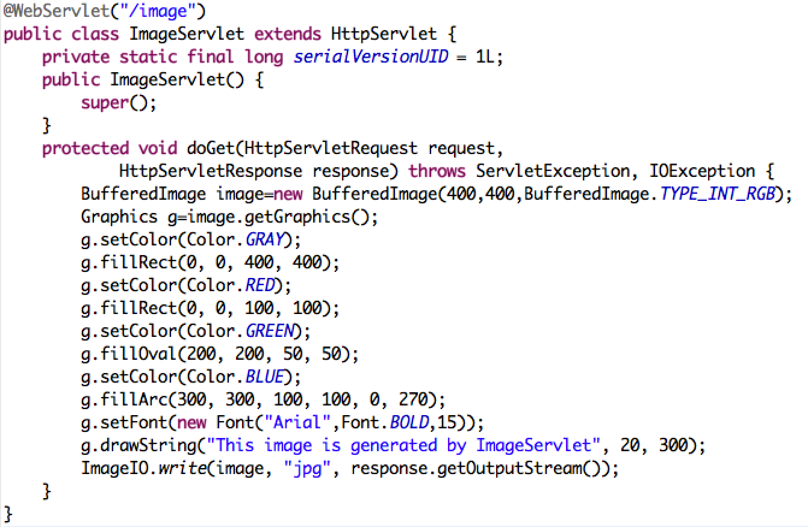
Image Servlet

Slide 29
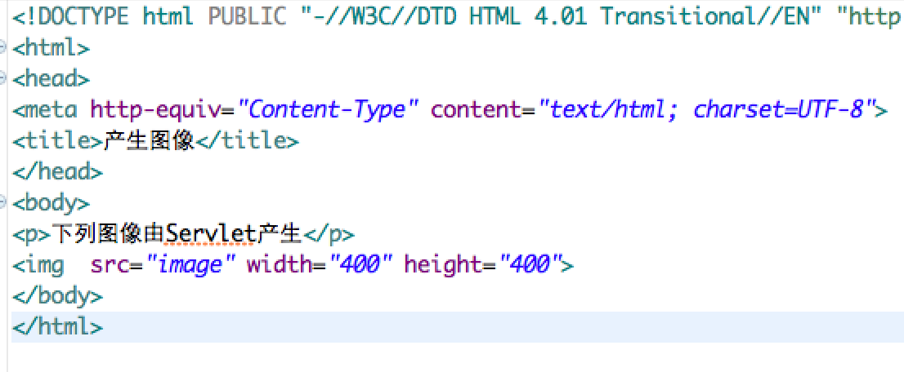
Test HTML

Slide 30
5.Session
What is Session
Session Demo

Slide 31
Http Session
Session provides a way to identify a user across more than one page request or visit to a Web site and to store information about that user.
The session persists for a specified time period, across more than one connection or page request from the user.
A session usually corresponds to one user, who may visit a site many times.

Slide 32
Session Demo
Visit viewSession.jsp to see whether the session is created.
Visit createSession.jsp to create a session.
Do not close your browser, visit other pages. Visit viewSession.jsp once again to the data stored in created session.

Slide 33
6.FilTER
What is Filter
Filter Demo

Slide 34
What is Filter
A filter is an object that performs filtering tasks on either the request to a resource (a servlet or static content), or on the response from a resource, or both.
Filters perform filtering in the doFilter method.
The usages of filter are:
  1) Authentication Filters
  2) Logging and Auditing Filters
  3) Image conversion Filters
  4) Data compression Filters
  5) Encryption Filters
  6) Tokenizing Filters
  7) Filters that trigger resource access events
  8) XSL/T filters
  9) Mime-type chain Filter
用Filter 设置request和response的编码

Slide 35
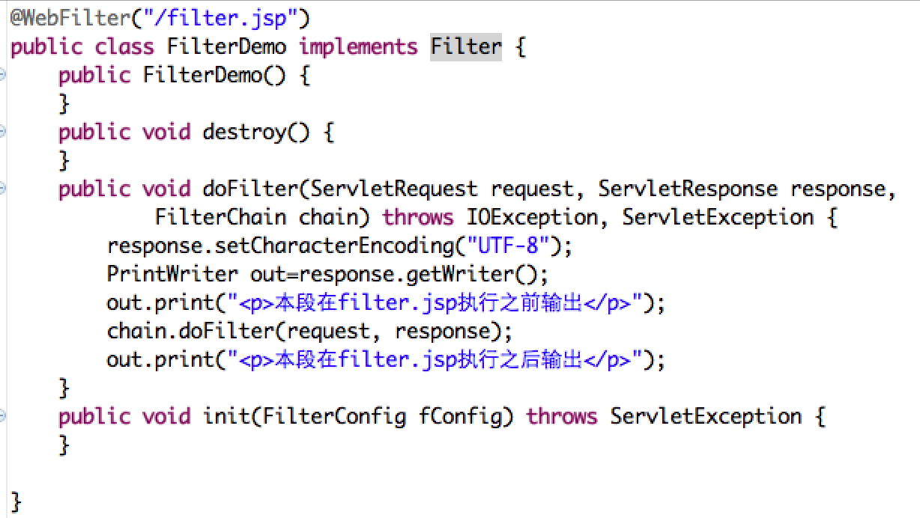
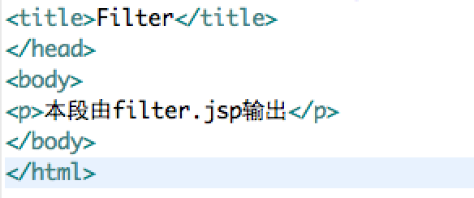
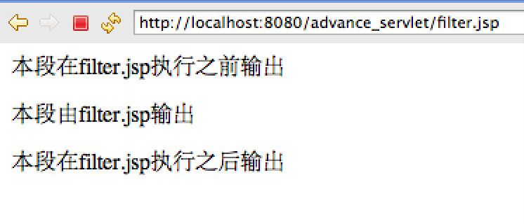
Filter Demo
“filter.FilterDemo” is used to filter “/filter.jsp”

Slide 36
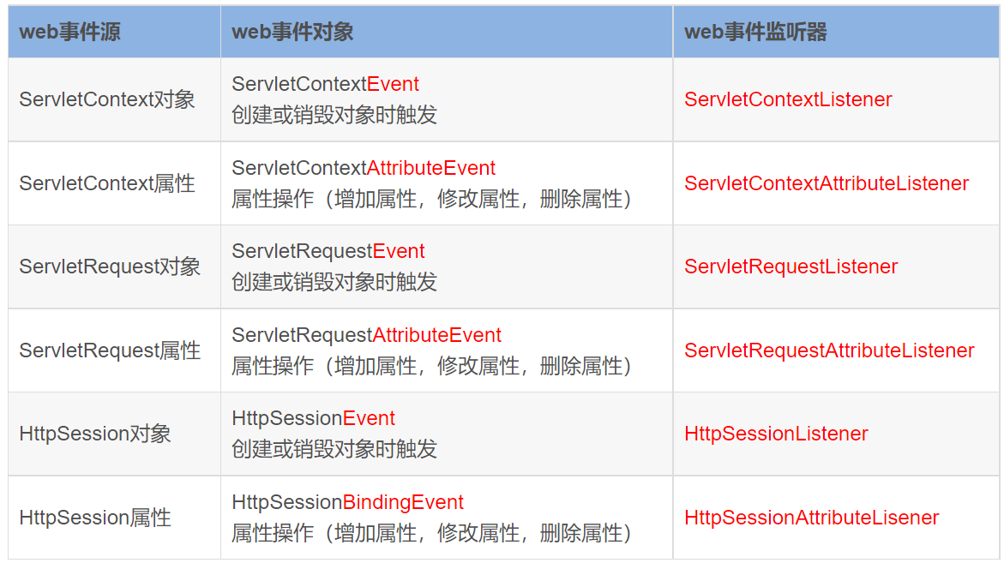
Listener
注册监听: 将事件,事件源,监听器绑定在一起,当事件源发生某个事件后,执行监听器代码
会频繁使用到三个对象：
  ServletContext、ServletRequest、HttpSession。
  在创建或销毁这些对象时，或者对这些对象进行属性操作时，触发一些事件，就可以使用web监听器去监听这些事件。
配合注解使用@WebListener

Slide 37
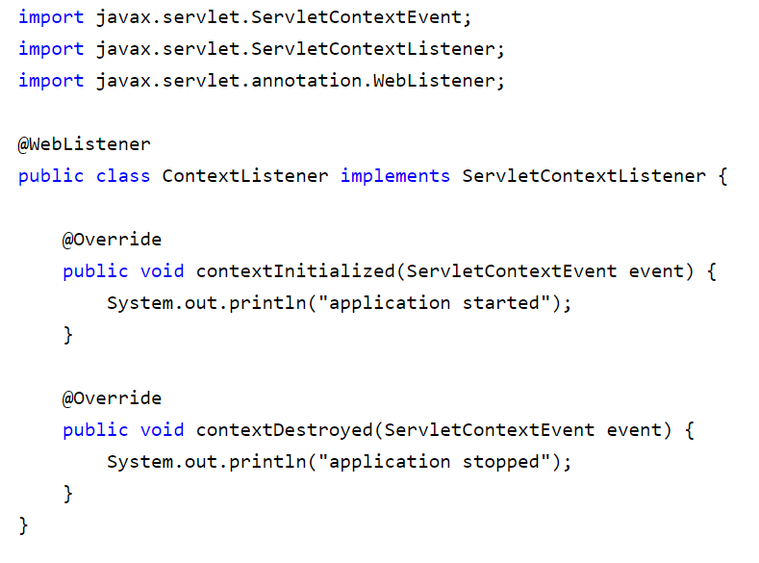
Listener的使用

Slide 38
Homework
练习使用：Servlet，Filter，Listener等组件

