Slide 1
Flow Chart Recognizer
– From hand-drawn flowcharts to digital components
Mu Chen, MS-SE (mu.chen@sjsu.edu) [SJSU ID: 014725425]
Roger Kuo, MS-SE (roger.kuo@sjsu.edu) [SJSU ID: 013784706]
Hardy Leung, MS-AI (kwok-shing.leung@sjsu.edu) [SJSU ID: 016711877]
Jasmine Wang, MS-AI (jasmine.wang@sjsu.edu) [SJSU ID: 002805362]

Slide 2
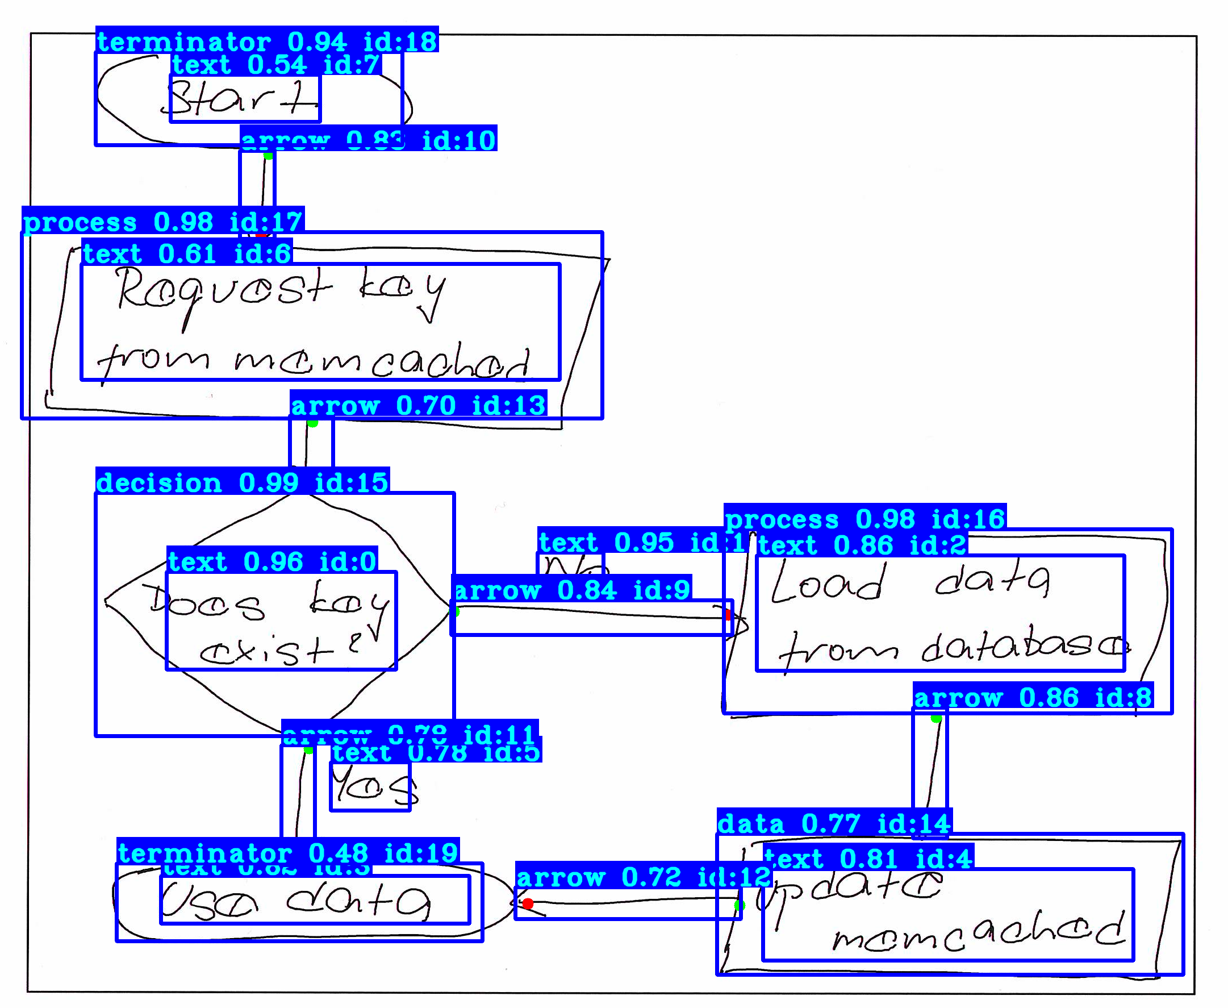
Problem Definition
Motivation
Introduction
Goal

Slide 3




Main Enemies
Gabby Google
Abraham Apple
Melinda Meta
Harry Hua Li
Notes:
(3.2) Roger -- talk about the overall architecture (= yolo + post processing + rendering). Talk a little bit about training data set. The 7 classes. training runtime, Google Colab, accuracy. Challenge
(3.3) Mu -- talk about preprocessing XML, training, post-processing to get the arrows (I know this is Roger's stuff so please coordinate). Talk about the rendering.

Slide 4
Model, Architecture & Algorithm
Model – custom yolo-v4 deep neural network
7 classes corresponding key components
text
arrow
data (parallelograms)
decision (diamonds)
process (straight or rounded rectangles)
terminator
connection (input/output)
Algorithm
Wrote a custom algorithm to detect arrow direction to establish the full logical relationship among 7 elements
Generated the full symbol representation of flowchart, together with the shapes and text elements

Slide 5
Tools & Dataset
Tools used
Google tesseract OCR engine and schemDraw
Yolo scripts from PyLessons
Yolo-v4
Python 3.10, openCV 2.0, and etc.
DataSet
Starting from scratch, we trained the dataset with 600+ high-quality annotated flowchart images to generate pre-trained yolo weights for transfer-learning later

Slide 6
Pre-processing & Post-processing
Pre-processing
XML files converted to yolo script format
Post-processing
Collected the list of detected objects with a rich set of positional and logic metadata and then converted to actual text based format

Slide 7
Demo
Can insert a pre-recorded video clip here

Slide 8
Post-Mortem Review
Challenges:
From laptop CPU to Google Colab Pro GPU, however it still took 6+ hours to train yolo weights
Set batch = 133 due to memory issues
Results:
Achieved 90%+ mAP with 96%+ accuracy on all flowchart elements except arrows and texts
Can be extended to other output formats:
SVG
iPyCanvas
LATEX,
Graphviz

Slide 9
Conclusion
The model is decent to handle the application we choose:
Validation scores and test scores all demonstrate how well the model can generalize and then eventually apply to unseen data
In the future:
Larger dataset
More GPUs –o migrate to Google Cloud
Modify code if needed
Computers haven’t taken our jobs … yet

Slide 10
References
Python scripts
https://pylessons.com/
Yolo v4
https://github.com/pythonlessons/TensorFlow-2.x-YOLOv3

