Slide 1
Project Meeting Schedule
COMP2432 Group Project (2022)
YANG Rongtao
LIU Qianli
GENG Longling
MA Sushi
HAN Jiaming
20075563D
20080796D
20080439D
20093291D
20075519D

Slide 2
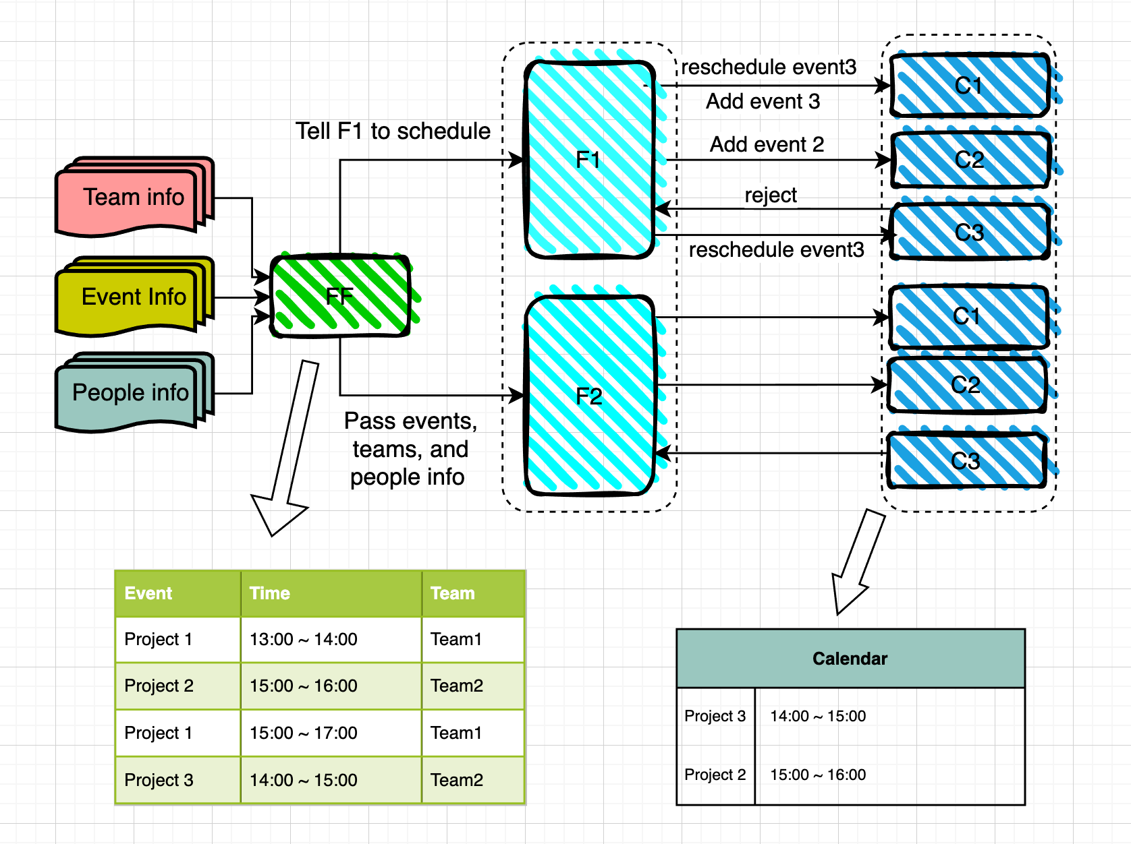
Introduction
Project Structure

Slide 3
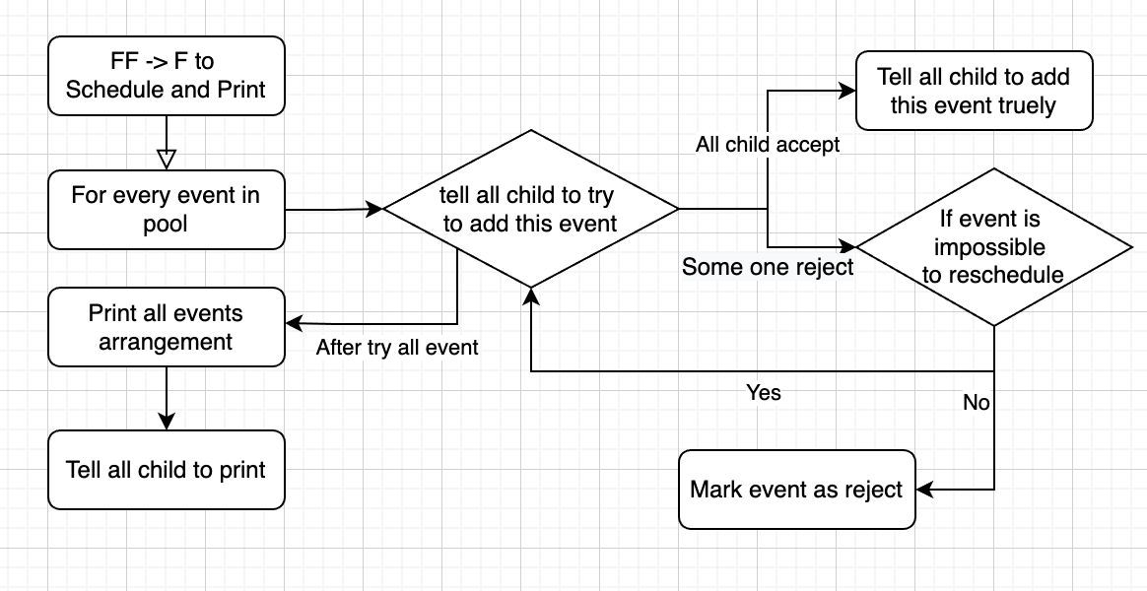
FCFS schedule

Slide 4
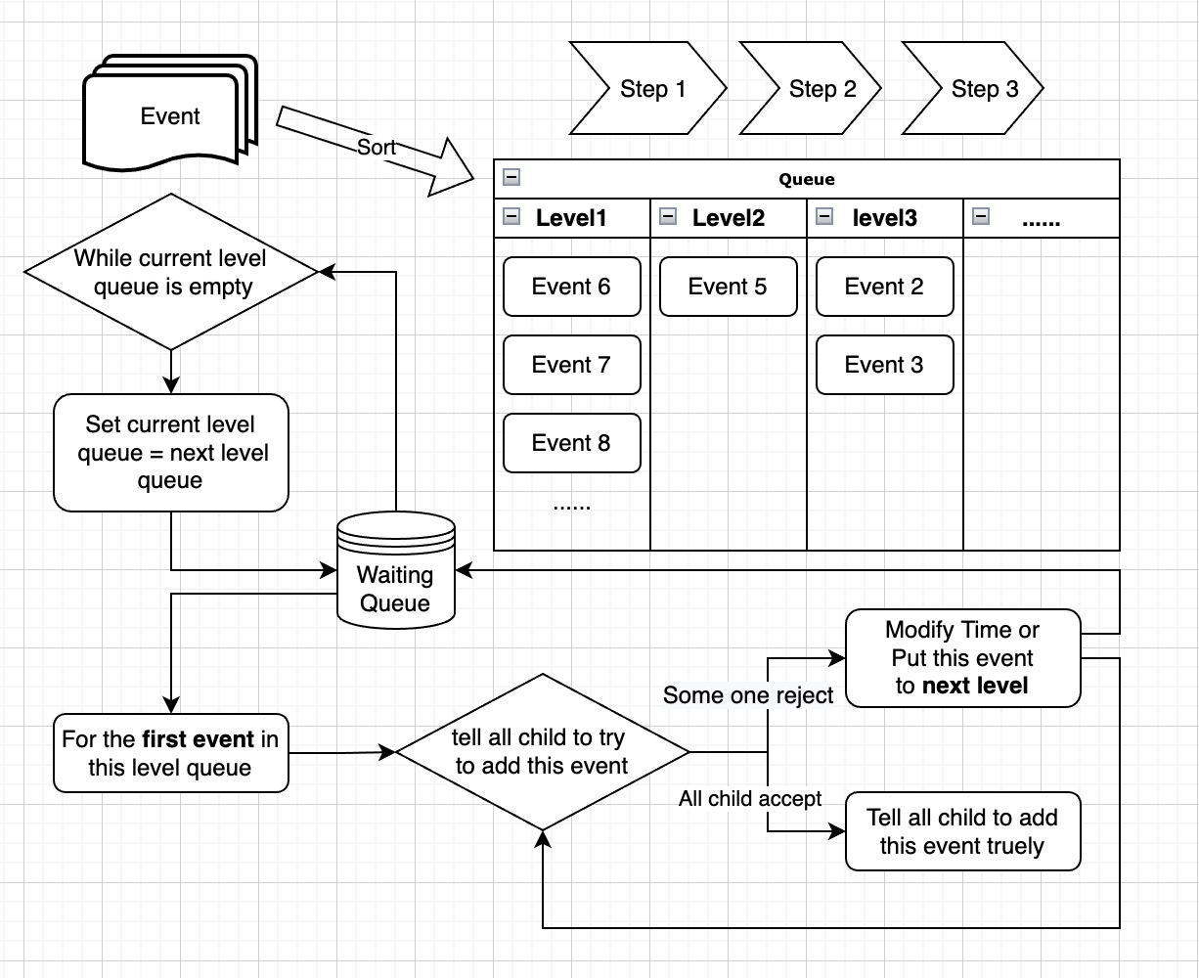
Our own
Schedule algorithm
Efficiency
Fairness
RR (q=10)
Multilevel queue

Slide 5
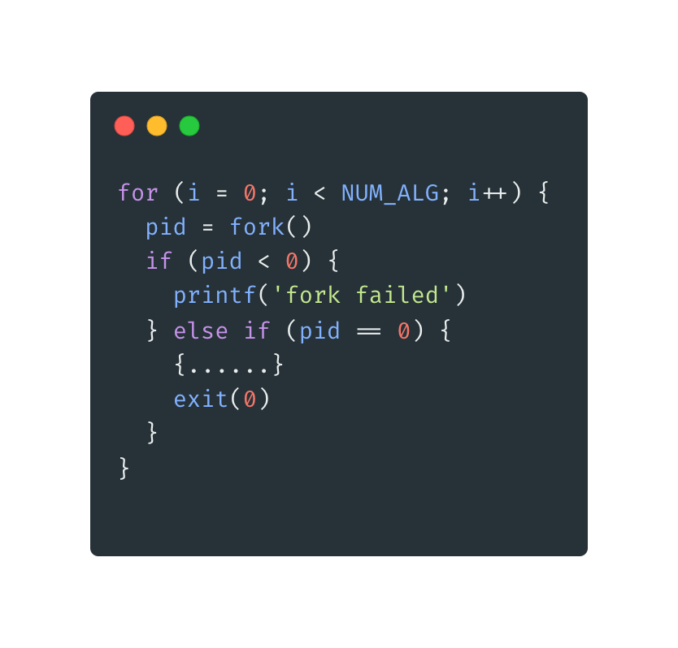
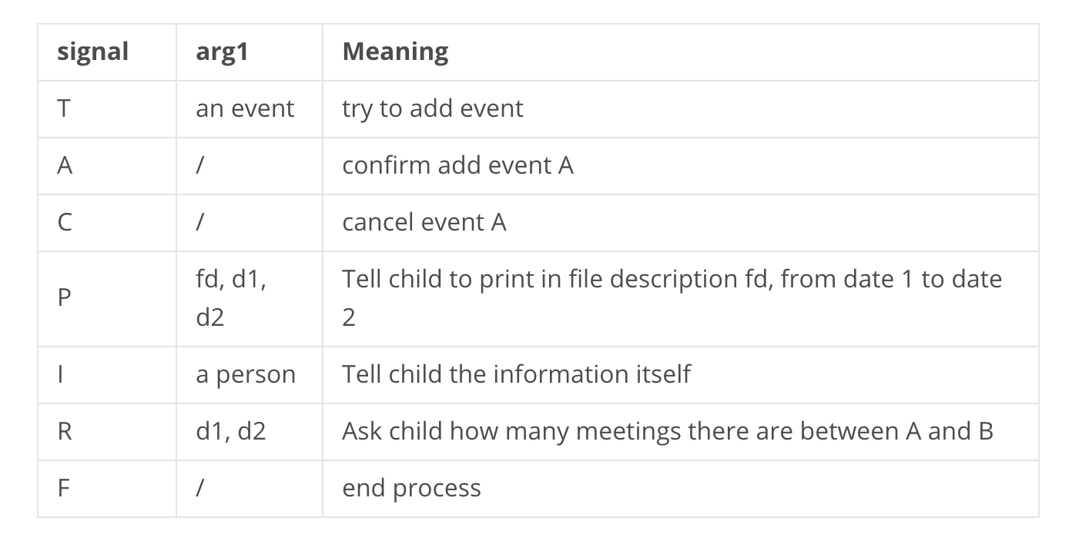
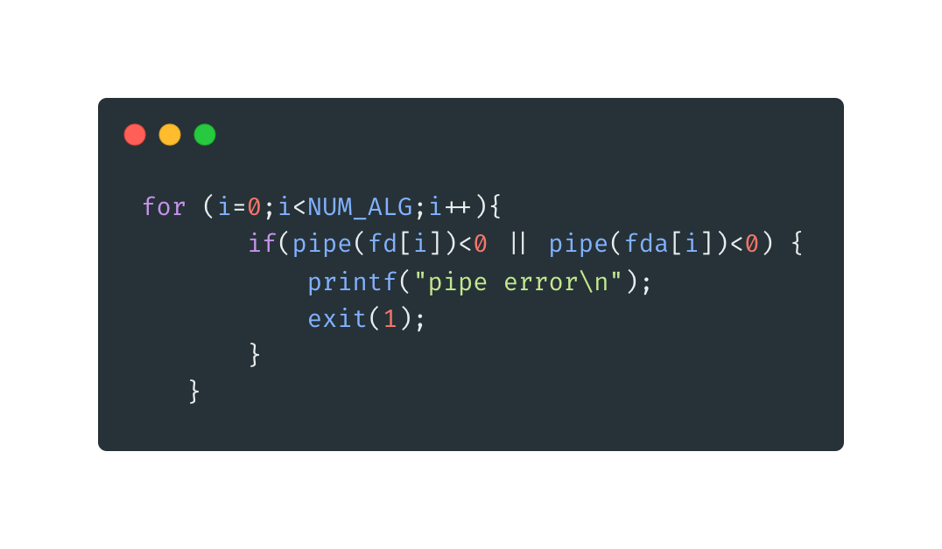
Application of course content
Process management (Lecture 4)
Interprocess communication (Lecture 5)
Interprocess Communication
Process Management
Communication Standard

Slide 6
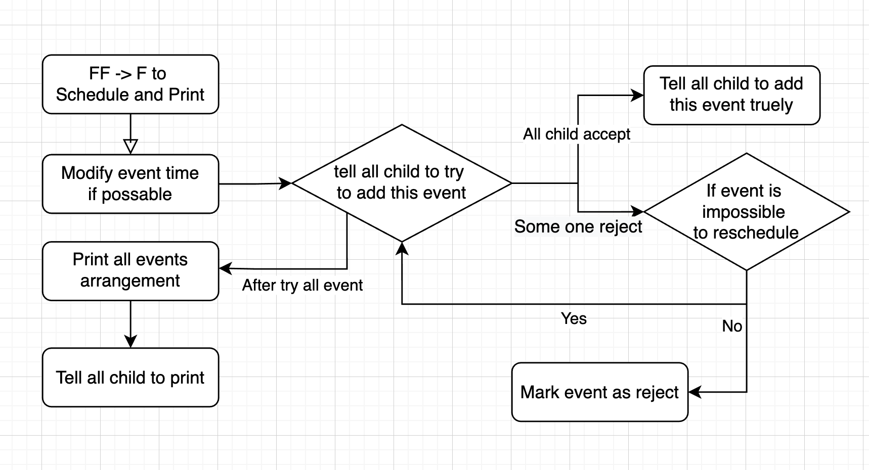
Application of course content
Round Robin (Lecture 6)
Multilevel Queue (Lecture 6)
FCFS
RR & Multilevel Queue

Slide 7
Thank you for your time

