Slide 1

Fundamentals of Programming
Mengzhuo Guo
mengzhguo@scu.edu.cn
Business School, Sichuan University

Slide 2
S3. Program Flow Control

Slide 3
Key Points:
  3.1 Program Flow
  3.2 Sequential Structure
  3.3 Selection Structure
  3.4 Repetition Structure

Slide 4
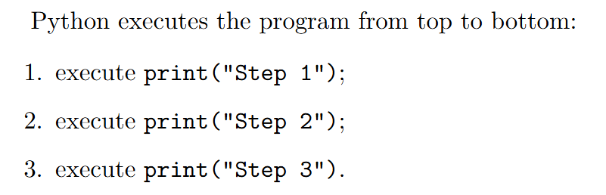
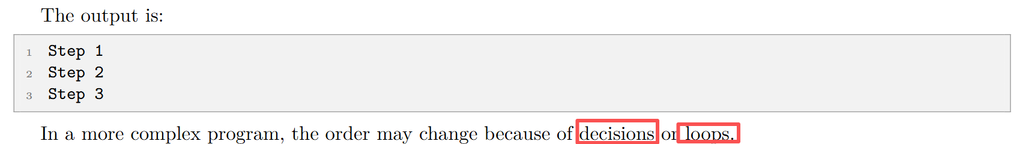
Program Flow (Program Flow)
Program flow describes the order in which the statements in a program are executed.
Notes:
Ask students tothink about this

Slide 5
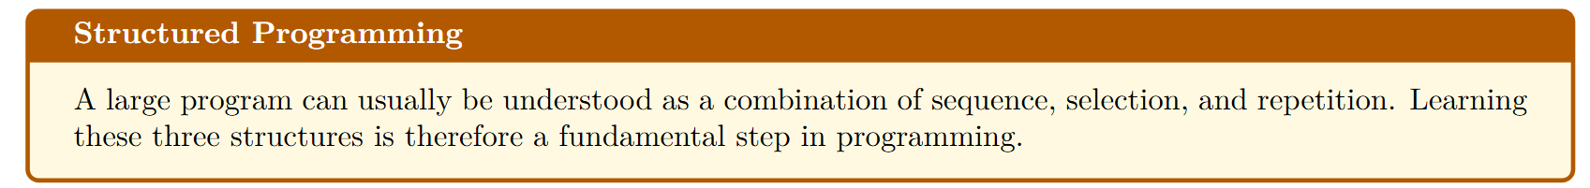
Program Flow (Program Flow)
Three Basic Control Structures (three structures)
1. Sequential structure
Statements are executed one after another, from top to bottom.
2. Selection structure
The program chooses one or more paths according to a condition.
3. Repetition structure
The program repeats a group of statements while a condition is true or for a specified number of times.
Notes:
Ask students tothink about this

Slide 6

Flowchart (Program Flowcharts)
  Input Data:Input starts a program. Data may come from many sources, including interactive input, parameters, random data, files, and networks.
  Process Data:Processing calculates from input data to produce output. A method for solving a computing problem is called an algorithm.
  Output Results:Output presents program results through the console, graphics, files, networks, and other channels.
Notes:
Ask students tothink about this

Slide 7
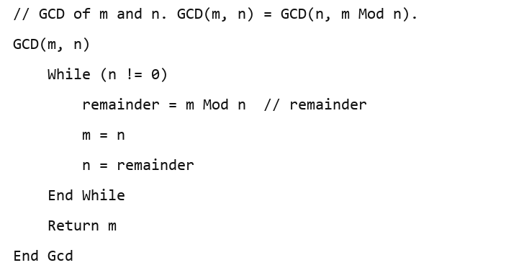
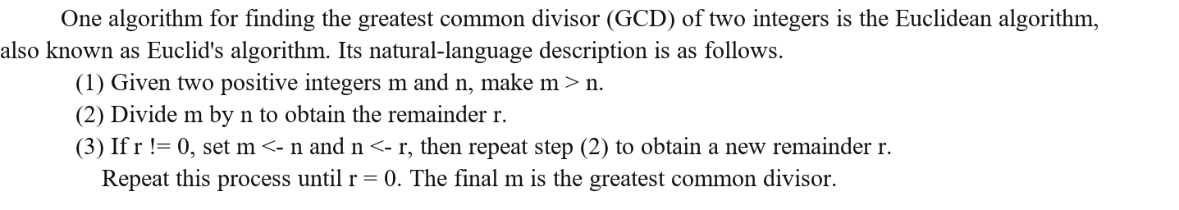
Program Flow
Core concept: algorithm
  An algorithm is a method for performing a specific task.
  Describe an algorithm: natural language & pseudocode -> implement it (coding)
GCD
Notes:
Ask students tothink about this

Slide 8
Program Flow
Given GCD pseudocode, we can write Python code
# GCD of m and n
GCD(m, n) = GCD(n, m Mod n)
def gcd(m,n):
if (m < n):
m, n = n, m
while (n != 0):
remainder = m % n # remainder
m = n
n = remainder
return m
if __name__ == '__main__':
print(24,36,"GCD:",gcd(24,36))
Decision block
Loop block
Seq.
Run the code in a separate .py file
Notes:
Ask students tothink about this

Slide 9
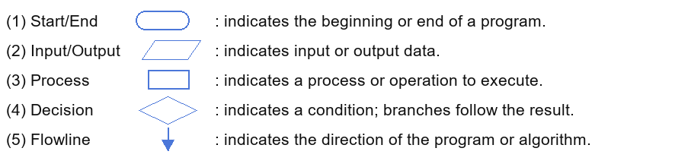
Program Flow
Program Flowchart
  a graphical representation of the steps in program execution
  conventions
Notes:
Ask students tothink about this

Slide 10
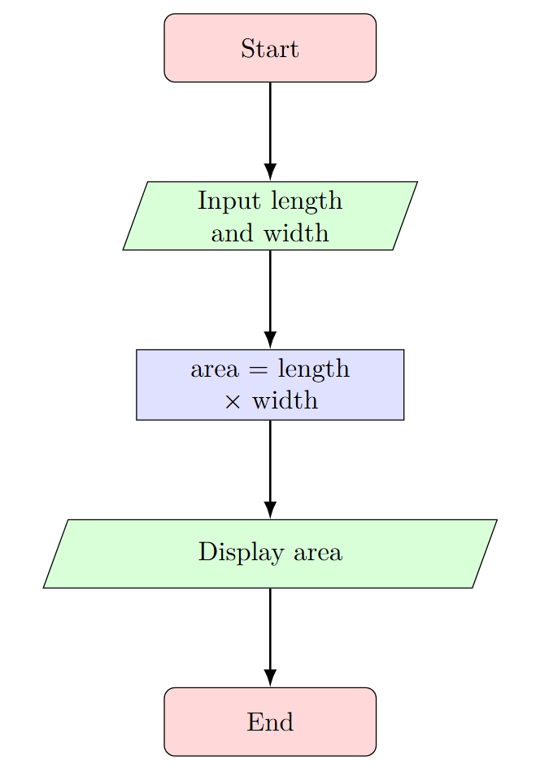
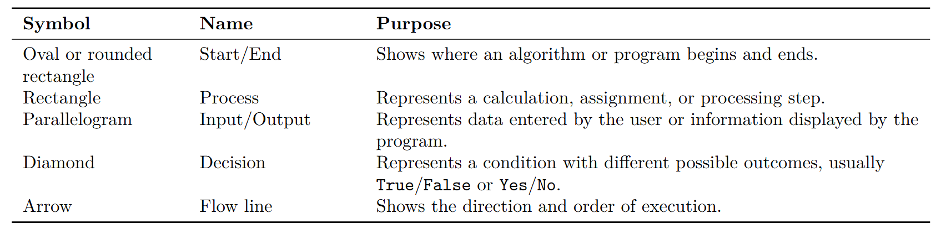
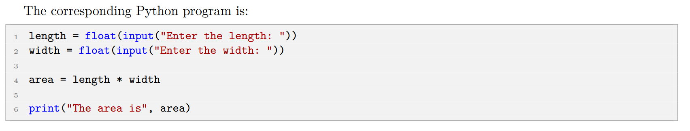
Flowchart -- A Sequential Flowchart
Notes:
Ask students tothink about this

Slide 11
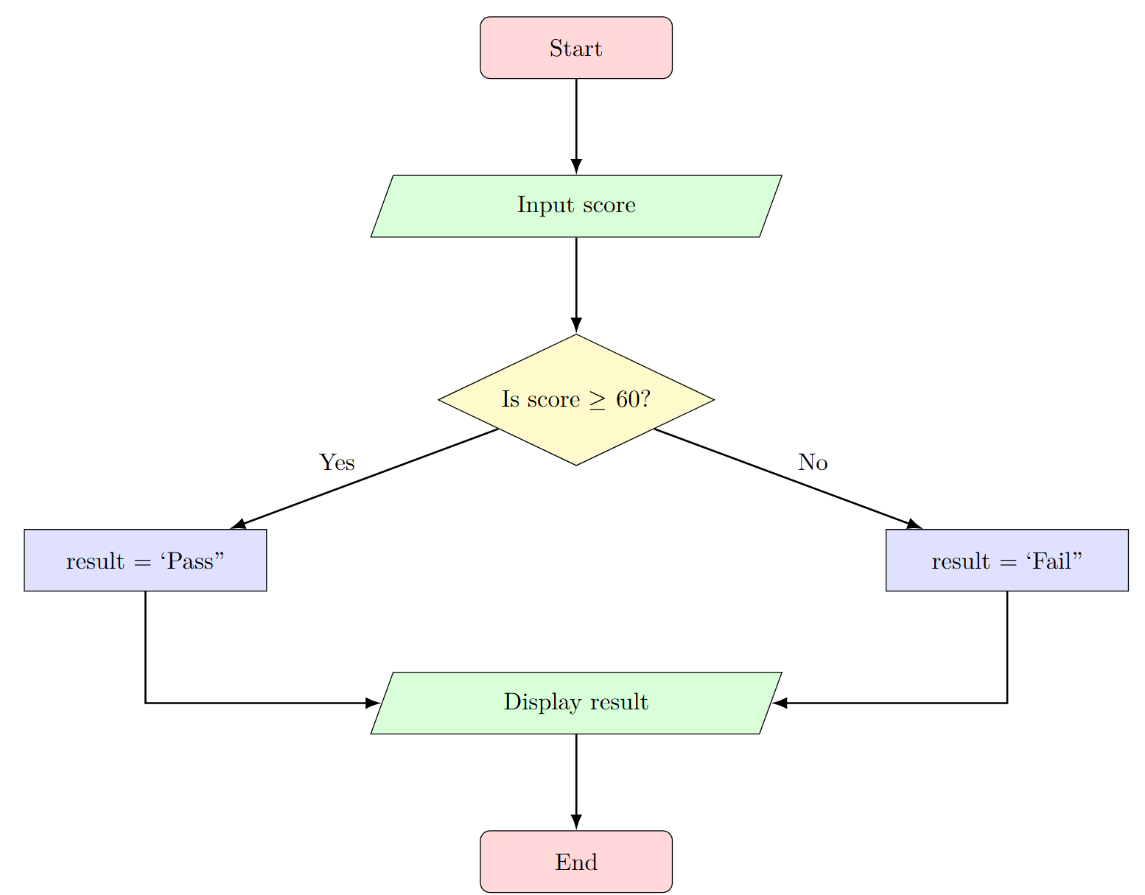
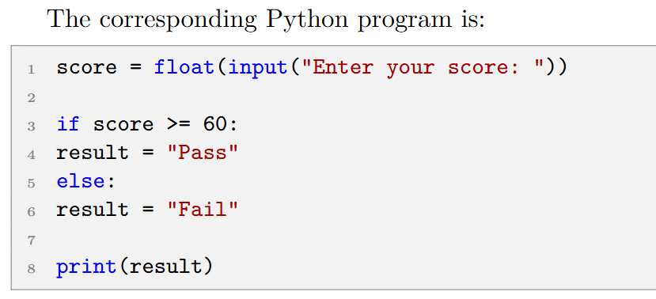
Flowchart -- A Selection Flowchart
Notes:
Ask students tothink about this

Slide 12
Program starts
Flowchart -- Finding the GCD
Input m, n
Program Flowchart
  GCD as an example
    Start
    Decision
      Condition true?
        Execute an operation
      Condition false?
        Execute another operation
    Loop
      Loop-exit criterion
    End
Yes
m<n?
m=n, n=m
No
remainder =
m % n
Set m = n
No
Set n = remainder
n=0?
Yes
Output m
Program ends
Notes:
Ask students tothink about this

Slide 13
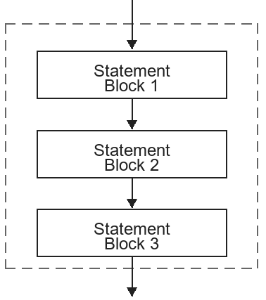
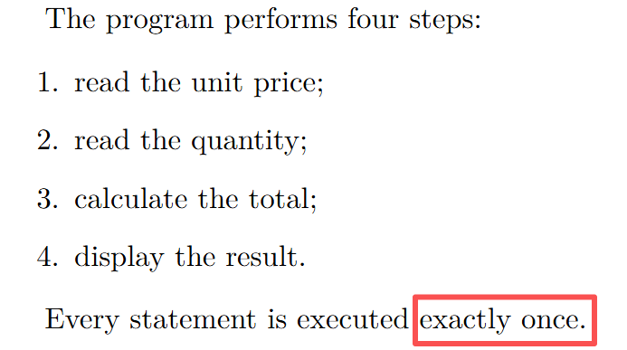
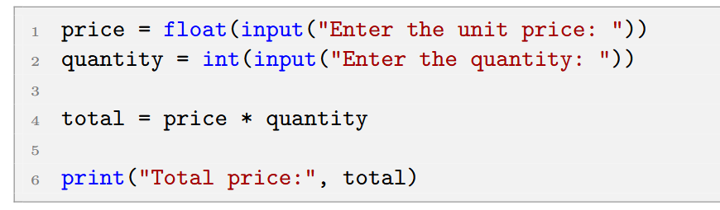
Sequential Structure - sequential structure
Execute statements bytheir order of appearanceExecute
  First statement block1,then2 and 3
Example: Suppose a customer buys several identical products. The program receives the unit price and quantity and then calculates the total price.
Notes:
Ask students tothink about this

Slide 14
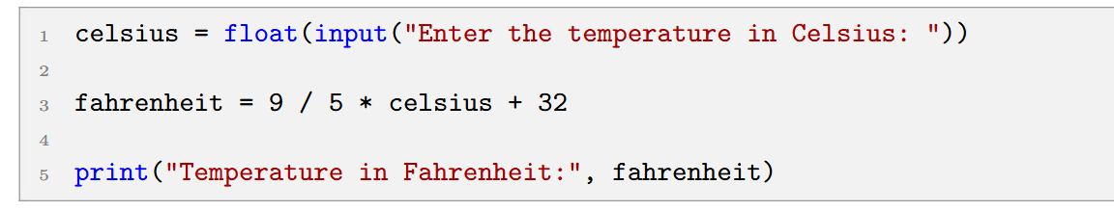
Sequential Structure - sequential structure
Example: Temperature Conversion
  The formula for converting Celsius temperature to Fahrenheit temperature is F=9/5 * C + 32.
NOTE THAT: This program does not make a decision. Therefore, it uses only a sequential structure.
Notes:
Ask students tothink about this

Slide 15
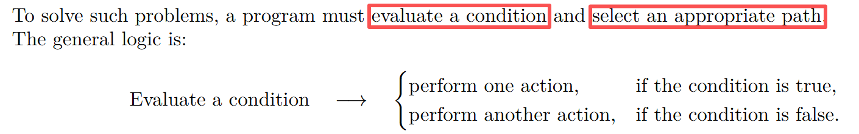
Selection Structure - Selection Structure
Why do we need a selection structure? Recall thefeatures of a sequential structure.
  Sequential programs always execute the same statements
  Many real-world problems require different actions in different situations:
    Examples include grading scores by range, checking passwords, and applying shopping discounts.
Notes:
Ask students tothink about this

Slide 16
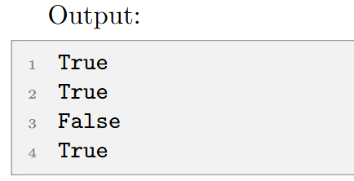
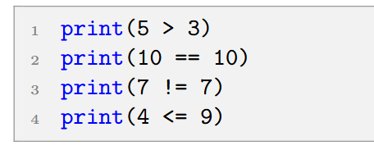
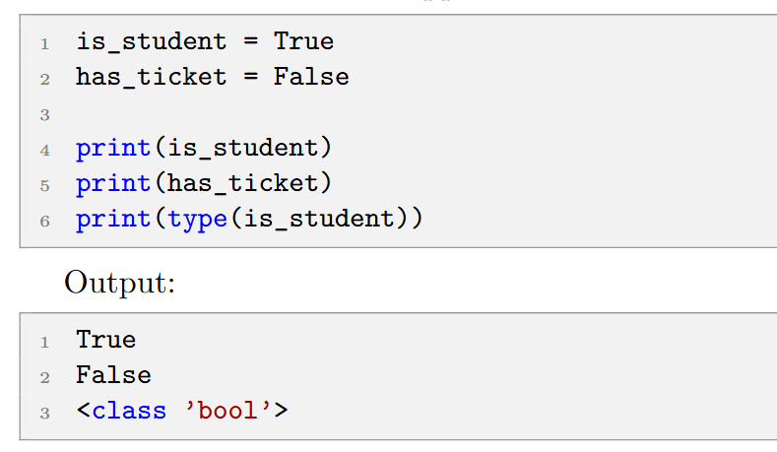
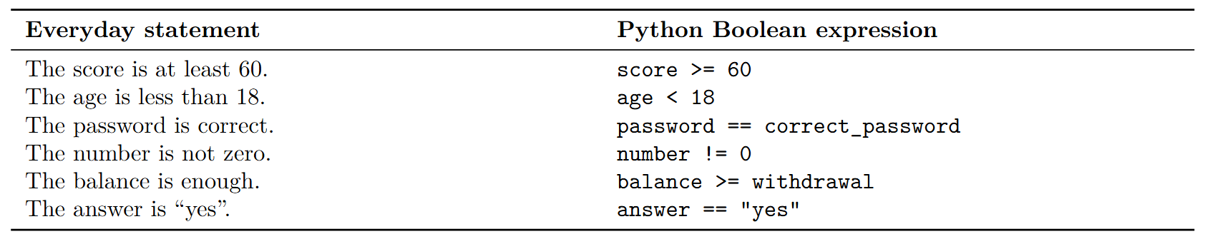
The Boolean Data Type!
Selection Structure - Which data type represents yes/no?
Boolean value has only two possible values:
  True
  False
A Boolean expression is an expression whose result is either True or False
Examples:
Try these codes:
Boolean expressions are the basis of conditional statements!!!
Notes:
Ask students tothink about this

Slide 17
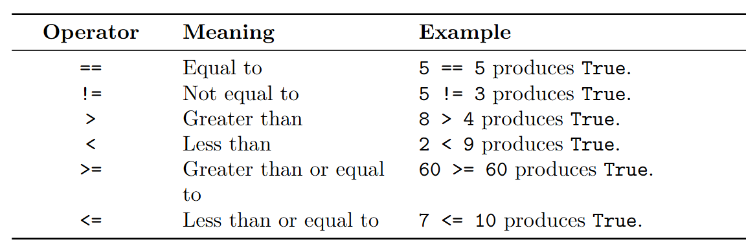
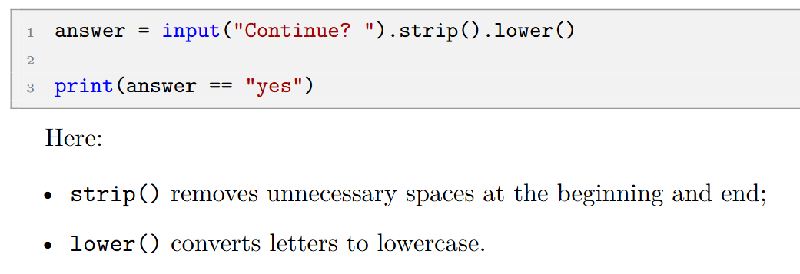
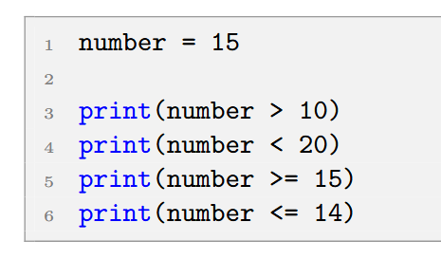
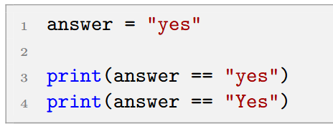
Selection Structure - Python Comparisons
Comparison operators compare two values and produce a Boolean result
Numbers can be compared:
Strings can be compared:
Python is case-sensitive!
How to standardize the user’s input?
Notes:
Ask students tothink about this

Slide 18
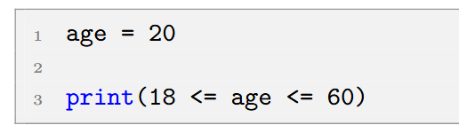
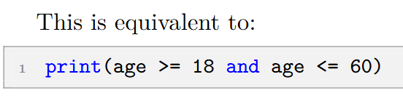
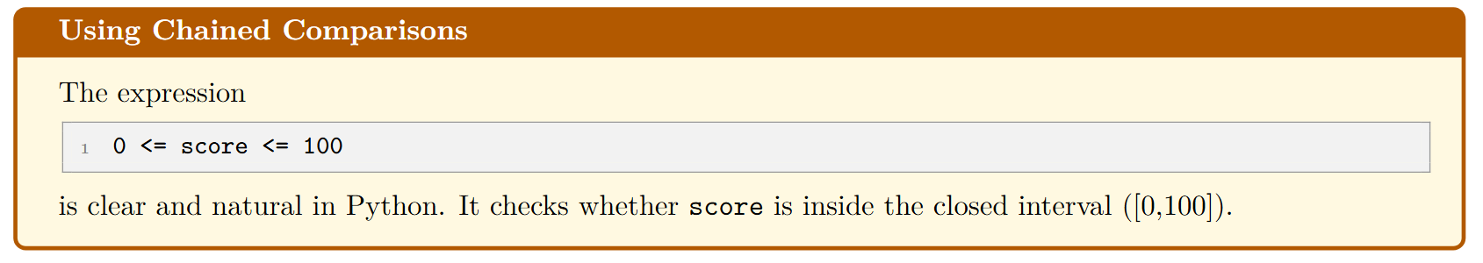
Selection Structure - Python Comparisons
Chained comparisons
What is the output?
Notes:
Ask students tothink about this

Slide 19
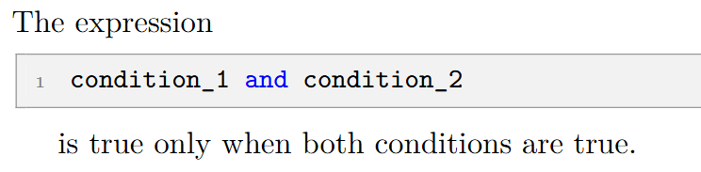
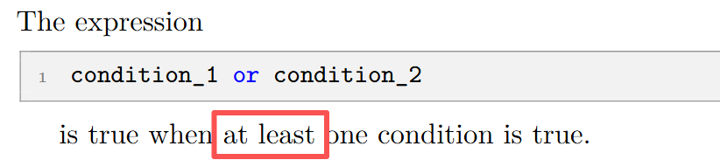
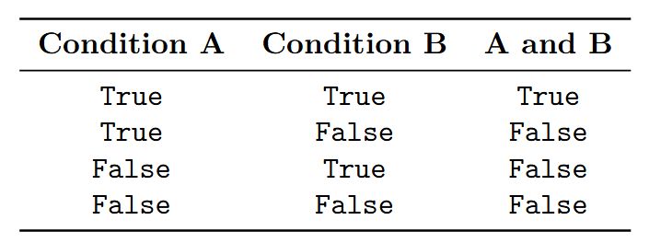
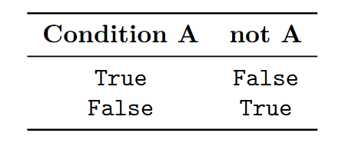
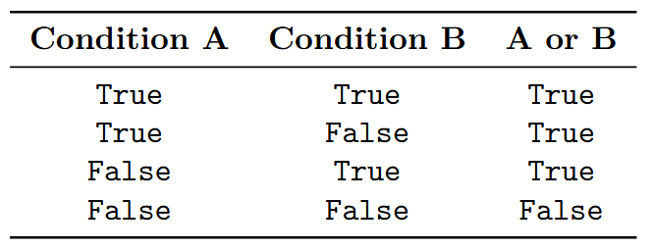
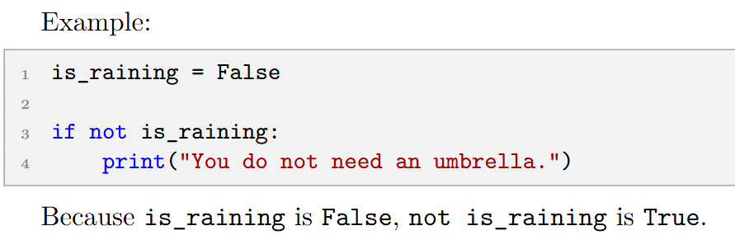
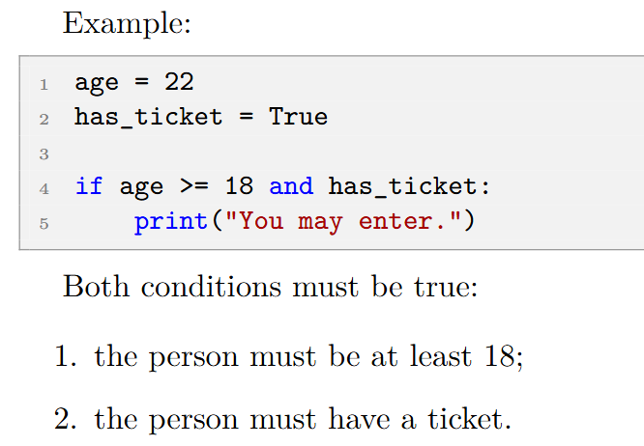
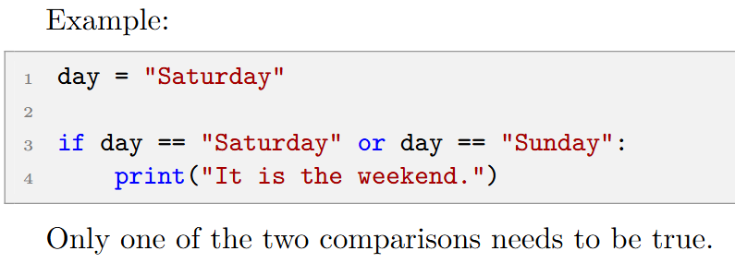
Selection Structure - Python Comparisons
Programs often combine Boolean expressions: and, or, not
The not operator reverses a Boolean value.
Notes:
Ask students tothink about this

Slide 20
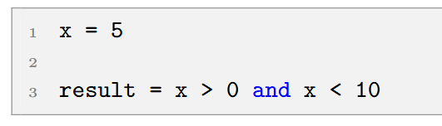
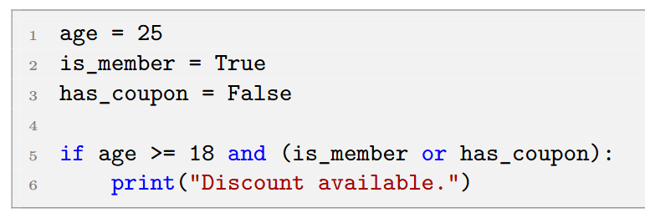
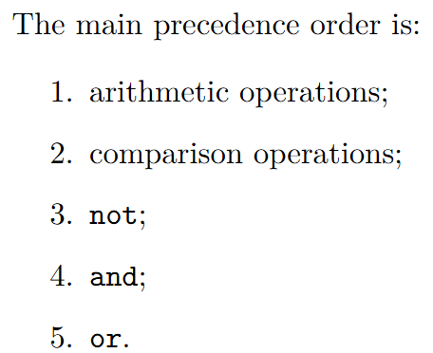
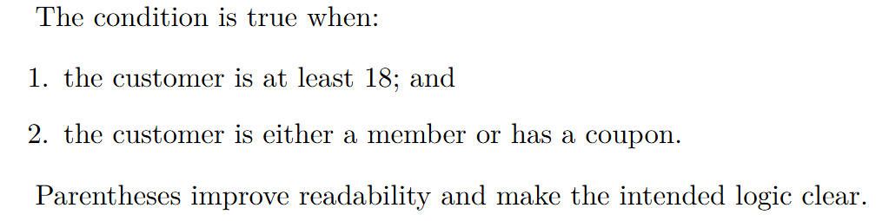
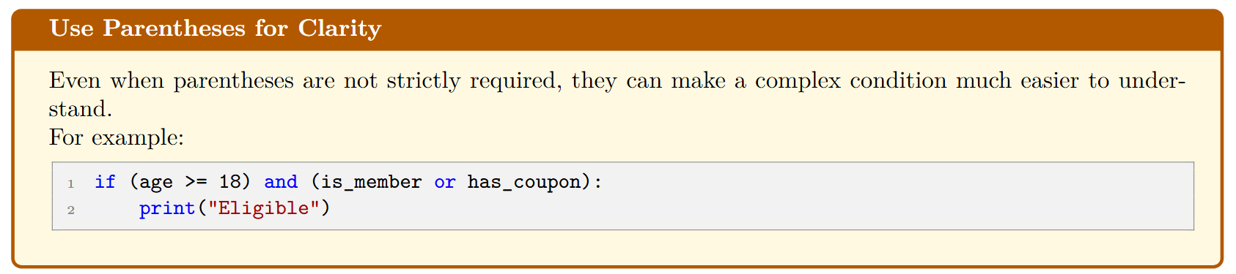
Selection Structure - Python Comparisons
Programs often combine Boolean expressions: and, or, not
Combining Logical Operators
Operator Precedence
What problem does this describe?
Use parentheses to make calculation logic clear.
Notes:
Ask students tothink about this

Slide 21
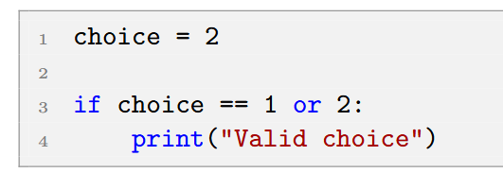
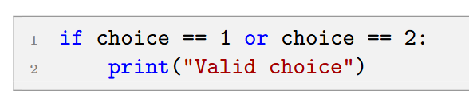
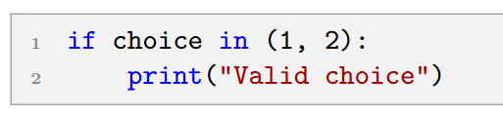
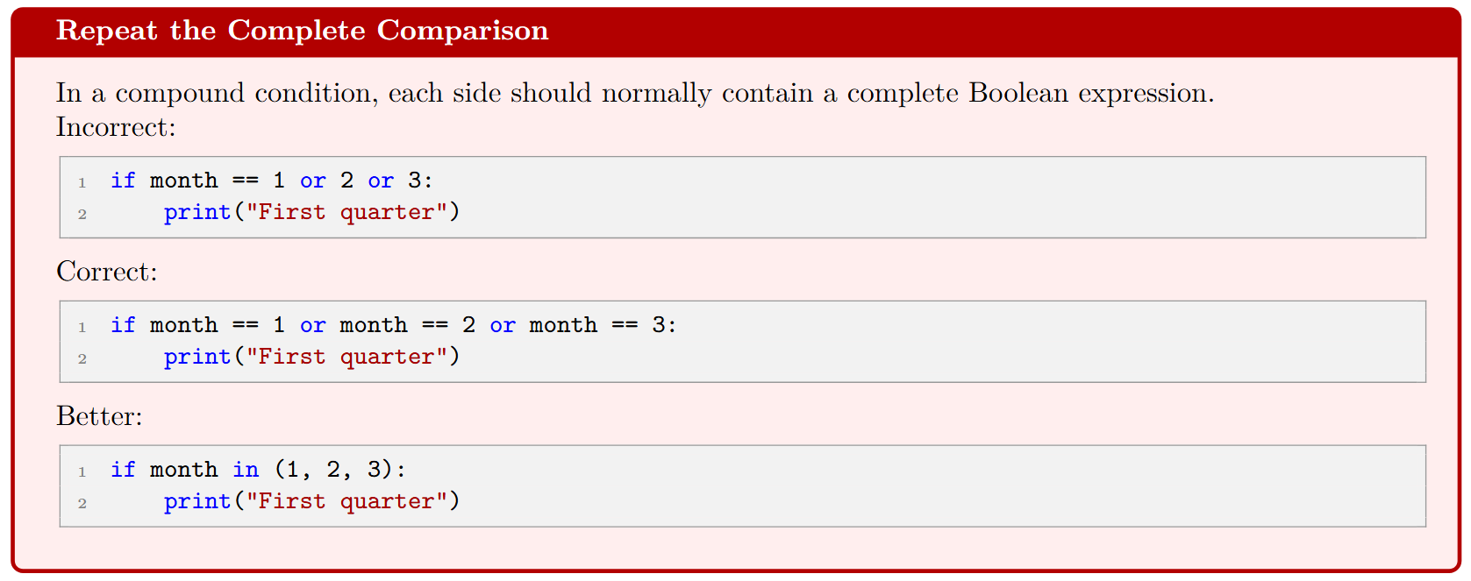
Selection Structure - Python Comparisons
Think: what problem does this code solve?
For logical comparisons, each side of a logical operator needs a complete Boolean expression!
Notes:
Ask students tothink about this

Slide 22
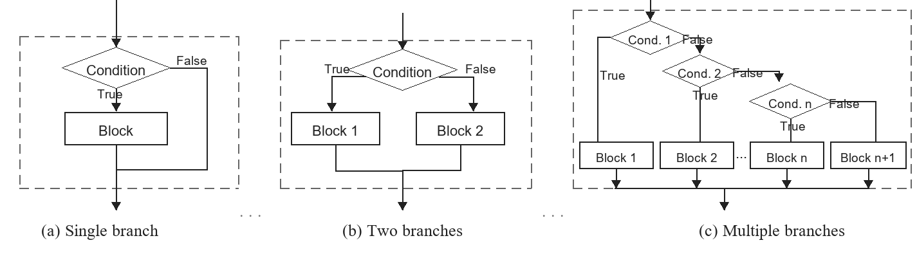
Selection Structure
Based onconditions, controlthe executed code:
  single-branch structure
  two-branch structure
  multi-branch structure
Notes:
Ask students tothink about this

Slide 23
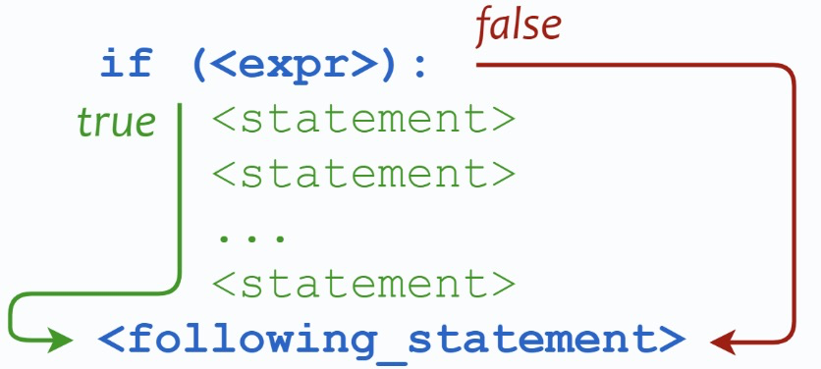
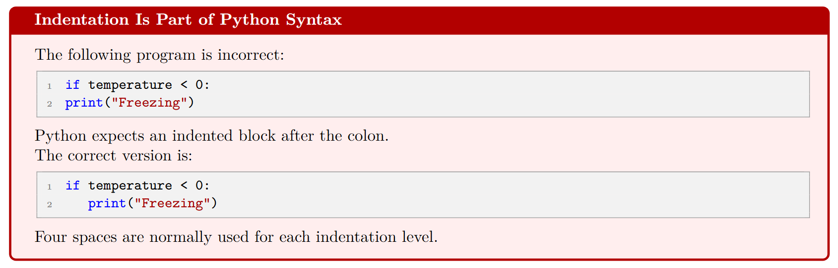
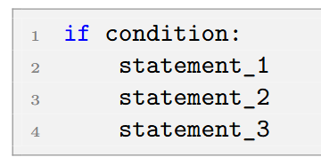
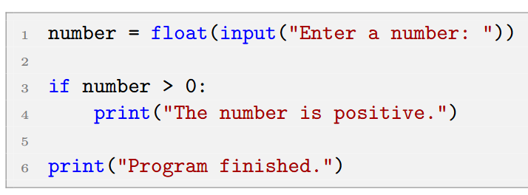
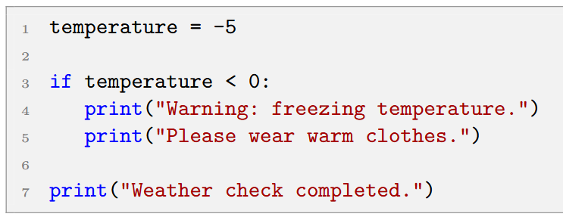
Selection Structure - Basic if Statement
A selection structure is controlled by if statements
  Code Execution Process
Example: Positive Number
Understanding Indentation - Python uses indentation to identify the statements that belong to an if block
A colon must appear
at the end of the if line.
Suppose we enter 8, what happens next?
These two print statements are inside the if block
They run only when the condition is met
Suppose we enter -3, what happens next?
Notes:
Ask students tothink about this

Slide 24





Selection Structure - if-else statement
Example: Larger of Two Numbers
Example: Pass or Fail
Example: Assigning a Result in Each Branch
Example: Even or Odd
This is often clearer than placing a separate print statement in each branch.
Notes:
Ask students tothink about this

Slide 25


Selection Structure - if-elif-else
So far, we have learned two statements: if and if-else
  Use a colon after each condition; the following block runs when the condition is met.
  Use indentation to define blocks; statements with the same indentation belong to one block.
For multiple output categories, must we repeat if-else many times? Excellent / Good / Pass / Fail
Python uses elif, meaning “else if”, to test additional conditions.
Notes:
Ask students tothink about this

Slide 26



Selection Structure - if-elif-else
Example: Letter Grade
Question: Does order matter? What if we swap the condition positions?
Suppose the score is 95.
Python tests:
  1. Is score >= 90? Yes.
2. Assign "A" to grade.
3. Skip all remaining branches.
One grade from A to F is always assigned.
What is the output?
For a score of 95, the first condition score >= 60 is already true. Therefore, the program assigns grade D and
never reaches the later conditions.
Notes:
Ask students tothink about this

Slide 27

Selection Structure - if-elif-else
Example: Letter Grade
Let's look again at the ranges explained by this code.
Although the program only writes score >= 80, entering this branch already implies score >= 90 is false.
Notes:
Ask students tothink about this

Slide 28



Selection Structure - if-elif-else
Example: Comparing Two Numbers
How to use elif
Consider equality
Example: Temperature Description
Question: What are the boundaries for each temperature description?
Notes:
Ask students tothink about this

Slide 29
Selection Structure - if-elif-else
Example: Dog Age Conversion
age = int(input("Enter your dog's age: "))
print("")
# How should we decide? Try inputs such as -10086 or 3.
if age <= 0:
print("Are you kidding me!")
elif age == 1:
print("Equivalent to a 14-year-old human.")
elif age == 2:
print("Equivalent to a 22-year-old human.")
elif age > 2:
human = 22 + (age -2)*5
print("Human age: ", human)
Notes:
From the result, we can see that because the variable var2 is 0, so the corresponding if block statements were not executed.

Slide 30


Selection Structure - if-elif-else
Question: Do we always need else?
No. An if-elif structure can be used without else; if no condition is met, the program does nothing.
Example:
However, an else branch is often useful for handling unexpected input, for example when the user enters invalid input.
Notes:
From the result, we can see that because the variable var2 is 0, so the corresponding if block statements were not executed.

Slide 31





Selection Structure - if-elif-else
Question: if vs. if-elif. Compare outputs in Jupyter.
Hints:
1. When multiple actions may apply, use if
VS
All three descriptions are true
All three conditions are evaluated independently.
More than one block can be executed.
After Python finds the first true condition, it skips the remaining branches
2.When there is only one specific category to choose from,use if-elif-else
Only one description is true
Notes:
From the result, we can see that because the variable var2 is 0, so the corresponding if block statements were not executed.

Slide 32



Selection Structure - Nested Conditionals
Nested Conditional Statements - A conditional statement placed inside another conditional statement
Example: Age and Ticket Check
and can be used
Question: Why are nested conditionals important?
-- when the second decision depends on the result of the first decision
Notes:
From the result, we can see that because the variable var2 is 0, so the corresponding if block statements were not executed.

Slide 33


Selection Structure - Nested Conditionals
Question: Why are nested conditionals important?
-- when the second decision depends on the result of the first decision
Think about scenarios that require multipledecisions.
Notes:
From the result, we can see that because the variable var2 is 0, so the corresponding if block statements were not executed.

Slide 34



Selection Structure - Non-Boolean Conditions
Python can treat some non-Boolean values as true or false in a condition
Python treats empty values and 0 as False; other values as True.
For beginners, clearer logic is recommended:
Both versions are correct.
Notes:
From the result, we can see that because the variable var2 is 0, so the corresponding if block statements were not executed.

Slide 35



Selection Structure - Common Conditional Patterns
In the reading materials, I listed common problems that selection statements can solve.
Question: How can we use if statements to find the largest of 3 numbers?
Please practice and understand them on your own.
Notes:
From the result, we can see that because the variable var2 is 0, so the corresponding if block statements were not executed.

Slide 36







Selection Structure - Find errors
Error 1: Using = Instead of ==
Error 2: Missing the Colon
Error 3: Incorrect Indentation
Error 4: Inconsistent Indentation
Error 5: Comparing Different Data Types
Error 6: Incorrect Use of or
Error 7: Overlapping Conditions in the Wrong Order
Notes:
From the result, we can see that because the variable var2 is 0, so the corresponding if block statements were not executed.

Slide 37



Selection Structure - Find errors
Error 8: Missing a Boundar if we consider 0 and 100
Error 9: Writing an Impossible Condition
Error 10: Writing an Always-True Condition
Notes:
From the result, we can see that because the variable var2 is 0, so the corresponding if block statements were not executed.

Slide 38

Selection Structure - Summary:
how to design an if statement
Step 1: Identify the Input
Step 2: Identify the Possible Outcomes
Step 3: Identify the Decision Rule
Step 4: Choose the Correct Structure
Step 5: Check the Boundaries
Step 6: Trace the Program
Notes:
From the result, we can see that because the variable var2 is 0, so the corresponding if block statements were not executed.

Slide 39


Selection Structure - Practice Examples
Take out paper and write a short solution for the following examples.
Example 1: Determine the Sign of a Number
Problem: Read a number and determine whether it is positive, negative, or zero.
Example 2: Check Whether a Year Is a Leap Year
Hint: A year is a leap year when:
    • it is divisible by 400; or
    • it is divisible by 4 but not divisible by 100.
Example 3: Body Mass Index Category
Notes:
From the result, we can see that because the variable var2 is 0, so the corresponding if block statements were not executed.

Slide 40
Selection Structure - Practice Examples
Take out paper and write a short solution for the following examples.
Example 4: Shipping Fee
Suppose a store uses the following rule:
  • purchase below 100 yuan: shipping fee is 10 yuan;
  • purchase from 100 to below 300 yuan: shipping fee is 5 yuan;
  • purchase of at least 300 yuan: free shipping.
Example 5: Triangle Validity
Three positive lengths can form a triangle when the sum of every two sides is greater than the third side: a+b>c, a+c>b, b+c>a
Example 6: Triangle Type
After confirming the sides form a triangle, classify it as equilateral, isosceles, or scalene.
Hint: First check validity, then classify by definition. Pay attention to order because some triangle types overlap.
Notes:
From the result, we can see that because the variable var2 is 0, so the corresponding if block statements were not executed.

Slide 41
Selection Structure - Practice Examples
Take out paper and write a short solution for the following examples.
Example 7: Electricity Bill - calculate a tiered electricity bill
Suppose electricity is charged using the following simplified rule:
  • first 100 units: 0.50 yuan per unit;
  • next 100 units: 0.75 yuan per unit;
  • units above 200: 1.00 yuan per unit.
Example 8: Rock, Paper, Scissors
Hint: use the following input statements:
player_1 = input("Player 1: ").strip().lower()
player_2 = input("Player 2: ").strip().lower()
Also define valid choices: valid_choices = ("rock", "paper", "scissors")
When is the input invalid? When is it a tie? When does player_1 win?
Notes:
From the result, we can see that because the variable var2 is 0, so the corresponding if block statements were not executed.

