Slide 1

Classification (Short Version)
Hung-yi Lee 李宏毅
Notes:
-- we cannot consider classification as regression
-- we use one-hot
-- how about mse (without softmax case)

Slide 2


Classification
To learn more ……
https://youtu.be/fZAZUYEeIMg
https://youtu.be/hSXFuypLukA
(in Mandarin)
(in Mandarin)

Slide 3






Classification as Regression?
Regression
Classification as regression?
Model
$$x$$
$$y$$
$$\hat{y}$$
Model
$$x$$
$$y$$
$$\hat{y}$$
class
1 = class 1
similar?
different?
2 = class 2
3 = class 3

Slide 4















Class as one-hot vector
Class 1
Class 2
Class 3
$$\left[\begin{aligned}1 \\ 0 \\ 0\end{aligned}\right]$$
$$\left[\begin{aligned}0 \\ 1 \\ 0\end{aligned}\right]$$
$$\left[\begin{aligned}0 \\ 0 \\ 1\end{aligned}\right]$$
$$\hat{y}=$$
or
or
$$a_{1}$$
$$r_{1}$$
+
only output one value
$$x_{1}$$
1
$$x_{2}$$
$$y$$
+
$$a_{2}$$
$$r_{2}$$
+
$$b$$
1
$$x_{3}$$
1
How to output multiple values?
$$a_{3}$$
$$r_{3}$$
+
1

Slide 5



Class as one-hot vector
Class 1
Class 2
Class 3
$$\left[\begin{aligned}1 \\ 0 \\ 0\end{aligned}\right]$$
$$\left[\begin{aligned}0 \\ 1 \\ 0\end{aligned}\right]$$
$$\left[\begin{aligned}0 \\ 0 \\ 1\end{aligned}\right]$$
$$\hat{y}=$$
or
or
$$y_{1}$$
+
$$a_{1}$$
$$r_{1}$$
+
$$x_{1}$$
1
1
$$x_{2}$$
$$y_{2}$$
+
$$a_{2}$$
$$r_{2}$$
+
1
1
$$x_{3}$$
$$y_{3}$$
+
$$a_{3}$$
$$r_{3}$$
+
1
1

Slide 6

















Regression
feature
label
$$\hat{y}$$
$$y$$
$$=$$
+
+
$$W$$
$$x$$
$$σ\left( \right)$$
$$b$$
$$c^{T}$$
$$b$$
Classification
feature
$$y$$
$$=$$
$$b′$$
+
$$b$$
+
$$W$$
$$x$$
$$σ\left( \right)$$
$$W′$$
label
$$\hat{y}$$
$$y′$$
$$=$$
$$softmax\left( \right)$$
$$y$$
0 or 1
Make all values between 0 and 1
Can have any value
Notes:
這裡需要想想怎麼解釋比較好

Slide 7


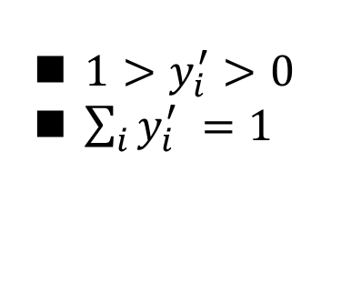





Soft-max
$$y_{i}^{′}=\frac{exp\left(y_{i}\right)}{\sum_{j}{exp\left(y_{i}\right)}}$$
$1>y_{i}^{′}>0$
$\sum_{i}{y_{i}^{′} =1}$
Softmax
How about binary classification? ☺
0.88
3
20
$$y_{1}^{′}$$
$$y_{1}$$
0.12
2.7
1
$$y_{2}^{′}$$
$$y_{2}$$
≈0
-3
0.05
$$y_{3}^{′}$$
$$y_{3}$$
logit

Slide 8


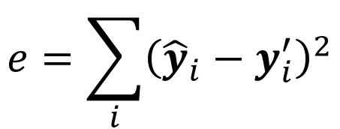




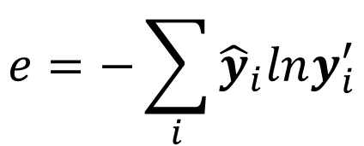
Loss of Classification
$$L=\frac{1}{N}\sum_{n}{e_{n}}$$
label
Network
$$\hat{y}$$
$$y′$$
softmax
$$y$$
$$x$$
$$e$$
$$e=\sum_{i}{{\left({\hat{y}}_{i}−y_{i}^{′}\right)}^{2}}$$
Mean Square Error (MSE)
Cross-entropy
$$e=−\sum_{i}{{\hat{y}}_{i}lny_{i}^{′}}$$
Minimizing cross-entropy is equivalent to maximizing likelihood.

Slide 9
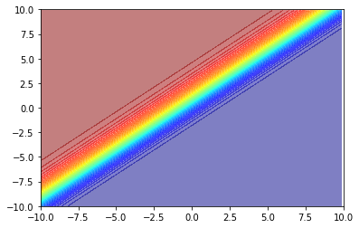
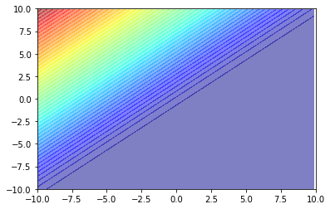












http://speech.ee.ntu.edu.tw/~tlkagk/courses/MLDS_2015_2/Lecture/Deep%20More%20(v2).ecm.mp4/index.html
-10 ~ 10
$$\left[\begin{aligned}1 \\ 0 \\ 0\end{aligned}\right]$$
$$y_{1}^{′}$$
$$y_{1}$$
-10 ~ 10
Network
$$y_{2}^{′}$$
softmax
$$y_{2}$$
$$x$$
$$e$$
$$y_{3}^{′}$$
-1000
$$y_{3}$$
large loss
Mean Square Error (MSE)
large loss
Cross-entropy
stuck!
$$y_{2}$$
$$y_{2}$$
small loss
small loss
$$y_{1}$$
$$y_{1}$$
Changing the loss function can change the difficulty of optimization.

