Slide 1
Error surface is rugged …
Tips for training: Adaptive Learning Rate

Slide 2
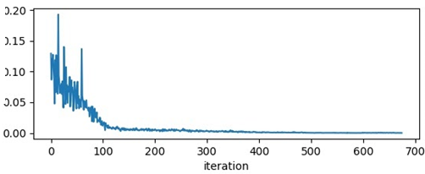
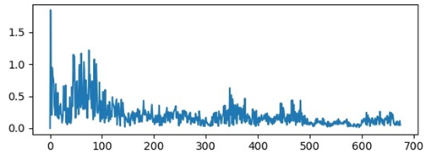

Training stuck $≠$ Small Gradient
https://docs.google.com/presentation/d/1siUFXARYRpNiMeSRwgFbt7mZVjkMPhR5od09w0Z8xaU/edit#slide=id.g3532c09be1_0_382
People believe training stuck because the parameters are around a critical point …
loss
norm of gradient
Notes:
This is a very usual case!
那之前 Hessian 的結果怎麼來的

Slide 3
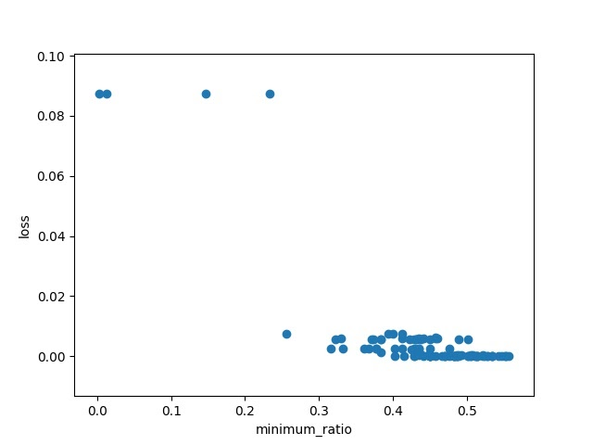
Wait a minute …
Notes:
use second order optimization method, such as Newton’s method or Levenberg-Marquardt algorithm (more stable)

Slide 4
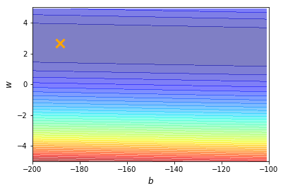
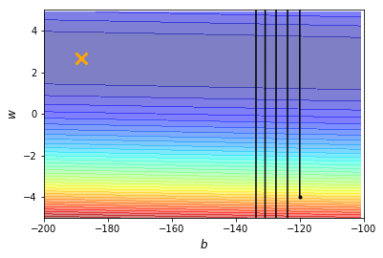
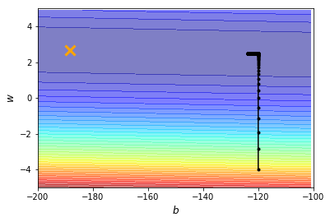
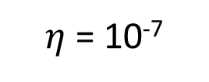
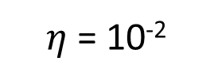
Training can be difficult even without critical points.
This error surface is convex.
Learning rate cannot be one-size-fits-all
100,000 updates
$\text{η}$ = 10⁻²
$\text{η}$ = 10⁻⁷
Notes:
=======
This is series even for a linear model
Should I describe why deep learning lead to this kind of error surface?

Slide 5
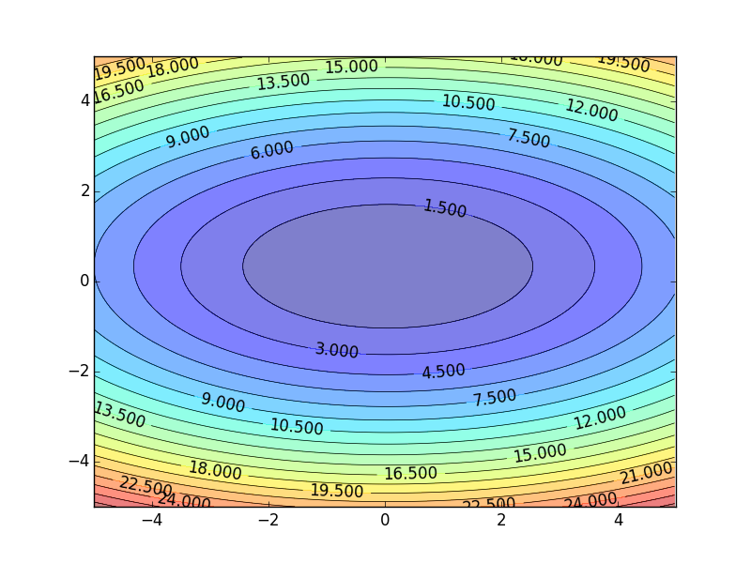
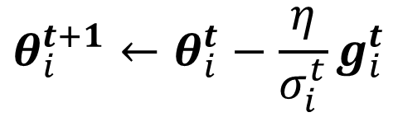



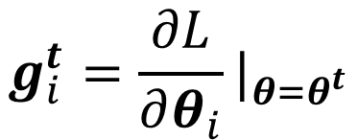
Different parameters needs different learning rate
Formulation for one parameter:
Smaller Learning Rate
$$θ_{i}^{t+1}←θ_{i}^{t}−\text{η}g_{i}^{t}$$
$$g_{i}^{t}=\frac{∂L}{∂θ_{i}}|_{θ=θ^{t}}$$
$$w_{2}$$
$$θ_{i}^{t+1}←θ_{i}^{t}−\frac{\text{η}}{σ_{i}^{t}}g_{i}^{t}$$
Larger Learning Rate
Parameter dependent
$$w_{1}$$
Notes:
We already know the principle.

Slide 6
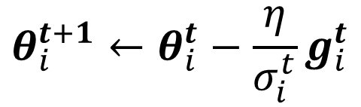
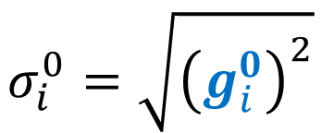
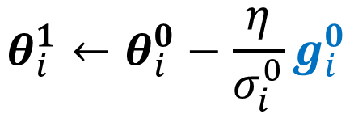

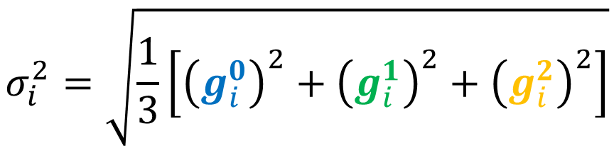
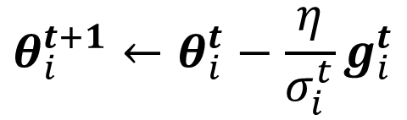
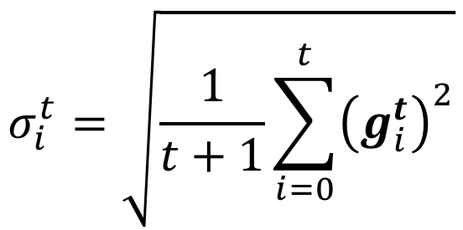
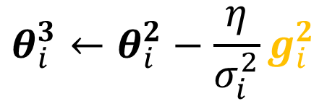
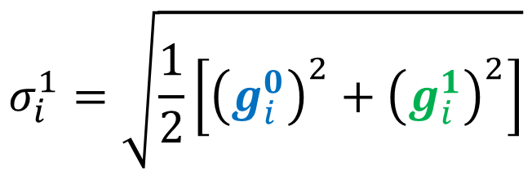
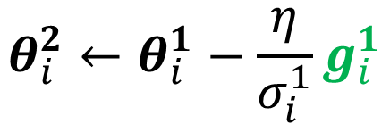
Root Mean Square
$$θ_{i}^{t+1}←θ_{i}^{t}−\frac{\text{η}}{σ_{i}^{t}}g_{i}^{t}$$
$$θ_{i}^{1}←θ_{i}^{0}−\frac{\text{η}}{σ_{i}^{0}}g_{i}^{0}$$
$$σ_{i}^{0}=\sqrt{{\left(g_{i}^{0}\right)}^{2}}$$
$$=\left|g_{i}^{0}\right|$$
$$σ_{i}^{1}=\sqrt{\frac{1}{2}\left[{\left(g_{i}^{0}\right)}^{2}+{\left(g_{i}^{1}\right)}^{2}\right]}$$
$$θ_{i}^{2}←θ_{i}^{1}−\frac{\text{η}}{σ_{i}^{1}}g_{i}^{1}$$
$$σ_{i}^{2}=\sqrt{\frac{1}{3}\left[{\left(g_{i}^{0}\right)}^{2}+{\left(g_{i}^{1}\right)}^{2}+{\left(g_{i}^{2}\right)}^{2}\right]}$$
$$θ_{i}^{3}←θ_{i}^{2}−\frac{\text{η}}{σ_{i}^{2}}g_{i}^{2}$$
……
$$σ_{i}^{t}=\sqrt{\frac{1}{t+1}\sum_{i=0}^{t}{{\left(g_{i}^{t}\right)}^{2}}}$$
$$θ_{i}^{t+1}←θ_{i}^{t}−\frac{\text{η}}{σ_{i}^{t}}g_{i}^{t}$$
Notes:
Divide the learning rate of each parameter by the root mean square of its previous derivatives

Slide 7
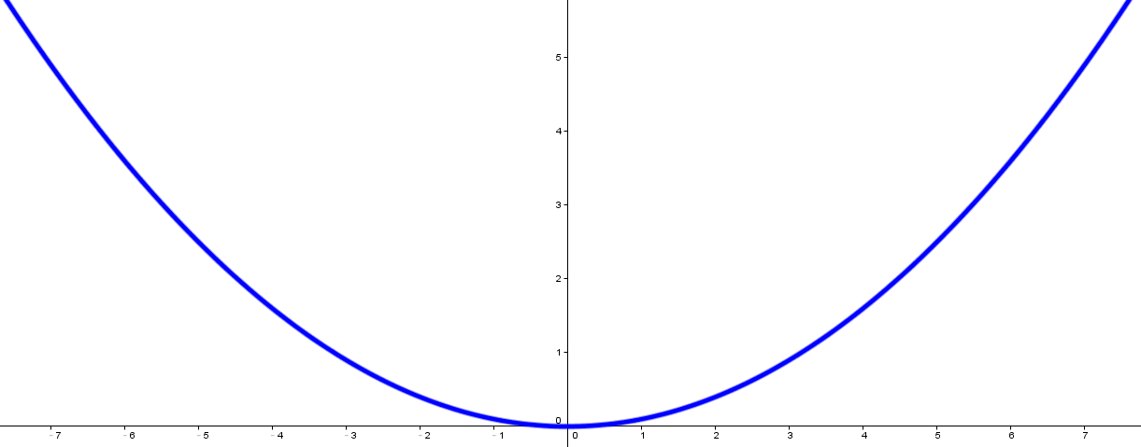
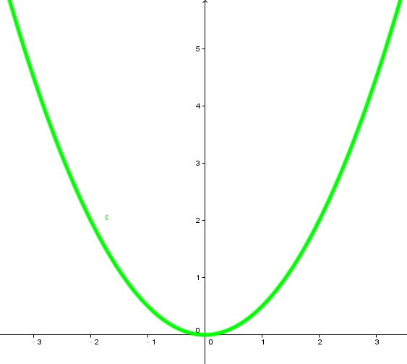


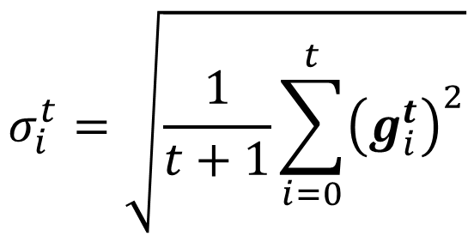




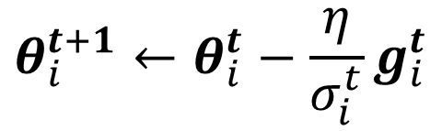


Root Mean Square
smaller
$$σ_{1}^{t}$$
$$g_{1}^{t−1}$$
larger step
$$g_{1}^{t}$$
$$θ_{i}^{t+1}←θ_{i}^{t}−\frac{\text{η}}{σ_{i}^{t}}g_{i}^{t}$$
$$θ_{1}$$
$$σ_{i}^{t}=\sqrt{\frac{1}{t+1}\sum_{i=0}^{t}{{\left(g_{i}^{t}\right)}^{2}}}$$
$$g_{2}^{t−1}$$
larger
$$σ_{2}^{t}$$
smaller step
$$g_{2}^{t}$$
Used in Adagrad
$$θ_{2}$$
Notes:
Why square

Slide 8
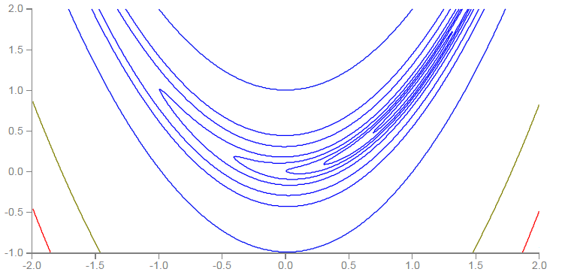


Learning rate adapts dynamically
Error Surface can be very complex.
Smaller Learning Rate
$$w_{2}$$
Larger Learning Rate
$$w_{1}$$

Slide 9
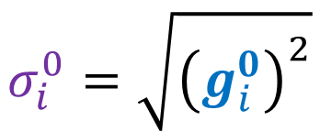


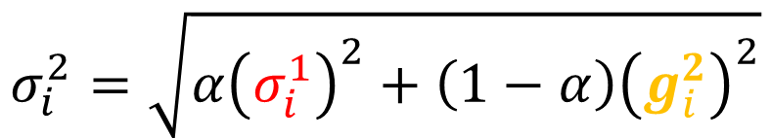
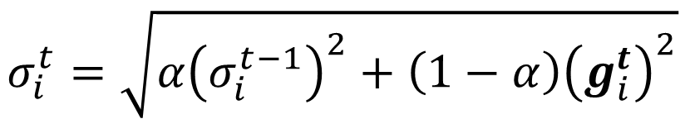
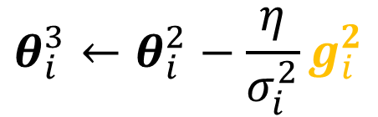
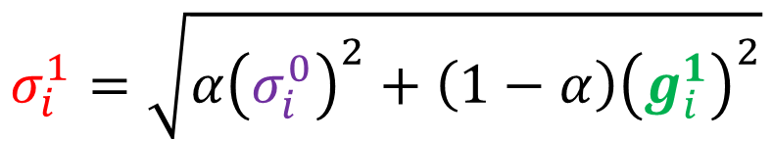

RMSProp
$$θ_{i}^{t+1}←θ_{i}^{t}−\frac{\text{η}}{σ_{i}^{t}}g_{i}^{t}$$
$$θ_{i}^{1}←θ_{i}^{0}−\frac{\text{η}}{σ_{i}^{0}}g_{i}^{0}$$
$$σ_{i}^{0}=\sqrt{{\left(g_{i}^{0}\right)}^{2}}$$
$$0<α<1$$
$$θ_{i}^{2}←θ_{i}^{1}−\frac{\text{η}}{σ_{i}^{1}}g_{i}^{1}$$
$$σ_{i}^{1}=\sqrt{{α\left(σ_{i}^{0}\right)}^{2}+\left(1−α\right){\left(g_{i}^{1}\right)}^{2}}$$
$$θ_{i}^{3}←θ_{i}^{2}−\frac{\text{η}}{σ_{i}^{2}}g_{i}^{2}$$
$$σ_{i}^{2}=\sqrt{{α\left(σ_{i}^{1}\right)}^{2}+\left(1−α\right){\left(g_{i}^{2}\right)}^{2}}$$
……
$$θ_{i}^{t+1}←θ_{i}^{t}−\frac{\text{η}}{σ_{i}^{t}}g_{i}^{t}$$
$$σ_{i}^{t}=\sqrt{{α\left(σ_{i}^{t−1}\right)}^{2}+\left(1−α\right){\left(g_{i}^{t}\right)}^{2}}$$
Notes:
Root Mean Squares of gradients
Root Mean Square of the gradients with previous gradients being decayed

Slide 10

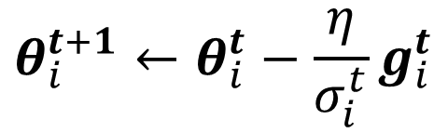

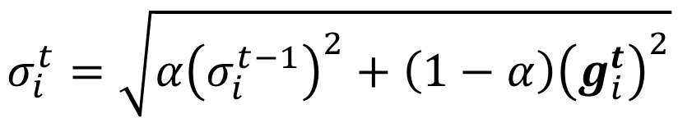

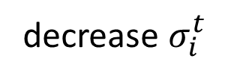

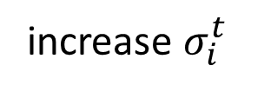

RMSProp
$$g_{i}^{1}$$
$$g_{i}^{2}$$
……
$$g_{i}^{t−1}$$
$$0<α<1$$
$$θ_{i}^{t+1}←θ_{i}^{t}−\frac{\text{η}}{σ_{i}^{t}}g_{i}^{t}$$
$$σ_{i}^{t}=\sqrt{{α\left(σ_{i}^{t−1}\right)}^{2}+\left(1−α\right){\left(g_{i}^{t}\right)}^{2}}$$
The recent gradient has larger influence, and the past gradients have less influence.
small $σ_{i}^{t}$
increase $σ_{i}^{t}$
larger step
smaller step
decrease $σ_{i}^{t}$
larger step
Notes:
Why square

Slide 11
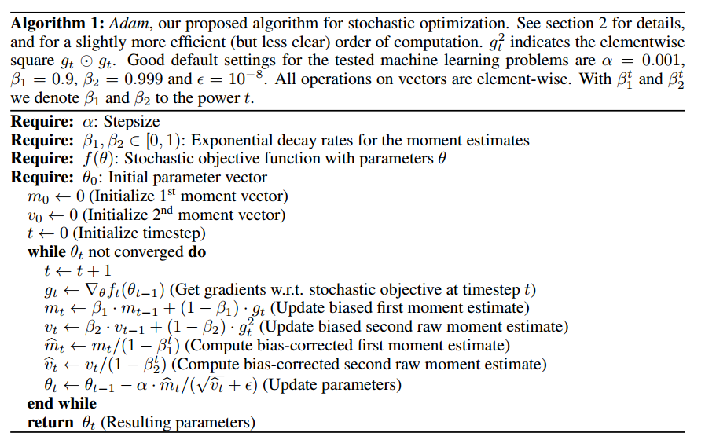
Adam: RMSProp + Momentum
Original paper: https://arxiv.org/pdf/1412.6980.pdf
for momentum
for RMSprop
Notes:
Why adam needs bias-corrected ?
Note that if we initialize v0=s0=0v0=s0=0 we have a significant amount of bias initially towards smaller values.
=======
Original paper: https://arxiv.org/pdf/1412.6980.pdf

Slide 12
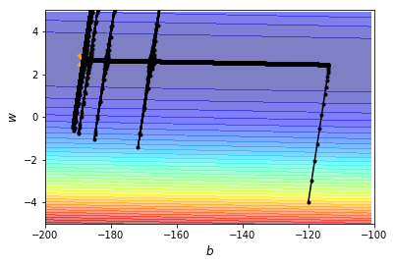
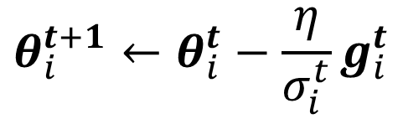
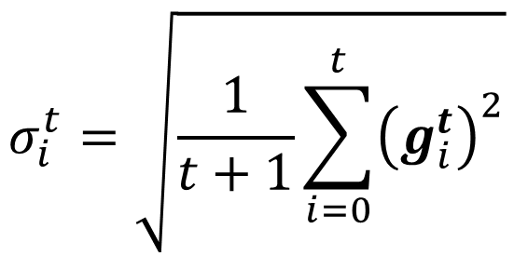
Without Adaptive Learning Rate
$$θ_{i}^{t+1}←θ_{i}^{t}−\frac{\text{η}}{σ_{i}^{t}}g_{i}^{t}$$
$$σ_{i}^{t}=\sqrt{\frac{1}{t+1}\sum_{i=0}^{t}{{\left(g_{i}^{t}\right)}^{2}}}$$

Slide 13
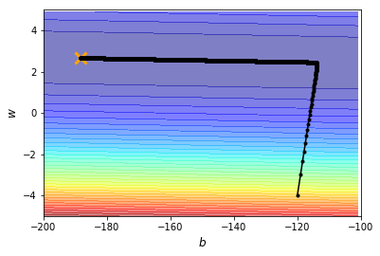
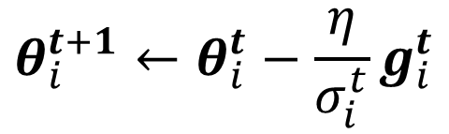



Learning Rate Scheduling
$${\text{η}}^{t}$$
$$θ_{i}^{t+1}←θ_{i}^{t}−\frac{\text{η}}{σ_{i}^{t}}g_{i}^{t}$$
$${\text{η}}^{t}$$
Learning Rate Decay
As the training goes, we are closer to the destination, so we reduce the learning rate.
$$t$$
Notes:
Popular & Simple Idea: Reduce the learning rate by some factor every few epochs.
E.g. 1/t decay: $η^{t}=η/{\sqrt{t+1}}$
At the beginning, we are far from the destination, so we use larger learning rate
After several epochs, we are close to the destination, so we reduce the learning rate

Slide 14


Learning Rate Scheduling
$${\text{η}}^{t}$$
$$θ_{i}^{t+1}←θ_{i}^{t}−\frac{\text{η}}{σ_{i}^{t}}g_{i}^{t}$$
$${\text{η}}^{t}$$
Learning Rate Decay
As the training goes, we are closer to the destination, so we reduce the learning rate.
$$t$$
Warm Up
$${\text{η}}^{t}$$
Increase and then decrease?
$$t$$
Notes:
Popular & Simple Idea: Reduce the learning rate by some factor every few epochs.
E.g. 1/t decay: $η^{t}=η/{\sqrt{t+1}}$
At the beginning, we are far from the destination, so we use larger learning rate
After several epochs, we are close to the destination, so we reduce the learning rate

Slide 15
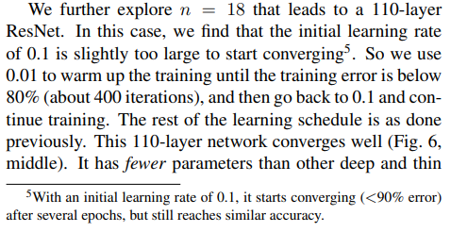
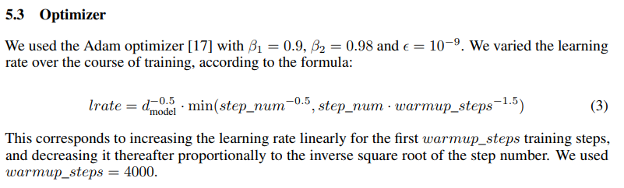
Residual Network
https://arxiv.org/abs/1512.03385
Transformer
https://arxiv.org/abs/1706.03762
Notes:
黑科技

Slide 16
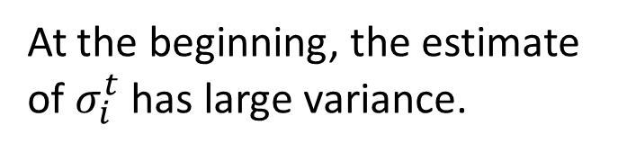
Learning Rate Scheduling
$${\text{η}}^{t}$$
$$θ_{i}^{t+1}←θ_{i}^{t}−\frac{\text{η}}{σ_{i}^{t}}g_{i}^{t}$$
$${\text{η}}^{t}$$
Learning Rate Decay
After the training goes, we are close to the destination, so we reduce the learning rate.
$$t$$
Warm Up
$${\text{η}}^{t}$$
Increase and then decrease?
At the beginning, the estimate of $σ_{i}^{t}$ has large variance.
$$t$$
Please refer to RAdam
https://arxiv.org/abs/1908.03265
Notes:
Popular & Simple Idea: Reduce the learning rate by some factor every few epochs.
E.g. 1/t decay: $η^{t}=η/{\sqrt{t+1}}$
At the beginning, we are far from the destination, so we use larger learning rate
After several epochs, we are close to the destination, so we reduce the learning rate

Slide 17
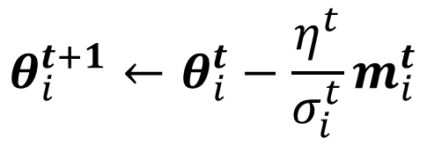

Summary of Optimization
(Vanilla) Gradient Descent
$$θ_{i}^{t+1}←θ_{i}^{t}−\text{η}g_{i}^{t}$$
Various Improvements
Learning rate scheduling
$$θ_{i}^{t+1}←θ_{i}^{t}−\frac{η^{t}}{σ_{i}^{t}}m_{i}^{t}$$
Momentum: weighted sum of the previous gradients
Consider direction
root mean square of the gradients
only magnitude
Notes:
Give an example about average v.s. absolute?

Slide 18


To Learn More ……
https://youtu.be/4pUmZ8hXlHM
https://youtu.be/e03YKGHXnL8
(in Mandarin)
(in Mandarin)

Slide 19
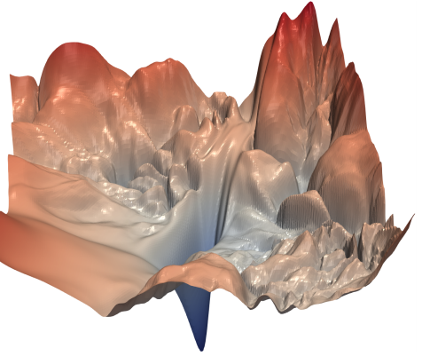
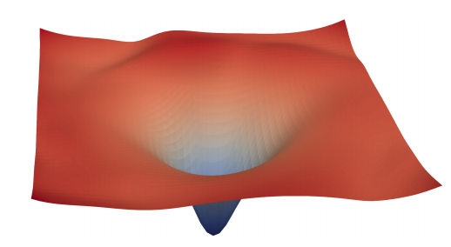
Next Time
Source of image: https://arxiv.org/abs/1712.09913
Next time
Better optimization strategies: If the mountain won't move, build a road around it.
Can we change the error surface?
Directly move the mountain!

