Slide 1

General Guidance
Hung-yi Lee 李宏毅
Notes:
TBD:
引用程式等等
不能用額外資料
=====
How is the results on 2/26?
======
Outline:
Model bias
Agnosis:
Solution:
2. Optimization Error
Agnosis:
Solution:
3. Variance?
Agnosis: model big, data little
Solution: collect data, augmentation
Model selection!
Constrain your model
====
Variance and bias trade-off – select your model carefully
====
4. Mismatch
Agnoisis: (it does not work even with more data)
Solution:
====================
-- Mention the issue of variance
-- Bias and variance trade off
lots of different things may influence them
-- You can’t have your cake and eat it (too)?

Slide 2

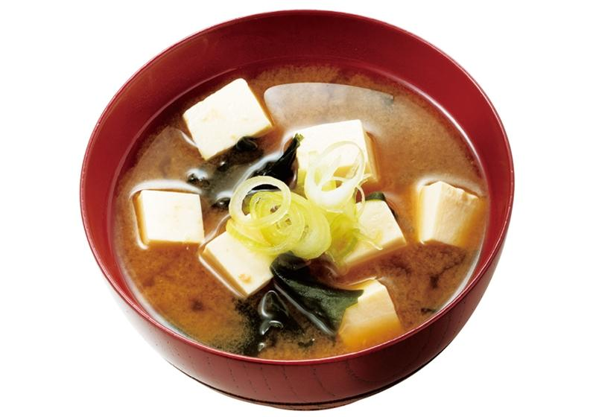

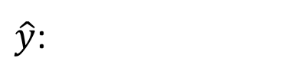


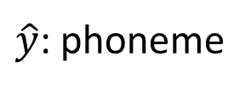
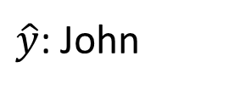



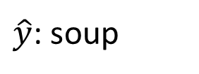
Framework of ML
Training data:
$$\left\{\left(x^{1},{\hat{y}}^{1}\right),\left(x^{2},{\hat{y}}^{2}\right),…,\left(x^{N},{\hat{y}}^{N}\right)\right\}$$
Testing data:
$$\left\{x^{N+1},x^{N+2},…,x^{N+M}\right\}$$
Speech Recognition
Image Recognition
$x$:
$\hat{y}$: phoneme
$\hat{y}$: soup
$x$:
Speaker Recognition
Machine Translation
$x$:
$\hat{y}$: John
$x$:
痛みを知れ
(speaker)
$\hat{y}$:
了解痛苦吧

Slide 3



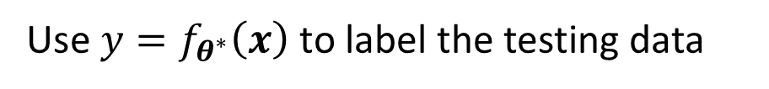



Framework of ML
Step 1: function with unknown
Step 2: define loss from training data
Step 3: optimization
Training data:
$$\left\{\left(x^{1},{\hat{y}}^{1}\right),\left(x^{2},{\hat{y}}^{2}\right),…,\left(x^{N},{\hat{y}}^{N}\right)\right\}$$
Training:
$$y=f_{θ}\left(x\right)$$
$$L\left(θ\right)$$
$$θ^{∗}=arg\min_{θ}{L}$$
Testing data:
$$\left\{x^{N+1},x^{N+2},…,x^{N+M}\right\}$$
Use $y=f_{θ^{∗}}\left(x\right)$ to label the testing data
$$\left\{y^{N+1},y^{N+2},…,y^{N+M}\right\}$$
Upload to Kaggle

Slide 4

General Guide
loss on training data
large
small
model
bias
loss on testing data
optimization
large
small
make your model complex
Next Lecture
overfitting
mismatch
more training data (not in HWs)
Not in HWs, except HW 11
data augmentation
make your model simpler
trade-off
Split your training data into training set and validation set for model selection
Notes:
跟魔關羽一樣 ….. XD

Slide 5



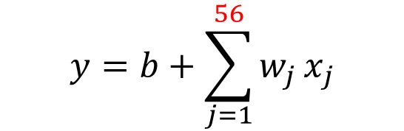


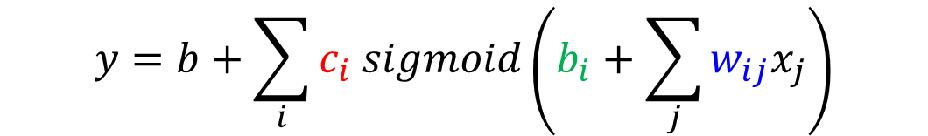

Model Bias
The model is too simple.
Solution: redesign your model to make it more flexible
$$f_{θ^{1}}\left(x\right)$$
$$y=f_{θ}\left(x\right)$$
$$f_{θ^{2}}\left(x\right)$$
find a needle in a haystack …
$$f_{θ^{∗}}\left(x\right)$$
… but there is no needle
too small …
$$f^{∗}\left(x\right)$$
small loss
More features
$$y=b+\sum_{j=1}^{56}{w_{j}}x_{j}$$
$$y=b+wx_{1}$$
Deep Learning
(more neurons, layers)
$$y=b+\sum_{i}{c_{i} sigmoid\left(b_{i}+\sum_{j}{w_{ij}x_{j}}\right)}$$

Slide 6
General Guide
loss on training data
large
small
model
bias
loss on testing data
optimization
large
small
make your model complex
Next Lecture
overfitting
mismatch
more training data (not in HWs)
Not in HWs, except HW 11
data augmentation
make your model simpler
trade-off
Split your training data into training set and validation set for model selection

Slide 7









Optimization Issue
Large loss not always imply model bias. There is another possibility …
$$f_{θ^{2}}\left(x\right)$$
$$f_{θ^{∗}}\left(x\right)$$
$$f_{θ^{1}}\left(x\right)$$
$$L$$
$$y=f_{θ}\left(x\right)$$
$$L\left(θ^{∗}\right)$$
large
$$f^{∗}\left(x\right)$$
$$θ$$
A needle is in a haystack …
$$θ^{∗}$$
… Just cannot find it.
Notes:
It is not helpful even if you make your model more flexible.

Slide 8









$$f_{θ^{1}}\left(x\right)$$
Model Bias
$$f_{θ^{2}}\left(x\right)$$
find a needle in a haystack …
$$f_{θ^{∗}}\left(x\right)$$
… but there is no needle
too small …
$$f^{∗}\left(x\right)$$
small loss
Which one???
$$f_{θ^{2}}\left(x\right)$$
$$f_{θ^{∗}}\left(x\right)$$
Optimization Issue
$$f_{θ^{1}}\left(x\right)$$
A needle is in a haystack …
$$y=f_{θ}\left(x\right)$$
… Just cannot find it.
$$f^{∗}\left(x\right)$$

Slide 9
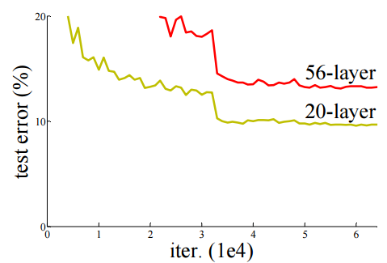
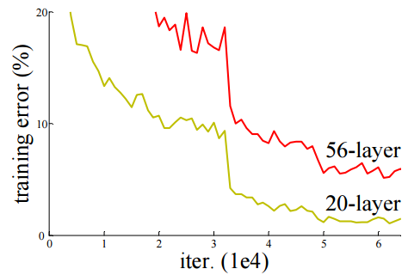

Model Bias v.s. Optimization Issue
Ref: http://arxiv.org/abs/1512.03385
Gaining the insights from comparison
Optimization issue
Overfitting?
Testing Data
Training Data
Notes:
Train a simpler model first, no optimization issue

Slide 10
Optimization Issue
Ref: http://arxiv.org/abs/1512.03385
Gaining the insights from comparison
Start from shallower networks (or other models), which are easier to optimize.
If deeper networks do not obtain smaller loss on training data, then there is optimization issue.
Solution: More powerful optimization technology (next lecture)
 | 1 layer | 2 layer | 3 layer | 4 layer | 5 layer
2017 – 2020 | 0.28k | 0.18k | 0.14k | 0.10k | 0.34k
Notes:
Train a simpler model first, no optimization issue

Slide 11
General Guide
loss on training data
large
small
model
bias
loss on testing data
optimization
large
small
make your model complex
Next Lecture
overfitting
mismatch
more training data (not in HWs)
Not in HWs, except HW 11
data augmentation
make your model simpler
trade-off
Split your training data into training set and validation set for model selection

Slide 12
General Guide
loss on training data
large
small
model
bias
loss on testing data
optimization
large
small
make your model complex
Next Lecture
overfitting
mismatch
more training data (not in HWs)
Not in HWs, except HW 11
data augmentation
make your model simpler
trade-off
Split your training data into training set and validation set for model selection

Slide 13




Overfitting
Small loss on training data, large loss on testing data. Why?
An extreme example
Training data:
$$\left\{\left(x^{1},{\hat{y}}^{1}\right),\left(x^{2},{\hat{y}}^{2}\right),…,\left(x^{N},{\hat{y}}^{N}\right)\right\}$$
$$f\left(x\right)=\left\{\begin{aligned}{\hat{y}}^{i} \\ random\end{aligned}\right.$$
$$∃x^{i}=x$$
Less than useless …
$$otherwise$$
This function obtains zero training loss, but large testing loss.
Notes:
-- reason
-- where does it come from
-- solution
=========
-- trade-off
-- Kaggle

Slide 14






Overfitting
$$y$$
“freestyle”
$$y$$
Flexible model
$$x$$
$$x$$
$$y$$
Large loss
Real data distribution (not observable)
Training data
Testing data
$$x$$
Notes:
Use the example of polynomial

Slide 15
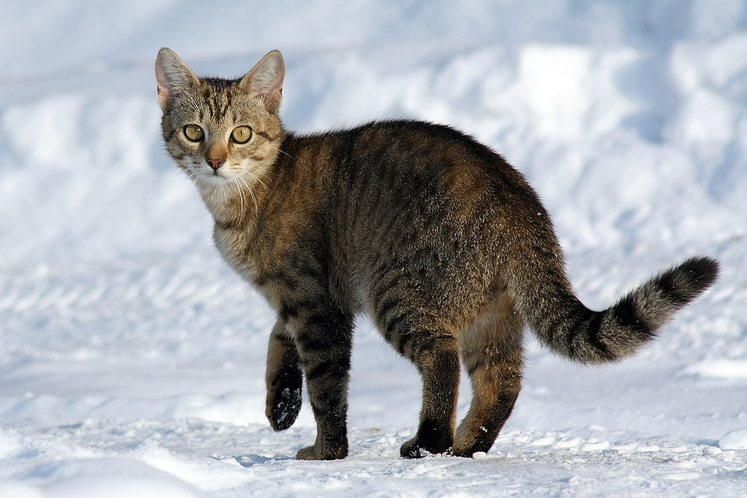
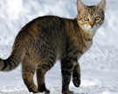
Overfitting
$$y$$
$$y$$
Flexible model
$$x$$
More training data
$$x$$
(cannot do it in HWs)
Data augmentation
(you can do that in HWs)
Notes:
Use the example of polynomial

Slide 16

Overfitting
$$y$$
$$y=a+bx+cx^{2}$$
$$y$$
constrained
model
$$x$$
$$x$$
Real data distribution (not observable)
Training data
Testing data
Notes:
Use the example of polynomial

Slide 17
Overfitting
$$y$$
$$y=a+bx+cx^{2}$$
$$y$$
constrained
model
$$x$$
$$x$$
$$y$$
Real data distribution (not observable)
Training data
Testing data
$$x$$
Notes:
Use the example of polynomial

Slide 18
Overfitting
$$y$$
$$y=a+bx+cx^{2}$$
$$y$$
constrained
model
$$x$$
$$x$$
Less parameters, sharing parameters
Less features
Early stopping
Regularization
Dropout
Fully-connected
CNN
Notes:
Use the example of polynomial

Slide 19

Overfitting
$$y$$
$$y=a+bx$$
$$y$$
constrain too much
$$x$$
$$x$$
$$y$$
Back to model bias …
Real data distribution (not observable)
Training data
Testing data
$$x$$
Notes:
Use the example of polynomial

Slide 20
Bias-Complexity Trade-off
loss
Testing loss
select this one
Training loss
Model becomes complex
(e.g. more features, more parameters)
Notes:
When nothing goes wrong in optimization

Slide 21

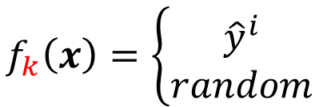
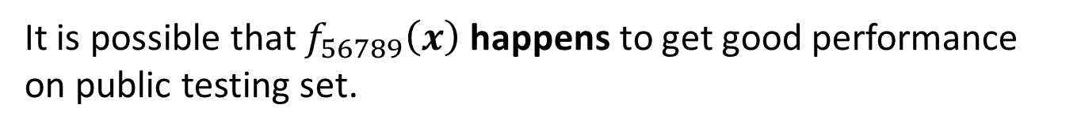
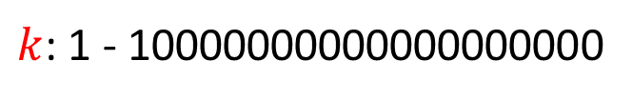

Homework
public
private
Training Set
Testing Set
Testing Set
Model 1
mse = 0.9
Model 2
mse = 0.7
Model 3
mse = 0.5
mse > 0.5
Pick this one!
May be poor …
The extreme example again
$$f_{k}\left(x\right)=\left\{\begin{aligned}{\hat{y}}^{i} \\ random\end{aligned}\right.$$
$$∃x^{i}=x$$
$k$: 1 - 10000000000000000000
$$otherwise$$
It is possible that $f_{56789}\left(x\right)$ happens to get good performance on public testing set.
So you select $f_{56789}\left(x\right)$ ……
Random on private testing set

Slide 22

Homework
public
private
Training Set
Testing Set
Testing Set
Why?
Model 1
mse = 0.9
Model 2
mse = 0.7
Model 3
mse = 0.5
mse > 0.5
Pick this one!
May be poor …
What will happen?
http://www.chioka.in/how-to-select-your-final-models-in-a-kaggle-competitio/
This explains why machine usually beats human on benchmark corpora. ☺
Notes:
Most famous example: MS, IBM
======
Even worse
Even worse

Slide 23
Cross Validation
How to split?
public
private
Training Set
Testing Set
Testing Set
Training Set
Validation
set
Using the results of public testing data to select your model
You are making public set better than private set.
Model 1
mse = 0.9
Model 2
mse = 0.7
Not recommend
Model 3
mse = 0.5
mse > 0.5
mse > 0.5
Notes:
有人在 public testing set 上好就得意了
排前幾名
Overfit 在 testing set 上啦

Slide 24
N-fold Cross Validation
Training Set
Model 1
Model 2
Model 3
Train
Train
Val
mse = 0.2
mse = 0.4
mse = 0.4
Train
Val
Train
mse = 0.4
mse = 0.5
mse = 0.5
Val
Train
Train
mse = 0.3
mse = 0.6
mse = 0.3
Avg mse
= 0.3
Avg mse
= 0.5
Avg mse
= 0.4
Testing Set
Testing Set
public
private

Slide 25
General Guide
loss on training data
large
small
model
bias
loss on testing data
optimization
large
small
make your model complex
Next Lecture
overfitting
mismatch
more training data (not in HWs)
Not in HWs, except HW 11
data augmentation
make your model simpler
trade-off
Split your training data into training set and validation set for model selection

Slide 26
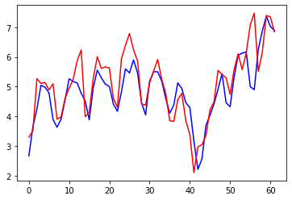
Let’s predict no. of views of 2/26!
 | 1 layer | 2 layer | 3 layer | 4 layer
2017 – 2020 | 0.28k | 0.18k | 0.14k | 0.10k
2021 | 0.43k | 0.39k | 0.38k | 0.44k
Red: real, Blue: predicted
2/26
e = 2.58k

Slide 27
General Guide
loss on training data
large
small
model
bias
loss on testing data
optimization
large
small
make your model complex
Next Lecture
overfitting
mismatch
more training data (not in HWs)
Not in HWs, except HW 11
data augmentation
make your model simpler
trade-off
Split your training data into training set and validation set for model selection

Slide 28
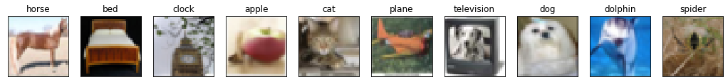
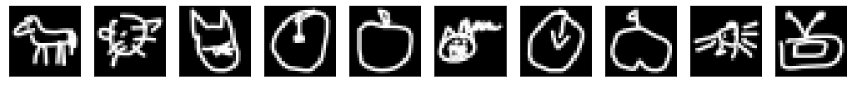
Mismatch
Your training and testing data have different distributions.
Be aware of how data is generated.
Most HWs do not have this problem, except HW11
Training Data
Simply increasing the training data will not help.
Testing Data

Slide 29
General Guide
loss on training data
large
small
model
bias
loss on testing data
optimization
large
small
make your model complex
Next Lecture
overfitting
mismatch
more training data (not in HWs)
Not in HWs, except HW 11
data augmentation
make your model simpler
trade-off
Split your training data into training set and validation set for model selection

