Slide 1

When gradient is small …
Hung-yi Lee 李宏毅
Notes:
TBD: Many papers shows that gradient decent lead to global
=======
Outline:
1. Local optimal (not always the issue)
2. Saddle point -> why I have to mention Degenerate?
=====
3. The parameters have very different gradients
Why? Input, internal (using initial learning rate as example)
4. The same parameters have very different gradients
Why? RNN? random
========
Hessien:
https://colab.research.google.com/drive/1yqtEcJHmXlCMhlaauEaRZYrnLXTVzou5?usp=sharing&fbclid=IwAR3Il0Ij_nN-H2djox4jssOH4WcLJgB3otvy0v-NXKDm0ZTpF5ycbB0vdO4
Paper survey: https://docs.google.com/spreadsheets/d/145SqCKXyYtVoenUvNx6iI2rDXGms442HnHmbbhW15S4/edit?fbclid=IwAR2QeFtW6pya42jkX0leF_oPaWVQ8Fu9ZfAK15U6nxI4rYuanVhmDyyULiE#gid=0
Experimental results of gradient vanish:
https://hackmd.io/-xXNzXhZS2imFlA3Aly6-w?fbclid=IwAR2tD5_Y_rlL58laB1QdCF5KzL7YYCAwArp0UFruiwYx2vWiuYF2pJ0l4eI
HW2:
https://docs.google.com/presentation/d/16aFQp1AtSkLngcK_B_7o0NqeCKEtPi7ljn_QXwYsY0o/edit#slide=id.p
https://colab.research.google.com/drive/1KfrNyDvmFAYMqLBUD4wlEEnqFX-CtI0V?usp=sharing

Slide 2
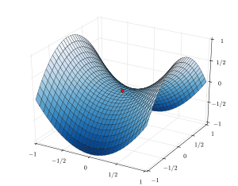
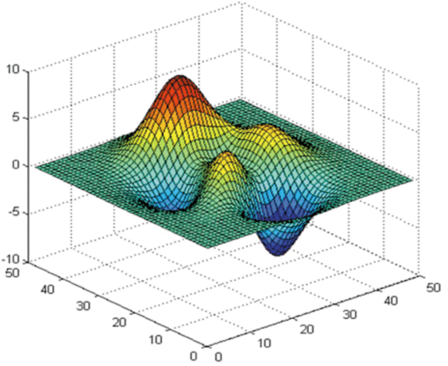
Optimization Fails because ……
local minima
saddle point
No way to go
escape
training
loss
Which one?
gradient is close to zero
critical point
Not small enough
updates
Notes:
People believe training stuck because the parameters are near a critical point

Slide 3
Warning of Math

Slide 4

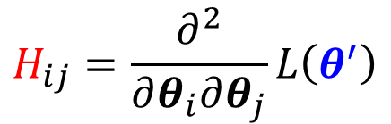

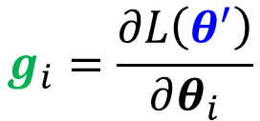




Tayler Series Approximation
$L\left(θ\right)$ around$θ=θ^{′}$ can be approximated below
$L\left(θ\right)≈L\left(θ^{′}\right)+{\left(θ−θ^{′}\right)}^{T}g+\frac{1}{2}$ ${\left(θ−θ^{′}\right)}^{T}H\left(θ−θ^{′}\right)$
Gradient $g$ is a vector
$$θ$$
$$g_{i}=\frac{∂L\left(θ^{′}\right)}{∂θ_{i}}$$
$$g=∇L\left(θ^{′}\right)$$
Hessian $H$ is a matrix
$$L\left(θ\right)$$
$θ^{′}$
$$H_{ij}=\frac{∂^{2}}{∂θ_{i}∂θ_{j}}L\left(θ^{′}\right)$$
Notes:
if the second derivatives of f are all continuous
Should we mention curvature?
海森矩陣的混合偏導數是海森矩陣非主對角線上的元素。假如他們是連續的，那麼求導順序沒有區別

Slide 5
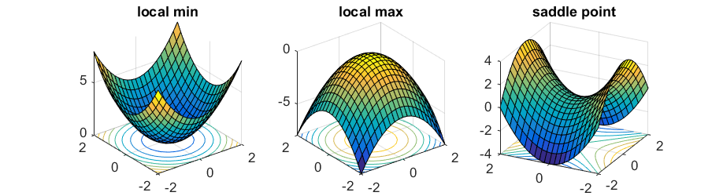
Hessian
Source of image:http://www.offconvex.org/2016/03/22/saddlepoints/
$L\left(θ\right)$ around$θ=θ^{′}$ can be approximated below
$L\left(θ\right)≈L\left(θ^{′}\right)+{\left(θ−θ^{′}\right)}^{T}g+\frac{1}{2}$ ${\left(θ−θ^{′}\right)}^{T}H\left(θ−θ^{′}\right)$
At critical point
telling the properties of critical points

Slide 6



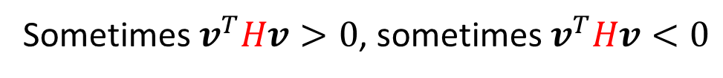







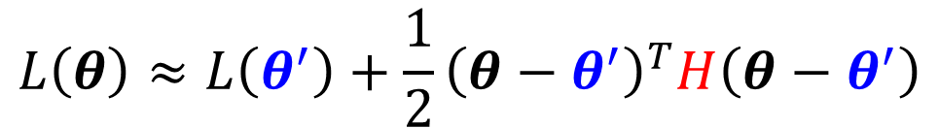

Hessian
At critical point:
$$v^{T}Hv$$
$$L\left(θ\right)≈L\left(θ^{′}\right)+\frac{1}{2}{\left(θ−θ^{′}\right)}^{T}H\left(θ−θ^{′}\right)$$
For all $v$
Around $θ^{′}$:
Local minima
$$v^{T}Hv>0$$
$$L\left(θ\right)>L\left(θ^{′}\right)$$
=
$H$ is positive definite
=
All eigen values are positive.
For all $v$
Around $θ^{′}$:
Local maxima
$$v^{T}Hv<0$$
$$L\left(θ\right)<L\left(θ^{′}\right)$$
=
$H$ is negative definite
=
All eigen values are negative.
Sometimes $v^{T}Hv>0$, sometimes $v^{T}Hv<0$
Saddle point
Some eigen values are positive, and some are negative.

Slide 7
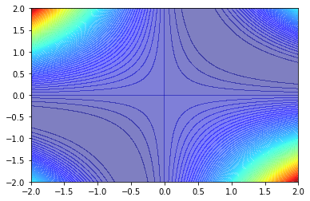










Example
$$y=w_{1}w_{2}x$$
$$w_{1}$$
$$w_{2}$$
$$x$$
$$y$$
$$\hat{y}$$
$$=1$$
$$=1$$
Error Surface
minima
$$w_{2}$$
saddle
minima
$$w_{1}$$
Notes:
https://arxiv.org/abs/1412.6544

Slide 8
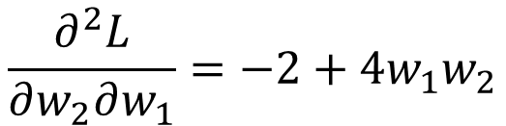


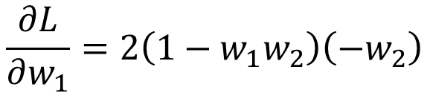

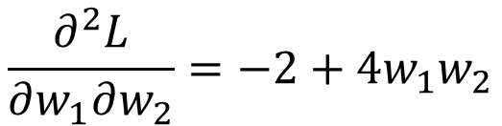





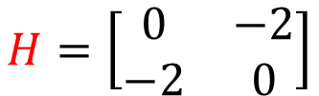

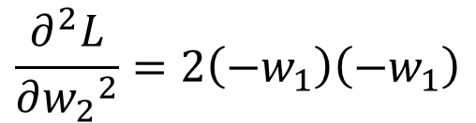


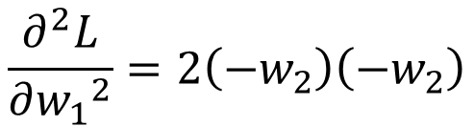





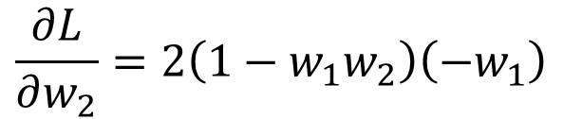



$$w_{1}$$
$$w_{2}$$
$$x$$
$$y$$
$$\hat{y}$$
$$=1$$
$$=1$$
$$L={\left(\hat{y}−w_{1}w_{2}x\right)}^{2}$$
$$={\left(1−w_{1}w_{2}\right)}^{2}$$
$$\frac{∂L}{∂w_{1}}=2\left(1−w_{1}w_{2}\right)\left(−w_{2}\right)$$
Critical point:
$$w_{1}=0,w_{2}=0$$
$$=0$$
$$H=\left[\begin{matrix}0 & −2 \\ −2 & 0\end{matrix}\right]$$
$$λ_{1}=2,λ_{2}=−2$$
$$\frac{∂L}{∂w_{2}}=2\left(1−w_{1}w_{2}\right)\left(−w_{1}\right)$$
Saddle point
$$=0$$
$$g$$
$$\frac{∂^{2}L}{∂{w_{1}}^{2}}=2\left(−w_{2}\right)\left(−w_{2}\right)$$
$$\frac{∂^{2}L}{∂w_{1}∂w_{2}}=−2+4w_{1}w_{2}$$
$$H$$
$$=0$$
$$=−2$$
$$\frac{∂^{2}L}{∂w_{2}∂w_{1}}=−2+4w_{1}w_{2}$$
$$\frac{∂^{2}L}{∂{w_{2}}^{2}}=2\left(−w_{1}\right)\left(−w_{1}\right)$$
$$=−2$$
$$=0$$

Slide 9



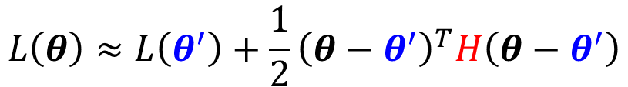





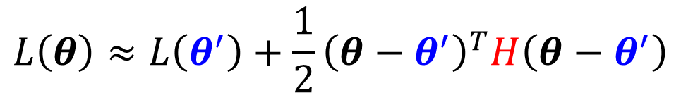





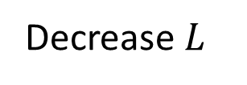
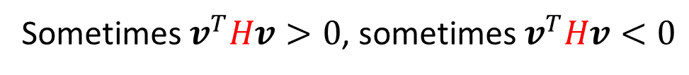
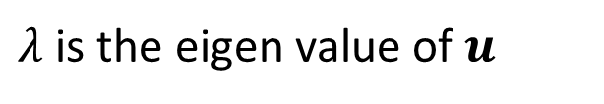

Don’t afraid of saddle point?
$$v^{T}Hv$$
$$L\left(θ\right)≈L\left(θ^{′}\right)+\frac{1}{2}{\left(θ−θ^{′}\right)}^{T}H\left(θ−θ^{′}\right)$$
At critical point:
Sometimes $v^{T}Hv>0$, sometimes $v^{T}Hv<0$
Saddle point
$H$ may tell us parameter update direction!
$u$ is an eigen vector of $H$
$$u^{T}Hu$$
$$=u^{T}\left(λu\right)$$
$$={λ\left\|u\right\|}^{2}$$
$λ$ is the eigen value of $u$
$<0$
$<0$
$λ<0$
$$u$$
$$u$$
$$L\left(θ\right)≈L\left(θ^{′}\right)+\frac{1}{2}{\left(θ−θ^{′}\right)}^{T}H\left(θ−θ^{′}\right)$$
$$L\left(θ\right)<L\left(θ^{′}\right)$$
$$θ−θ^{′}=u$$
$$θ=θ^{′}+u$$
Decrease $L$
Notes:
Don’t afraid of saddle point?

Slide 10


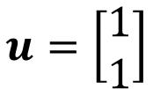
$$w_{1}$$
$$w_{2}$$
$$x$$
$$y$$
$$\hat{y}$$
$$=1$$
$$=1$$
$$L={\left(\hat{y}−w_{1}w_{2}x\right)}^{2}$$
$$={\left(1−w_{1}w_{2}\right)}^{2}$$
$$\frac{∂L}{∂w_{1}}=2\left(1−w_{1}w_{2}\right)\left(−w_{2}\right)$$
Critical point:
$$w_{1}=0,w_{2}=0$$
$$H=\left[\begin{matrix}0 & −2 \\ −2 & 0\end{matrix}\right]$$
$$λ_{1}=2,λ_{2}=−2$$
$$\frac{∂L}{∂w_{2}}=2\left(1−w_{1}w_{2}\right)\left(−w_{1}\right)$$
Saddle point
$$λ_{2}=−2$$
Has eigenvector
$$u=\left[\begin{aligned}1 \\ 1\end{aligned}\right]$$
Update the parameter along the direction of $u$
You can escape the saddle point and decrease the loss.
(this method is seldom used in practice)

Slide 11
End of Warning

Slide 12

Saddle Point v.s. Local Minima
A.D. 1543
Notes:
公元1453年5月
狄奧倫娜
君士坦丁十一世
她可能是人類歷史上唯一真正的魔法師。而在這之前約十小時，短暫的魔法時代也結束了。魔法時代開始於公元1453年5月3日16時，那時高維碎塊首次接觸地球；結束於1453年5月28日21時，這時碎塊完全離開地球；歷時二十五天五小時。之後，這個世界又回到了正常的軌道上。
https://santi.huijiwiki.com/wiki/%E7%8B%84%E5%A5%A5%E4%BC%A6%E5%A8%9C
https://www.b111.net/novel/49/49312/4411146.html

Slide 13
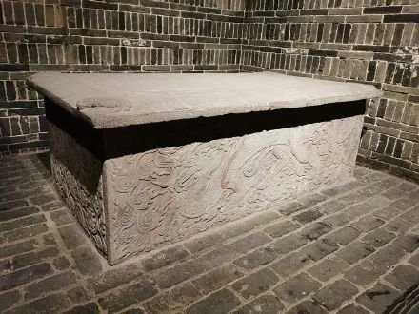

Saddle Point v.s. Local Minima
來源《三體Ⅲ·死神永生》
The Magician Diorena (魔法師狄奧倫娜)
From 3 dimensional space, it is sealed.
It is not in higher dimensions.
Source of image: https://read01.com/mz2DBPE.html#.YECz22gzbIU
Notes:
公元1453年5月
狄奧倫娜
聖索菲亞大教堂重建時，同其他聖物一起放入教堂地基深處一個完全封閉的小密室中。眼前這個顯然是後者，因為前一隻已經烙上了時間的印痕，變得有些黯淡當然是與眼前這只對比才能看出來，這只聖盃看上去彷彿昨天才鑄出來一般嶄新。
她可能是人類歷史上唯一真正的魔法師。而在這之前約十小時，短暫的魔法時代也結束了。魔法時代開始於公元1453年5月3日16時，那時高維碎塊首次接觸地球；結束於1453年5月28日21時，這時碎塊完全離開地球；歷時二十五天五小時。之後，這個世界又回到了正常的軌道上。
https://santi.huijiwiki.com/wiki/%E7%8B%84%E5%A5%A5%E4%BC%A6%E5%A8%9C
https://www.b111.net/novel/49/49312/4411146.html

Slide 14
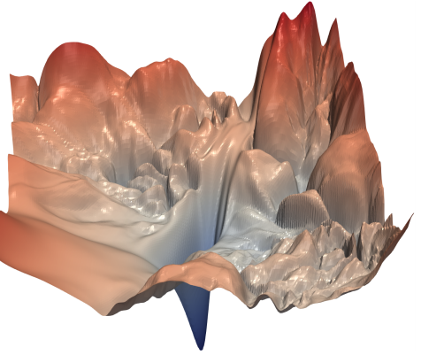
Saddle Point v.s. Local Minima
Source of image: https://arxiv.org/abs/1712.09913
Saddle point in higher dimension?
When you have lots of parameters, perhaps local minima is rare?

Slide 15
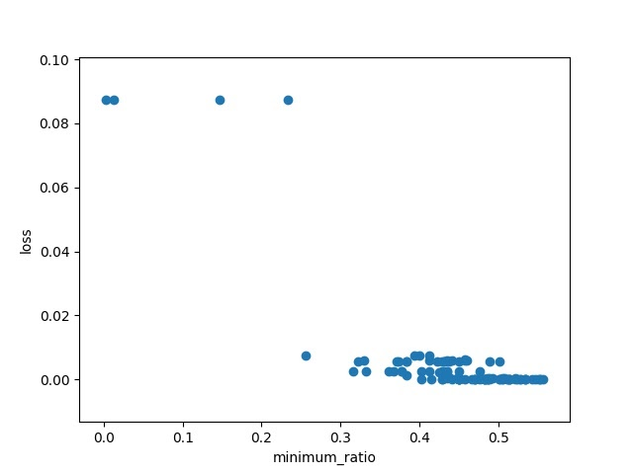
Empirical Study
More “like” local minima
Training Loss
never reach a real “local minima”
Train a network once, until it converges to critical point.
Minimum Ratio
Number of Positive Eigen values
Minimum ratio
=
Number of Eigen values
Source:https://docs.google.com/presentation/d/1siUFXARYRpNiMeSRwgFbt7mZVjkMPhR5od09w0Z8xaU/edit#slide=id.g31470fd33a_0_33

Slide 16



Small Gradient …
Loss
Gradient Descent
Very slow at the plateau
Stuck at saddle point
Stuck at local minima
$$∂L∕∂w$$
$$≈0$$
$$∂L∕∂w$$
$$=0$$
$$∂L∕∂w$$
$$=0$$
The value of a network parameter w

Slide 17

Tips for training: Batch and Momentum
Notes:
=====TBA=====
More reference for large batch size
https://docs.google.com/spreadsheets/d/145SqCKXyYtVoenUvNx6iI2rDXGms442HnHmbbhW15S4/edit?fbclid=IwAR2QeFtW6pya42jkX0leF_oPaWVQ8Fu9ZfAK15U6nxI4rYuanVhmDyyULiE#gid=0
https://medium.com/deep-learning-experiments/effect-of-batch-size-on-neural-net-training-c5ae8516e57
http://proceedings.mlr.press/v119/lin20b.html
https://syncedreview.com/2020/09/13/a-closer-look-at-the-generalization-gap-in-large-batch-training-of-neural-networks/
===========
Outline:
Zero gradient:
For zero gradient
-> batch
-> momentum
Local optimal -> not always the issue
=====
3. The parameters have very different gradients
4. The same parameters have very different gradints
-- adaptive learning rate
-- clipping (for sudden too large)
=====
Q: critical v.s. batch / momentum
Q:Warm up?
=====
-- Batch norm
-- Sigmoid -> ReLU
-- SELU
-- residual
-- initialization

Slide 18
Batch
Notes:
Full batch (太花時間了)
不是可以平行嗎?
但是平行運算也是有極限啊
Batch
Batch v.s. Full batch
好處: 快; 壞處: 不穩
但是不穩反而好?
Interesting side effect of batch size
Tip: Shuffle (not mention?)
Smaller batch sizes are noisy, offering a regularizing effect and lower generalization error.
Smaller batch sizes make it easier to fit one batch worth of training data in memory (i.e. when using a GPU).

Slide 19











Review: Optimization with Batch
$$θ^{∗}=arg\min_{θ}{L}$$
B
batch
$$L$$
(Randomly) Pick initial values $θ^{0}$
Compute gradient $g^{0}=∇L^{1}\left(θ^{0}\right)$
$$L^{1}$$
batch
update
$$θ^{1}←θ^{0}−ηg^{0}$$
N
Compute gradient $g^{1}=∇L^{2}\left(θ^{1}\right)$
$$L^{2}$$
batch
update
$$θ^{2}←θ^{1}−ηg^{1}$$
Compute gradient $g^{3}=∇L^{3}\left(θ^{2}\right)$
$$L^{3}$$
batch
$$θ^{3}←θ^{2}−ηg^{3}$$
update
1 epoch = see all the batches once
Shuffle after each epoch

Slide 20
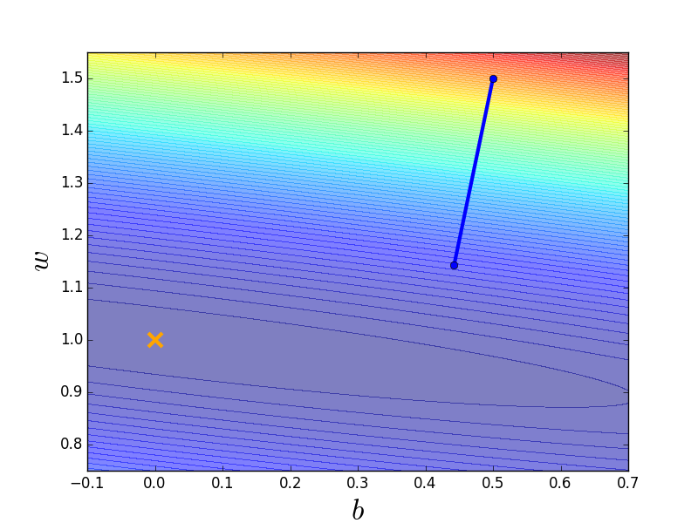
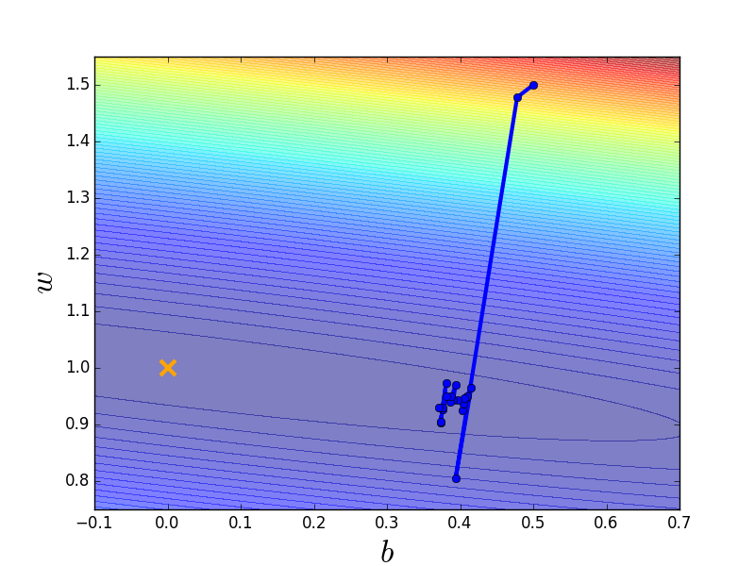
Small Batch v.s. Large Batch
Consider 20 examples (N=20)
Batch size = N (Full batch)
Batch size = 1
Update after seeing all the 20 examples
Update for each example
Update 20 times in an epoch
See all examples
See only one example
See all examples
Long time for cooldown, but powerful
Short time for cooldown, but noisy
Notes:
Full?

Slide 21
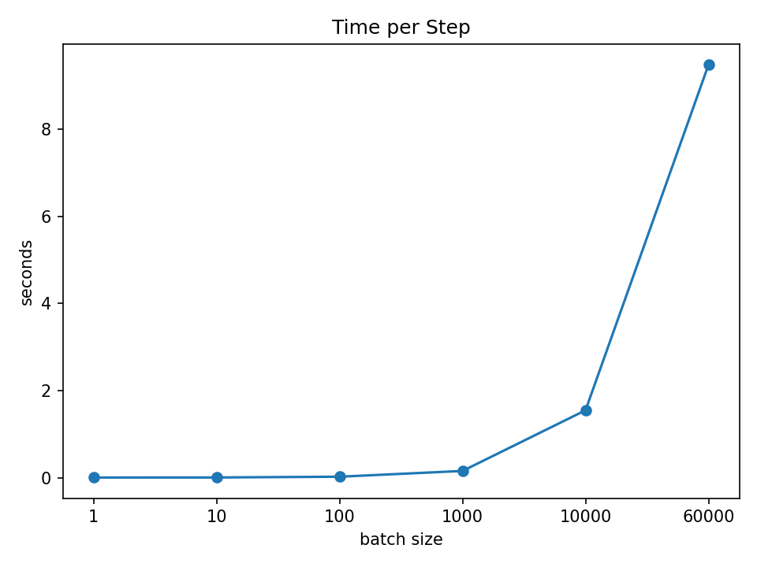
Small Batch v.s. Large Batch
oldest slides: http://speech.ee.ntu.edu.tw/~tlkagk/courses/MLDS_2015_2/Lecture/DNN%20(v4).pdf
old slides: http://speech.ee.ntu.edu.tw/~tlkagk/courses/ML_2017/Lecture/Keras.pdf
Larger batch size does not require longer time to compute gradient
(unless batch size is too large)
Time for each update
MNIST: digit classification
Having limitation
Parallel computing
Tesla V100 GPU
full
Notes:
960
780

Slide 22
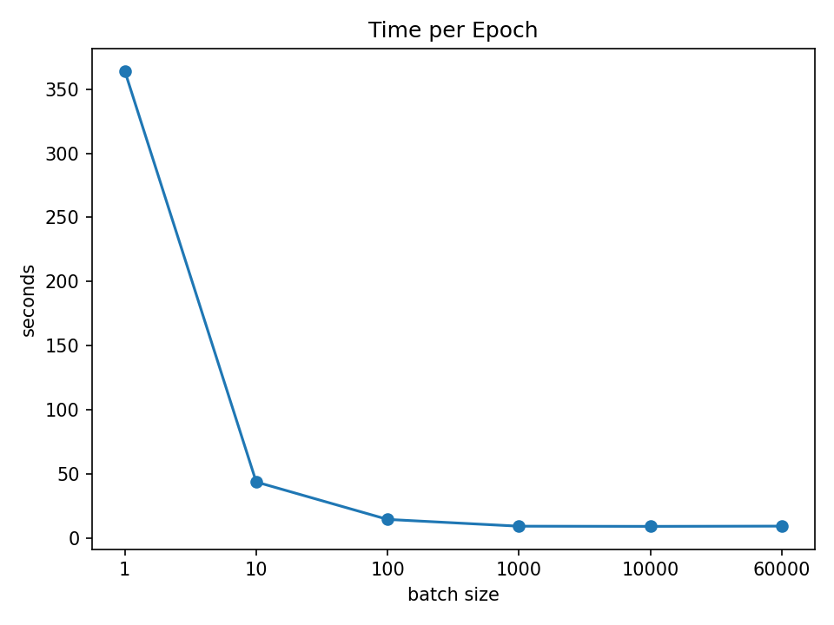
Small Batch v.s. Large Batch
Smaller batch requires longer time for one epoch (longer time for seeing all data once)
Time for one update
Time for one epoch
slower
60 updates
faster
60000 updates in one epoch

Slide 23
Small Batch v.s. Large Batch
Consider 20 examples (N=20)
Batch size = N (Full Batch)
Batch size = 1
Update after seeing all the 20 examples
Update for each example
Update 20 times in an epoch
See all examples
See only one example
See all examples
Long time for cooldown, but powerful
Short time for cooldown, but noisy
Notes:
Full?

Slide 24
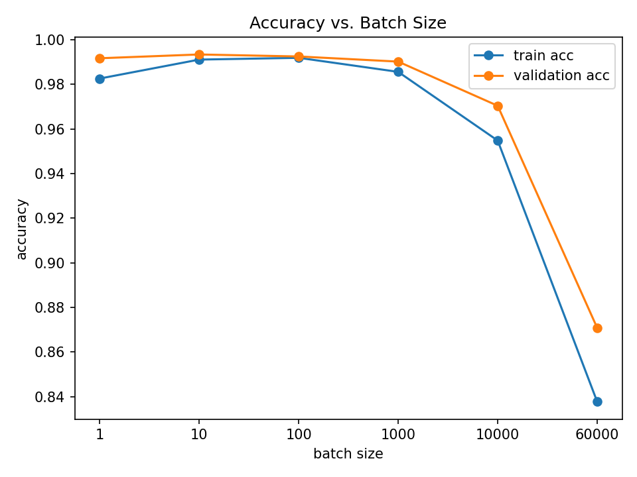
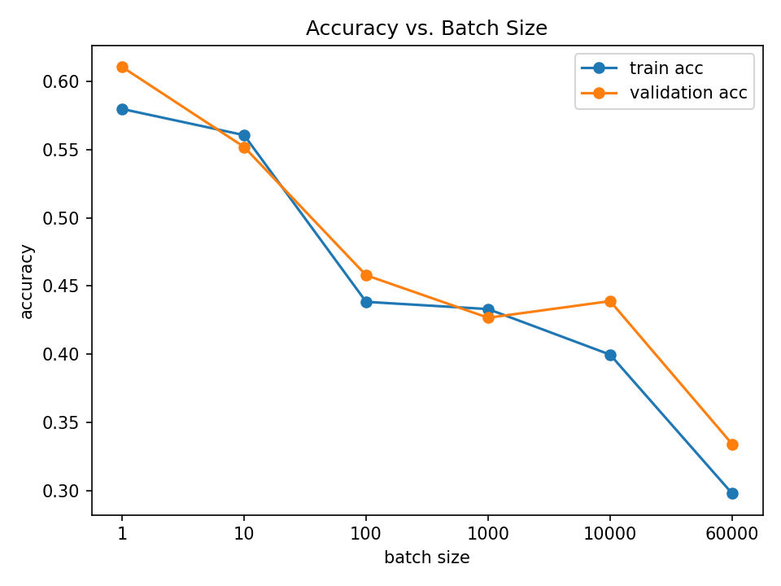
Small Batch v.s. Large Batch
MNIST
CIFAR-10
Smaller batch size has better performance
What’s wrong with large batch size?
Optimization Fails
Notes:
We already use Adam here…
We use validation set, that is, we have early stopping here

Slide 25



Small Batch v.s. Large Batch
Smaller batch size has better performance
“Noisy” update is better for training
Full Batch
Small Batch
$$L$$
$$L^{2}$$
stuck
stuck
$$L^{1}$$
trainable

Slide 26
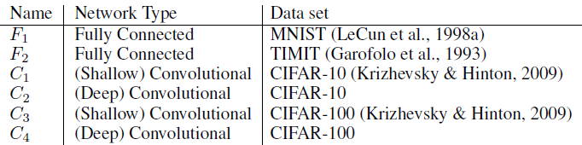
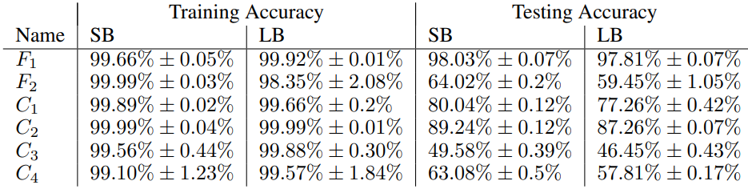
Small Batch v.s. Large Batch
On Large-Batch Training for Deep Learning: Generalization Gap and Sharp Minima
https://arxiv.org/abs/1609.04836
Small batch is better on testing data?
SB = 256
LB =
0.1 x data set

Slide 27
Small Batch v.s. Large Batch
On Large-Batch Training for Deep Learning: Generalization Gap and Sharp Minima
https://arxiv.org/abs/1609.04836
Small batch is better on testing data?
large batch
bad for testing
Testing Loss
small batch
good for testing
Training Loss
Flat Minima
Sharp Minima

Slide 28

Small Batch v.s. Large Batch
 | Small | Large
Speed for one update (no parallel) | Faster | Slower
Speed for one update (with parallel) | Same | Same (not too large)
Time for one epoch | Slower | Faster
Gradient | Noisy | Stable
Optimization | Better | Worse
Generalization | Better | Worse
Batch size is a hyperparameter you have to decide.
Notes:
Full batch (太花時間了)
不是可以平行嗎?
但是平行運算也是有極限啊
Batch
Batch v.s. Full batch
好處: 快; 壞處: 不穩
但是不穩反而好?
Interesting side effect of batch size
Tip: Shuffle (not mention?)
Smaller batch sizes are noisy, offering a regularizing effect and lower generalization error.
Smaller batch sizes make it easier to fit one batch worth of training data in memory (i.e. when using a GPU).

Slide 29
Have both fish and bear's paws?
Large Batch Optimization for Deep Learning: Training BERT in 76 minutes (https://arxiv.org/abs/1904.00962)
Extremely Large Minibatch SGD: Training ResNet-50 on ImageNet in 15 Minutes (https://arxiv.org/abs/1711.04325)
Stochastic Weight Averaging in Parallel: Large-Batch Training That Generalizes Well (https://arxiv.org/abs/2001.02312)
Large Batch Training of Convolutional Networks (https://arxiv.org/abs/1708.03888)
Accurate, large minibatch sgd: Training imagenet in 1 hour (https://arxiv.org/abs/1706.02677)

Slide 30
Momentum

Slide 31
Small Gradient …
Loss
Consider the physical world …
How about put this phenomenon in gradient descent?
The value of a network parameter w

Slide 32













(Vanilla) Gradient Descent
$$g^{0}$$
Starting at $θ^{0}$
$$g^{1}$$
Compute gradient $g^{0}$
$$θ^{0}$$
$$θ^{1}$$
Move to $θ^{1}=θ^{0}−ηg^{0}$
$$g^{2}$$
Compute gradient $g^{1}$
$$θ^{2}$$
Gradient
Move to $θ^{2}=θ^{1}−ηg^{1}$
Movement
$$g^{3}$$
$$θ^{3}$$
……
Notes:
平凡的；普通的；乏味的

Slide 33
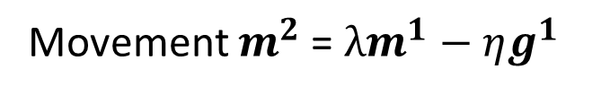



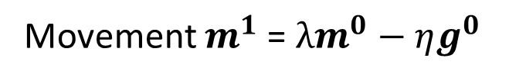











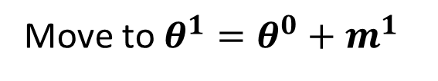
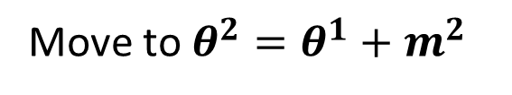

Gradient Descent + Momentum
Movement: movement of last step minus gradient at present
Starting at $θ^{0}$
Movement $m^{0}=0$
$$g^{0}$$
Compute gradient $g^{0}$
$$g^{1}$$
$$m^{1}$$
Movement $m^{1}$= $λm^{0}−ηg^{0}$
$$θ^{0}$$
$$θ^{1}$$
Move to $θ^{1}=θ^{0}+m^{1}$
$$m^{2}$$
$$g^{2}$$
Compute gradient $g^{1}$
$$θ^{2}$$
Gradient
Movement $m^{2}$= $λm^{1}−ηg^{1}$
$$m^{3}$$
Move to $θ^{2}=θ^{1}+m^{2}$
Movement
$$θ^{3}$$
Movement
of the last step
$$g^{3}$$
Movement not just based on gradient, but previous movement.

Slide 34
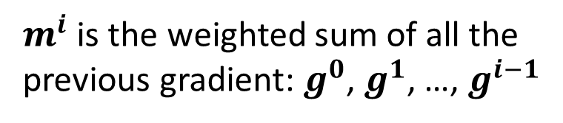
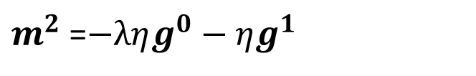
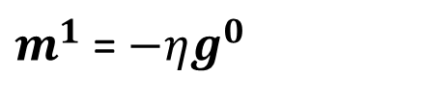

Gradient Descent + Momentum
Movement: movement of last step minus gradient at present
Starting at $θ^{0}$
Movement $m^{0}=0$
Compute gradient $g^{0}$
$m^{i}$ is the weighted sum of all the previous gradient: $g^{0}$, $g^{1}$, …, $g^{i−1}$
Movement $m^{1}$= $λm^{0}−ηg^{0}$
Move to $θ^{1}=θ^{0}+m^{1}$
$$m^{0}=0$$
Compute gradient $g^{1}$
$m^{1}$= $−ηg^{0}$
Movement $m^{2}$= $λm^{1}−ηg^{1}$
Move to $θ^{2}=θ^{1}+m^{2}$
$m^{2}$=$−ληg^{0}−ηg^{1}$
Movement not just based on gradient, but previous movement.
……
Notes:
Lambda = 0.9

Slide 35

Gradient Descent + Momentum
loss
Movement =
Negative of 𝜕𝐿∕𝜕𝑤 + Last Movement
Negative of $∂L∕∂w$
Last Movement
Real Movement
𝜕𝐿∕𝜕𝑤 = 0
Notes:
Still not guarantee reaching global minima, but give some hope ……

Slide 36
Concluding Remarks
Critical points have zero gradients.
Critical points can be either saddle points or local minima.
Can be determined by the Hessian matrix.
It is possible to escape saddle points along the direction of eigenvectors of the Hessian matrix.
Local minima may be rare.
Smaller batch size and momentum help escape critical points.

Slide 37
Acknowledgement
感謝作業二助教團隊(陳宣叡、施貽仁、孟妍李威緒)幫忙跑實驗以及蒐集資料

