Slide 1

Megasyllis nipponica genome assembly
2025.07.23

Slide 2
First batch
Second batch
Original sample ID | BGI sample ID | Sample detail
DNA1 | MegNDNA1 | 6 individuals
DNA2 | MegNDNA2 | 1 male
DNA3 | MegNDNA3 | 1 adult without a stolon
DNA4 | MegNDNA4 | 1 adult without a stolon
DNA5 | MegNDNA5 | 1 adult without a stolon
DNA6 | MegNDNA6 | 1 adult without a stolon
Tissue1 | Tissue1A | 3 individuals without stolons
Tissue2 | Tissue2A | 3 individuals without stolons
Tissue3 | Tissue3A | 1 male
Tissue4 | Tissue4A | 1 female
Tissue5 | Tissue5A | 1 male
Tissue6 | Tissue6A | 1 adult without a stolon
Original sample | BGI sample ID | Sample detail
M5-1 | M5-1 | 5 males pooling
M5-2 | M5-2 | 5 males pooling
M5-3 | M5-3 | 5 males pooling
M3-1 | M3-1 | 3 males pooling
M3-2 | M3-2 | 3 males pooling
M1-1 | M1-1 | 1 male
M1-2 | M1-2 | 1 male
M1-3 | M1-3 | 1 male
M1-4 | M1-4 | 1 male
F3-1 | F3-1 | 3 females pooling
F3-2 | F3-2 | 3 females pooling
F1-1 | F1-1 | 1 female
F1-2 | F1-2 | 1 female
F1-3 | F1-3 | 1 female
F1-4 | F1-4 | 1 female
2024/11/11 HK received
2025/02/17 HK received

Slide 3
A summary of all samples recieved
Sample type | BGI sample ID | Usage
Male | Tissue5A | Extracted-DNA backup
 | M5-3
 | M1-1
 | M1-2 | HiFi
 | MegNDNA2
 | M5-1 | Hi-C
 | M5-2 | Cross-linked Tissue backup
 | M3-1
 | M1-3
 | M1-4
 | Tissue3A | short-read WGS
 | M3-2 | Tissue backup in Hongkong
Female | F3-1 | Cross-linked Tissue backup
 | F3-2 | Hi-C
 | F1-1 | DNA extracted for HiFi but not enough for sequencing
 | F1-2
 | F1-3
 | F1-4
 | Tissue4A | short-read WGS
Adult without stolon (sex unknown) | MegNDNA5 | short-read WGS
 | Tissue6A
 | MegNDNA3 | DNA Backup
 | MegNDNA4
 | MegNDNA5
 | MegNDNA6
 | Tissue1A
 | Tissue2A
 | Tissue6A
Mix (male+female+unknown) | MegNDNA1 | short-read WGS
For the male sample,
Short-read WGS, Hi-C, and HiFi data production have been completed.
The dataset is sufficient for assembling the male genome.
For the female samples,
Short-read WGS, Hi-C data production have been completed.
DNA extraction from individual for HiFi-sequencing is fail.
Can not assemble the female genome.

Slide 4
HiFi sequencing DNA extraction results
Sample ID | Volume (μL) | Concentration (ng/μL) | 260/280 | 260/230 | Amount (μg) | Main Band Size | Extraction Method
M1-1 (1 individual) | 38 | 122 | 1.83 | 2.01 | 4.636 | >23130bp | Salting
M1-2 (1 individual) | 91 | 134 | 1.82 | 1.85 | 12.194 | >23130bp | SDS
M5-3 (5 individual) | 97 | 902 | 1.88 | 2.26 | 87.494 | 15000-23130bp | SDS
F1-1 (1 individual) | 38 | 17.1 | 1.92 | 2.09 | 0.65 | >23130bp | Salting
F1-2 (1 individual) | 17 | 39.6 | 1.91 | 2.03 | 0.673 | >23130bp | SDS
F1-3 (1 individual) | 44 | 26.5 | 1.91 | 2.01 | 1.166 | >23130bp | CTAB
F1-4 (1 individual) | 44 | 61.5 | 1.91 | 2.06 | 2.706 | 15000-23130bp | Kit
Salting: salt precipitation base extraction method; SDS: Sodium dodecyl sulfate (SDS) base extraction method CTAB: Cetrimonium bromide (CTAB) base extraction method; Kit: QIAGEN Genomic DNA Kit (Lot.19060).
M1-2 have enough amount (>6 μg) to be used for single individual HiFi sequencing.
DNA extraction results suggest potential quantitative differences between male and female samples.
DNA extraction from single female individual do not have enough amount for HiFi sequencing.

Slide 5
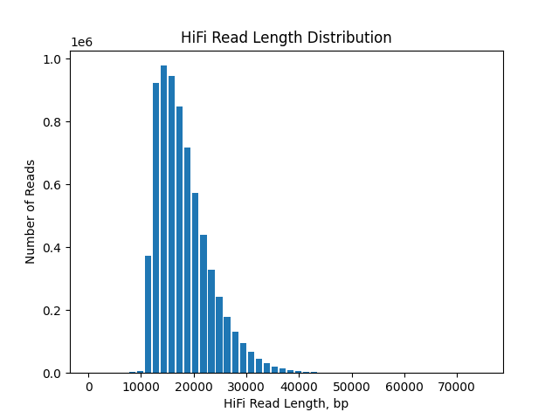
HiFi sequencing results
 | Sample ID | HiFi reads | HiFi bases(bp) | Sequencing coverage (X) | HiFi reads mean length(bp) | reads N50 length(bp) | HiFi reads max length(bp)
First library | MegN-DNA2 | 193,783 | 2,209,336,225 | 4.4 | 11,401.00 | 11,781 | 32,105
Second library | M1-2 | 6,982,194 | 126,464,020,980 | 249.5 | 18,112.00 | 18,455 | 75,168
Second library
For the new HiFi sequencing:
Due to suboptimal results from the initial HiFi sequencing, we dedicated significant effort to optimizing DNA input quantity and library preparation protocols for the new DNA sample.
For sequencing length, the lengths of HiFi CCS reads are predominantly concentrated around 18 kb, which is match the general average sequencing length of HiFi sequencing (15–20 kb).
For sequencing data volume, the obtained HiFi CCS data amount of 126 Gb is also significantly higher than the typical level for HiFi sequencing (general species around 80 Gb).

Slide 6
Raw sequencing data overview
Sequence platform | Sample | Data (Gb) | Coverage (X)
DNBSEQ short-read WGS | MegNDNA1 (mix) | 123 | 246
 | MegNDNA5 (1 adult without stolon) | 147 | 294
 | Tissue6A (1 adult without stolon) | 178 | 356
 | Tissue4A (1 female) | 177 | 354
 | Tissue3A (1 male) | 143 | 286
DNBSEQ Hi-C | M5-1 (1 male); F3-2 (1 female) | 60 | 120
PacBio HiFi | MegN-DNA2 (1 male) | 2.2 | 4.4
 | M1-2 (1 male) | 126 | 252
RNA-seq | Published (DRR333006) | 15.3 | -
Sufficient sequencing data were generated from the male individual to support the assembly.

Slide 7
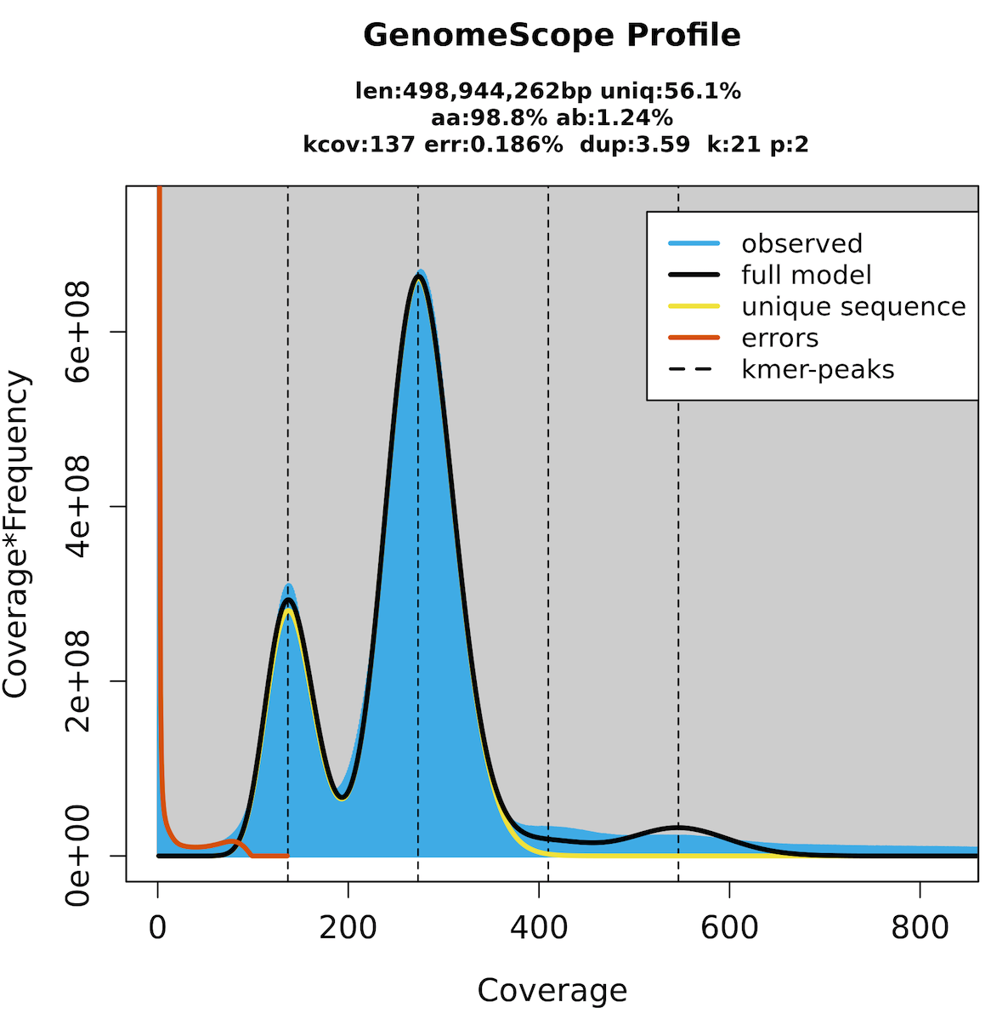
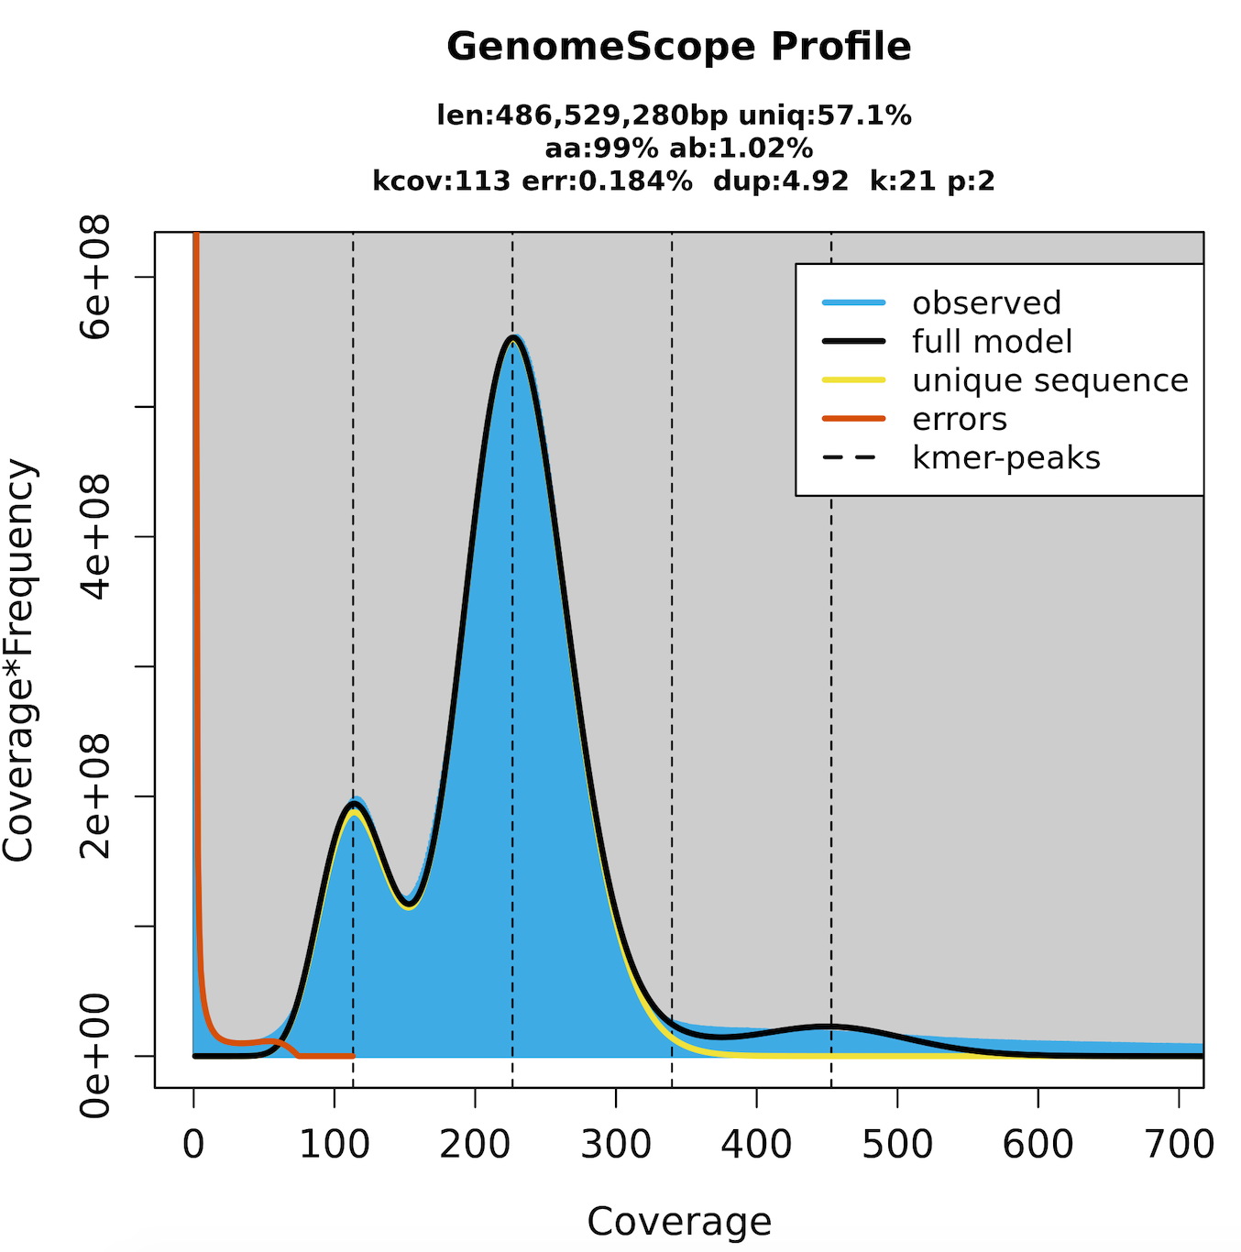
Genome Survey
Data | k | Total number of k-mers | Minimum coverage (X) | Number of erroneous k-mers | Homozygous peak | Estimated genome size (Mb) | GenomeScope2
 |  |  |  |  |  |  | Estimated genome size (Mb) | Estimated heterozygosity (%) | % Repeat
Tissue4A (1 female) | 19 | 145,202,837,069 | 56 | 4,468,409,139 | 279 | 504 | 499 | 1.26 | 46.66
 | 21 | 141,658,122,591 | 54 | 4,865,229,647 | 271 | 505 | 499 | 1.25 | 43.91
 | 23 | 138,113,627,719 | 50 | 5,141,511,336 | 264 | 504 | 498 | 1.23 | 42.42
 | 25 | 134,569,330,219 | 50 | 5,420,413,897 | 257 | 503 | 498 | 1.20 | 41.24
 | 27 | 131,025,218,164 | 50 | 5,668,682,323 | 250 | 501 | 498 | 1.18 | 40.22
Tissue3A (1 male) | 19 | 117,347,927,885 | 47 | 3,763,915,217 | 229 | 496 | 487 | 1.04 | 45.51
 | 21 | 114,483,100,264 | 45 | 4,085,133,230 | 223 | 495 | 487 | 1.03 | 42.85
 | 23 | 111,618,458,016 | 43 | 4,328,701,536 | 217 | 494 | 486 | 1.01 | 41.39
 | 25 | 108,753,989,023 | 42 | 4,547,378,945 | 211 | 494 | 486 | 0.98 | 40.24
 | 27 | 105,889,678,165 | 40 | 4,725,224,596 | 204 | 496 | 485 | 0.96 | 39.22
Tissue4A (1 female)
_Tissue3A (1 male)
Genome Size : 494 ~ 505 Mb; heterozygosity : 0.96% ~ 1.26%; Repeat : 39% ~ 46%
Medium Heterozygosity, High Repetition

Slide 8
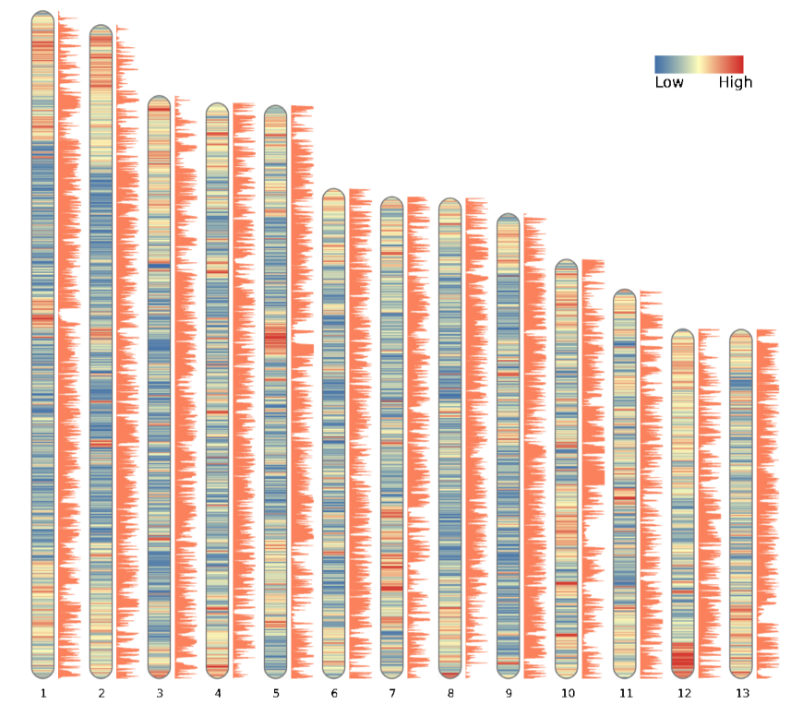
Summary of genome assembly for Megasyllis nipponica
Repeat content
Feature | Assembly Result
Genome Size (Mb) | 472
Anchor Rate (%) | 100
Chromosome Num | 13
Gap Num | 56
Contig N50 (Mb) | 20.7
Complete BUSCO (%) | 97.6
Mapping Rate (%) | 99.35
QV | 65.46
Gene density

Slide 9
Genome annotation result
Protein-coding gene annotation
Repeat element annotation
Characteristics of protein-coding genes | Summary
Total number of protein-coding genes | 17,972
Mean gene size (bp) | 10,325
Mean CDS length (bp) | 1,751
Mean exon number | 7.97
% complete open reading frame | 100%
BUSCO of metazoa | C: 96.9%
% of proteins with functional annotation | ~%
Statistics of repetitive sequences | Summary
Percentage of repeats | 40.78%
Repeat bases | 203 Mb
DNA transposons | 79.9 Mb
Long interspersed nuclear elements | 0.067 Mb
Short interspersed nuclear elements | 0 Mb
Long terminal repeats | 91.5 Mb
Unknown Repeat elements | 32.0 Mb

Slide 10
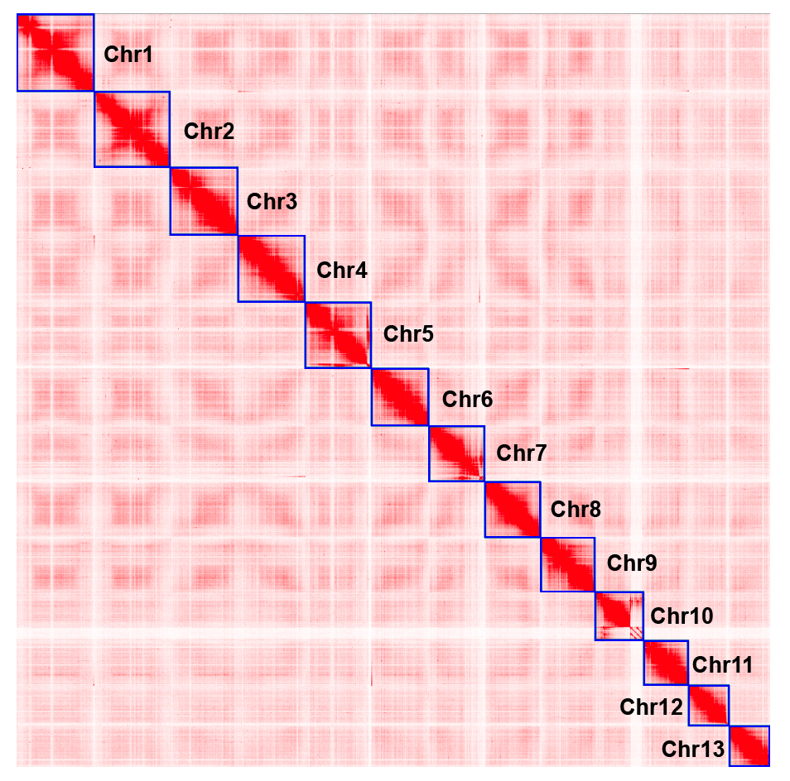
~ 120X DNBSEQ Hi-C data
Chromosome-level assembly
The Hi-C scaffolding results indicated the presence of 13 chromosomes.

Slide 11
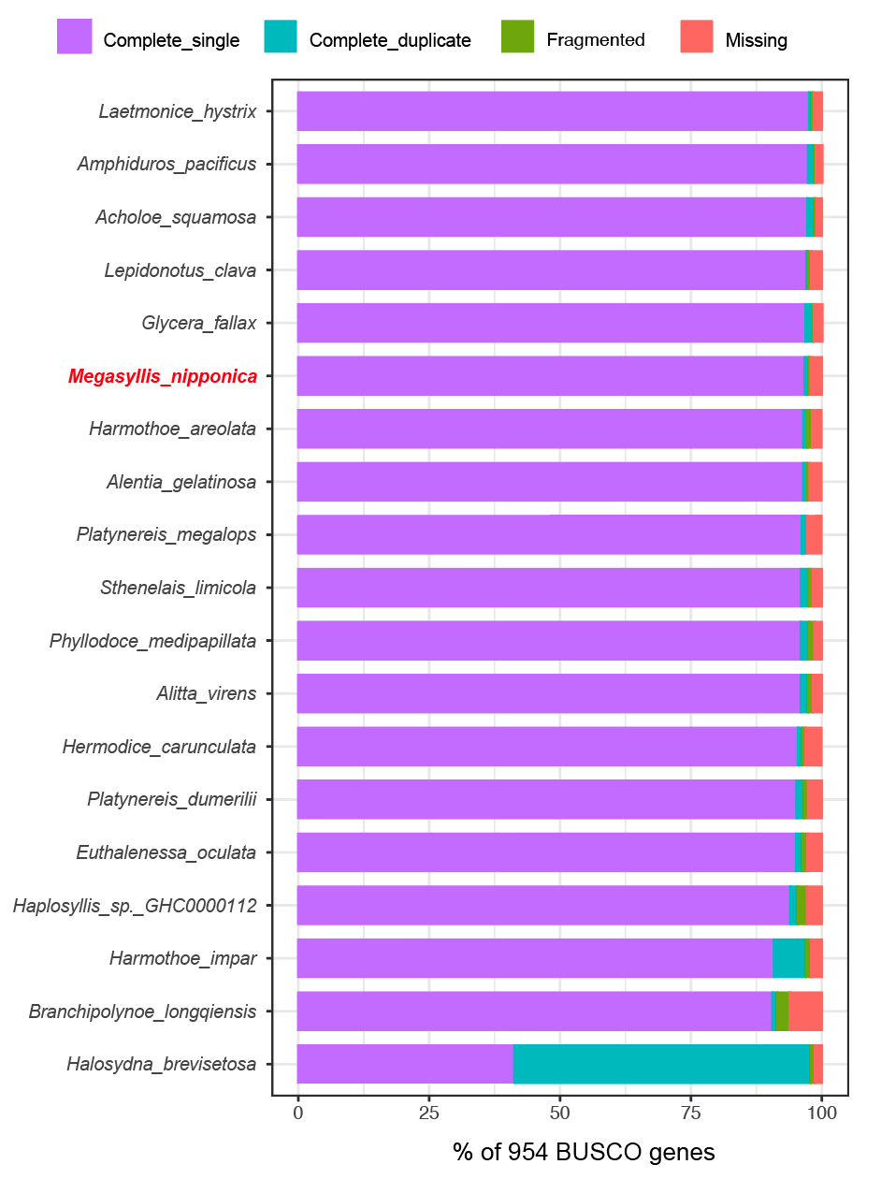
Comparison of assembly completeness with the published genomes of the subclass Errantia subclass
This species also exhibits exceptionally high completeness.

Slide 12
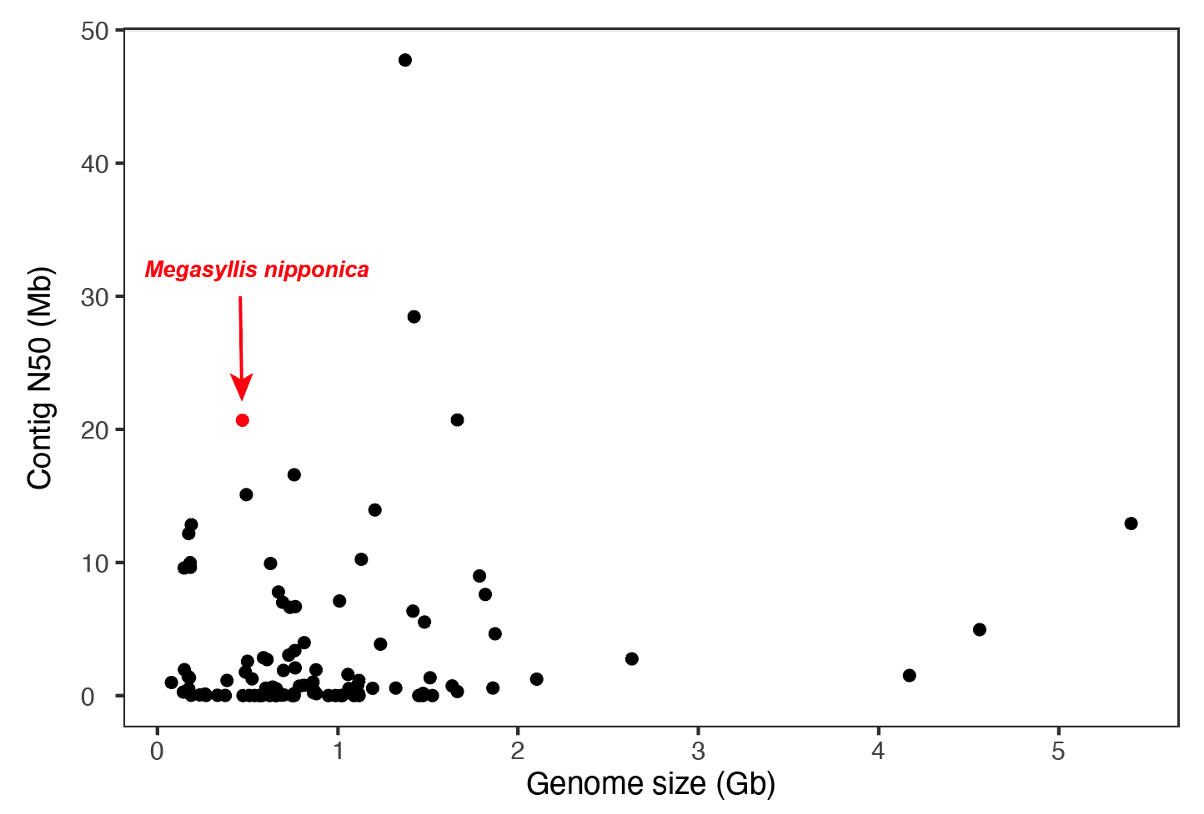
Comparison of genome assembly continuity with that of Annelida phylum
A total of 98 species’ genome have been published
59 at chromosome-level; 26 at scaffold-level; and 13 at contig-level
The genome assembly continuity of the marine worm is among the highest within all published annelid genomes.

Slide 13
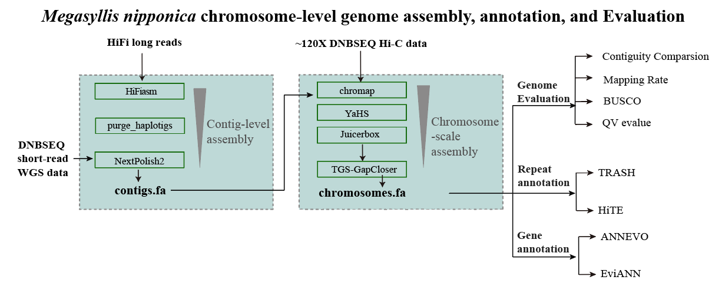
Conclusion
First, we generated sufficient WGS, HiFi, and Hi-C datasets for one male individual.
Leveraging the above assembly–annotation–evaluation pipeline, we successfully constructed the genome map for one male marine worm.
A chromosome-level assembly consisting of 13 chromosomes.
Comprehensive assessments from multiple perspectives confirm that the assembly exhibits both high completeness and excellent continuity.

Slide 14
Genome assembly and annotation can be downloaded following the link:
https://github.com/guoqunfei/Megasyllis_nipponica

Slide 15
THANKS
OMICS FOR ALL
基 因 科 技 造 福 人 类

