Slide 1
Kaggle
Guorun Huang， PatternRecognition and ComputerVision 25Fall Final Project
Img 2 Biomass Contest
--- background & dataset: img of pasture taken by phone->estimation of the amount of green and withered grass

Slide 2
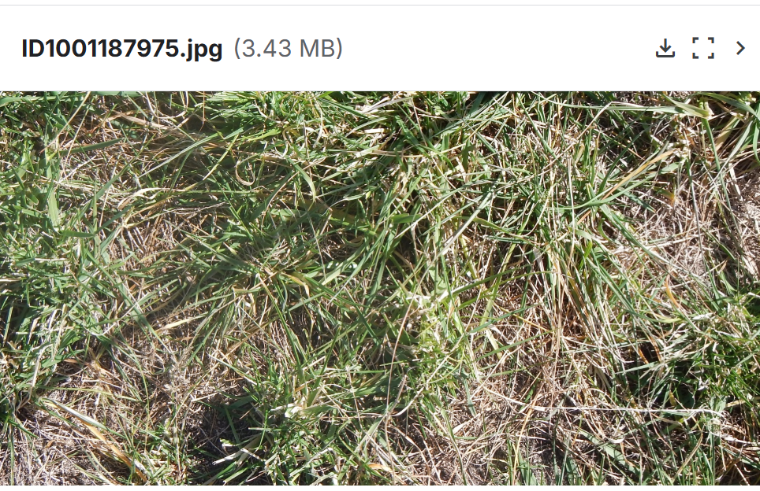
Model1：Img ->feature ->XGBoost
XGBoost is a decision-tree algorithm and a frequent winner in data science competitions like Kaggle.
Think of it as a "team of top students." The first student solves a problem. The second student focuses on fixing the first one's mistakes. The third student corrects the errors made by the previous two, and so on. Finally, the team combines their insights to produce a highly accurate answer.

Slide 3
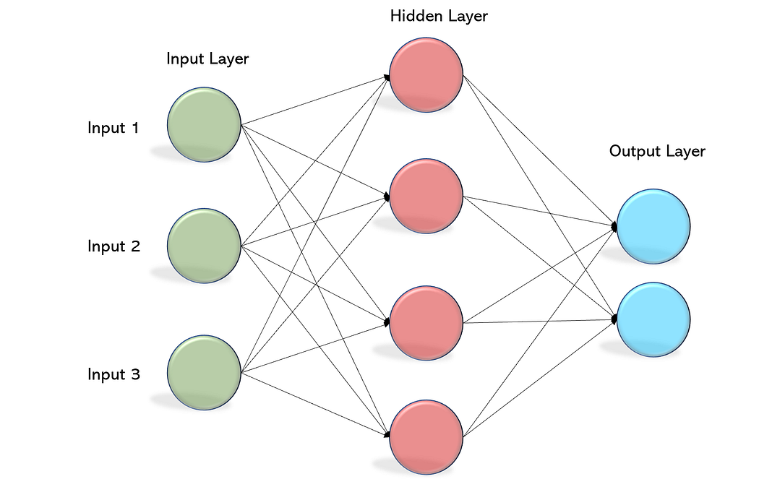
Model2：Img ->feature ->MLP
A multilayer perceptron (MLP) neural network model was employed in this study. It is one of the simplest forms of an ANN.
two hidden layers (64 nodes each) and one output
activation function - rectified linear unit and the
optimisation algorithm - Adam
learning rate of 0.001
5 epochs.
source: https://becominghuman.ai/multi-layer-perceptron-mlp-models-on-real-world-banking-data-f6dd3d7e998f

Slide 4
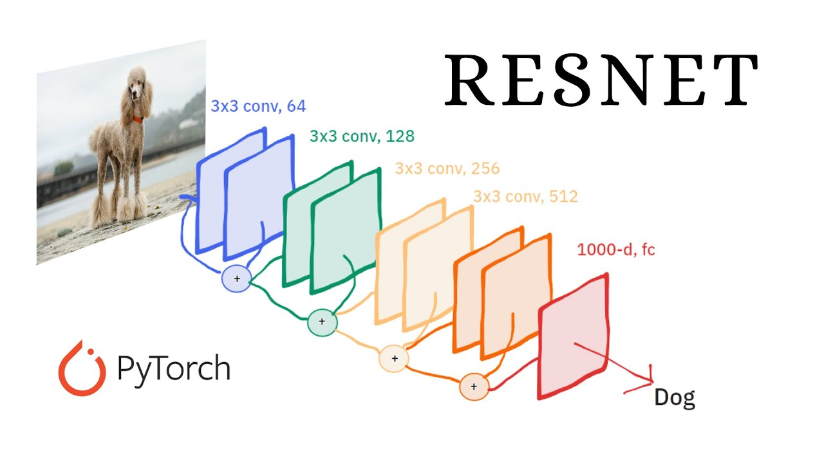
Model3：Img ->ResNet
Images are processed by ResNet, where the output of the final convolutional layer serves as an embedding to model pasture biomass.
source: https://www.youtube.com/watch?v=woEs7UCaITo

Slide 5
Model4：Fusion model
raw data
Img
ResNet
XGBoost
Handcrafted features, metadata, and ResNet embeddings (extracted from the final conv layer) are concatenated and input into XGBoost.
features
meta statistic data

Slide 6
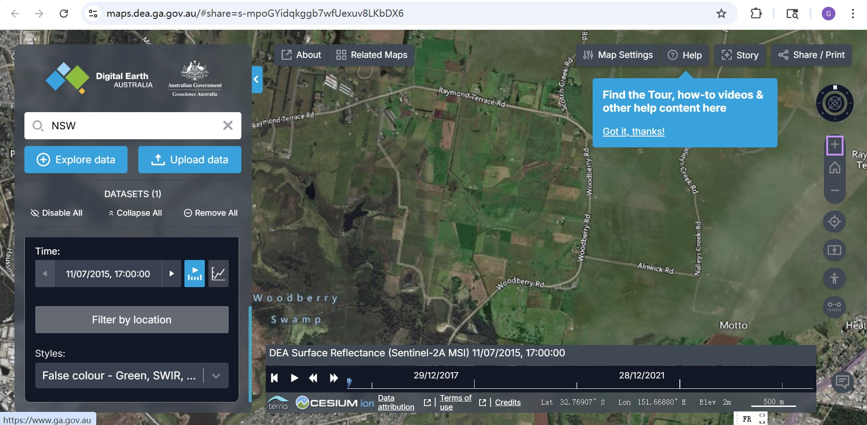
Model5：[Img ->feature + Remote Sensor->feature]->MLP
Images are processed by ResNet, where the output of the final convolutional layer serves as an embedding to model pasture biomass.

Slide 7
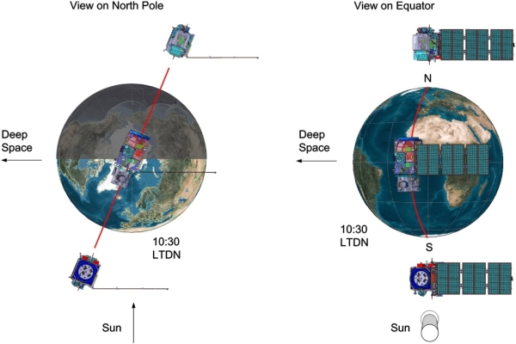
Model5：[Img ->feature + Remote Sensor->feature]->MLP
Remote sensor:How it works
source: https://sentiwiki.copernicus.eu/web/s2-mission

Slide 8
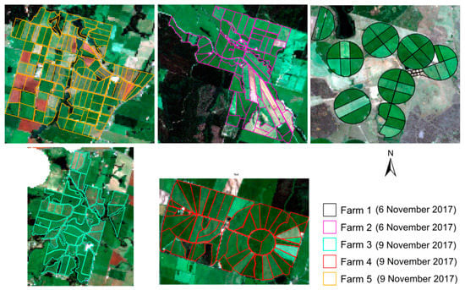
Model5：[Img ->feature + Remote Sensor->feature]->MLP
Data: How to use
coordinate (shape)
time
radio range
resolution
satellite
cloud cover
source: https://www.mdpi.com/2072-4292/13/4/603#Appendix_A_Cloud_Coverage_Analysis_of_the_Sentinel2_Imagery

Slide 9
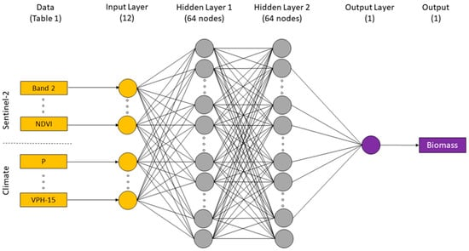
Model5：[Img ->feature + Remote Sensor->feature]->MLP
For each sample, the median value of all Sentinel‑2 bands is combined with the engineered features and metadata, then passed into an MLP.
source: https://www.mdpi.com/2072-4292/13/4/603#Appendix_A_Cloud_Coverage_Analysis_of_the_Sentinel2_Imagery

Slide 10
Result
Model Input + Algorithm | Target: GDM_g (R2) (Train / Val) | Target: Dry_Total_g (R2) (Train / Val) | Training time (sec)
Images + ResNet | -0.4491 / -1.2452 | -0.6701 / -1.2970 | 267.15 (Slowest)
Hand-crafted + Meta + XGBoost | 0.9997 / 0.7140 👑 | 0.9998 / 0.6618 👑 | 251.00
Hand-crafted + Meta + MLP | 0.5519 / 0.3956 | 0.4625 / 0.1569 | 112.91 (Fastest)
Sentinel-2 + Features + MLP | 0.3524 / 0.5116 | 0.3898 / 0.2550 | 126.72
Fusion (ResNet + XGBoost) | 0.9511 / 0.6518 | 0.9999 / 0.5423 | 182.58

Slide 11
Result
Best Model (Model 2): By achieving the highest validation $R^2$ on both GDM_g and Dry_Total_g, Model 2 demonstrates that Structured Features paired with XGBoost is the optimal approach for this data.
Value of Satellite Data: Comparing the MLP models, adding Sentinel-2 data (Model 4) raised the GDM_g score from 0.3956 to 0.5116 over the baseline (Model 3), validating the utility of satellite inputs.
Image Data Issues: Model 1 (ResNet) failed to converge, resulting in negative scores. Consequently, the fusion model (Model 5) underperformed Model 2, as the image data effectively acted as noise.
Further Work: other remote sensor data, network(DCN)

