Slide 1
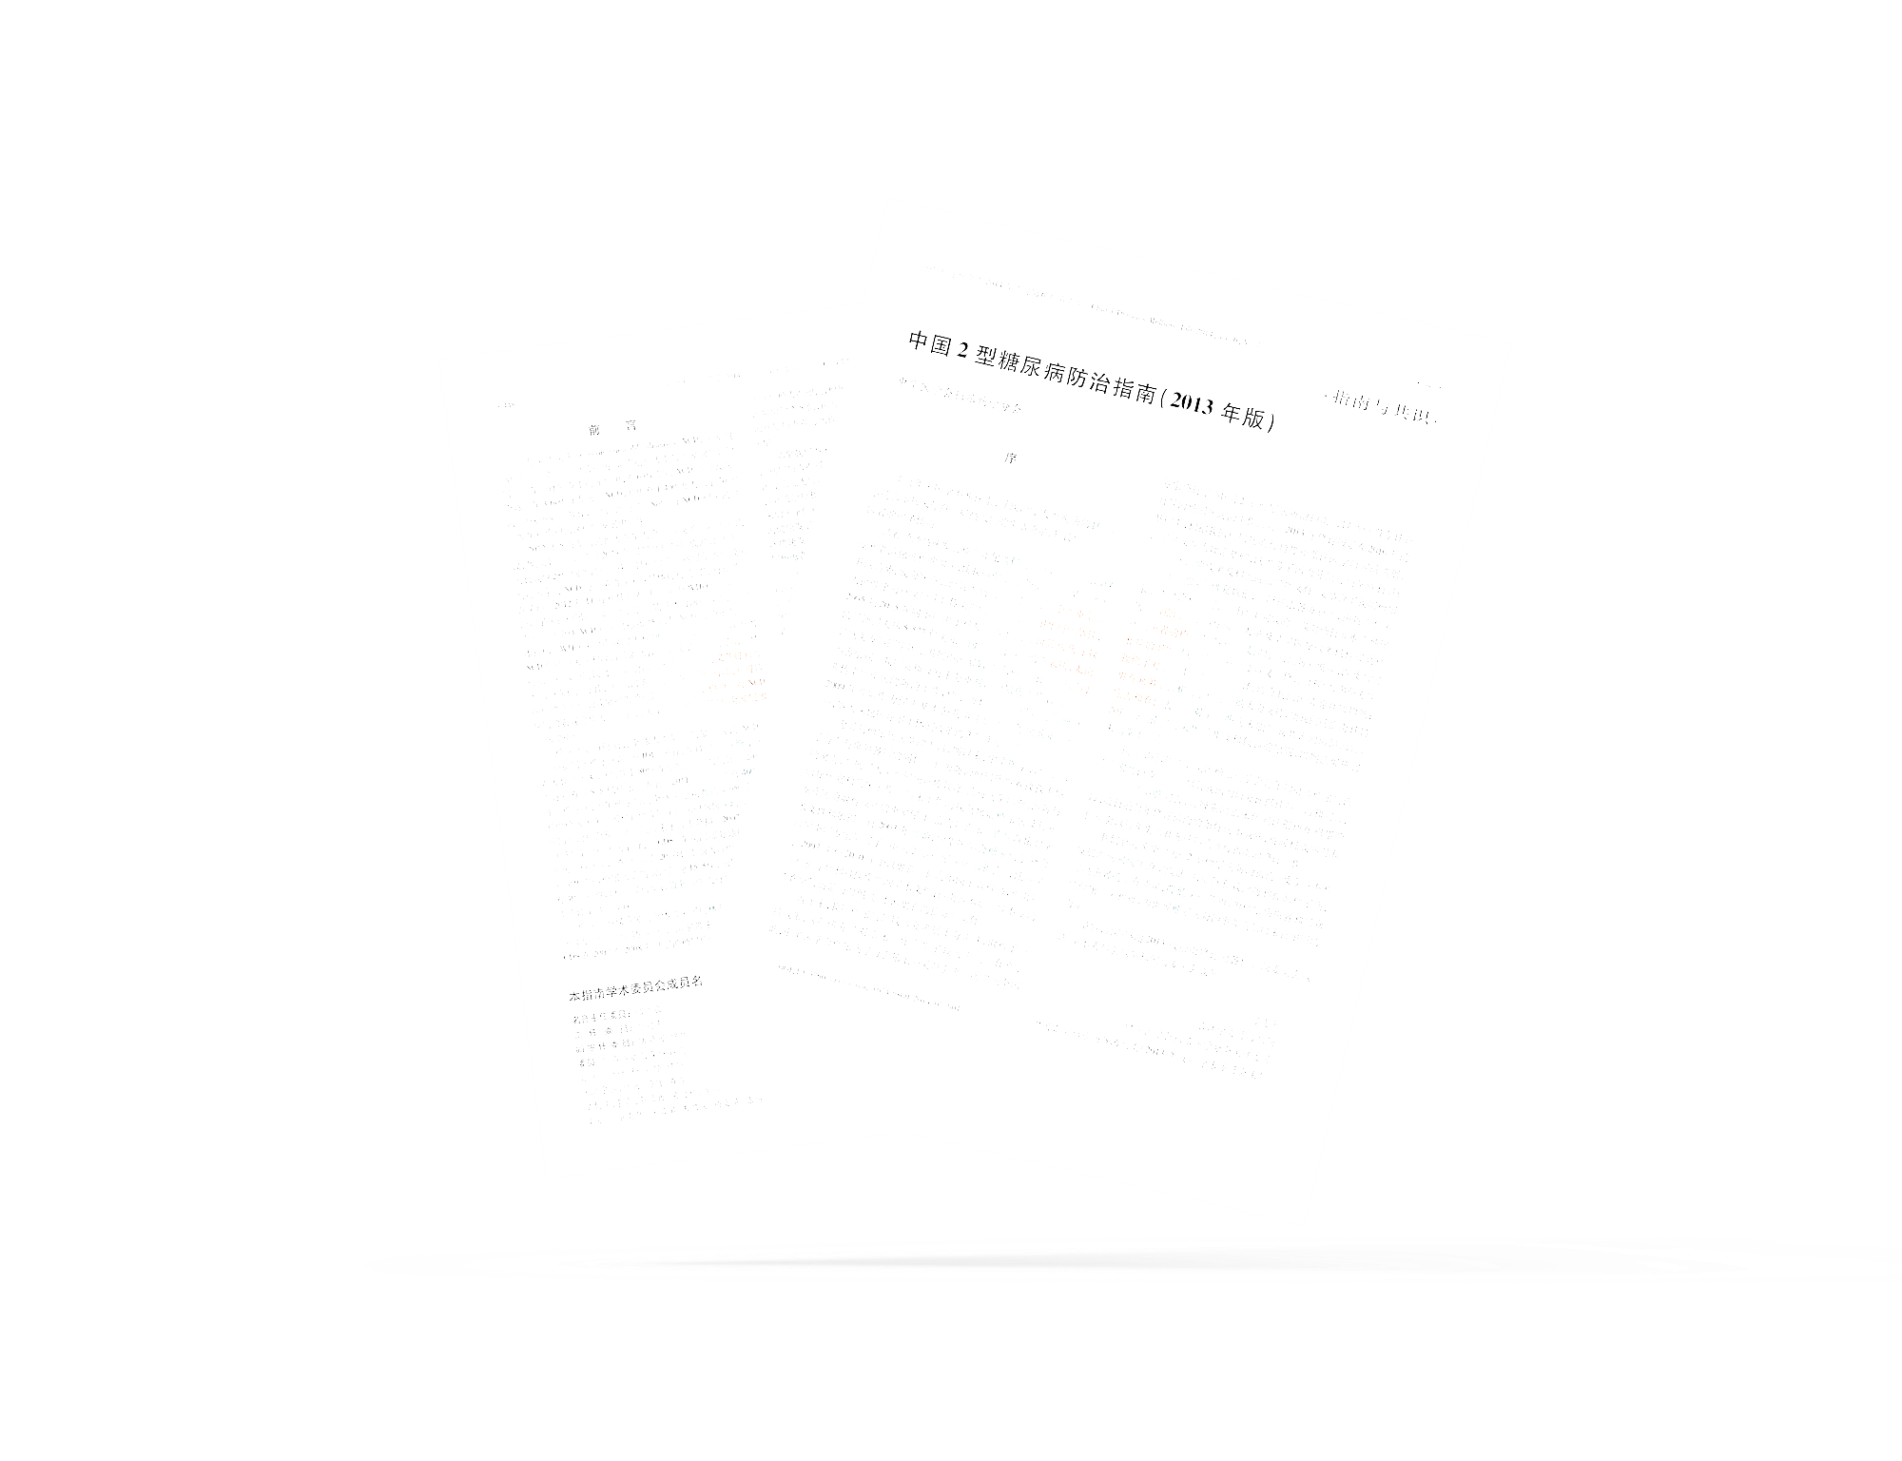
XuKaiyun（Bruce）
Semantic feature map
PART1
Load ImageNet dataset and use Generative AI to create dataset with different styles.
PART2
Develop the models based on our task goal
PART3
Train the models on dataset
PART4
Evalute the models based on their performance on dataset
5

Slide 2
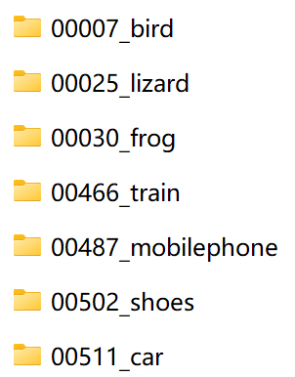
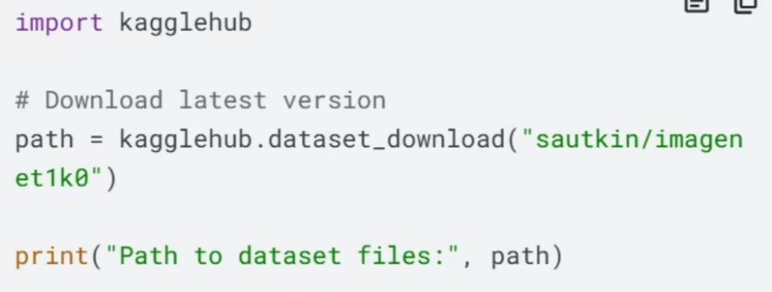
XuKaiyun（Bruce）
Semantic feature map
PART1
1.Download the ImageNet testing dataset and sampling 7 classes.
6

Slide 3
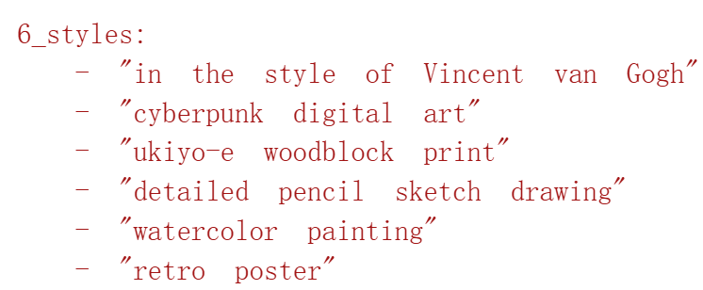
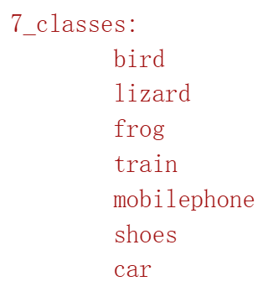
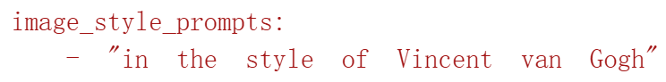
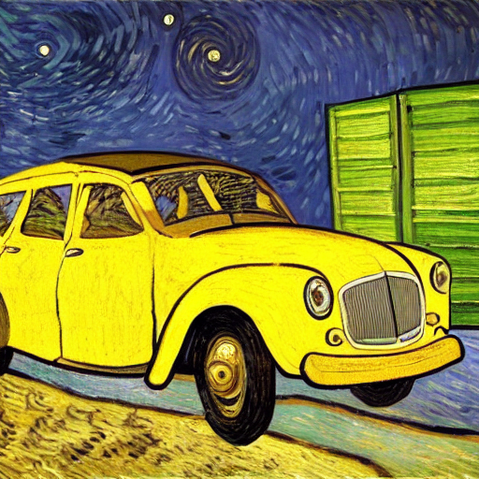
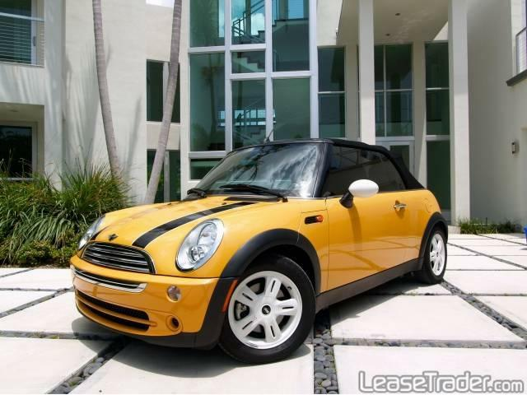
XuKaiyun（Bruce）
Semantic feature map
PART1
2.Use stable diffusion and input the images(in seven classes) and prompt text(shown on the right) to get images of different styles.
Input1:text:
Input2:image(car):
7

Slide 4
XuKaiyun（Bruce）
Semantic feature map
PART1
3.Create labels for image pairs(800×4=3200pairs)
-identical: 0.90
ex.two image of cars painted in style of Van Goph
-same_style_diff_content: 0.85
ex.one image of bird and another image of car, both painted in style of Van Goph
-same_content_diff_style: 0.35
ex. one image of bird, painted in style of Van Goph, and another image of bird painted in style of watercolor
-completely_different: 0.15
ex. one image of bird, painted in style of Van Goph, and another image of car painted in style of watercolor
8

Slide 5
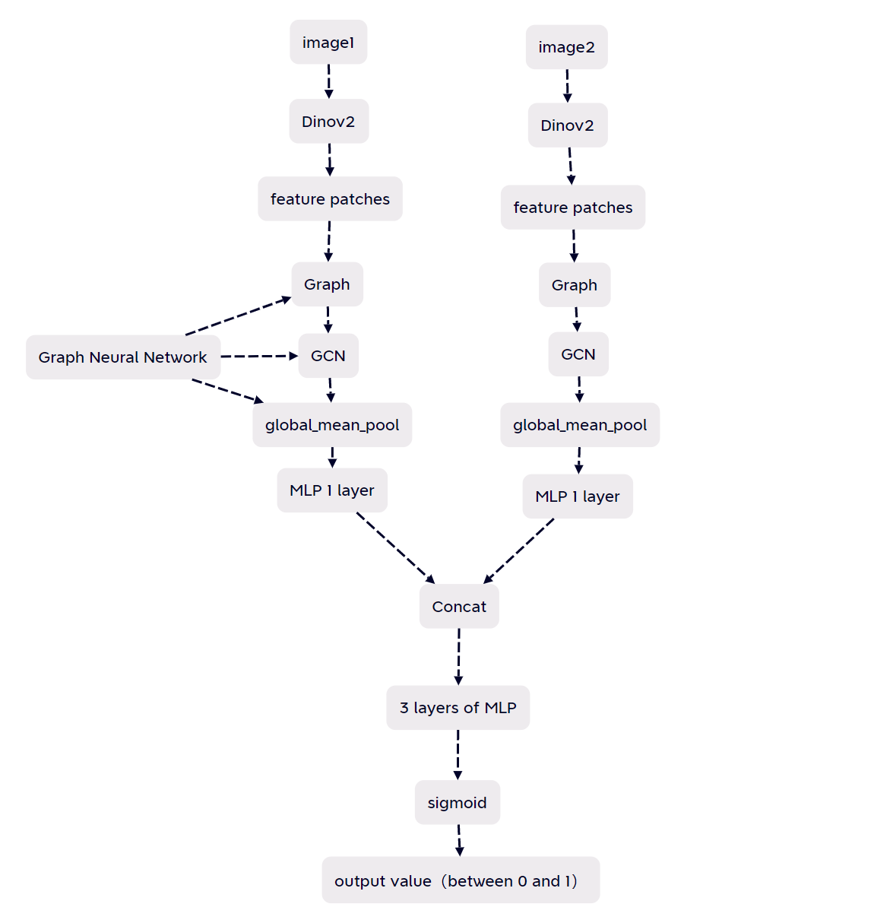
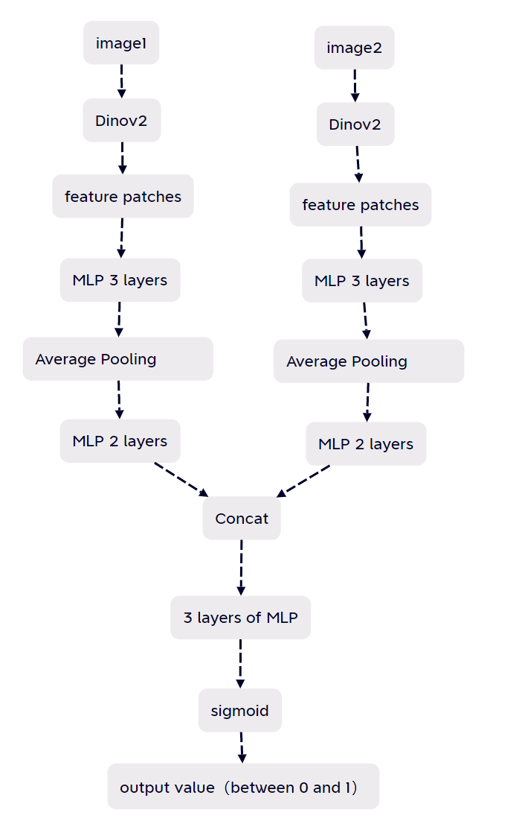
XuKaiyun（Bruce）
Semantic feature map
1.Based on Graph Neural Network
2.Based on Neural Network
PART2
1.Develop model pipelines.
(1)Feature extractions
(1)Feature extractions
(2)Anaylze features
(2)Anaylize features
(3)Comparing feature maps from two images
(4)Choose Mean Square Error as loss function
(3)Comparing feature maps from two images
9

Slide 6
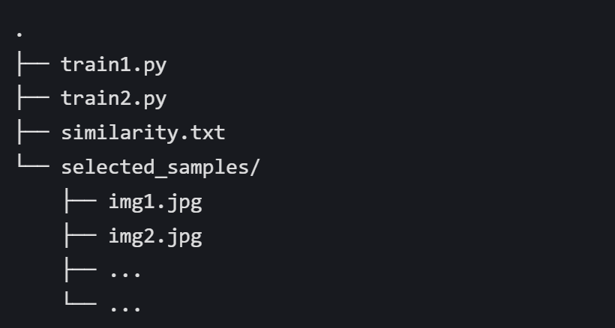
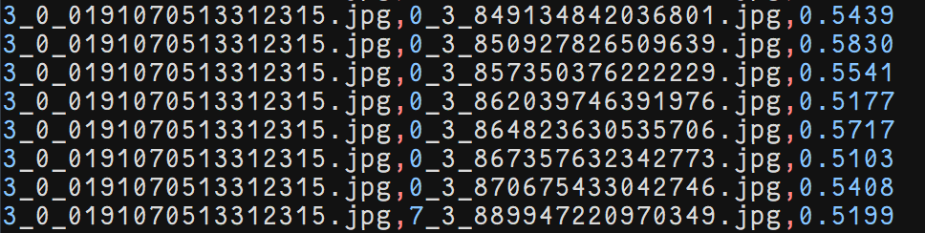
XuKaiyun（Bruce）
Semantic feature map
PART3
1.Make sure the file structure (shown on the right).
2.Make sure the data format in the similarity.txt (shown on the right).
10

Slide 7
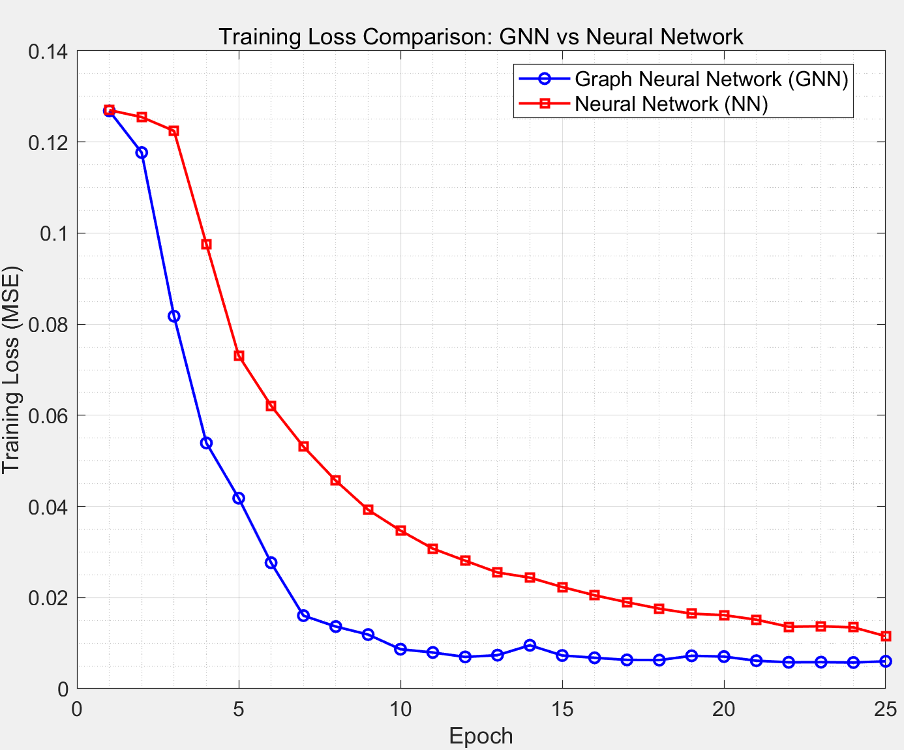
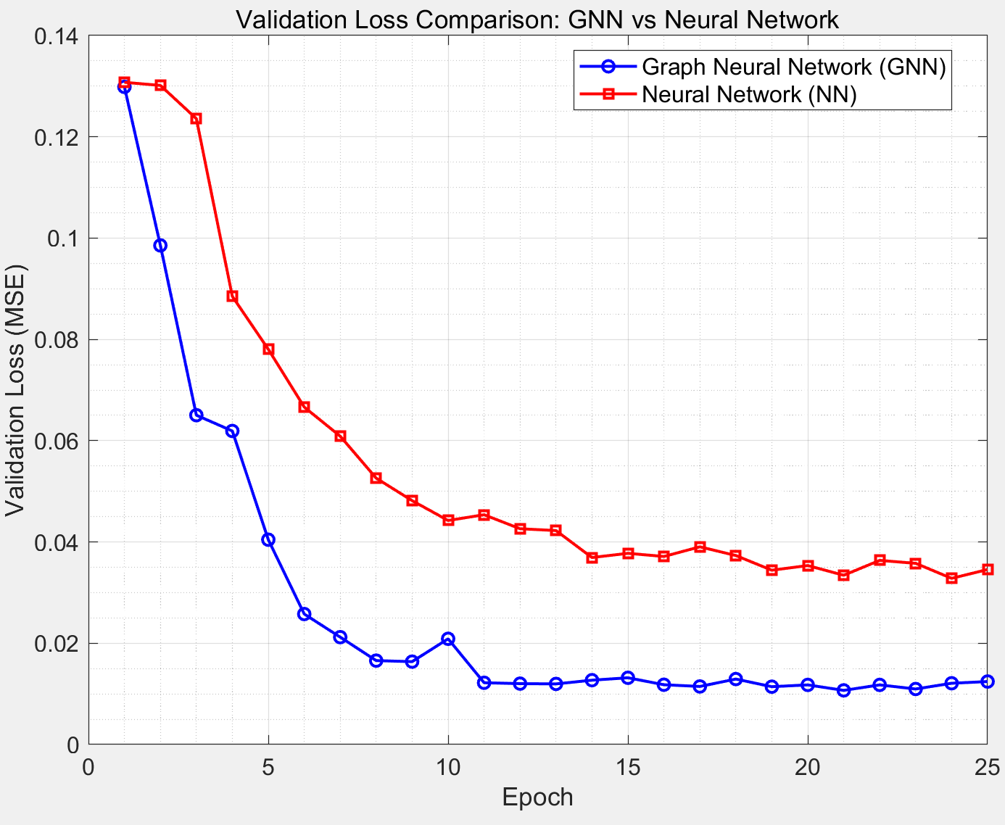
XuKaiyun（Bruce）
Semantic feature map
PART4
1.Compare the training loss and the validation loss of two methods.(based on Graph Neural Network and based on Neural Network)
11

Slide 8
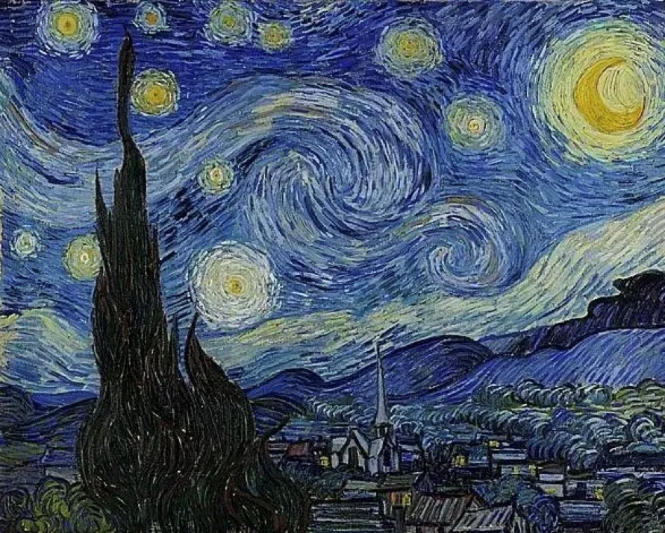
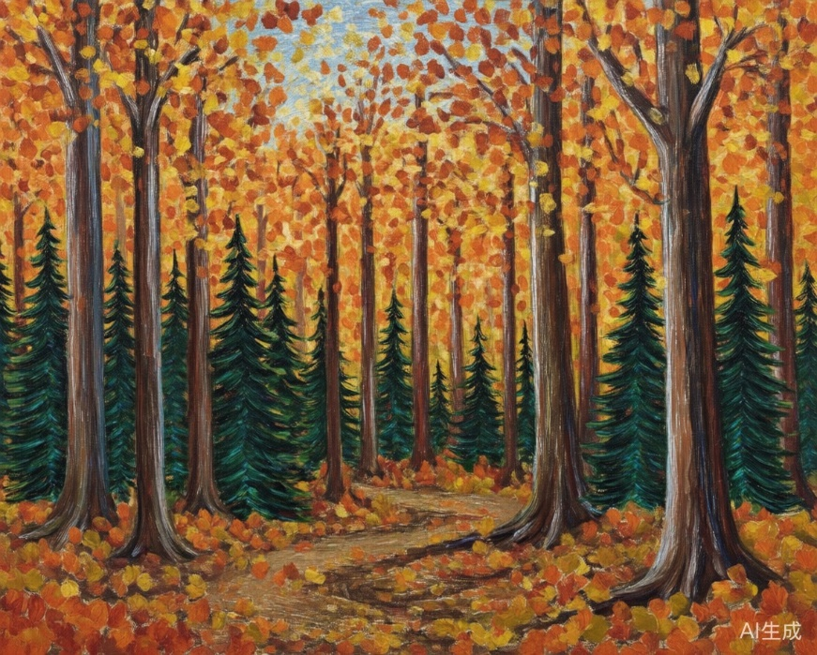
XuKaiyun（Bruce）
Semantic feature map
PART4
Van Goph’s masterpiece
AI generated image
1.Test the GNN-based method by Van Goph’s masterpiece and AI generated image
final score: 0.8814
(same_style_diff_content: 0.85)
12

