Slide 1



Cornell MEng Data Forecasting Project Week 10
Team: Abhishek Dixit, Benjamin Elbaz,
Anqi Huang, Shuang Wei
Advisor: Kris Iyer
Date: March 18th, 2016

Slide 2
Overview
Preliminary Analysis on Nobivac data
Data cleaning (Weekly data for SalesIn and SalesOut from 12/31/2012 to 11/23/2015 (152 data points)
Error Checking
ARIMA Forecast with Fourier Transformation for Nobivac SalesOut
4 month ahead predictions
Dynamic Regression to model Nobivac SalesIn using lags of SalesOut only
Incorporated predicted SaleOut
Select model that minimizes error on the validation set
* Sample model on Nobivac Sku 6772, 31664, 54215

Slide 3
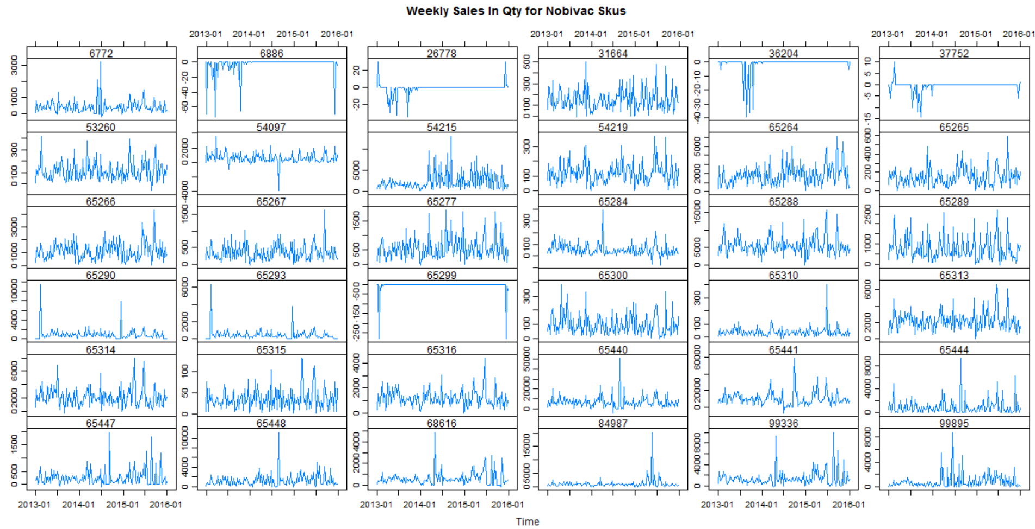
: Sample Models
Preliminary Analysis
: Consistent and Large Returns

Slide 4
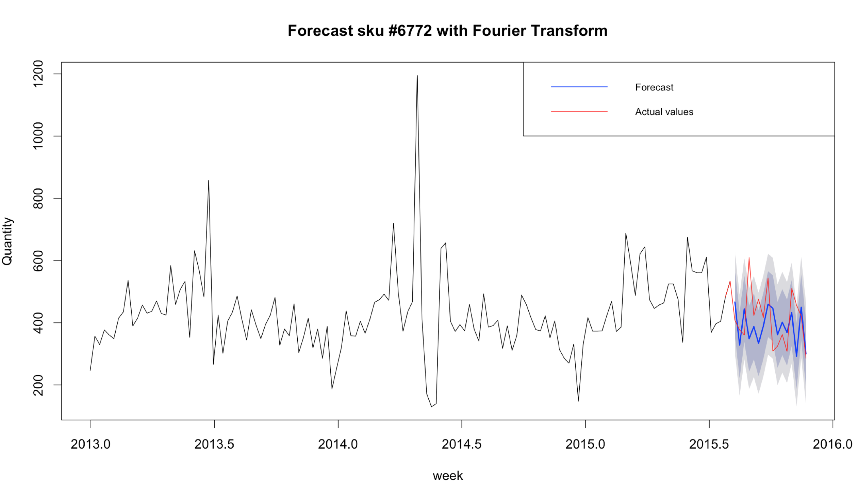
Improvement of the Sales Out forecast for NOBIVAC
Switch to Nobivac SKUs to use the new weekly SALES_IN data and forecast quantity sold out:
- Wrote a function to forecast any Nobivac Sales Out using the Fourier Transformation:
Observations:
No need to remove first 40 weeks ( no BOGO promotion) => more points
Trend well modeled
Can be still improved
1 year

Slide 5
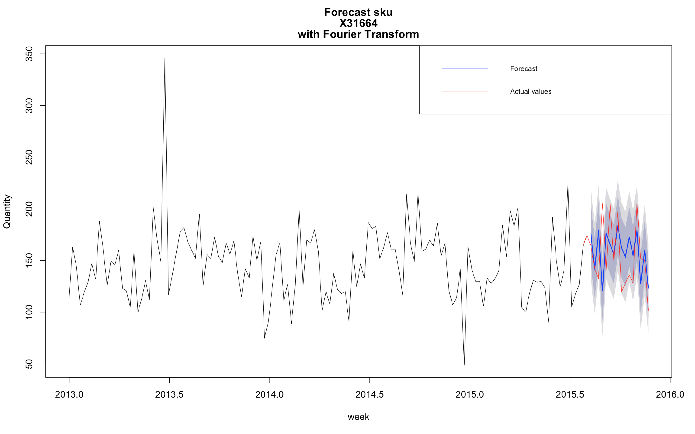
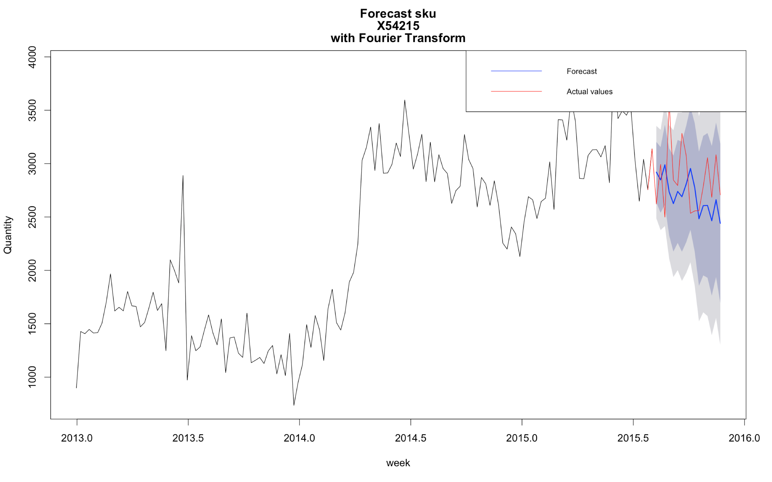
Improvement of the Sales Out forecast
Application for others Nobivac SKUs:

Slide 6
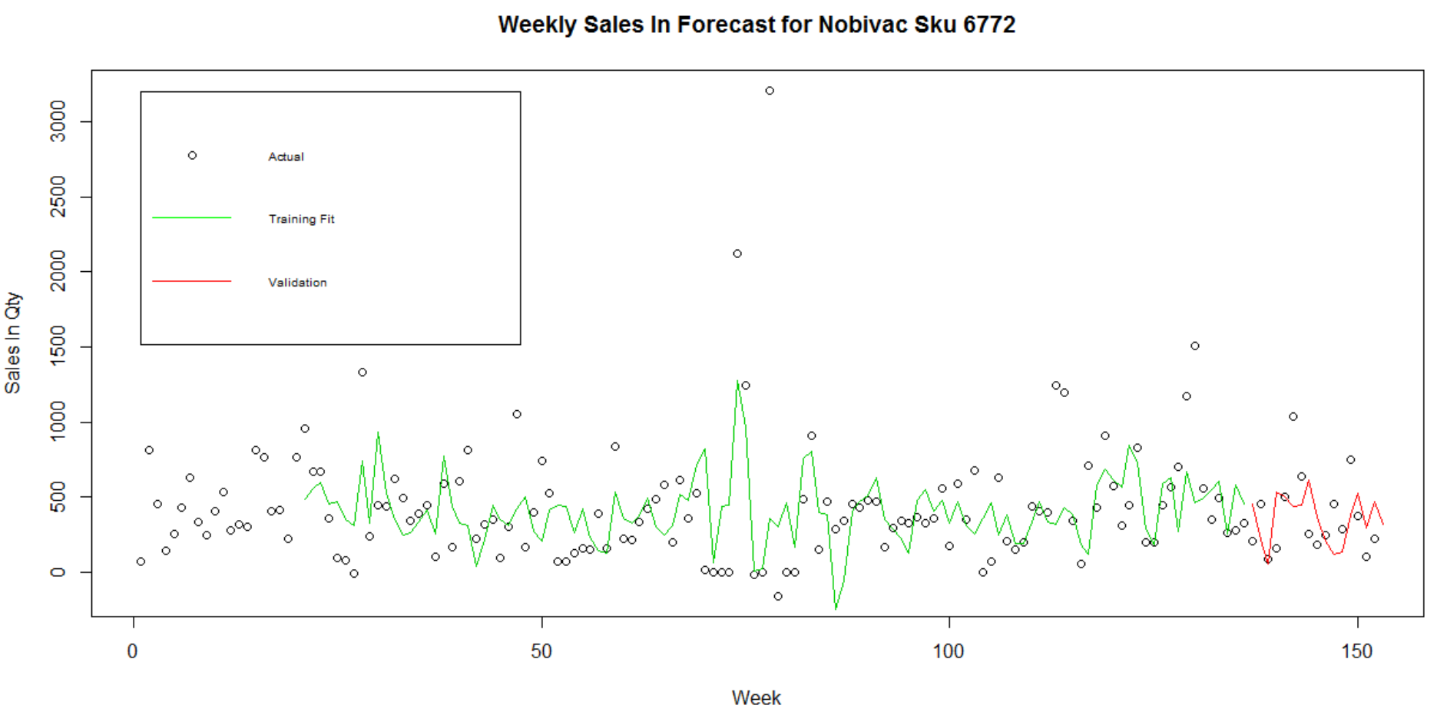
Sales In Forecast for Sku 6772
136 weeks training;
16 weeks validation
Model the training data with lags of sales out (the first 16 lags are predicted values from ARIMA)
Select the one with the least validation error (RMSE)
Tried 16 to 32 lags; optimal with 20 lags and RMSE = 269.65

Slide 7
Next Steps:
- Use the new data set to test our models
- Use inventory to improve the model

