Slide 1



Cornell MEng Data Forecasting Project Week 4
Team: Abhishek Dixit, Benjamin Elbaz,
Anqi Huang, Shuang Wei
Advisor: Kris Iyer
Date: Jan 25th, 2016

Slide 2
Objective: Explore the data of Nobivac and Activyl
Methodology:
Separate the data into two subsets (Nobivac and Activyl)
Determine the number of SKUs for each product
Aggregate the quantity for each SKU by day , week and month
Plot the time series for each SKU
Analyze the time series

Slide 3
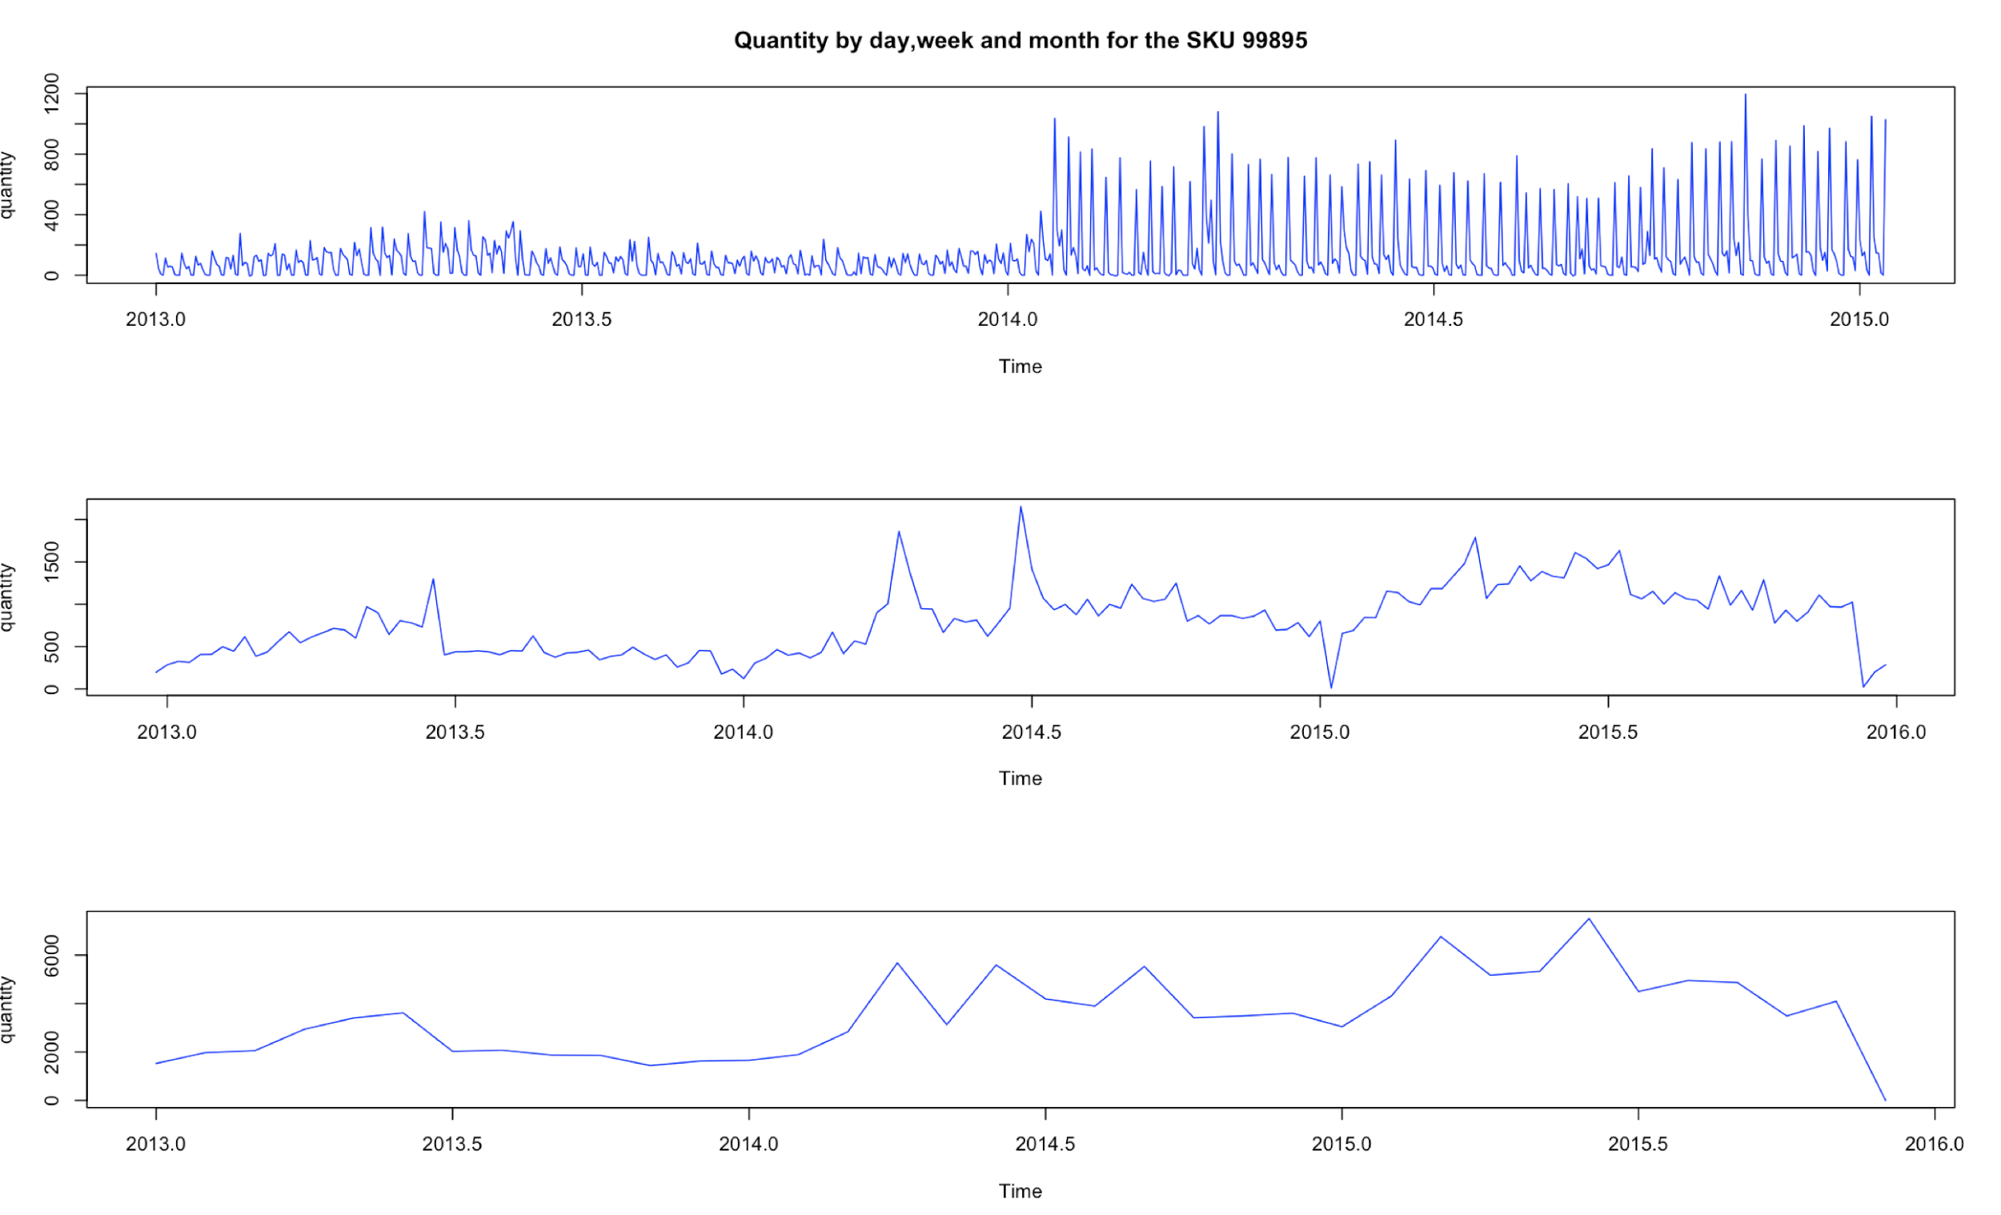
Summary Statistics of the Data
24 SKUs for Activyl and 37 SKUs for Nobivac
Time period: Jan 2013 to Dec 2015

Slide 4
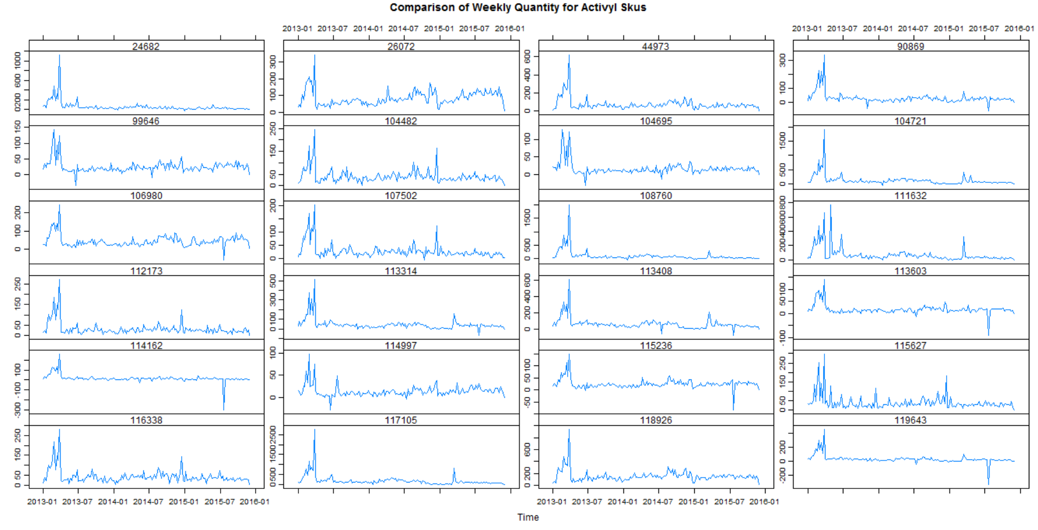

Slide 5
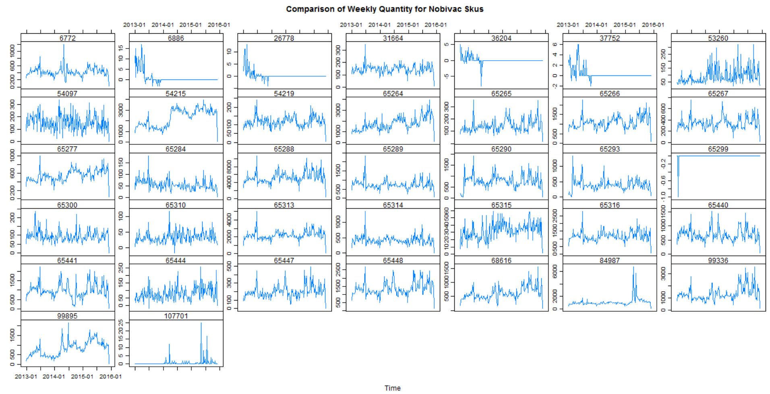

Slide 6
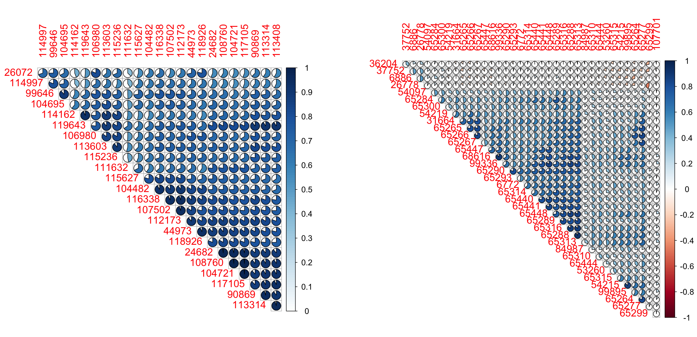



Correlations between SKUs
Activyl
Nobivac
=0.9
=0.5
=0

Slide 7
Questions:
Why does quantity equal to 0, negative, and decimal? (Discount, return orders)
Sometimes quantity =1 but sales=0?
Different sales for the same product on the same date?
Should we sum sales or quantity for each sku on each day?
Missing values, NA=0? Is data complete? If the data is missing, how do we fill it?
What is the unit of the quantity in data? In package or dose? If it’s dose, how many does per package?
Define shipments?
What happened in Feb and March 2013? There is a high peak.
What would be a good ratio for data partition?
Should we do demand forecast or supply forecast?
What is the business layer of Merck? Merck, warehouse, vet..
Is the inventory data weekly or monthly?
What does sales stand for?
Inconsistency of the three data file?

Slide 8
Next Steps:
- Analyze the seasonality of the two products
- Start making model for a single SKU.

