Slide 1



Cornell MEng Data Forecasting Project Week 9
Team: Abhishek Dixit, Benjamin Elbaz,
Anqi Huang, Shuang Wei
Advisor: Kris Iyer
Date: March 10th, 2016

Slide 2
Overview
Automated Sales In forecast based on Dynamic Regression
Created generic code for the model with diff(Inventory Level) and lags(Sales Out)
Added error metrics for model selection
Improved ARIMA model for Sales Out forecast
Started modeling inventory levels
Next Step
*Take Activyl Sku 24682 for example

Slide 3
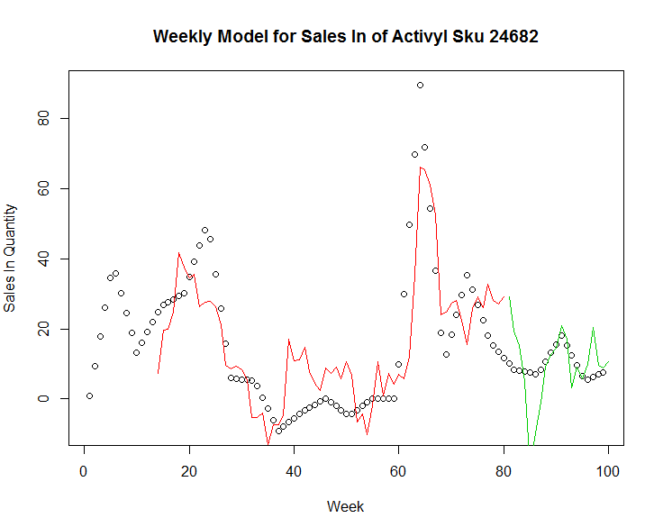
Sales In Forecast
80 weeks training; 20 weeks testing
Model the training data with different combinations of differenced inventory levels and lags of sales out
[e.g. diff(inv, lag=i) for i =1, …,4
lag(salesout, 1:j) for j = 1,2,... 16]
Select the best model from the 64 cases based on MAE and RMSE
For Sku 24682, the best model considers
diff(inv, lag=4) and lag(salesout, 1:13);
training - MAE = 9.84, RMSE = 12.49
testing - MAE = 6.75, RMSE = 9.56
Training
Test

Slide 4
Further Improvements on Sales In Forecast
Use the actual weekly Sales In data
Design better metrics to represent the tradeoff between training and testing
Extend the model to monthly Sales In

Slide 5
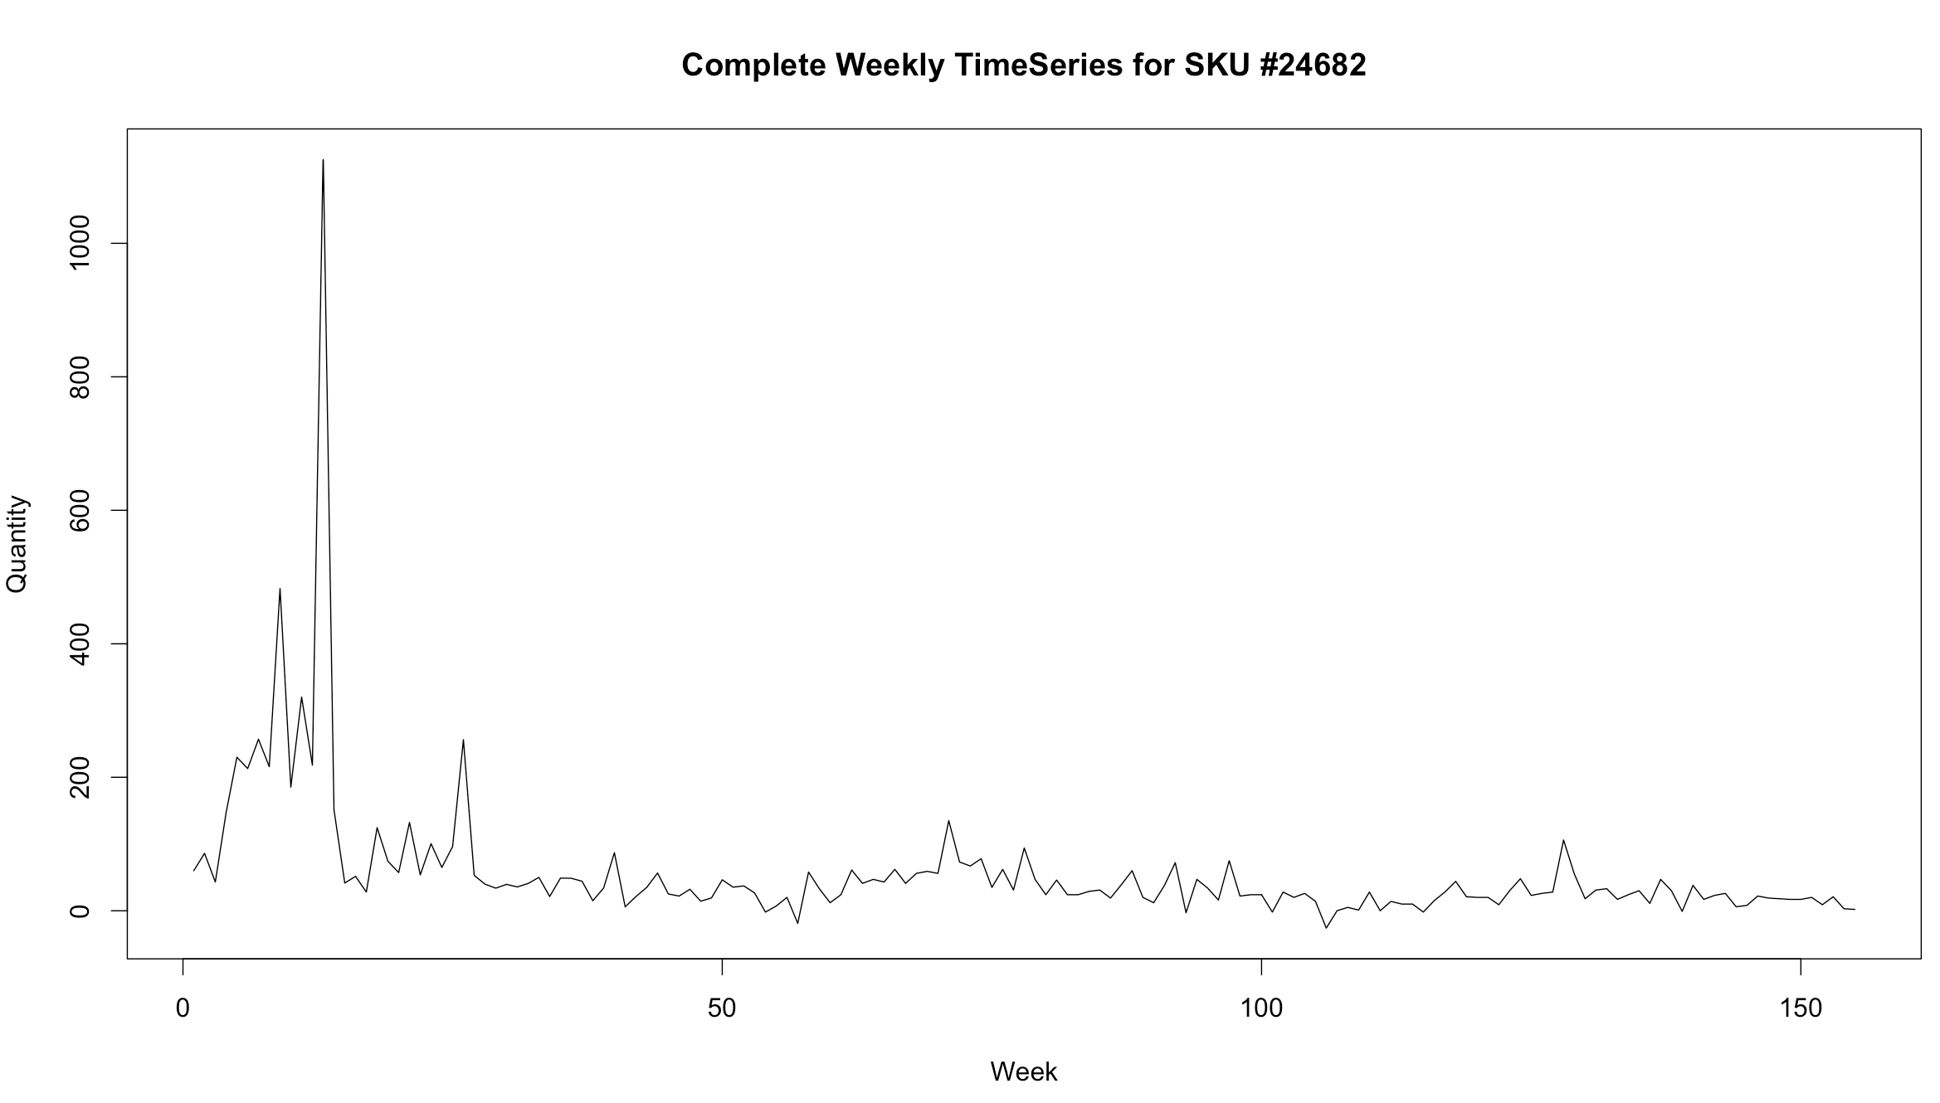
Improvement of the Sales Out forecast
For SKU #24682 (Activyl), the complete weekly TimeSeries of quantity sold out is:
Observations:
Need to remove High Peak in the First 40 weeks: BOGO promotion
Focus on the apparent seasonality to have an accurate model

Slide 6
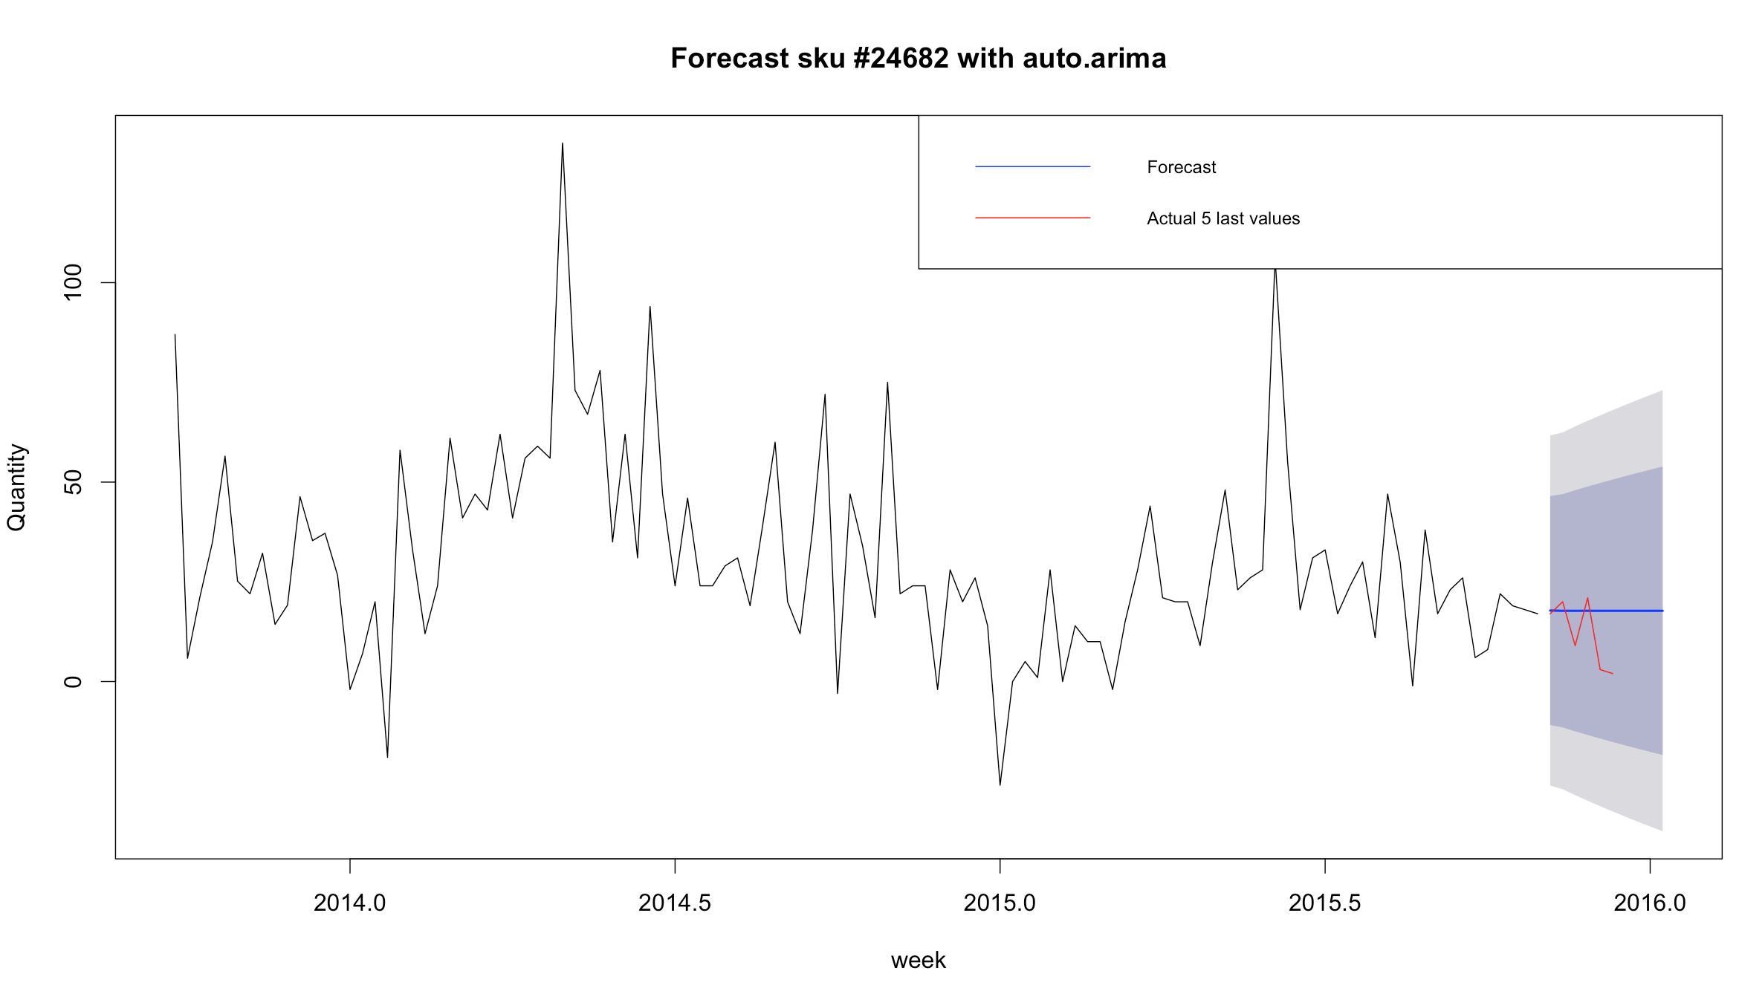
Improvement of the Sales Out forecast
For SKU #24682 (Activyl), the weekly forecast of quantity sold out after removing first 40w:
Observations:
Strong yearly seasonality
Auto.arima function gives a very bad forecast
Auto.arima can’t handle yearly seasonality
1 year

Slide 7
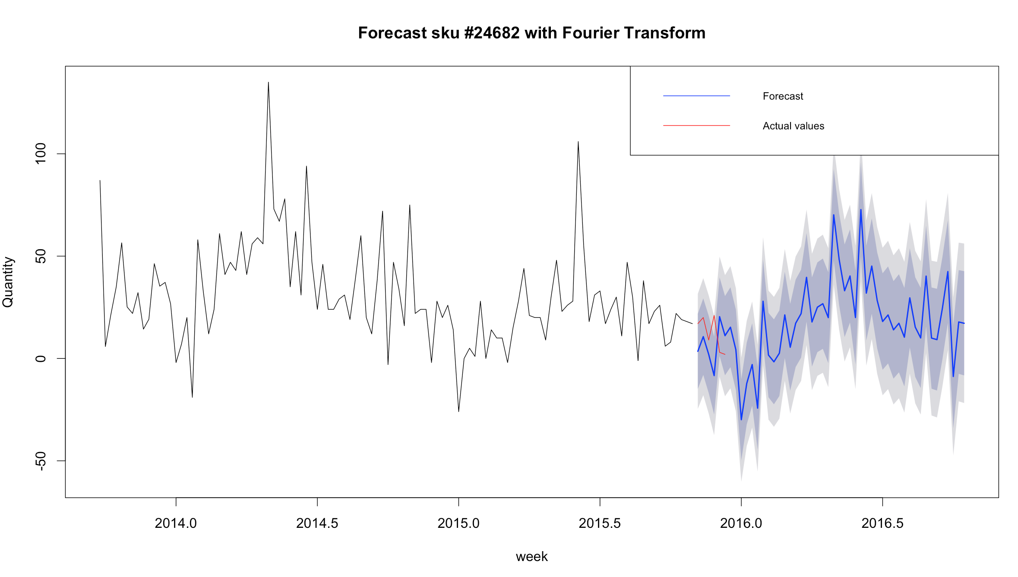
Improvement of the Sales Out forecast
Need to select another type of modelisation using a FOURIER transformation:
Observations:
Seasonality well modeled

Slide 8
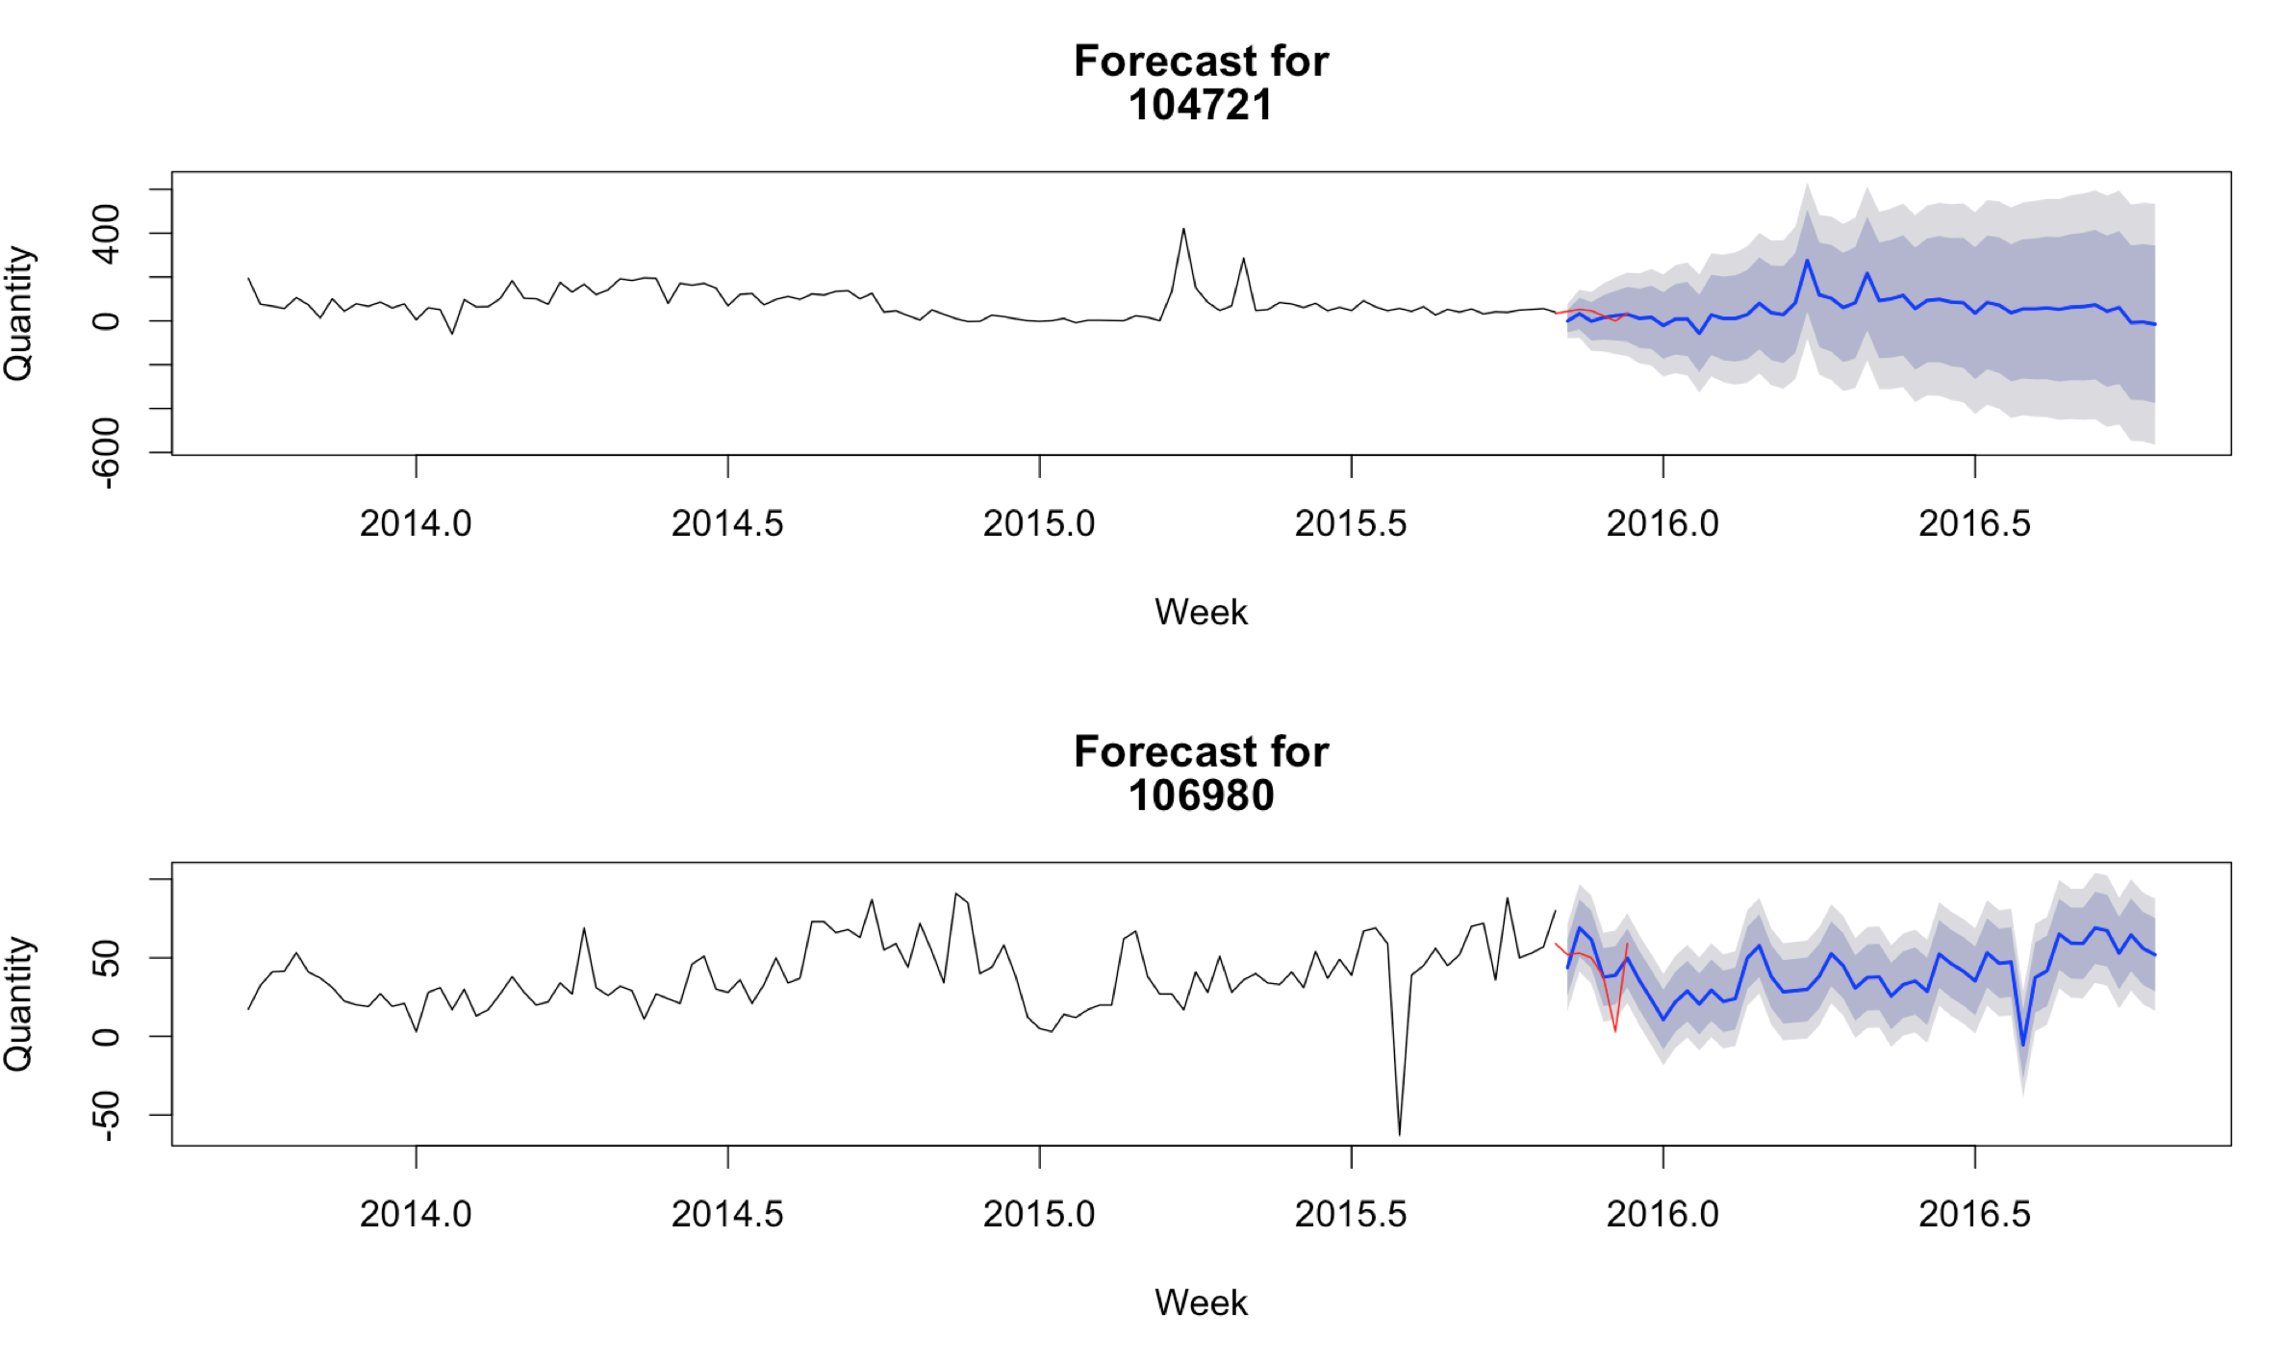
Improvement of the Sales Out forecast
Application for others Activyl SKUs:
Observations:
Not every Activyl SKU has a seasonality
Good prediction even without seasonality

Slide 9
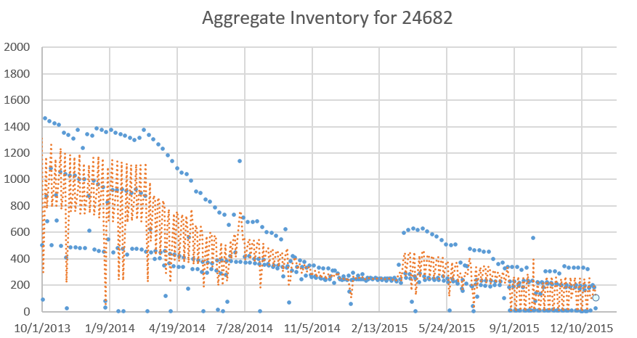
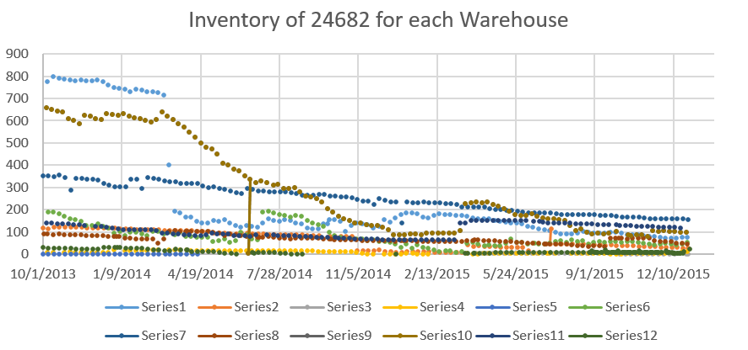
Inventory Concerns
- The aggregated inventory data has a decreasing trend
Aggregated inventory
- Orange trend line: average period = 2 weeks
Observations:
- 2 type of behaviour: decreasing and flat inventory level.
- Sudden change in July 2014
- Two warehouses have exact same data(9&10)

Slide 10
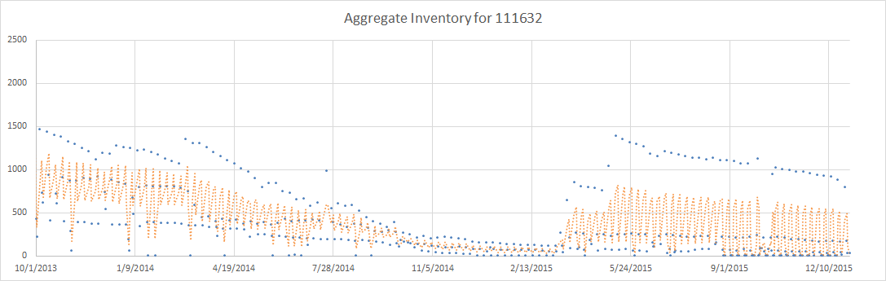
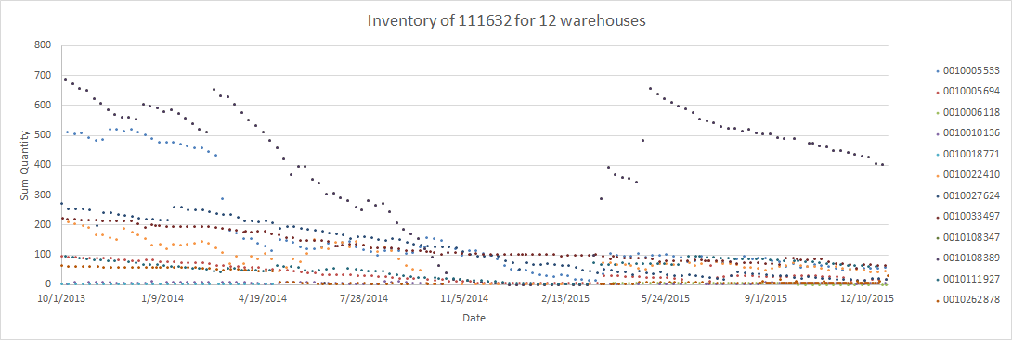
Inventory Concerns, different SKU
Observations:
- Sill 2 type of behaviour: decreasing and flat inventory level.

Slide 11
Inventory Concerns:
Given Sales Out data does not contain information regarding which warehouse the order is coming from
We see no direct connection between demand and each warehouse’s inventory
Each warehouse has different inventory policy
When forecasting Inventory data, we need information that can link the demand to each warehouse’s inventory

Slide 12
Possible Solutions:
1. Need additional information in Sales out data (i.e. for each order received by vet, which warehouse is it coming from?) to model each warehouse’s inventory separately.
2. What could be an alternative way to forecast inventory?

Slide 13
Next Steps:
Improve Sales In forecast
Finish modeling Inventory data
Use the new Sales Out model to improve Sales in forecast

