Slide 1


Merck Animal Health Forecasting Project Final Presentation
Team: Anqi Huang, Shuang Wei, Abhishek Dixit, Benjamin Elbaz
Advisor: Krishnamurthy Iyer
Date: May 19th, 2016
Notes:
B

Slide 2
Agenda
Topic | Presenter
Overview Introduction Objective Data Sources Project Charter* | Abhishek Abhishek Anqi Anqi
2. Methodology Driven Factors Forecasting Models Forecasting Accuracy Metrics | Anqi Anqi Benjamin
3. Results Nobivac Sales Out Nobivac Sales In Activyl Sales Out Activyl Sales In | Benjamin Shuang Shuang Wendy/Angie
4. Recommendations | Abhishek
Notes:
B

Slide 3
Overview Agenda
Topic | Presenter
1. Introduction | Abhishek
2. Objective | Abhishek
3. Data Source | Anqi
4. Project Charter | Anqi
Overview
Methodology
Recommendations
Results
Notes:
B

Slide 4
1.Introduction
Merck & Co, Inc. (MSD) is a $42B NJ-based pharmaceutical company operating vaccines, medications, and animal health products
Merck Animal Health:
Second largest in the animal health industry in terms of revenue and market share; Annual revenue: more than $3B
Offers veterinarians, pet owners and governments a wide range of pharmaceuticals, vaccines and health management services
Business Chain:
Merck
Distributors
Vets
Consumer
Overview
Methodology
Recommendations
Results
Notes:
A

Slide 5
2.Objectives
Build demand forecasting models in the US Market
Given the timeline, 2 products were chosen:
Nobivac: Mature Product
Actyvil: Proxy to newly launched product (launched in January 2013)
Objectives fot these two products are:
1. Nobivac
Forecast Sales In to dertermine its driving factors
Use forecast models to
Prevent stock out
Avoid cost of excess inventory
2. Activyl
Forecast the Sales In behavior for a newly launch product
Overview
Objectives
Methodology
Recommendations
Results
Notes:
A

Slide 6
3. Data Sources
Products considered:
Nobivac: Mature product, 31 SKUs
Activyl: Newly Launched product, 24 SKUs
Merck
Distributors
Vets
Consumer
SALES IN
Nobivac: Monthly from January 2013 to March 2016
Actyvil: Monthly from January 2013 to June 2014
INVENTORY LEVEL
For each Warehouse
For actyvil and Nobivac
In quantity
SALES OUT
Nobivac: Monthly from January 2013 to November 2015
Actyvil: Monthly from January 2013 to June 2014
EXETERNAL MARKET DATA
Total shipments accross all competitors
In Doses converted in quantity
Only for Nobivac
Overview
Objectives
Methodology
Recommendations
Results
Notes:
A

Slide 7
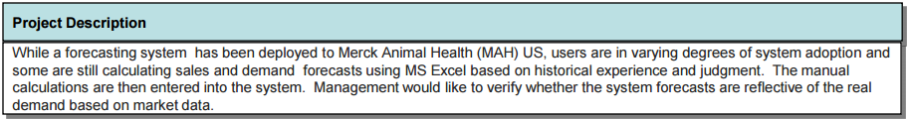
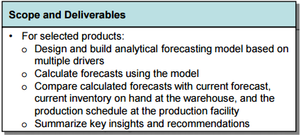
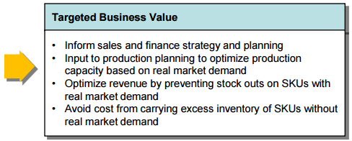

4.Project Overview - Charter
Overview
Methodology
Recommendations
Results
Notes:
A

Slide 8
Methodology Agenda
Topic | Presenter
Driving Factors | Anqi
2. Forecasting Models Nobivac Activyl | Anqi Anqi
3. Accuracy Metrics Demand Forecast Accuracy (DFA) Exponential Weighted Average | Benjamin Benjamin
Overview
Methodology
Recommendations
Results
Notes:
A

Slide 9
1.Driven Factors
Sales In
Sales Out
External Market Data
Distributors’ Inventory Status
* Trend and Seasonality of historical data are considered in each forecasting model
Different models can be derived based on the flow chart. For example:
Model 1 :Sales In is driven by Historical Sales In and Historical Sales Out
Model 2 : Sales In is driven by Historical Sales In and Inventory Status Forecast
Other Factors:
Sales Out
Vet’s current inventory status;
Customer behavior (due to extreme weather, disease outbreak, etc.)
Sales In
Price Competitiveness
Overview
Methodology
Recommendations
Results
Notes:
A

Slide 10
2.Forecasting Models - Nobivac
3 types of model were built to assess the tradeoff accuracy/time:
Sku-Level : 31 models
Cluster-Level :5 Clusters formed based on correlations between Sales In quantities
Product-Level : 1 model applied for every SKU
2 steps were needed for each level of forecast:
Forecast Sales out
2. Forecast Sales In
Forecasting Model For Sales Out
External Market Data
Historical Sales Out
Forecasting Model For Sales In
External Market Data
Inventory Status
Historical Sales In
Sales Out
Granger Causality Test:
Determine input factors
Transfer Function Model
Cross-validation with out of sample and out of time period data to choose the best combination of factors
Overview
Methodology
Recommendations
Results
Notes:
A

Slide 11
2.Forecasting Models - Activyl
Previous modeling approach didn’t work for Activyl because:
Poor quality of 2013 data
Few data points available for training
3 types of model were built:
Sku-Level (24 models)
Product-Level (1 model)
Cluster-Level :
- by SKU type (3 models)
Activyl® Dogs; Activyl® Cats; Activyl® TICK PLUS Dogs
- by SKU size (2 models)
Activyl® 6 X 6; Activyl® 22 X 1
- by SKU type and size (6 models)
Activyl® Dogs 6 X 6; Activyl® Cats 6 X 6; Activyl® TICK PLUS Dogs 6 X 6
Activyl® Dogs 22 X 1; Activyl® Cats 22 X 1; Activyl® TICK PLUS Dogs 22 X 1
Overview
Methodology
Recommendations
Results
Notes:
A

Slide 12
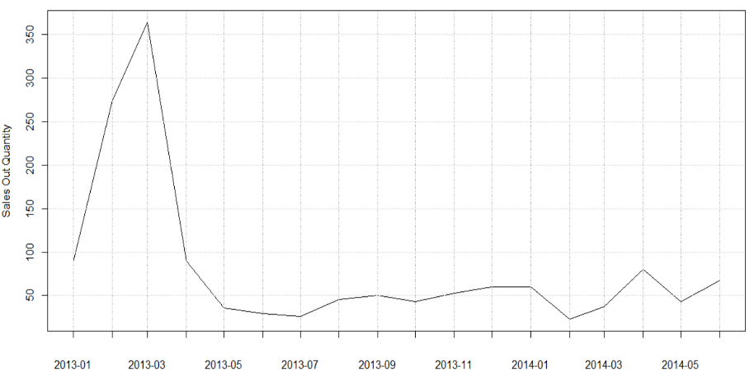
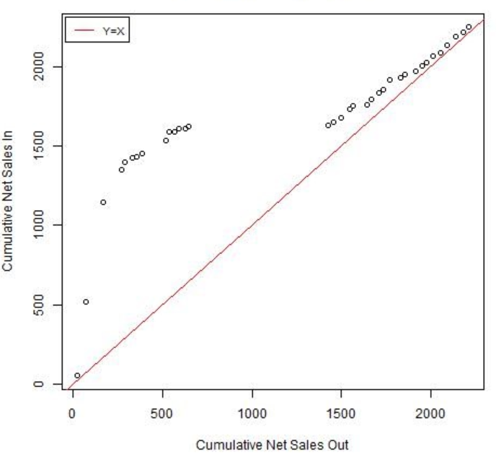
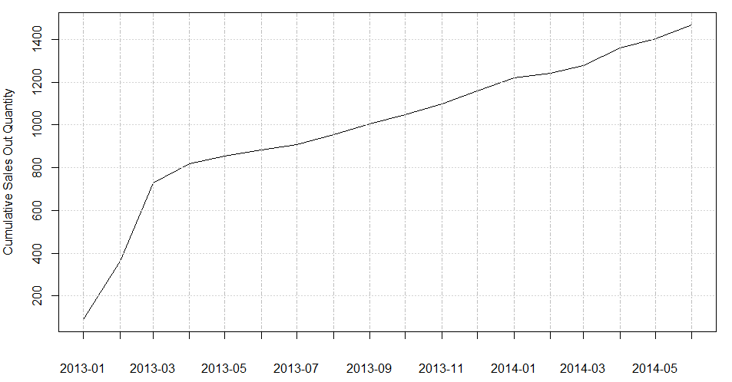
2.Forecasting Models - Activyl
Three steps are needed for each level:
(Use SKU 113603: Activyl® Small Dogs/Puppies 22 X 1 X 0.77ML as an example)
Forecast Sales Out after removing pipeline effects
Analyze Net Sales In and Net Sales Out based on inventory data
Forecast Actual Sales In using the model of Net Sales In
Initial Sales Out fed into Vets’ pipeline
Sales Out dispensed by Vets
Pipeline Stage
Overview
Methodology
Recommendations
Results
Notes:
A

Slide 13
3.Forecasting Accuracy Metrics
2 Forecast Accuracy Metrics were used to evaluate our models:
Only for Nobivac Sales Out
To be compared with EY’s current model
High DFA is good (>85%)
$$\left(1\right) Demand Forecst Accuracy=1 − \left|\frac{2 month Forecast −2 month ActualSales}{2 month Forecast}\right|$$
$$\left(2\right) Weighted Average= \frac{{Error\left(1st Month\right)}/{2^{0}}+{Error\left(2nd Month\right)}/{2^{1}}+{Error\left(3rd Month\right)}/{2^{2}}+{Error\left(4th Month\right)}/{2^{3}}}{1/{2^{0}}+1/{2^{1}}+1/{2^{2}}+1/{2^{3}}}$$
- Give more weight to the next first month forecast
- For Sales Out AND Sales In
- Low Weighted Average is good (<20%)
Overview
Methodology
Recommendations
Results
Notes:
B

Slide 14
Results Agenda
Topic | Presenter
Nobivac Sales Out Demand Forecast Accuracy Weighted Average Accuracy | Benjamin
2. Nobivac Sales In Weighted Average Accuracy Driving Factors Analysis High Error SKUs Analysis | Shuang
3. Activyl Sales Out Demand Forecast Accuracy Weighted Average Accuracy | Shuang
Activyl Sales In Weighted Average Accuracy Inventory Analysis | Shuang Anqi
Overview
Methodology
Recommendations
Results
Notes:
B

Slide 15
1.Nobivac Sales Out – Demand Forecast Accuracy
Average DFA by Month and Model:
[ 4-Month Forecast from Aug 2015 to Nov 2015]
$$DFA=1 − \left|\frac{2 month Forecast of Sales Out −2 month Actual Sales Out}{2 month Forecast of Sales Out}\right|$$
 | EY Model | SKU Level | Cluster Level | Product Level
August + September DFA | 80% | 76% | 88% | 88%
September + October DFA | 76% | 85% | 91% | 87%
October + November DFA | 71% | 82% | 86% | 86%
Cluster Level has the highest monthly DFA average
Use Sales Out predictions based on the cluster level to predict Sales In
Overview
Methodology
Recommendations
Results
Notes:
B

Slide 16
1.Nobivac Sales Out – Weighted Average Accuracy
Distribution of Weighted Average Metrics across all 31 skus of each level:
[ 4-Month Forecast from Aug 2015 to Nov 2015]
24 SKUs below 35% error
26 SKUs below 35% error
+ 3 SKUs to model individually:
- 53260: NOBIVAC® Puppy-DPv: 27.90%
- 54097: NOBIVAC® INTRA-TRAC® KC: 38.58%
- 84987: NOBIVAC® Canine Flu H3N8: 43.94%
28 SKUs below 35% error
Overview
Methodology
Recommendations
Results
Notes:
B

Slide 17
2.Nobivac Sales In – Driving Factors
Insights:
All SKUs use historical SI
SO is used to predict 14 SKUs
INV helps forecasting 8 SKUs :
EXT is used for 7 SKUs:
Driving Factors:
SO: Sales Out Forecast
SI: Historical Sales In
Inv: Inventory
Ext: External Market Data
NOBIVAC® Feline 3-HCP
NOBIVAC® Feline 1-HCP+ FeLV
NOBIVAC® FeLV
NOBIVAC® Feline 1-HCPCh+ FeLV
NOBIVAC® Canine 1-DAPPvL2
NOBIVAC® Canine 3-DAPv
NOBIVAC® Canine 1-Cv
NOBIVAC® 3-Rabies CA
NOBIVAC® INTRA-TRAC® KC
NOBIVAC® INTRA-TRAC®3 ADT
NOBIVAC® Canine 1-DAPPvL4
NOBIVAC® Canine Flu H3N8
NOBIVAC® 3-Rabies CA
NOBIVAC® 3-Rabies
NOBIVAC® Feline 1-HCPCh
Overview
Methodology
Recommendations
Results
Notes:
B

Slide 18
2.Nobivac Sales In – Weighted Average Accuracy
Distribution of Weighted Average Metrics across all 31 skus of each level:
[ 8-Month Forecast from Aug 2015 to Mar 2016]
31 SKUs below 35% error
11 SKUs below 50% error
Notice: 3 “Outstanding” SKUs to model individually:
- 53260: NOBIVAC® Puppy-DPv: 22.36%
- 54097: NOBIVAC® INTRA-TRAC® KC: 82.26%
- 84987: NOBIVAC® Canine Flu H3N8: 77.56%
14 SKUs below 50% error
SKU Level Model tends to outperform the other 2 models.
Recommend using SKU Level model to forecast Sales IN.
Overview
Methodology
Recommendations
Results
Notes:
W

Slide 19
2.Nobivac Sales In – High Error SKUs Analysis
Production Insights:
Comparison of actual sales in with production data shows production shortage for high error rate SKUs.
Out of 29 SKUs,17 SKUs were under-produced
(Notice: 2 SKUs are missing from production data)
SKU 99336(Nobivac Canine 1-DAPPvL4 25x1DS 229 MRK) was under-produced 75% of the time during the forecasting period.
2 SKUs have high error rate in both SKU level and Cluster Level method:
65440
99336
9 SKUs have high error rate in both Cluster level and Unionized Level method:
65289,65310,65314,65290,65293,65300,65444,99336
Cluster Level:
12 High Error SKUs
SKU Level:
5 High Error SKUs
Product Level:
14 High Error SKUs
2
9
1
1
SKU Code | Description | Over/Under Production | Percentage
65289 | Nobivac Canine 1-DAPPv+CV 25x1ds 229 MRK | Under | 75%
65310 | Nobivac Intra-Trac 3 150 x 1 ds 240 | Under | 100%
65314 | Nobivac Intra-Trac 3 2 x 5ds 240 | Under | 87%
65290 | Nobivac Canine 1-DAPPvL2 25x1 ds 229 MRK | Over | 50%
65293 | Nobivac Canine 1-DAPPvL2+Cv 25x1ds 229 M | Under | 100%
65300 | Nobivac Canine 1-Pv 25x 1 ds 229 MRK | Under | 87%
65284 | Nobivac Canine 1-Cv 25 x 1ds 240 MRK | Under | 100%
99336 | Nobivac Canine 1-DAPPvL4 25x1DS 229 MRK | Under | 75%
1 SKU has high error rate in the three method levels: 99336
Overview
Methodology
Recommendations
Results
Notes:
W

Slide 20
3.Activyl Sales Out – Demand Forecast Accuracy
Average DFA Distribution among 24 SKUs within 12-Month of Prediction
[ 8-Month Forecast from Jul 2013 to Jun 2014]
DFA:
The highest, the better
All 24 SKUs had at least 100% improvements on DFA using our new model during the 11-month period.
(Notice, since 2 month of data were used to calculate monthly DFA, DFA is only available from Aug 2013 to June 2014.
DFA improved percentages are ranged from 125% to 4339%.
Overview
Methodology
Recommendations
Results
Notes:
W

Slide 21
3.Activyl Sales Out – Weighted average accuracy
Weighted average rrror Distribution across all 24 Actyvil skus:
Same distribution for all three levels
( SKU, Cluster and Product Level)
Insights:
Error Rate tends to be relatively higher than Nobivac.
This is reasonable considering Activyl is a new product with limited data.
Overall, new model performs better than the current one of EY.
Overview
Methodology
Recommendations
Results
Notes:
W

Slide 22
4.Activyl Sales In – Comparison of 3 Clustering Models
Distribution of Weighted Average Metrics across all skus of each Cluster Model:
[ 8-Month Forecast from Jul 2013 to Jun 2014]
12 SKUs below 30% error
15 SKUs below 30% error
11 SKUs below 30% error
Cluster by SKU size tends to outperform the other 2 clustering methods.
Notice: 4 SKUs needed to model individually:
115627: ACTIVYL EXTRA LARGE DOGS 6x4.62ML 240
114997: ACTIVYL EXTRA LARGE DOGS 1x4.62ML 240
114162: Activyl Tick plus X-Lg Dog 1x6ml 240
24682: Activyl Tick plus X Lg Dog 6x6ml 240
Overview
Methodology
Recommendations
Results
Notes:
W

Slide 23
4.Activyl Sales In – Comparison of 3 Level Models
Distribution of Weighted Average Metrics across all 24 skus of each level:
[ 8-Month Forecast from Jul 2013 to Jun 2014]
All 24 SKUs below 25% error
15 SKUs below 30% error
23 SKUs below 30% error
SKU Level outperforms the other 2 levels.
Recommend using Product Level model to save time and appy only one model
Notice: 4 SKUs needed to model individually:
115627: ACTIVYL EXTRA LARGE DOGS 6x4.62ML 240
114997: ACTIVYL EXTRA LARGE DOGS 1x4.62ML 240
114162: Activyl Tick plus X-Lg Dog 1x6ml 240
24682: Activyl Tick plus X Lg Dog 6x6ml 240
Overview
Methodology
Recommendations
Results
Notes:
W

Slide 24
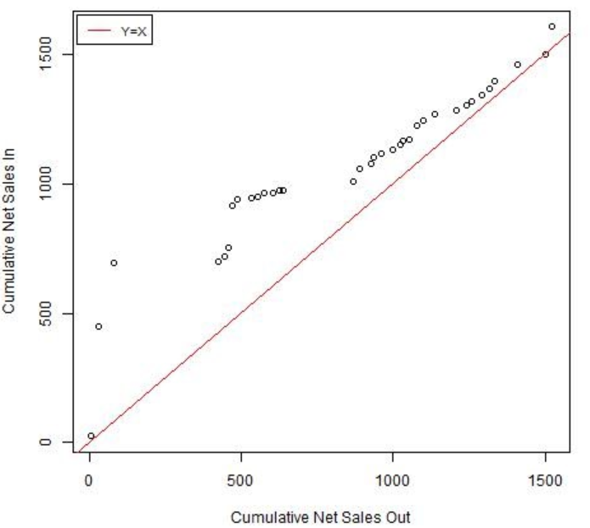
4.Activyl Sales In – Inventory Analysis
For the 4 SKUs of Extra Large Dogs:
Sales In follows a zig-zag shape - Quantities are strongly influenced by market demand instead of historical values - These SKUs should be modeled individually.
SKU 114997
Extra Large Dogs/Puppies 22 X 1 X 4.62ML
For the rest 12 SKUs of Dogs and Cats:
Pack size determines how Sales In behaves:
- Distributors have high expectations for SKUs with pack size 22 X 1
- SKUs with pack size 6 X 6 receives much less attention when they are launched
- Distributors tend to underestimate vets’ demand of these 6 X 6 size
For 8 TICK PLUS SKUs of Dogs :
SKU type determines how Sales In behaves:
- SKUs with the same type but different pack size have similar trends in terms of Sales In.
- Distributors have a mild order policy since the product launch
Overview
Methodology
Recommendations
Results
Notes:
A

Slide 25
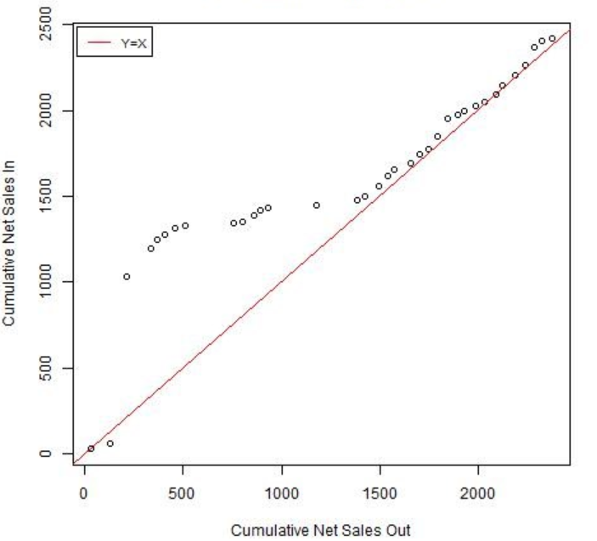
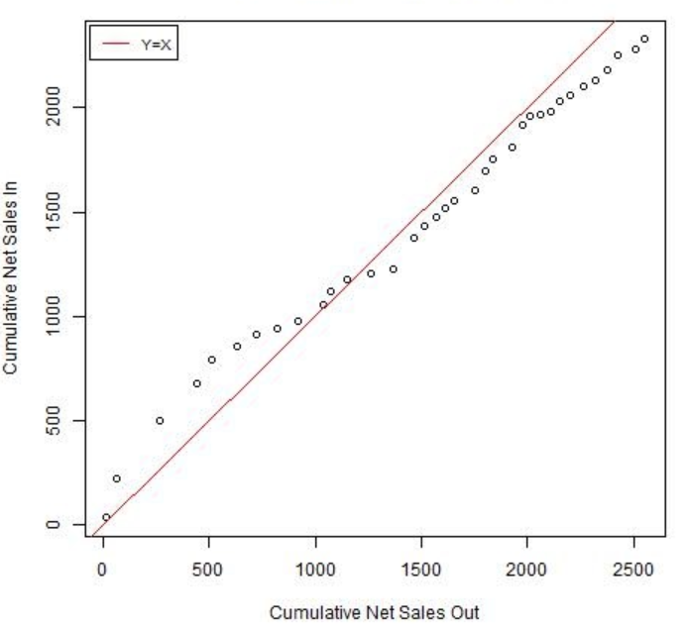
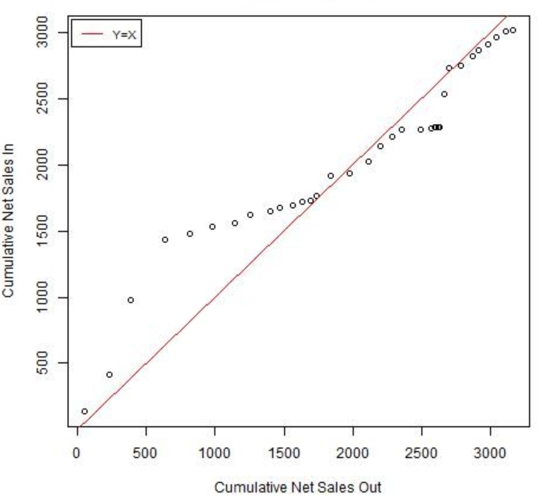
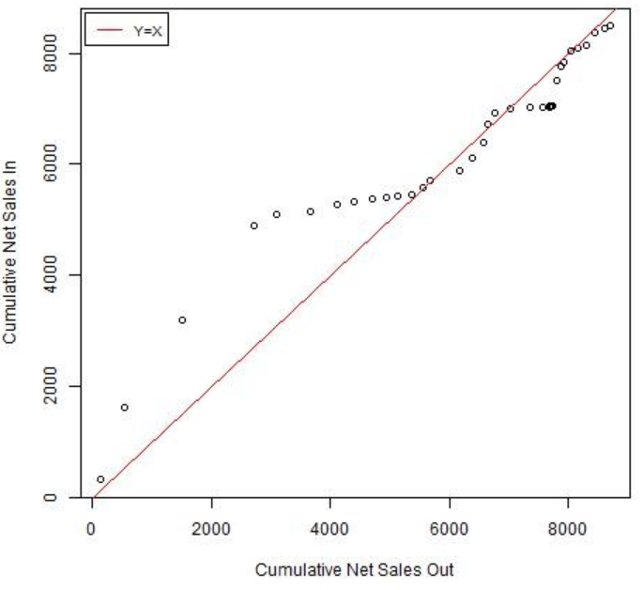
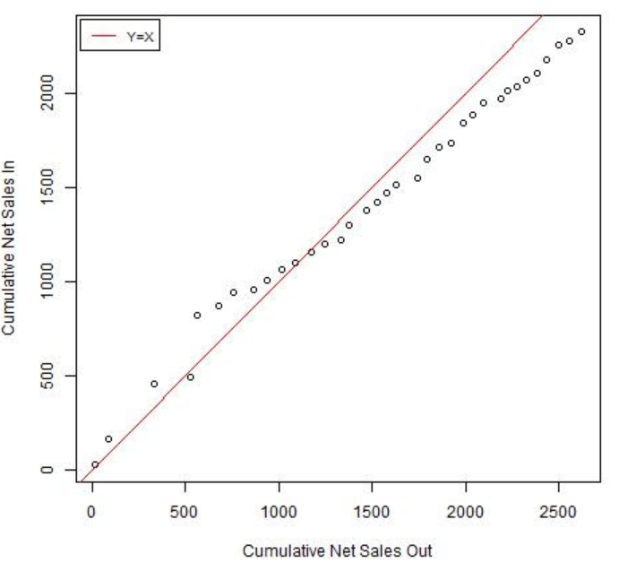
4.Activyl Sales In – Inventory Analysis
SKU 114997
Extra Large Dogs/Puppies 22 X 1 X 4.62ML
SKU 115236
Activyl® Toy Dogs/Puppies 22 X 1 X 0.51ML
SKU 104482
Activyl® Toy Dogs/Puppies 6 X 6 X 0.51ML
SKU 113408
Activyl® TICK PLUS Large Dogs/Puppies 22 X 1 X 4.0ML
SKU 117105
Activyl® TICK PLUS Large Dogs/Puppies 6 X 6 X 4.0ML
SKU 116338
Activyl® Large Dogs/Puppies 6 X 6 X 3.08ML
Notes:
A

Slide 26
Final Recommendations - Nobivac
Limitations
At least 25 months of data are required for both Sales In and Sales Out forecasting models.
Product
Clusters SKUs based on correlations between Sales In quantities leads to the best level model
Sales Out Model
Use Sales Out predictions based on the Cluster Level to predict Sales In
Sales In Model
When forecasting Nobivac, Historical Sales In and Forecast of Sales Out data are the most important driven factors.
Recommend using SKU Level model since it outperforms the other 2 models.
Comparison of actual sales in with production data shows production shortage for high error rate SKUs.
Special events (e.g. BOGO promotions) are difficult to be captured.
Cluster Level model, 3 SKUs need to be modeled separately with SKU Level model
Notice, these 3 SKUs tend to be high-cost/high-seasonal product.
Overview
Methodology
Recommendations
Results
Notes:
A

Slide 27
Final Recommendations -Activyl
Assumptions
Accurate data since the launch time (January 2013)
The relationship between Net Sales In and Net Sales Out reflect the relationship between actual Sales In and actual Sales Out
Product
Clustering SKUs based on physical characteristics (e.g. SKU type and pack size) helps identify Sales In and Sales out behavior. SKUs with irregular demand (e.g. extra large dogs) should be considered individually.
With very few data points available, all three types of model result in the same Sales Out forecasts.
Model
When forecasting Sales In, both SKU-Level and Unionized model work well. If a Cluster-Level model is needed, we recommend using the Cluster-Level model by SKU size.
External market data might also be an useful factor. But due to the availability of data, it cannot be incorporated in the model.
Overview
Methodology
Recommendations
Results
Notes:
A

Slide 28
Questions?
Thank you !

Slide 29
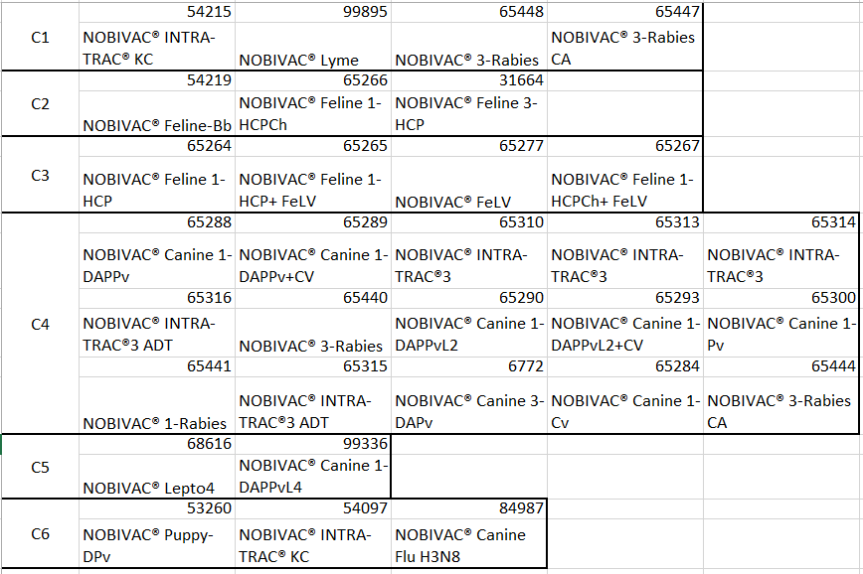
Appendix – Nobivac Clustering
For C6, correlations < 0.5
Recommendation: Model the 3 SKUs individually

Slide 30
Appendix – Activyl Clustering by Type
Cluster Model 1
C1 | 104482 | 112173 | 107502 | 116338 | 115236 | 113603 | 104695 | 099646
 | Activyl® Toy Dogs/Puppies 6 X 6 X 0.51ML | Activyl® Small Dogs/Puppies 6 X 6 X 0.77ML | Activyl® Medium Dogs/Puppies 6 X 6 X 1.54ML | Activyl® Large Dogs/Puppies 6 X 6 X 3.08ML | Activyl® Toy Dogs/Puppies 22 X 1 X 0.51ML | Activyl® Small Dogs/Puppies 22 X 1 X 0.77ML | Activyl® Medium Dogs/Puppies 22 X 1 X 1.54ML | Activyl® Large Dogs/Puppies 22 X 1 X 3.08ML
C2 | 044973 | 118926 | 106980 | 026072
 | Activyl® Kitten 6 X 6 X 0.51ML | Activyl® Cats 6 X 6 X 1.0ML | Activyl® Kitten 22 X 1 X 0.51ML | Activyl® Cats 22 X 1 X 1.0ML
C3 | 111632 | 104721 | 108760 | 117105 | 090869 | 113314 | 119643 | 113408
 | Activyl® TICK PLUS Toy Dogs/Puppies 6 X 6 X 0.5ML | Activyl® TICK PLUS Small Dogs/Puppies 6 X 6 X 1.0ML | Activyl® TICK PLUS Medium Dogs/Puppies 6 X 6 X 2.0ML | Activyl® TICK PLUS Large Dogs/Puppies 6 X 6 X 4.0ML | Activyl® TICK PLUS Toy Dogs/Puppies 22 X 1 X 0.5ML | Activyl® TICK PLUS Small Dogs/Puppies 22 X 1 X 1.0ML | Activyl® TICK PLUS Medium Dogs/Puppies 22 X 1 X 2.0ML | Activyl® TICK PLUS Large Dogs/Puppies 22 X 1 X 4.0ML

Slide 31
Appendix – Activyl Clustering by Size
Cluster Model 2
C1 | 104482 | 112173 | 107502 | 116338 | 044973 | 118926 | 115236 | 113603
 | Activyl® Toy Dogs/Puppies 6 X 6 X 0.51ML | Activyl® Small Dogs/Puppies 6 X 6 X 0.77ML | Activyl® Medium Dogs/Puppies 6 X 6 X 1.54ML | Activyl® Large Dogs/Puppies 6 X 6 X 3.08ML | Activyl® Kitten 6 X 6 X 0.51ML | Activyl® Cats 6 X 6 X 1.0ML | Activyl® Toy Dogs/Puppies 22 X 1 X 0.51ML | Activyl® Small Dogs/Puppies 22 X 1 X 0.77ML
 | 104695 | 099646 | 106980 | 026072 | 111632 | 104721 | 108760 | 117105
 | Activyl® Medium Dogs/Puppies 22 X 1 X 1.54ML | Activyl® Large Dogs/Puppies 22 X 1 X 3.08ML | Activyl® Kitten 22 X 1 X 0.51ML | Activyl® Cats 22 X 1 X 1.0ML | Activyl® TICK PLUS Toy Dogs/Puppies 6 X 6 X 0.5ML | Activyl® TICK PLUS Small Dogs/Puppies 6 X 6 X 1.0ML | Activyl® TICK PLUS Medium Dogs/Puppies 6 X 6 X 2.0ML | Activyl® TICK PLUS Large Dogs/Puppies 6 X 6 X 4.0ML
C2 | 115236 | 113603 | 104695 | 099646 | 090869 | 113314 | 119643 | 113408
 | Activyl® Toy Dogs/Puppies 22 X 1 X 0.51ML | Activyl® Small Dogs/Puppies 22 X 1 X 0.77ML | Activyl® Medium Dogs/Puppies 22 X 1 X 1.54ML | Activyl® Large Dogs/Puppies 22 X 1 X 3.08ML | Activyl® TICK PLUS Toy Dogs/Puppies 22 X 1 X 0.5ML | Activyl® TICK PLUS Small Dogs/Puppies 22 X 1 X 1.0ML | Activyl® TICK PLUS Medium Dogs/Puppies 22 X 1 X 2.0ML | Activyl® TICK PLUS Large Dogs/Puppies 22 X 1 X 4.0ML

Slide 32
Appendix – Activyl Clustering by Size & Type
Cluster Model 3
C1 | 104482 | 112173 | 107502 | 116338
 | Activyl® Toy Dogs/Puppies 6 X 6 X 0.51ML | Activyl® Small Dogs/Puppies 6 X 6 X 0.77ML | Activyl® Medium Dogs/Puppies 6 X 6 X 1.54ML | Activyl® Large Dogs/Puppies 6 X 6 X 3.08ML
C2 | 044973 | 118926
 | Activyl® Kitten 6 X 6 X 0.51ML | Activyl® Cats 6 X 6 X 1.0ML
C3 | 115236 | 113603 | 104695 | 099646
 | Activyl® Toy Dogs/Puppies 22 X 1 X 0.51ML | Activyl® Small Dogs/Puppies 22 X 1 X 0.77ML | Activyl® Medium Dogs/Puppies 22 X 1 X 1.54ML | Activyl® Large Dogs/Puppies 22 X 1 X 3.08ML
C4 | 106980 | 026072
 | Activyl® Kitten 22 X 1 X 0.51ML | Activyl® Cats 22 X 1 X 1.0ML
C5 | 111632 | 104721 | 108760 | 117105
 | Activyl® TICK PLUS Toy Dogs/Puppies 6 X 6 X 0.5ML | Activyl® TICK PLUS Small Dogs/Puppies 6 X 6 X 1.0ML | Activyl® TICK PLUS Medium Dogs/Puppies 6 X 6 X 2.0ML | Activyl® TICK PLUS Large Dogs/Puppies 6 X 6 X 4.0ML
C6 | 090869 | 113314 | 119643 | 113408
 | Activyl® TICK PLUS Toy Dogs/Puppies 22 X 1 X 0.5ML | Activyl® TICK PLUS Small Dogs/Puppies 22 X 1 X 1.0ML | Activyl® TICK PLUS Medium Dogs/Puppies 22 X 1 X 2.0ML | Activyl® TICK PLUS Large Dogs/Puppies 22 X 1 X 4.0ML

