Slide 1



Cornell MEng Data Forecasting Project Week 7
Team: Abhishek Dixit, Benjamin Elbaz,
Anqi Huang, Shuang Wei
Advisor: Kris Iyer
Date: Feb 17th, 2016

Slide 2
Work over the past week:
Work on the inventory data:
Create a weekly and monthly inventory level for each SKU and each Warehouse
Aggregate by SKU
Build a T by k matrix (T=number of weeks, k=number of sku) representing the sum of the inventory level
Match the three set of data, for each SKU:
Create a T by 3 matrix: T=number of weeks, Column 1: Sales in, Column 2: Sales Out, Column 3: Inventory level
Build simple forecasting model for Sales Out - Univariate ARIMA
Work on different theoretical multivariate time series model:
VARIMA
ARIMAX

Slide 3
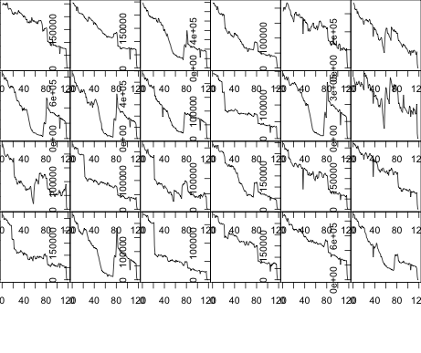
Inventory Data for Activyl
High peak in 2013 due to Buy One Get One Promotion;
Decreasing trend afterwards
(Picture to the right shows the weekly inventory level of all 24 Skus of Activyl after eliminating the 2013 high peak corresponding to 40 weeks)

Slide 4
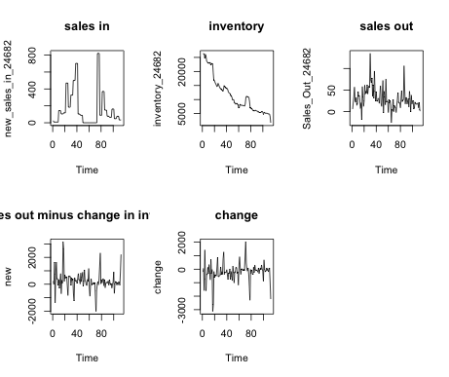
Sales In, Sales Out, and Inventory Status of Activyl Sku 24682

Slide 5
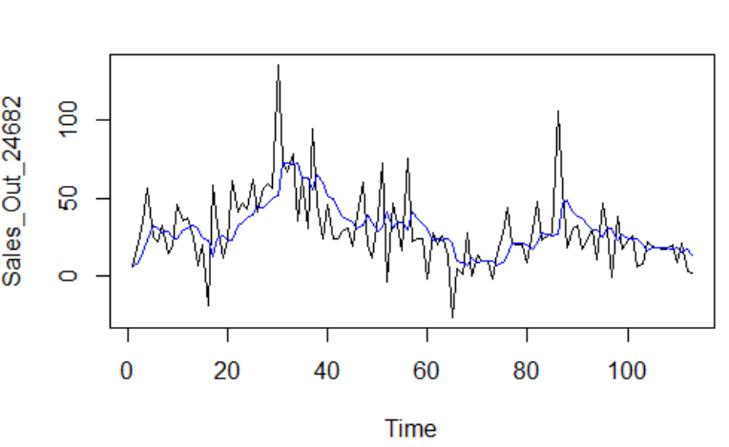
Example of forecasting Sales Out
Weekly Sales Out Forecast for Activyl Sku - 24682
MA(1) with 1 order of differencing

Slide 6
Next Steps:
- More analysis on inventory data
- Complete and improve forecasting model for Sales Out
- Start building multivariate models for Sales In

