Slide 1



Cornell MEng Data Forecasting Project Week 8
Team: Abhishek Dixit, Benjamin Elbaz,
Anqi Huang, Shuang Wei
Advisor: Kris Iyer
Date: Feb 26th, 2016

Slide 2
Work over the past week:
Interpolate sales-in data from monthly to weekly format
Built a 99 x 3 matrix for each SKU containing weekly data
99 data points from 1st week of January 2014 to last week of November 2015
3 columns correspond to sales-in, sales-out, and inventory data.
Test run of ARIMA model failed on sales-in and inventory data
Used DYNLM package(dynamic linear regression for time series) to model 2 SKUs
SKU 024682 ACTIVYL TICK PLUS X LG DOG 6 X 6 ML 240
SKU 111632 ACTIVYL TICK PLUS TOY DOG 6 X 0.5 ML 240
Compare original time series with predictions

Slide 3
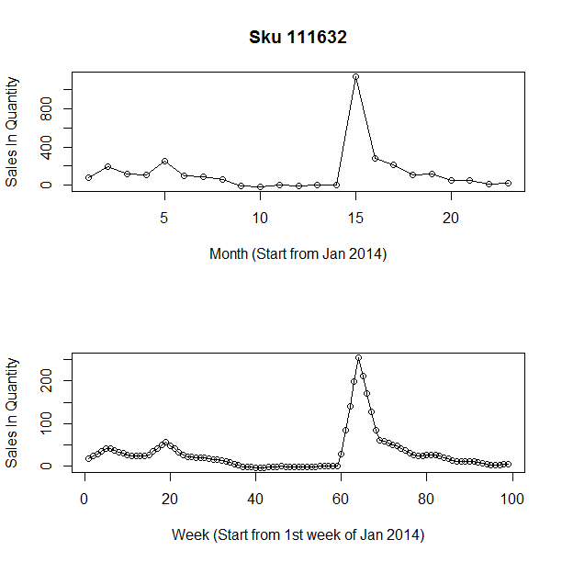
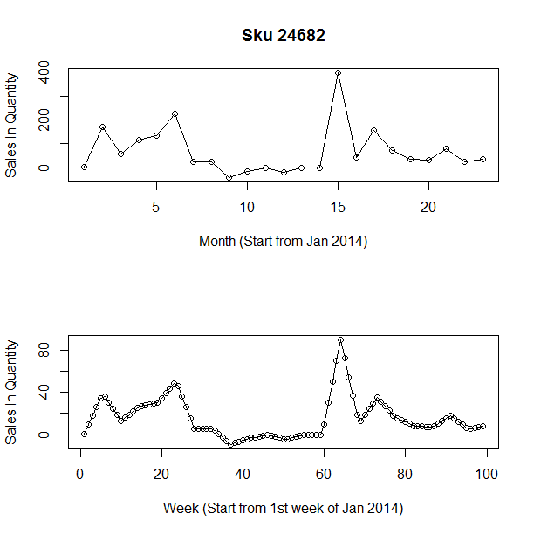
Interpolation of Sales-in Data

Slide 4
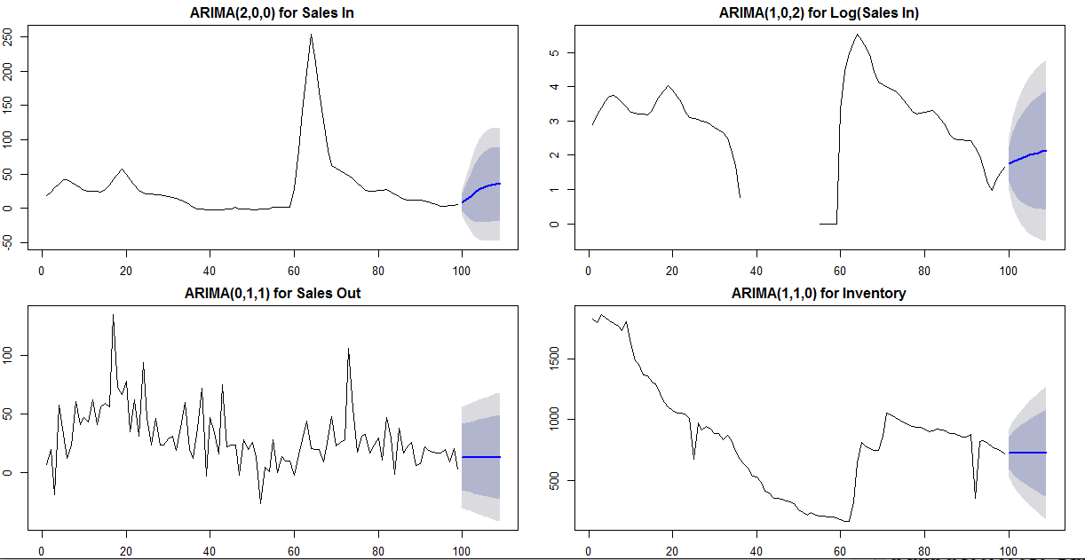
Test Run of ARIMA Model for SKU 111632

Slide 5
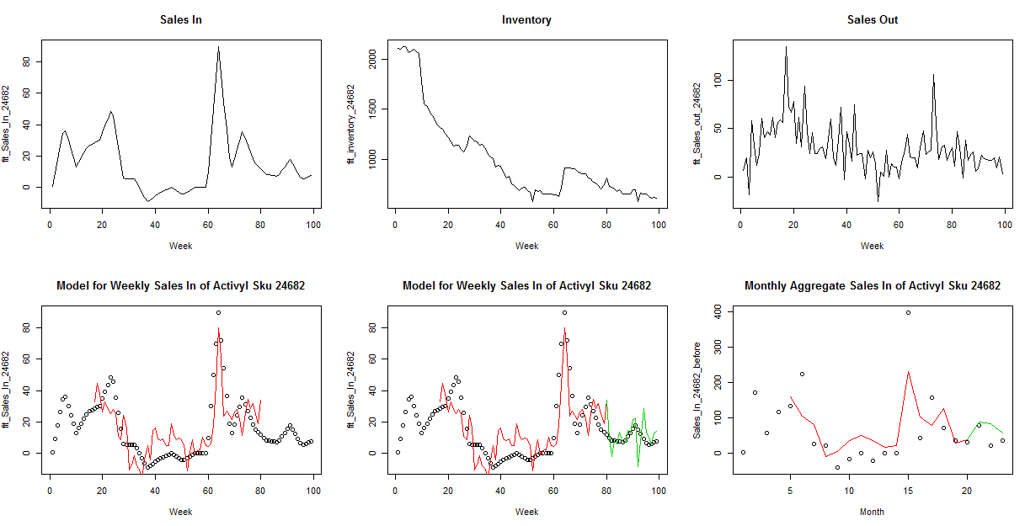
Weekly Model for Sales In - Sku 24682

Slide 6
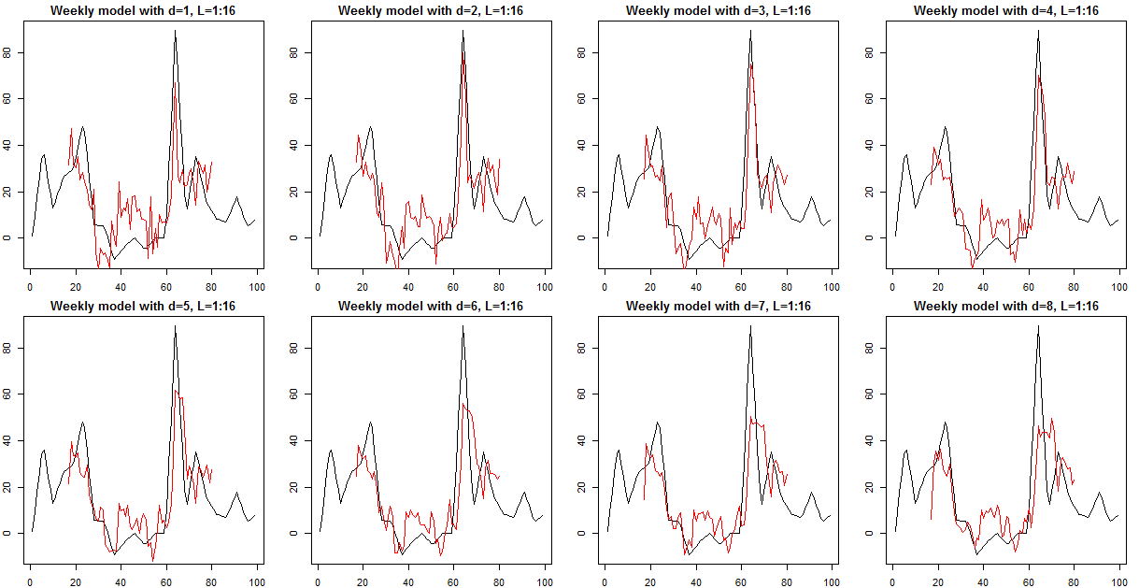
Model Selection: Weekly Model for Sales In - Sku 24682

Slide 7
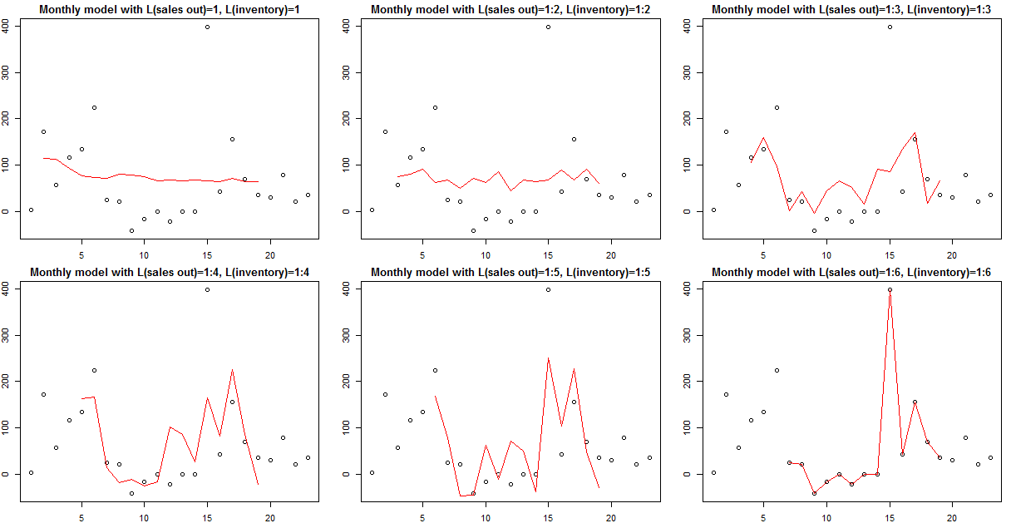
Model Selection: Monthly Model for Sales In - Sku 24682

Slide 8
Next Steps:
- Complete and improve forecasting model for sales-in data of the rest of Activyl SKUs(22).
-Expected to complete in 2 weeks
- Construct a prediction function for all SKUs
- Complete building forecasting models for sales out and inventory data

