Slide 1
On Topological Entropy and Stability of
Switched Linear Systems
Guosong Yang¹, João P. Hespanha¹, and Daniel Liberzon²
¹Center for Control, Dynamical Systems, and Computation
University of California, Santa Barbara
²Coordinated Science Laboratory
University of Illinois at Urbana-Champaign
22nd ACM International Conference on Hybrid Systems: Computation and Control (HSCC ’19)
April 17, 2019

Slide 2





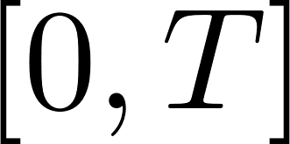





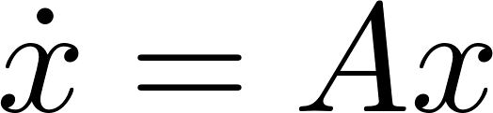
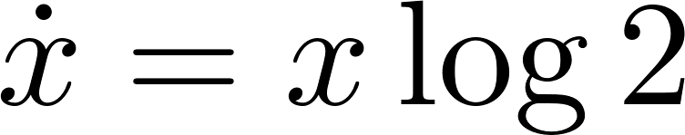
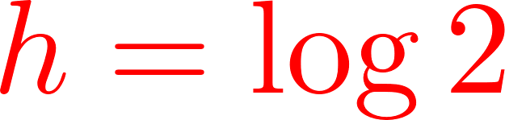
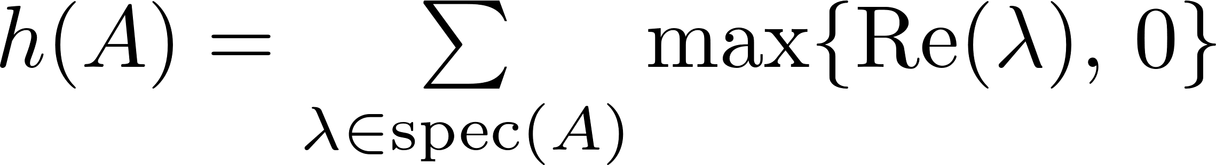
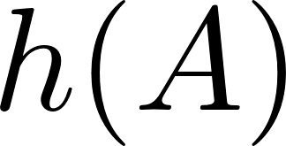
Topological Entropy
Systems theory
  Originated from Kolmogorov’s metric entropy [Kolmogorov-58]
  Defined by [Adler-Konheim-McAndrew-65; Bowen-71; Dinaburg-70]
Essential idea: Uncertainty growth
  Dynamical system with bounded initial set
  Need balls of radius to cover the reachable set on
  Topological entropy: how fast does increase (exponentially)?
Control theory: Minimal data rate
  Feedback control [Nair-Evans-Mareels-Moran-04; Colonius-Kawan-09]
  Estimation [Savkin-06; Liberzon-Mitra-18]
Linear time-invariant (LTI) systems:
  The entropy is
  Minimal data rate for feedback stabilization is also [Hespanha-Ortega-Vasudevan-02; Nair-Evans-03; Tatikonda-Mitter-04]

Slide 3
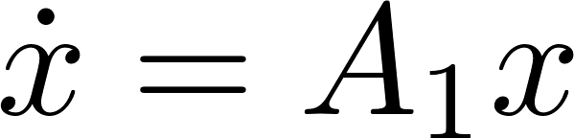
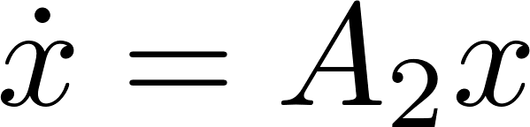
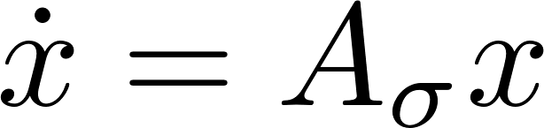
Switched System
Dynamical system switches between multiple dynamics
Ubiquitous in real-world systems
  Electrical network, vehicles, etc.
  Cyber-physical systems: continuous dynamics orchestrated by discrete decisions
Theoretical viewpoint
  Switching between simple dynamics (modes) could generate rich behaviors
Minimal data rate and entropy
  Sufficient data rate [Liberzon-14; Sibai-Mitra-17; Y-Liberzon-18]
  Topological entropy [Y-Schmidt-Liberzon-18; Y-Hespanha-18]

Slide 4
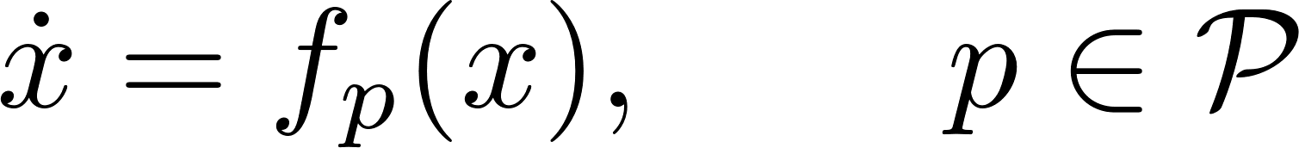
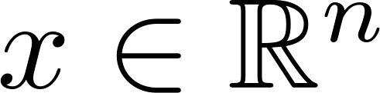

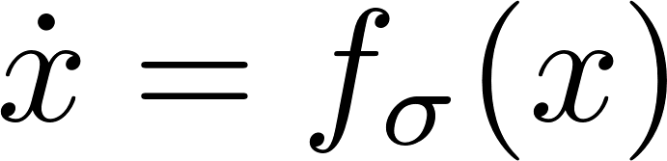
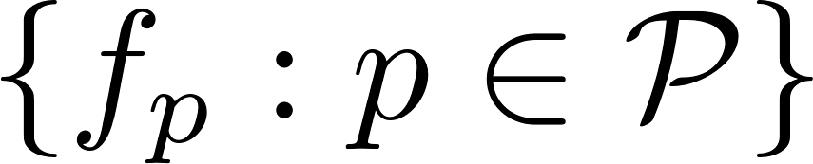
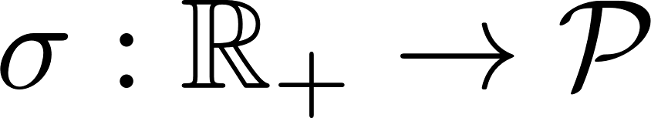
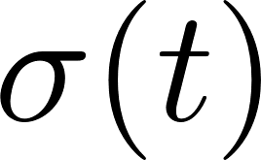
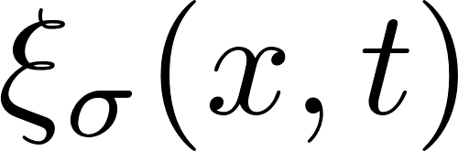



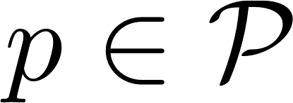
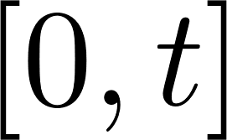
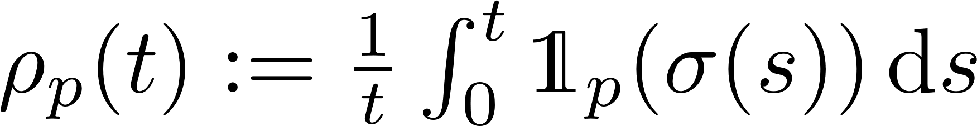
Switched System
A finite family of continuous-time dynamical systems
with the state and an index set .
A switched system
Individual modes
Switching signal ; active mode
Solution : at time with initial state and switching signal
The active rate of mode over

Slide 5


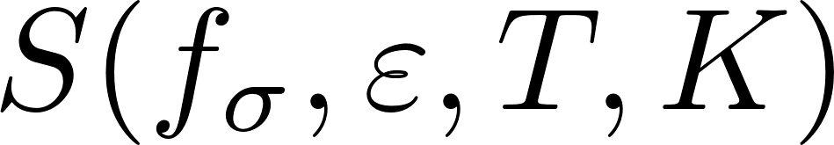
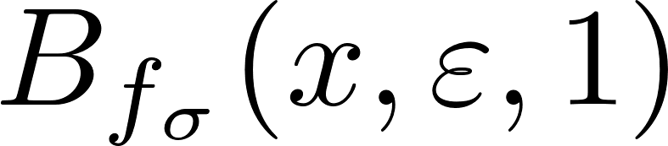
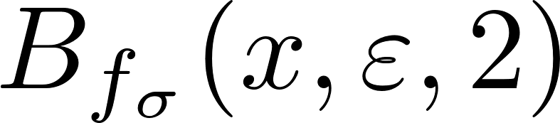
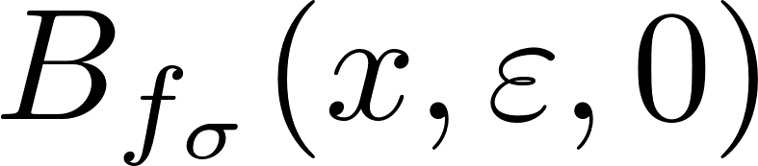
Entropy Definition
A switched system with a compact initial set
Given a time horizon and a radius , define the open ball
Let be the minimal number of such balls so that their union covers
The topological entropy is its exponential growth rate
Properties
  Nonnegative
  Depends on the switching signal and the initial set
  Independent of the norm

Slide 6
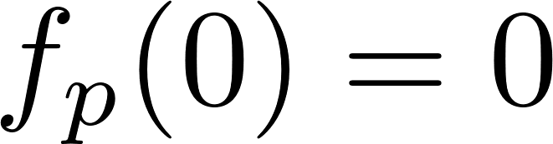

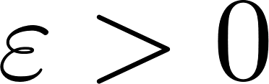

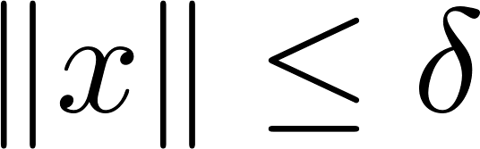
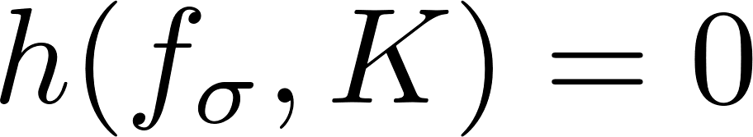

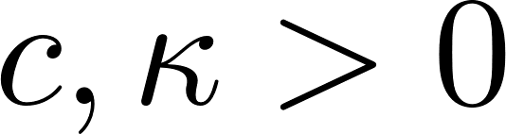

Stability Notions
Common equilibrium: for all
(Lyapunov) stability: for each , there is a such that if then
  Stability implies the entropy for small enough initial sets
Global exponential stability (GES): there are such that for all ,
  GES implies the entropy for all initial sets
It is possible that while the switched system is unstable

Slide 7

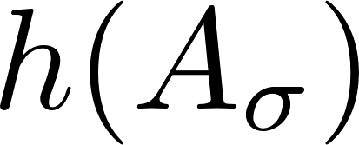
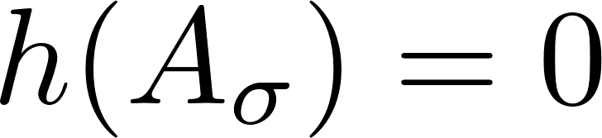
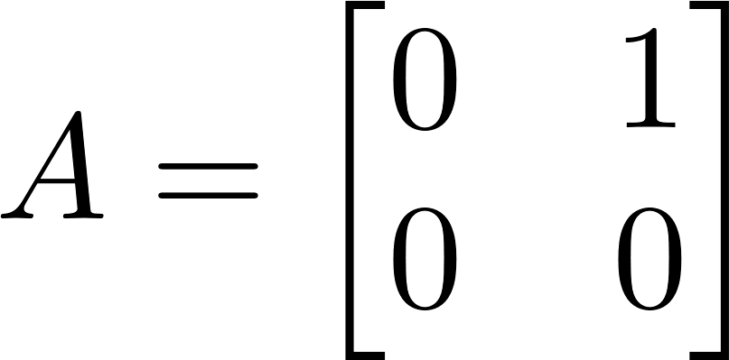
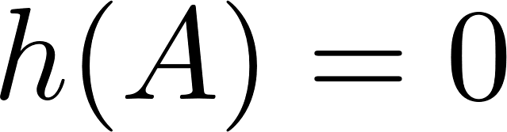

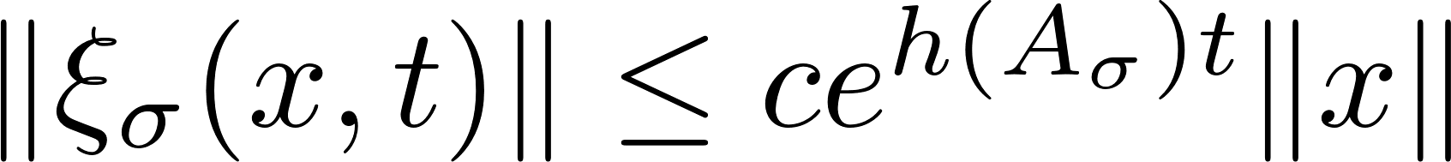
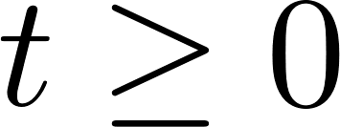
Switched Linear System
A switched linear system
Previous results on topological entropy
  The topological entropy is independent of the initial set [Y-Schmidt-Liberzon-18]
  Upper and lower bounds for the general case [Y-Schmidt-Liberzon-18]
  Formulae for the case with pairwise commuting matrices [Y-Hespanha-18]
Topological entropy and stability
  Both stability and GES imply
  Unstable LTI system with : consider
Challenge: There is no such that for all
Goals of this paper
  Formulate a direct relation between topological entropy and stability properties
  Use stability conditions to estimate topological entropy
  Use entropy bounds to establish stability conditions

Slide 8


An Entropy-based Solution Estimation
A switched linear system
Challenge: There is no such that for all
Theorem 3.1. For each , there is a such that for all ,
Remarks
  Exponential growth rate of solutions are essentially bounded by the topological entropy
  A direct relation between topological entropy and stability

Slide 9
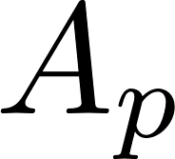
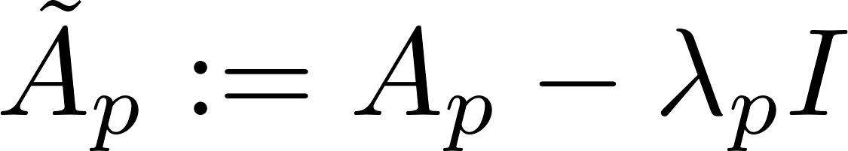
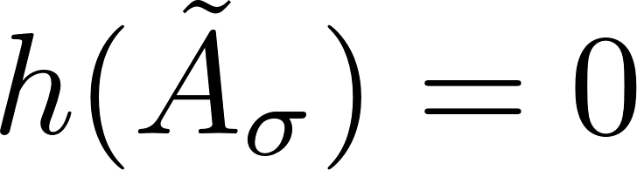
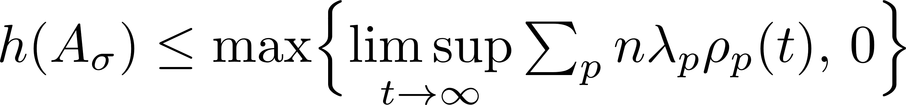

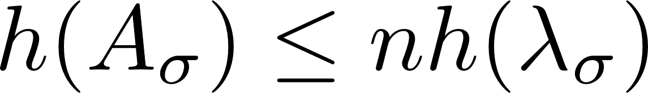
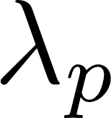
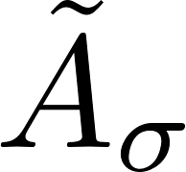
Entropy Estimation via Decomposition
A switched linear system
Approach: Decompose each into a simple unstable part, and an almost stable part that does not affect the entropy
Theorem 4.1. If the residual switched linear system defined by
satisfies , then
Remarks
  Following [Y-Schmidt-Liberzon-18],
  Generalization: replace the scalar part with matrices satisfying a commutation property
  Application: select large enough so that is stable
active rate of mode

Slide 10
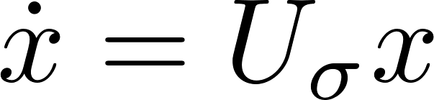
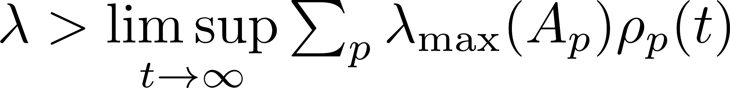
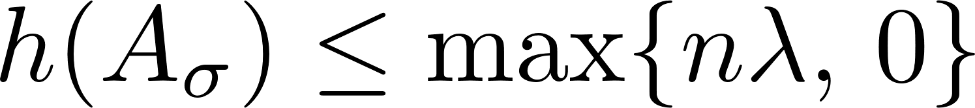
Entropy Estimation via Decomposition
A general switched linear system
Corollary 4.5.
A switched triangular system
Corollary 4.6.
A general switched linear system with slow switching
  Average dwell-time (ADT) [Hespanha-Morse-99]
Corollary 4.7. For each , there is a large
enough ADT under which

Slide 11
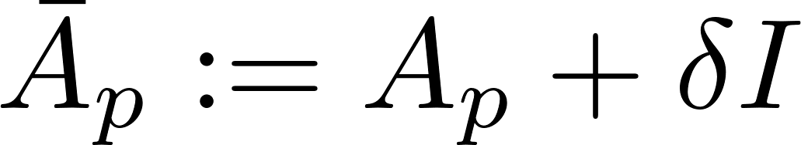
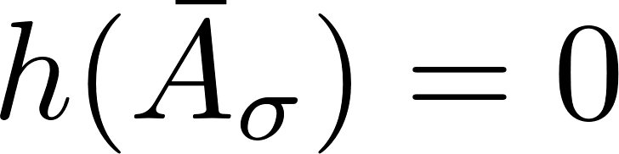

Entropy-based Stability Conditions
A switched linear system
Approach: Destabilizing perturbation
Theorem 5.1. If there is a such that the entropy of the switched linear
system define by satisfies ,
then the original switching linear system is GES.
Remark
  The switched linear system is GES if its entropy remains after a destabilizing perturbation
  Application: combine with entropy bounds

Slide 12
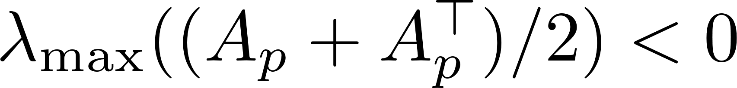
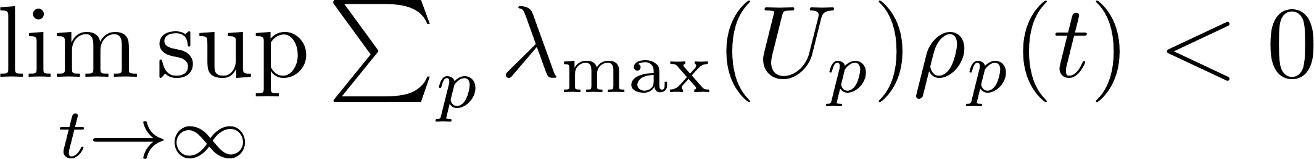
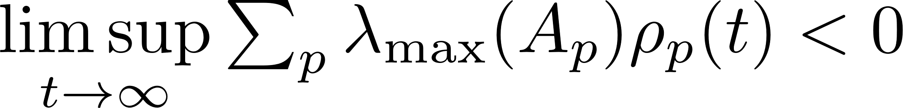
Entropy-based Stability Conditions
A general switched linear system
Corollary 5.2. GES if
Remark: GES under arbitrary switching if
A switched triangular system
Corollary 5.3. GES if
A general switched linear system with slow switching
Corollary 5.4. If , then GES under a large
enough ADT

Slide 13
Conclusion
Contributions
Entropy and stability of switched linear systems
An entropy-based solution estimation
  Exponential growth rate of solutions are essentially bounded by the entropy
Entropy estimation via decomposition
  Decomposition into a simple unstable part and an almost stable part
Entropy-based stability conditions
  A switched linear system is GES if its entropy remains under a destabilizing perturbation
Applications to three classes of switched linear systems
Future research
Implications on minimal data rate for control
Extension to switched nonlinear systems
Thank you!

